Slide 1
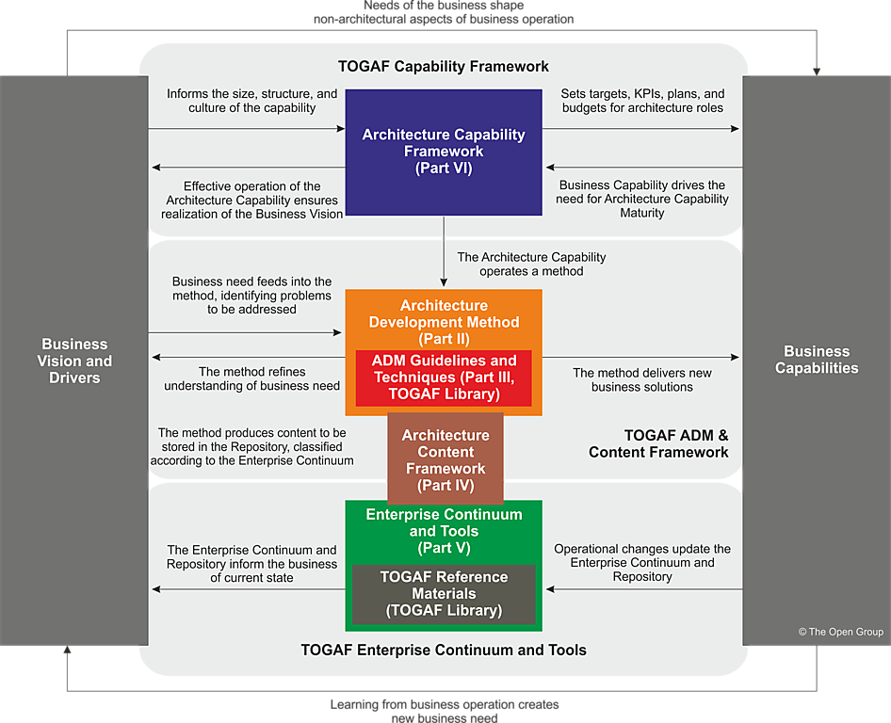
An Overview Of TOGAF
L1 / L2

Slide 2
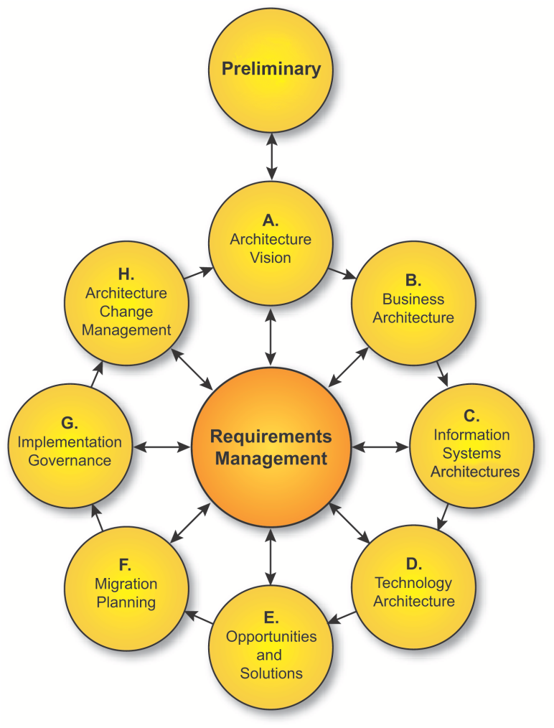
The Architecture Framework
L1 / L2
The Open Group Architecture Framework (TOGAF) is a tool for assisting in the acceptance, production, use, and maintenance of enterprise architectures
It is based on an iterative process model supported by best practices and a re-usable set of existing architectural assets.
It is developed and maintained by The Open Group Architecture Forum.
The first version of TOGAF, developed in 1995, was based on the US Department of Defence Technical Architecture Framework for Information Management (TAFIM).
It has also incorporated elements from most of the other major architecture approaches from across the industry (e.g. Zachman, DODAF, MODAF, FEAF) into an overall consistent framework and development process.
T

Slide 3
The Four Major Viewpoints Of The Architecture Framework
L1 / L2
The latest version, TOGAF 9, was introduced in 2009. It can be used for developing a broad range of different enterprise architectures. TOGAF complements, and can be used in conjunction with, other frameworks that are more focused on specific deliverables for particular vertical sectors such as Government and Telecommunications. TOGAF is
A framework, not an architecture
A generic framework for developing architectures to meet different business needs
Not a “one-size-fits-all” architecture
Focuses on business IT alignment
Based in best practices
Widely adopted in the market
Tailorable to meet an organisation and industry needs
It is broken down into phases that have a continuous flow into each other as an organisation evolves its capability and the associated architecture views.
The specific architectural elements within TOGAF are:
Business architecture
Information systems architecture
Technology architecture
Preliminary
Understanding your capability
and setting the context
A
Architecture
Vision
Creating , implementing & governing solution building
blocks
Defining the architecture building blocks
H
Architecture
Change
Management
B
Business
Architecture
G
Implementation Governance
Requirements
Management
C
Information
Systems
Architecture
F
Migration
Planning
D
Technology
Architecture
Identifying candidate solution building blocks
E
Opportunities
&
Solutions
Final choice of
solution building blocks
and implementation and
transition
planning
Notes:
16 April, 2019
© The Open Group 2008
3

Slide 4
Document Deliverables Around the Lifecycle (Outputs)
L1 / L2
Each phase can generate a set of deliverables to help manage the evolution of the enterprise architecture and each specific change introduced into the organisation.
Business Principles, Goals & Drivers
Request For Architecture Work
Organisation Model For Enterprise Architecture
Architecture Repository
Tailored Architecture Framework
Governance Framework
Architecture Principles
Architecture Tools
Preliminary
Approved Statement of Architecture Work
Communications Plan
Tailored Architecture Framework
Architecture Vision
Architecture Principles
Capability Assessment
Vision Architecture Definition Document
Vision Architecture Requirements Specification
Vision Candidate Roadmap
A
Architecture
Vision
Managed
Architecture Update
Approved Statement of Architecture Work
Draft Architecture Definition Document (Business)
Draft Architecture Requirements Spec. (Business)
Business Architecture Principles
Candidate Roadmap
H
Architecture
Change
Management
B
Business
Architecture
Signed Architecture Contract
Solution Building Block
Compliance Assessment
Architecture Compliant Solution
Governance Framework
Change Request
G
Implementation Governance
Requirements
Management
C
Information
Systems
Architecture
Approved Statement of Architecture Work
Draft Architecture Definition Document (IS)
Draft Architecture Requirements Spec. (IS)
IS Architecture Principles
Candidate Roadmap
Request For Architecture Work
Final Architecture Definition Document
Final Architecture Requirements Spec.
Final Architecture Roadmap
Final Transition Architecture
Draft Architecture Contract
Implementation & Migration Plan
Implementation & Migration Strategy
Implementation Governance Model
Finalised Architecture Building Block
Change Request
F
Migration
Planning
D
Technology
Architecture
**
Approved Statement of Architecture Work
Draft Architecture Definition Document (Technology)
Draft Architecture Requirements Spec. (Technology)
Technology Architecture Principles
Candidate Roadmap
E
Opportunities
&
Solutions
Architecture Requirement
Requirements Impact Assessment
**
Approved Statement of Architecture Work
Draft Architecture Definition Document
Draft Architecture Requirements Spec.
Consolidated Architecture Roadmap ( ) Transition Architecture
(Initial) Implementation & Migration Plan
(Initial) Implementation & Migration Strategy
Notes:
16 April, 2019
© The Open Group 2008
4

Slide 5
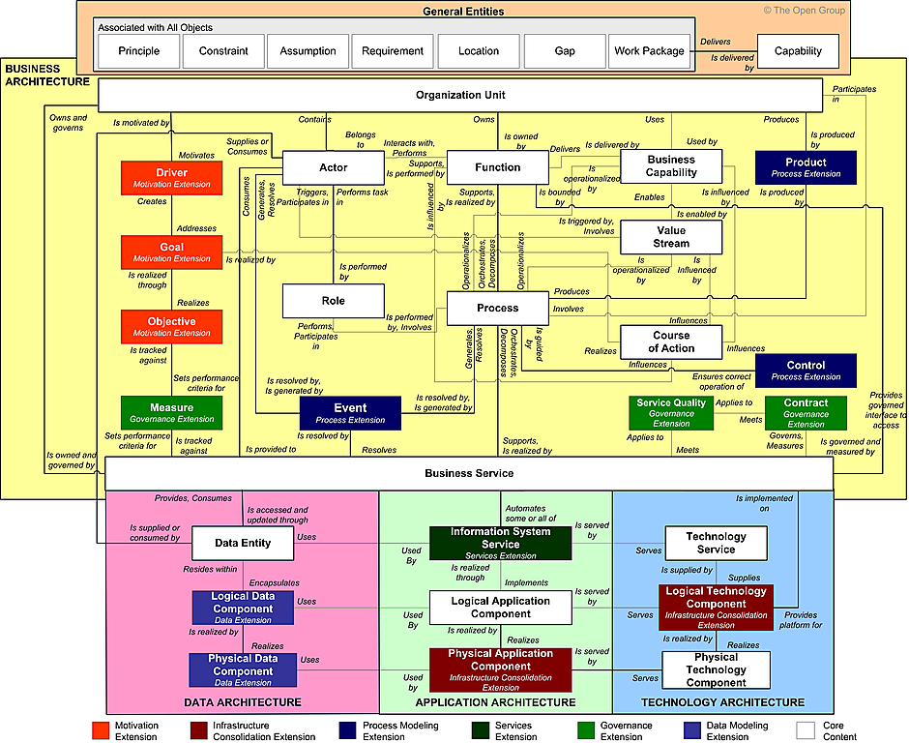
The Content Framework Metamodel
L1 / L2

Slide 6
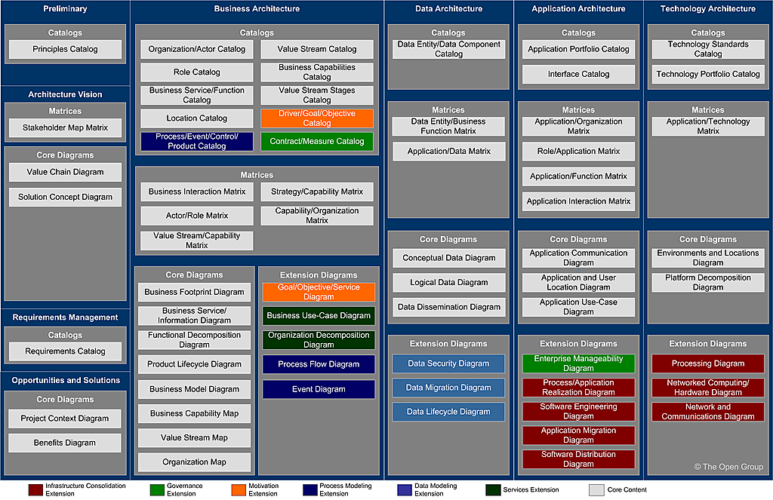
Example Specific Architecture Artefacts In The Content Framework
L1 / L2
Preliminary
Architecture Vision

Slide 7
Making Sense Of The Capabilities and Layering
L1 / L2
The TOGAF content framework differentiates between the processes of a business and the services of a business.
Business services are speciﬁc processes that have explicit, deﬁned boundaries that are explicitly governed.
Services are distinguished from processes through the explicit deﬁnition of a service contract that defines a post condition and it performance attributes.
The granularity of business services should be determined according to the business drivers, goals, objectives, and measures for this area of the business. Finer-grained services permit closer management and measurement (and can be combined to create coarser-grained services), but require greater effort to govern.
Identify which specific abilities a business should have
Business strategy layer
Competencies
Capabilities
provide the context for choosing which services to offer
Business management layer
Business Services
provide the contractual terms for the execution of
provide the context for and sequencing of
manage the state of
require the participation of
Logical operations layer
Processes
(Activities)
Procedures (Algorithms)
Entities
(Objects)
record the state of
may invoke
identify the processing required by
IS / Application Services
Physical operations layer
Application Components
change the state of
Data
Entities
provide the execution platform for
Platform/Technology/Infrastructure Services
Technology Components

Slide 8
Completing The Business Architecture View (POPIT)
L1 / L2
Identify which specific abilities a business should have
Business strategy layer
Competencies
Capabilities
provide the context for choosing which services to offer
Business management layer
Business Services
provide the contractual terms for the execution of
provide the context for and sequencing of
manage the state of
require the participation of
Logical operations layer
Processes
(Activities)
Procedures (Algorithms)
Entities
(Objects)
record the state of
may invoke
identify the processing required by
IS / Application Services
People
(Roles)
Organisation
(Structures)
Application Components
change the state of
Data
Entities
Physical operations layer
provide the execution platform for
Platform/Technology/Infrastructure Services
Facilities and Non
Computing Technology
Technology Components

Slide 9
Solution Architecture Conformance Checkpoints
Project Management Cycle
Opportunity
Feasibility
Deliver
Realise
Enterprise Architecture Conformance Cycle
Develop initial
architectural view
Develop high level
solution architecture
and align to enterprise
architecture
Review on-going development,
back track to develop high level solution architecture if
changes during detailed design and build require it
Review in-life reality against architectural expectations
respond appropriately
EA Review Gate 1
Record project as architecturally
impacting or exempt
EA Review Gate 2
Confirm or otherwise of architecture compliance for specific solution to be developed
EA Review Gate 3
Confirm or otherwise of architecture compliance for specific solution that has been developed
EA Review Gate 4
Identify effectiveness of architectural decisions and capture learning points for improvement
Business Investment Cycle
Investment
proposal
Business case
Value creation
Benefits
realisation

