Slide 1

Module 01/16
TOGAF® EA Training - Foundation
TOGAF® Standard, 10th Edition
Module 01
Overview
TOGAF® is a registered trademark of The Open Group Copyright © The Open Group 2022
​
Initially MOD 01

Slide 2
Module 01/16
TOGAF® EA Training - Foundation
TOGAF® Standard, 10th Edition
Module 01
Overview
TOGAF® is a registered trademark of The Open Group Copyright © The Open Group 2022
​
Initially MOD 01

Slide 3
Course Module Index
# | Topic – Level 1
1 | Module 00 - Course Introduction | ✓
2 | Module 01 - Overview
3 | Module 02 - Concepts
4 | Module 03 - Introduction to the ADM
5 | Module 04 - Introduction to the ADM - Techniques
6 | Module 05 – Applying ADM
7 | Module 06 - Architecture Governance
8 | Module 07 – Architecture Content
# | Topic – Level 2
9 | Module 00 - Course Introduction
10 | Module 08 - The Context for Enterprise Architecture
11 | Module 09 – Stakeholder Management
12 | Module 10 – Phase A
13 | Module 11 – Architecture Development
14 | Module 12 – Implementing the Architecture
15 | Module 13 – Architecture Change Management
16 | Module 14 – Requirements Management
17 | Module 15 – Supporting the ADM Work
18 | Module 16 – Closure
Course
Module
Index
Initially MOD 01

Slide 4
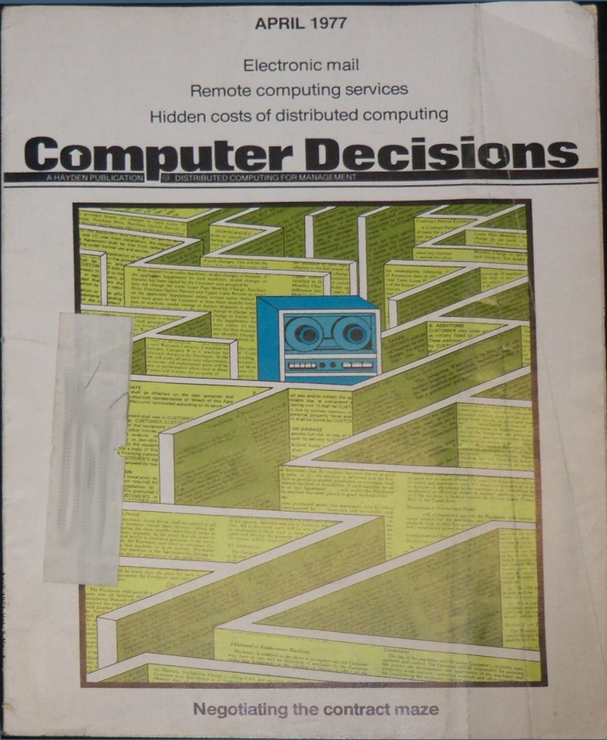


Where did EA come from? – 01/02
‘Formal’ EA can be traced from:
1967 - John Zachman article
1969 - Sal Catalano & Dewey Walker - need for two phases:
Customization
  A two week survey to find Asset Management issues
  Is there access to enterprise-wide, coherent data to support enterprise-wide
  decision making?
Definition
  This was not defined
Companies need
A plan
A long-term strategy to support the rapid growth of technology
Modern EA
Extends this thinking to the entire business
Ensuring business is aligned with digital
EA focuses on bringing legacy processes and applications together to form an integrated environment.
John Zachman
Initially MOD 01
Notes:
The roots of ‘formal’ EA can be traced to thinking by two IBM employees, Sal Catalano and Dewey Walker. This was published in 1969 editions of Computer Decisions Magazine under the titles “Where Do We Go from Here with MIS?”, and “Next in MIS: ‘Data Managed’ System Design”.
Dewey further developed his thinking to the need for two phases - Customization and Definition. Customization was a two week survey to see if there were any Asset Management issues - if an enterprise was leaking assets then probably management did not have access to enterprise-wide, coherent data to support enterprise-wide decision making.
However, based on this seminal thinking, and as a response to the increase of business technology, John Zachman published an article in IBM Systems Journal Volume 25, Number 3, beginning on page 276,in 1987 which became the root of EA thinking.
Companies understood they would need both a plan and a long-term strategy to support the rapid growth of technology - that remains true today.
Modern EA extends this thinking to the entire business, thus ensuring business is aligned with digital transformation strategies and technological growth.
EA attains substantial traction in large businesses addressing digital transformation - it focuses on bringing legacy processes and applications together to form an integrated environment.

Slide 5

Where did EA come from? – 02/02
Boundaryless Information Flow™
From a notion articulated by John Francis Welch Jr. (November 19, 1935 – March 1, 2020), Chairman and CEO of General Electric, 1981-2001
… an organization behaviour
Boundaryless
Defined as one which
  Removed the barriers between traditional functions
  Supported finding great ideas
  Was anywhere within the organization
  Or from outside the organization
  Shared with everyone within the company
"Jack Welch's approach to breaking down silos still works …”
- 2015 - Harvard Business
Initially MOD 01
Notes:
Boundaryless Information Flow™
From a notion articulated by John Francis Welch Jr. (November 19, 1935 – March 1, 2020), Chairman and CEO of General Electric, 1981-2001
Jack Welch instilled an organization behavior which he called "boundaryless”, defined as one which removed the barriers between traditional functions, and supported finding great ideas, anywhere within the organization, or from outside the organization, and sharing them with everyone within the company.
A 2015 article in Harvard Business argues that "Jack Welch's approach to breaking down silos still works", citing examples of engineering companies who have discovered for themselves that "fragmented, geographically dispersed" patterns of organization make it "very difficult ... to coordinate efforts across functions, keep everyone focused on the cost and delivery goals and get people to reach consensus”.

Slide 6
Why Enterprise Architecture? – 01/04
The universe is full of systems, weather systems, immune systems, social systems, tax systems etc. . . . these systems are complex, and constantly adapting to their environment.
Interactions between individual entities at the lower level create patterns observable at the higher level which, in turn, impact on the interactions between individual entities.
Patterns
Feedback
Feedback
Regularities
Agents
A complex adaptive systems does not have to be perfect in order to thrive. It only has to be
slightly better than its competitors. Any energy used on being better than that is wasted energy.
Once it has reached the state of being good enough it will, every time, trade off increased efficiency,
in favour of greater effectiveness.
Complex Adaptive Systems and Complexity Theory, Peter Fryer
Initially MOD 01
Notes:
Þ M-48
See e.g.
https://www.researchgate.net/publication/44939495_Complexity_Levels_of_Representing_Dynamics_in_EA_Planning/link/0046352f5041ba2022000000/download
https://ieeexplore.ieee.org/document/8536112
A Systemic Perspective to Managing Complexity with Enterprise Architecture : Pallab Saha : ISBN13: 9781466645189
https://www.google.com/url?sa=t&rct=j&q=&esrc=s&source=web&cd=&ved=2ahUKEwiw09yJ8qf2AhWfSfEDHbF-DMgQFnoFCJoBEAE&url=https%3A%2F%2Fwww.scitepress.org%2FPapers%2F2021%2F104757%2F104757.pdf&usg=AOvVaw2DGD48rh7Nd_BPLAvOL1cH

Slide 7

Why Enterprise Architecture? – 02/04
Max output for min input
Considers the present state
Consistent method
Focus on process
Doing the right things
Doing the right things right
Efficiency
Low High
Doing things
Doing things right
Low High
Effectiveness
Compare measured vs. desired output
Considers the long term
Innovative ways of working
Focuses on result
Image courtesy of Oriental
Outpost-https://www.orientaloutpost.com
Initially MOD 01
Notes:
You can give a man a fish . . .

Slide 8
Why Enterprise Architecture? – 03/04
Why enterprise architecture?
Situations constantly arise that require a response
The decision-making should be as agile as possible
The business has an asset that supports decision making
An Enterprise Architecture is a properly indexed repository of business knowledge
Enterprise Architecture supports analysis and development of decision options
The Enterprise Architecture repository provides a framework which can capture the quantitative outcomes of decisions
Initially MOD 01
Notes:
Situations constantly arise that require a response.
The decision-making process needs to be as agile as possible so that an appropriate response can be both adopted rapidly and executed efficiently.
The business, with a well-structured, content-rich and properly maintained Enterprise Architecture, has an asset that supports decision-making.
An Enterprise Architecture is a properly indexed repository of business knowledge . . . the power to make ‘good’ and rapid business decision is greatly enhanced.
Enterprise Architecture supports analysis and development of decision options and assists in the assessment of the business and/or technical impacts.
The Enterprise Architecture repository provides a framework which can capture the quantitative outcomes of decisions.

Slide 9
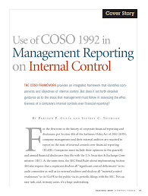
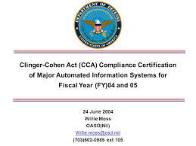
Where did TOGAF® come from – 01/04
Committee of Sponsoring Organizations (COSO) 1985
sponsored the National Commission on Fraudulent Financial Reporting (the Treadway Commission). 1992, September, released the Internal Control— Integrated Framework report
Re-published with minor amendments in 1994
  A common definition of internal control
  A framework against which internal control systems may be assessed and improved.
Image source: http://researchgate.net/
The Clinger–Cohen Act (CCA) 1996 [cf. The Open Group foundation date]
United States information technology (IT)
Focusing on information resource planning
Implementing a capital planning and investment control
Rethinking and restructuring the way they do their work before investing
Images source: slideplayer.com
Initially MOD 01
Notes:
Committee of Sponsoring Organizations (COSO) 1985
sponsored the National Commission on Fraudulent Financial Reporting (the Treadway Commission).
The Commission was jointly sponsored and funded by five main professional accounting associations and institutes, under chairman James C. Treadway, Jr., former Commissioner of the U.S. Securities and Exchange Commission
1992, September, released the Internal Control— Integrated Framework report
1994 re-published with minor amendments
A common definition of internal control
A framework against which internal control systems may be assessed and improved.
The Clinger–Cohen Act (CCA) 1996 [cf. The Open Group foundation date]
United States information technology (IT).
Focusing information resource planning to support their strategic missions;
Implementing a capital planning and investment control process that links to budget formulation and execution; and
Rethinking and restructuring the way they do their work before investing in information systems.
The Act directed the development and maintenance of Information Technology Architectures by federal agencies to maximize the benefits of information technology (IT).

Slide 10
Where did TOGAF® come from – 02/04
Pressure in 1980s from Government – IT industry to control diversity
X/Open Company, Ltd. 1984-1996
European UNIX systems manufacturers consortium
Groupe Bull, ICL, Siemens, Olivetti, Nixdorf Computer, Philips, Ericsson
Open Software Foundation (OSF) 1988-1996
not-for-profit organization founded under the U.S. National Cooperative Research Act, 1984
Apollo Computer, Groupe Bull, Digital Equipment Corporation, Hewlett-Packard, IBM, Nixdorf Computer, and Siemens AG, Philips, Hitachi
The Open Group LLC was incorporated in 1996
as the parent of X/Open Company Limited
(now The Open Group Limited) and OSF
Initially MOD 01
Notes:
Þ Q-41
X/Open Company, Ltd. 1984-1996
European UNIX systems manufacturers consortium
identify and promote open IT standards
define a single spec for UNIX OSs
increase application interoperability
reduce the cost of porting software
Groupe Bull, ICL, Siemens, Olivetti, Nixdorf, Philips, Ericsson
Open Software Foundation (OSF) 1988-1996
not-for-profit organization founded under the U.S. National Cooperative Research Act,1984
create an open standard for an implementation of the UNIX operating system
Apollo Computer, Groupe Bull, Digital Equipment Corporation, Hewlett-Packard, IBM, Nixdorf Computer, and Siemens AG, Philips, Hitachi
The Open Group LLC was incorporated in 1996
as the parent of X/Open Company Limited
(now The Open Group Limited) and OSF
certifying body for the UNIX trademark
publication of the Single UNIX Specification
the official definition of a UNIX system
develops and manages the TOGAF standard
Also e.g. ODBD, CDE, DCOM, DRDA, FACE, Motif,
OSIMM, SRM, CMPI, UDEF, FAIR

Slide 11

Where did TOGAF® come from – 03/04
“a global consortium that enables the achievement
of business through technology standards”
Vision:
Boundaryless Information Flow™
Open standard components that provide services in a customer's extended enterprise that:
Combine multiple sources of information
Securely deliver the information whenever and wherever it is needed, in the right context for the people or systems using that information.
Boundaryless Information Flow is a trademark and UNIX and The Open Group are registered trademarks of The Open Group
Initially MOD 01
Notes:
“a global consortium that enables the achievement of business through technology standards”
Vision:
Boundaryless Information Flow™
a shorthand representation of “access to integrated information to support business process improvements” represents a desired state of an enterprise’s infrastructure and is specific to the business needs of the organization.
An infrastructure that provides Boundaryless Information Flow™ has open standard components that provide services in a customer's extended enterprise that:
Combine multiple sources of information
Securely deliver the information whenever and wherever it is needed, in the right context for the people or systems using that information.

Slide 12
Where did TOGAF® come from – 04/04
‘22
TOGAF® Standard, 10th Edition
‘18
TOGAF Standard, Version 9.2
‘09
TOGAF 9 Enterprise Edition
TOGAF 8.1.1
‘06
TOGAF 8 – Enterprise Edition - first TOGAF
Certification Program launched
‘03
‘02
TOGAF 7 Technical Edition
‘01
The Interoperable Enterprise Business Scenario first published
‘96
TOGAF first published
Customer members select TAFIM as preferred starting point
DoD Information Systems Agency [DISA] donate TAFIM as base
‘94
Customer members demand architecture standards
‘93
Initially MOD 01
Notes:
Initially TOGAF was purely technical in nature.
There were annual updates until circa 1999 when The Open Group realised it had something it could leverage and decided to do ‘a proper job’.
‘Customers’ referred to were primarily the US Government’s Department of Defense and its major corporate suppliers.
Technical Architecture Framework for Information Management (TAFIM) was the 1990s reference model for enterprise architecture by and for the United States Department of Defense (DoD).
a target common conceptual framework or reference model for an information system infrastructure
and the specific applications that the information system must support.

Slide 13
TOGAF® Training – 01/02
Level | Tag | Purpose
1 | TOGAF Foundation | To provide validation that the candidate has gained knowledge of the TOGAF terminology, structure and basic concepts, and understands the core principles of Enterprise Architecture and the TOGAF standard [40 multiple choice questions, select 1 response, 60 minutes, closed book]
2 | TOGAF Practitioner | To provide validation that in addition to knowledge and comprehension, the candidate is able to analyze and apply knowledge of the TOGAF standard [8 complex scenario questions, gradient scoring (0,1,3,5), 90 minutes, open book]
Exam pass needs ≥ 60% in each, resit only failed Tag after 1 month
Initially MOD 01

Slide 14
TOGAF® Training – 02/02
The target audience for TOGAF Foundation (Level 1) training includes but is not limited to:
Individuals who require a basic understanding of the TOGAF Standard, 10th Edition
Professionals who are working in roles associated with an architecture project, such as those responsible for planning, execution, development, delivery and operation
Architects who are looking for a first introduction to the TOGAF Standard, 10th Edition
Architects who want to achieve Level 2 certification in a stepwise approach.
Initially MOD 01
Notes:
The target audience for TOGAF Foundation (Level 1) training includes but is not limited to:
Individuals who require a basic understanding of the TOGAF Standard, 10th Edition
Professionals who are working in roles associated with an architecture project, such as those responsible for planning, execution, development, delivery and operation
Architects who are looking for a first introduction to the TOGAF Standard, 10th Edition
Architects who want to achieve Level 2 certification in a stepwise approach.

Slide 15
What is an Enterprise ? - 01/03
The TOGAF Standard considers an "enterprise" to be any collection of organizations that have common goals
For example, an enterprise could be:
A whole corporation or a division of a corporation
A government agency or a single government department
A chain of geographically distant organizations linked together by common ownership
Groups of countries, governments, or governmental partnerships
Introduction and Core Concepts : Page 2 : §1.1
Initially MOD 01
Notes:
Þ Q-42 M-49
Level=1 : L.O.= 1.1a : Describe what an enterprise is.
See: TOGAF® Standard – Introduction and Core Concepts : Page 2 : §1.1
The TOGAF Standard considers an "enterprise" to be any collection of organizations that have common goals.
For example, an enterprise could be:
A whole corporation or a division of a corporation
A government agency or a single government department
A chain of geographically distant organizations linked together by common ownership
Groups of countries, governments, or governmental organizations (such as militaries) working together to create common or shareable deliverables or infrastructures
Partnerships and alliances of businesses working together, such as a consortium or supply chain
1.1 Executive Overview
This section provides an executive overview of Enterprise Architecture, the basic concepts of
what it is (not just another name for IT Architecture), and why it is needed. It provides a
summary of the benefits of establishing an Enterprise Architecture and adopting the TOGAF
approach to achieve that.
What is an enterprise?
The TOGAF Standard considers an "enterprise" to be any collection of organizations that have
common goals.
For example, an enterprise could be:
■ A whole corporation or a division of a corporation
■ A government agency or a single government department
■ A chain of geographically distant organizations linked together by common ownership
■ Groups of countries, governments, or governmental organizations (such as militaries)
working together to create common or shareable deliverables or infrastructures
■ Partnerships and alliances of businesses working together, such as a consortium or supply
chain
The term "Enterprise" in the context of "Enterprise Architecture" can be applied to either an
entire enterprise, encompassing all of its business activities and capabilities, information, and
technology that make up the entire infrastructure and governance of the enterprise, or to one or
more specific areas of interest within the enterprise. An enterprise may include partners,
suppliers, and customers as well as internal business units. In all cases, the architecture crosses
... CONTINUES ... SEE REFERENCE SPECIFIED

Slide 16
What is an Enterprise ? - 02/03
Can be applied to an entire enterprise, encompassing all of its:
1
Business activities
Capabilities
Information
Technology
Could include
2
Partners
Suppliers
Customers
Internal business units
Regulators
Introduction and Core Concepts : Page 2 : §1.1
Initially MOD 01
Notes:
Level=1 : L.O.= 1.1a : Describe what an enterprise is.
See : TOGAF® Standard – Introduction and Core Concepts : Page 2 : §1.1
Can be applied to an entire enterprise, encompassing all of its:
Business activities
Capabilities
Information
Technology
that make up the entire infrastructure and governance of the enterprise,
or to one or more specific areas of interest within the enterprise.
Will/may include
Partners
Suppliers
Customers
Internal business units
Regulators
In all cases, the architecture crosses multiple systems, and multiple functional groups within the enterprise.
1.1 Executive Overview
This section provides an executive overview of Enterprise Architecture, the basic concepts of
what it is (not just another name for IT Architecture), and why it is needed. It provides a
summary of the benefits of establishing an Enterprise Architecture and adopting the TOGAF
approach to achieve that.
What is an enterprise?
The TOGAF Standard considers an "enterprise" to be any collection of organizations that have
common goals.
For example, an enterprise could be:
■ A whole corporation or a division of a corporation
■ A government agency or a single government department
■ A chain of geographically distant organizations linked together by common ownership
■ Groups of countries, governments, or governmental organizations (such as militaries)
working together to create common or shareable deliverables or infrastructures
■ Partnerships and alliances of businesses working together, such as a consortium or supply
chain
The term "Enterprise" in the context of "Enterprise Architecture" can be applied to either an
entire enterprise, encompassing all of its business activities and capabilities, information, and
technology that make up the entire infrastructure and governance of the enterprise, or to
... CONTINUES ... SEE REFERENCE SPECIFIED

Slide 17
What is an Enterprise ? - 03/03
The Enterprise operating model concept is useful to determine the nature and scope of the Enterprise Architecture within an organization
Many organizations may comprise multiple enterprises
These enterprises often have much in common with each other
Introduction and Core Concepts : Page 2 : §1.1
Initially MOD 01
Notes:
Level=1 : L.O.= 1.1a : Describe what an enterprise is.
See : TOGAF® Standard – Introduction and Core Concepts : Page 2 : §1.1
The Enterprise operating model concept is useful to determine the nature and scope of the Enterprise Architecture within an organization
Many organizations may comprise multiple enterprises, and may develop and maintain a number of independent Enterprise Architectures to address each one.
These enterprises often have much in common with each other including processes, functions, and their information systems, and there is often great potential for wider gain in the use of a common architecture framework. For example, a common framework can provide a basis for the development of common building blocks and solutions, and a shareable Architecture Repository for the integration and re-use of business models, designs, information, and data.
1.1 Executive Overview
This section provides an executive overview of Enterprise Architecture, the basic concepts of
what it is (not just another name for IT Architecture), and why it is needed. It provides a
summary of the benefits of establishing an Enterprise Architecture and adopting the TOGAF
approach to achieve that.
What is an enterprise?
The TOGAF Standard considers an "enterprise" to be any collection of organizations that have
common goals.
For example, an enterprise could be:
■ A whole corporation or a division of a corporation
■ A government agency or a single government department
■ A chain of geographically distant organizations linked together by common ownership
■ Groups of countries, governments, or governmental organizations (such as militaries)
working together to create common or shareable deliverables or infrastructures
■ Partnerships and alliances of businesses working together, such as a consortium or supply
chain
The term "Enterprise" in the context of "Enterprise Architecture" can be applied to either an
entire enterprise, encompassing all of its business activities and capabilities, information, and
technology that make up the entire infrastructure and governance of the enterprise, or to one or
more specific areas of interest within the enterprise. An enterprise may include partners,
suppliers, and customers as well as internal business units. In all cases, the architecture crosses
multiple systems, and multiple functional groups within the enterprise.
... CONTINUES ... SEE REFERENCE SPECIFIED

Slide 18

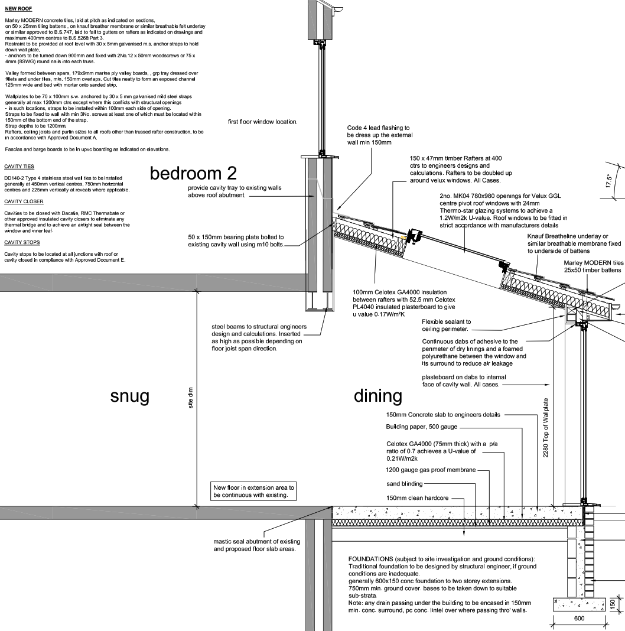
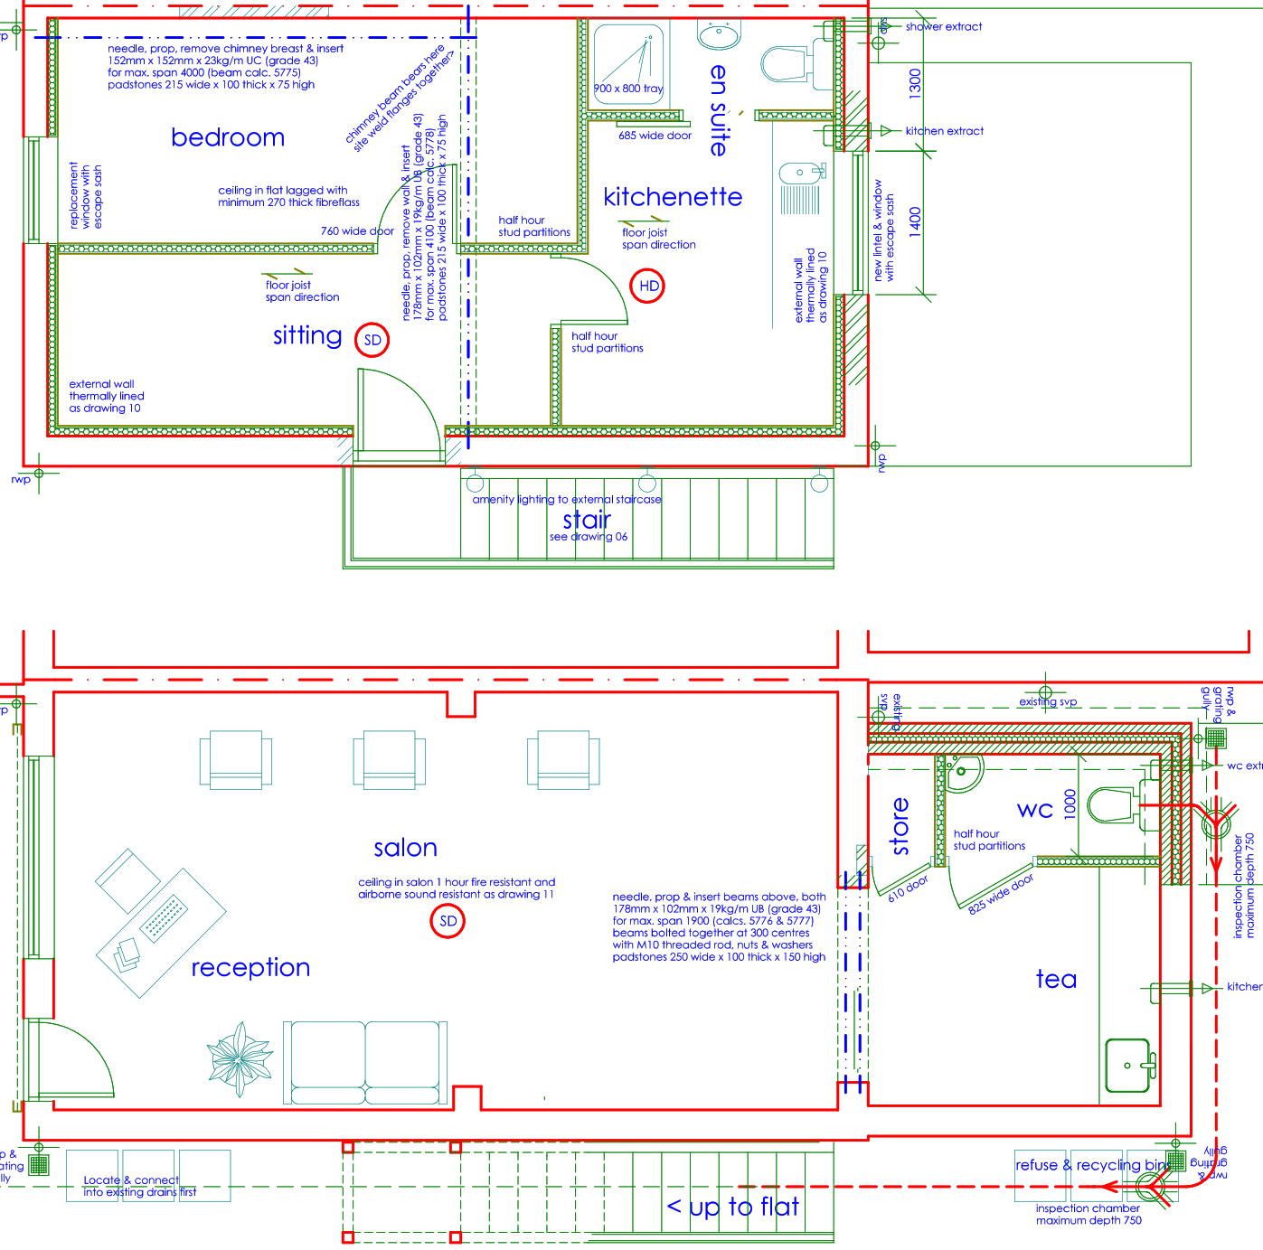
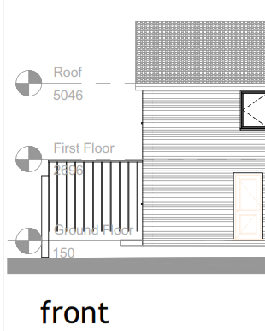
What is an Architecture ?
An Architecture is the fundamental concepts or properties of a system in its environment, embodied in:
its elements
their relationships to each other and the environment
and the principles governing its design and evolution
Adapted from ISO/IEC/IEEE 42010:2011
Initially MOD 01
Notes:
ISO/IEC/IEEE 42010:2011 defines “architecture” as:
“The fundamental concepts or properties of a system in its environment embodied in its elements, relationships, and in the principles of its design and evolution.”
The TOGAF Standard embraces but does not strictly adhere to ISO/IEC/IEEE 42010:2011 terminology. In addition to the ISO/IEC/IEEE 42010:2011 definition, the TOGAF Standard adds a second definition depending on the context:
“The structure of components, their inter-relationships, and the principles and guidelines governing their design and evolution over time.”
ISO/IEC/IEEE 42010: 2011, Systems and Software Engineering — Architecture Description.
We will look later at “What is an Architecture Framework”

Slide 19
Purpose of Enterprise Architecture – 01/03
To optimize the utilization of resources across the enterprise
The effective management and exploitation of information and digital transformation are key factors to business success, and are indispensable means to achieving competitive advantage
A good Enterprise Architecture enables you to achieve the right balance between business transformation and continuous operational efficiency
Enterprise Architecture supports the needs of the organization to be met with an integrated strategy*
*Formulation of the strategy is one of the major responsibilities of the Board of Directors. We will consider this when we look at Governance in general.
Introduction and Core Concepts : Page 2 : §1.1
Initially MOD 01
Notes:
Þ S-47 M-50
Level=1 : L.O.= 1.2a : Explain the purpose of Enterprise Architecture.
See : TOGAF® Standard – Introduction and Core Concepts : Page 2 : §1.1
To optimize the utilisation of resources across the enterprise.
Usually by consolidating the often fragmented legacy of processes (both manual and automated) into an appropriately integrated environment that is responsive to change and supportive of the delivery of the Business Strategy*.
The effective management and exploitation of information and digital transformation are key factors to business success and an indispensable means to achieving competitive advantage.
An Enterprise Architecture addresses this need by providing a strategic context for the evolution and reach of digital capability in response to the constantly changing needs of the business environment.
A good Enterprise Architecture enables you to achieve the right balance between business transformation and continuous operational efficiency.
It allows individual business units to innovate safely in their pursuit of evolving business goals and competitive advantage.
Enterprise Architecture supports the need of the organization, and this is addressed by an integrated strategy which permits the closest possible synergies across the enterprise and beyond.
1.1 Executive Overview
This section provides an executive overview of Enter prise Architecture, the basic concepts of
what it is (not just another name for IT Architecture), and why it is needed. It provides a
summary of the benefits of establishing an Enterprise Architecture and adopting the TOGAF
approach to achieve that.
What is an enterprise?
The TOGAF Standard considers an "enterprise" to be any collection of organizations that have
common goals.
For example, an enterprise could be:
■ A whole corporation or a division of a corporation
■ A government agency or a single government department
■ A chain of geographically distant organizations linked together by common ownership
■ Groups of countries, governments, or governmental organizations (such as militaries)
working together to create common or shareable deliverables or infrastructures
■ Partnerships and alliances of businesses working together, such as a consortium or supply
chain
The term "Enterprise" in the context of "Enterprise Architecture" can be applied to either an
... CONTINUES ... SEE REFERENCE SPECIFIED

Slide 20


Purpose of Enterprise Architecture – 02/03
Most global privacy legislation demands that processes around personal data are fully documented
The creation of this basic documentation arises from the changed fundamental considerations and this is now crucial
Note:
Most of the legislation mandates the creation of the Privacy Impact Assessment for every process – the only tenable basis for this is a properly articulated and documented Enterprise Architecture.
Introduction and Core Concepts : Page 2 : §1.1
Initially MOD 01
Notes:
Þ M-52
Level=1 : L.O.= 1.2a : Explain the purpose of Enterprise Architecture.
See : TOGAF® Standard – Introduction and Core Concepts : Page 2 : §1.1
Most global privacy legislation demands that processes around personal data are fully documented in a way that can be easily understood by untrained readers — such as the data subjects and judges and lawyers. The penalties for failing to have this can be very significant.
Clearly the creation of this basic documentation arises from the changed fundamental considerations and this is now crucial.
Note:
Most of the legislation mandates the creation of the Privacy Impact Assessment for every process – the only tenable basis for this is a properly articulated and documented Enterprise Architecture.
1.1 Executive Overview
This section provides an executive overview of Enterprise Architecture, the basic concepts of
what it is (not just another name for IT Architecture), and why it is needed. It provides a
summary of the benefits of establishing an Enterprise Architecture and adopting the TOGAF
approach to achieve that.
What is an enterprise?
The TOGAF Standard considers an "enterprise" to be any collection of organizations that have
common goals.
For example, an enterprise could be:
■ A whole corporation or a division of a corporation
■ A government agency or a single government department
■ A chain of geographically distant organizations linked together by common ownership
■ Groups of countries, governments, or governmental organizations (such as militaries)
working together to create common or shareable deliverables or infrastructures
■ Partnerships and alliances of businesses working together, such as a consortium or supply
chain
The term "Enterprise" in the context of "Enterprise Architecture" can be applied to either an
entire enterprise, encompassing all of its business activities and capabilities, information, and
technology that make up the entire infrastructure and governance of the enterprise, or to one or
more specific areas of interest within the enterprise. An enterprise may include partners,
suppliers, and customers as well as internal business units. In all cases, the architecture crosses
... CONTINUES ... SEE REFERENCE SPECIFIED

Slide 21
Purpose of Enterprise Architecture – 03/03
Elsewhere, these same ‘purpose thoughts’ are expressed from a slightly different viewpoint:
Pretty much all enterprises seek to ‘improve’
Guidance on effective change will take place during the activity to realize the approved EA
The scope of the improvement drives everything that is done
EA must describe the future state and the current state
The gap between the current state and future state highlights what must change
The above blocks highlight the conceptual scope of EA
This scope often leads to the assumption that EA is only used to answer the big questions
The scope of the system varies
All of the concepts remain the same
A Practitioners’ Approach to Developing Enterprise Architecture Following the ADM : Page 8 : §3.1
Initially MOD 01
Notes:
Þ M-52
Level=1 : L.O.= 1.2a : Explain the purpose of Enterprise Architecture.
See : TOGAF® Standard – Introduction and Core Concepts : Page 2 : §1.1
Elsewhere, these same ‘purpose thoughts’ are expressed from a slightly different viewpoint:
Pretty much all enterprises seek to ‘improve’.
Improvement can be:
shareholder value
agility for a private enterprise
mandate-based value proposition or efficiency for a public enterprise
simply an improvement of mission for a social enterprise
Guidance on effective change will take place during the activity to realize the approved EA.
During implementation, EA is used by the stakeholders to govern change.
The scope of the improvement drives everything that is done.
EA must describe the future state:
to enable the right people to understand what must be done
And also describe the current state
The gap between the current state and future state highlights what must change
A list of gaps makes obvious what must change and the implications of that change
The above bullets highlight the conceptual scope of EA:
This scope often leads to the assumption that EA is only used to answer the big questions
The scope of the system varies - the detailed description of elements and properties vary
All of the concepts remain the same
1.1 Executive Overview
This section provides an executive overview of Enter prise Architecture, the basic concepts of
what it is (not just another name for IT Architecture), and why it is needed. It provides a
summary of the benefits of establishing an Enterprise Architecture and adopting the TOGAF
approach to achieve that.
What is an enterprise?
The TOGAF Standard considers an "enterprise" to be any collection of organizations that have
common goals.
For example, an enter prise could be:
■ A whole corporation or a division of a corporation
■ A government agency or a single government department
... CONTINUES ... SEE REFERENCE SPECIFIED

Slide 22
Why Enterprise Architecture is needed ?
The Open Group’s explanation for why Enterprise Architecture is needed:
  Effective management and exploitation of information through IT is key to business success
  Good information management
  = competitive advantage
  Current IT systems do not really meet the needs of business
  Investment in Information Technology
Why Enterprise Architecture is needed ?
Introduction and Core Concepts : Page 2 : §1.1
Initially MOD 01
Notes:
Level=1 : L.O.= 1.2a : Explain the purpose of Enterprise Architecture.
See: TOGAF® Standard – Introduction and Core Concepts : Page 2 : §1.1
The Open Group’s explanation for why Enterprise Architecture is needed:
Effective management and exploitation of information through IT is key to business success
Good information management = competitive advantage
Current IT systems do not really meet the needs of business
Fragmented, duplicated
Poorly understood
Not responsive to change
Investment in Information Technology
Focussed on system maintenance
Tactical developments rather than a strategic plan
1.1 Executive Overview
This section provides an executive overview of Enterprise Architecture, the basic concepts of
what it is (not just another name for IT Architecture), and why it is needed. It provides a
summary of the benefits of establishing an Enterprise Architecture and adopting the TOGAF
approach to achieve that.
What is an enterprise?
The TOGAF Standard considers an "enterprise" to be any collection of organizations that have
common goals.
For example, an enterprise could be:
■ A whole corporation or a division of a corporation
■ A government agency or a single government department
■ A chain of geographically distant organizations linked together by common ownership
■ Groups of countries, governments, or governmental organizations (such as militaries)
working together to create common or shareable deliverables or infrastructures
■ Partnerships and alliances of businesses working together, such as a consortium or supply
chain
The term "Enterprise" in the context of "Enterprise Architecture" can be applied to either an
entire enterprise, encompassing all of its business activities and capabilities, information, and
technology that make up the entire infrastructure and governance of the enterprise, or to one or
more specific areas of interest within the enterprise. An enterprise may include partners,
suppliers, and customers as well as internal business units. In all cases, the architecture crosses
... CONTINUES ... SEE REFERENCE SPECIFIED

Slide 23
Enabling Enterprise Agility
The TOGAF Standard recognizes the need to recursively break down the Enterprise Architecture to more granular levels - enabling a cross-cutting view across the TOGAF domains:
A description of the elements within an organization
A framework (structure, approach and process) for managing change
The practice of acting to manage and evolve the Enterprise Architecture
This provides a structured framework helping to assure the context and the value-add of Agile implementation.
Enabling Enterprise Agility : Page 9 : §1.2
Initially MOD 01
Notes:
Level=1 : L.O.= 1.2c : Explain the purpose of Enterprise Architecture.
See : TOGAF® Series Guide: Enabling Enterprise Agility : Page 9 : §1.2
The TOGAF Standard recognizes the need to recursively break down the Enterprise Architecture to more granular levels.
These smaller pieces can then be more easily specified and implemented following an Agile approach, enabling a cross-cutting view across the TOGAF domains:
A description of the elements within an organization, what they are meant to achieve, how they are arranged, how they perform in practice, and how they respond to change
A framework (structure, approach, and process) for managing change to those elements and their arrangement; to continuously adapt to organizational change in line with strategy (goals and objectives) and circumstances (specific requirements)
The practice of acting to manage and evolve the Enterprise Architecture at all levels of control, change, and pace
This provides a structured framework helping to assure the context and the value-add of Agile implementation.

Slide 24
Benefits of having an Enterprise Architecture – 01/02
There are many benefits to having a properly organised understanding of a business:
More effective strategic decision-making by C-Level executives/business leaders:
More effective and efficient business operations:
More effective and efficient Digital Transformation and operations:
Better return on existing investment, reduced risk for future investment:
Faster, simpler, and cheaper procurement:
Introduction and Core Concepts : Page 2 : §1.1
Initially MOD 01
Notes:
Level=1 : L.O.= 1.3a : List the key benefits of having an Enterprise Architecture.
See : TOGAF® Standard – Introduction and Core Concepts : Page 2 : §1.1
There are many benefits to having a properly organized understanding of a business:
Helps an organization achieve its business strategy
Faster time to market for new innovations and capabilities
More consistent business processes and information across business units
More reliability and security
Better understanding of risk
More effective and efficient business operations
More effective and efficient IT operations
Better return on existing investment
Reduced risk for future investment
Faster, simpler, and cheaper procurement
1.1 Executive Overview
This section provides an executive overview of Enter prise Architecture, the basic concepts of
what it is (not just another name for IT Architecture), and why it is needed. It provides a
summary of the benefits of establishing an Enterprise Architecture and adopting the TOGAF
approach to achieve that.
What is an enterprise?
The TOGAF Standard considers an "enterprise" to be any collection of organizations that have
common goals.
For example, an enterprise could be:
■ A whole corporation or a division of a corporation
■ A government agency or a single government department
■ A chain of geographically distant organizations linked together by common ownership
■ Groups of countries, governments, or governmental organizations (such as militaries)
working together to create common or shareable deliverables or infrastructures
■ Partnerships and alliances of businesses working together, such as a consortium or supply
chain
The term "Enterprise" in the context of "Enterprise Architecture" can be applied to either an
entire enterprise, encompassing all of its business activities and capabilities, information, and
technology that make up the entire infrastructure and governance of the enterprise, or to one or
more specific areas of interest within the enterprise. An enterprise may include partners,
suppliers, and customers as well as internal business units. In all cases, the architecture crosses
... CONTINUES ... SEE REFERENCE SPECIFIED

Slide 25

Benefits of having an Enterprise Architecture – 01/02
There is no single correct scope, level of detail, or purpose for an Enterprise Architecture.
Different enterprises will expect their EA to guide change at different levels within the enterprise.
There are two main challenges:
recognizing that the range, scope, and scale of an EA
the ability to develop, use, and sustain the required EA
The skill/role of an architect is to navigate these dimensions of Architecture.
The purpose of EA:
is to optimize the enterprises realization of a business strategy –
all optimization requires all components to work together
optimization is to the Enterprise strategy or mission
helps facilitate effective management and exploitation opportunities
provides a strategic context for the evolution of the enterprise
responds to the constantly changing needs of the business environment
enables the whole enterprise achieve balance across conflicting demands
forces that all the concerns and requirements will be considered
supports any appropriate trade-off
Cons
Pros
The TOGAF Leader’s Guide to Establishing and Evolving an EA Capability : Page 12 : §3.6
Initially MOD 01
Notes:
Level=1 : L.O.= 1.3b : List the key benefits of having an Enterprise Architecture.
See : TOGAF® Series Guide: The TOGAF Leader’s Guide to Establishing and Evolving an EA Capability : Page 12 : §3.6
There is no single correct scope, level of detail, or purpose for an Enterprise Architecture.
Different enterprises will expect their EA to guide change at different levels within the enterprise.
There are two main challenges:
recognizing the range, scope, and scale of EA
the ability to develop, use, and sustain the required EA
The skill/role of an architect is to navigate these dimensions of architecture.
The purpose of EA is to optimize the enterprise’s realization of a business strategy –
all optimization requires all components to work together
optimization is to the enterprise’s strategy or mission
helps facilitate effective management and exploitation opportunities
provides a strategic context for the evolution of the enterprise
responds to the constantly changing needs of the business environment
enables the whole enterprise to achieve balance across conflicting demands
forces all the concerns and requirements to be considered
supports any appropriate trade-off
3.6 Characteristics of EA
The World-Class Enterprise Architecture White Paper highlights the fact that there is no single correct scope, level of detail, or purpose for an EA. Different enterprises will expect their EA to guide change at different levels within the enterprise.
Herein lies a pair of substantive challenges. First, recognizing that the range, scope, and scale of an EA are as broad as the scope and scale of enterprises and their change programs. Second, the ability to develop, use, and sustain the required EA will be equally as broad. Later in this Guide, various approaches to scope (strategy, portfolio, or project), the effort, and an approach to enhance the positive impact of EA are discussed.
The purpose of EA is to optimize the enterprise to realize a specific business strategy or mission. All optimization must be responsive to change. Optimizing an enterprise to best realize the business strategy or mission requires all components to work together. Achieving competitive advantage is possible when all components are optimized to the enterprise strategy or mission.
An EA that highlights the relationship between the components of an enterprise helps facilitate effective management and exploitation opportunities. EA provides a strategic context for the evolution of the enterprise in response to the constantly changing needs of the business environment.
Furthermore, a good EA enables the sponsors and the enterprise as a whole to achieve the ... CONTINUES ... SEE REFERENCE SPECIFIED

Slide 26
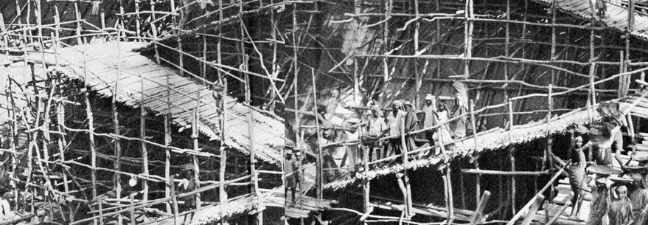
TOGAF as a framework
Using the TOGAF Standard results in Enterprise Architecture that is:
Consistent
Reflects the needs of stakeholders
Employs best practice
Guidance provided by the standard is intended to be adapted to address different needs, including
Agile enterprises
Digital transformation
Introduction and Core Concepts : Page 2 : §1.1
Initially MOD 01
Notes:
Þ Q-44
Level=1 : L.O.= 1.4a : Explain why the TOGAF Standard is suitable for use as a framework for Enterprise Architecture.
See : TOGAF® Standard – Introduction and Core Concepts : Page 2 : §1.1
Using the TOGAF Standard results in Enterprise Architecture that is:
consistent
reflects the needs of stakeholders
employs best practice
gives due consideration to
current requirements
addresses perceived future needs
is standardized
builds workable and economic solutions
addresses business and technology trends
Guidance provided by the standard is intended to be adapted to address different needs.
Thus it can be used to create a sustainable Enterprise Architecture for a broad range of use-cases, including
agile enterprises
digital transformation
1.1 Executive Overview
This section provides an executive overview of Enter prise Architecture, the basic concepts of
what it is (not just another name for IT Architecture), and why it is needed. It provides a
summary of the benefits of establishing an Enterprise Architecture and adopting the TOGAF
approach to achieve that.
What is an enterprise?
The TOGAF Standard considers an "enterprise" to be any collection of organizations that have
common goals.
For example, an enterprise could be:
■ A whole corporation or a division of a corporation
■ A government agency or a single government department
■ A chain of geographically distant organizations linked together by common ownership
■ Groups of countries, governments, or governmental organizations (such as militaries)
working together to create common or shareable deliverables or infrastructures
■ Partnerships and alliances of businesses working together, such as a consortium or supply
chain
The term "Enterprise" in the context of "Enterprise Architecture" can be applied to either an
entire enterprise, encompassing all of its business activities and capabilities, information,
... CONTINUES ... SEE REFERENCE SPECIFIED

Slide 27
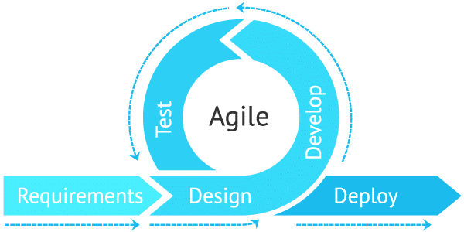
Enterprise Agility – 01/02
A commonly used term includes:
Responsiveness to change
Value-driven
Practical experimentation
Empowered, autonomous teams
Customer communication and collaboration
Continuous improvement
Respect for people
Important because it enables an enterprise to react better, and Agile principles and techniques can be applied to adapt the TOGAF framework.
See e.g. Manifesto for Agile Software Development, agilemanifesto.org
Enabling Enterprise Agility : Page 9 : §1.2
Initially MOD 01
Notes:
Level=1 : L.O.= 1.4b : Explain why the TOGAF Standard is suitable for use as a framework for Enterprise Architecture.
See : TOGAF® Series Guide: Enabling Enterprise Agility : Page 9 : §1.2
A commonly used term includes:
Responsiveness to change
Value-driven
Practical experimentation
Empowered, autonomous teams
Customer communication and collaboration
Continuous improvement
Respect for people
Important because it enables an enterprise to better react to change by being more:
Customer and product-centric
Efficient
Able to ensure regulatory compliance
Agile principles and techniques can be applied to adapt the TOGAF framework.
Enterprise agility is a broader context than Agile.
Additional techniques are employed in adapting the TOGAF framework to an Agile enterprise.
1.2. What is the Role of Enterprise Architecture?
Enterprise Architecture provides a framework for change, linked to both strategic direction and
business value. It provides a sufficient view of the organization to manage complexity, support
continuous change, and manage the risk of unanticipated consequences.
Enterprise Architecture is:
Chapter 1. Introduction 1.1. What is Meant by Agility and Why is it Important?
The TOGAF Framework – Enabling Enterprise Agility
The Open Group Confidential
Architecture Forum Members Only
Members Only
• A description of the elements within an organization, what they are meant to achieve, how they are
arranged, how they perform in practice, and how they respond to change
• A framework (structure, approach, and process) for managing change to those elements and their
arrangement; to continuously adapt to organizational change in line with strategy (goals and
objectives) and circumstances (specific requirements)
• The practice of acting to manage and evolve the Enterprise Architecture at all levels of
... CONTINUES ... SEE REFERENCE SPECIFIED

Slide 28
Enterprise Agility – 02/02
TOGAF® Standard, 10th Edition, 2022 gives context by:
Describing the elements within an organization​
Being a framework for managing change
Supports adapting to change that is aligned
to strategy
Iterative development is a useful tool to obtain early stakeholder feedback and results
Dividing work into sprints does not only mean dividing work into small pieces, but also learning by doing in short cycles and adapting the work accordingly
Enabling Enterprise Agility : Page 10 : §1.3
Initially MOD 01
Notes:
Level=1 : L.O.= 1.4c : Explain why the TOGAF Standard is suitable for use as a framework for Enterprise Architecture.
See : TOGAF® Series Guide: Enabling Enterprise Agility : Page 10 : §1.3
TOGAF® Standard, 10th Edition, 2022 gives context by:
Describing the elements within an organization:
what they should achieve
their arrangement
how they perform in practice, and response to change
Being a framework for:
managing change to those elements and their arrangement
supporting adaptation to change that is aligned to strategy and circumstances
Iterative development, such as practices like sprints with shorter iterations, is a useful tool to obtain early stakeholder feedback and results.
It enables the Enterprise Architects to deliver value earlier and iteratively, whether in a planned or emergent manner.
Dividing work into sprints does not only mean dividing work into small pieces, but also learning by doing in short cycles and adapting the work accordingly.
1.3. The Demand for Agility is Not New!
The US Clinger-Cohen Act of 1996 was a major driver for the adoption of Enterprise Architecture
because it required any investment in new IT systems (in the US public sector) to demonstrate a fit with
existing systems. Almost immediately, it was recognized that it is not practical to develop a full
Enterprise Architecture from the “top down”; it is necessary to structure work into smaller units to
respond to the specific needs of the enterprise in a timely manner, and to have some form of
“integration architecture” to ensure the pieces fit together and are aligned with the strategic direction
of the enterprise.
The TOGAF framework has embraced the call to respond to the needs of the enterprise in a timely
manner, through the concepts of “partitions” and “levels”. Partitions define how the work is broken
down into multiple architecture initiatives. Levels define how the overall architecture can be
developed at different levels of granularity and detail.
Each architecture initiative needs to be scoped to address the specific needs of the enterprise to be
... CONTINUES ... SEE REFERENCE SPECIFIED

Slide 29
Architecture Domains – 01/02
Business (Process) Architecture
Business strategy
Governance
Organization
Business processes
Data Architecture
Logical data assets
Physical data assets
Data management resources
Application Architecture
Individual application systems
Their interactions
Relationship to core business processes
Technology Architecture
The infrastructure intended to support deployment of applications
Business
Application
Data
Technology
Introduction and Core Concepts : Page 15 : §3.3
Initially MOD 01
Notes:
Level=1 : L.O.= 1.5a : List the four architecture domains that are commonly accepted as subsets of an overall Enterprise Architecture and which the TOGAF Standard supports.
See : TOGAF® Standard – Introduction and Core Concepts : Page 15 : §3.3
The TOGAF standard covers the development of four architecture domains.
These are commonly accepted as subsets of an overall Enterprise Architecture. They are as follows:
Business (Process) Architecture
Defines the business strategy, governance, organization and key business processes
Data Architecture
Describes the structure of an organization’s logical and physical data assets and data management resources
Application Architecture
A blueprint for the individual application systems to be deployed, their interactions and relationship to core business processes
Technology Architecture
Describes the software infrastructure intended to support deployment of core mission-critical applications
3.3 What Kind of Architecture Does the TOGAF Standard Deal With?
TOGAF® Standard — Introduction and Core Concepts 15
What Kind of Architecture Does the TOGAF Standard Deal With? Core Concepts
There are four architecture domains that are commonly accepted as subsets of an overall
Enterprise Architecture, all of which the TOGAF Standard is designed to support:
■ The Business Architecture defines the business strategy, governance, organization, and
key business processes
■ The Data Architecture describes the structure of an organization’s logical and physical
data assets and data management resources
■ The Application Architecture provides a blueprint for the individual applications to be
deployed, their interactions, and their relationships to the core business processes of the
organization
■ The Technology Architecture describes the digital architecture and the logical software
and hardware infrastructure capabilities and standards that are required to support the
deployment of business, data, and applications services. This includes digital services,
Internet of Things (IoT), social media infrastructure, cloud services, IT infrastructure,
middleware, networks, communications, processing, standards, etc.
There are many other domains that could be defined by combining appropriate views of the
Business, Data, Application, and Technology domains. For example:
... CONTINUES ... SEE REFERENCE SPECIFIED

Slide 30
Architecture Domains – 02/02
Business
There are many other domains that could
be defined by combining appropriate/cross-cutting views of these domains.
For example:
Information Architecture
Risk and Security Architectures
Digital Architecture
Privacy Architecture
Application
Data
Technology
The TOGAF Framework both enables and expects the creation of these multi-dimensional views to consider the wider scope of the enterprise and capabilities.
Introduction and Core Concepts : Page 15 : §3.3
Initially MOD 01
Notes:
Level=1 : L.O.= 1.5a : List the four architecture domains that are commonly accepted as subsets of an overall Enterprise Architecture and which the TOGAF Standard supports.
See : TOGAF® Standard – Introduction and Core Concepts : Page 15 : §3.3
There are many other domains that could be defined by combining appropriate/cross-cutting views of these domains.
For example:
Information Architecture
Risk and Security Architectures
Digital Architecture
Privacy Architecture
The TOGAF framework both enables and expects the creation of these multi-dimensional views to consider the wider scope of the enterprise and capabilities.
3.3 What Kind of Architecture Does the TOGAF Standard Deal With?
TOGAF® Standard — Introduction and Core Concepts 15
What Kind of Architecture Does the TOGAF Standard Deal With? Core Concepts
There are four architecture domains that are commonly accepted as subsets of an overall
Enterprise Architecture, all of which the TOGAF Standard is designed to support:
■ The Business Architecture defines the business strategy, governance, organization, and
key business processes
■ The Data Architecture describes the structure of an organization’s logical and physical
data assets and data management resources
■ The Application Architecture provides a blueprint for the individual applications to be
deployed, their interactions, and their relationships to the core business processes of the
organization
■ The Technology Architecture describes the digital architecture and the logical software
and hardware infrastructure capabilities and standards that are required to support the
deployment of business, data, and applications services. This includes digital services,
Internet of Things (IoT), social media infrastructure, cloud services, IT infrastructure,
middleware, networks, communications, processing, standards, etc.
There are many other domains that could be defined by combining appropriate views of the
Business, Data, Application, and Technology domains. For example:
■ Information Architecture
■ Risk and Security Architectures
■ Digital Architecture
The TOGAF framework enables the creation of these multi-dimensional views and categorizes
them to create specific domains that enable an enterprise to consider the wider scope of its
capabilities.

Slide 31
Architecture Abstraction
An technique for dividing a problem area into smaller problem areas that are easier to model.
Abstraction levels moving from high-level models to more detailed models.
Four distinct abstraction levels across the domains:
Why - Contextual Abstraction Level​
What - Conceptual Abstraction Level [Service/Behaviour]​
How - Logical Abstraction Level​
With What - Physical Abstraction Level​
Introduction and Core Concepts : Page 23 : §3.7
Initially MOD 01
Notes:
Þ Q-45
Level=1 : L.O.= 1.6a : Briefly describe how architecture abstraction can be used in Enterprise Architecture.
See : TOGAF® Standard – Introduction and Core Concepts : Page 23 : §3.7
Note that “why, what, and how” have no connection to their use in the Zachman® Enterprise Architecture Framework.
Figure represents the top level ISO 7-layer model
A technique for dividing a problem area into smaller problem areas that are easier to model.
Abstraction levels moving from high-level models to more detailed models.
Four distinct abstraction levels across the domains:
Why - Contextual Abstraction Level
focuses on understanding the operational environment, the context in which architecture work is planned and executed, why we undertake architecture work, scope of work, and motivation - goals, drivers, and objectives.
What - Conceptual Abstraction Level [Service/Behavior]
centered on decomposing requirements to understand the problem and what is needed to address the problem, without unduly focusing on how the architecture will be realized.
How - Logical Abstraction Level
focused on identifying the kinds of business, data, application, and technology components needed to achieve the services identified in the conceptual level
With What - Physical Abstraction Level
manages the allocation and implementation of physical components to meet the identified logical components
3.7 Architecture Abstraction
An architectural technique for dividing a problem area into smaller problem areas that are easier
to model and therefore easier to solve.
Abstraction levels are layered in nature, moving from high-level models to more detailed models.
Architecture effort can be divided into four distinct abstraction levels that cross the Business,
Data, Application, and Technology domains to answer fundamental questions about an
architecture:
■ Why — why is the architecture needed?
■ What — what functionality and other requirements need to be met by the architecture?
■ How — how do we structure the functionality?
■ With what — with what assets shall we implement this structure?
... CONTINUES ... SEE REFERENCE SPECIFIED

Slide 32
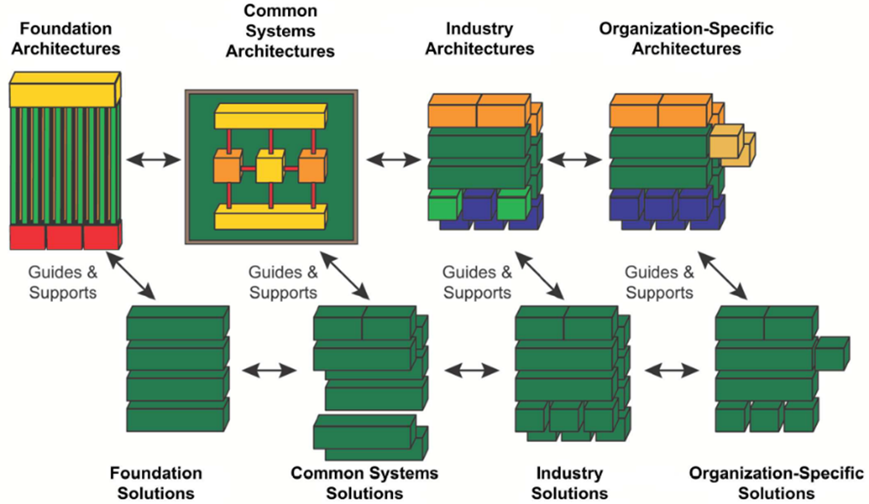
Enterprise Continuum - 01/02
Conceptual indexing system - Classification
‘Discrete’ model
Introduction and Core Concepts : Page 26 : §3.10
Initially MOD 01
Notes:
Þ M-58
Level=1 : L.O.= 1.7a : Briefly describe the Enterprise Continuum.
See : TOGAF® Standard – Introduction and Core Concepts : Page 26 : §3.10
3.10 Enterprise Continuum
The TOGAF Standard includes the concept of the Enterprise Continuum, which sets the broader
context for an architect and explains how generic solutions can be leveraged and specialized in
order to support the requirements of an individual organization.
The Enterprise Continuum is a categorization for assets held in the Enterprise Repositories that
provides methods for classifying assets, including architecture and solution artifacts as they
evolve from generic Foundation Architectures to Organization-Specific Architectures.
Core Concepts Enterprise Continuum
Enterprise Continuum comprises two complementary concepts: the Architecture Continuum and
the Solutions Continuum.
The Enterprise Continuum is described in detail in the TOGAF Standard — Architecture
Content.

Slide 33
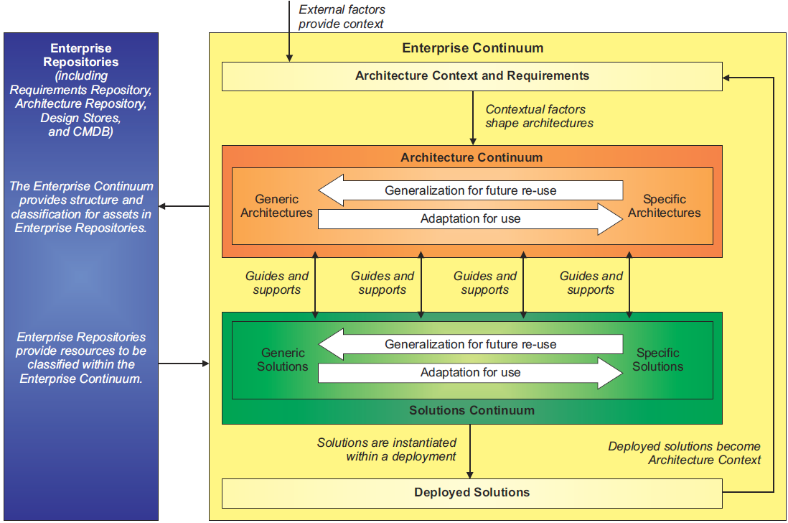
Enterprise Continuum - 01/02
Conceptual indexing system - Based on ‘Generic-ness’
‘Continuous’ model
‘Discrete’ model
Note the Deployed Solutions layer ...
Example:
Architecture : accounting system
Solutions : Sage, Oracle, Compiere, Agresso
Deployed : Sage, Agresso
Introduction and Core Concepts : Page 26 : §3.10
Initially MOD 01
Notes:
Þ M-58
Level=1 : L.O.= 1.7a : Briefly describe the Enterprise Continuum.
See : TOGAF® Standard – Introduction and Core Concepts : Page 26 : §3.10
3.10 Enterprise Continuum
The TOGAF Standard includes the concept of the Enterprise Continuum, which sets the broader
context for an architect and explains how generic solutions can be leveraged and specialized in
order to support the requirements of an individual organization.
The Enterprise Continuum is a categorization for assets held in the Enterprise Repositories that
provides methods for classifying assets, including architecture and solution artifacts as they
evolve from generic Foundation Architectures to Organization-Specific Architectures.
Core Concepts Enterprise Continuum
Enterprise Continuum comprises two complementary concepts: the Architecture Continuum and
the Solutions Continuum.
The Enterprise Continuum is described in detail in the TOGAF Standard — Architecture
Content.

Slide 34
Enterprise Continuum – 02/02
Conceptual indexing system
‘Continuous’ model
Standard – Architecture Content : Page 85 : §6.2
Initially MOD 01
Notes:
Level=1 : L.O.= 1.7b : Briefly describe the Enterprise Continuum.
See : TOGAF® Standard – Architecture Content : Page 85 : §6.2
6.2 Enterprise Continuum and Architecture Re-Use
The simplest way of thinking of the Enterprise Continuum is as a view of the repository of all the
architecture assets. It can contain Architecture Descriptions, models, building blocks,patterns,
architecture viewpoints, and other artifacts — that exist both within the enterprise and in the IT
industry at large,which the enterprise considers to have available for the development of
architectures for the enterprise.
Examples of internal architecture and solution artifacts are the deliverables of previous
architecture work, which are available for re-use. Examples of external architecture and solution
artifacts are the wide variety of industry reference models and architecture patterns that exist,
and are continually emerging, including those that are highly generic (such as the TOGAF TRM);
those speciﬁc to certain aspects of IT (such as a web services architecture,or a generic
manageability architecture); those speciﬁc to certain types of infor mation processing, such as eCommerce,supply chain management, etc.; and those speciﬁc to certain vertical industries, such as the models generated by vertical consortia like the TM Forum (in the
Telecommunications sector), ARTS (Retail), Energistics®(Petrotechnical), etc.

Slide 35
Architecture Repository – 02/02
Comprises (including)
EA Landscape
Reference Library
Standards Library
Requirements Repository
Compliance Assessments in the Governance Log
Typically, these are implemented by a modelling and analytic tool,
and a file repository.
A Practitioners’ Approach to Developing Enterprise Architecture Following the ADM : Page 28 : §5.1
Initially MOD 01
Notes:
Level=1 : L.O.= 1.8b : Briefly explain the Architecture Repository.
See : TOGAF® Series Guide: A Practitioners’ Approach to Developing Enterprise Architecture Following the TOGAF® ADM : Page 28 : §5.1
The Practitioner is directly concerned with the:
EA Landscape
Reference Library
Standards Information Base
Requirements Repository
Compliance Assessments in the Governance Log.
Typically, these are implemented by a modelling and analytic tool, and a file repository.
A significant factor, that results in a well-run sustainable EA Repository, is the ruthless minimization of information gathered and maintained.
Information that is not required for the current Architecture Project, or that supports minimal traceability, should not be captured.
Good practitioners will not confuse ruthless minimization of work with skipping necessary work: all stakeholders’ concerns must be addressed.
Leading practitioners will understand that stakeholder management is necessary and attention to non-key stakeholders is rarely on the critical path.​
The test of sufficiency is a function of fitness for purpose.​
5.1 What to Expect in a Well-Run Architecture Repository & EA Landscape
Note: In order to provide concrete examples of working in a repository, this Guide presents a few screenshots using a modelling tool. These represent one way that the challenges of managing an EA Landscape can be met. As outlined in Section 1.3, this Guide does not mean to suggest that the referenced tool, techniques, and literature are definitive. These examples are intended to illustrate the TOGAF concepts. Other tools and techniques are available.
The TOGAF Standard identifies a broad set of materials that will be contained within the Architecture Repository. As a Practitioner, you will be directly concerned with the EA Landscape, Reference Library, Standards Information Base, Requirements Repository, and the Compliance Assessments in the Governance Log. Typically, these are implemented by a modelling and analytic tool, and a file repository. A Practitioners’ Approach to Developing Enterprise Architecture Following the TOGAF® ADM 29
Figure 6: TOGAF Architecture Repository
A high-functioning EA team cannot deliver without using modelling and analytic software. Some practitioners sketch diagrams casually as initial steps in understanding a system or explaining one. Maintenance of a collection of sketches is not practical. It does not matter whether they use a marker and 11” x 17” paper or spend hours connecting objects in drawing software, these sketches are not modelling and do not provide a meaningful contribution to ... CONTINUES ...
... CONTINUES ... SEE REFERENCE SPECIFIED

Slide 36
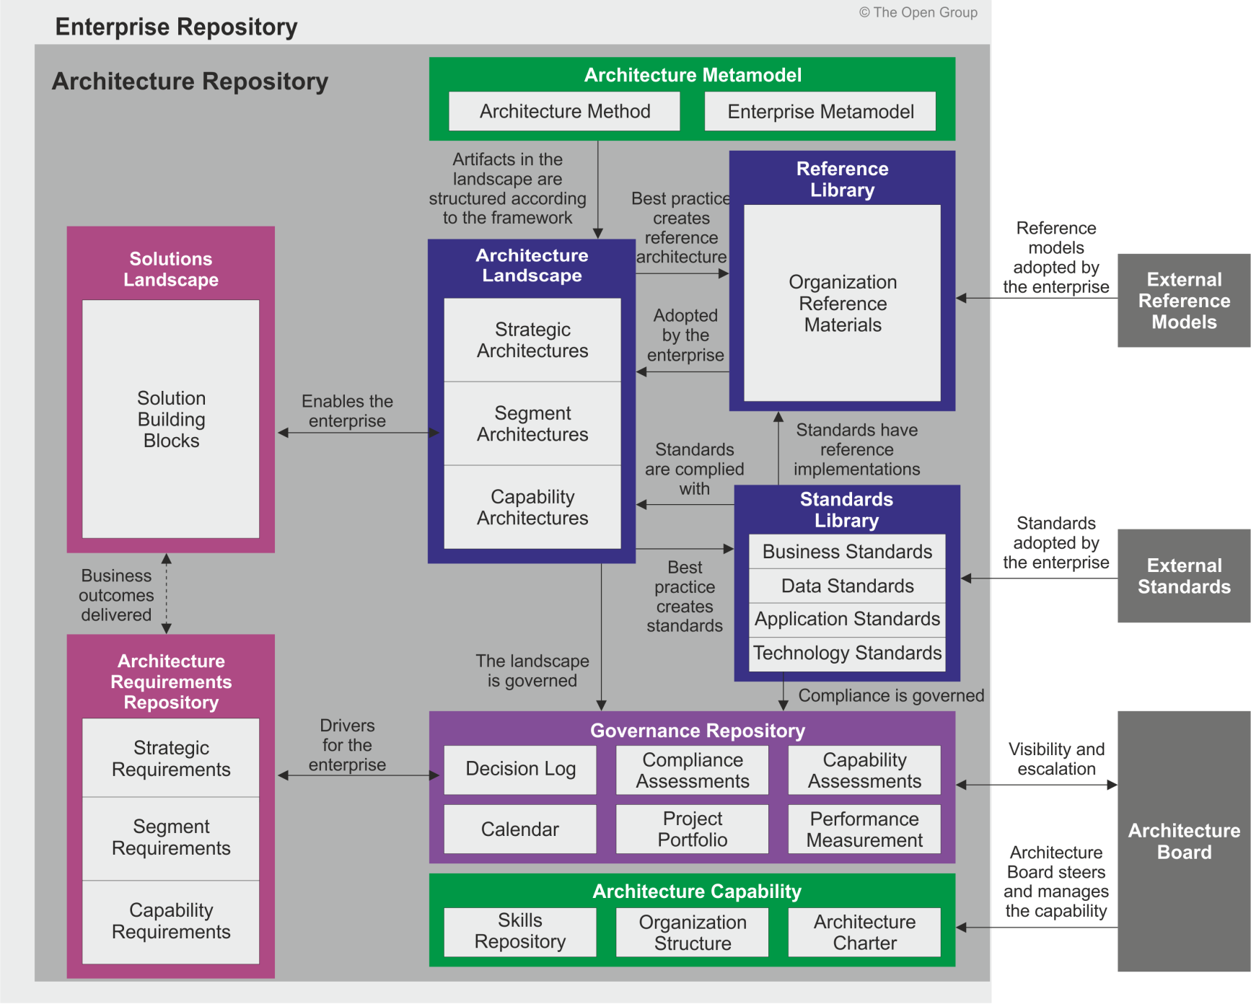
Architecture Repository – 01/02
Conceptual
The effective management and leverage of architectural work products
requires a formal taxonomy for different types of architectural assets alongside dedicated
processes and tools for architectural content storage.
Introduction and Core Concepts : Page 27 : §3.11
Initially MOD 01
Notes:
Þ M-57
Level=1 : L.O.= 1.8a : Briefly explain the Architecture Repository.
See : TOGAF® Standard – Introduction and Core Concepts : Page 27 : §3.11
3.11 Architecture Repository
Supporting the Enterprise Continuum is the concept of an Architecture Repository which can be
used to store different classes of architectural output at different levels of abstraction, created by
the ADM. In this way, the TOGAF Standard facilitates understanding and co-operation between
stakeholders and practitioners at different levels.
By means of the Enterprise Continuum and Architecture Repository, architects are encouraged
to leverage all other relevant architectural resources and assets in developing an Organization-
Specific Architecture. In this context, the TOGAF ADM can be regarded as describing a process
lifecycle that operates at multiple levels within the organization, operating within a holistic
governance framework and producing aligned outputs that reside in an Architecture Repository.
The Enterprise Continuum provides a valuable context for understanding architectural models: it
shows building blocks and their relationships to each other, and the constraints and
requirements on a cycle of architecture development.
TOGAF® Standard — Introduction and Core Concepts 27
Architecture Repository Core Concepts
The structure of the TOGAF Architecture Repository is shown in Figure 3-5.
Architecture Repository
Artifacts in the landscape are structured according to the metamodel Best practice
creates reference architecture adopted by the enterprise.
... CONTINUES ... SEE REFERENCE SPECIFIED

Slide 37
TOGAF Metamodel
The Content Framework is used to structure architectural information
in an orderly way
Which processes are orchestrated by the differentiating capability?
Which processes require an application change?
What functionality does an application support?
What is the impact on information security of using A cloud infrastructure for the application?
The TOGAF Enterprise Metamodel provides a list of common
  Components
  Relationships
The TOGAF Leader’s Guide to Establishing and Evolving an EA Capability : Page 54 : §8.3
Initially MOD 02
Content Metamodel 1 changed to Content Framework (V10)
Content Metamodel 2 changed to Enterprise Metamodel (V10)
Notes:
Level=1 : L.O.= 1.9b : Briefly explain the TOGAF Content Framework and Enterprise Metamodel.
See : TOGAF® Series Guide: The TOGAF Leader’s Guide to Establishing and Evolving an EA Capability : Page 54 : §8.3
So, we left off when we’d had a look at the Content Metamodel
The Content Metamodel is used to structure architectural information in an orderly way:
Which processes are orchestrated by the differentiating capability?
Which processes require an application change?
What functionality does an application support?
What is the impact on information security of using a cloud infrastructure for the application?
The TOGAF Content Metamodel provides a list of common
components
relationships
8.3 What Constitutes the Content Metamodel?
Regarding information management, the purpose defines what information the EA Capability must have at hand. In practical terms, information needs are derived from the viewpoint library and the information that supports the viewpoints. Consider what information is required to answer these two questions:
• How can the enterprise maximize the differentiation by aligning delivery of the portfolio?
• What should be done in response to one of the technology suppliers changing its product?
The Content Metamodel is used to structure architectural information in an orderly way so that it can be processed to meet stakeholder needs. The majority of architecture stakeholders do not actually need to know what the architecture Content Metamodel is and are only concerned with specific issues, such as: “How can the enterprise maximize differentiation by aligning delivery of the portfolio?”.
The difficulty comes when, to answer this question, the EA Capability may need to know:
• Which processes are orchestrated by the differentiating capability?
• Which processes require an application change?
• What functionality does an application support?
• What is the impact of using a cloud infrastructure for the application on information security?
There are two approaches to defining the Content Metamodel. The most successful practice ensures that the central questions the EA Capability is established to address concern the focus. In this case, look at the questions the EA Capability is established to answer, and identify the concerns and the viewpoints that address these concerns. The resulting viewpoint library defines the Content Metamodel. Anything more is noise and results in ... CONTINUES ... SEE REFERENCE SPECIFIED

Slide 38
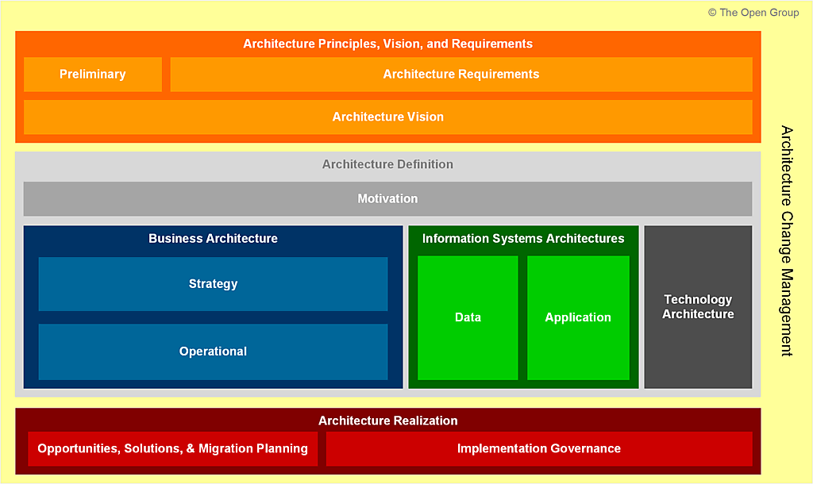
The TOGAF Content Framework
Detailed model of architectural work products
Drives consistency in the outputs created during the ADM
A comprehensive checklist of potential output
Reduces the risk of gaps within the final deliverables
Mandates standard architecture deliverables
Introduction and Core Concepts : Page 29 : §3.12
Initially MOD 01
Replaced old Content Framework with V10 version section 3.12
Notes:
Level=1 : L.O.= 1.9a : Briefly explain the TOGAF Content Framework and Enterprise Metamodel.
See : TOGAF® Standard – Introduction and Core Concepts : Page 29 : §3.12
3.12 TOGAF Content Framework and Enterprise Metamodel
3.12.1 Overview
The TOGAF ADM provides lifecycle management to create and manage architectures within an
enterprise. At each phase within the ADM, a discussion of inputs, outputs, and steps describes a
number of architectural work products.
An essential task when establishing the enterprise-specific Enterprise Architecture Capability in
the Preliminary Phase of the ADM is to define:
■ A categorization framework to be used to structure the Architecture Descriptions, the work
products used to express an architecture, and the collection of models that describe the
architecture; this is referred to as the Content Framework
■ An understanding of the types of entities within the enterprise and the relationships
between them that need to be captured, stored, and analyzed in order to create the
Architecture Description; this Enterprise Metamodel depicts this information in the form of
a formal model
■ The specific artifacts to be developed (see Section 3.6)
The Content Framework chosen is likely to be influenced by:
■ The Architecture Framework selected as the basis for the Enterprise Architecture
Capability
■ The chosen software tool used to support the Enterprise Architecture Capability
3.12.2 Content Framework
The Content Framework defines a categorization framework to be used to describe the building
blocks and artifacts reflecting decisions taken in creating the overall architecture deliverables.
The Architecture Repository, which is explained in Section 3.11, is structured to store the
artifacts and work products identified in the Content Framework. The Content Framework is one
element of the Enterprise-Specific Architecture Framework.
There are many alternative Content Frameworks (e.g., the TOGAF Content Framework, the
Zachman Framework, DoDAF, NAF, etc.). Selecting a Content Framework is essential even
though the choice of Content Framework is less important. The final Content Framework is
... CONTINUES ... SEE REFERENCE SPECIFIED

Slide 39
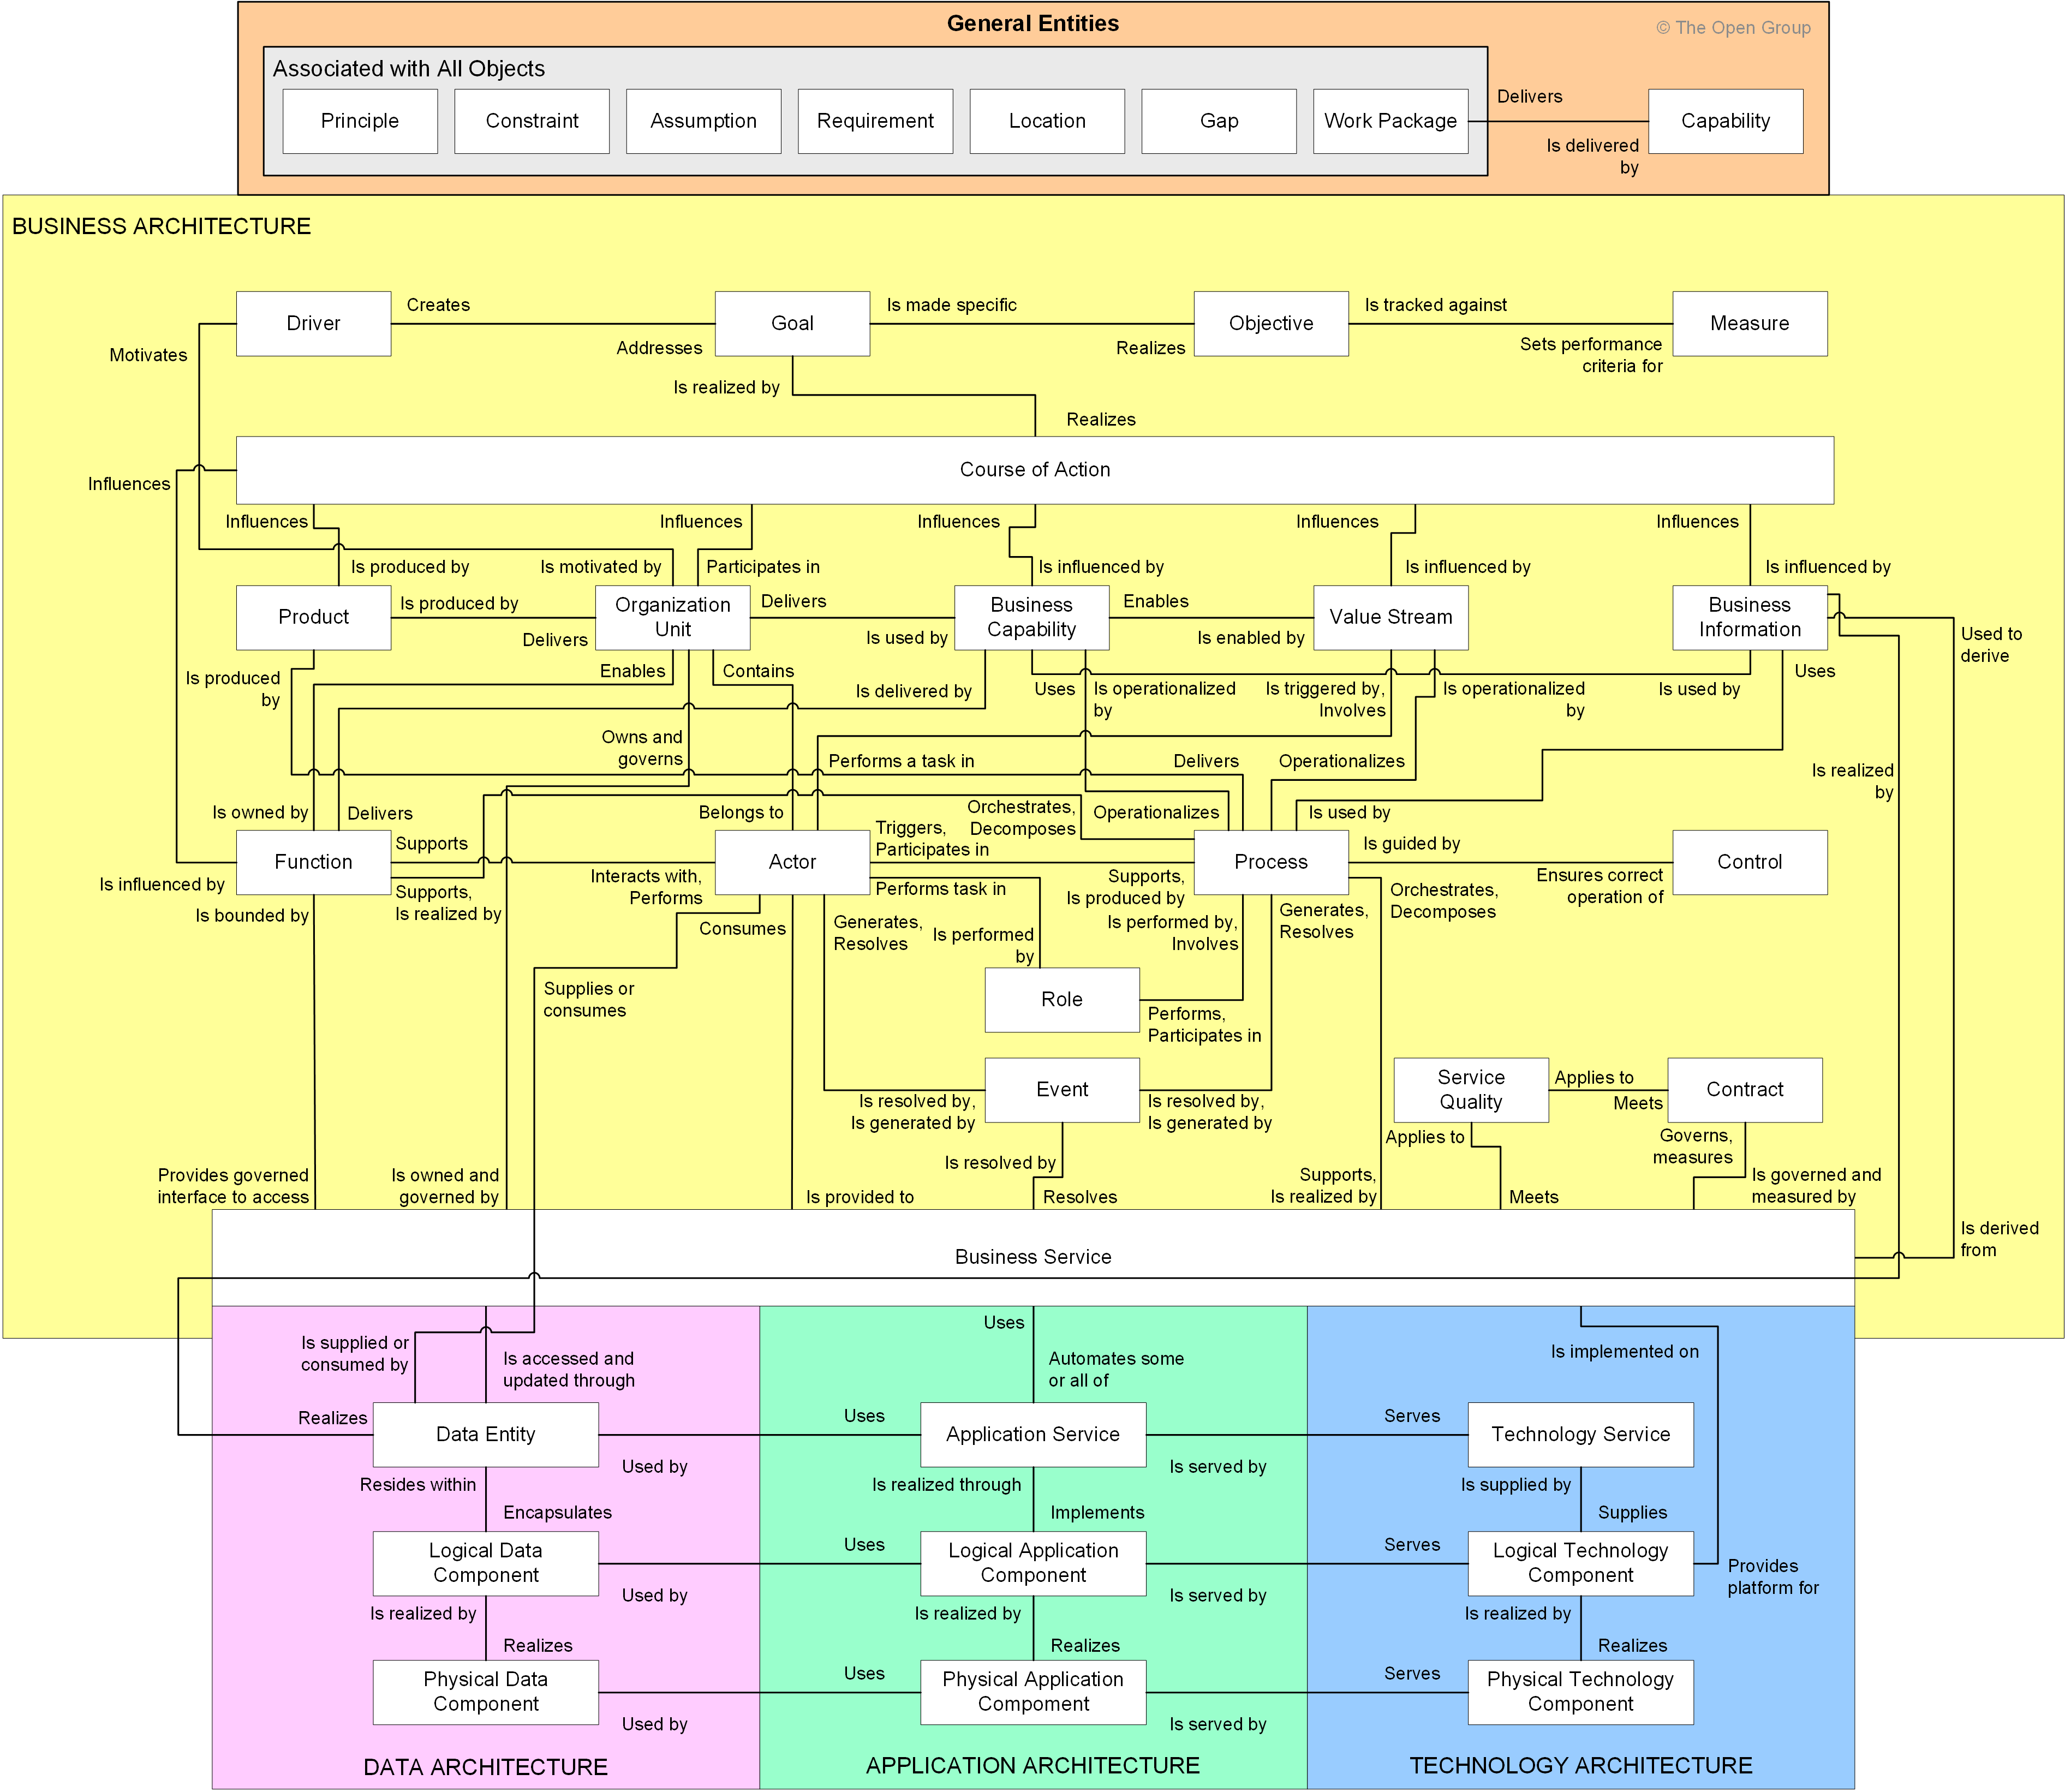
The Enterprise Metamodel – 01/02
The TOGAF Leader’s Guide to Establishing and Evolving an EA Capability : Page 54 : §8.3
Initially MOD 01
Notes:
Level=1 : L.O.= 1.9b : Briefly explain the TOGAF Content Framework and Enterprise Metamodel.
See : TOGAF® Series Guide: The TOGAF Leader’s Guide to Establishing and Evolving an EA Capability : Page 54 : §8.3
8.3 What Constitutes the Content Metamodel?
Regarding information management, the purpose defines what information the EA Capability must have at hand. In practical terms, information needs are derived from the viewpoint library and the information that supports the viewpoints. Consider what information is required to answer these two questions:
• How can the enterprise maximize the differentiation by aligning delivery of the portfolio?
• What should be done in response to one of the technology suppliers changing its product?
The Content Metamodel is used to structure architectural information in an orderly way so that it can be processed to meet stakeholder needs. The majority of architecture stakeholders do not actually need to know what the architecture Content Metamodel is and are only concerned with specific issues, such as: “How can the enterprise maximize differentiation by aligning delivery of the portfolio?”.
The difficulty comes when the EA Capability may need to answer:
• Which processes are orchestrated by the differentiating capability?
• Which processes require an application change?
• What functionality does an application support?
• What is the impact on information security of using a cloud infrastructure for the application?
There are two approaches to defining the Content Metamodel. The most successful practice ensures that the central questions the EA Capability is established to address concern the focus. In this case, look at the questions the EA Capability is established to answer, and identify the concerns and the viewpoints that address these concerns. The resulting viewpoint library defines the Content Metamodel. Anything more is noise and results in unnecessary work in future. The TOGAF® Leader’s Guide to Establishing and Evolving an EA Capability 55
Following this approach leads to smaller information demands and crisply focuses the EA Capability on expected value. Any expansion in the range of critical questions the EA Capability is expected to answer will expand the information requirements. The majority of Enterprise Architects and analysts who have gone ahead to capture more information than is actually required have consistently failed.
An alternative practice is to use an established Content Metamodel. This approach enables the EA Capability to address a broader set of questions. However, this approach typically of
... CONTINUES ... SEE REFERENCE SPECIFIED

Slide 40
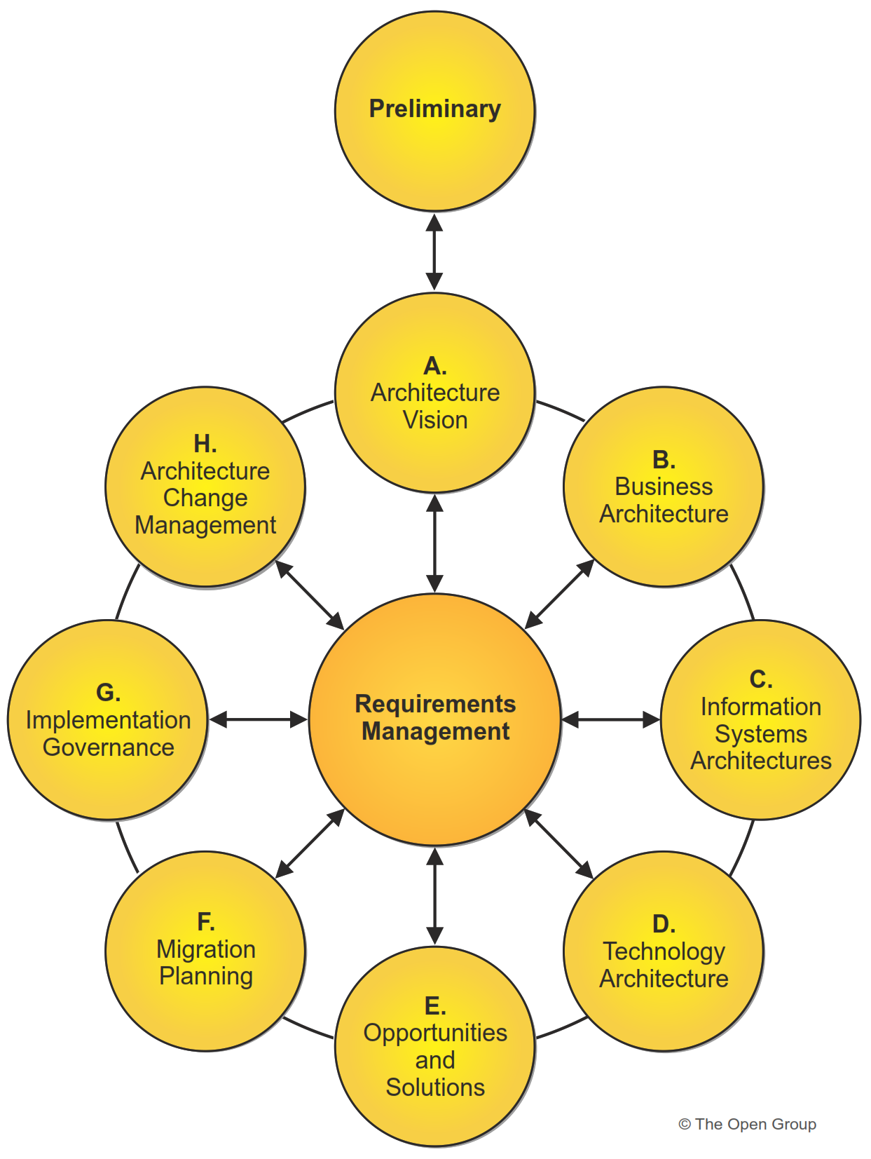
The Architecture Development Method
A tested and repeatable process for developing architectures
Carried out within an iterative cycle
Allows organizations to transform their enterprises:
in a controlled manner
in response to business goals and opportunities
The Standard TOGAF® ‘crop-circle’
Introduction and Core Concepts : Page 16 : §3.4
Initially MOD 02
Added this here to provide a complete overview
Notes:
Level=1 : L.O.= 3.1a : Briefly describe the ADM and its phases.
See : TOGAF® Standard – Introduction and Core Concepts : Page 16 : §3.4
A tested and repeatable process for developing architectures includes:
establishing an architecture framework
developing architecture content transitioning
governing the realization of architectures
Carried out within an iterative cycle of continuous:
architecture deﬁnition
realization
Allows organizations to transform their enterprises:
in a controlled manner
in response to business goals and opportunities
3.4 Architecture Development Method
The TOGAF Architecture Development Method (ADM) provides a tested and repeatable process
for developing architectures. The ADM includes establishing an architecture framework,
developing architecture content, transitioning, and governing the realization of architectures.
All of these activities are carried out within an iterative cycle of continuous architecture definition
and realization that allows organizations to transform their enterprises in a controlled manner in
response to business goals and opportunities. This is illustrated in the Figure.
Phases within the ADM are as follows:
■ The Preliminary Phase describes the preparation and initiation activities required to
create an Architecture Capability including customization of the TOGAF framework and
definition of Architecture Principles
■ Phase A: Architecture Vision describes the initial phase of an architecture development
Cycle.
It includes information about defining the scope of the architecture development initiative,
identifying the stakeholders, creating the Architecture Vision, and obtaining approval to
proceed with the architecture development
■ Phase B: Business Architecture describes the development of a Business Architecture
to support the agreed Architecture Vision
■ Phase C: Information Systems Architectures describes the development of Information
Systems Architectures to support the agreed Architecture Vision
■ Phase D: Technology Architecture describes the development of the Technology
Architecture to support the agreed Architecture Vision
■ Phase E: Opportunities & Solutions

Slide 41
Summary of Module 01
The 17 Learning Points covered in Module 01 are:
1.1a : Describe what an enterprise is.
1.2a : Explain the purpose of Enterprise Architecture.
1.2b : Explain the purpose of Enterprise Architecture.
1.2c : Explain the purpose of Enterprise Architecture.
1.3a : List the key benefits of having an Enterprise Architecture.
1.3b : List the key benefits of having an Enterprise Architecture.
1.4a : Explain why the TOGAF Standard is suitable for use as a framework for Enterprise Architecture.
1.4b/c : Explain why the TOGAF Standard is suitable for use as a framework for Enterprise Architecture.
1.4d : Explain why the TOGAF Standard is suitable for use as a framework for Enterprise Architecture.
1.5a : List the four architecture domains which the TOGAF Standard supports.
1.6a : Briefly describe how architecture abstraction can be used in Enterprise Architecture.
1.7a : Briefly describe the Enterprise Continuum.
1.8a : Briefly explain the Architecture Repository.
1.8b : Briefly explain the Architecture Repository.
1.9a : Briefly explain the TOGAF Content Framework and Enterprise Metamodel.
1.9b : Briefly explain the TOGAF Content Framework and Enterprise Metamodel.
Initially MOD 01

Slide 42
End of Teaching Slides
End of
Module 01
Overview
Initially MOD 01

Slide 43
Module 02/16
TOGAF® EA Training - Foundation
TOGAF® Standard, 10th Edition
Module 02
Concepts
TOGAF® is a registered trademark of The Open Group Copyright © The Open Group 2022
​
Initially MOD 02

Slide 44
Course Module Index
# | Topic – Level 1 | ✓
1 | Module 00 - Course Introduction | ✓
2 | Module 01 - Overview | ✓
3 | Module 02 - Concepts
4 | Module 03 - Introduction to the ADM
5 | Module 04 - Introduction to the ADM - Techniques
6 | Module 05 – Applying ADM
7 | Module 06 - Architecture Governance
8 | Module 07 – Architecture Content
# | Topic – Level 2
9 | Module 00 - Course Introduction
10 | Module 08 - The Context for Enterprise Architecture
11 | Module 09 – Stakeholder Management
12 | Module 10 – Phase A
13 | Module 11 – Architecture Development
14 | Module 12 – Implementing the Architecture
15 | Module 13 – Architecture Change Management
16 | Module 14 – Requirements Management
17 | Module 15 – Supporting the ADM Work
18 | Module 16 – Closure
Course
Module
Index
Initially MOD 02

Slide 45
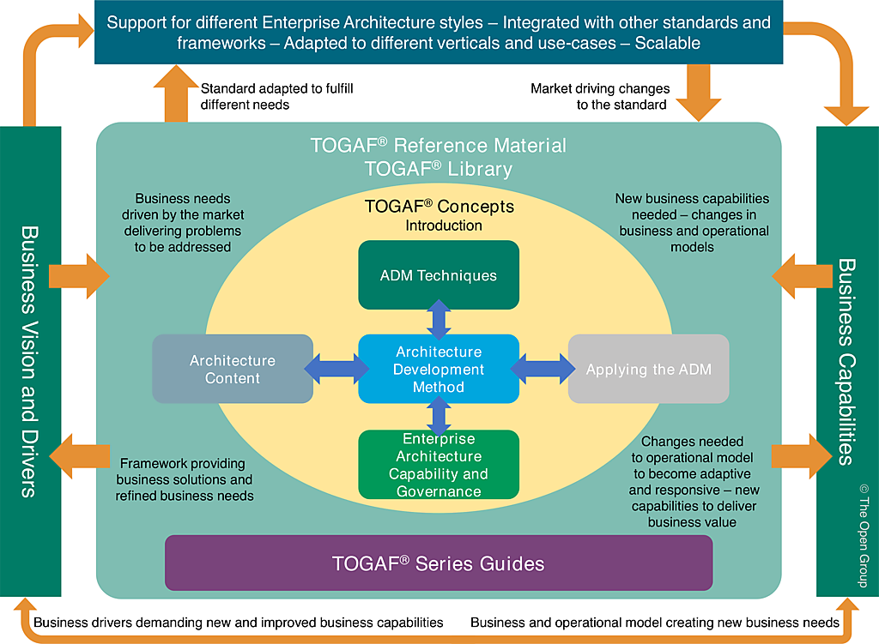
How to apply the TOGAF Standard - Guidance
Introduction and Core Concepts : Page 10 : §2.2
Initially MOD 05
Notes:
Level=1 : L.O.= 5.1a : Describe where guidance on how to apply the TOGAF Standard is provided.
See: TOGAF® Standard – Introduction and Core Concepts : Page 10 : §2.2
The TOGAF Standard is an open, industry consensus framework for Enterprise Architecture.
It is a foundational framework: it is applicable to the development of any kind of architecture in any context.
This foundational framework is supplemented by The Open Group TOGAF Library, an extensive and growing portfolio of guidance material, providing practical guidance in the application of the TOGAF framework in specific contexts.
The structure of the TOGAF Standard reflects the structure and content of an Architecture Capability within an enterprise.

Slide 46
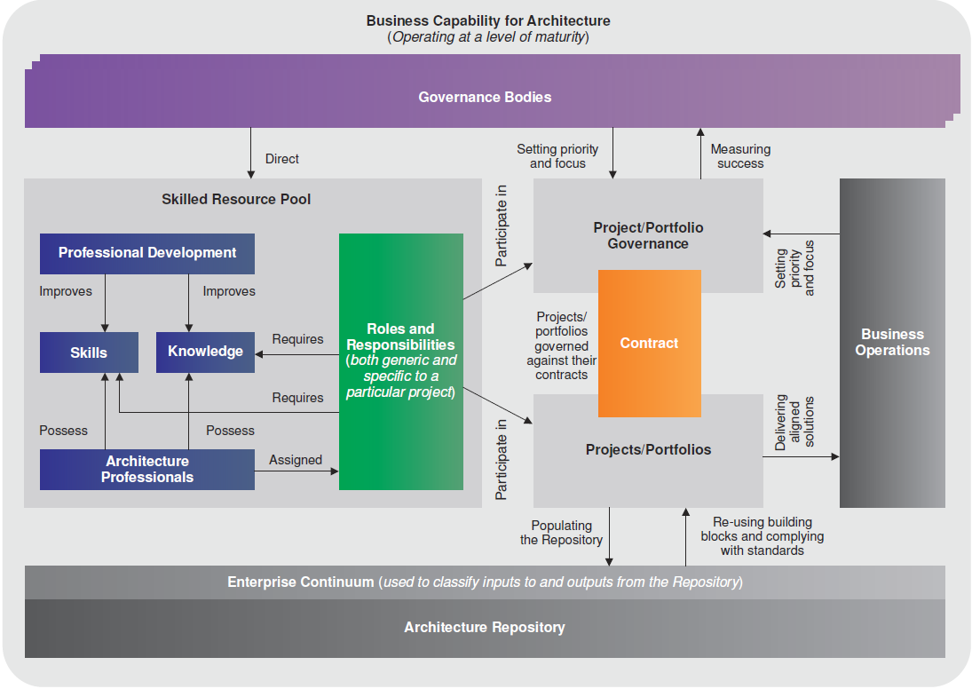
Architecture Capability – 01/01
Architecture Capability Framework
or How to establish an architecture function
Capability = An ability that an organization, person, or system possesses
It is necessary to put in
place an appropriate business capability for architecture
What do we need
How do we handle it
What are the compromises
Introduction and Core Concepts : Page 33 : §3.13
Initially MOD 02
Replaced capability definition with the one in the V10 standard Section – 4.33
Changed Architecture Capability Framework to Architecture Capability Overview as in V10 standard 3.13 Figure 3-9
Notes:
Level=1 : L.O.= 1.10 : Briefly explain what an Architecture Capability is.
See : TOGAF® Standard – Introduction and Core Concepts : Page 33 : §3.13
capability = ability to perform or achieve certain actions/outcomes
It is necessary to put in place an appropriate business capability for architecture, through organization structures, roles, responsibilities, skills, and processes.
What do we need
How do we handle it
What are the compromises
3.13 Establishing and Maintaining an Enterprise Architecture Capability
In order to carry out architectural activity effectively within an enterprise, it is necessary to put in
place an appropriate business capability for architecture, through organization structures, roles,
responsibilities, skills, and processes.

Slide 47
Architecture Capability – 02/05
An Enterprise Architecture practice must be treated as a business -
and should establish capabilities in the areas such as:
Financial Management
Performance Management
Service Management
Risk and Opportunity Management
Resource Management
Communications and Stakeholder Management
Quality Management
Introduction and Core Concepts : Page 33 : §3.13
Initially MOD 02
Notes:
Þ Q-41
Level=1 : L.O.= 1.10 : Briefly explain what an Architecture Capability is.
See : TOGAF® Standard – Introduction and Core Concepts : Page 33 : §3.13
An Enterprise Architecture practice must be treated as a business -
and should establish capabilities in the areas such as:
Financial Management
Performance Management
Service Management
Risk and Opportunity Management
Resource Management
Communications and Stakeholder Management
Quality Management
Supplier Management
Configuration Management
Environment Management
3.13 Establishing and Maintaining an Enterprise Architecture Capability
In order to carry out architectural activity effectively within an enterprise, it is necessary to put in
place an appropriate business capability for architecture, through organization structures, roles, responsibilities, skills, and processes.

Slide 48
Architecture Capability – 03/05
All architecturally significant activity is controlled and aligned within a single framework.
TOGAF is aligned with current best practice around Governance:
Increased transparency
Proactive risk and opportunity management
Protection of the existing asset base
Proactive control, monitoring, and management mechanisms
Process, concept, and component re-use across all business units
Value creation through monitoring, measuring, evaluation, and feedback
Increased visibility supporting internal processes
Greater shareholder value
Integrates with existing processes and methodologies
Introduction and Core Concepts : Page 34 : §3.14
Initially MOD 02
Notes:
Level=1 : L.O.= 1.10a : Briefly explain what an Architecture Capability is.
See : TOGAF® Standard – Introduction and Core Concepts : Page 34 : §3.14
All architecturally significant activity is controlled and aligned within a single framework.
TOGAF is aligned with current best practice around Governance, realizing the following benefits:
Increased transparency of accountability/informed delegation of authority
Proactive risk and opportunity management
Protection of the existing asset base
Proactive control, monitoring, and management mechanisms
Process, concept, and component re-use across all business units
Value creation through monitoring, measuring, evaluation, and feedback
Increased visibility supporting internal processes and external parties’ requirements
Greater shareholder value
Integrates with existing processes and methodologies
3.14 Establishing the Architecture Capability as an Operational Entity
Barring those Architecture Capabilities that are set up to purely support change delivery programs, it is
increasingly recognized that a successful Enterprise Architecture practice must sit on a firm
operational footing. In effect, an Enterprise Architecture practice must be run like any other
operational unit within a business; i.e., it should be treated like a business. To this end, and over
and above the core processes defined within the ADM, an Enterprise Architecture practice
should establish capabilities in the following areas:
■ Financial Management
■ Performance Management
■ Service Management
■ Risk and Opportunity Management (see Section B.34)
■ Resource Management
■ Communications and Stakeholder Management (see Section 4.36)
34 The Open Group Standard (2021)
Core Concepts Establishing the Architecture Capability as an Operational Entity
■ Quality Management
■ Supplier Management (see Section B.40)
■ Configuration Management (see Section B.7)
■ Environment Management
Central to the notion of operating an ongoing architecture is the execution of well-defined and
effective governance, whereby all architecturally significant activity is controlled and aligned
within a single framework.
... CONTINUES ... SEE REFERENCE SPECIFIED
... CONTINUES ... SEE REFERENCE SPECIFIED

Slide 49
Architecture Capability – 05/05
Architecture Capability as a Role
Is clearly defined in the TOGAF Skills Guide
but the wider literature on the role of an Enterprise Architect will often leave no understanding of:
What is expected?
Where will the EA Capability team be engaged?
How to validate whether the EA Capability is doing the right thing?
EA is primarily an enabler that defines the Gap between the enterprise’s current state and future state
= what must change within the enterprise
The TOGAF Leader’s Guide to Establishing and Evolving an EA Capability : Page 30 : §5.1
Initially MOD 02
The TOGAF Skill Guide clearly says what the roles of Enterprise, Segment and Solution architect are. The Series Guide is referring to generalised literature (which is not really true) but is in the Series Guide. So have added the third line.
Notes:
Level=1 : L.O.= 1.10c : Briefly explain what an Architecture Capability is.
See : TOGAF® Series Guide: The TOGAF Leader’s Guide to Establishing and Evolving an EA Capability : Page 30 : §5.1
At the extremes, the role is classified as an enabler of enterprise transformation or responsible for the selection of technical IT standards. This wide variance is responsible for most failures of an EA Capability. A mixed bag of expectations will result in improper scoping for work products and planning the evolution and development of the EA Capability.
Architecture Capability as a Role
The literature on the role of an Enterprise Architect will leave no understanding of:
What is expected?
Where the EA Capability team will be engaged?
How to validate that the EA Capability is doing the right thing?
EA is primarily an Enabler …
to describe the future state of an enterprise.
to guide the change to reach the future state.
to enable key people to understand what must be in their enterprise to meet the enterprise’s goals, objective, mission, and vision in the context within which the enterprise operates.
EA defines the Gap between the enterprise’s current state and future state
= what must change within the enterprise
5.1 What is Expected?
Where will the EA Capability team be engaged? How to validate that the EA Capability is doing the right thing?
A quick perusal of the literature on the role of an Enterprise Architect or EA Capability will leave no understanding of the role. At the extremes, the role is classified as an enabler of enterprise transformation or responsible for the selection of technical IT standards. This wide variance is responsible for most failures of an EA Capability. A mixed bag of expectations will result in improper scoping for work products and planning the evolution and development of the EA Capability.
In its simplest terms, EA is used to describe the future state of an enterprise to guide the change in order to reach the future state. The description of the future state enables key people to understand what must be in their enterprise to meet the enterprise’s goals, objective, mission, and vision in the context within which the enterprise operates.
The gap between the enterprise’s current state and future state highlights what must change within the enterprise. This gap is a function of the enterprise context and the scope of changes the enterprise sees.

Slide 50
TOGAF Architect Role Definitions
The Enterprise Architect
has the responsibility for architectural design and documentation at a landscape and technical reference model level. The Enterprise Architect often leads a group of the Segment Architects and/or Solution Architects related to a given program. The focus of the Enterprise Architect is on enterprise-level business functions required.
The Segment Architect
has the responsibility for architectural design and documentation of specific business problems or organizations. A Segment Architect re-uses the output from all other architects, joining detailed technical solutions to the overall architectural landscape. The focus of the Segment Architect is on enterprise-level business solutions in a given domain, such as finance, human resources, sales, etc.
The Solution Architect
has the responsibility for architectural design and documentation at a system or subsystem level, such as management or security ……… for a specific solution.

Slide 51
TOGAF Comments On Architect Roles
“An architect is involved in the entire process; beginning with working with the customer to understand real needs, as opposed to wants, and then throughout the process to translate those needs into capabilities verified to meet the needs.
Additionally, the architect may present different models to the customer that communicate how those needs may be met and is therefore an essential participant in the consultative selling process.
However, the architect is not the builder, and must remain at a level of abstraction necessary to ensure that they do not get in the way of practical implementation.
The following excerpt from The Art of Systems Architecting (Rechtin and Maier, 2000) depicts this notion: "It is the responsibility of the architect to know and concentrate on the critical few details and interfaces that really matter, and not to become overloaded with the rest.“
The architect's focus is on understanding what it takes to satisfy the client, where qualitative worth is used more than quantitative measures. The architect uses more inductive skills than the deductive skills of the builder. The architect deals more with guidelines, rather than rules that builders use as a necessity.”

Slide 52
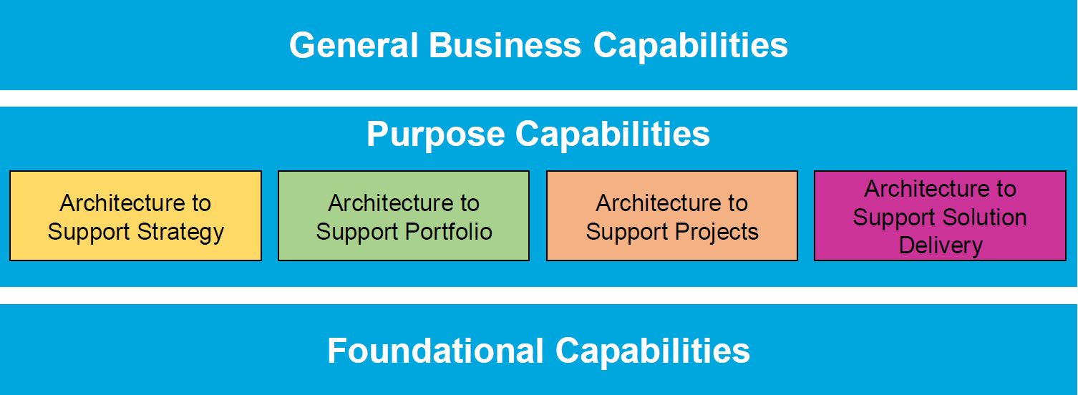
Architecture Capability – 04/05
Typically, there are four broad purposes of an EA Capability:
EA to support Strategy
EA to support Portfolio
EA to support Project
EA to support Solution Delivery
The TOGAF Leader’s Guide to Establishing and Evolving an EA Capability : Page 9 : §3.3
Initially MOD 02
Notes:
Level=1 : L.O.= 1.10b : Briefly explain what an Architecture Capability is.
See : TOGAF® Series Guide: The TOGAF Leader’s Guide to Establishing and Evolving an EA Capability : Page 9 : §3.3
Typically, there are four broad purposes of an EA Capability:
1. EA to support Strategy:
deliver EA to provide a target architecture, and develop roadmaps of change over a three to ten-year period.
2. EA to support Portfolio:
deliver EA to support cross-functional, multi-phase, and multi-project change initiatives spanning a single portfolio.
3. EA to support Project:
deliver EA to support the enterprise’s project delivery method.
EA to support Solution Delivery:
deliver EA that is used to support the solution deployment
3.3 What is an EA Capability and EA?
In short, an EA Capability is the ability to develop, use, and sustain the architecture of a particular enterprise, and use the architecture to govern change.
This Guide discusses establishing and evolving an EA Capability; it explicitly does not discuss an EA department or any other organizational element. The term Capability is often defined tortuously, most commonly when it is used as part of a formal analysis technique when definition must be precise and constrained. This Guide uses EA Capability as a management concept that facilitates planning improvements in the ability to do something that leads to enhanced outcomes enabled by the Capability.
In its simplest terms, EA is used to describe the future state of an enterprise to guide the change to reach the future state. The description of the future state enables key people to understand what must be in their enterprise to meet the enterprise’s goals, objective, mission, and vision in 10 TOGAF® Series Guide (2018)
the context within which the enterprise operates. The gap between the enterprise’s current state and future state guides what must change within the enterprise.
General Business Capabilities Purpose Capabilities Architecture to Support Strategy Architecture to Support Portfolio Architecture to Support Projects Architecture to Support Solution Delivery Foundational Capabilities
Figure 2: EA Capability Model6
Using the capability model in the World-Class Enterprise Architecture White Paper7 as a base, we assume that an EA Capability is established specifically to support one or more purposes. Typically, there are four broad purposes of an EA Capability:
• EA to support Strategy: deliver EA to provide a target architecture, and develop roadmaps
... CONTINUES ... SEE REFERENCE SPECIFIED

Slide 53

Risk Management – 01/05
It is important to identify, classify, and mitigate these risks before starting so that they can be tracked throughout the transformation effort
Generally, two levels of risk should be considered:
Initial Level of Risk: Risk categorization prior to determining and implementing mitigating actions
Residual Level of Risk: Risk categorization after the implementation of mitigating actions
ISO7010
ADM Techniques : Page 67 : §9
Initially MOD 02
Notes:
Þ M-50
Level=1 : L.O.= 1.11a : Briefly explain risk management.
See : TOGAF® Standard – ADM Techniques : Page 67 : §9
It is important to identify, classify, and mitigate these risks before starting
so that they can be tracked throughout the transformation effort.
Generally, two levels of risk should be considered:
Initial Level of Risk: Risk categorization prior to determining and implementing mitigating actions.
Residual Level of Risk: Risk categorization after implementation of mitigating actions
The process for risk management is:
Risk identification
Risk classification
Initial risk assessment
Risk mitigation and residual risk assessment
Risk monitoring
9.2 Risk Classification
Risk is pervasive in any Enterprise Architecture activity and is present in all phases within the
ADM. From a management perspective, it is useful to classify the risks so that the mitigation of
the risks can be executed as expeditiously as possible.
One common way for risks to be classified is with respect to their likely impact on the organization (as
discussed in Section 9.4), whereby risks with certain impacts have to be addressed by certain
levels of governance.
Risks are normally classified as time (schedule), cost (budget), and scope but they could also
include client transformation relationship risks, contractual risks, technological risks, scope and
complexity risks, environmental (corporate) risks, personnel risks, and client acceptance risks.
Another way of delegating risk management is to further classify risks by architecture domains.
Classifying risks as business, information, applications, and technology is useful but there may
be organizationally-specific ways of expressing risk that the corporate Enterprise Architecture
directorate should adopt or extend rather than modify.
Ultimately, Enterprise Architecture risks are corporate risks and should be classified and, as
Appropriate, managed in the same or extended way.

Slide 54

Risk Management – 02/05
Risks are first identified in Phase A.
Risk is pervasive in any Enterprise Architecture activity and is present in all phases within the ADM.
Risk assessment considers effect and frequency.
Effect:
Catastrophic
Critical
Marginal
Negligible
ISO7010
ADM Techniques : Page 67 : §9
Initially MOD 02
V10 does not say risks are identified in Phase A in 9.1 on page 67
But does say Risk is pervasive in any Enterprise Architecture activity and is present in all phases within the ADM in 9.2 page 68.
Notes:
Level=1 : L.O.= 1.11a : Briefly explain risk management.
See : TOGAF® Standard – ADM Techniques : Page 67 : §9
Risks are identified in Phase A
- part of the initial Business Transformation Readiness Assessment
The risk identification and mitigation assessment worksheets are maintained as
governance artifacts.
Implementation governance can identify critical risks that are not being mitigated.
Insurance industry calculation: Human Life Value (HLV) the monetary value of a human life, measured by determining the net present value of benefits that others (the decedent's spouse, dependents, partners, employers) might reasonably expect to receive from the future efforts of the individual whose life is being valued. The amount of HLV is used to calculate the benefit amount needed to replace lost future earnings of a wage earner to set the amount of life insurance or the amount of a liability award or settlement. Also known as the economic value of an individual life.
$50,000. is the international standard most private and government-run health insurance plans worldwide use to determine whether to cover a new medical procedure.
9.4 Initial Risk Assessment
The next step is to classify risks with respect to their effect and frequency in accordance with scales
used within the organization. Combine effect and frequency to come up with a preliminary risk
assessment.
There are no hard and fast rules with respect to measuring effect and frequency. The following
guidelines are based upon existing risk management best practices.
68 The Open Group Standard (2021)
Risk Management Initial Risk Assessment
Effect could be assessed using the following example criteria:
■ Catastrophic infers critical financial loss that could result in bankruptcy of the organization
■ Critical infers serious financial loss in more than one line of business leading to a loss in
productivity and no return on investment on the IT investment
■ Marginal infers a minor financial loss in a line of business and a reduced return on
investment on the IT investment
■ Negligible infers a minimal impact on a line of business’ ability to deliver services and/or
products
Frequency could be indicated as follows:
■ Frequent: likely to occur very often and/or continuously
... CONTINUES ... SEE REFERENCE SPECIFIED

Slide 55


Risk Management – 03/05
Frequency:
Frequent
Likely
Occasional
Seldom
Unlikely
The Effect and Frequency are then combined:
Extremely High Risk (E)
High Risk (H)
Moderate Risk (M)
Low Risk (L)
ISO7010
ADM Techniques : Page 67 : §9
Initially MOD 02
Notes:
Level=1 : L.O.= 1.11a : Briefly explain risk management.
See : TOGAF® Standard – ADM Techniques : Page 67 : §9
Frequency:
Frequent: Likely to occur very often and/or continuously.
Likely: Occurs several times over the course of a transformation cycle.
Occasional: Occurs sporadically.
Seldom: Remotely possible and would probably occur not more than once in the course of a transformation cycle.
Unlikely: Will probably not occur during the course of a transformation cycle.
The Effect and Frequency are then combined:
Extremely High Risk (E): The transformation will most likely fail with severe
consequences.
High Risk (H): Significant failure of parts of the transformation
resulting in certain goals not being achieved.
Moderate Risk (M): Noticeable failure of parts of the transformation
threatening the success of some goals.
Low Risk (L): Some goals will not be wholly successful
9.4 Initial Risk Assessment
The next step is to classify risks with respect to effect and frequency in accordance with scales
used within the organization. Combine effect and frequency to come up with a preliminary risk
assessment.
There are no hard and fast rules with respect to measuring effect and frequency. The following
guidelines are based upon existing risk management best practices.
68 The Open Group Standard (2021)
Risk Management Initial Risk Assessment
Effect could be assessed using the following example criteria:
■ Catastrophic infers critical financial loss that could result in bankruptcy of the organization
■ Critical infers serious financial loss in more than one line of business leading to a loss in
productivity and no return on investment on the IT investment
■ Marginal infers a minor financial loss in a line of business and a reduced return on
investment on the IT investment
■ Negligible infers a minimal impact on a line of business’ ability to deliver services and/or
... CONTINUES ... SEE REFERENCE SPECIFIED

Slide 56
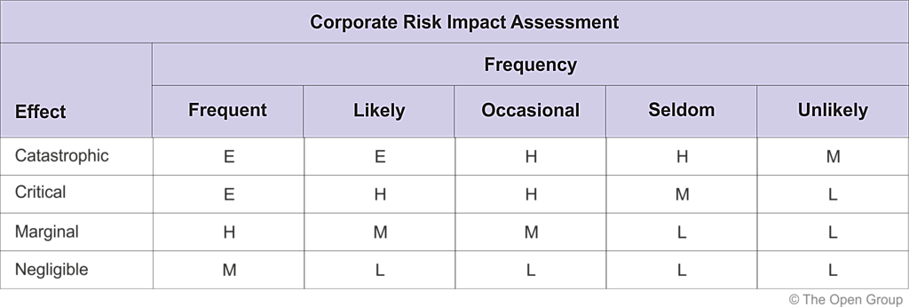
Risk Management – 04/05
Risk Classification Scheme
In practice, EHML is a suggestion, and a greater ‘scale’ may or may not be needed/used.
Negligible, Seldom and Unlikely risks should not be ignored.
If they are and only the obvious risks are handled that would leave exposure to rare risks
(black swan events)
ADM Techniques : Page 67 : §9
Initially MOD 02
V10 does not say EHML is too limiting anywhere in section 9.
Revised words to say what section 9 actually says.
Notes:
Level=1 : L.O.= 1.11a : Briefly explain risk management.
See : TOGAF® Standard – ADM Techniques : Page 67 : §9
In practice, EHML is too limiting and a greater ‘scale’ is needed/used.
Negligible, Seldom and Unlikely risks are usually ignored.
This is unfortunate – the obvious Risks are handled leaving exposure to Rare Risks.
9.4 Initial Risk Assessment
The next step is to classify risks with respect to effect and frequency in accordance with scales
used within the organization. Combine effect and frequency to come up with a preliminary risk
assessment.
There are no hard and fast rules with respect to measuring effect and frequency. The following
guidelines are based upon existing risk management best practices.
68 The Open Group Standard (2021)
Risk Management Initial Risk Assessment
Effect could be assessed using the following example criteria:
■ Catastrophic infers critical financial loss that could result in bankruptcy of the organization
■ Critical infers serious financial loss in more than one line of business leading to a loss in
productivity and no return on investment on the IT investment
■ Marginal infers a minor financial loss in a line of business and a reduced return on
investment on the IT investment
■ Negligible infers a minimal impact on a line of business’ ability to deliver services and/or
products
Frequency could be indicated as follows:
■ Frequent: likely to occur very often and/or continuously
■ Likely: occurs several times over the course of a transformation cycle
■ Occasional: occurs sporadically
■ Seldom: remotely possible and would probably occur not more than once in the course of
a transformation cycle
■ Unlikely: will probably not occur during the course of a transformation cycle
Combining the two factors to infer impact would be conducted using a heuristically-based but
consistent classification scheme for the risks. A potential scheme to assess corporate impact
could be as follows:
■ Extremely High Risk (E): the transformation effort will most likely fail with severe
consequences
■ High Risk (H): significant failure of parts of the transformation effort resulting in certain
goals not being achieved
... CONTINUES ... SEE REFERENCE SPECIFIED

Slide 57
Risk Management – 05/05
Risk Identification and Mitigation Worksheet
 |  | Preliminary Risk |  |  |  | Residual Risk
Risk ID | Risk | Effect | Frequency | Impact | Mitigation | Effect | Frequency | Impact
P-01
P-02
P-03 | PM leaves early | Catastrophe | 1 | $5,000k | Golden Handcuffs | Mod | 1 | $200k
Risk can rarely be 100% mitigated.
‘Residual Risk’ may be handled by on-going monitoring or taking out insurance.
ADM Techniques : Page 67 : §9
Initially MOD 02
V10 does not say residual risk is handled by insurance anywhere in section 9.
Revised words to say what section 9 actually says – monitoring as well.
Notes:
Þ Q-39 M-51
Level=1 : L.O.= 1.11a : Briefly explain risk management.
See : TOGAF® Standard – ADM Techniques : Page 67 : §9
Risk can rarely be 100% mitigated.
Traditionally the ‘Residual Risk’ has been handled by taking out insurance.
9.6 Conduct Residual Risk Assessment
Once the mitigation effort has been identified for each one of the risks, re-assess the effect and
frequency and then recalculate the impacts and see whether the mitigation effort has really
made an acceptable difference. The mitigation efforts will often be resource-intensive and any
major outlay for little or no residual risk should be challenged.
Once the initial risk is mitigated, then the risk that remains is called the "residual risk". The key
consideration is that the mitigating effort actually reduces the corporate impact and does not just
move the risk to another similarly high quadrant. For example, changing the risk from
frequent/catastrophic to frequent/critical still delivers an extremely high risk. If this occurs, then the mitigation effort has to be re-considered.

Slide 58
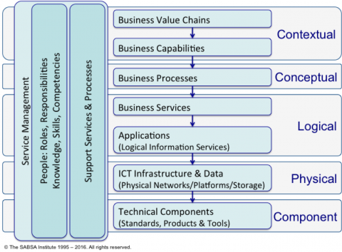
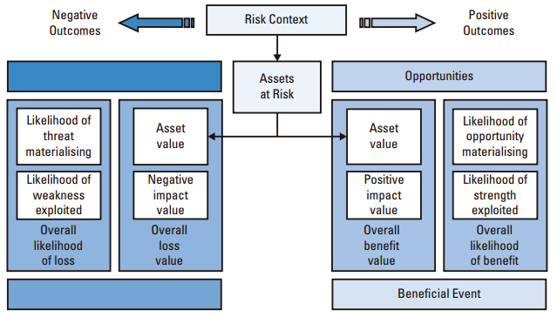
Risk and Security
TOGAF works well with the SABSA view of security analysis
Business Stack
© The SABSA Institute
© The SABSA Institute
Operational risk is concerned with the threats and opportunities arising in business operations
SABSA is an architectural and operational framework for reaching out to opportunities
Integrating Risk and Security within a Enterprise Architecture : Page 9 : §3.1.1
Initially MOD 02
Notes:
Level=1 : L.O.= 1.11b : Briefly explain risk management.
See : TOGAF® Series Guide: Integrating Risk and Security within a TOGAF® Enterprise Architecture : Page 9 : §3.1.1
TOGAF works well with the SABSA view of security analysis - that everything must be derived from an analysis of the business requirements for security and within the context of ISO 31000 generally.
Operational risk is concerned with the threats and opportunities arising in business operations.
SABSA is an architectural and operational framework for reaching out to opportunities - enabling positive outcomes to attain defined business targets, and managing negative outcomes of loss events, to within an enterprise’s tolerance towards risk – namely their risk appetite.
3.1.1 Definition of Risk
Risk is the “effect of uncertainty on objectives” (ISO 31000:2009 [6]).
The effect of uncertainty is any deviation from what is expected – positive and negative.
Understanding the term “risk” is central to understanding the broader concepts of ERM, and the role of effective Enterprise Architecture and Enterprise Security Architecture. In this Guide we define risk in line with ISO 31000:2009. Risk is the effect that uncertainty has on the achievement of business objectives. The uncertainty is concerned with predicting future outcomes, given the limited amount of information available when making a business decision. This information can never be perfect, although our expectation is that given better quality information we can make better quality decisions. Every decision is based on assessing the balance between potential opportunities and threats, the likelihood of beneficial outcomes versus damaging outcomes, the magnitude of these potential positive or negative events, and the likelihood associated with each identified outcome. Identifying and assessing these factors is known as “risk assessment” or “risk analysis”. “Risk management” is the art and science of applying these concepts in the decision-making process. Risk can be seen at the strategic long-term level (overall direction of the business), the medium term tactical level (transformation projects and programs), and at the operational level (regular day-to-day operational decisions, processes, and practices). The objective of risk management is to optimize business outcomes to maximize business value and minimize business losses. Risk can be seen at any level in the business stack (see Figure 2), but is always driven top-down from assessment of business value and its optimization.
© The SABSA Institute
Figure 2: Business Risk versus Cyber Risk Areas
Uncertainty typically involves a deficiency of information and leads to inadequate or exists ... CONTINUES ... SEE REFERENCE SPECIFIED

Slide 59
Gap Analysis – 01/04
Gap Analysis results in a formal statement of the difference between the Baseline (current state) and the Target (future state).
Potential sources of Gaps include, for example:
Business domain gaps
Applications impacted, eliminated, or created
Data domain gaps
Technologies impacted, eliminated, or created
ADM Techniques : Page 45 : §5
Initially MOD 02
Notes:
Level=1 : L.O.= 1.12a : Briefly explain Gap Analysis.
See : TOGAF® Standard – ADM Techniques : Page 45 : §5
The process of Gap Analysis, in TOGAF, results in a formal statement of the difference between the Baseline (current state) and the Target (future state).
Potential sources of Gaps include, for example:
Business domain gaps:
People gaps
Process gaps
Tools gaps
Information gaps
Measurement gaps
Financial gaps
Facilities gaps
Applications impacted, eliminated, or created
Data domain gaps:
Data not of sufficient currency
Data not located where it is needed
Not the data that is needed
Data not available when needed
Data not created
Data not consumed
Data relationship gaps
Technologies impacted, eliminated, or created
5.1 Introduction
A key step in validating an architecture is to consider what may have been forgotten. The
architecture must support all of the essential information processing needs of the organization.
The most critical source of gaps that should be considered is stakeholder concerns that have not
been addressed in prior architectural work.
Potential sources of gaps include:
■ Business domain gaps:
— People gaps (e.g., cross-training requirements)
— Process gaps (e.g., process inefficiencies)
— Tools gaps (e.g., duplicate or missing tool functionality)
— Information gaps
— Measurement gaps
— Financial gaps
... CONTINUES ... SEE REFERENCE SPECIFIED

Slide 60

Gap Analysis – 02/04
Example analysis for Architecture Building Blocks . . .
services from the Network Services category of the Technical Reference Model (TRM) showing a number of services from the Baseline Architecture missing from the Target.
Target →
Architecture
Baseline ↓
Video Conferenc’g
Enhanced Telephony
Mailing List services
Eliminated
↓
Broadcast
Intentionally eliminated
Video Conferenc’g
Included
Enhanced Telephony
Potential match
Shared Screen
ERROR
Gap in Target
New →
Gap –
develop/
produce
Gap –
develop/
produce
ADM Techniques : Page 45 : §5
Initially MOD 02
Notes:
Level=1 : L.O.= 1.12a : Briefly explain gap analysis.
See : TOGAF® Standard – ADM Techniques : Page 45 : §5
Example analysis for Architecture Building Blocks . . .
services from the Network Services category of the Technical Reference Model (TRM) showing a number of Services from the Baseline Architecture missing from the Target.
5.2 Suggested Steps
The suggested steps are as follows:
■ Draw up a matrix with all the ABBs of the Baseline Architecture on the vertical axis, and all
the ABBs of the Target Architecture on the horizontal axis
■ Add to the Baseline Architecture axis a final row labelled "New", and to the Target
Architecture axis a final column labelled "Eliminated"
■ Where an ABB is available in both the Baseline and Target Architectures, record this with
"Included" at the intersecting cell
■ Where an ABB from the Baseline Architecture is missing in the Target Architecture, each
must be reviewed
If it was correctly eliminated, mark it as such in the appropriate "Eliminated" cell. If it was
not, then an accidental omission in the Target Architecture has been uncovered that must be
addressed by reinstating the ABB in the next iteration of the architecture design — mark it
as such in the appropriate "Eliminated" cell.
■ Where an ABB from the Target Architecture cannot be found in the Baseline Architecture,
mark it at the intersection with the "New" row as a gap that needs to filled, either by
developing or procuring the building block
When the exercise is complete, anything under "Eliminated" or "New" is a gap, which should
either be explained as correctly eliminated, or marked as to be addressed by reinstating or
developing/procuring the building block.

Slide 61
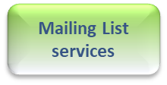
Gap Analysis – 03/04
Sort – each domain, to gather Gaps
Target →
Architecture
Baseline ↓
Enhanced Telephony
Shared Screen
Video Conferencing
Eliminated
↓
Perform this process for each domain
Broadcast
Intentionally eliminated
Target →
Architecture
Baseline ↓
Enhanced Telephony
Shared Screen
Video Conferencing
Eliminated
↓
Target →
Architecture
Baseline ↓
Enhanced Telephony
Shared Screen
Video Conferencing
Eliminated
↓
Shared Screen
ERROR
Gap in Target
Target →
Architecture
Baseline ↓
Enhanced Telephony
Shared Screen
Video Conferencing
Eliminated
↓
Target →
Architecture
Baseline ↓
Enhanced Telephony
Shared Screen
Video Conferencing
Eliminated
↓
Enhanced Telephony
Broadcast
Intentionally eliminated
Potential match
Broadcast
Intentionally eliminated
Broadcast
Intentionally eliminated
Shared Screen
Broadcast
ERROR
Gap in Target
Video Conferencing
Included
Intentionally eliminated
ERROR
Gap in Target
Enhanced Telephony
Potential Match
ERROR
Gap in Target
Shared Screen
ERROR
Gap in Target
New →
Gap –
develop/produce
Gap –
develop/produce
Enhanced Telephony
Potential Match
Enhanced Telephony
Potential Match
Vodeo Conferencing
Enhanced Telephony
Potential match
Included
Vodeo Conferencing
Included
Vodeo
Included
New →
Gap –
develop/produce
Gap Columns
Video Conferencing
Gap –
develop/produce
Included
Technology
Data
Application
Business
New →
Gap –
develop/produce
Gap –
develop/produce
New →
Gap –
develop/produce
Gap –
develop/produce
New →
Gap –
develop/produce
Gap –
develop/produce
Consolidate all Gap rows/columns on one sheet
Sort Columns by precursor/priority
= Consolidated Gaps ordered by work-order
ADM Techniques : Page 45 : §5
Initially MOD 02
Notes:
Level=1 : L.O.= 1.12a : Briefly explain gap analysis.
See : TOGAF® Standard – ADM Techniques : Page 45 : §5
Consolidate all Gap rows/columns on one sheet
Sort Columns by precursor/priority = Consolidated Gaps ordered by work-order
5.2 Suggested Steps
The suggested steps are as follows:
■ Draw up a matrix with all the ABBs of the Baseline Architecture on the vertical axis, and all
the ABBs of the Target Architecture on the horizontal axis
■ Add to the Baseline Architecture axis a final row labelled "New", and to the Target
Architecture axis a final column labelled "Eliminated"
■ Where an ABB is available in both the Baseline and Target Architectures, record this with
"Included" at the intersecting cell
■ Where an ABB from the Baseline Architecture is missing in the Target Architecture, each
must be reviewed
If it was correctly eliminated, mark it as such in the appropriate "Eliminated" cell. If it was
not, then an accidental omission in the Target Architecture has been uncovered that must be
addressed by reinstating the ABB in the next iteration of the architecture design — mark it
as such in the appropriate "Eliminated" cell.
■ Where an ABB from the Target Architecture cannot be found in the Baseline Architecture,
mark it at the intersection with the "New" row as a gap that needs to filled, either by
developing or procuring the building block
When the exercise is complete, anything under "Eliminated" or "New" is a gap, which should either be explained as correctly eliminated, or marked as to be addressed by reinstating or developing/procuring the building block.

Slide 62
Gap Analysis – 04/04
It is good practice to continuously assess in-flight change
Consider using summary reporting with a high visual impact
Binary test preferred
 | Constraint (Architecture Principle/ Requirements /Specification/ Control) | Value (Best done in terms of the enterprise’s mandatory concerns) | Gap
Current State: assess what the enterprise has | Conforms | Fails to Deliver | Not Applicable
Implementation Project: assess project, design and implementation | Violates | Not Applicable | Filling
Roadmap, Portfolio or Program: assess plans and directions | Not Applicable | Delivers | Leaving Open
Example: reporting against constraints, expected value, and known gaps.
A Practitioners’ Approach to Developing Enterprise Architecture Following the ADM : Page 114 : §15.2.3
Initially MOD 02
Notes:
Þ Q-43
Level=1 : L.O.= 1.12b : Briefly explain gap analysis.
See : TOGAF® Series Guide: A Practitioners’ Approach to Developing Enterprise Architecture Following the TOGAF® ADM : Page 114 : §15.2.3
It is good practice to continuously assess in-flight change
Consider using summary reporting with a high visual impact
Binary test preferred:
compliance and non-compliance (Red/Green)
otherwise 1-to-3 scale (Red/Yellow/Green) should be sufficient.
Example: reporting against constraints, expected value, and known gaps.
15.2.3 Long-Term Compliance Reporting
The chapters discussing walk-throughs for Architecture to Support Strategy, Portfolio, and Project all included assessments of in-flight change and considered using summary reporting with a high visual impact. Below is an example of reporting against constraints, expected value, and known gaps. In all cases, the assessment will return either not applicable, conformance, or non-conformance. Good practitioners will look for binary tests: compliance and con-compliance (Red/Green) where possible. Where binary testing is not possible, a 1-to-3 scale (Red/Yellow/Green) should provide sufficient range to provide a summary report.

Slide 63




Definitions – 01/07
Application Architecture
A description of the structure and interaction of the applications that provide key business capabilities and manage the data assets.
Architecture Landscape
The architectural representation of assets in use, or planned, by the enterprise at particular points in time.
Architecture Model
A representation of a subject of interest.
Artifact
An architectural work product that describes an aspect of the architecture.
Introduction and Core Concepts : Page 41 : §4.3
Initially MOD 02
Notes:
Level=1 : L.O.= 2.1a : Define the following concepts: Application Architecture
See : TOGAF® Standard – Introduction and Core Concepts : Page 41 : §4.3
These texts are reproduced from the TOGAF® Standard, 10th Edition, 2022
Application Architecture
A description of the structure and interaction of the applications that provide key business capabilities and manage the data assets.
Architecture Landscape
The architectural representation of assets in use, or planned, by the enterprise at particular points in time.
Architecture Model
A representation of a subject of interest.
Note: An architecture model provides a smaller scale, simplified,
and/or abstract representation of the subject matter.
Artifact
An architectural work product that describes an aspect of the architecture.
For terms, not defined in Introduction and Core Concepts see Merriam-Webster® Collegiate Dictionary

Slide 64
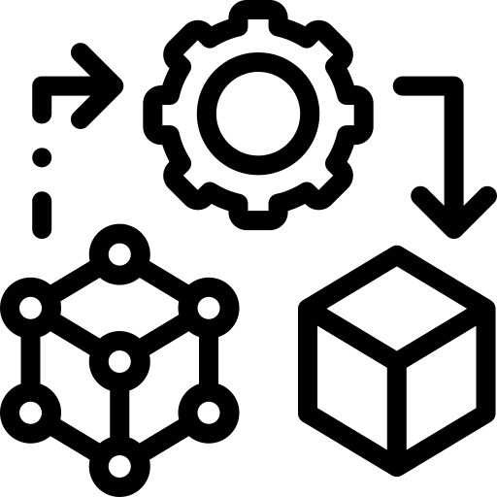
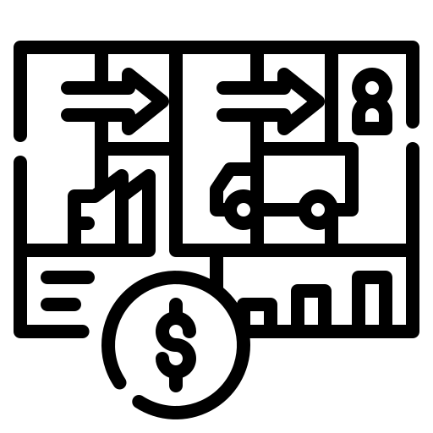

Definitions – 02/07
Business Architecture
A representation of holistic, multi-dimensional business views of: capabilities, end-to-end value delivery, information, and organizational structure; and the relationships among these business views and strategies, products, policies, processes, initiatives, and stakeholders.
Business Model
A model describing the rationale for how an enterprise creates, delivers, and captures value.
Capability
An ability that an organization, person, or system possesses.
Introduction and Core Concepts : Page 43 : §4.15
Initially MOD 02
Notes:
Level=1 : L.O.= 2.1b : Define the following concepts: Architecture Landscape
See : TOGAF® Standard – Introduction and Core Concepts : Page 43 : §4.15
These texts are reproduced from the TOGAF® Standard, 10th Edition, 2022
Business Architecture
A representation of holistic, multi-dimensional business views of: capabilities, end-to-end value delivery, information, and organizational structure; and the relationships among these business views and strategies, products, policies, processes, initiatives, and stakeholders.
Note: Business Architecture relates business elements to business goals and
elements of other domains.
Capability
An ability that an organization, person, or system possesses.
Note: This a general-purpose definition.
See Section 4.28 for how this concept is refined for usage in Business Architecture.
Business Model
A model describing the rationale for how an enterprise creates, delivers, and captures value.
Capability
An ability that an organization, person, or system possesses.
Note: This a general-purpose definition.
See Section 4.28 for how this concept is refined for usage in Business Architecture.

Slide 65
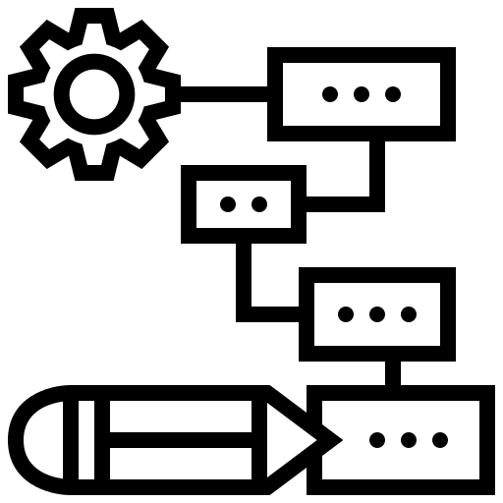


Definitions – 03/07
Capability Architecture
An architecture that describes the abilities that an enterprise possesses.
Data Architecture
A description of the structure of the enterprise’s major types and sources of data, logical data assets, physical data assets, and data management resources.
Deliverable
An architectural work product that is contractually specified and in turn formally reviewed, agreed, and signed off by the stakeholders.
Introduction and Core Concepts : Page 44 : §4.17
Initially MOD 02
Notes:
Level=1 : L.O.= 2.1c : Define the following concepts: Architecture Model
See : TOGAF® Standard – Introduction and Core Concepts : Page 44 : §4.17
These texts are reproduced from the TOGAF® Standard, 10th Edition, 2022
Capability Architecture
An architecture that describes the abilities that an enterprise possesses.
Data Architecture
A description of the structure of the enterprise’s major types and sources of data, logical data assets, physical data assets, and data management resources.
Note: Data Architecture is described in the TOGAF Standard — Architecture Development Method.
Deliverable
An architectural work product that is contractually specified and in turn formally reviewed, agreed, and signed off by the stakeholders.
Note: Deliverables represent the output of projects and those deliverables that are
in documentation form will typically be archived on completion of a project, or
transitioned into an Architecture Repository as a reference model, standard, or
snapshot of the Architecture Landscape at a point in time.

Slide 66
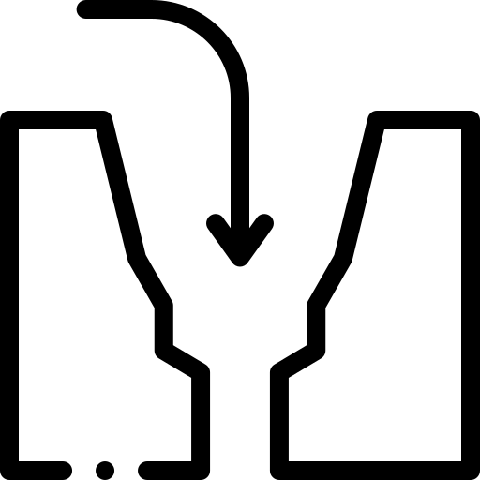
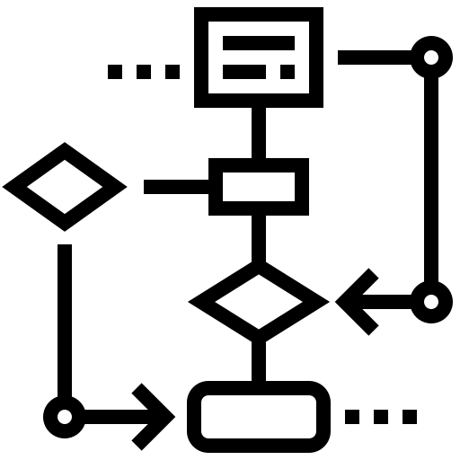

Definitions – 04/07
Gap
A statement of difference between two states. Used in the context of gap analysis, where the difference between the Baseline and Target Architecture is identified.
Metamodel
A model that describes the entities used in building an Architecture Description, their characteristics, and the key relationships between those entities.
Modelling
A technique through construction of models which enables a subject to be represented in a form that enables reasoning, insight, and clarity concerning the essence of the subject matter.
Introduction and Core Concepts : Page 45 : §4.23
Initially MOD 02
Notes:
Level=1 : L.O.= 2.1d : Define the following concepts: Artifact
See : TOGAF® Standard – Introduction and Core Concepts : Page 45 : §4.23
These texts are reproduced from the TOGAF® Standard, 10th Edition, 2022
Gap
A statement of difference between two states. Used in the context of gap analysis, where the difference between the Baseline and Target Architecture is identified.
Note: Gap analysis is described in the TOGAF Standard — ADM Techniques.
Metamodel
A model that describes the entities used in building an Architecture Description, their characteristics, and the key relationships between those entities.
Modeling
A technique through construction of models which enables a subject to be represented in a form that enables reasoning, insight, and clarity concerning the essence of the subject matter.

Slide 67

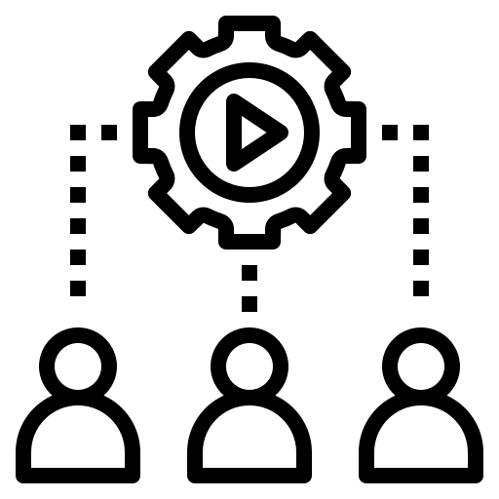

Definitions – 05/07
Requirement
A statement of need, which is unambiguous, testable or measurable, and necessary for acceptability.
Role
1. The usual or expected behaviour of an actor, or the part somebody or something plays in a particular process or event. An actor may have a number of roles.
2. The part an individual plays in an organization and the contribution they make through the application of their skills, knowledge, experience, and abilities.
Segment Architecture
A detailed, formal description of areas within an enterprise, used at the program or portfolio level to organize and align change activity.
Introduction and Core Concepts : Page 46 : §4.27
Initially MOD 02
Notes:
Level=1 : L.O.= 2.1e : Define the following concepts: Business Architecture
See : TOGAF® Standard – Introduction and Core Concepts : Page 46 : §4.27
These texts are reproduced from the TOGAF® Standard, 10th Edition, 2022

Slide 68


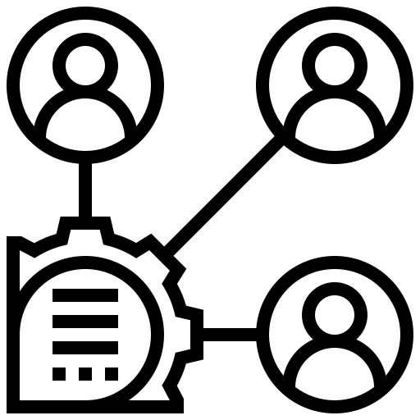
Definitions – 06/07
Stakeholder
An individual, team, organization, or class thereof, having an interest in a system.
Strategic Architecture
A summary formal description of the enterprise, providing an organizing framework for operational and change activity, and an executive-level, long-term view for direction setting.
Technology Architecture
A description of the structure and interaction of the technology services and technology components.
Introduction and Core Concepts : Page 46 : §4.31
Initially MOD 02
Notes:
Level=1 : L.O.= 2.1f : Define the following concepts: Business Model
See : TOGAF® Standard – Introduction and Core Concepts : Page 46 : §4.31
These texts are reproduced from the TOGAF® Standard, 10th Edition, 2022
Stakeholder
An individual, team, organization, or class thereof, having an interest in a system.
Strategic Architecture
A summary formal description of the enterprise, providing an organizing framework for operational and change activity, and an executive-level, long-term view for direction setting.
Technology Architecture
A description of the structure and interaction of the technology services and technology components.
Note: Technology Architecture is described in the TOGAF Standard — Architecture Development Method

Slide 69
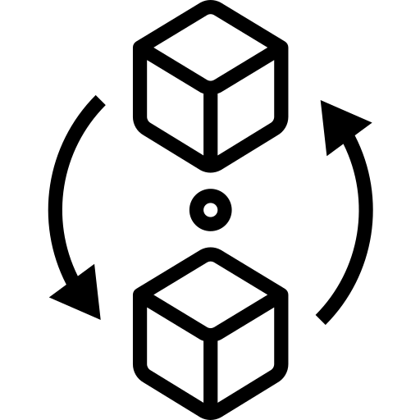

Definitions – 07/07
Transition Architecture
A formal description of one state of the architecture at an architecturally significant point in time.
Work Package
A set of actions identified to achieve one or more objectives for the business. A work package can be a part of a project, a complete project, or a program.
Introduction and Core Concepts : Page 46 : §4.33
Initially MOD 02
Notes:
Þ Q-45
Level=1 : L.O.= 2.1f : Define the following concepts: Business Model
See : TOGAF® Standard – Introduction and Core Concepts : Page 46 : §4.33
These texts are reproduced from the TOGAF® Standard, 10th Edition, 2022
Transition Architecture
A formal description of one state of the architecture at an architecturally significant point in time.
Note: One or more Transition Architectures may be used to describe the progression in time from the Baseline to the Target Architecture.
Transition Architecture is described in the TOGAF Standard — Architecture Content: Architecture Definition Document.
Work Package
A set of actions identified to achieve one or more objectives for the business. A work package can be a part of a project, a complete project, or a program.

Slide 70
The Architecture Development Method – 01/06
A tested and repeatable process for developing architectures
Carried out within an iterative cycle
Allows organizations to transform their enterprises:
in a controlled manner
in response to business goals and opportunities
The Standard TOGAF® ‘crop-circle’
Introduction and Core Concepts : Page 16 : §3.4
Initially MOD 02
Notes:
Level=1 : L.O.= 3.1a : Briefly describe the ADM and its phases.
See : TOGAF® Standard – Introduction and Core Concepts : Page 16 : §3.4
A tested and repeatable process for developing architectures includes:
establishing an architecture framework
developing architecture content transitioning
governing the realization of architectures
Carried out within an iterative cycle of continuous:
architecture deﬁnition
realization
Allows organizations to transform their enterprises:
in a controlled manner
in response to business goals and opportunities
3.4 Architecture Development Method
The TOGAF Architecture Development Method (ADM) provides a tested and repeatable process
for developing architectures. The ADM includes establishing an architecture framework,
developing architecture content, transitioning, and governing the realization of architectures.
All of these activities are carried out within an iterative cycle of continuous architecture definition
and realization that allows organizations to transform their enterprises in a controlled manner in
response to business goals and opportunities. This is illustrated in the Figure.
Phases within the ADM are as follows:
■ The Preliminary Phase describes the preparation and initiation activities required to
create an Architecture Capability including customization of the TOGAF framework and
definition of Architecture Principles
■ Phase A: Architecture Vision describes the initial phase of an architecture development
Cycle.
It includes information about defining the scope of the architecture development initiative,
identifying the stakeholders, creating the Architecture Vision, and obtaining approval to
proceed with the architecture development
■ Phase B: Business Architecture describes the development of a Business Architecture
to support the agreed Architecture Vision
■ Phase C: Information Systems Architectures describes the development of Information
Systems Architectures to support the agreed Architecture Vision
■ Phase D: Technology Architecture describes the development of the Technology
Architecture to support the agreed Architecture Vision
■ Phase E: Opportunities & Solutions

Slide 71
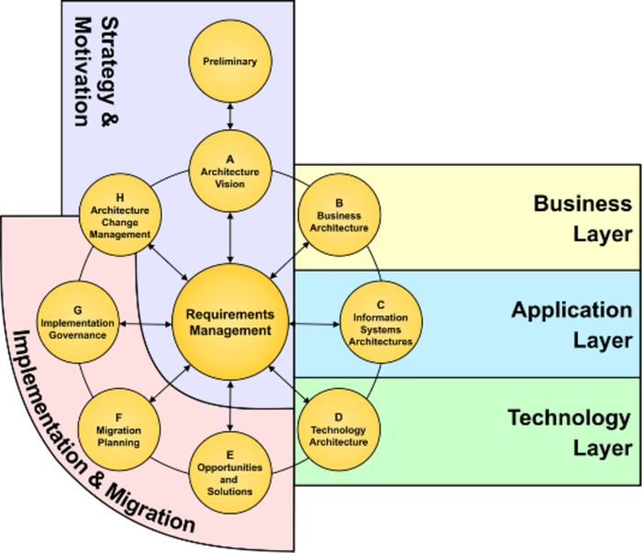
The Architecture Development Method – 02/06
Preliminary
A.
Architecture Vision
H.
Architecture Change Management
B.
Business
Architecture
Requirements Management
C.
Information Systems Architectures
G.
Implementation
Governance
F.
Migration Planning
D.
Technology Architecture
E.
Opportunities and
Solutions
Introduction and Core Concepts : Page 16 : §3.4
Initially MOD 02
Notes:
Level=1 : L.O.= 3.1a : Briefly describe the ADM and its phases.
See : TOGAF® Standard – Introduction and Core Concepts : Page 16 : §3.4
3.4 Architecture Development Method
The TOGAF Architecture Development Method (ADM) provides a tested and repeatable process
for developing architectures. The ADM includes establishing an architecture framework,
developing architecture content, transitioning, and governing the realization of architectures.
All of these activities are carried out within an iterative cycle of continuous architecture definition
and realization that allows organizations to transform their enterprises in a controlled manner in
response to business goals and opportunities. This is illustrated in Figure 3-1.
16 The Open Group Standard (2021)
Core Concepts Architecture Development Method
Requirements
Management
Preliminary
© The Open Group
G.
Implementation
Governance
E.
Opportunities
and
Solutions
D.
Technology
Architecture
B.
Business
Architecture
F.
Migration
Planning
A.
Architecture
Vision
H.
... CONTINUES ... SEE REFERENCE SPECIFIED

Slide 72
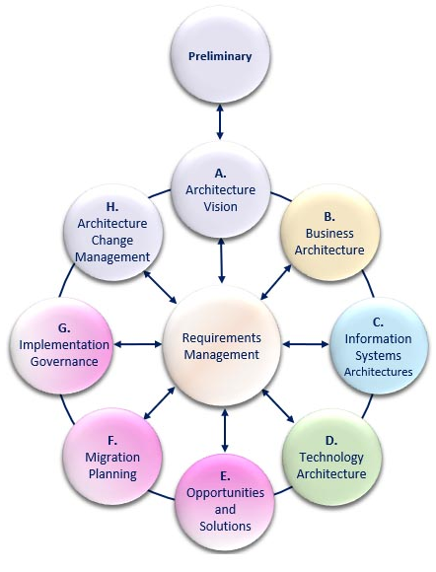
The Architecture Development Method – 03/06
The TOGAF framework recommends that the ADM be adapted
In particular, the ADM does NOT:
- Mandate that the phases must be performed in any speciﬁc sequence
- Mandate a "waterfall" method
The Enterprise Metamodel identifies the building blocks candidate entities from the phases
Introduction and Core Concepts : Page 16 : §3.4
Initially MOD 02
Content Metamodel 1 replaced with correct Enterprise Metamodel (V10)
The colours do not align (never have) so revised text to describe relationship between the metamodel and the ADM.
Notes:
Level=1 : L.O.= 3.1a : Briefly describe the ADM and its phases.
See : TOGAF® Standard – Introduction and Core Concepts : Page 16 : §3.4
The TOGAF framework recommends that the ADM be adapted to meet the needs of the enterprise and to support different architecture styles.
In particular, the ADM does NOT:
Mandate that the phases must be performed in any speciﬁc sequence
Mandate a "waterfall" method
The colors used hereinafter underscore the relationship with the Content Metamodel.
If Archimate® is used then it may be sensible to be clear about the mapping, though there are no formal semantics assigned to colors by Archimate®.
3.4 Architecture Development Method
The TOGAF Architecture Development Method (ADM) provides a tested and repeatable process
for developing architectures. The ADM includes establishing an architecture framework,
developing architecture content, transitioning, and governing the realization of architectures.
All of these activities are carried out within an iterative cycle of continuous architecture definition
and realization that allows organizations to transform their enterprises in a controlled manner in
response to business goals and opportunities. This is illustrated in Figure 3-1.
16 The Open Group Standard (2021)
Core Concepts Architecture Development Method
Requirements
Management
Preliminary
© The Open Group
G.
Implementation
Governance
E.
Opportunities
and
Solutions
D.
Technology
Architecture
B.
... CONTINUES ... SEE REFERENCE SPECIFIED

Slide 73
The Architecture Development Method – 04/06
The ADM graphic should be viewed as a reference model
It should NOT be viewed as a process model
Essentially the ADM is a generic ‘tick list’
The TOGAF Standard describes how the ADM can be used iteratively
The ADM maps to the information flow of outputs from each phase.
Introduction and Core Concepts : Page 16 : §3.4
Initially MOD 02
Added text to state the specific change made in describing the ADM in V10
Notes:
Level=1 : L.O.= 3.1a : Briefly describe the ADM and its phases.
See : TOGAF® Standard – Introduction and Core Concepts : Page 16 : §3.4
The ADM graphic should be viewed as a reference model deﬁning what has to be done in order to deliver solutions in an architected way…
It should not be viewed as a process model.
It is helpful to identify interacting components across the enterprise and the relationships between them.
Essentially the ADM is a generic ‘tick list’, a starting point for the development of support within a specific enterprise.
It is the product of 100s of 1000s of hours of work by some very successful practitioners – they have written down the things that work.
The TOGAF Standard describes how the ADM can be used iteratively to develop a comprehensive Enterprise Architecture landscape.
3.4 Architecture Development Method
The TOGAF Architecture Development Method (ADM) provides a tested and repeatable process
for developing architectures. The ADM includes establishing an architecture framework,
developing architecture content, transitioning, and governing the realization of architectures.
All of these activities are carried out within an iterative cycle of continuous architecture definition
and realization that allows organizations to transform their enterprises in a controlled manner in
response to business goals and opportunities. This is illustrated in Figure 3-1.
16 The Open Group Standard (2021)
Core Concepts Architecture Development Method
Requirements
Management
Preliminary
© The Open Group
G.
Implementation
Governance
E.
Opportunities
and
Solutions
D.
Technology
... CONTINUES ... SEE REFERENCE SPECIFIED

Slide 74
The Architecture Development Method – 05/06
The ADM is iterative between phases, and within phases.
For each iteration of the ADM, fresh decisions must be made
  These decisions are based on a practical assessment of resource
  and competence availability
As a generic method, the ADM is intended to be used by a wide variety of enterprises
It may be tailored to specific needs.
Architecture Development Method : Page 3 : §1.2.2
Initially MOD 02
Notes:
Level=1 : L.O.= 3.1b : Briefly describe the ADM and its phases.
See : TOGAF® Standard – Architecture Development Method : Page 3 : §1.2.2
The ADM is iterative, overall, between phases, and within phases
For each iteration of the ADM, a fresh decision must be taken as to:
The breadth of coverage of the enterprise to be defined
The level of detail to be defined
The extent of the time period aimed at, including the number and
extent of any intermediate time periods
The architectural assets to be leveraged, including:
Assets created in previous iterations of the ADM cycle
Assets available elsewhere in the industry
These decisions should be based on a practical assessment of resource
and competence availability, and the value that can realistically be
expected to accrue to the enterprise from the chosen scope of the work.
As a generic method, the ADM is intended to be used by enterprises in a
wide variety of different geographies and applied in different vertical sectors/industry types.
As such, it may be tailored to specific needs. For example, it may be used in conjunction with the set of deliverables of another framework (for example, those that many US Federal agencies have developed, specific to their particular departmental needs.)
1.2.2 Basic Structure
The basic structure of the ADM is shown in Figure 1-1.
Throughout the ADM cycle, there needs to be frequent validation of results against the original
expectations, both those for the whole ADM cycle, and those for the particular phase of the
process.
TOGAF® Standard — Architecture Development Method 3
Architecture Development Cycle Introduction
Requirements
Management
Preliminary
© The Open Group
G.
Implementation
Governance
E.
Opportunities
and
... CONTINUES ... SEE REFERENCE SPECIFIED

Slide 75
The Architecture Development Method – 06/06
The difference between “draft” and “approved” deliverables
Documents with no formal review approval are designated "draft"
Reviewed and approved documents are "approved“
Approved does not necessarily mean finalized
Documents may only be changed through change control
Architecture Development Method : Page 3 : §1.2.2
Initially MOD 02
Notes:
Þ Q-47
Level=1 : L.O.= 3.1b : Briefly describe the ADM and its phases.
See : TOGAF® Standard – Architecture Development Method : Page 3 : §1.2.2
The difference between “draft” and “approved” deliverables.
Output is generated throughout the process
That from an early phase may be modified in a later phase.
In the ADM, the status of outputs at each stage is defined.
The lifecycle of outputs must be managed through a version numbering policy, to work with the architecture tools.
Documents under development and with no formal review /approval are designated "draft".
Reviewed and approved documents are "approved“.
Approved does not necessarily mean finalized.
Documents may only be changed through an appropriate change control and governance process.
This is used in particular within the ADM to illustrate the evolution of Baseline and Target Architecture Definitions.
1.2.2 Basic Structure
The basic structure of the ADM is shown in Figure 1-1.
Throughout the ADM cycle, there needs to be frequent validation of results against the original
expectations, both those for the whole ADM cycle, and those for the particular phase of the
process.
Requirements
Management
Preliminary
© The Open Group
G.
Implementation
Governance
E.
Opportunities
and
Solutions
D.
Technology
Architecture
B.
Business
... CONTINUES ... SEE REFERENCE SPECIFIED

Slide 76
The iterative approach of the ADM – 01/03
Each iteration of the ADM requires fresh decisions
These decisions should be based on a practical assessment
As a generic method, the ADM is intended to be used by any enterprise
It should be tailored to specific needs
The ADM is iterative
Architecture Development Method : Page 5 : §1.3
Initially MOD 02
Notes:
Level=1 : L.O.= 3.3a : Explain the iterative approach of the ADM.
See : TOGAF® Standard – Architecture Development Method : Page 5 : §1.3
The ADM is iterative
over the whole process
between phases
within phases
Each iteration of the ADM requires fresh decisions about:
breadth of coverage
level of detail
time period aimed at
architectural assets to be leveraged
These decisions should be based on a practical assessment of:
resource
competence
availability
value
As a generic method, the ADM is intended to be used by enterprises in:
different geographical areas
different vertical sectors
different industry types
It will be tailored to specific needs.
1.3 Adapting the ADM
The ADM is a generic method for architecture development, which is designed to deal with most
system and organizational requirements. However, it will often be necessary to modify or extend
the ADM to suit specific needs. One of the tasks before applying the ADM is to review its
components for applicability, and then tailor them as appropriate to the circumstances of the
individual enterprise. This activity may well produce an "enterprise-specific" ADM.
One reason for wanting to adapt the ADM, which it is important to stress, is that the order of the
phases in the ADM is to some extent dependent on the maturity of the architecture discipline
within the enterprise. For example, if the business case for doing architecture at all is not well
recognized, then creating an Architecture Vision is almost always essential; and a detailed
Business Architecture often needs to come next, in order to underpin the Architecture Vision,
detail the business case for remaining architecture work, and secure the active participation of
... CONTINUES ... SEE REFERENCE SPECIFIED

Slide 77
The iterative approach of the ADM – 02/03
ADM iteration in practice
The TOGAF ADM is a logical method that places key activity steps together
The classic TOGAF crop-circle diagram is a stylized flow path
TOGAF recognizes that developing a Target Architecture requires consideration of the entire architecture
The TOGAF framework provides an ADM phase for each essential set of output
It depends on best practice
A Practitioners’ Approach to Developing Enterprise Architecture Following the ADM : Page 40 : §5.2
Initially MOD 02
Notes:
Level=1 : L.O.= 3.3b : Explain the iterative approach of the ADM.
See : TOGAF® Series Guide: A Practitioners’ Approach to Developing Enterprise Architecture Following the TOGAF® ADM : Page 40 : §5.2
ADM Iteration in Practice:
The TOGAF ADM is a logical method that places key activity steps together for the purpose of understanding relationship of activity and clarifying information flow.
The classic TOGAF crop-circle diagram is a stylized path that demonstrates essential information flow.
TOGAF recognizes that the inter-dependent nature of developing a Target Architecture requires consideration of the entire architecture.
Describing that level of interaction is not practical; to address this complexity, the TOGAF framework provides an ADM phase for each essential set of output.
It depends on best practice to ensure practitioners use effective information inputs and produce useful outputs.
5.2 How is ADM Iteration Realized in Practice?
An often-misunderstood element of the TOGAF framework is the ADM and the concept of iteration. The TOGAF ADM graphic provides a stylized representation that is often misinterpreted as a linear waterfall process model. This approach leads to some of the most confusing diagrams and explanations. The TOGAF ADM is a logical method that places key activity steps together for the purpose of understanding relationship of activity and clarifying information flow. The classic TOGAF crop-circle diagram is a stylized path that demonstrates essential information flow.
The TOGAF ADM should not be understood as a processes model. The ADM graphic is a stylized representation showing essential information flows and is not a representation of activity sequence.
The important thing to realize is every time the EA team is undertaking any activity within the scope of the ADM. it is executing a phase and developing the contents of the EA Landscape. For example, if a practitioner is working on roadmap development, the practitioner is exercising the steps in the TOGAF ADM Phase E (Opportunities and Solutions). The practitioner needs to consume the mandatory inputs and produce the mandatory outputs. This applies to all ADM phases.
Start with recognizing that the inter-dependent nature of developing a Target Architecture requires considering the entire architecture, resulting gaps, and resulting work to clear the gap simultaneously. No practitioner can consider a change, without considering the impact on all other domains, the resulting set of gaps, and the resulting set of work to clear the gap.
Unfortunately, describing that level of interaction is not practical. To address the complexity, the TOGAF framework provides an ADM phase for each essential output. Best practice ensures practitioners use effective information inputs and produce useful outputs.
... CONTINUES ... SEE REFERENCE SPECIFIED

Slide 78
The iterative approach of the ADM – 03/03
This Gantt shows that the ADM phases stay open to address
the information required; once it is provided, they close
Regardless, if the Business Architecture is being developed the practitioner is executing Phase B
The EA continually revisits the required phases.
A Practitioners’ Approach to Developing Enterprise Architecture Following the ADM : Page 51 : §5.2.3
Initially MOD 02
Notes:
Level=1 : L.O.= 3.3c : Explain the iterative approach of the ADM.
See : TOGAF® Series Guide: A Practitioners’ Approach to Developing Enterprise Architecture Following the TOGAF® ADM : Page 51 : §5.2.3
This Gantt shows the ADM phases stay open to address the information required; once it is provided they close.
Regardless of where the practitioner is in time or purpose, if the Business Architecture is being developed the practitioner is executing Phase B - addressing the stakeholder concerns from the perspective of the Business Architecture domain.
The figure highlights simultaneous execution of steps.
Applying this stylized Gantt chart to each purpose, shows that the EA continually revisits the required phases.
5.2.3 Iteration
The ADM provides a model of activity that supports producing the essential output by producing one or more work products. The central question determines whether there is a need for the essential purpose of a phase on a particular Architecture Project. If so, you will enter the phase at some point in time. If the essential purpose is not needed or has already been addressed, then this Architecture Project does not enter the phase.
Most commentary in the TOGAF Standard on the iteration of the ADM is designed to address the point that if the practitioner does not have the information at hand in the EA Landscape, the information must be produced. These commentaries speak in terms of activity rather than output. Instead of considering iteration in terms of re-sequencing and looping the ADM, the practitioner should explore the EA Landscape. If the information required, in terms of subject, detail, time, and recency is available – move on. If not, produce the material required. To produce material, the practitioner is exercising a TOGAF ADM phase.
As an example, see the stylized Gantt chart in Figure 10. This figure provides a process-oriented view of executing the ADM. The Gantt shows the inter-dependent nature of EA requires all ADM phases that develop a candidate architecture and test it for acceptance to be open simultaneously. The ADM phases stay open to address the information required; once it is provided they close. Also, regardless of where the practitioner is in time or purpose or Architecture Project, if the Business Architecture is being developed the practitioner is executing Phase B. Executing Phase B is all about addressing the stakeholder concerns from the perspective of the Business Architecture domain, identifying the gaps in the Business Architecture, and looking at impacts across the EA Landscape. The figure highlights that many of the steps in the ADM phases can be executed simultaneously. Good practitioners will explore impacts and address stakeholder concerns across the entire architecture.
This does not suggest that one person does it all. Developing an EA is a team sport with specialist positions. Following the analogy, the team has to play the same game at the same time.
... CONTINUES ... SEE REFERENCE SPECIFIED

Slide 79
Govern the maintenance of EA
Architecture Board
The Architecture Board should be satisfied that the ADM is being applied correctly
Governance
Compliance with the ADM is fundamental to governance
Controlled
environment
Management of all architectural artifacts, governance, and
related processes should be supported by a controlled
environment
Typically this is based on the repository
Architecture Development Method : Page 7 : §1.4
Initially MOD 02
Notes:
Þ Q-49
Level=1 : L.O.= 3.4c : Explain the need to govern the creation development and maintenance of Enterprise Architecture.
See : TOGAF® Series Guide: A Practitioners’ Approach to Developing Enterprise Architecture Following the TOGAF® ADM : Page 109 : §15.1.2
The Architecture Board should be satisfied that the ADM is being applied correctly across all phases of an architecture development iteration
Compliance with the ADM is fundamental to the governance of the architecture
Management of all architectural artifacts, governance, and related processes should be supported by a controlled
environment.
Typically this is based on the repository which supports versioned objects, process control, and status of:
Reference Data - existing collateral, information + its governance
Process Status - the state of all governance processes
Audit information – a record of all completed governance processes
1.4 Architecture Governance
The ADM, whether adapted by the organization or used as documented here, is a key process to
be managed in the same manner as other architecture artifacts classified through the Enterprise
Continuum and held in the Architecture Repository. The Architecture Board should be satisfied
that the method is being applied correctly across all phases of an architecture development
iteration. Compliance with the ADM is fundamental to the governance of the architecture, to
ensure that all considerations are made and all required deliverables are produced.
The management of all architectural artifacts, governance, and related processes should be
supported by a controlled environment. Typically, this would be based on one or more
repositories supporting versioned objects, process control, and status.
The major information areas managed by a governance repository should contain the following
types of information:
■ Reference Data (collateral from the organization’s own repositories/Enterprise Continuum,
including external data; e.g., COBIT®, the IT4IT Reference Architecture): used for
guidance and instruction during project implementation
This includes the details of information outlined above. The reference data includes a
description of the governance procedures themselves.
... CONTINUES ... SEE REFERENCE SPECIFIED
... CONTINUES ... SEE REFERENCE SPECIFIED

Slide 80
Summary of Module 02
The 17 Learning Points covered in Module 02 are:
1.9b Briefly explain the TOGAF Content Framework and Enterprise Metamodel
1.10a/d : Briefly explain what an Architecture Capability is
1.11b : Briefly explain risk management.
1.12a/b : Briefly explain gap analysis.
2.1a/u : Define the following concepts:
…
3.1a : Briefly describe the ADM and its phases
3.1b : Briefly describe the ADM and its phases.
3.2a/c : Describe the difference between “draft” and “approved” deliverables
Initially MOD 02

Slide 81
End of Teaching Slides
End of
Module 02/17
Concepts
Initially MOD 02

Slide 82
Module 03/16
TOGAF® EA Training - Foundation
TOGAF® Standard, 10th Edition
Module 03
An Introduction to the ADM
TOGAF® is a registered trademark of The Open Group Copyright © The Open Group 2022
​
Initially MOD 03
©2022 Materials - sole property of Mundo Cognito Ltd – may not be copied or reproduced without written permission

Slide 83
Course Module Index
# | Topic – Level 1
1 | Module 00 - Course Introduction | ✓
2 | Module 01 - Overview | ✓
3 | Module 02 - Concepts | ✓
4 | Module 03 - Introduction to the ADM
5 | Module 04 - Introduction to the ADM - Techniques
6 | Module 05 – Applying ADM
7 | Module 06 - Architecture Governance
8 | Module 07 – Architecture Content
# | Topic – Level 2
1 | Module 00 - Course Introduction
9 | Module 08 - The Context for Enterprise Architecture
10 | Module 09 – Stakeholder Management
11 | Module 10 – Phase A
12 | Module 11 – Architecture Development
13 | Module 12 – Implementing the Architecture
14 | Module 13 – Architecture Change Management
15 | Module 14 – Requirements Management
16 | Module 15 – Supporting the ADM Work
17 | Module 16 – Closure
Course Module Index
Initially MOD 03

Slide 84
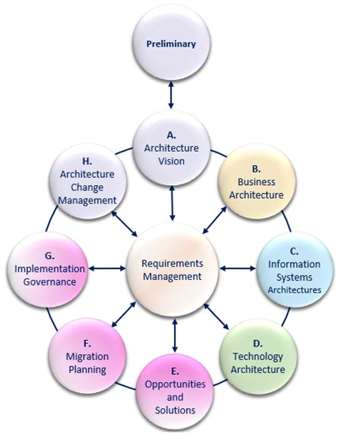
Govern the creation development - 01/03
The Architecture Project ( a cycle of architecture 3work (A-H)):
Used to direct and control the EA team to address issues in the enterprise
Starts with a request for Architecture work
An architecture Project progresses towards a Target Architecture (often through Transitional Architecture States)
Primary control is Architecture Project Management using the Statement of Architecture Work bound to a Request for Architecture work.
Are the stakeholder’s concerns being addressed?
A Practitioners’ Approach to Developing Enterprise Architecture Following the ADM : Page 108 : §15.1.1
Initially MOD 03
Revised words to - An architecture Project progresses towards a Target Architecture (often through Transitional Architecture States) - the previous ones made no sense.
Notes:
Level=1 : L.O.= 3.4b : Explain the need to govern the creation development and maintenance of Enterprise Architecture.
See : TOGAF® Series Guide: A Practitioners’ Approach to Developing Enterprise Architecture Following the TOGAF® ADM : Page 108 : §15.1.1
For a broader discussion of controlling the development of the Target Architecture see:
G188 : TOGAF® Series Guide: Architecture Project Management
in the TOGAF Library, at https://publications.opengroup.org/catalogsearch/result/?q=G188
Target Architecture
The TOGAF Standard provides a key concept to govern the Target Architecture: the Architecture Project.
The Architecture Project:
Is used to direct and control the EA team to address issues in the enterprise
Starts with a Request for Architecture Work
Primary control is Architecture Project Management using the Statement of Architecture Work:
Develop an architecture within a controlled scope
Directed to the stakeholder’s baseline preferences:
objective
priority
specification
Are the stakeholder’s concerns being addressed?
15.1.1 Target Architecture
The TOGAF Standard provides a key concept to govern the Target Architecture: the Architecture Project.
The Architecture Project is used to direct and control the EA team to address issues in the enterprise. An Architecture Project starts with a Request for Architecture Work. The primary control is Architecture Project Management using the Statement of Architecture Work.

Slide 85
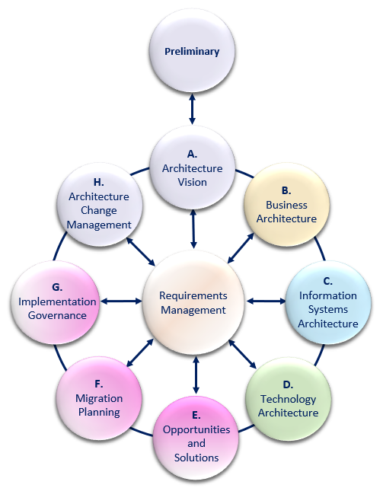
Govern the creation development - 02/03
Roles, duties, and decision rights
Sponsor Stakeholders have approval rights for decisions about the Target Architecture
Architects have recommendation rights for decisions about the Target Architecture
Different Governance roles
Stakeholder
Stakeholder Agent
Subject Matter Expert
Implementer
Architect
Auditor
Governance process not heavyweight
Based on demonstrating traceability
A Practitioners’ Approach to Developing Enterprise Architecture Following the ADM : Page 109 : §15.1.2
Initially MOD 03
Revised words to - Sponsor Stakeholders have approval rights for decisions about the Target Architecture
Architects have recommendation rights about the Target Architecture – this addresses the complete confusion about the architect role created by the words used in the series guide.
Notes:
Level=1 : L.O.= 3.4c : Explain the need to govern the creation development and maintenance of Enterprise Architecture.
See : TOGAF® Series Guide: A Practitioners’ Approach to Developing Enterprise Architecture Following the TOGAF® ADM : Page 109 : §15.1.2
Roles, Duties, and Decision Rights
Stakeholders make decisions about the Target Architecture. Other Governance roles with different accountability and decision rights are:
Stakeholder: owner of the architecture - decisions about the Target Architecture, and any relief from and enforcement of the target
Stakeholder Agent: representative of the stakeholder
Subject Matter Expert: possesses specialized knowledge about some aspect of the enterprise or the environment in which it operates - provides knowledge, advice, and validation of
interpretation.
Implementer: responsible for performing all change activity; transformative projects and incremental operational changes are changes performed by an implementer; makes decisions about implementation choices (design, product selection, change sequence)
Architect: developer of the Target Architecture; provides recommendations when non-compliance with the target is determined
Auditor: performs systematic reviews of both the target and implementation; makes decisions about compliance during the development of the architecture and implementation
The governance process does not have to be a heavyweight bureaucracy.
It is based on demonstrating sufficient traceability so that the organization can have confidence that the target is the best path to achieving the enterprise’s preferences.
With confidence, the enterprise will enforce the target in deliberate change activity.
15.1.2 Implementation Projects and Other Change
The TOGAF Standard provides two key concepts to govern Implementation Projects and other change: the Architecture Contract and the Architecture Requirements Specification.
The Architecture Contract is used to direct and control the implementation team to work towards a specific future. Regardless of the document structure an Architecture Contract takes in a Practitioner’s organization it will contain the same directional elements and provide a means to test compliance.
The Architecture Requirements Specification is used to direct and control the creativity of the implementation team. Every Architecture Requirements Specification enables control of the implementation team. Design, implementation, and other change choices can be tested against the Architecture Requirements Specification.
... CONTINUES ... SEE REFERENCE SPECIFIED

Slide 86
Example Stakeholder Understanding Checklist
1 | Were the correct stakeholders identified? | Yes - proceed | No - direct the architect to engage with the stakeholders appropriate to the scope of the architecture being developed.
2 | Were constraints and guidance from the superior architecture taken into account? | Yes - proceed | No - direct the Practitioner to perform their job and take into account guidance and constraints from the superior architecture. Where the Practitioner identifies a conflict, obtain a recommendation on whether to grant relief from the superior architecture or enforce the superior architecture. This decision must be made by the superior architecture stakeholders.
3 | Do appropriate SMEs agree with the facts and interpretation of the facts in the architecture? | Yes - proceed | No, the Practitioner has to do their job and engage with the SMEs. Where the Practitioner identifies a conflict with, or between, SMEs, develop a recommendation for the stakeholders that they should have limitations in confidence.
4 | Do any constraints or guidance produced reflect the views produced for stakeholders and any underpinning architecture models and analysis? | Yes - proceed | No, the Practitioner needs to do their job and develop appropriate views that are consistent with analysis.
5 | Do the views produced for the stakeholders reflect both their concerns and any underpinning architecture models and analysis? | Yes - proceed | No, the Practitioner needs to do their job and develop appropriate views.
6 | Do the stakeholders understand the value, and any uncertainty in achieving the value, provided by reaching the target state? | Yes - proceed | No, the Practitioner needs to do their job and develop appropriate views, and other work products, then return to the stakeholders.
7 | Do the stakeholders understand the work necessary to reach the target state and any uncertainty (risk) in successfully accomplishing the work? | Yes - proceed | No, the Practitioner needs to do their job and develop appropriate work products and return to the stakeholders.
8 | Do the stakeholders understand any limitations in confidence they should have in the Target Architecture? | Yes - proceed | No, the Practitioner needs to do their job and develop appropriate guidance on the limitations in confidence and return to the stakeholders.
9 | Have the stakeholders approved the views? | Yes - proceed | No
A Practitioners’ Approach to Developing Enterprise Architecture Following the ADM : Page 110 : §15.2.1
Initially MOD 03
Changed heading to clarify reason for the slide - Example Stakeholder Understanding Checklist
Notes:
Þ Q-30
Level=1 : L.O.= 3.4d : Explain the need to govern the creation development and maintenance of Enterprise Architecture.
See : TOGAF® Series Guide: A Practitioners’ Approach to Developing Enterprise Architecture Following the TOGAF® ADM : Page 110 : §15.2.1
15.2.1 Target Checklist
Use the following checklist to execute architecture governance. Good Practitioners understand that only stakeholders can approve architecture. A good governance process will require the Practitioner to demonstrate the following when assessing a Target Architecture:
1.
Were the correct stakeholders identified?
Yes/No
If yes, proceed.
If no, direct the architect to engage with the stakeholders appropriate to the scope of the architecture being developed.
2.
Were constraints and guidance from the superior architecture taken into account?
Yes/No
If yes, proceed.
If no, direct the Practitioner to perform their job and take into account guidance and constraints from the superior architecture. Where the Practitioner identifies a conflict, obtain a recommendation on whether to grant relief from the superior architecture or enforce the superior architecture. This decision must be made by the superior architecture stakeholders.
3
Do appropriate SMEs agree with the facts and interpretation of the facts in the architecture?
Yes/No
If yes, proceed.
If no, the Practitioner has to do their job and engage with the SMEs. Where the Practitioner identifies a conflict with, or between, SMEs, develop a recommendation for the stakeholders that they should have limitations in confidence.
4.
Do any constraints or guidance produced reflect the views produced for stakeholders and any underpinning architecture models and analysis?
Yes/No
If yes, proceed.
If no, the Practitioner needs to do their job and develop appropriate views that are consistent with analysis.
5.
Do the views produced for the stakeholders reflect their concerns and reflect any
... CONTINUES ... SEE REFERENCE SPECIFIED

Slide 87
Scope an Architecture – 01/02
Reasons to constrain the scope of the architecture:
The organizational authority
The objectives and stakeholder
People, finance, and other resources
Business
The work of all architects (and other stakeholders) should be effectively governed and integrated.
This requires a set of aligned architecture partitions.
It also requires both definitions of re-use - and of the compliance relationships between architecture partitions.
Application
Data
Technology
Architecture Development Method : Page 7 : §1.5
Initially MOD 03
Notes:
Level=1 : L.O.= 3.5a : Briefly explain how to scope an architecture.
See : TOGAF® Standard – Architecture Development Method : Page 7 : §1.5
*The division of the enterprise and its architecture-related activity is discussed in more detail in the TOGAF Standard — Applying the ADM.
Reasons to constrain the scope of the architecture:
The organizational authority of the team producing the architecture
The objectives and stakeholder concerns to be addressed within the architecture
The availability of people, finance, and other resources
Scope chosen for the architecture activity must allow the work of all architects to be effectively governed and integrated.
This requires a set of aligned "architecture partitions“, to ensure architects are not working on duplicate or conflicting activities.
It also requires both definition of re-use - and of the compliance relationships between architecture partitions.
1.5 Scoping the Architecture
TOGAF® Standard — Architecture Development Method 7
Scoping the Architecture Introduction
There are many reasons to constrain (or restrict) the scope of the architectural activity to be
undertaken, most of which relate to limits in:
■ The organizational authority of the team producing the architecture
■ The objectives and stakeholder concerns to be addressed within the architecture
■ The availability of people, finance, and other resources
The scope chosen for the architecture activity should ideally allow the work of all architects
within the enterprise to be effectively governed and integrated. This requires a set of aligned
"architecture partitions" that ensure architects are not working on duplicate or conflicting
activities. It also requires the definition of re-use and compliance relationships between
architecture partitions.
The division of the enterprise and its architecture-related activity is discussed in more detail in
the TOGAF Standard — Applying the ADM.
Four dimensions are typically used in order to define and limit the scope of an architecture:
■ Breadth: what is the full extent of the enterprise, and what part of that extent will this
architecting effort deal with?
— Many enterprises are very large, effectively comprising a federation of organizational
units that could validly be considered enterprises in their own right
— The modern enterprise increasingly extends beyond its traditional boundaries, to
embrace a fuzzy combination of a traditional business enterprise combined with
... CONTINUES ... SEE REFERENCE SPECIFIED

Slide 88
Scope an Architecture – 02/02
Four dimensions are often used in order to define the scope of an architecture:
Breadth:
Depth:
Time Period:
Domains:
Breadth
Business
Time
Depth (detail)
Application
Data
Technology
Notes: The modern enterprise increasingly extends beyond its traditional boundaries.
Architecture Development Method : Page 7 : §1.5
Initially MOD 03
Notes:
Level=1 : L.O.= 3.5a : Briefly explain how to scope an architecture.
See : TOGAF® Standard – Architecture Development Method : Page 7 : §1.5
Four dimensions are often used in order to define the scope of an architecture:
Breadth: what is the full extent of the enterprise, and what part of that extent will this architecting effort deal with?
Depth: to what level of detail should the architecting effort go?
How much architecture is "enough"? What is the appropriate demarcation between the architecture effort and other, related activities (system design/engineering/development)?
Time Period: what is the time period that needs to be articulated for the Architecture Vision, and does it make sense.
If not, how many Transition Architectures are to be defined, and what are their time periods?
Domains: a complete Enterprise Architecture Description should contain all four architecture domains resource – in reality, constraints often mean there is not enough time build an all-inclusive Architecture Description.
Notes: The modern enterprise increasingly extends beyond its traditional boundaries, to embrace a fuzzy combination of a traditional business enterprise combined with suppliers, customers, and partners
The scope chosen for the architecture activity should allow the work of all architects to be effectively governed and integrated. This requires a set of aligned "architecture partitions" to prevent duplicate or conflicting activities.
It also requires the definition of re-use and compliance relationships between architecture partitions.
1.5 Scoping the Architecture
TOGAF® Standard — Architecture Development Method 7
Scoping the Architecture Introduction
There are many reasons to constrain (or restrict) the scope of the architectural activity to be
undertaken, most of which relate to limits in:
■ The organizational authority of the team producing the architecture
■ The objectives and stakeholder concerns to be addressed within the architecture
■ The availability of people, finance, and other resources
The scope chosen for the architecture activity should ideally allow the work of all architects
within the enterprise to be effectively governed and integrated. This requires a set of aligned
"architecture partitions" that ensure architects are not working on duplicate or conflicting
activities. It also requires the definition of re-use and compliance relationships between
architecture partitions.
... CONTINUES ... SEE REFERENCE SPECIFIED

Slide 89





Architecture alternatives
There are many solutions to a problem
Warmth
Architecture Development Method : Page 11 : §1.6
Initially MOD 03
Notes:
Þ M-39
Level=1 : L.O.= 3.6a : Briefly explain the reasons for considering architecture alternatives including understanding concerns and trade-offs.
See : TOGAF® Standard – Architecture Development Method : Page 11 : §1.6
There is very often more than one possible Target Architecture that would conform to the Architecture Vision, Architecture Principles, and Requirements.
It is important to identify alternative Target Architectures and build an understanding of different possibilities and identify trade-offs between the alternatives.
Creating an architecture normally requires trade-offs among competing forces.
Presenting different alternatives and trade-offs to stakeholders helps architects to extract hidden agendas, principles, and requirements that could impact the final Target Architecture.
1.6 Architecture Alternatives
There is often more than one possible Target Architecture that would conform to the Architecture
Vision, Architecture Principles, and Requirements. It is important to identify alternative Target
Architectures and build an understanding of different possibilities and identify trade-offs between the
alternatives. Creating an architecture normally requires trade-offs among competing forces.
Presenting different alternatives and trade-offs to stakeholders helps architects to extract hidden
agendas, principles, and requirements that could impact the final Target Architecture.

Slide 90
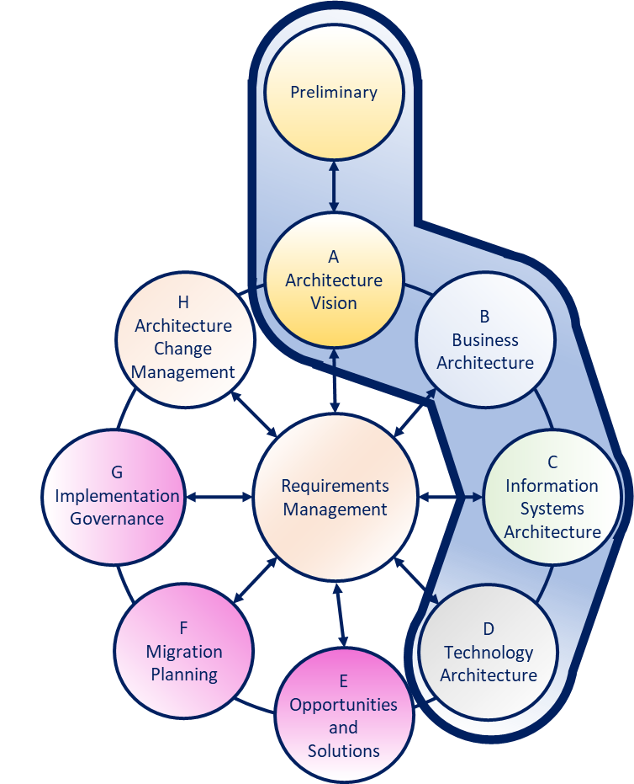
The Architecture Phases
The Preliminary Phase maintains ensures that the required EA capability is in place and can be governanced.
In that context it is the first of the Architecture Phases of the TOGAF ADM.
In Phase A we clarify what is wanted, how badly, and by whom.
But the real Enterprise Architecture legwork is in the Phases A through to D.
Initially MOD 03
Slide moved to its logical place in the set
Notes:
No notes

Slide 91

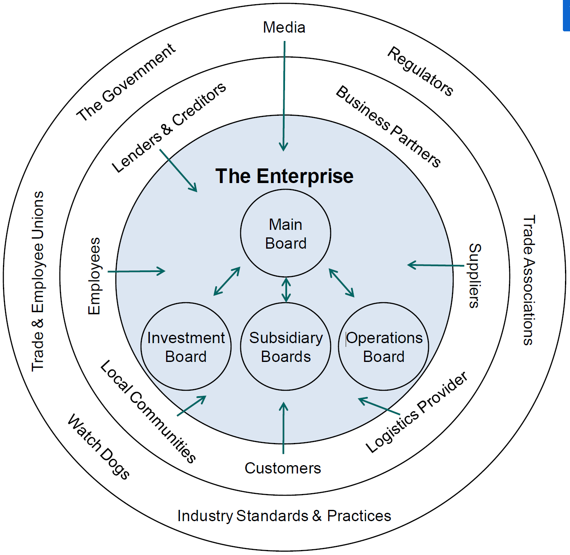
Preliminary Phase – 01/03 - Purpose
The Preliminary Phase determines the architecture capability needed for a change and establishes that capability (may create a customized journey of the TOGAF ADM).
The ADM is not a linear process model.
The figure below highlights that in order to complete Phase A, some amount of work is needed in Phases B, C, and D
Interactions Affecting Governance
Here, several TOGAF ADM phases are entered iteratively.
The TOGAF Leader’s Guide to Establishing and Evolving an EA Capability : Page 100 : §13.1
Initially MOD 03
Added the real objectives of Preliminary from V10 2.1 page 16 – to the series guide statement
Notes:
Level=1 : L.O.= 3.7a : Briefly explain the purpose of the Preliminary Phase in developing an Enterprise Architecture Capability.
See : TOGAF® Series Guide: The TOGAF Leader’s Guide to Establishing and Evolving an EA Capability : Page 100 : §13.1
The Preliminary Phase is designed as a customized journey of the TOGAF ADM.
The ADM is not a linear process model; it is a logical method that places key activity steps together for the purpose of understanding the relationship of each activity and clarifying information flow.
Only do work to the extent needed to answer any question at hand. More elaboration will be done in the subsequent architecture work.
The Figure highlights that in order to complete Phase A, some amount of work is needed in Phases B, C, and D.
To an architect there is no difference between exercising the ADM than EA Capability, a finance capability, a portfolio, or an organizational strategy – we are using the concepts of ADM to support two different activities.
Interactions Affecting Governance
Here, several TOGAF ADM phases are entered iteratively.
13.1 Mapping the EA Leader’s Guide to TOGAF ADM Phases
The Preliminary Phase is designed as a customized journey of the TOGAF ADM. This journey is predicated on the best practice of developing EA. The ADM is not a linear process model; rather it is a logical method that places key activity steps together for the purpose of understanding the relationship of activity and clarifying information flow. In Table 9 several TOGAF ADM phases are entered iteratively. Partial indicates work only to the extent needed to answer the question at hand. More elaboration can be done in subsequent architecture work.
For a graphical representation of this journey see Figure 19. The graphic in Figure 19 focuses on Phase A. It highlights that in order to complete Phase A, some amount of work is needed in Phases B, C, and D. The ADM is used to develop the EA. There is no difference between exercising the ADM to architect an EA Capability, a finance capability, a portfolio, or an organizational strategy. We are using the concepts of ADM to support two different activities. Application of steps in ADM phases is limited by the context of supporting the EA Capability.

Slide 92
Preliminary Phase - 02/03 - Objectives
Determine the Architecture Capability desired by the organization
Establish the Architecture Capability
Exit the Preliminary Phase in a fit state in order to be able to do the ADM cycle.
Architecture Development Method : Page 16 : §2.1
Initially MOD 03
Notes:
Level=1 : L.O.= 3.8a : Describe the objectives of the Preliminary Phase.
See : TOGAF® Standard – Architecture Development Method : Page 16 : §2.1
1. Determine the Architecture Capability desired by the organization:
Review the organizational context for conducting Enterprise Architecture
Identify and scope the elements of the enterprise organizations affected by the Architecture Capability
Identify the established frameworks, methods, and processes that intersect with the Architecture Capability. Establish Capability Maturity target
2. Establish the Architecture Capability:
Define and establish the Organizational Model for Enterprise Architecture
Define and establish the detailed process and resources for Architecture Governance
Select and implement tools that support the Architecture Capability
Define the Architecture Principles
2.1 Objectives
The objectives of the Preliminary Phase are to:
1. Determine the Architecture Capability desired by the organization:
■ Review the organizational context for conducting Enterprise Architecture
■ Identify and scope the elements of the enterprise organizations affected by the
Architecture Capability
■ Identify the established frameworks, methods, and processes that intersect with the
Architecture Capability
■ Establish Capability Maturity target
2. Establish the Architecture Capability:
■ Define and establish the Organizational Model for Enterprise Architecture
■ Define and establish the detailed process and resources for Architecture Governance
■ Select and implement tools that support the Architecture Capability
■ Define the Architecture Principles

Slide 93
Preliminary Phase - 03/03 - Outputs
Represented as (model contains):
Request for Architecture Work
Architecture Principles Architecture Repository
Business Principles, Goals, Drivers
Organizational model for EA
Tailored Architecture Framework
Architecture Development Method : Page 16 : §2.1
Initially MOD 03
Notes:
Þ M-41
Level=1 : L.O.= 3.8a : Describe the objectives of the Preliminary Phase.
See : TOGAF® Standard – Architecture Development Method : Page 16 : §2.1
Represented as:
Request for Architecture Work
Architecture Principles* - properly documented
Architecture Repository
Business Principles, Goals, Drivers* - confirmed and validated
Organizational model for EA
Tailored Architecture Framework
*
It is important to sustain the Architecture Principles
It is important to be consistent with Business Principles, Goals, Drivers
It may be that, on closer examination, we find issues
Throughout the ADM cycle check on the integrity of these
2.1 Objectives
The objectives of the Preliminary Phase are to:
1. Determine the Architecture Capability desired by the organization:
■ Review the organizational context for conducting Enterprise Architecture
■ Identify and scope the elements of the enterprise organizations affected by the
Architecture Capability
■ Identify the established frameworks, methods, and processes that intersect with the
Architecture Capability
■ Establish the Capability Maturity target
2. Establish the Architecture Capability:
■ Define and establish the Organizational Model for Enterprise Architecture
■ Define and establish the detailed process and resources for Architecture Governance
■ Select and implement tools that support the Architecture Capability
■ Define the Architecture Principles

Slide 94
Phase A - 01/04 - Summary
Phase | Output & Outcome | Essential Knowledge
Phase A: Architecture Vision | Sufficient documentation to get permission to proceed. Permission to proceed to develop a Target Architecture to prove out a summary target. | The scope of the problem being addressed. Those who have interests that are fundamental to the problem being addressed. (stakeholders & concerns) What summary answer to the problem is acceptable to the stakeholders? (Architecture Vision) Stakeholder priority and preference. What value does the summary answer provide?
A Practitioners’ Approach to Developing Enterprise Architecture Following the ADM : Page 43 : §5.2.2 Table4
Initially MOD 03
Notes:
Þ Q-33
Level=1 : L.O.= 3.9a : Briefly explain the purpose of Phase A.
See : TOGAF® Series Guide: A Practitioners’ Approach to Developing Enterprise Architecture Following the TOGAF® ADM : Page 43 : §5.2.2
Table 4
5.2.2 Essential ADM Output and Knowledge
A summary of the essential outcome and output is provided in Table 4. Keep in mind that the essential output is what stakeholders, sponsor, and boss’ boss’ boss wants. No-one wants an architecture; they want guidance on planning and executing an effective change. Practitioners use an architected approach to providing the best available guidance on effective change. The essential outcomes and outputs are derived from the objectives of the phase – the statement of why a Practitioner should perform this activity.
What the Enterprise values and consumes is typically different than what the Practitioner produces. Practitioners deliver an essential output. It is provided as views, roadmaps, architecture specifications, controls, and other useful things. Architecture is developed, and the EA Landscape populated. To do this, Practitioners require a set of essential knowledge. The Enterprise consumes effective guidance about and the ability to govern change.
Read Table 4 in conjunction with Table 3 to confirm whether for a particular purpose the output of the phase is already in existence, needs to be created, or is extraneous to the current Architecture Project. Good Practitioners will adjust their work accordingly. Table 4 lists only key outputs and outcomes. For an exhaustive list, refer to the TOGAF Standard. In order to achieve these outcomes, the Practitioner may have to perform more activities or create more deliverables than those listed in the table below. The intent is to keep the focus on what is pursued, not what is done.

Slide 95
Phase A - 02/04 - Purpose
Set-up essentials:
Define the scope of the Architecture Project
What problem are you solving?
Where will this architecture be used?
Identify stakeholders, concerns, and requirements
Explore the EA Repository
Do Stakeholder Map
Assess the capability of the EA team
Completion essentials:
Key stakeholder agreement
Sufficient architecture development
Scope of change to ACHIEVE their articulated preferences
Expect multiple potential targets after the initial exploration.
A Practitioners’ Approach to Developing Enterprise Architecture Following the ADM : Page 41 : §5.2.1
Initially MOD 03
Notes:
Level=1 : L.O.= 3.9a : Briefly explain the purpose of Phase A.
See : TOGAF® Series Guide: A Practitioners’ Approach to Developing Enterprise Architecture Following the TOGAF® ADM : Page 41 : §5.2.1
Set-up essentials:
Define the scope of the Architecture Project
What problem are you solving? … the necessary level of detail?
Where in the business cycle will this architecture be used?
Identify stakeholders, concerns, and associated requirements
Explore the EA Repository for superior architecture constraints and guidance
Produce the Stakeholder Map and identify what they are worrying about.
Assess the capability of the EA team
Confirm the ability of EA team to deliver on this architecture development project
Completion essentials:
Key stakeholder agreement
summary of the target
work to reach the target
value of the target
Sufficient architecture development in all domains to enable communication to key stakeholders on how the problem can be addressed
Scope of change to reach their articulated preferences
Expect multiple potential targets after the initial exploration.
More than one approach to addressing the problem is normal/acceptable.
It facilitates better trade-off when performing more detailed analysis.
Until the form of the target is finalized, EAs are exploring the best potential future, not selling a particular future.
5.2.1 Phase A: The Starting Point
All architecture development needs to start with Phase A. Without the set-up inherent in Phase A Practitioners can expect to slide off-course and fail to deliver useful architecture.
The set-up essentials of Phase A are:
• Define the scope of the Architecture Project
What problem are you solving? In terms of the EA Landscape (breadth and planning-horizon) and in terms of purpose, which will tend to confirm the necessary level of detail. Be completely clear where in the business cycle this architecture will be used.
• Identify stakeholders, concerns, and associated requirements
Explore the EA Repository for superior architecture constraints and guidance. Do the ... CONTINUES ... SEE REFERENCE SPECIFIED

Slide 96
Phase A - 03/04 - Objectives
TWO clear objectives of Phase A:
Develop a high-level aspirational vision of the capabilities and business value to be delivered as a result of the proposed Enterprise Architecture
Obtain approval for a Statement of Architecture Work that defines a program of works to develop and deploy the architecture outlined in the Architecture Vision
Architecture Development Method : Page 30 : §3.1
Initially MOD 03
Notes:
Level=1 : L.O.= 3.10a : Describe the objectives of Phase A.
See : TOGAF® Standard – Architecture Development Method : Page 30 : §3.1
There are TWO clear objectives of Phase A -these are :
Develop a high-level aspirational vision of the capabilities and business value to be delivered as a result of the proposed Enterprise Architecture
Obtain approval for a Statement of Architecture Work that defines a program of works to develop and deploy the architecture outlined in the Architecture Vision
3.1 Objectives
The objectives of Phase A are to:
■ Develop a high-level aspirational vision of the capabilities and business value to be
delivered as a result of the proposed Enterprise Architecture
■ Obtain approval for a Statement of Architecture Work that defines a program of works to
develop and deploy the architecture outlined in the Architecture Vision

Slide 97
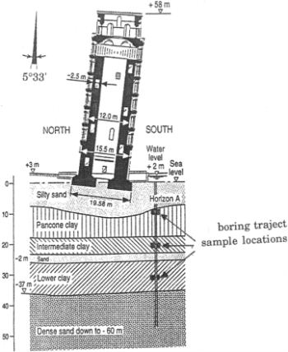
Phase A - 04/04 - Outputs
The whole cycle rests upon Phase A outputs
Represented as:
Architecture Vision
Architecture Principles
Business Principles, Goals, Drivers
Capability Assessment
Communications Plan
Statement of Architecture Work
Tailored Architecture Framework
Boring trajectory
sample locations
A Practitioners’ Approach to Developing Enterprise Architecture Following the ADM : Page 43 : §5.2.2 Table4
Initially MOD 03
Heading changed to what the slide is about Outputs not Objectives
Notes:
Þ M-43
Level=1 : L.O.= 3.10a : Describe the objectives of Phase A.
See : TOGAF® Standard – Architecture Development Method : Page 30 : §3.1
Instantiated as:
Architecture Vision – properly documented
Architecture Principles - confirmed and validated
Business Principles, Goals, Drivers - confirmed and validated
Capability Assessment - rectification plan
Communications Plan – with Corporate Communications
Statement of Architecture Work – per the Project Management method
Tailored Architecture Framework – for this EA project
5.2.2 Essential ADM Output and Knowledge
A summary of the essential outcome and output is provided in Table 4. Keep in mind that the essential output is what stakeholders, sponsor, and boss’ boss’ boss wants. No-one wants an architecture; they want guidance on planning and executing an effective change. Practitioners use an architected approach to providing the best available guidance on effective change. The essential outcomes and outputs are derived from the objectives of the phase – the statement of why a Practitioner should perform this activity.
What the Enterprise values and consumes is typically different from what the Practitioner produces. Practitioners deliver an essential output. It is provided as views, roadmaps, architecture specifications, controls, and other useful things. Architecture is developed, and the EA Landscape populated. To do this, Practitioners require a set of essential knowledge. The Enterprise consumes effective guidance about and the ability to govern change.
Read Table 4 in conjunction with Table 3 to confirm whether for a particular purpose the output of the phase is already in existence, needs to be created, or is extraneous to the current Architecture Project. Good Practitioners will adjust their work accordingly. Table 4 lists only key outputs and outcomes. For an exhaustive list, refer to the TOGAF Standard. In order to achieve these outcomes, the Practitioner may have to perform more activities or create more deliverables than those listed in the table below. The intent is to keep the focus on what is pursued, not what is done.

Slide 98
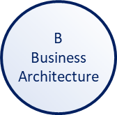
Phase B – 01/03 - Summary
Phase | Output & Outcome | Essential Knowledge
Phase B: Business Architecture | A set of domain architectures approved by the stakeholders for the problem being addressed, with a set of gaps, and the work required to clear these gaps understood by the stakeholders. | How does the current enterprise fail to meet the preferences of the stakeholders? What must change to enable the enterprise to meet the preferences of the stakeholders? (Gaps) What work is necessary to realize the changes, that is consistent with the additional value being created? (Work Package) How stakeholder priorities and preferences adjust in response to value, effort, and risk of change. (Stakeholder Requirements)
Architecture Development Method : Page 42 : §4.1
Initially MOD 03
Notes:
Level=1 : L.O.= 3.12a : Describe the objectives of Phase B.
See : TOGAF® Standard – Architecture Development Method : Page 42 : §4.1
4.1 Objectives
The objectives of Phase B are to:
■ Develop the Target Business Architecture that describes how the enterprise needs to
operate to achieve the business goals, and respond to the strategic drivers set out in the
Architecture Vision, in a way that addresses the Statement of Architecture Work and
stakeholder concerns
■ Identify candidate Architecture Roadmap components based upon gaps between the
Baseline and Target Business Architectures

Slide 99
Phase B - 02/03 - Objectives
Phase B – Business Architecture
The objectives of Phase B are:
Develop the Target Business Architecture that describes how the enterprise needs to operate to achieve the business goals, and respond to the strategic drivers set out in the Architecture Vision, in a way that addresses the Statement of Architecture Work and stakeholder concerns
Identify candidate Architecture Roadmap components based upon gaps between the Baseline and Target Business Architectures
Architecture Development Method : Page 42 : §4.1
Initially MOD 03
Notes:
Level=1 : L.O.= 3.12a : Describe the objectives of Phase B.
See : TOGAF® Standard – Architecture Development Method : Page 42 : §4.1
Phase B – Business Architecture
The objectives of Phase B are:
Develop the Target Business Architecture that describes how the enterprise needs to operate to achieve the business goals, and respond to the strategic drivers set out in the Architecture Vision, in a way that addresses the Statement of Architecture Work and stakeholder concerns
Identify candidate Architecture Roadmap components based upon gaps between the Baseline and Target Business Architectures
4.1 Objectives
The objectives of Phase B are to:
■ Develop the Target Business Architecture that describes how the enterprise needs to
operate to achieve the business goals, and respond to the strategic drivers set out in the
Architecture Vision, in a way that addresses the Statement of Architecture Work and
stakeholder concerns
■ Identify candidate Architecture Roadmap components based upon gaps between the
Baseline and Target Business Architectures

Slide 100
Phase B - 03/03 - Outputs
Architecture Definition Document
Architecture Principles
Architecture Requirements Specification
Recorded candidate roadmap components
Business Principles, Goals, Drivers
Statement of Architecture Work
Architecture Development Method : Page 42 : §4.1
Initially MOD 03
Heading changed to what the slide is about Outputs not Objectives – removed the objectives which were already on the previous slide.
Notes:
Þ Q-35 M-48
Level=1 : L.O.= 3.12a : Describe the objectives of Phase B.
See : TOGAF® Standard – Architecture Development Method : Page 42 : §4.1
Architecture Definition Document - confirmed and validated
Architecture Principles* - properly documented
Architecture Requirements Specification
Architecture Roadmap
Business Principles, Goals, Drivers* - confirmed and validated
Statement of Architecture Work - per the Project Management method
*
These were looked at in the previous Phase, A.
Phase A was not a ‘detailed look’ with the same granularity as Phase B.
It may be that, on closer examination, we find issues.
These can be resolved, or not, by adjusting the Principles or the Project.
Best case – nothing in them changes
Worst case – this project should not proceed
4.1 Objectives
The objectives of Phase B are to:
■ Develop the Target Business Architecture that describes how the enterprise needs to
operate to achieve the business goals, and respond to the strategic drivers set out in the
Architecture Vision, in a way that addresses the Statement of Architecture Work and
stakeholder concerns
■ Identify candidate Architecture Roadmap components based upon gaps between the
Baseline and Target Business Architectures

Slide 101
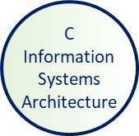
Phase C – 01/03 - Summary
Phase | Output & Outcome | Essential Knowledge
Phase C: Information Systems Architecture | A set of domain architectures approved by the stakeholders for the problem being addressed, with a set of gaps, and the work required to clear these gaps understood by the stakeholders. | How does the current enterprise fail to meet the preferences of the stakeholders? What must change to enable the enterprise to meet the preferences of the stakeholders? (Gaps) What work is necessary to realize the changes, that is consistent with the additional value being created? (Work Package) How stakeholder priorities and preferences adjust in response to value, effort, and risk of change. (Stakeholder Requirements)
Architecture Development Method : Page 58 : §5.1
Initially MOD 03
Notes:
Level=1 : L.O.= 3.13a : Describe the objectives of Phase C for Data Architecture and Application Architecture.
See : TOGAF® Standard – Architecture Development Method : Page 58 : §5.1
5.1 Objectives
The objectives of Phase C are to:
■ Develop the Target Information Systems Architectures, describing how the enterprise’s
Information Systems Architecture will enable the Business Architecture and the
Architecture Vision, in a way that addresses the Statement of Architecture Work and
stakeholder concerns
■ Identify candidate Architecture Roadmap components based upon gaps between the
Baseline and Target Information Systems (Data and Application) Architectures

Slide 102
Phase C – 02/03 - Objectives
Phase C – Information Systems Architecture
Develop the Target Information Systems Architectures,
describing how the enterprise’s Information Systems
Architecture will enable the Business Architecture and
the Architecture Vision …
… in a way that addresses both the Statement of Architecture Work and stakeholder concerns
Identify candidate Architecture Roadmap components based upon gaps between the Baseline and Target Information Systems (Data and Application) Architectures
Architecture Development Method : Page 58 : §5.1
Initially MOD 03
Notes:
Level=1 : L.O.= 3.13b : Describe the objectives of Phase C for Data Architecture and Application Architecture.
See : TOGAF® Standard – Architecture Development Method : Page 58 : §5.1
Phase C – Information Systems Architecture
Develop the Target Information Systems Architectures, describing how the enterprise’s Information Systems
Architecture will enable the Business Architecture and the Architecture Vision
- in a way that addresses both the Statement of Architecture Work and stakeholder concerns
Identify candidate Architecture Roadmap components based upon gaps between the Baseline and Target Information Systems
(Data and Application) Architectures
5.1 Objectives
The objectives of Phase C are to:
■ Develop the Target Information Systems Architectures, describing how the enterprise’s Information Systems Architecture will enable the Business Architecture and the
Architecture Vision, in a way that addresses the Statement of Architecture Work and stakeholder concerns
■ Identify candidate Architecture Roadmap components based upon gaps between the Baseline and Target Information Systems (Data and Application) Architectures

Slide 103
Phase C – 03/03 - Outputs
Architecture Definition Document
Architecture Principles*
Architecture Requirements Specification
Architecture Roadmap Components
Business Principles, Goals, Drivers*
Statement of Architecture Work
Architecture Development Method : Page 58 : §5.1
Initially MOD 03
Heading changed to what the slide is about Outputs not Objectives – removed the unnecessary text
Notes:
Þ Q-37
Level=1 : L.O.= 3.13c : Describe the objectives of Phase C for Data Architecture and Application Architecture.
See: TOGAF® Standard – Architecture Development Method : Page 58 : §5.1
Phase C – Information Systems Architecture
Instantiated as:
Architecture Definition Document - confirmed and validated
Architecture Principles* - properly documented
Architecture Requirements Specification
Architecture Roadmap
Business Principles, Goals, Drivers* - confirmed and validated
Statement of Architecture Work - per the Project Management method
5.1 Objectives
The objectives of Phase C are to:
■ Develop the Target Information Systems Architectures, describing how the enterprise’s
Information Systems Architecture will enable the Business Architecture and the
Architecture Vision, in a way that addresses the Statement of Architecture Work and stakeholder concerns
■ Identify candidate Architecture Roadmap components based upon gaps between the
Baseline and Target Information Systems (Data and Application) Architectures

Slide 104
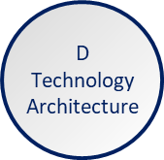
Phase D – 01/03 - Summary
Phase | Output & Outcome | Essential Knowledge
Phase D: Technology Architecture | A set of domain architectures approved by the stakeholders for the problem being addressed, with a set of gaps, and work to clear the gaps understood by the stakeholders. | How does the current Enterprise fail to meet the preferences of the stakeholders? What must change to enable the Enterprise to meet the preferences of the stakeholders? (Gaps) What work is necessary to realize the changes, that is consistent with the additional value being created? (Work Package) How stakeholder priority and preference adjust in response to value, effort, and risk of change. (Stakeholder Requirements)
Architecture Development Method : Page 59 : §6.1
Initially MOD 03
Notes:
Level=1 : L.O.= 3.14 : Describe the objectives of Phase D.
See : TOGAF® Standard – Architecture Development Method : Page 59 : §6.1
6.1 Objectives
The objectives of the Data Architecture part of Phase C are to:
■ Develop the Target Data Architecture that enables the Business Architecture and the
Architecture Vision, in a way that addresses the Statement of Architecture Wor k and
stakeholder concerns
■ Identify candidate Architecture Roadmap components based upon gaps between the
Baseline and Target Data Architectures

Slide 105
Phase D – 02/03 - Objectives
Phase D - Technology Architecture
Develop the Target Technology Architecture that enables the Architecture Vision, target business, data, and application building blocks to be delivered through technology components and technology services, in a way that addresses the Statement of Architecture Work and stakeholder concerns
Identify candidate Architecture Roadmap components based upon gaps between the Baseline and Target Technology Architectures
Architecture Development Method : Page 59 : §6.1
Initially MOD 03
Notes:
Level=1 : L.O.= 3.14 : Describe the objectives of Phase C for Data Architecture and Application Architecture.
See : TOGAF® Standard – Architecture Development Method : Page 59 : §6.1
Phase D - Technology Architecture
Develop the Target Technology Architecture that enables the Architecture Vision, target business, data, and application building blocks to be delivered through technology components and technology services, in a way that addresses the Statement of Architecture Work and stakeholder concerns
Identify candidate Architecture Roadmap components based upon gaps between the Baseline and Target Technology Architectures
6.1 Objectives
The objectives of the Data Architecture part of Phase C are to:
■ Develop the Target Data Architecture that enables the Business Architecture and the
Architecture Vision, in a way that addresses the Statement of Architecture Work and stakeholder concerns
■ Identify candidate Architecture Roadmap components based upon gaps between the Baseline and Target Data Architectures

Slide 106
Phase D – 03/03 - Outputs
Architecture Definition Document
Architecture Principles
Architecture Requirements Specification
Architecture Roadmap Components
Business Principles, Goals, Drivers
Statement of Architecture Work
Architecture Development Method : Page 59 : §6.1
Initially MOD 03
Heading changed to what the slide is about Outputs not Objectives – removed the objectives which were already on the previous slide.
Notes:
Þ M-51
Level=1 : L.O.= 3.14 : Describe the objectives of Phase C for Data Architecture and Application Architecture.
See : TOGAF® Standard – Architecture Development Method : Page 59 : §6.1
Phase D - Technology Architecture
Instantiated as:
Architecture Definition Document - confirmed and validated
Architecture Principles* - properly documented
Architecture Requirements Specification
Architecture Roadmap
Business Principles, Goals, Drivers* - confirmed and validated
Statement of Architecture Work - per the Project Management method
6.1 Objectives
The objectives of the Data Architecture part of Phase C are to:
■ Develop the Target Data Architecture that enables the Business Architecture and the
Architecture Vision, in a way that addresses the Statement of Architecture Work and stakeholder concerns
■ Identify candidate Architecture Roadmap components based upon gaps between the Baseline and Target Data Architectures

Slide 107
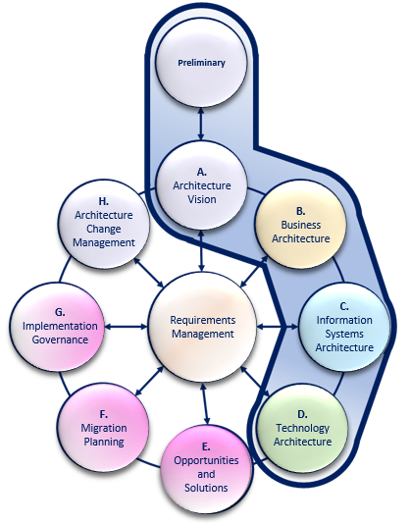
The Vision and Definition Phases of the ADM
Outcome/Essential Knowledge
Phase A: Architecture Vision
Sufficient documentation to get permission to proceed.
The scope of the problem being addressed.
Those who have interests
What summary answer to the problem is acceptable?
What value does the summary answer provide?
Phase B, Phase C, & Phase D
A set of domain architectures
How does the current enterprise fail to meet the preferences?
What must change?
What work is necessary?
How do stakeholder priorities and preferences adjust in response?
Initially MOD 03
Notes:
Outcome/Essential Knowledge
Phase A: Architecture Vision
Sufficient documentation to get permission to proceed.
Permission to proceed to develop a Target Architecture in order to prove out a summary target.
The scope of the problem being addressed.
Those who have interests that are fundamental to the problem being addressed.
(Stakeholders & Concerns)
What summary answer to the problem is acceptable to the stakeholders?
(Architecture Vision)
Stakeholder priority and preference.
What value does the summary answer provide?
Phase B, Phase C, & Phase D
A set of domain architectures approved by the stakeholders for the problem being addressed,
with a set of gaps, and the work required to clear these gaps understood by the stakeholders.
How does the current enterprise fail to meet the preferences of the stakeholders?
What must change to enable the enterprise to meet the preferences of the stakeholders? (Gaps)
What work is necessary to realize the changes, that is consistent with the additional
value being created? (Work Package)
How stakeholder priorities and preferences adjust in response to value, effort, and risk of change. (Stakeholder Requirements)

Slide 108
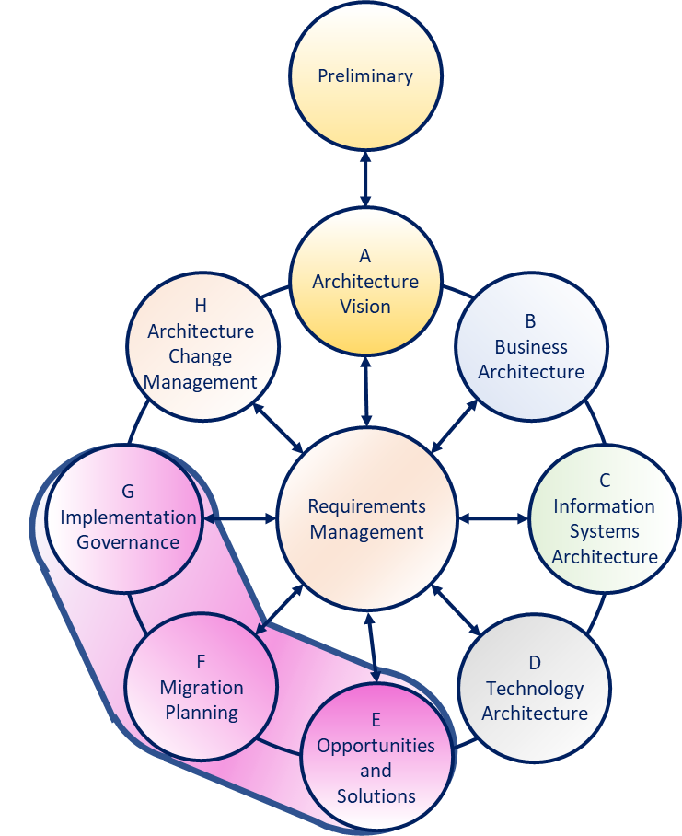
The Realization Phases
The point of EA is to produce a detailed description of something that can be created
It is not sufficient to just pass plans to
‘the builders’
The Enterprise Architect ‘signs off’ the output from the builders
A formal process and understanding of relationships is needed
Initially MOD 04
Notes:
The point of EA is to produce a detailed description of something that can be created.
As with plans produced by any design system it is not sufficient to just pass these to ‘the builders’ in the hope of flawless creation.
It is the Enterprise Architect that ‘signs off’ that the output from the builders [developers] maps accurately to the design.
A formal process and understanding of relationships is needed to assure this happens.

Slide 109

Phase E – 01/03 - Summary
Phase | Output & Outcome | Essential Knowledge
Phase E: Opportunities & Solutions | A set of work packages that address the set of gaps, with an indication of value produced and effort required, and dependencies between the work packages to reach the adjusted target. | Dependency between the set of changes (Work Package & Gap dependency). Value, effort, and risk associated with each change and work package. How stakeholder priorities and preferences adjust in response to value, effort, and risk of change.
A Practitioners’ Approach to Developing Enterprise Architecture Following the ADM : Page 43 : §5.2.2 Table4
Initially MOD 04
Notes:
Level=1 : L.O.= 3.15a : Briefly explain the purpose of Phase E.
See: TOGAF® Series Guide: A Practitioners’ Approach to Developing Enterprise Architecture Following the TOGAF® ADM : Page 43 : §5.2.2
Table 4
5.2.2 Essential ADM Output and Knowledge
A summary of the essential outcome and output is provided in Table 4. Keep in mind that the essential output is what the stakeholders, sponsor, and boss’ boss’ boss want. No-one wants an architecture; they want guidance on planning and executing an effective change. Practitioners use an architected approach to providing the best available guidance on effective change. The essential outcomes and outputs are derived from the objectives of the phase – the statement of why a Practitioner should perform this activity.
What the enterprise values and consumes is typically different from what the Practitioner produces. Practitioners deliver an essential output. It is provided as views, roadmaps, architecture specifications, controls, and other useful things. Architecture is developed, and the EA Landscape populated. To do this, Practitioners require a set of essential knowledge. The enterprise consumes effective guidance about and the ability to govern change.
Read Table 4 in conjunction with Table 3 to confirm whether for a particular purpose the output of the phase is already in existence, needs to be created, or is extraneous to the current Architecture Project. Good Practitioners will adjust their work accordingly. Table 4 lists only key outputs and outcomes. For an exhaustive list, refer to the TOGAF Standard. In order to achieve these outcomes, the Practitioner may have to perform more activities or create more deliverables than those listed in the table. The intent is to keep the focus on what is pursued, not what is done.

Slide 110
Phase E – 02/03 - Objectives
Phase E: Opportunities & Solutions
Generate
Generate the initial complete version of the Architecture Roadmap, based upon the Gap Analysis and candidate Architecture Roadmap components from Phases B, C, and D
Determine
Determine whether an incremental approach is required and, if so, identify Transition Architectures that will deliver continuous business value
Define
Define the overall Solution Building Blocks (SBBs) to finalize the Target Architecture based on the ABBs
Architecture Development Method : Page 94 : §9.1
Initially MOD 04
Notes:
Þ M-39
Level=1 : L.O.= 3.16a : Describe the objectives of Phase E.
See: TOGAF® Standard – Architecture Development Method : Page 94 : §9.1
Phase E: Opportunities & Solutions
Generate the initial complete version of the Architecture Roadmap, based upon the Gap Analysis and candidate Architecture Roadmap components from Phases B, C, and D
Determine whether an incremental approach is required and, if so, identify Transition Architectures that will deliver continuous business value
Define the overall Solution Building Blocks (SBBs) to finalize the Target Architecture based on the ABBs
9.1 Objectives
The objectives of Phase E are to:
■ Generate the initial complete version of the Architecture Roadmap, based upon the Gap
Analysis and candidate Architecture Roadmap components from Phases B, C, and D
■ Determine whether an incremental approach is required and, if so, identify Transition
Architectures that will deliver continuous business value
■ Define the overall Solution Building Blocks (SBBs) to finalize the Target Architecture based on the ABBs

Slide 111
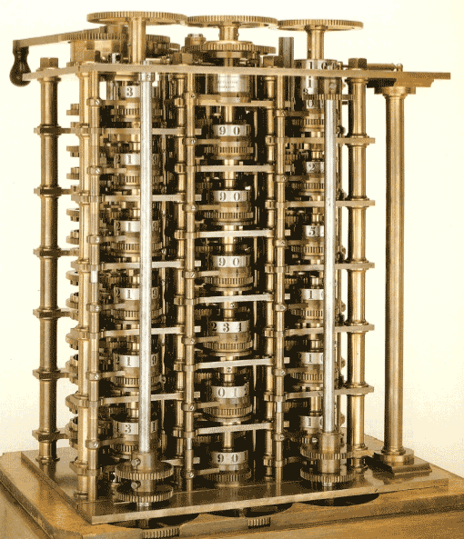
Phase E – 03/03 - Outputs
Architecture Definition Document
Architecture Requirements Specification
Architecture Roadmap
Architecture Vision*
Statement of Architecture Work
Benefits Diagram
Example: Babbage’s ‘Difference Engine’, designed 1822, was not actually built until 2002 due to precision manufacture that is required.
Architecture Development Method : Page 94 : §9.1
Initially MOD 04
Heading changed to what the slide is about Outputs not Objectives – removed the objectives which were already on the previous slide.
Notes:
Þ Q-25 M-40
Level=1 : L.O.= 3.16a : Describe the objectives of Phase E.
See: TOGAF® Standard – Architecture Development Method : Page 94 : §9.1
Phase E: Opportunities & Solutions
Instantiated as:
Architecture Definition Document - confirmed and validated
Architecture Requirements Specification
Architecture Roadmap
Architecture Vision*
Statement of Architecture Work
Benefits Diagram
*
It is a matter of pragmatic experience that ‘no design is perfect’.
It is possible to require or design something that cannot be fully realised due, for example, to limitations of current technology.
So, even at this stage, an iteration to Phase A is a valid option that may result in a modification of the Vision as a whole – or worse.
9.1 Objectives
The objectives of Phase E are to:
■ Generate the initial complete version of the Architecture Roadmap, based upon the Gap
Analysis and candidate Architecture Roadmap components from Phases B, C, and D
■ Determine whether an incremental approach is required and, if so, identify Transition
Architectures that will deliver continuous business value
■ Define the overall Solution Building Blocks (SBBs) to finalize the Target Architecture based
on the ABBs

Slide 112
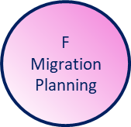
Phase F – 01/03 - Summary
Phase | Output & Outcome | Essential Knowledge
Phase F: Implementation and Migration Plan. | An approved set of projects, containing the objective and any necessary constraints, resources required, and start and finish dates. | Resources available to undertake the change. How stakeholder priorities and preferences adjust in response to value, effort, and risk of change (Stakeholder Requirements).
A Practitioners’ Approach to Developing Enterprise Architecture Following the ADM : Page 43 : §5.2.2 Table4
Initially MOD 04
Notes:
Level=1 : L.O.= 3.17a : Briefly explain the purpose of Phase F.
See: TOGAF® Series Guide: A Practitioners’ Approach to Developing Enterprise Architecture Following the TOGAF® ADM : Page 43 : §5.2.2
Table4
5.2.2 Essential ADM Output and Knowledge
A summary of the essential outcome and output is provided in Table 4. Keep in mind that the essential output is what the stakeholders, sponsor, and boss’ boss’ boss want. No-one wants an architecture; they want guidance on planning and executing an effective change. Practitioners use an architected approach to providing the best available guidance on effective change. The essential outcomes and outputs are derived from the objectives of the phase – the statement of why a Practitioner should perform this activity.
What the enterprise values and consumes is typically different from what the Practitioner produces. Practitioners deliver an essential output. It is provided as views, roadmaps, architecture specifications, controls, and other useful things. Architecture is developed, and the EA Landscape populated. To do this, Practitioners require a set of essential knowledge. The enterprise consumes effective guidance about and the ability to govern change.
Read Table 4 in conjunction with Table 3 to confirm whether for a particular purpose the output of the phase is already in existence, needs to be created, or is extraneous to the current Architecture Project. Good Practitioners will adjust their work accordingly. Table 4 lists only key outputs and outcomes. For an exhaustive list, refer to the TOGAF Standard. In order to achieve these outcomes, the Practitioner may have to perform more activities or create more deliverables than those listed in the table below. The intent is to keep the focus on what is pursued, not what is done.

Slide 113
Phase F – 02/03 - Objectives
Phase F: Implementation and Migration Plan
Finalize the Architecture Roadmap and the supporting Implementation and Migration Plan
Ensure that the Implementation and Migration Plan is co-ordinated with the enterprise’s approach to managing and implementing change
Ensure that the business value and cost of work packages and Transition Architectures is understood by key stakeholders
Architecture Development Method : Page 104 : §10.1
Initially MOD 04
Notes:
Level=1 : L.O.= 3.18a : Describe the objectives of Phase F.
See: TOGAF® Standard – Architecture Development Method : Page 104 : §10.1
Phase F: Implementation and Migration Plan
Finalize the Architecture Roadmap and the supporting Implementation and Migration Plan
Ensure that the Implementation and Migration Plan is co-ordinated with the enterprise’s approach to managing and implementing change in the enterprise’s overall change portfolio
Ensure that the business value and cost of work packages and Transition Architectures is understood by key stakeholders
10.1 Objectives
The objectives of Phase F are to:
■ Finalize the Architecture Roadmap and the supporting Implementation and Migration Plan
■ Ensure that the Implementation and Migration Plan is co-ordinated with the enterprise’s
approach to managing and implementing change in the enterprise’s overall change
portfolio
■ Ensure that the business value and cost of work packages and Transition Architectures is understood by key stakeholders

Slide 114
Phase F – 03/03 - Outputs
Architecture Definition Document
Architecture Requirements Specification
Architecture Roadmap
Change Request
Implementation and Migration Plan
Request for Architecture Work
Statement of Architecture Work
Architecture Development Method : Page 104 : §10.1
Initially MOD 04
Heading changed to what the slide is about Outputs not Objectives – removed the objectives which were already on the previous slide.
Notes:
Þ Q-27 M-44
Level=1 : L.O.= 3.18a : Describe the objectives of Phase F.
See: TOGAF® Standard – Architecture Development Method : Page 104 : §10.1
Phase F: Implementation and Migration Plan
Instantiated as:
Architecture Definition Document - confirmed and validated
Architecture Requirements Specification
Architecture Roadmap
Change Request
Implementation and Migration Plan
Request for Architecture Work
Statement of Architecture Work - per the Project Management method
10.1 Objectives
The objectives of Phase F are to:
■ Finalize the Architecture Roadmap and the supporting Implementation and Migration Plan
■ Ensure that the Implementation and Migration Plan is co-ordinated with the enterprise’s
approach to managing and implementing change in the enterprise’s overall change portfolio
■ Ensure that the business value and cost of work packages and Transition Architectures is
understood by key stakeholders

Slide 115
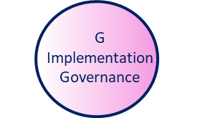
Phase G – 01/03 - Summary
Phase | Output & Outcome | Essential Knowledge
Phase G: Implementation Governance | Completion of the projects to implement the changes necessary in order to reach the adjusted target state. | Purpose and constraints on the implementation team (Gap, Architecture Requirement Specification, Control). How stakeholder priority and preference adjust in response to success, value, effort, and risk of change (Stakeholder Requirements).
A Practitioners’ Approach to Developing Enterprise Architecture Following the ADM : Page 43 : §5.2.2 Table4
Initially MOD 04
Notes:
Level=1 : L.O.= 3.19a : Briefly explain the purpose of Phase G.
See : TOGAF® Series Guide: A Practitioners’ Approach to Developing Enterprise Architecture Following the TOGAF® ADM : Page 43 : §5.2.2
Table4
5.2.2 Essential ADM Output and Knowledge
A summary of the essential outcome and output is provided in Table 4. Keep in mind that the essential output is what the stakeholders, sponsor, and boss’ boss’ boss want. No-one wants an architecture; they want guidance on planning and executing an effective change. Practitioners use an architected approach to providing the best available guidance on effective change. The essential outcomes and outputs are derived from the objectives of the phase – the statement of why a Practitioner should perform this activity.
What the enterprise values and consumes is typically different from what the Practitioner produces. Practitioners deliver an essential output. It is provided as views, roadmaps, architecture specifications, controls, and other useful things. Architecture is developed, and the EA Landscape populated. To do this, Practitioners require a set of essential knowledge. The enterprise consumes effective guidance about and the ability to govern change.
Read Table 4 in conjunction with Table 3 to confirm whether for a particular purpose the output of the phase is already in existence, needs to be created, or is extraneous to the current Architecture Project. Good Practitioners will adjust their work accordingly. Table 4 lists only key outputs and outcomes. For an exhaustive list, refer to the TOGAF Standard. In order to achieve these outcomes, the Practitioner may have to perform more activities or create more deliverables than those listed in the table below. The intent is to keep the focus on what is pursued, not what is done.

Slide 116
Phase G – 02/03 - Objectives
Phase G: Implementation Governance
Ensure conformance with the Target Architecture by implementation projects
Perform appropriate Architecture Governance functions for the solution and any implementation-driven architecture Change Requests
Architecture Development Method : Page 112 : §11.1
Initially MOD 04
Notes:
Level=1 : L.O.= 3.20a : Describe the objectives of Phase G.
See : TOGAF® Standard – Architecture Development Method : Page 112 : §11.1
Phase G: Implementation Governance
Ensure conformance with the Target Architecture by implementation projects
Perform appropriate Architecture Governance functions for the solution and any implementation-driven architecture Change Requests
11.1 Objectives
The objectives of Phase G are to:
■ Ensure conformance with the Target Architecture by implementation projects
■ Perform appropriate Architecture Governance functions for the solution and any
implementation-driven architecture Change Requests

Slide 117
Phase G – 03/03 - Outputs
Compliance Assessment
Solution Building* Blocks
Statement of Architecture Work - per the Project Management method
Handled in line with the parameters agreed in the Architecture Contract with the Project Management Office
* Handled in a later module
Architecture Development Method : Page 112 : §11.1
Initially MOD 04
Heading changed to what the slide is about Outputs not Objectives – removed the objectives which were already on the previous slide.
Notes:
Þ Q-30 M-47
Level=1 : L.O.= 3.20a : Describe the objectives of Phase G.
See: TOGAF® Standard – Architecture Development Method : Page 112 : §11.1
Phase G: Implementation Governance
Instantiated as:
Compliance Assessment
Solution Building Blocks *
Statement of Architecture Work - per the Project Management method
Handled in line with the parameters agreed in the Architecture Contract with the Project Management Office
11.1 Objectives
The objectives of Phase G are to:
■ Ensure conformance with the Target Architecture by implementation projects
■ Perform appropriate Architecture Governance functions for the solution and any implementation-driven architecture Change Requests

Slide 118
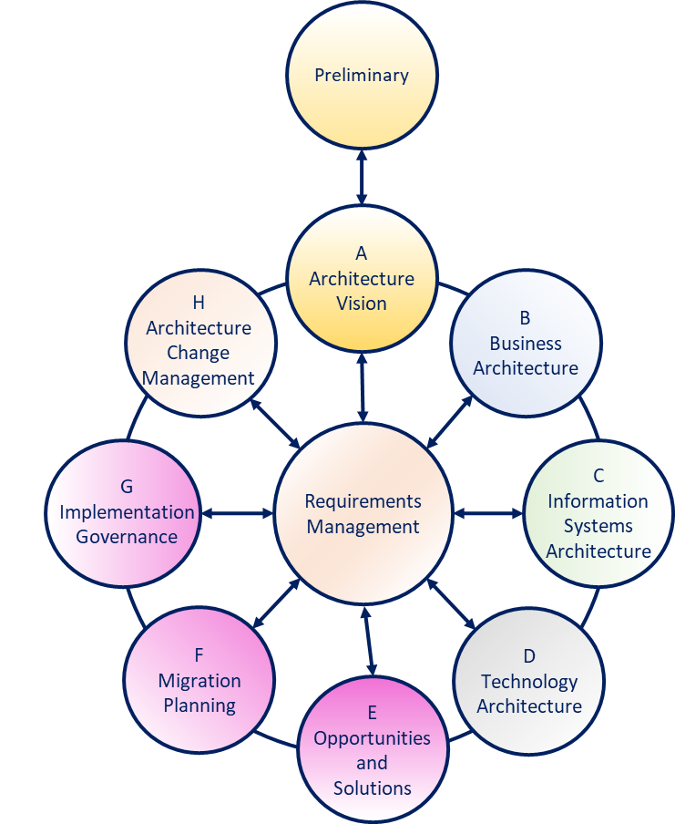
The Maintenance Phases
Although Phase H is much visited during the Realization Phases, it is an essential component of the Lifetime Experience of processes.
All alterations to processes should be marshalled and governed via Architecture Change Management.
The parameters of step-change are gathered in the Requirements Management processes – which are fed from anywhere within and outside of the organization, and at any time.
Initially MOD 04
Notes:
No notes

Slide 119
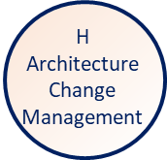
Phase H – 01/03 - Summary
Phase | Output & Outcome | Essential Knowledge
Phase H: Architecture Change Management | Direction to proceed and start developing a Target Architecture that addresses perceived, real, or anticipated shortfalls in the enterprise relative to stakeholder preferences. | Gaps between approved target, or preferences, and realization from prior work (Value Realization). Changes in preferences or priorities (Stakeholder Requirements).
A Practitioners’ Approach to Developing Enterprise Architecture Following the ADM : Page 43 : §5.2.2 Table4
Initially MOD 04
Notes:
Level=1 : L.O.= 3.21a : Briefly explain the purpose of Phase H.
See: TOGAF® Series Guide: A Practitioners’ Approach to Developing Enterprise Architecture Following the TOGAF® ADM : Page 43 : §5.2.2
Table4
5.2.2 Essential ADM Output and Knowledge
A summary of the essential outcome and output is provided in Table 4. Keep in mind that the essential output is what the stakeholders, sponsor, and boss’ boss’ boss want. No-one wants an architecture; they want guidance on planning and executing an effective change. Practitioners use an architected approach to providing the best available guidance on effective change. The essential outcomes and outputs are derived from the objectives of the phase – the statement of why a Practitioner should perform this activity.
What the enterprise values and consumes is typically different from what the Practitioner produces. Practitioners deliver an essential output. It is provided as views, roadmaps, architecture specifications, controls, and other useful things. Architecture is developed, and the EA Landscape populated. To do this, Practitioners require a set of essential knowledge. The enterprise consumes effective guidance about and the ability to govern change.
Read Table 4 in conjunction with Table 3 to confirm whether for a particular purpose the output of the phase is already in existence, needs to be created, or is extraneous to the current Architecture Project. Good Practitioners will adjust their work accordingly. Table 4 lists only key outputs and outcomes. For an exhaustive list, refer to the TOGAF Standard. In order to achieve these outcomes, the Practitioner may have to perform more activities or create more deliverables than those listed in the table below. The intent is to keep the focus on what is pursued, not what is done.

Slide 120
Phase H – 02/03 - Objectives
Phase H: Architecture Change Management
Ensure
Ensure that the architecture development cycle is maintained.
Ensure
Ensure that the Architecture Governance Framework is executed.
Ensure
Ensure that the Enterprise Architecture Capability meets current requirements.
Architecture Development Method : Page 120 : §12.1
Initially MOD 04
Notes:
Level=1 : L.O.= 3.22a : Describe the objectives of Phase H.
See : TOGAF® Standard – Architecture Development Method : Page 120 : §12.1
Phase H: Architecture Change Management
Ensure that the architecture development cycle is maintained
Ensure that the Architecture Governance Framework is executed
Ensure that the Enterprise Architecture Capability meets current requirements
12.1 Objectives
The objectives of Phase H are to:
■ Ensure that the architecture development cycle is maintained
■ Ensure that the Architecture Governance Framework is executed
■ Ensure that the Enterprise Architecture Capability meets current requirements

Slide 121
Phase H – 03/03 - Outputs
Change Request
Request for Architecture Work
Statement of Architecture Work
Architecture Development Method : Page 120 : §12.1
Initially MOD 04
Notes:
Þ Q-33
Level=1 : L.O.= 3.22a : Describe the objectives of Phase H.
See: TOGAF® Standard – Architecture Development Method : Page 120 : §12.1
Phase H: Architecture Change Management
Instantiated as:
Change Request
Request for Architecture Work
Statement of Architecture Work
12.1 Objectives
The objectives of Phase H are to:
■ Ensure that the architecture development cycle is maintained
■ Ensure that the Architecture Governance Framework is executed
■ Ensure that the Enterprise Architecture Capability meets current requirements

Slide 122
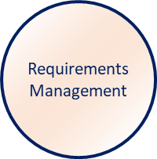
Requirements Management – 01/04 - Summary
Phase | Output & Outcome | Essential Knowledge
Requirements Management | Direction to proceed and start developing a Target Architecture that addresses Requirements in order of stakeholder priorities. | Distinction between Architecture Requirements and Implementation Requirements Changes in preference or priority (Stakeholder Requirements).
A Practitioners’ Approach to Developing Enterprise Architecture Following the ADM : Page 43 : §5.2.2 Table4
Initially MOD 04
Notes:
Þ M-48
No notes

Slide 123
Requirements Management – 02/04 - Objectives
Requirements Management
Ensure
Ensure that the Requirements Management process is sustained and operates for all relevant ADM phases
Manage
Manage architecture requirements identified during any execution of the ADM cycle or a phase
Ensure
Ensure that relevant architecture requirements are available for use by each phase as that phase is executed
Architecture Development Method : Page 130 : §13.1
Initially MOD 04
Notes:
Level=1 : L.O.= 3.23a : Describe the objectives of the Requirements Management process.
See: TOGAF® Standard – Architecture Development Method : Page 130 : §13.1
Requirements Management
Ensure that the Requirements Management process is sustained and operates for all relevant ADM phases
Manage architecture requirements identified during any execution of the ADM cycle or a phase
Ensure that relevant architecture requirements are available for use by each phase as that phase is executed
13.1 Objectives
The objectives of the Requirements Management phase are to:
■ Ensure that the Requirements Management process is sustained and operates for all
relevant ADM phases
■ Manage architecture requirements identified during any execution of the ADM cycle or a
phase
■ Ensure that relevant architecture requirements are available for use by each phase as that
phase is executed

Slide 124
Requirements Management – 03/04 - Outputs
Architecture Requirements Specification
Requirements Impact Assessment
Architecture Development Method : Page 130 : §13.1
Initially MOD 04
Heading changed to what the slide is about Outputs not Objectives – removed the objectives which were already on the previous slide.
Notes:
Þ Q-36
Level=1 : L.O.= 3.23a : Describe the objectives of the Requirements Management process.
See: TOGAF® Standard – Architecture Development Method : Page 130 : §13.1
Requirements Management
Instantiated as:
Architecture Requirements Specification
Requirements Impact Assessment
13.1 Objectives
The objectives of the Requirements Management phase are to:
■ Ensure that the Requirements Management process is sustained and operates for all
relevant ADM phases
■ Manage architecture requirements identified during any execution of the ADM cycle or a
phase
■ Ensure that relevant architecture requirements are available for use by each phase as that
phase is executed

Slide 125
Requirements Management – 04/04
Stakeholder Engagement and Requirements Management
Stakeholders own approval rights for the architecture
Effective Requirements Management is dependent upon clear traceability from the organization’s vision
Distinguish between direct effective support and loose association
Success requires abandoning the absolute and entering the realm of satisficing
Effective engagement is based on the concept of view and viewpoint
Concerns are addressed and represented to the stakeholder
A Practitioners’ Approach to Developing Enterprise Architecture Following the ADM : Page 54 : §6.1.1
Initially MOD 04
Notes:
Level=1 : L.O.= 3.24a : Describe the purpose of Requirements Management.
See: TOGAF® Series Guide: A Practitioners’ Approach to Developing Enterprise Architecture Following the TOGAF® ADM : Page 54 : §6.1.1
Stakeholder Engagement and Requirements Management
Stakeholders own the architecture and the value that the architecture is expected to enable.
Effective Requirements Management is dependent upon clear traceability from the organization’s vision, mission, business model, and strategies through the most detailed statement of requirement.
In order to perform this, distinguish between direct effective support and loose association.
Things that do not best enable the complete set of stakeholder preferences are distractions.
EAs maintain the complete set of
every stakeholder’s preference
implications of those preferences
Success requires abandoning the absolute and entering the realm of satisficing.
Effective engagement is based upon effective communication.
Effective communication is based on the concept of view and viewpoint.
Different stakeholders have different concerns about the architecture.
These concerns are addressed and represented to the stakeholder - to enable the stakeholder to approve the Target Architecture.
6.1.1 Stakeholder Engagement and Requirements Management
The TOGAF framework places requirements management and stakeholder engagement at the center of architecture development. Practitioners develop EA in accordance with the preferences and priorities of their organization’s stakeholders. Architecture is never sold to a stakeholder. stakeholder preferences are never manipulated.
Stakeholders own the architecture and the value preferences and priorities the architecture is expected to enable. Practitioners must completely submerge their preferences, biases, and priorities. Practitioners must act for their stakeholders.
This is one of the most difficult activities a Practitioner must perform. Good Practitioners are passionately engaged in the future of their organization, as well as participating in defining and realizing the target state. Practitioners typically perform several roles: they will act as ... CONTINUES ... SEE REFERENCE SPECIFIED

Slide 126
Summary of Module 03/01
The 1st 16 Learning Points covered in Module 03 are:
3.4a/b/c/d: Explain the need to govern the creation, development and maintenance of Enterprise Architecture.
3.5a : Briefly explain how to scope an architecture.
3.6a : Briefly explain the reasons for considering architecture alternatives including understanding concerns and trade-offs.
3.7a : Briefly explain the purpose of the Preliminary Phase in developing an Enterprise Architecture Capability.
3.8a : Describe the objectives of the Preliminary Phase.
3.9a/b : Briefly explain the purpose of Phase A.
3.10a : Describe the objectives of Phase A.
3.11a : Briefly explain the purpose of Phases B, C, and D.
3.12a : Describe the objectives of Phase B.
3.13a/b: Describe the objectives of Phase C for Data Architecture and Application Architecture.
3.14a : Describe the objectives of Phase D.
Initially MOD 03
Notes:
3.4a/b/c/d: Explain the need to govern the creation development and maintenance of Enterprise Architecture.
3.5a : Briefly explain how to scope an architecture.
3.6a : Briefly explain the reasons for considering architecture alternatives including understanding concerns and trade-offs.
3.7a : Briefly explain the purpose of the Preliminary Phase in developing an Enterprise Architecture Capability.
3.8a : Describe the objectives of the Preliminary Phase.
3.9a/b : Briefly explain the purpose of Phase A.
3.10a : Describe the objectives of Phase A.
3.11a : Briefly explain the purpose of Phases B C and D.
3.12a : Describe the objectives of Phase B.
3.13a/b: Describe the objectives of Phase C for Data Architecture and Application Architecture.
3.14a : Describe the objectives of Phase D.

Slide 127
Summary of Module 03/02
The Next 10 Learning Points covered in Module 03 are:
3.15a : Briefly explain the purpose of Phase E.
3.16a : Describe the objectives of Phase E.
3.17a : Briefly explain the purpose of Phase F.
3.18a : Describe the objectives of Phase F.
3.19a : Briefly explain the purpose of Phase G.
3.20a : Describe the objectives of Phase G.
3.21a : Briefly explain the purpose of Phase H.
3.22a : Describe the objectives of Phase H.
3.23a : Describe the objectives of the Requirements Management process.
3.24a : Describe the purpose of Requirements Management.
Initially MOD 04

Slide 128
End of Teaching Slides
End of
Module 03
An Introduction to the ADM
Initially MOD 03

Slide 129
Module 04/16
TOGAF® EA Training - Foundation
TOGAF® Standard, 10th Edition
Module 04
Introduction to the ADM - Techniques
TOGAF® is a registered trademark of The Open Group Copyright © The Open Group 2022
​
Initially MOD 04

Slide 130
Course Module Index
# | Topic – Level 1 | ✓
1 | Module 00 - Course Introduction | ✓
2 | Module 01 - Overview | ✓
3 | Module 02 - Concepts | ✓
4 | Module 03 - Introduction to the ADM | ✓
5 | Module 04 - Introduction to the ADM - Techniques
6 | Module 05 – Applying ADM
7 | Module 06 - Architecture Governance
8 | Module 07 – Architecture Content
# | Topic – Level 2
9 | Module 00 - Course Introduction
10 | Module 08 - The Context for Enterprise Architecture
11 | Module 09 – Stakeholder Management
12 | Module 10 – Phase A
13 | Module 11 – Architecture Development
14 | Module 12 – Implementing the Architecture
15 | Module 13 – Architecture Change Management
16 | Module 14 – Requirements Management
17 | Module 15 – Supporting the ADM Work
18 | Module 16 – Closure
Course Module Index
Initially MOD 04

Slide 131

Supporting Guidelines and Techniques
The application of the TOGAF ADM is supported by an extended set of resources - guidelines, templates, check-lists, and other detailed materials.
These are included in:
www.opengroup.org/togaf-library
The TOGAF Standard -ADM Techniques
TOGAF Series Guides - the guidance part of the Standard (guidance material on how to use and adapt the TOGAF Standard for specific needs)
White Papers and Guides published by The Open Group, classified and referenced in the TOGAF Library
The individual guidelines and techniques are described separately so that they can be referenced from the relevant points in the ADM as necessary, rather than having the detailed text clutter the description of the ADM itself.
Architecture Development Method : Page 2 : §1.1.3
Initially MOD 04
Notes:
Þ M-53
Level=1 : L.O.= 4.1a : Briefly describe how the ADM and Supporting Guidelines and Techniques relate to each other.
See: TOGAF® Standard – Architecture Development Method : Page 2 : §1.1.3
The application of the TOGAF ADM is supported by an extended set of resources - guidelines, templates, check-lists, and other detailed materials.
These are included in:
The TOGAF Standard -ADM Techniques
TOGAF Series Guides - the guidance part of the Standard (guidance material on how to use and adapt the TOGAF Standard for specific needs)
White Papers and Guides published by The Open Group, classified and referenced in the TOGAF Library
The individual guidelines and techniques are described separately so that they can be referenced from the relevant points in the ADM as necessary, rather than having the detailed text clutter the description of the ADM itself.
1.1.3 ADM and Supporting Guidelines and Techniques
The application of the TOGAF ADM is supported by an extended set of resources — guidelines, templates, checklists, and other detailed materials. These are included in:
■ The TOGAF Standard — ADM Techniques
■ TOGAF Series Guides — the guidance part of the Standard (guidance material on how to use and adapt the TOGAF Standard for specific needs)
■ White Papers and Guides published by The Open Group, classified and referenced in the TOGAF Library (see: www.opengroup.org/togaf-library)
The individual guidelines and techniques are described separately so that they can be referenced from the relevant points in the ADM

Slide 132
Information Flow
The TOGAF ADM is often misinterpreted as a waterfall process model
The TOGAF ADM places key activity steps together
The TOGAF ADM should not be understood as a processes model
The ADM graphic is not a representation of activity sequence
Mandatory inputs are consumed to produce mandatory outputs
Recognize the inter-dependent nature of developing a Target
With change, consider the impact on all other domains
A Practitioners’ Approach to Developing Enterprise Architecture Following the ADM : Page 40 : §5.2
Initially MOD 04
Notes:
Level=1 : L.O.= 3.25a : Explain the information flow between the ADM phases
See: TOGAF® Series Guide: A Practitioners’ Approach to Developing Enterprise Architecture Following the TOGAF® ADM : Page 40 : §5.2
An often-misunderstood element of the TOGAF framework is the ADM and the concept of iteration.
The TOGAF ADM graphic provides a stylized representation that is often misinterpreted as a linear waterfall process model. This approach leads to some of the most confusing diagrams and explanations.
The TOGAF ADM is a logical method that places key activity steps together for the purpose of understanding relationship of activity and clarifying information flow.
The TOGAF ADM should not be understood as a processes model.
The ADM graphic is a stylized representation showing essential information flows and is not a representation of activity sequence.
Every time the EA team undertakes any activity, within the scope of the ADM, it is executing a Phase and developing the contents of the EA Landscape.
If working on roadmap development, the EA is exercising the steps in the TOGAF ADM Phase E.
The mandatory inputs are consumed to produce the mandatory outputs.
This applies to all ADM phases.
Recognize that the inter-dependent nature of developing a Target Architecture requires:
considering the entire architecture
considering the resulting gaps
consequent work to clear the gap
A change cannot be considered without considering the impact on all other domains, the resulting set of gaps, and the resulting set of work to clear these gaps.
To address the complexity, the TOGAF framework provides an ADM phase for each essential output.
Best practice ensures the use of effective information inputs to produce useful outputs.
5.2 How is ADM Iteration Realized in Practice?
An often-misunderstood element of the TOGAF framework is the ADM and the concept of ... CONTINUES ... SEE REFERENCE SPECIFIED

Slide 133
Architecture in an Agile Enterprise
“The Agile movement is not anti-methodology, in fact many of us want to restore credibility to the word ‘methodology’. We want to restore a balance. We embrace modelling … We embrace documentation … We plan but recognize the limits of planning in a turbulent environment.
- Jim Highsmith, History: “The Agile Manifesto”
The TOGAF Standard aligns to Agile (significant discovery) Development in Phase G.
All techniques generate a specification that is implemented and governed via Phase G.
A good Architecture will identify what products the Enterprise needs
Architecture to Support Project and Solution Delivery will have a set of constraints that limit the choices of the Agile team
In Phase G the EA serves the stakeholders - guarding enterprise value (conforms to the specification)..
A Practitioners’ Approach to Developing Enterprise Architecture Following the ADM : Page 98 : §12.1
Initially MOD 04
Notes:
Þ M-52
Level=1 : L.O.= 3.26a : Explain how developing architecture for different purposes or levels of detail can be applied to support Agile software development.
See: TOGAF® Series Guide: A Practitioners’ Approach to Developing Enterprise Architecture Following the TOGAF® ADM : Page 98 : §12.1
“The Agile movement is not anti-methodology, in fact many of us want to restore credibility to the word methodology. We want to restore a balance. We embrace modeling … We embrace documentation … We plan, but recognize the limits of planning in a turbulent environment. - Jim Highsmith, History: “The Agile Manifesto”
The TOGAF Standard aligns to Agile development in Phase G … Full stop!
A good Architecture, to Support Portfolio or Project, will identify what products the enterprise needs, the boundary of the products, and what constraints a product owner has.
Architecture to Support Project and Solution Delivery will have a set of constraints that limit the choices of the Agile team e.g. where an individual product must bend to enterprise issues and the narrow preference of a product owner is not valid.
In Phase G, Implementation Governance: the EA serves the stakeholders guarding the mission, vision, goals, and investment roadmap - guarding enterprise value.
12.1 Architecture in an Agile Enterprise
There has been a great deal of conversation about aligning to Agile implementation methods. Ink has been spilled trying to align the phases of the ADM to these development methods. All of this conversation has blurred the line between implementation and architecture. The TOGAF Standard aligns to Agile development in Phase G. Full stop.
A good Architecture to Support Portfolio, or Project, will identify what products the enterprise needs, the boundary of the products, and what constraints a product owner has. In short, a good architecture defines the enterprise’s backlog.
Architecture to support Project and Solution Delivery will have a set of constraints that limit the choices of the Agile team. These constraints are where an individual product must bend to enterprise issues and the parochial preference of a product owner is not valid.
Then Phase G, Implementation Governance: the Practitioner serves the stakeholders guarding the mission, vision, goals, and investment roadmap. In short, guarding enterprise value.

Slide 134
EA Principles – 01/06
Principles are high-level definitions of fundamental values
They are the basis for architecture development, policies, and standards.
The principles of EA define general rules and guidelines
They reflect a level of consensus across the organization
The TOGAF Leader’s Guide to Establishing and Evolving an EA Capability : Page 27 : §4.3.3
Initially MOD 05
Notes:
Level=1 : L.O.= 4.2a : Explain the purpose of Architecture Principles.
See: TOGAF® Series Guide: The TOGAF Leader’s Guide to Establishing and Evolving an EA Capability : Page 27 : §4.3.3
Principles are high-level definitions of fundamental values that guide business and technology decisions.
They are the basis for architecture development, policies, and standards.
The principles of EA define general rules and guidelines to use and implement with all Information and Technology resources and assets throughout the organization.
They reflect a level of consensus across the organization, constituting the basis for current and future decisions regarding the business and technology direction and also constitute a set of guidelines to be applied to increase the consistency and quality of technology decision making.
Principles support Consistency
Architecture principles define the fundamental assumptions and rules of conduct for the IT organization to create and maintain IT capability. Without architecture principles, the IT organization has no compass to guide its journey from the current state to the desired future state, nor standards to measure its progress. There is no framework for decision making as each initiative is left to weigh decisions which the enterprise will live with for years to come based upon its own parochial measures of success. Without a common set of underlying principles held by business and IT leaders, each initiative will be left on its own to determine what projects will be funded, which assets will be leveraged, what vendors will be used and how applications will be constructed, maintained and retired.
4.3.3 EA Principles
Often EA Capability is not a greenfield effort. Most enterprises have undertaken the initiative to establish an EA Capability more than once. In the event the enterprise has a greenfield EA Capability, the Leader should revisit this chapter after having read Chapter 5 (Business Objectives for the EA Capability). Whether EA Capability is being set up afresh or reinstated or evolved, one of the enduring guidelines is a set of EA principles.
Existing EA principles provide a special context for prior activity performed by an EA Capability. It is important to review the existing principles for two reasons. First, they provide a context of previous efforts to establish a successful EA Capability – they inform how the EA Capability was viewed, viewed itself, and what purpose it was explicitly, or implicitly, EA ... CONTINUES ... SEE REFERENCE SPECIFIED
Review questions to ask include:
overseas, primary, and supporting activities?
or was, aligned?
... CONTINUES ... SEE REFERENCE SPECIFIED
inform architecture development align to the organizational context.

Slide 135
EA Principles – 02/06
Component | Intent | Example
Name | the essence of the rule easy to remember unambiguous | “Reuse before buy before build”
Statement | summarized unambiguous expressed as an outcome | We look to find already available potential building blocks before incurring higher cost and risk.
Rationale | the business benefits of adhering to the principle relationship to other principles relative weight | We enable lower risk, faster delivery and lower cost in our solutions.
Implications | highlight the requirements for carrying out the principle the impact to the business and consequences of adopting | We must evaluate building blocks for potential reuse and gain approvals when we cannot reuse.
ADM Techniques : Page 4 : §2.3
Initially MOD 05
Notes:
Level=1 : L.O.= 4.3a : Explain the recommended template for Architecture Principles.
See: TOGAF® Standard – ADM Techniques : Page 4 : §2.3
2.3 Components of Architecture Principles
It is useful to have a standard way of defining principles. In addition to a definition statement,
each principle should have associated rationale and implications statements, both to promote
understanding and acceptance of the principles themselves, and to support the use of the
principles in explaining and justifying why specific decisions are made.
A recommended template is given in Table 2-1.
Name Should both represent specific technology platforms and should not be mentioned in the
name or statement of a principle. Avoid ambiguous words in the Name and in
the Statement such as: "support", "open", "consider", and for lack of good
measure the word "avoid", itself, be careful with "manage(ment)", and look for
unnecessary adjectives and adverbs (fluff).
Statement Should summerized and unambiguously communicate the fundamental rule.
For the most part, the principles statements for managing information are
similar from one organization to the next. It is vital that the principles
statement is unambiguous.
Rationale Should highlight the business benefits of adhering to the principle, using
business terminology. Point to the similarity of information and technology
principles to the principles governing business operations. Also describe the
relationship to other principles, and the intentions regarding a balanced
interpretation. Describe situations where one principle would be given
precedence or carry more weight than another for making a decision.
Implications Should highlight the requirements, both for the business and IT, for carrying
out the principle — in terms of resources, costs, and activities/tasks.
Although it may often be apparent that current systems, standards, or
practices would be incongruent with the principle upon adoption, context will
drive the degree of scope. The impact to the business and consequences of
adopting a principle should be clearly stated. The reader should readily
discern the answer to: "How does this affect me?". It is important not to
oversimplify, trivialize, or judge the merit of the impact. Some of the
... CONTINUES ... SEE REFERENCE SPECIFIED

Slide 136
EA Principles – 03/06
Merely having a written statement that is called a principle does not mean that the principle is good - even if everyone agrees with it.
There are five criteria that distinguish a good set of principles:
Understandable
Robust
Complete
Consistent
Stable
ADM Techniques : Page 6 : §2.4.1
Initially MOD 05
Notes:
Level=1 : L.O.= 4.4a : Explain what makes a good Architecture Principle.
See: TOGAF® Standard – ADM Techniques : Page 6 : §2.4.1
Merely having a written statement that is called a principle does not mean that the principle is good - even if everyone agrees with it.
There are five criteria that distinguish a good set of principles:
Understandable: the underlying tenets can be quickly grasped and understood by individuals throughout the organization. The intention of the principle is clear and unambiguous, so that violations, whether intentional or not, are minimized.
Robust: enable good quality decisions about architectures and plans to be made, and enforceable policies and standards to be created. Each principle should be sufficiently definitive and precise to support consistent decision making in complex, potentially controversial situations.
Complete: every potentially important principle governing the management of information and technology for the organization is defined — the principles cover every situation perceived.
Consistent: strict adherence to one principle may require a loose interpretation of another principle. The set of principles must be expressed in a way that allows a balance of interpretations. Principles should not be contradictory to the point where adhering to one principle would violate the spirit of another. Every word in a principle statement should be carefully chosen to allow consistent yet flexible interpretation.
Stable: principles should be enduring, yet able to accommodate changes. An amendment process should be established for adding, removing, or altering principles after they are ratified initially.
2.4.1 Qualities of Principles
Merely having a written statement that is called a principle does not mean that the principle is
good, even if everyone agrees with it.
A good set of principles will be founded in the beliefs and values of the organization and expressed in language that the business understands and uses. Principles should be few in number, future-oriented, and endorsed and championed by senior management. They provide a firm foundation for making architecture and planning decisions, framing policies,
... CONTINUES ... SEE REFERENCE SPECIFIED

Slide 137
EA Principles – 04/05
Often EA Capability is not a greenfield effort
It is important to review the existing principles for two reasons.
They provide a context of previous efforts to establish a successful EA Capability
To ensure that they align to the actual enterprise context
A greenfield project is one that lacks constraints imposed
by prior work on the site.
The TOGAF Leader’s Guide to Establishing and Evolving an EA Capability : Page 27 : §4.3.3
Initially MOD 05
Notes:
Level=1 : L.O.= 4.2a : Explain the purpose of Architecture Principles.
See: TOGAF® Series Guide: The TOGAF Leader’s Guide to Establishing and Evolving an EA Capability : Page 27 : §4.3.3
Often EA Capability is not a greenfield effort.
Many enterprises have undertaken the initiative to establish an EA Capability more than once. Whether EA Capability is being set up afresh or reinstated or evolved, one of the enduring guidelines is the set of EA principles.
It is important to review the existing principles for two reasons.
They provide a context of previous efforts to establish a successful EA Capability – they inform how the EA Capability was viewed, viewed itself, and what purpose it was explicitly, or implicitly, supporting.
To ensure that they align to the actual enterprise context for the current EA initiative.
This review provides insights on how the EA Capability has been framed regarding purpose, role, and engagement.
Review questions to ask include:
Do the existing architecture principles represent the enterprise context?
Do they represent all organizational elements of the enterprise such as domestic and overseas, primary, and supporting activities?
Do they represent the preferences of the organization to which the EA Capability team is, or was, aligned?
Care must be taken to ensure that the principles used to inform the development of EA, and change projects, align to the organizational context and that the principles used to inform architecture development align to the organizational context.
4.3.3 EA Principles
Often EA Capability is not a greenfield effort. Most enterprises have undertaken the initiative to establish an EA Capability more than once. In the event the enterprise has a greenfield EA Capability, the Leader should revisit this chapter after having read Chapter 5 (Business Objectives for the EA Capability). Whether EA Capability is being set up afresh or reinstated or evolved, one of the enduring guidelines is a set of EA principles.
Existing EA principles provide a special context for prior activity performed by an EA Capability. It is important to review the existing principles for two reasons. First, they provide a context of previous efforts to establish a successful EA Capability – they inform how the EA ... CONTINUES ... SEE REFERENCE SPECIFIED

Slide 138

EA Principles – 05/06
Architecture Principles are typically developed by:
Enterprise Architects
Key stakeholders
Architecture Principles will be:
Informed by enterprise principles
Clearly articulated
Development of Principles is influenced by:
Enterprise mission and plans
External constraints
Current systems and technology
Emerging industry trends
ADM Techniques : Page 5 : §2.4
Initially MOD 05
Notes:
Level=1 : L.O.= 4.4a : Explain what makes a good Architecture Principle.
See: TOGAF® Standard – ADM Techniques : Page 5 : §2.4
Architecture Principles are typically developed by
Enterprise Architects
Key stakeholders
and are approved by the Architecture Board.
Architecture Principles will be:
informed by principles at the enterprise level
clearly traceable
clearly articulated to guide decision making
chosen so as to ensure alignment of the architecture, and implementation of the Target Architecture, with business strategies and visions
Development is influenced by:
Enterprise mission and plans
Enterprise strategic initiatives
External constraints
Current systems and technology
Emerging industry trends
How many Principles?
Typically circa 4 each for
Overarching – e.g. The Law principle
Business
Application
Data
Technology
2.4 Developing Architecture Principles
Architecture Principles are typically developed by the Enterprise Architects, in conjunction with
the key stakeholders, and are approved by the Architecture Board.
Architecture Principles will be informed by principles at the enterprise level, if they exist.
Architecture Principles must be clearly traceable and clearly articulated to guide decision making.
... CONTINUES ... SEE REFERENCE SPECIFIED

Slide 139
EA Principles – 06/06
This is especially true:
In a multi-lingual/multi-cultural environment
Within the same language
When covering a wide range of educational backgrounds
Creating a set of unambiguous principles is not easy
And often not possible.
Initially MOD 05
Notes:
Þ Q-37 M-46
Level=1 : L.O.= 4.4a : Explain what makes a good Architecture Principle.
See: TOGAF® Standard – ADM Techniques : Page 5 : §2.4
Creating a set of unambiguous principles is not easy
This is specially true:
in a multi-lingual/multi-cultural environment
within the same language
– e.g. Spanish-Spanish vs. Hispanic-Spanish : Portuguese vs. Brazilian
when covering a wide range of educational backgrounds
Sample set of EA Principles can be found:
TOGAF® Standard — ADM Techniques §2.7 p7
Principles should ALWAYS be stated as Outcomes
e.g.
“We obey all written statute and regulation in each territory within which we operate”
And NOT
“We should always obey the Laws”
Modal verbs are ‘bad news’ and mitigate against Yes/NO decision making.
English modal verbs include must, shall, will, should, would, can, could, may, and might.

Slide 140
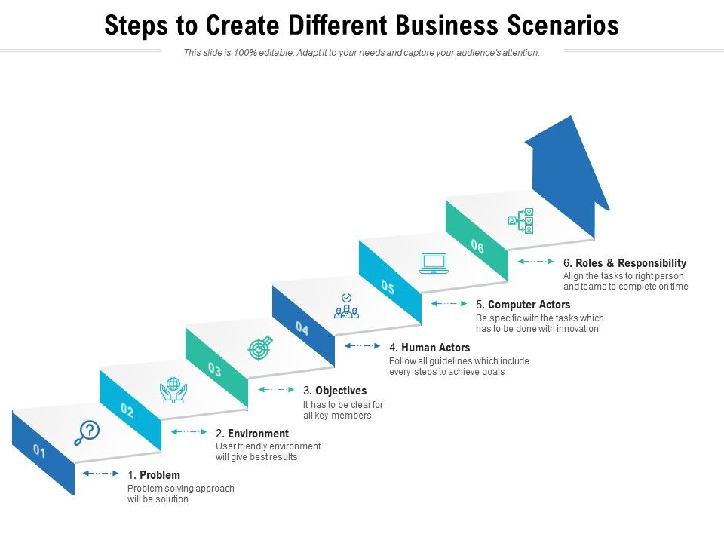
The Business Scenario method
The Business Scenario method – technique
to validate the premise behind an EA.
Principally used in the Preliminary, A and B Phases.
A uniform description of:
Typically, a 5/6 step process
Business Scenarios : Page 1 : §1
Real business problems
The business and technology environment
Value chains enabled by capabilities
The desired outcome of proper execution
The human and computing components
A good Business Scenario is also “SMART
Initially MOD 05
Notes:
Þ M-47
Level=1 : L.O.= 4.5a : Briefly explain business scenarios.
See: TOGAF® Series Guide: Business Scenarios : Page 1 : §1
The Business Scenario method is a technique to validate the premise behind an EA effort by understanding and documenting the key elements of a Business Scenario in successive iterations where:
Each iteration requires planning, data gathering, analysis, documentation, and review
Each iteration should improve one or more of the key elements
Iterations are repeated until your understanding is fit-for-purpose
The method is principally used for the Preliminary, A and B Phases to help identify, understand, and document business needs, thus the business requirements – which are documented as a Business Scenario.
A Business Scenario is a uniform description of:
Real business problems
The business and technology environment in which those problems occur
Value chains enabled by capabilities
The desired outcome(s) of proper execution
The human and computing components (the “actors”) who provide the capabilities
A good Business Scenario is also “SMART”:
Specific, by defining what needs to be done in the business
Measurable - through clear metrics for success
Actionable, by -
clearly segmenting the problem
providing the basis for determining solution elements and
Realistic - the problem can be solved within the bounds of reality
Time-bound - a clear statement of when the solution opportunity expires
Typically a 7-step process – the 7th step being to refine.
The process is iterated till satisfaction is attained!
1 Introduction
A key factor in the success of an Enterprise Architecture is the extent to which it is linked to ... CONTINUES ... SEE REFERENCE SPECIFIED

Slide 141
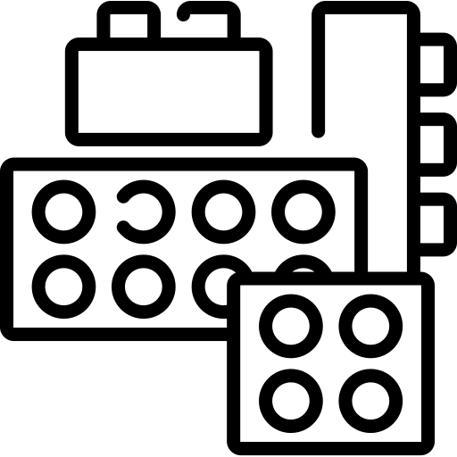
Interoperability - 01/02
"the ability to share information and services“
Determination of interoperability is present throughout the ADM
Many organizations categorize Interoperability:
Illustration:
Lego
Operational or Business
Information
Technical
Preventing inappropriate interoperability is just as important – e.g. for security /privacy
Introduction and Core Concepts : Page 25 : §3.9
Initially MOD 05
Notes:
Level=1 : L.O.= 4.7a : Briefly explain interoperability and how it is used.
See: TOGAF® Standard – Introduction and Core Concepts : Page 25 : §3.9
"the ability to share information and services“
Defining the degree to which the information and services are to be shared, or not, is a
very useful architectural requirement.
Determination of interoperability is present throughout the ADM as follows:
Phase A - the nature and security/privacy considerations of the various exchanges
show in the business scenarios
Phase B - the exchanges are further defined in business terms
Phase C [Data] - the content of the exchanges is detailed using the corporate data
and/or information exchange model
Phase C [Application] - the way that the various applications share the
information/services is specified
Phase D - appropriate technical mechanisms to permit exchanges are specified
Phase E - the actual solutions (COTS packages) are selected
Phase F - the interoperability is logically implemented
Many organizations categorize Interoperability:
Operational or Business - how different parts of the enterprise work
together at the business level
Information - how information is to be shared
Technical - how technical resources are to be shared or at least connect to one another
Preventing interoperability is just as important – e.g. for security /privacy
3.9 Interoperability
A definition of interoperability is "the ability to share information and services". Defining the
degree to which the information and services are or are not to be shared is a very useful
architectural requirement, especially in a complex organization and/or extended enterprise.
The determination of interoperability is present throughout the Architecture Development Method
(ADM) as follows:
■ In the Architecture Vision (Phase A), the nature and security considerations of the
information and service exchanges are first revealed within the business scenarios
■ In the Business Architecture (Phase B), the information and service exchanges are further
... CONTINUES ... SEE REFERENCE SPECIFIED

Slide 142
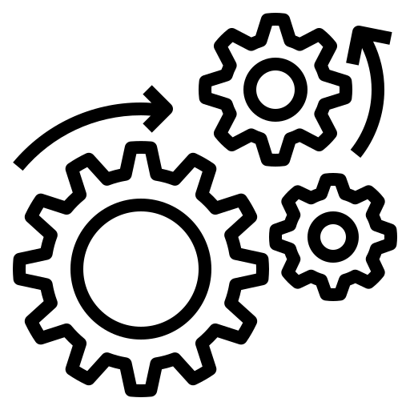
Interoperability - 02/02
From an IT perspective consider interoperability
like Enterprise Application Integration (EAI); specifically:
Illustration:
Gears
Presentation Integration
Information Integration
Application Integration
Technical Integration
Introduction and Core Concepts : Page 25 : §3.9
Initially MOD 05
Notes:
Þ M-50
Level=1 : L.O.= 4.7a : Briefly explain interoperability and how it is used.
See: TOGAF® Standard – Introduction and Core Concepts : Page 25 : §3.9
From an IT perspective, it is useful to consider interoperability like Enterprise Application Integration (EAI); specifically:
Presentation Integration - common look-and-feel guides the user to the underlying functionality
Information Integration - corporate information is seamlessly shared between the various corporate applications to achieve, e.g. a common set of client information. Normally based on a commonly accepted corporate ontology and shared services for the structure, quality, access, and security/ privacy for the information.
Application Integration - corporate functionality is integrated and shareable so applications are not duplicated (e.g., one change of address service/component; not one for every application) and are seamlessly linked together through functionality such as workflow. This impacts the business and infrastructure applications and is closely linked to corporate business process unification.
Technical Integration - includes common methods and shared services for the communication, storage, processing, and access to data primarily in the application platform and communications infrastructure domains.
Interoperability and Interoperability Requirements are addressed in detail in the TOGAF Standard — ADM Techniques.
3.9 Interoperability
A definition of interoperability is "the ability to share information and services". Defining the
degree to which the information and services are or are not to be shared is a very useful
architectural requirement, especially in a complex organization and/or extended enterprise.
The determination of interoperability is present throughout the Architecture Development Method
(ADM) as follows:
■ In the Architecture Vision (Phase A), the nature and security considerations of the
information and service exchanges are first revealed within the business scenarios
■ In the Business Architecture (Phase B), the information and service exchanges are further
defined in business terms
... CONTINUES ... SEE REFERENCE SPECIFIED

Slide 143
Business Transformation Readiness Assessment – 01/03
The Human Element
– the most important change dimension.
An innovative Architecture Vision entails change
Change is rarely welcome
Understanding the readiness of the organization to accept change is key
The recommended activities are:
Determine
Determine the readiness factors that will impact the organization
Present
Present the readiness factors
Assess
Assess the readiness factors
Assess
Assess the risks for these factors
ADM Techniques : Page 59 : §8.1
Initially MOD 05
Notes:
Þ Q-35
Level=1 : L.O.= 4.8a : Explain Business Transformation Readiness Assessment and where it can be used in the ADM.
See: TOGAF® Standard – ADM Techniques : Page 59 : §8.1
The change in Sweden to drive on the wrong side of the road is a good example of substantive change.
It is also easy for people to imagine what must have been considered in a BTRA
The Human Element – the most important change dimension
An innovative Architecture Vision (Phase A) and supporting Architecture Definition (Phases B to D) will entail considerable change.
Change is rarely welcome. Given a change-averse culture and a narrowly skilled workforce, the most sound and innovative architecture could go nowhere.
Understanding the readiness of the organization to accept change is key to successful architecture transformation in Phases E and F - and is a joint effort between corporate staff, lines of business, and (IT) planners.
The recommended activities in an assessment of an organization’s readiness to address business transformation are:
Determine the readiness factors that will impact the organization
Present the readiness factors – possibly using maturity models
Assess the readiness factors - determination of readiness factor ratings
Assess the risks for these factors - identify improvement actions to mitigate risk
Work these actions into Phase E and F, Implementation and Migration Plan.
8.1 Introduction
Enterprise Architecture is a major endeavour within an organization and most often an innovative Architecture Vision (Phase A) and supporting Architecture Definition (Phases B to D) will entail considerable change. There are many dimensions to change, but by far the most important is the human element. For example, if the enterprise envisages a consolidation of information holdings and a move to a new paradigm such as service orientation for integrated service delivery,
... CONTINUES ... SEE REFERENCE SPECIFIED

Slide 144

Business Transformation Readiness Assessment – 02/03
BTEP uses a Readiness Rating Scheme
The columns against each factor score for:
Urgency
Readiness Status
Degree of Difficulty to Fix
ADM Techniques : Page 59 : §8.1
Initially MOD 05
Notes:
Level=1 : L.O.= 4.8a : Explain Business Transformation Readiness Assessment and where it can be used in the ADM.
See: TOGAF® Standard – ADM Techniques : Page 49 : §8.1
The BTEP* uses a Readiness Rating Scheme that can be used as a start point for any organization in any vertical.
Typically a Summary representation is presented showing the Factors: formular
The columns against each factor score for:
Urgency - action needed before a transformation initiative can begin
Readiness Status - Low (needs substantial work before proceeding)
Fair (needs some work before proceeding)
Acceptable (some readiness issues exist),
Good (relatively minor issues exist)
High (no readiness issues)
Degree of Difficulty to Fix -
No Action Needed
Easy
Moderate
Difficult [aka. Expensive]
What is BTEP ?
Business Transformation Enablement Program is a Strategic Design and Planning (SD&P) methodology supporting the
Information Management in the Government of Canada program – see https://www.tbs-sct.gc.ca/im-gi/resources/tv-lv/tv-lv10-eng.asp
8.1.1 Business Transformation Enablement Program (BTEP)
The Canadian Government Business Transformation Enablement Program (BTEP) provides
guidance on how to identify the business transformation-related issues.
The BTEP recommends that all projects conduct a transformation readiness assessment to at
least uncover the business transformation issues. This assessment is based upon the
determination and analysis/rating of a series of readiness factors. The outcome is a deeper
understanding of the challenges and opportunities that could be presented in the course of the
endeavour. Many of the challenges translate directly into risks that have to be addressed,
... CONTINUES ... SEE REFERENCE SPECIFIED

Slide 145

Business Transformation Readiness Assessment – 03/03
Present factors in such a way that the assessment is clear
Possibly use maturity models
If each factor is converted into a maturity model accompanied by a standard worksheet, it can be a very useful tool.
recommended target state
ADM Techniques : Page 59 : §8.1
Initially MOD 05
Notes:
Level=1 : L.O.= 4.8a : Explain Business Transformation Readiness Assessment and where it can be used in the ADM.
See: TOGAF® Standard – ADM Techniques : Page 49 : §8.1
Once the factors are determined, it is necessary to present them in such a way that the assessment is clear and the maximum value is derived from the participants.
One such presentation is through the use of maturity models.
If each factor is converted into a maturity model (a re-usable governance asset as well) accompanied by a standard worksheet template containing all of the information and deductions that have to be gathered, it can be a very useful tool.
Note that the model shown also has a recommended target state indicated [in yellow] by the Enterprise Architect - this again acts as governance.
See: www.opengroup.org/architecture/0404brus/presents/weisman/OpenGroup_BTEP_CaseStudyApr2004V4.pdf&usg=AOvVaw12rK4dy0U1Keazqu6_qIQG
8.1 Introduction
Enterprise Architecture is a major endeavour within an organization and most often an innovative
Architecture Vision (Phase A) and supporting Architecture Definition (Phases B to D) will entail
considerable change. There are many dimensions to change, but by far the most important is the
human element. For example, if the enterprise envisages a consolidation of information holdings
and a move to a new paradigm such as service orientation for integrated service delivery, then
the human resource implications are major. Potentially coupled with a change-averse culture and
a narrowly skilled workforce, the most sound and innovative architecture could go nowhere.
Understanding the readiness of the organization to accept change, identifying the issues, and
then dealing with them in the Implementation and Migration Plans is key to successful
architecture transformation in Phases E and F. This will be a joint effort between corporate
(especially human resources) staff, lines of business, and IT planners.
The recommended activities in an assessment of an organization’s readiness to address
... CONTINUES ... SEE REFERENCE SPECIFIED

Slide 146
Characteristics of architecture Risk Management – 01/05
There is risk with any architecture/business transformation ​
Mitigation is an ongoing effort ​
It is within the governance framework that risks have to be first accepted and then managed
There are two levels of risk
Initial
Level of Risk
Residual
Level of Risk
The process for risk management:
classification
identification
initial assessment
mitigation and residual assessment
monitoring
ADM Techniques : Page 67 : §9.1
Initially MOD 05
Notes:
Þ M-52
Level=1 : L.O.= 4.9a : Briefly explain the characteristics of architecture risk management and where it is used within the TOGAF ADM.
See: TOGAF® Standard – ADM Techniques : Page 67 : §9.1
There is risk with any architecture/business transformation effort. It is important to identify, classify, and mitigate these risks before starting so that they can be tracked throughout the transformation effort.
Mitigation is an ongoing effort and planners must monitor the transformation context constantly.
While an Enterprise Architect may identify the risks, and mitigate certain ones, it is within the governance framework that risks have to be first accepted and then managed.
There are two levels of risk that should be considered, namely:
Initial Level of Risk: risk categorization prior to determining and implementing mitigating actions
Residual Level of Risk: risk categorization after implementation of mitigating actions (if any)
The process for risk management follows and consists of:
classification
identification
initial assessment
mitigation and residual assessment
monitoring

Slide 147
Characteristics of architecture Risk Management – 02/05
Risk Classification
Risk Identification
Is with respect to impact on the organization
Certain impacts have to be addressed by certain levels of governance
Risks are typically classified:
time (schedule)
cost (budget)
scope
Use:
Maturity and Transformation Readiness Assessments
Capability Maturity Models (CMMs)
Implication of NOT achieving the target state
Risk documentation is completed in the context of a Risk Management Plan
ADM Techniques : Page 67 : §9.1
Initially MOD 05
Notes:
Level=1 : L.O.= 4.9a : Briefly explain the characteristics of architecture risk management and where it is used within the TOGAF ADM.
See: TOGAF® Standard – ADM Techniques : Page 67 : §9.1
Risk Classification
One common way for risks to be classified is with respect to their impact on the organization, whereby risks with certain impacts have to be addressed by certain levels of governance.
Risks are typically classified:
time (schedule)
cost (budget)
scope
but should include:
client transformation
relationship risks
contractual risks
technological risks
complexity risks
environmental (corporate) risks
personnel risks
acceptance risks
Risk Identification
Maturity and Transformation Readiness Assessments will reveal many risks.
Capability Maturity Models (CMMs) are suitable for specific factors associated with architecture delivery - to first identify baseline and target.
The implications of not achieving the target state can result in the discovery of risks.
Risk documentation is completed in the context of a Risk Management Plan - see e.g. PMBOK® and PRINCE2®
9.1 Introduction
There will always be risk with any architecture/business transformation effort. It is important to
identify, classify, and mitigate these risks before starting so that they can be tracked throughout
the transformation effort.
... CONTINUES ... SEE REFERENCE SPECIFIED
... CONTINUES ... SEE REFERENCE SPECIFIED

Slide 148

Characteristics of architecture Risk Management – 03/05
Effect is assessed using:
Catastrophic
Critical
Marginal
Negligible
Frequency as:
Frequent
Likely
Occasional
Seldom
Unlikely
These are combined using a heuristically-based but consistent classification such as:​
    Extremely High Risk (E)​
    High Risk (H)​
    Moderate Risk (M)​
    Low Risk (L)
ADM Techniques : Page 67 : §9.1
Initially MOD 05
Notes:
Level=1 : L.O.= 4.9a : Briefly explain the characteristics of architecture risk management and where it is used within the TOGAF ADM.
See : TOGAF® Standard – ADM Techniques : Page 67 : §9.1
Effect is assessed using:
Catastrophic infers critical financial loss that could result in bankruptcy of the organization
Critical infers serious financial loss in more than one line of business leading to a loss in productivity and no ROI
Marginal infers a minor financial loss in a line of business and a reduced ROI
Negligible infers a minimal impact on a line of business’ ability to deliver services and/or products
Frequency as:
Frequent: likely to occur very often and/or continuously
Likely: occurs several times over the course of a transformation cycle
Occasional: occurs sporadically
Seldom: remotely possible and would probably occur not more than once
Unlikely: will probably not occur during the course of a transformation cycle
These are combined using a heuristically-based but consistent classification such as:
Extremely High Risk (E): the transformation effort will fail with severe consequences
High Risk (H): significant failure of parts of the transformation effort resulting in certain goals not being achieved
Moderate Risk (M): noticeable failure of parts of the transformation effort threatening the success of certain goals
Low Risk (L): certain goals will not be wholly successful
9.1 Introduction
There will always be risk with any architecture/business transformation effort. It is important to
identify, classify, and mitigate these risks before starting so that they can be tracked throughout
the transformation effort.
Mitigation is an ongoing effort and often the risk triggers may be outside the scope of the transformation planners (e.g., merger, acquisition) so planners must monitor the transfor…
... CONTINUES ... SEE REFERENCE SPECIFIED

Slide 149
Characteristics of architecture Risk Management – 04/05
There are several other issues that arise:
The classification E, H, M, L may not of sufficient granularity
The tendency is to concentrate on the mitigation of perceived ‘big’ risks.
Modelling of rare events
There is now a need to understand, in principle, such things as:
Mathematical bases
Statistical methods
Applications
ADM Techniques : Page 67 : §9.1
Initially MOD 05
Notes:
Level=1 : L.O.= 4.9a : Briefly explain the characteristics of architecture risk management and where it is used within the TOGAF ADM.
See: TOGAF® Standard – ADM Techniques : Page 67 : §9.1
It is NOT expected that the EA will have to indulge in these things – but it is necessary to appreciate them so that
sensible conversation can be held and the meaning of Risk Analysis outputs can be comprehended and assessed.
There are several other issues that arise.
the classification E, H, M, L is not of sufficient granularity to allow sensible prioritization. Probably a scale 0.1 thru 99.9 is more useful.
in reality, bearing in mind resource constraints, the tendency is to concentrate on the mitigation of perceived ‘big’ risks.
modelling of rare events, such as stock market crashes, storms and structural failures, can be important and there is now a need to understand, in principle, such things as:
Mathematical bases: behaviour of maxima and threshold exceedances in large samples, both for independent and dependent data. Poisson process modelling.
Statistical methods: modelling using the GEV and GP distributions, for independent and dependent data. Likelihood and Bayesian inference. Non-stationarity. Extremal coefficients. Multivariate extreme-value distributions. Max-stable processes.
Applications: Environmental, financial, and engineering applications. Use of R for extremal modelling.
9.1 Introduction
There will always be risk with any architecture/business transformation effort. It is important to
identify, classify, and mitigate these risks before starting so that they can be tracked throughout
the transformation effort.
Mitigation is an ongoing effort and often the risk triggers may be outside the scope of the
transformation planners (e.g., merger, acquisition) so planners must monitor the transformation
context constantly.
It is also important to note that the Enterprise Architect may identify the risks and mitigate
... CONTINUES ... SEE REFERENCE SPECIFIED
... CONTINUES ... SEE REFERENCE SPECIFIED

Slide 150
Characteristics of architecture Risk Management – 05/05
Conduct Residual Risk Assessment
See whether the mitigation effort has really made an acceptable difference
The risk that remains is called the "residual risk".
Does the mitigating effort reduce the impact?
The final deliverable should be a transformation risk assessment:
Risk identification and mitigation assessment worksheets are maintained as governance artifacts - kept up-to-date in Phase G where risk monitoring is conducted.
ADM Techniques : Page 67 : §9.1
Initially MOD 05
Notes:
Þ Q-39
Level=1 : L.O.= 4.9a : Briefly explain the characteristics of architecture risk management and where it is used within the TOGAF ADM.
See: TOGAF® Standard – ADM Techniques : Page 67 : §9.1
Conduct Residual Risk Assessment
Once the mitigation effort has been identified, see whether the mitigation effort has really made an acceptable difference.
The risk that remains is called the "residual risk".
Does the mitigating effort actually reduces the impact?
The final deliverable should be a transformation risk assessment: [figure]
Risk Monitoring and Governance (Phase G)
The execution of the mitigating actions is to be carefully monitored to ensure that the enterprise is dealing with residual rather than initial risk. Risk identification and mitigation assessment worksheets are maintained as governance artifacts - kept up-to date in Phase G where risk monitoring is conducted.
9.1 Introduction
There will always be risk with any architecture/business transformation effort. It is important to
identify, classify, and mitigate these risks before starting so that they can be tracked throughout
the transformation effort.
Mitigation is an ongoing effort and often the risk triggers may be outside the scope of the
transformation planners (e.g., merger, acquisition) so planners must monitor the transformation
context constantly.
It is also important to note that the Enterprise Architect may identify the risks and mitigate
certain ones, but it is within the governance framework that risks have to be first accepted and
then managed.
There are two levels of risk that should be considered, namely:
1. Initial Level of Risk: risk categorization prior to determining and implementing mitigating
actions
... CONTINUES ... SEE REFERENCE SPECIFIED

Slide 151

Trade-Off Decisions
Trade-off:
“a balance achieved between two desirable but incompatible features; a compromise​
“losing one quality, aspect, or amount of something in return for gaining another quality, aspect, or amount”
Trade-offs should never be about irrelevant compromises
Jumping to low-cost choices can result in sub-optimal achievement
Look for the hidden value – which will rarely be obvious!
A Practitioners’ Approach to Developing Enterprise Architecture Following the ADM : Page 56 : §6.2
Initially MOD 06
Moved into the techniques section
Notes:
Þ M-32
Level=1 : L.O.= 6.3c : Briefly explain the role of an Architecture Board and its responsibilities.
See: TOGAF® Series Guide: A Practitioners’ Approach to Developing Enterprise Architecture Following the TOGAF® ADM : Page 56 : §6.2
The most common interpretations of trade-off are:
“a balance achieved between two desirable but incompatible features; a compromise
“losing one quality, aspect, or amount of something in return for gaining another quality, aspect, or amount”.
In developing an Enterprise Architecture, trade-offs should never be about compromises, but about a question of when, or the context.
When the context or the objective of the Enterprise is poorly analyzed, some choices may appear obvious or low-cost. Jumping to employ those choices as a viable candidate can result in sub-optimal achievement of the target or total failure of the initiative.
For example, when an obvious improvement without a champion is found, it is easy to jump to a decision based on poor analysis.
Look for the hidden value – which will rarely be obvious !
27 Refer to Jeff Conklin’s Wicked Problems & Social Complexity within Dialog Mapping (see Referenced Documents).
6.2 Trade-Off Decisions
The most common interpretations of trade-off are “a balance achieved between two desirable but incompatible features; a compromise” and “losing one quality, aspect, or amount of something in return for gaining another quality, aspect, or amount”. In developing an Enterprise Architecture, trade-offs are never about compromises, but about a question of when or the context. When the context or the objective of the Enterprise is poorly analyzed, some will appear obvious or low-cost. Jumping to employ those choices as a viable candidate will result in sub-optimal achievement of the target or total failure of the initiative.
For example, when a Practitioner is exploring a candidate target architecture and discovers what appears to be an obvious improvement without a champion, they are likely to be jumping to a decision that is based on poor analysis. When faced with such circumstances, the Practitioner should look for the hidden value. Hidden value will never be described in terms of the obvious cost savings.

Slide 152
Summary of Module 04
The 10 Learning Points covered in Module 04 are:
4.1a : Briefly describe how the ADM and supporting Guidelines and Techniques relate to each other.
3.25a : Explain the information flow between the ADM phases.
4.2a : Explain the purpose of Architecture Principles
4.3a : Explain the recommended template for Architecture Principles
4.4a : Explain what makes a good Architecture Principle
4.7a : Briefly explain interoperability and how it is used
4.8a : Explain Business Transformation Readiness Assessment and where it can be used in the ADM.
4.9a : Briefly explain the characteristics of architecture risk management and where it is used within the TOGAF ADM
3.23a : Describe the objectives of the Requirements Management process.
3.24a : Describe the purpose of Requirements Management.
Initially MOD 04

Slide 153
End of Teaching Slides
End of
Module 04
Introduction to the ADM - Techniques
Initially MOD 04

Slide 154
Module 05/16
TOGAF® EA Training - Foundation
TOGAF® Standard, 10th Edition
Module 05
Applying ADM
TOGAF® is a registered trademark of The Open Group Copyright © The Open Group 2022
​
Initially MOD 05
Note – removed the slides The Context of Governance 1 and 2 – they make no sense in this section and are addressed elsewhere – also where not linked to any learning points.

Slide 155
Course Module Index
# | Topic – Level 1 | ✓
1 | Module 00 - Course Introduction | ✓
2 | Module 01 - Overview | ✓
3 | Module 02 - Concepts | ✓
4 | Module 03 - Introduction to the ADM | ✓
5 | Module 04 - Introduction to the ADM - Techniques | ✓
6 | Module 05 – Applying ADM
7 | Module 06 - Architecture Governance
8 | Module 07 – Architecture Content
# | Topic – Level 2
9 | Module 00 - Course Introduction
10 | Module 08 - The Context for Enterprise Architecture
11 | Module 09 – Stakeholder Management
12 | Module 10 – Phase A
13 | Module 11 – Architecture Development
14 | Module 12 – Implementing the Architecture
15 | Module 13 – Architecture Change Management
16 | Module 14 – Requirements Management
17 | Module 15 – Supporting the ADM Work
18 | Module 16 – Closure
Course
Module
Index
Initially MOD 05

Slide 156

How to apply the TOGAF Standard - Guidance
The TOGAF Standard is a foundational framework:
Applicable to the development of any kind of architecture in any context
Supplemented by The Open Group TOGAF Library
Reflects the structure and content of an Architecture Capability
Introduction and Core Concepts : Page 10 : §2.2
Initially MOD 05
Notes:
Level=1 : L.O.= 5.1a : Describe where guidance on how to apply the TOGAF Standard is provided.
See: TOGAF® Standard – Introduction and Core Concepts : Page 10 : §2.2
The TOGAF Standard is an open, industry consensus framework for Enterprise Architecture.
It is a foundational framework: it is applicable to the development of any kind of architecture in any context.
This foundational framework is supplemented by The Open Group TOGAF Library, an extensive and growing portfolio of guidance material, providing practical guidance in the application of the TOGAF framework in specific contexts.
The structure of the TOGAF Standard reflects the structure and content of an Architecture Capability within an enterprise.

Slide 157

How iteration within the ADM enables concurrency - 01/02
The ‘crop circle’ diagram is intended to swiftly and academically impart the
two key concepts that are used to manage the complexity
Iteration
Levels
Iteration - the process of describing a comprehensive Architecture Landscape -
to develop a comprehensive Architecture
within an ADM cycle
to manage the Architecture Capability
Applying the ADM : Page 3 : §2.1
Initially MOD 05
Notes:
Þ M-43
Level=1 : L.O.= 5.2a : Explain how iteration within the ADM enables concurrent operation of multiple ADM phases.
See: TOGAF® Standard – Applying the ADM : Page 3 : §2.1
The ‘crop circle’ diagram is intended to swiftly and academically impart the ADM but should NOT be taken to imply a ‘waterfall’ approach.
In practice, two key concepts are used to manage the complexity of developing an Enterprise Architecture and managing its lifecycle — iteration and levels: the two concepts are tightly linked.
Iteration
The process of describing a comprehensive Architecture Landscape through multiple ADM cycles based upon individual initiatives bounded by the scope of the Request for Architecture Work
The integrated process of developing an architecture where the activities described
in different ADM phases interact to produce an integrated architecture
The process of managing change to the organization’s Architecture Capability
Iteration to develop a comprehensive Architecture Landscape:
Projects will exercise through the entire ADM cycle, commencing with Phase A
each cycle of the ADM will be bound by a Request for Architecture Work
Separate projects may operate their own ADM cycles concurrently
One project may trigger the initiation of another project
Iteration happens also within an ADM cycle (Architecture Development iteration):
Projects may operate multiple ADM phases concurrently
Projects may cycle between ADM phases, in planned cycles covering multiple phases to
converge on a detailed Target Architecture
Projects may return to previous phases to update work products with new information eg. when the implementation details and scope trigger a change
Iteration to manage the Architecture Capability (Architecture Capability iteration):
Projects may require a new iteration of the Preliminary Phase to (re-)establish aspects of the Architecture Capability identified in
Phase A to address a Request for Architecture Work
Projects may require a new iteration of the Preliminary Phase to adjust the organization’s Architecture Capability
... CONTINUES ... SEE REFERENCE SPECIFIED

Slide 158
How iteration within the ADM enables concurrency – 02/02
Architecture Capability iterations support the creation and evolution of the required Architecture Capability
Architecture Development iterations allow the creation of architecture content by cycling through, or integrating, Business, Information Systems and Technology Architecture phases
Transition Planning iterations support the creation of formal change roadmaps for a defined architecture
Architecture Governance iterations support the governance of change activity progressing towards a defined Target Architecture
Note that ‘iteration’ in the TOGAF context includes recursion.
Applying the ADM : Page 3 : §2.1
Initially MOD 05
Notes:
Level=1 : L.O.= 5.2a : Explain how iteration within the ADM enables concurrent operation of multiple ADM phases.
See: TOGAF® Standard – Applying the ADM : Page 3 : §2.1
Architecture Capability iterations support the creation and evolution of the required Architecture Capability …
This includes the initial mobilization of the architecture activity for a given purpose or architecture engagement type by establishing or adjusting the architecture approach, principles, scope, vision, and governance.
Architecture Development iterations allow the creation of architecture content by cycling through, or integrating, Business, Information Systems, and Technology Architecture phases …
These iterations ensure that the architecture is considered as a whole. In this type of iteration, stakeholder reviews are typically broader. As the iterations converge on a target, extensions into the Opportunities & Solutions and Migration Planning phases ensure that the architecture’s implementability is considered as the architecture is finalized.
Transition Planning iterations support the creation of formal change roadmaps for a defined architecture
Architecture Governance iterations support governance of change activity progressing towards a defined Target Architecture
Note that ‘iteration’ in the TOGAF context includes recursion.
2.1 Overview
The graphical representation of the TOGAF ADM and the description of the ADM phases discretely in order, as shown in the TOGAF Standard — Architecture Development Method, can be read to imply a deterministic waterfall methodology. This method of presentation is provided for the purpose of quickly communicating the basics of architecture development and the architecture development cycle. In practice, two key concepts are used to manage the complexity of developing an Enterprise Architecture and managing its lifecycle — iteration and levels (see Chapter 3). The two concepts are tightly linked.
... CONTINUES ... SEE REFERENCE SPECIFIED

Slide 159

Architecture Landscape - Levels
A framework for dividing the Architecture Landscape into three levels of granularity:
1. Strategic Architecture provides an organizing framework for operational and change activity at an executive level.
2. Segment Architecture provides an organizing framework for operational and change activity at a program or portfolio level.
3. Capability Architecture provides an organizing framework for change activity realizing capability increments.
Breadth
Depth
Time
Grouped into Strategic, Segment, and Capability Architecture levels.
It is worth separately considering a ‘fourth dimension -
Recency
Applying the ADM : Page 17 : §3.2
Initially MOD 05
Notes:
Level=1 : L.O.= 5.3s : List the three levels of the Architecture Landscape.
See: TOGAF® Standard – Applying the ADM : Page 17 : §3.2
A framework for dividing the Architecture Landscape into three levels of granularity:
Strategic Architecture provides an organizing framework for operational and change activity and allows for direction setting at an executive level.
Segment Architecture provides an organizing framework for operational and change activity and allows for direction setting and the development of effective architecture roadmaps at a program or portfolio level.
Capability Architecture provides an organizing framework for change activity and the development of effective architecture roadmaps realizing capability increments.
Breadth: the breadth (subject matter) area is generally the primary organizing characteristic for describing an Architecture Landscape
Depth: with broader subject areas, less detail is needed to ensure that the architecture has a manageable size
Time: for a specific breadth and depth an enterprise can create a Baseline Architecture and a set of Target Architectures that stretch into the future
Using these, architectures can be grouped into Strategic, Segment, and Capability Architecture levels.
It is worth separately considering a ‘fourth dimension - Recency – which is an aspect of the Time dimension.
Recency: each architecture view will progress through a development cycle where it increases in accuracy until approved – then an architecture will begin to decrease in accuracy if not actively maintained.
3.2 Architecture Landscape
Levels provide a framework for dividing the Architecture Landscape into three levels of
granularity:
1. Strategic Architecture provides an organizing framework for operational and change
activity and allows for direction setting at an executive level.
2. Segment Architecture provides an organizing framework for operational and change
activity and allows for direction setting and the development of effective architecture
roadmaps at a program or portfolio level.
3. Capability Architecture provides an organizing framework for change activity and the
... CONTINUES ... SEE REFERENCE SPECIFIED

Slide 160
Architecture Landscape - Partitions
Architectures are partitioned because:
Organizational unit architectures conflict with one another
Different teams need to work on different elements
Effective architecture re-use requires modular architecture
It is impractical to present a definitive partitioning model
Consider the classification criteria that are applied to architectures and how these can be leveraged to partition the enterprise with:
Manageable complexity for each individual architecture or solution
Defined groupings
Defined hierarchies and navigation structures
Appropriate processes, roles, and responsibilities attached to each grouping
Characteristic | Usage to Support Solution Partitioning
Subject Matter (Breadth) | Solutions are naturally organized into groups to support operational management and control. e.g. applications, departments, divisions, products, services, service centers, sites, etc. Subject is typically the fundamental technique for structuring solutions and the architectures that represent them.
Time | Solution lifecycles are typically organized around a timeline, which allows the impact of solution lifecycle to be managed against other business activity occurring in similar time periods.
Maturity/ Volatility | These typically impact the speed of execution required for the solution lifecycle and will shape investment priorities. Solutions existing in highly volatile environments may be better suited to rapid, Agile development techniques.
Depth | Detail of an architecture strongly correlates with interested stakeholders. Less detailed architectures will be of interest to executives. Increasing detail more relevant to implementation and operational personnel.
Applying the ADM : Page 21 : §4.1
Initially MOD 05
Notes:
Level=1 : L.O.= 5.4s : Briefly explain how partitioning helps simplify the development of an Enterprise Architecture.
See: TOGAF® Standard – Applying the ADM : Page 21 : §4.1
Architectures are partitioned because:
Organizational unit architectures conflict with one another
Different teams need to work on different elements of architecture at the same time and partitions allow for specific groups of architects to own and develop specific elements of the architecture
Effective architecture re-use requires modular architecture segments that can be taken and incorporated into broader architectures and solutions
It is impractical to present a definitive partitioning model for architecture. Each enterprise needs to adopt a partitioning model that reflects its own operating model
Consider the classification criteria that are applied to architectures and how these can be leveraged to partition the enterprise with:
Manageable complexity for each individual architecture or solution
Defined groupings
Defined hierarchies and navigation structures
Appropriate processes, roles, and responsibilities attached to each grouping
4.1 Overview
Partitions are used to simplify the development and management of the Enterprise Architecture.
Partitions lie at the foundation of Architecture Governance and are distinct from levels and the organizing concepts of the Architecture Continuum (see the TOGAF Standard — Architecture Content).
Architectures are partitioned because:
■ Organizational unit architectures conflict with one another
■ Different teams need to work on different elements of architecture at the same time and partitions allow for specific groups of architects to own and develop specific elements of the architecture
■ Effective architecture re-use requires modular architecture segments that can be taken and
... CONTINUES ... SEE REFERENCE SPECIFIED

Slide 161
Architecture Landscape - Purpose
There are four broad purposes of an EA Capability - to support:
Strategy
Portfolio
Project
Solution Delivery
Architecture to Support Strategy
Architecture to Support Portfolio
Architecture to Support Project
Architecture to Support Delivery
Purpose | Breadth | Level of Detail | Time | Recency
Architecture to Support Strategy | no firm pattern | not detailed more about guidance | looking ahead for a 3 to 10-year | highly variable
Architecture to Support Portfolio | cover single subjects – (the portfolio) | not very detailed | valid for 2 to 5-year period | highly variable
Architecture to Support Project | typically discrete projects | contains detailed constraints | valid as a target for <2 years | will be retained in the EA landscape
Architecture to Support Solution Delivery | very narrow breadth. | contains the most detailed constraint. | valid as a target for <2 years | retained for an extended period
A Practitioners’ Approach to Developing Enterprise Architecture Following the ADM : Page 13 : §3.2.2
Initially MOD 05
Notes:
Þ Q-41
Level=1 : L.O.= 5.5s : List the four purposes that help to frame the planning horizon and breadth and depth of the Architecture Project.
See: TOGAF® Series Guide: A Practitioners’ Approach to Developing Enterprise Architecture Following the TOGAF® ADM : Page 13 : §3.2.2
There are four broad purposes of an EA Capability, and these are to support:
Strategy: provide an end-to-end Target Architecture, and develop roadmaps of change over a three to ten-year period.
An architecture for this purpose spans many change programs or portfolios and identifies change initiatives, supporting portfolio and programs and sets terms of reference, identifies synergies, and governs the execution.
Portfolio: support cross-functional, multi-phase, and multi-project change initiatives.
This purpose spans a single portfolio and is used to identify projects, set their TOR, align approaches, identify synergies, and govern execution of projects.
Project: support the Enterprise’s project delivery method.
This purpose spans a single project and is used to clarify the purpose and value, identify requirements to address synergy and future dependency, assure governance compliance and alignment between projects.
Solution Delivery: support the solution deployment.
Typically be a single project or a significant part. Defines how the change will be designed and delivered, identify constraints, controls and architecture requirements to the design, and is the governance framework..
The purpose-based EA Capability model was introduced in the World-Class Enterprise Architecture, White Paper (www.opengroup.org/library/w102)
3.2.2 Introduction to Purpose
A purpose-based EA Capability model identifies four purposes that typically frame the planning horizon, depth and breadth of an Architecture Project, and the contents of the EA Repository. The purpose-based EA Capability model used in this Guide was introduced in the World-Class Enterprise Architecture White Paper (see Referenced Documents) and refined in the TOGAF® Leader’s Guide to Establishing and Evolving an EA Capability (see Referenced Documents).
Figure 3: Purposes of Enterprise Architecture
... CONTINUES ... SEE REFERENCE SPECIFIED

Slide 162

Support the Digital enterprise
Enterprise Architecture supports and enables the Agile environment by providing insight into:
Reactively managing technical debt
Proactively managing technical debt
Managing matured digital products and delivering operational excellence
When the TOGAF® Standard began, hardware and net-working equipment needed to allow for adequate lead time
​
Drivers, e.g. the rapid change in technologies, lend them-selves to new ways of working
Example: Universal Automatic Computer Model II. Remington Rand Univac Div.
Sperry Rand Corp.
Photo : U. S. Navy Electronics Supply Office
Using the TOGAF Standard in the Digital Enterprise : Page 17 : §2.1
Initially MOD 05
Notes:
Level=1 : L.O.= 5.6s : Briefly explain how the TOGAF Standard can be applied to support the Digital enterprise.
See: TOGAF® Series Guide: Using the TOGAF Standard in the Digital Enterprise : Page 17 : §2.1
Enterprise Architecture supports and enables the Agile environment by providing insight into:
Reactively managing technical debt as the result of sprints in a cohesive and connected fashion
Proactively managing technical debt and anticipating Agile development needs by:
Identifying standards/reusable standard components to support shortened Agile development cycles
Appropriate governance or guardrails to oversee reuse of components
Managing matured digital products and delivering operational excellence by:
Simplifying complexity in the digital ecosystem using the TOGAF Architecture Development Method
Establishing Enterprise Architecture capability to drive operational excellence in the management of digital products and services
Institutionalizing Agile development methods by enabling them as another used framework
When the TOGAF Standard began hardware and networking equipment needed to be well-planned and in place in the early stages of a project - to allow for adequate lead time.
The environment has changed but the business functions needed to deliver an IT capability still exist and require an understanding of the concepts behind the business process, with a methodology to accomplish the associated tasks.
Drivers, such as the rapid change in technologies, lend themselves to new ways of working, socializing, and entertaining.
An Enterprise Architecture should be seen as supporting and enabling the Agile environment in delivering and enhancing digital products and services by providing insight into these various areas.
2.1. Introduction
The TOGAF Standard began to evolve at a time when server hardware and networking equipment
... CONTINUES ... SEE REFERENCE SPECIFIED

Slide 163
Summary of Module 05
The 6 Learning Points covered in Module 05 are:​
5.1a : Describe where guidance on how to apply the TOGAF Standard is provided
5.2a : Explain how iteration within the ADM enables concurrent operation of multiple ADM phases
5.3a : List the three levels of the Architecture Landscape
5.4a : Briefly explain how partitioning helps simplify the development of an Enterprise Architecture
5.5a : List the four purposes that help to frame the planning horizon and breadth and depth of the Architecture Project
5.6a : Briefly explain how the TOGAF Standard can be applied to support the Digital Enterprise

Slide 164
End of Teaching Slides
End of
Module 05/16
Applying ADM
Initially MOD 05

Slide 165
Module 06/16
TOGAF® EA Training - Foundation
TOGAF® Standard, 10th Edition
Module 06
Architecture Governance
TOGAF® is a registered trademark of The Open Group Copyright © The Open Group 2022
​
Initially MOD 06

Slide 166
Course Module Index
# | Topic – Level 1 | ✓
1 | Module 00 - Course Introduction | ✓
2 | Module 01 - Overview | ✓
3 | Module 02 - Concepts | ✓
4 | Module 03 - Introduction to the ADM | ✓
5 | Module 04 - Introduction to the ADM - Techniques | ✓
6 | Module 05 – Applying ADM | ✓
7 | Module 06 - Architecture Governance
8 | Module 07 – Architecture Content
# | Topic – Level 2
9 | Module 00 - Course Introduction
10 | Module 08 - The Context for Enterprise Architecture
11 | Module 09 – Stakeholder Management
12 | Module 10 – Phase A
13 | Module 11 – Architecture Development
14 | Module 12 – Implementing the Architecture
15 | Module 13 – Architecture Change Management
16 | Module 14 – Requirements Management
17 | Module 15 – Supporting the ADM Work
18 | Module 16 – Closure
Course
Module
Index
Initially MOD 06

Slide 167

Architecture Governance – 01/03
Architecture Governance operates within a hierarchy of governance structures:
Corporate Governance
Technology Governance
Architecture Governance
IT Governance
“If management is about running the business, governance is about seeing that it is run properly.”
R Tricker - the Father of Corporate Governance (1984).
“Architecture Governance is the practice and orientation by which Enterprise Architectures and other architectures are managed and controlled at an enterprise-wide level.”
TOGAF® Standard, 10th Edition
Architecture Governance includes:
Enterprise Architecture Capability and Governance : Page 9 : §3.1
Implementing
Implementing a system of controls over the creation and monitoring of all architectural components and activities
Implementing
Implementing a system to ensure compliance with internal and external standards and regulatory obligations
Establishing
Establishing processes that support effective management
Developing
Developing practices that ensure accountability
Each of these domains of governance may exist at multiple levels
Initially MOD 05
Notes:
Level=1 : L.O.= 6.1s : Briefly explain the concept of Architecture Governance.
See: TOGAF® Standard – Enterprise Architecture Capability and Governance : Page 9 : §3.1
“Architecture Governance is the practice and orientation by which Enterprise Architectures and other architectures are managed and controlled at an enterprise-wide level.” TOGAF® Standard
Architecture Governance operates within a hierarchy of governance structures:
Corporate Governance
Technology Governance
Architecture Governance
IT Governance
Each of these domains of governance may exist at multiple geographic levels — global, regional, and local — within the overall enterprise.
Corporate Governance generally is beyond the scope of an Enterprise Architecture framework.
Architecture Governance includes:
Implementing a system of controls over the creation and monitoring of all architectural components and activities, to ensure the effective introduction, implementation, and evolution of architectures within the organization
Implementing a system to ensure compliance with internal and external standards and regulatory obligations
Establishing processes that support effective management of the above processes within agreed parameters
Developing practices that ensure accountability to a clearly identified stakeholder community, both inside and outside the organization

Slide 168

Architecture Governance – 02/03
Conceptually, Architecture Governance is an approach, a series of processes, a cultural orientation, and set of owned responsibilities that ensure the integrity and effectiveness of the organization’s architectures.
The split of process, content, and context is key to the support of the Architecture Governance initiative
This content-agnostic approach ensures that the framework is flexible
Key Architecture Governance Processes:
Policy Management and Take-On
Compliance
Dispensation / Waiver
Monitoring and Reporting
Business Control
Environment Management
Enterprise Architecture Capability and Governance : Page 13 : §3.2
Initially MOD 05
Notes:
Þ M-55
Level=1 : L.O.= 6.2s : Explain why Architecture Governance is beneficial.
See: TOGAF® Standard – Enterprise Architecture Capability and Governance : Page 13 : §3.2
Conceptually, Architecture Governance is an approach, a series of processes, a cultural orientation, and set of owned responsibilities that ensure the integrity and effectiveness of the organization’s architectures.
The split of process, content, and context are key to the support of the Architecture Governance initiative, by allowing the introduction of new governance material (legal, regulatory, standards-based, or legislative) without unduly impacting the processes.
This content-agnostic approach ensures that the framework is flexible: the processes are typically independent of the content and implement a proven best practice approach to active governance.
Key Architecture Governance Processes
Policy Management and Take-On - processes ensure the orderly integration with existing governance.
Compliance –assessments against SLAs, OLAs, standards etc. are implemented on an ongoing basis and reviewed within the governance framework.
Dispensation/Waiver - granted for a given time period with a set of identified service and operational criteria that must be enforced.
Monitoring and Reporting - includes monitoring against SLAs and OLAs, feedback for adjustment, and reporting.
Business Control - relates to the processes invoked to ensure compliance with the organization’s policies.
Environment Management - ensures the orderly integration with existing governance content.
3.2 Architecture Governance Framework
This section describes a conceptual and organizational framework for Architecture Governance
As previously explained, Phase G of the TOGAF ADM (see the TOGAF Standard — Architecture
Development Method) is dedicated to implementation governance, which concerns itself with the
realization of the architecture through change projects.
... CONTINUES ... SEE REFERENCE SPECIFIED

Slide 169
Architecture Governance – 02/03
Notes:
Þ M-55
Level=1 : L.O.= 6.2s : Explain why Architecture Governance is beneficial.
See: TOGAF® Standard – Enterprise Architecture Capability and Governance : Page 13 : §3.2
Conceptually, Architecture Governance is an approach, a series of processes, a cultural orientation, and set of owned responsibilities that ensure the integrity and effectiveness of the organization’s architectures.
The split of process, content, and context are key to the support of the Architecture Governance initiative, by allowing the introduction of new governance material (legal, regulatory, standards-based, or legislative) without unduly impacting the processes.
This content-agnostic approach ensures that the framework is flexible: the processes are typically independent of the content and implement a proven best practice approach to active governance.
Key Architecture Governance Processes
Policy Management and Take-On - processes ensure the orderly integration with existing governance.
Compliance –assessments against SLAs, OLAs, standards etc. are implemented on an ongoing basis and reviewed within the governance framework.
Dispensation/Waiver - granted for a given time period with a set of identified service and operational criteria that must be enforced.
Monitoring and Reporting - includes monitoring against SLAs and OLAs, feedback for adjustment, and reporting.
Business Control - relates to the processes invoked to ensure compliance with the organization’s policies.
Environment Management - ensures the orderly integration with existing governance content.
3.2 Architecture Governance Framework
This section describes a conceptual and organizational framework for Architecture Governance
As previously explained, Phase G of the TOGAF ADM (see the TOGAF Standard — Architecture
Development Method) is dedicated to implementation governance, which concerns itself with the
realization of the architecture through change projects.
... CONTINUES ... SEE REFERENCE SPECIFIED

Slide 170
Architecture Governance – 03/03
Ensuring Project Compliance
Project Architectures
Processes are:
Formal
Documented
Integrated into QM
Applied to ALL Projects
Compliance Review Processes
Projects
Projects
Projects
Projects
Projects
Enterprise/IT Governance
Projects
Compliance Review Processes
Compliance Review Processes
Compliance Review Processes
Compliance Review Processes
The TOGAF Leader’s Guide to Establishing and Evolving an EA Capability : Page 31 : §6.1
Initially MOD 05
Notes:
Þ M-54
Level=1 : L.O.= 6.2t : Explain why Architecture Governance is beneficial.
See: TOGAF® Series Guide: The TOGAF Leader’s Guide to Establishing and Evolving an EA Capability : Page 31 : §6.1
Conceptually, Architecture Governance is an approach, a series of processes, a cultural orientation, and set of owned responsibilities that ensure the integrity and effectiveness of the organization’s architectures.
The split of process, content, and context are key to the support of the Architecture Governance initiative, by allowing the introduction of new governance material (legal, regulatory, standards-based, or legislative) without unduly impacting the processes.
This content-agnostic approach ensures that the framework is flexible: the processes are typically independent of the content and implement a proven best practice approach to active governance.
Key Architecture Governance Processes
Policy Management and Take-On - processes ensure the orderly integration with existing governance.
Compliance –assessments against SLAs, OLAs, standards etc. are implemented on an ongoing basis and reviewed within the governance framework.
Dispensation/Waiver - granted for a given time period with a set of identified service and operational criteria that must be enforced.
Monitoring and Reporting - includes monitoring against SLAs and OLAs, feedback for adjustment, and reporting.
Business Control - relates to the processes invoked to ensure compliance with the organization’s policies.
Environment Management - ensures the orderly integration with existing governance content.
6.1 Introduction
Ensuring the compliance of individual projects with the Enterprise Architecture is an essential aspect of Architecture Governance (see Chapter 3). To this end, the IT governance function within an enterprise will normally deﬁne two complementary processes:
■ The Architecture function will be required to prepare a series of Project Architectures; i.e., project-speciﬁc views of the Enterpr ise Architecture that illustrate how the Enterprise Architecture impacts on the major projects within the organization (see ADM Phases A to F)
■ The Enterprise and IT Governance functions will deﬁne a formal Architecture Compliance review process (see Section 6.3)for reviewing the compliance of all projects to the Enterprise Architecture
Apart from deﬁning for mal processes,the Architecture Governance function (see Chapter 3) may also stipulate that the architecture function should extend beyond the role of architecture ... CONTINUES ... SEE REFERENCE SPECIFIEDArchitecture, and maximize the value of centralized commercial negotiation.

Slide 171
Architecture Governance Framework – 01/03
Distinguish and contrast between
Implementation Governance
is just one aspect of Architecture Governance, and concerns itself with the realization of the architecture through change projects [e.g., Phase G]
and …
Architecture Governance
supported by an Architecture Governance Framework.
Enterprise Architecture Capability and Governance : Page 13 : §3.2
Initially MOD 06
Notes:
Level=1 : L.O.= 6.2s : Explain why Architecture Governance is beneficial.
See: TOGAF® Standard – Enterprise Architecture Capability and Governance : Page 13 : §3.2
Distinguish, and contrast, between
Implementation Governance
is just one aspect of Architecture Governance, and concerns itself with the realization of the architecture through change projects [e.g. Phase G] and which covers the management and control of all aspects of the development and evolution of Enterprise Architectures and other architectures within the enterprise …
and …
Architecture Governance
supported by an Architecture Governance Framework.
TOGAF implies a generic framework that can be adapted to the existing governance environment of an enterprise.
It is intended to assist in identifying effective processes and organizational structures, so that the business responsibilities associated with Architecture Governance can be elucidated, communicated, and managed effectively.
3.2 Architecture Governance Framework
This section describes a conceptual and organizational framework for Architecture Governance
As previously explained, Phase G of the TOGAF ADM (see the TOGAF Standard — Architecture Development Method) is dedicated to implementation governance, which concerns itself with the
realization of the architecture through change projects.
Implementation governance is just one aspect of Architecture Governance, which covers the management and control of all aspects of the development and evolution of Enterprise
Architectures and other architectures within the enterprise.
Architecture Governance needs to be supported by an Architecture Governance Framework, described below. The governance framework described is a generic framework that can be
adapted to the existing governance environment of an enterprise. It is intended to assist in identifying effective processes and organizational structures, so that the business responsibilities
... CONTINUES ... SEE REFERENCE SPECIFIED

Slide 172

Architecture Governance Framework – 02/03
Architecture Governance is the practice and orientation by which architectures are managed and controlled - will typically include:
Global governance board
Local governance board
Design authorities
Working parties
The architecture organization illustrated here highlights the major structural elements required for an Architecture Governance initiative
Enterprise Architecture Capability and Governance : Page 13 : §3.2
Initially MOD 06
Notes:
Level=1 : L.O.= 6.2s : Explain why Architecture Governance is beneficial.
See: TOGAF® Standard – Enterprise Architecture Capability and Governance : Page 13 : §3.2
Architecture Governance is the practice and orientation by which architectures are managed and controlled:
- it is necessary to have organizational structures established to support all of the governance activities.
An Architecture Governance structure will typically include:
Global governance board
Local governance board
Design authorities
Working parties
The architecture organization illustrated here highlights the major structural elements required for an Architecture Governance initiative.
While each enterprise will have differing requirements, it is expected that the basics/generics of the organizational design shown will be applicable and implementable in a wide variety of organizational types.
3.2 Architecture Governance Framework
This section describes a conceptual and organizational framework for Architecture Governance
As previously explained, Phase G of the TOGAF ADM (see the TOGAF Standard — Architecture Development Method) is dedicated to implementation governance, which concerns itself with the
realization of the architecture through change projects.
Implementation governance is just one aspect of Architecture Governance, which covers the management and control of all aspects of the development and evolution of Enterprise
Architectures and other architectures within the enterprise.
Architecture Governance needs to be supported by an Architecture Governance Framework, described below. The governance framework described is a generic framework that can be
adapted to the existing governance environment of an enterprise. It is intended to assist in identifying effective processes and organizational structures, so that the business responsibilities
... CONTINUES ... SEE REFERENCE SPECIFIED

Slide 173

Architecture Governance Framework – 03/03
Enterprise Continuum manages
all content:
The architectures themselves
Architecture Governance processes
Benefits
Links the IT to organizational strategies and objectives
Institutionalizes best practices
Aligns with industry frameworks
Enables the organization to take full advantage of its IS assets
Protects the underlying digital assets
Promotes visible risk management
Enterprise Architecture Capability and Governance : Page 13 : §3.2
Initially MOD 06
Notes:
Level=1 : L.O.= 6.2s : Explain why Architecture Governance is beneficial.
See : TOGAF® Standard – Enterprise Architecture Capability and Governance : Page 13 : §3.2
Key areas:
Develop
Implement
Deploy
Develop responsibilities, processes, and structures are usually linked to the TOGAF ADM
The Enterprise Continuum manages all content:
the architectures themselves
Architecture Governance processes
Benefits derived through the continuing governance of architectures:
Links the IT processes, resources, and information to organizational strategies and objectives
Integrates and institutionalizes IT best practices
Aligns with industry frameworks such as COBIT
Enables the organization to take full advantage of its IS assets
Protects the underlying digital assets of the organization
Supports regulatory and best practice
Promotes visible risk management
These benefits support an approach, processes, cultural orientation, and owned responsibilities, to ensure the integrity and effectiveness of the organization’s architectures.
3.2 Architecture Governance Framework
This section describes a conceptual and organizational framework for Architecture Governance
As previously explained, Phase G of the TOGAF ADM (see the TOGAF Standard — Architecture Development Method) is dedicated to implementation governance, which concerns itself with the
realization of the architecture through change projects.
Implementation governance is just one aspect of Architecture Governance, which covers the management and control of all aspects of the development and evolution of Enterprise
Architectures and other architectures within the enterprise.
Architecture Governance needs to be supported by an Architecture Governance Framework, described below. The governance framework described is a generic framework that can be
adapted to the existing governance environment of an enterprise. It is intended to assist in identifying effective processes and organizational structures, so that the business responsibilities
... CONTINUES ... SEE REFERENCE SPECIFIED

Slide 174


Architecture Governance Strategy
*Not explicitly stated in the TOGAF model but is general in practice and also ‘good sense’.
TOGAF-compliant Structural View
A key element is a cross-organization Architecture Board
Representative stakeholders
Executives
From the organization:
local
global
From outside the organization:*
outsourced service providers
The board is established with identifiable and articulated:
Responsibilities
Decision-making capabilities
Remit and authority limits
Enterprise Architecture Capability and Governance : Page 21 : §4.1
Initially MOD 06
Notes:
Level=1 : L.O.= 6.3s : Briefly explain the role of an Architecture Board and its responsibilities.
See: TOGAF® Standard – Enterprise Architecture Capability and Governance : Page 21 : §4.1
A key element in a successful Architecture Governance strategy is a cross-organization Architecture Board
representative of all the key stakeholders
executives responsible for the review and maintenance of the overall architecture
from the organization:
local (domain experts, line responsibility)
global (organization-wide responsibility)
from outside the organization:*
outsourced service providers
The board will be established with identifiable and articulated:
Responsibilities and decision-making capabilities
Remit and authority limits
4.1 Role
A key element in a successful Architecture Governance strategy (see Chapter 3) is a cross-organization Architecture Board to oversee the implementation of the strategy. This body should
be representative of all the key stakeholders in the architecture, and will typically comprise a group of executives responsible for the review and maintenance of the overall architecture.
Architecture Boards may have global, regional, or business line scope. Particularly in larger enterprises, Architecture Boards typically comprise representatives from the organization at a
minimum of two levels:
■ Local (domain experts, line responsibility)
■ Global (organization-wide responsibility)
In such cases, each board will be established with identifiable and articulated:
■ Responsibilities and decision-making capabilities
■ Remit and authority limits

Slide 175
Architecture Board – Responsibilities – 01/02
Is responsible, and accountable, for achieving some or all of:
Meeting on a regular basis
Providing the basis for all decision-making with regard to the architectures
Consistency between sub-architectures
Establishing targets for re-use of components
Flexibility of the Enterprise Architecture:
To meet changing business needs
To leverage new technologies
Enforcement of Architecture Compliance
Improving the maturity level of architecture discipline within the organization
Ensuring that the discipline of architecture-based development is adopted
Supporting a visible escalation capability for out-of-bounds decisions
All aspects of monitoring and control of the Architecture Contract
Ensuring the effective and consistent management and implementation of the architectures
Resolving ambiguities, issues, or conflicts that have been escalated
Providing advice, guidance, and information
Ensuring compliance with the architectures: granting dispensations that are in keeping with the technology strategy and objectives
Considering policy changes where similar dispensations are requested and granted; e.g., new form of service requirement
Ensuring that all information relevant to the implementation of the Architecture Contract is published under controlled conditions and made available to authorized parties
Validation of reported service levels, cost savings, etc. for realignment through dispensations or policy updates
Enterprise Architecture Capability and Governance : Page 21 : §4.2
Initially MOD 06
Notes:
Level=1 : L.O.= 6.3b : Briefly explain the role of an Architecture Board and its responsibilities.
See : TOGAF® Standard – Enterprise Architecture Capability and Governance : Page 21 : §4.2
4.2 Responsibilities
The Architecture Board is typically made responsible, and accountable, for achieving some or all
of the following goals:
■ Providing the basis for all decision-making with regard to the architectures
■ Consistency between sub-architectures
■ Establishing targets for re-use of components
■ Flexibility of the Enterprise Architecture:
— To meet changing business needs
— To leverage new technologies
■ Enforcement of Architecture Compliance
■ Improving the maturity level of architecture discipline within the organization
■ Ensuring that the discipline of architecture-based development is adopted
TOGAF® Standard — Enterprise Architecture Capability and Governance 21
Responsibilities Architecture Board
■ Supporting a visible escalation capability for out-of-bounds decisions
Further responsibilities from an operational perspective should include:
■ All aspects of monitoring and control of the Architecture Contract
■ Meeting on a regular basis
■ Ensuring the effective and consistent management and implementation of the architectures
■ Resolving ambiguities, issues, or conflicts that have been escalated
■ Providing advice, guidance, and information
■ Ensuring compliance with the architectures, and granting dispensations that are in keeping
with the technology strategy and objectives
■ Considering policy (schedule, SLAs, etc.) changes where similar dispensations are
requested and granted; e.g., new for m of service requirement
■ Ensuring that all information relevant to the implementation of the Architecture Contract is
published under controlled conditions and made available to authorized parties
■ Validation of reported service levels, cost savings, etc.

Slide 176
Architecture Board – Responsibilities – 02/02
From a governance perspective, the Architecture Board is also responsible for:
The production of usable GOVERNANCE material
Providing A mechanism for the formal acceptance and approval of architecture
Providing A control mechanism for effective implementation of the architecture
Maintaining the link between the implementation, strategy, objectives
Identifying divergence from the architecture
Enterprise Architecture Capability and Governance : Page 21 : §4.2
Initially MOD 06
Notes:
Þ Q-25 M-39
Level=1 : L.O.= 6.3b : Briefly explain the role of an Architecture Board and its responsibilities.
See: TOGAF® Standard – Enterprise Architecture Capability and Governance : Page 21 : §4.2
4.2 Responsibilities [cont.]
From a governance perspective, the Architecture Board is also responsible for :
■ The production of usable governance material and activities
■ Providing a mechanism for the formal acceptance and approval of architecture through
consensus and authorized publication
■ Providing a fundamental control mechanism for ensuring the effective implementation of
the architecture
■ Establishing and maintaining the link between the implementation of the architecture, the
architectural strategy and objectives embodied in the Enterprise Architecture, and the
strategic objectives of the business
■ Identifying divergence from the architecture and planning activities for realignment through dispensations or policy updates

Slide 177

Architecture Contracts – 01/03
Generally, a contract is a binding agreement that
Defines
Governs the
rights
duties
obligations
between or among its parties.
Architecture Contracts - joint agreements:
Development partners
Sponsors
on the
Deliverables
Quality
Fitness-for-purpose
of an architecture.
Enterprise Architecture Capability and Governance : Page 27 : §5.1
Initially MOD 06
Notes:
Level=1 : L.O.= 6.4d : Briefly explain the role of Architecture Contracts.
See: TOGAF® Standard – Enterprise Architecture Capability and Governance : Page 27 : §5.1
Generally, contract is a binding agreement that
Defines
Governs the
rights
duties
obligations
between or among its parties.
Contracted behaviour occurs at the interface between any two parties.
In business, it is often instantiated as a Service Level Agreement [SLA] and thus defines the relationship between a client and a service-provider: it is meant to be used as a tool that can build a relationship between the two parties.
Architecture Contracts are joint agreements between
Development partners
Sponsors
on the
Deliverables
Quality
Fitness-for-purpose
of an architecture.
Implementation of these contracts is through effective Architecture Governance.
Note - >two-way contracts are troublesome and used only when there is no other practical possibility.
Especially true if multi-jurisdictional.
5.1 Role
Architecture Contracts are the joint agreements between development partners and sponsors on the deliverables, quality, and fitness-for-purpose of an architecture. Successful implementation of
these agreements will be delivered through effective Architecture Governance (see Chapter 3).
By implementing a governed approach to the management of contracts, the following will be
... CONTINUES ... SEE REFERENCE SPECIFIED

Slide 178

Architecture Contracts – 02/03
By implementing a governed approach to the management of contracts, the following will be ensured:
A set of processes and practices that ensure
Accountability
Responsibility
Discipline with regard to the
development
usage
of all architectural artifacts
A formal understanding of the governance organization
Their level of authority
Scope of the architecture under their governance
The Architecture Contract is traditionally an agreement between the sponsor and the Architecture Function or Information Systems (IS) department.
But more services are being provided by third parties, co-ordinated through the Architecture
Function or IS department, driving a need for the Architecture Contract to establish joint agreements between all parties involved in the architecture development and delivery.
Enterprise Architecture Capability and Governance : Page 27 : §5.1
Initially MOD 06
Notes:
Level=1 : L.O.= 6.4d : Briefly explain the role of Architecture Contracts.
See: TOGAF® Standard – Enterprise Architecture Capability and Governance : Page 27 : §5.1
By implementing a governed approach to the management of contracts, the following will be ensured:
A system of continuous monitoring to check:
integrity
changes
decision-making
audit of all architecture-related activities
Adherence to the:
Principles
Standards
Requirements
of the existing or developing architectures.
Identification of risks against accepted:
standards
policies,
technologies
products
operational aspects
of the architectures such that the organization can continue its business within a resilient environment
A set of processes and practices that ensure:
Accountability
Responsibility
Discipline with regard to the
development
usage
of all architectural artifacts
A formal understanding of the governance organization:
their level of authority
scope of the architecture under their governance
The Architecture Contract is traditionally an agreement between the sponsor and the ... CONTINUES ... SEE REFERENCE SPECIFIED

Slide 179
Architecture Contracts – 03/03
Architecture Contracts may occur at various stages of the ADM
The Statement of Architecture Work created in Phase A of the Architecture Development Method is effectively an Architecture Contract
The development of one or more architecture domains
(Business, Data, Application, Technology)*
Normally governed by an Architecture Contract
* In large and international organizations, the commissioning of ‘local’ divisions to do work is equivalent to subcontracting to a third party.
Enterprise Architecture Capability and Governance : Page 27 : §5.1
Notes:
Level=1 : L.O.= 6.4d : Briefly explain the role of Architecture Contracts.
See: TOGAF® Standard – Enterprise Architecture Capability and Governance : Page 27 : §5.1
Architecture Contracts may occur at various stages of the ADM; for example:
The Statement of Architecture Work created in Phase A
The Architecture Development Method is effectively an Architecture Contract between the architecting organization and the sponsor of the Enterprise Architecture (or the IT governance function)
The development of one or more architecture domains (Business, Data, Application, Technology), and in some cases the oversight of the overall Enterprise Architecture, may be contracted out to systems integrators, applications providers, and/or service providers*
Each of these arrangements will normally be governed by an Architecture Contract
5.1 Role - Architecture Contracts may occur at various stages of the ADM; for example:
■ The Statement of Architecture Work created in Phase A of the TOGAF Standard —
Architecture Development Method is effectively an Architecture Contract between the
architecting organization and the sponsor of the Enterprise Architecture (or the IT
governance function)
■ The development of one or more architecture domains (Business, Data, Application,
Technology), and in some cases the oversight of the overall Enterprise Architecture, may
be contracted out to systems integrators, applications providers, and/or service providers.
Each of these arrangements will normally be governed by an Architecture Contract that
defines the deliverables, quality, and fitness-for-purpose of the developed architecture, and
the processes by which the partners in the architecture development will work together.
■ At the beginning of Phase G (Implementation Governance), between the architecture
function and the function responsible for implementing the Enterprise Architecture defined
in the preceding ADM phases; typically, this will be either the in-house systems
development function, or a major contractor to whom the work is outsourced
— What is being "implemented" in Phase G of the ADM is the overall Enterprise
Architecture
This will typically include the technology infrastructure (from Phase D), and also
those enterprise applications and data management capabilities that have been
defined in the Application Architecture and Data Architecture (from Phase C), either
... CONTINUES ... SEE REFERENCE SPECIFIED

Slide 180
Architecture Compliance
TOGAF puts the Enterprise Architect in a similar position to a Buildings Architect …
Ensuring the compliance of individual projects
The Client signs off completion with the Architect
Two complementary processes:
Prepare a series of Project Architectures
A formal Architecture Compliance review
Enterprise Architecture Capability and Governance : Page 31 : §6.1
Initially MOD 06
Notes:
Þ Q-27 M-37
Level=1 : L.O.= 6.5e : Briefly explain the need for Architecture Compliance.
See: TOGAF® Standard – Enterprise Architecture Capability and Governance : Page 31 : §6.1
TOGAF puts the Enterprise Architect in a similar position to a Buildings Architect in that the EA signs-off the work of the Developers (aka Builders) …
The Client signs off completion with the Architect.
Ensuring the compliance of individual projects with the Enterprise Architecture is an essential aspect of Architecture Governance.
To this end, the IT Governance function within an enterprise will normally define two complementary processes:
The Architecture function will prepare a series of Project Architectures - project-specific views of the Enterprise Architecture that illustrate how the Enterprise Architecture impacts on the major projects within the organization
The Enterprise and IT Governance functions will agree a formal Architecture Compliance review process for reviewing the compliance of all projects to the Enterprise Architecture
It is common for the Architecture Governance function to stipulate that the architecture function extends beyond the role of architecture definition and standards selection. It participates also in the technology selection, possibly in the commercial relationships involved in external service provision and product purchases. This helps to minimize misinterpretation of the Enterprise Architecture, and to maximize the value of centralized commercial negotiation.
6.1 Introduction
Ensuring the compliance of individual projects with the Enterprise Architecture is an essential aspect of Architecture Governance (see Chapter 3). To this end, the IT Governance function
within an enterprise will normally define two complementary processes:
■ The Architecture function will be required to prepare a series of Project Architectures; i.e., project-specific views of the Enterprise Architecture that illustrate how the Enterprise
Architecture impacts on the major projects within the organization (see ADM Phases A to F)
■ The Enterprise and IT Governance functions will define a formal Architecture Compliance
... CONTINUES ... SEE REFERENCE SPECIFIED

Slide 181
Summary of Module 06
The 8 Learning Points covered in Module 06 are:​
6.1a : Briefly explain the concept of Architecture Governance
6.2a: Explain why Architecture Governance is beneficial
6.2s : Explain why Architecture Governance is beneficial
6.3a/c: Briefly explain the role of an Architecture Board and its responsibilities
6.4d: Briefly explain the role of Architecture Contracts
6.5e: Briefly explain the need for Architecture Compliance
Initially MOD 06

Slide 182
End of Teaching Slides
End of
Module 06
Architecture Governance
Initially MOD 07

Slide 183
Module 07/16
TOGAF® EA Training - Foundation
TOGAF® Standard, 10th Edition
Module 07
Architecture Content
TOGAF® is a registered trademark of The Open Group Copyright © The Open Group 2022
​
Initially MOD 07

Slide 184
Course Module Index
# | Topic – Level 1 | ✓
1 | Module 00 - Course Introduction | ✓
2 | Module 01 - Overview | ✓
3 | Module 02 - Concepts | ✓
4 | Module 03 - Introduction to the ADM | ✓
5 | Module 04 - Introduction to the ADM - Techniques | ✓
6 | Module 05 – Applying ADM | ✓
7 | Module 06 - Architecture Governance | ✓
8 | Module 07 – Architecture Content
# | Topic – Level 2
9 | Module 00 - Course Introduction
10 | Module 08 - The Context for Enterprise Architecture
11 | Module 09 – Stakeholder Management
12 | Module 10 – Phase A
13 | Module 11 – Architecture Development
14 | Module 12 – Implementing the Architecture
15 | Module 13 – Architecture Change Management
16 | Module 14 – Requirements Management
17 | Module 15 – Supporting the ADM Work
18 | Module 16 – Closure
Course
Module Index
Initially MOD 07

Slide 185
Content - Outputs - Building Blocks, Artifacts and Deliverables
Building blocks:
Components that can be combined with other building blocks to deliver architectures and solutions.
Usually have a type corresponding to the Enterprise Metamodel.
ABBs describe and specify the required capabilities and shape of SBBs.
SBBs implement the required capability as deployable configurations and components.
Artifacts:
An artifact is an architectural work product that describes an aspect of the architecture
Relatively fine-grained products (view) that describe an architecture from a specific perspective (viewpoint).
Artifacts are generally classified as catalogues (lists of things), matrices (relationships between things) and diagrams (pictures of things).
For example: use-case specifications, architectural requirements, network diagrams, deployment diagrams etc.
Artifacts make up much of the content of the Architecture Repository
Deliverables:
Formal products.
Contractually specified.
Outputs from an ADM phase.
A deliverable can contain many artifacts describing many building blocks.
Architecture Content : Page 79 : §5.2.2
Initially MOD 06
Added this slide to give the right context for talking about content.

Slide 186
Content - Outputs - Building Blocks, Artefacts and Deliverables
Building blocks:
Components that can be combined with other building blocks to deliver architectures and solutions.
Usually have a type corresponding to the Enterprise Metamodel.
ABBs describe and specify the required capabilities and shape of SBBs.
SBBs implement the required capability as deployable configurations and components.
Artifacts:
An artifact is an architectural work product that describes an aspect of the architecture
Relatively fine-grained products (view) that describe an architecture from a specific perspective (viewpoint).
Artifacts are generally classified as catalogues (lists of things), matrices (relationships between things) and diagrams (pictures of things).
For example: use-case specifications, architectural requirements, network diagrams, deployment diagrams etc.
Artifacts make up much of the content of the Architecture Repository
Deliverables:
Formal products.
Contractually specified.
Outputs from an ADM phase.
A deliverable can contain many artifacts describing many building blocks.
Architecture Content : Page 79 : §5.2.2
Initially MOD 06
Added this slide to give the right context for talking about content.

Slide 187
The Enterprise Metamodel – The Basis For Building Blocks
The TOGAF Leader’s Guide to Establishing and Evolving an EA Capability : Page 54 : §8.3
Initially MOD 01
Added this slide to identify example building blocks of the types in the enterprise metamodel
Notes:
Level=1 : L.O.= 1.9b : Briefly explain the TOGAF Content Framework and Enterprise Metamodel.
See : TOGAF® Series Guide: The TOGAF Leader’s Guide to Establishing and Evolving an EA Capability : Page 54 : §8.3
8.3 What Constitutes the Content Metamodel?
Regarding information management, the purpose defines what information the EA Capability must have at hand. In practical terms, information needs are derived from the viewpoint library and the information that supports the viewpoints. Consider what information is required to answer these two questions:
• How can the enterprise maximize the differentiation by aligning delivery of the portfolio?
• What should be done in response to one of the technology suppliers changing its product?
The Content Metamodel is used to structure architectural information in an orderly way so that it can be processed to meet stakeholder needs. The majority of architecture stakeholders do not actually need to know what the architecture Content Metamodel is and are only concerned with specific issues, such as: “How can the enterprise maximize differentiation by aligning delivery of the portfolio?”.
The difficulty comes when the EA Capability may need to answer:
• Which processes are orchestrated by the differentiating capability?
• Which processes require an application change?
• What functionality does an application support?
• What is the impact on information security of using a cloud infrastructure for the application?
There are two approaches to defining the Content Metamodel. The most successful practice ensures that the central questions the EA Capability is established to address concern the focus. In this case, look at the questions the EA Capability is established to answer, and identify the concerns and the viewpoints that address these concerns. The resulting viewpoint library defines the Content Metamodel. Anything more is noise and results in unnecessary work in future. The TOGAF® Leader’s Guide to Establishing and Evolving an EA Capability 55
Following this approach leads to smaller information demands and crisply focuses the EA Capability on expected value. Any expansion in the range of critical questions the EA Capability is expected to answer will expand the information requirements. The majority of Enterprise Architects and analysts who have gone ahead to capture more information than is actually required have consistently failed.
An alternative practice is to use an established Content Metamodel. This approach enables the EA Capability to address a broader set of questions. However, this approach typically of
... CONTINUES ... SEE REFERENCE SPECIFIED

Slide 188
Building Blocks – 01/02
The purpose of Enterprise Architecture is to optimize across the enterprise the often-fragmented elements into an integrated environment that is responsive to change and supportive of the delivery of the business strategy. A key aim of Enterprise Architecture is re-use of building blocks.
Building blocks have generic characteristics as follows:
A package of functionality
Normally has a type
Has a defined boundary
Interoperates with other building blocks
Illustration: Building block
A good building block has the following characteristics:
Considers implementation and usage, and evolves
May be assembled from other building blocks
Re-usable, replaceable and well specified
Architecture Content : Page 79 : §5.2.2
Initially MOD 06
Moved into this section where they belong. Added the purpose of EA to the slide.
Notes:
Level=1 : L.O.= 7.2a : Explain what building blocks are and their use in the ADM.
See: TOGAF® Standard – Architecture Content : Page 79 : §5.2.2
An aim of Enterprise Architecture is to both reduce cost and increase efficiency by the re-use of effective components.
We see a similar thing when we consider Object-Oriented code - the re-use of Objects from an Object Library.
The concept of a building block in EA is completely analogous.
Building blocks have generic characteristics as follows:
A package of functionality defined to meet the business needs across an organization
Normally has a type that corresponds to the metamodel (such as actor, business service, application, or data entity)
Has a defined boundary and is generally recognizable as "a thing" by domain experts
May interoperate with other, inter-dependent building blocks.
A good building block has the following characteristics:
It considers implementation and usage, and evolves to exploit technology and standards
It may be assembled from other building blocks
It may be a sub-assembly of other building blocks
Ideally a building block is re-usable and replaceable, and specific
A building block’s boundary and specification should be loosely coupled to its implementation; it should be possible to realize a building block in several different ways without impacting the boundary or specification of the building block.
5.2.2 Generic Characteristics
Building blocks have generic characteristics as follows:
■ A building block is a package of functionality defined to meet the business needs across an
organization
■ A building block normally has a type that corresponds to the metamodel (such as actor,
business service, application, or data entity)
■ A building block has a defined boundary and is generally recognizable as "a thing" by
domain experts
■ A building block may interoperate with other, inter-dependent building blocks.
■ A good building block has the following characteristics:
... CONTINUES ... SEE REFERENCE SPECIFIED

Slide 189


Building Blocks – 02/02
The assembling into building blocks varies
Organizations must decide what arrangement works best
A good choices lead to improvements in:
Legacy system integration
Interoperability
Flexibility in the creation of new systems and applications
Systems are built up from collections of building blocks.
Most building blocks have to interoperate with other building blocks.
Interfaces to a building block are published and stable.
A building block can simply consist of a name or an outline description.
Later on – it is decomposed into multiple building blocks plus a full specification.
Architecture Content : Page 79 : §5.2.2
Initially MOD 06
Moved into this section where they belong.
Notes:
Level=1 : L.O.= 7.2a : Explain what building blocks are and their use in the ADM.
See: TOGAF® Standard – Architecture Content : Page 79 : §5.2.2
The way in which assets and capabilities are assembled into building blocks will vary widely between individual architectures.
Every organization must decide for itself what arrangement of building blocks works best for it.
A good choice* of building blocks can lead to improvements in:
Legacy system integration
Interoperability
Flexibility in the creation of new systems and applications.
Systems are built up from collections of building blocks.
Most building blocks have to interoperate with other building blocks.
Where that is true, it is important that the interfaces to a building block are published and stable.
Building blocks can be defined at various levels of detail, depending on what stage of architecture development has been reached.
For instance, at an early stage, a building block can simply consist of a name or an outline description.
Later on, a building block may be decomposed into multiple supporting building blocks, accompanied by a full specification.
5.2.2 Generic Characteristics
Building blocks have generic characteristics as follows:
■ A building block is a package of functionality defined to meet the business needs across an
organization
■ A building block normally has a type that corresponds to the metamodel (such as actor,
business service, application, or data entity)
■ A building block has a defined boundary and is generally recognizable as "a thing" by
domain experts
■ A building block may interoperate with other, inter-dependent building blocks.
■ A good building block has the following characteristics:
— It considers implementation and usage, and evolves to exploit technology and
Standards
... CONTINUES ... SEE REFERENCE SPECIFIED

Slide 190

Architecture Building Blocks
Architecture Building Blocks (ABBs) are composed of EA artifacts
ABBs:
Capture architecture requirements
Domain requirements
Direct/guide the development of SBBs
ABB specifications include at least:
Fundamental functionality/attributes:
semantic
unambiguous
security
capability
Interfaces:
chosen set
supplied
Interoperability and relationship with other building blocks
Dependent building blocks
Map to business/organization
manageability
Architecture Content : Page 80 : §5.3.2
Initially MOD 06
Moved into this section where they belong.
Notes:
Level=1 : L.O.= 7.2b : Explain what building blocks are and their use in the ADM.
See: TOGAF® Standard – Architecture Content : Page 80 : §5.3.2
Architecture Building Blocks (ABBs) relate to the Architecture and are composed of EA artifacts.
They are defined or selected as a result of the application of the ADM.
ABBs:
Capture architecture requirements
Business, Data, Application, and Technology
requirements
Direct and guide the development of SBBs
ABB specifications include at least the following:
Fundamental functionality/attributes:
semantic
unambiguous
security
capability
manageability
Interfaces:
chosen set
supplied
Interoperability and relationship with other building blocks
Dependent building blocks with required functionality and named user interfaces
Map to business/organizational entities and policies
*Refer to www.omg.org/spec/RAS
5.2.3 Architecture Building Blocks
Architecture Building Blocks (ABBs) relate to the Architecture Continuum (see Section 6.4.1),
and are defined or selected as a result of the application of the ADM.
5.2.3.1 Characteristics
ABBs:
■ Capture architecture requirements; e.g., Business, Data, Application, and Technology
requirements
■ Direct and guide the development of SBBs
... CONTINUES ... SEE REFERENCE SPECIFIED

Slide 191




Solution Building Blocks
While Architecture Building Blocks (ABBs) relate to logical structures, their idealization -
Solution Building Blocks are their realization in the form of physical structures
Note that some ABBs can be physical and some SBBs logical
SBBs are the implementation configurations and components used in the target solutions
ABBs
SBBs
Solution Building Blocks can be built from SBBs, example:
1. Recruitment & selection
2. Performance management
3. Learning & development
4. Compensation management
5. Succession planning
6. HR Information Systems
7. HR data and analytics
Wages and Salary
Incentives
Fringe Benefits
Perquisites
Non-Monetary
}
}
Complete HR system
At each level the SBB can be modified/replaced;
even a complete HR system can be replaced – this happens, for example, during corporate take-overs.
Architecture Content : Page 80 : §5.3.2
Initially MOD 06
Notes:
Þ Q-31
Level=1 : L.O.= 7.2b : Explain what building blocks are and their use in the ADM.
See : TOGAF® Standard – Architecture Content : Page 80 : §5.3.2
5.2.3 Architecture Building Blocks
Architecture Building Blocks (ABBs) relate to the Architecture Continuum (see Section 6.4.1),
and are defined or selected as a result of the application of the ADM.
5.2.3.1 Characteristics
ABBs:
■ Capture architecture requirements; e.g., Business, Data, Application, and Technology
requirements
■ Direct and guide the development of SBBs
5.2.3.2 Specification Content
ABB specifications include the following as a minimum:
■ Fundamental functionality and attributes: semantic, unambiguous, including security
capability and manageability
■ Interfaces: chosen set, supplied
■ Interoperability and relationship with other building blocks
■ Dependent building blocks with required functionality and named user interfaces
■ Map to business/organizational entities and policies

Slide 192
Content - Outputs - Building Blocks, Artefacts and Deliverables
Building blocks:
Components that can be combined with other building blocks to deliver architectures and solutions.
Usually have a type corresponding to the Enterprise Metamodel.
ABBs describe and specify the required capabilities and shape of SBBs.
SBBs implement the required capability as deployable configurations and components.
Artifacts:
An artifact is an architectural work product that describes an aspect of the architecture
Relatively fine-grained products (view) that describe an architecture from a specific perspective (viewpoint).
Artifacts are generally classified as catalogues (lists of things), matrices (relationships between things) and diagrams (pictures of things).
For example: use-case specifications, architectural requirements, network diagrams, deployment diagrams etc.
Artifacts make up much of the content of the Architecture Repository
Deliverables:
Formal products.
Contractually specified.
Outputs from an ADM phase.
A deliverable can contain many artifacts describing many building blocks.
Architecture Content : Page 79 : §5.2.2
Initially MOD 06
Added this slide to give the right context for talking about content.

Slide 193
Artifacts
Architectural artifacts are created in order to describe a system, solution, or state of the enterprise. The concepts discussed in this section have been adapted from definitions contained in ISO/IEC/IEEE 42010: 2011 and ISO/IEC/IEEE 15288: 2015. They are illustrated in Figure 3-1.
Initially MOD 07
Added this slide to at least describe Artifacts from V10 standard 3.1 page 31
Notes:
The Phases of the ADM imply that we perform sets of tasks to create the Documentation that defined our Target Architecture.
Tasks cannot be performed ‘out of the blue’, so there is a clear implication that some resources [Input] are injected into Phases, some action is performed and Output is produced.
The ADM formalizes this, on the basis that until the appropriate Inputs are available, the tasks of the Phase cannot be fully executed.
So there is a fairly formal, and generic, exposition of the Inputs and Outputs expected by each Phase.
TOGAF refers to these using TOGAF nomenclature – the expectation is that you will adapt these to fit with ‘your TOGAF’.
This module discusses the Key Docs/Information that is input/output during the cycle.

Slide 194

Formal Relationships – ISO42010 – 01/03
Artifact can be defined as “a thing made by human beings, especially with a view to subsequent use.”
TOGAF relates to the schema of
ISO/IEC/IEEE 42010: 2011
ISO/IEC/IEEE 15288: 2015
Started as an IEEE standard around Software Development -adopted by ISO in 2000
It relates the different things one finds in an Architected system
Architecture Content : Page 31 : §3.1
Initially MOD 06
Moved into this section where they belong.
Notes:
Level=1 : L.O.= 7.1a : Define and explain the following key concepts: stakeholders concerns, architecture views, architecture viewpoints and their relationships.
See: TOGAF® Standard – Architecture Content : Page 31 : §3.1
Architectural ‘artifacts’ are created in order to describe a system, solution, or state of the enterprise.
Artifact can be defined as “a thing made by human beings, especially with a view to subsequent use.”
To understand the EA artifact space it is useful to have more formal definitions. TOGAF relates to the schema of:
ISO/IEC/IEEE 42010: 2011
ISO/IEC/IEEE 15288: 2015
This formal view started off as an IEEE standard around Software Development and was adopted by ISO in 2000.
It relates to the different things one finds in an Architected system.
3.1 Basic Concepts
Architectural artifacts are created in order to describe a system, solution, or state of the enterprise. The concepts discussed in this section have been adapted from more formal
definitions contained in ISO/IEC/IEEE 42010: 2011 and ISO/IEC/IEEE 15288: 2015. They are illustrated in Figure 3-1.
The "environment" of a system is the context determining the setting and circumstances of all influences upon a system. The environment of a system includes developmental, technological,
business, operational, organizational, political, economic, legal, regulatory, ecological, and social influences.
A "system" is a combination of interacting elements organized to achieve one or more stated purposes.
The "architecture" of a system is the fundamental concepts or properties of a system in its environment embodied in its elements, relationships, and in the principles of its design and
evolution.
... CONTINUES ... SEE REFERENCE SPECIFIED

Slide 195
Formal Relationships – ISO42010 – 02/03
“System" is a placeholder
The "environment" of a system is the context determining the influences upon that system
The "architecture" of a system is the fundamental concepts or properties of a system
An "Architecture Description" is a work product used to express an architecture
"Stakeholders" are individuals, teams, organizations having an interest in a system
"Concerns" are interests in a system
An "architecture view" is a representation of a system
Architecture Content : Page 31 : §3.1
Moved into this section where they belong.
Notes:
Level=1 : L.O.= 7.1a : Define and explain the following key concepts: stakeholders concerns architecture views architecture viewpoints and their relationships.
See: TOGAF® Standard – Architecture Content : Page 31 : §3.1
"system" The Standard takes no position on the question, What is a system?
In the Standard, the term system is used as a placeholder – e.g., it could refer to an enterprise, a system of systems, a product line, a service, a subsystem, or software. Systems can be man-made or natural. Nothing in the Standard depends upon a particular definition of system. Users of the Standard are free to employ whatever system theory they choose.
The premise of the Standard is, For a system of interest to you, the Standard provides guidance for documenting an architecture for that system.
The "environment" of a system is the context determining the setting and circumstances of all influences upon a system.
The "architecture" of a system is the fundamental concepts or properties of a system in its environment embodied in its elements, relationships, and in the principles of its design and evolution.
An "Architecture Description" is a work product used to express an architecture; a collection of architecture views and models that together document the architecture.
"Stakeholders" are individuals, teams, organizations, or classes thereof, having an interest in a system.
"Concerns" are interests in a system relevant to one or more of its stakeholders. They may pertain to any aspect of the system’s function, development, or operation.
An "architecture view" is a representation of a system from the perspective of a related set of concerns and consists of architecture models of the system.
3.1 Basic Concepts
Architectural artifacts are created in order to describe a system, solution, or state of the enter prise. The concepts discussed in this section have been adapted from more formal
definitions contained in ISO/IEC/IEEE 42010: 2011 and ISO/IEC/IEEE 15288: 2015. They are illustrated in Figure 3-1.
The "environment" of a system is the context determining the setting and circumstances of all influences upon a system. The environment of a system includes developmental,
... CONTINUES ... SEE REFERENCE SPECIFIED

Slide 196
Formal Relationships – ISO42010 – 03/03
An “Architecture Model” is a representation of a subject of interest
An “Architecture viewpoint” is a specification of the conventions for a particular kind of architecture view
A “Model Kind” establishes conventions for a type of modeling
A “Viewpoint Library” is a collection of the specifications of architecture viewpoints
Architecture Content : Page 31 : §3.1
Initially MOD 06
Moved into this section where they belong.
Notes:
Þ Q-30 M-35
Level=1 : L.O.= 7.1a : Define and explain the following key concepts: stakeholders concerns architecture views architecture viewpoints and their relationships.
See: TOGAF® Standard – Architecture Content : Page 31 : §3.1
An "Architecture Model" is a representation of a subject of interest - a smaller scale, simplified, and/or abstract representation of the subject matter.
An "architecture viewpoint" is a specification of the conventions for a particular kind of architecture view. It can also be called the definition or schema for that kind of architecture view.
A "Model Kind" establishes conventions for a type of modeling. [An architecture viewpoint references one or more model kinds; an architecture view incorporates one or more models.]
A "viewpoint library" is a collection of the specifications of architecture viewpoints contained in the Reference Library portion of the Architecture Repository.
3.1 Basic Concepts
Architectural artifacts are created in order to describe a system, solution, or state of the enterprise. The concepts discussed in this section have been adapted from more formal
definitions contained in ISO/IEC/IEEE 42010: 2011 and ISO/IEC/IEEE 15288: 2015. They are illustrated in Figure 3-1.
The "environment" of a system is the context determining the setting and circumstances of all influences upon a system. The environment of a system includes developmental, technological,
business, operational, organizational, political, economic, legal, regulatory, ecological, and social influences.
A "system" is a combination of interacting elements organized to achieve one or more stated purposes.
The "architecture" of a system is the fundamental concepts or properties of a system in its environment embodied in its elements, relationships, and in the principles of its design and
evolution.
An "Architecture Description" is a work product used to express an architecture; a collection
... CONTINUES ... SEE REFERENCE SPECIFIED

Slide 197




Example Artifacts Describing Building Blocks
Use Case Model
System, Role and Activity Building Blocks
Data Dissemination Diagram
Data, Technology, Application. Location and Role Building Blocks
Software Communication Diagram
Actor and Code Building Blocks
Environments And Locations Diagram
Location, Network, Technology and Role Building Blocks
Initially MOD 07
Added some example artifacts

Slide 198


Example Artifacts Describing Building Blocks
Software Code Building Blocks
Described By A
Software Processing Diagram Artifact
Data Centre Device Building Blocks
Described By A
Network Computing / Hardware Diagram Artifact
Deployed Onto Server Types In The Data Centre
The solution building blocks are the configurations of the actual code, the devices, the data centres, the locations, the people, the data, the processes etc. and the associated deployed components in the sub-systems and systems that have been created to deliver the changed business services in line with the specifications provided by the architecture building blocks.
Initially MOD 07
Added some example building blocks

Slide 199
Content - Outputs - Building Blocks, Artefacts and Deliverables
Building blocks:
Components that can be combined with other building blocks to deliver architectures and solutions.
Usually have a type corresponding to the Enterprise Metamodel.
ABBs describe and specify the required capabilities and shape of SBBs.
SBBs implement the required capability as deployable configurations and components.
Artifacts:
An artifact is an architectural work product that describes an aspect of the architecture
Relatively fine-grained products (view) that describe an architecture from a specific perspective (viewpoint).
Artifacts are generally classified as catalogues (lists of things), matrices (relationships between things) and diagrams (pictures of things).
For example: use-case specifications, architectural requirements, network diagrams, deployment diagrams etc.
Artifacts make up much of the content of the Architecture Repository
Deliverables:
Formal products.
Contractually specified.
Outputs from an ADM phase.
A deliverable can contain many artifacts describing many building blocks.
Architecture Content : Page 79 : §5.2.2
Initially MOD 06
Added this slide to give the right context for talking about content.

Slide 200
TOGAF - Deliverables
Collate the Documentation that defines the Target Architecture.
Resources [Input] are injected into Phases
some action is performed
Output is produced
The ADM formalizes this listing:
Input
Output
expected by each Phase.
TOGAF refers to these using TOGAF nomenclature
Adapt to fit with ‘your TOGAF’
This module discusses the Key Docs
Initially MOD 07
Notes:
The Phases of the ADM imply that we perform sets of tasks to create the Documentation that defined our Target Architecture.
Tasks cannot be performed ‘out of the blue’, so there is a clear implication that some resources [Input] are injected into Phases, some action is performed, and Output is produced.
The ADM formalizes this, on the basis that until the appropriate Inputs are available, the tasks of the Phase cannot be fully executed.
So there is a fairly formal, and generic, exposition of the Inputs and Outputs expected by each Phase.
TOGAF refers to these using TOGAF nomenclature – the expectation is that you will adapt these to fit with ‘your TOGAF’.
This module discusses the Key Docs/Information that is input/output during the cycle.

Slide 201

TOGAF® - ADM Inputs and Outputs Extent
INPUTS
OUTPUTS
BoD strat/plans/p inciples/goals/drivers
Major/Governance/Legal frameworks
Arch. capability
Partnership /contract agreements
Org.Model for EA
Existing Architecture Framework
Org Model for EA
Tailored Arch./Governance Framework
Initial Arch. Repository
Restate/reference principles/goals/drivers
Request for Arch. Work
Capability /Catalogs
Org. Model for EA
Tailored Architecture Framework
Statement of Architecture Work
Arch. Vision/Repository
Arch. Definition Doc/Requirements Specification
Arch. Roadmap/Contract
Change Request(s)
Implementation Governance Model
Compliance Assessments
Implement/Migrate Plan
Architecture updates
Changes to Arch. framework and principles
New Request for Arch. Work
Statement ofb Arch. Work
Arch. Contract / Compliance Assessments
Approved SoAW
Refined principles/goals/drivers
Capability Assessment
Tailored Architecture Framework
Arch. Vision
Arch. any architecture domain
Communications Plan
Output of EA cycle
Arch.Vision
Refined/updated Vision
Draft Arch. Definition Doc
Draft Arch. Requirements Specification
Biz Arch components of Arch. Roadmap
Architecture Contract (signed)
Compliance Assessments
Change Requests
Arch.-compliant solutions deployed
Organizational Model for EA
Tailored Arch. Framework
Statement of Arch. Work
Arch. Vision/Repository
Arch. Definition Doc/Requirements Spec
Arch. Roadmap/Governance Framework
Implementation Governance Mode
Architecture Contract
Request for Arch. Work
Implementation and Migration Plan
Arch. Vision
Refined/updated Vision
Draft Arch. Definition Doc
Draft Arch. Requirements Specification
Data Arch components of Arch. Roadmap
App. Arch components of Arch. Roadmap
Change Request
Requirements Impact Assess
Implement/ Migrate Plan, Approved
Finalized Arch. Definition Doc
Finalized Arch. Requirements Specification
Finalized Arch. Roadmap
Re-Usable ABBs
Requests forArch.Work
Implementation Governance Model
Change Requests for the Arch. Capability
Refined/updated Vision
Draft Arch. Definition Doc
Draft Arch. Requirements Specification
Tech Arch components of an Architecture Roadmap
Request for Arch. Work
Capability Assessment
Communications Plan
Org. Model for EA
Governance models and frameworks
Tailored Arch. Framework
Statement of Arch. Work
Arch. Vision
Arch. Repository
Draft Arch. Definition Doc,
Change Requests for existing progs/projects
Draft Arch. Roadmap/Implement/Migrate Plan
Org. Model for EA.
Governance models and frameworks
Tailored Arch. Framework
Statement ofArch. Work
Candidate Arch.Roadmap components from Phases B, C, D
Arch. Repository
Draft Arch. Definition Doc
Draft Arch. Requirements Specification
Change Requests for existing programs and projects
Refined/updated version of Arch. Vision deliverables
Draft Arch. Definition Doc
Draft Arch. Requirements Specification
Capability Assessments
Arch. Roadmap
Implement /Migrate Plan, Draft,
Initially MOD 07
Notes:
Here is an exciting summary – try to contain yourself.

Slide 202

TOGAF - Key ADM Deliverables
The TOGAF Content Framework - defines a categorization framework to be used to describe the building blocks and artifacts reflecting decisions taken in creating the overall architecture deliverables.
Deliverables produced as outputs potentially consumed as inputs.
Other deliverables may be produced elsewhere and consumed by the ADM.
This is not a complete or exhaustive table – but a guide.
Create enterprise interpretation to systematize the management of the EA cycles.
Initially MOD 07
Added text at the top to use the specific definition of the content framework from V10 3.12.1 page29
Notes:
A typical baseline set of architecture deliverables – used to better define the activities required in the ADM and act as a starting point for tailoring within a specific organization.
The TOGAF Content Framework identifies deliverables that are produced as outputs from executing the ADM cycle and potentially consumed as inputs at other points in the ADM.
Other deliverables may be produced elsewhere and consumed by the ADM.
This is not a complete or exhaustive table – but a guide. Individual organizations will produce their own interpretation in order to systematize the management of the EA cycles.

Slide 203
Deliverable Descriptions
The following sections provide example descriptions of some of the deliverables referenced in the ADM
External references should be used where possible
These are descriptions of generic expectation
Ignoring any input or output item may cause problems downstream.
Note also that it is the existence of the formal description of
the information that is the important thing – not the ‘Title’ of
the Doc
Architecture Content : Page 64 : §4.2
Initially MOD 07
Notes:
Þ Q-28
Level=1 : L.O.= 7.3b : Briefly describe the TOGAF Standard deliverables created and consumed in different TOGAF ADM phases: Architecture Definition Doc
See: TOGAF® Standard – Architecture Content : Page 64 : §4.2
The following sections provide example descriptions of deliverables referenced in the ADM.
Not all the content described here needs to be contained in a particular deliverable.
It is recommended that external references be used where possible;
for example, the strategic plans of a business should not be copied into a Request for Architecture Work, but rather the title of the strategic plans should be referenced [a URL].
These are descriptions of generic expectation - each element should be considered carefully.
Ignoring any input or output item may cause problems downstream.
Note also that it is the existence of the formal description of the information that is the important thing – not the ‘Title’ of the Doc. That said, for cross-communication, especially between enterprises [e.g. outsourcing, cloud] it is helpful to be able, at least, to map to the TOGAF nomenclature.
4.2 Deliverable Descriptions
The following sections provide example descriptions of deliverables referenced in the ADM.
Note that not all the content described here need be contained in a particular deliverable.
Rather, it is recommended that external references be used where possible; for example, the strategic plans of a business should not be copied into a Request for Architecture Work, but
rather the title of the strategic plans should be referenced.
Also, it is not suggested that these descriptions should be followed to the letter. However, each element should be considered carefully; ignoring any input or output item may cause problems
downstream.

Slide 204
Architecture Contract
Purpose
Architecture Contracts are the joint agreements between development partners and sponsors on the deliverables, quality, and fitness-for-purpose of an architecture. Successful implementation of these agreements will be delivered through effective Architecture Governance.
By implementing a governed approach to the management of contracts, the following will be ensured:
A system of continuous monitoring
Adherence to the principles, standards, and requirements
Identification of risks
A set of processes and practices
A formal understanding of the governance organization
Content
Typical contents of an Architecture Design and Development Contract are:
Introduction and background
The nature of the agreement
Scope of the architecture
Architecture and strategic principles and requirements
Conformance requirements
Architecture development and management process and roles
Target Architecture measures
Defined phases of deliverables
Prioritized joint workplan
Time window(s)
Architecture delivery and business metrics
Deliverable descriptions
Architecture deliverables
Typical contents of a Business Users’ Architecture Contract are:
Introduction and background
The nature of the agreement
Scope
Strategic requirements
Conformance requirements
Architecture adopters
Time window
Architecture business metrics
Service architecture (includes Service-Level Agreement (SLA))
For more detail on the use of Architecture Contracts, see the TOGAF Standard — Enterprise
Architecture Capability and Governance.
Architecture Content : Page 65 : §4.2.2
Initially MOD 07
Notes:
Level=1 : L.O.= 7.3c : Briefly describe the TOGAF Standard deliverables created and consumed in different TOGAF ADM phases:
Architecture Contract
See: TOGAF® Standard – Architecture Content : Page 65 : §4.2.2
4.2.2 Architecture Contract
Purpose
Architecture Contracts are the joint agreements between development partners and sponsors on
the deliverables, quality, and fitness-for-purpose of an architecture. Successful implementation of
these agreements will be delivered through effective Architecture Governance (see the TOGAF
Standard — Enterprise Architecture Capability and Governance). By implementing a governed
approach to the management of contracts, the following will be ensured:
■ A system of continuous monitoring to check integrity, changes, decision-making, and audit
of all architecture-related activities within the organization
■ Adherence to the principles, standards, and requirements of the existing or developing
architectures
■ Identification of risks in all aspects of the development and implementation of the
architecture(s) covering the internal development against accepted standards, policies,
technologies, and products as well as the operational aspects of the architectures such
that the organization can continue its business within a resilient environment
■ A set of processes and practices that ensure accountability, responsibility, and discipline
with regard to the development and usage of all architectural artifacts
■ A formal understanding of the governance organization responsible for the contract, their
level of authority, and scope of the architecture under the governance of this body
Content
Typical contents of an Architecture Design and Development Contract are:
■ Introduction and background
■ The nature of the agreement
■ Scope of the architecture
■ Architecture and strategic principles and requirements
■ Conformance requirements
■ Architecture development and management process and roles
■ Target Architecture measures
■ Defined phases of deliverables
■ Prioritized joint workplan
■ Time window(s)
■ Architecture delivery and business metrics
... CONTINUES ... SEE REFERENCE SPECIFIED

Slide 205
Architecture Definition Document
Purpose
The Architecture Definition Doc is the deliverable container for the core outputs.
A Transition Architecture shows the enterprise at an architecturally significant state between the Baseline and Target Architectures.
The Architecture Definition Doc is a companion to the Architecture Requirements Specification:
The Architecture Definition Doc provides a qualitative view of the solution to communicate the intent of the architects.
The Architecture Requirements Specification provides a quantitative view of the solution.
Content
Typical contents of an Architecture Definition Doc:
Scope
Goals, objectives, and constraints
Architecture Principles
Baseline Architecture
Architecture models (for each state):
  Business Architecture models
  Data Architecture models
  Application Architecture models
  Technology Architecture models
Rationale and justification for architectural approach
Mapping to Architecture Repository:
  Mapping to Architecture Landscape
  Mapping to reference models
  Mapping to standards
  Re-use assessment
Gap analysis
Impact assessment
Transition Architecture:
  Definition of transition states
  Business Architecture for each transition state
  Data Architecture for each transition state
  Application Architecture for each transition state
  Technology Architecture for each transition state
Architecture Content : Page 66 : §4.2.3
Initially MOD 07
Notes:
Level=1 : L.O.= 7.3c : Briefly describe the TOGAF Standard deliverables created and consumed in different TOGAF ADM phases:
Architecture Contract
See: TOGAF® Standard – Architecture Content : Page 66 : §4.2.3
4.2.3 Architecture Definition Doc
Purpose
The Architecture Definition Doc is the deliverable container for the core architectural artifacts created during a project and for important related information. The Architecture
Definition Doc spans all architecture domains (Business, Data, Application, and Technology) and also examines all relevant states of the architecture (Baseline, Transition, and
Target).
A Transition Architecture shows the enterprise at an architecturally significant state between the Baseline and Target Architectures. Transition Architectures are used to describe transitional
Target Architectures necessary for effective realization of the Target Architecture.
The Architecture Definition Doc is a companion to the Architecture Requirements Specification, with a complementary objective:
■ The Architecture Definition Doc provides a qualitative view of the solution and aims to communicate the intent of the architects
■ The Architecture Requirements Specification provides a quantitative view of the solution, stating measurable criteria that must be met during the implementation of the architecture
Content
Typical contents of an Architecture Definition Doc are:
■ Scope
■ Goals, objectives, and constraints
■ Architecture Principles
■ Baseline Architecture
■ Architecture models (for each state to be modelled):
— Business Architecture models
— Data Architecture models
— Application Architecture models
— Technology Architecture models
■ Rationale and justification for architectural approach
■ Mapping to Architecture Repository:
— Mapping to Architecture Landscape
— Mapping to reference models
— Mapping to standards
— Re-use assessment
■ Gap analysis
... CONTINUES ... SEE REFERENCE SPECIFIED

Slide 206
Architecture Requirements Specification
Purpose
The Architecture Requirements Specification provides a set of quantitative statements that outline what an implementation project must do in order to comply with the architecture.
The Architecture Definition Doc provides a qualitative view
The Architecture Requirements Specification provides a quantitative view
Content
Typical contents of an Architecture Requirements Specification are:
Success measures
Architecture requirements
Business service contracts
Application service contracts
Implementation guidelines
Implementation specifications
Implementation standards
Interoperability requirements
IT Service Management requirements
Constraints
Assumptions
Note
Requirements can come from anywhere – the initial triggering set, usually from the sponsor/stakeholder, is always to be considered a minimum set.
Architecture Content : Page 68 : §4.2.6
Initially MOD 07
Notes:
Þ M-35
Level=1 : L.O.= 7.3d : Briefly describe the TOGAF Standard deliverables created and consumed in different TOGAF ADM phases:
Architecture Requirements Specification
See: TOGAF® Standard – Architecture Content : Page 68 : §4.2.6
4.2.6 Architecture Requirements Specification
Purpose
The Architecture Requirements Specification provides a set of quantitative statements that
outline what an implementation project must do in order to comply with the architecture. An
Architecture Requirements Specification will typically form a major component of an
implementation contract or a contract for more detailed Architecture Definition.
As mentioned above, the Architecture Requirements Specification is a companion to the
Architecture Definition Doc, with a complementary objective:
■ The Architecture Definition Doc provides a qualitative view of the solution and aims
to communicate the intent of the architect
■ The Architecture Requirements Specification provides a quantitative view of the solution,
stating measurable criteria that must be met during the implementation of the architecture
Content
Typical contents of an Architecture Requirements Specification are:
■ Success measures
■ Architecture requirements
■ Business service contracts
■ Application service contracts
■ Implementation guidelines
■ Implementation specifications
■ Implementation standards
■ Interoperability requirements
■ IT Service Management requirements
■ Constraints
■ Assumptions

Slide 207
Architecture Principles
Purpose
Principles are general rules and guidelines, intended to be enduring and seldom amended.
Principles may be just one element in a structured set of ideas.
Content
See the TOGAF Standard — ADM Techniques for guidelines and a detailed set of generic Architecture Principles, including:
Business principles
Data principles
Application principles
Technology principles
Note
Adhering to Principles is important in assuring the integrity of EA output.
Architecture Content : Page 67 : §4.2.4
Initially MOD 07
Notes:
Level=1 : L.O.= 7.3c : Briefly describe the TOGAF Standard deliverables created and consumed in different TOGAF ADM phases:
Architecture Principles
See: TOGAF® Standard – Architecture Content : Page 67 : §4.2.4
4.2.4 Architecture Principles
Purpose
Principles are general rules and guidelines, intended to be enduring and seldom amended, that
inform and support the way in which an organization sets about fulfilling its mission.
In their turn, principles may be just one element in a structured set of ideas that collectively
define and guide the organization, from values through to actions and results.
Content
See the TOGAF Standard — ADM Techniques for guidelines and a detailed set of generic
Architecture Principles, including:
■ Business principles (see the TOGAF Standard — ADM Techniques)
■ Data principles (see the TOGAF Standard — ADM Techniques)
■ Application principles (see the TOGAF Standard — ADM Techniques)
■ Technology principles (see the TOGAF Standard — ADM Techniques)

Slide 208

Architecture Roadmap – 01/02
Purpose
The Architecture Roadmap:
Illustration: Roadmap
Lists individual work packages that will realize the Target Architecture
Highlights individual work packages’ business value at each stage
Details Transition Architectures
Is incrementally developed throughout Phases E and F
Architecture Content : Page 69 : §4.2.7
Initially MOD 07
Notes:
Level=1 : L.O.= 7.3e : Briefly describe the TOGAF Standard deliverables created and consumed in different TOGAF ADM phases:
Architecture Roadmap
See: TOGAF® Standard – Architecture Content : Page 69 : §4.2.7
Notes
PMBOK® defines business value as the entire value of the business; the total sum of all tangible and intangible elements.
So here we really mean ‘increase in business value’.
Although always measured in monetary units, these ‘values’ are often of intangible elements like brand-recognition, goodwill, public benefit, and trademarks – and the basis of the valuations depend on the type and style of the entities.
4.2.7 Architecture Roadmap
Purpose
The Architecture Roadmap lists individual work packages that will realize the Target Architecture
and lays them out on a timeline to show progression from the Baseline Architecture to the Target
Architecture. The Architecture Roadmap highlights individual work packages’ business value at
each stage. Transition Architectures necessary to effectively realize the Target Architecture are
identified as intermediate steps. The Architecture Roadmap is incrementally developed
throughout Phases E and F, and informed by readily identifiable roadmap components from
Phase B, C, and D within the ADM.
Content
Typical contents of an Architecture Roadmap are:
■ Work package portfolio:
— Work package description (name, description, objectives, deliverables)
— Functional requirements
— Dependencies
— Relationship to opportunity
— Relationship to Architecture Definition Doc and Architecture Requirements
Specification
— Business value
■ Implementation Factor catalog, including:
— Risks
— Issues
— Assumptions
— Dependencies
— Actions
— Inputs
... CONTINUES ... SEE REFERENCE SPECIFIED

Slide 209
Architecture Roadmap – 02/02
Content
Typical contents of an Architecture Roadmap are:
Work package portfolio:
work package description (name, description, objectives, deliverables)
functional requirements
dependencies
relationship to opportunity
relationship to Architecture Definition Doc and Architecture requirements
Specification:
  business value
Implementation Factor catalog, including:
Risks
Issues
Assumptions
Consolidated Gaps, Solutions, and Dependencies matrix, including:
Architecture domain
Gap
Potential solutions
Dependencies
Dependencies
Actions
Inputs
Any Transition Architectures
Implementation recommendations:
criteria measures of effectiveness of projects
Architecture Content : Page 69 : §4.2.7
Initially MOD 07
Notes:
Þ Q-32
Level=1 : L.O.= 7.3e : Briefly describe the TOGAF Standard deliverables created and consumed in different TOGAF ADM phases:
Architecture Roadmap
See: TOGAF® Standard – Architecture Content : Page 69 : §4.2.7
4.2.7 Architecture Roadmap
Content
Typical contents of an Architecture Roadmap are:
■ Work package portfolio:
— Work package description (name, description, objectives, deliverables)
— Functional requirements
— Dependencies
— Relationship to opportunity
— Relationship to Architecture Definition Doc and Architecture Requirements
Specification
— Business value
■ Implementation Factor catalog, including:
— Risks
— Issues
— Assumptions
— Dependencies
— Actions
— Inputs
■ Consolidated Gaps, Solutions, and Dependencies matrix, including:
— Architecture domain
— Gap
— Potential solutions
— Dependencies
■ Any Transition Architectures
■ Implementation recommendations:
—Criteria measures of effectiveness of projects
— Risks and issues
— Solution Building Blocks

Slide 210

Architecture Vision
Purpose
The Architecture Vision is created early in the ADM cycle:
A summary of the changes to the enterprise that will arise from successful deployment
Provide key stakeholders with a formally agreed outcome
Content
Typical contents of an Architecture Vision are:
Problem description:
  stakeholders and their concerns
  list of issues/scenarios to be addressed
  objective of the statement of Architecture Work
Summary views necessary for the Request for Architecture Work and the Draft Business
Data, Application, and Technology Architectures created; typically including:
  Value Chain diagram
  Solution Concept diagram
Mapped requirements
Reference to Draft Architecture Definition Doc
Architecture Content : Page 70 : §4.2.8
Notes:
Þ M-39
Level=1 : L.O.= 7.3f : Briefly describe the TOGAF Standard deliverables created and consumed in different TOGAF ADM phases:
Architecture Vision
See: TOGAF® Standard – Architecture Content : Page 70 : §4.2.8
4.2.8 Architecture Vision
Purpose
The Architecture Vision is created early on in the ADM cycle. It provides a summary of the
changes to the enterprise that will accrue from successful deployment of the Target Architecture.
The purpose of the Architecture Vision is to provide key stakeholders with a formally agreed
outcome. Early agreement on the outcome enables the architects to focus on the detail
necessary to validate feasibility. Providing an Architecture Vision also supports stakeholder
communication by providing a summary version of the full Architecture Definition.
Content
Typical contents of an Architecture Vision are:
■ Problem description:
— Stakeholders and their concerns
— List of issues/scenarios to be addressed
■ Objective of the Statement of Architecture Work
■ Summary views necessary for the Request for Architecture Work and the Draft Business,
Data, Application, and Technology Architectures created; typically including:
— Value Chain diagram
— Solution Concept diagram
■ Mapped requirements
■ Reference to Draft Architecture Definition Doc

Slide 211
Business Principles, Business Goals, and Business Drivers
Purpose
Business principles, business goals, and business drivers provide context - describing the needs and ways of working employed by the enterprise.
Many factors that lie outside the consideration of Architecture discipline may have significant implications for the way that Architecture is developed.
Content
Typical contents and structure of business context for Architecture is likely to vary considerably from one organization to the next.
Note
Example of common business drivers:
Number of stores or locations
Average size per location
Number of products sold (volume)
Prices of products/ services sold
Number of salesperson
Effectiveness of salespeople
Conversion rate of traffic to a website
Production rate for manufacturing
Efficiency rates and downtime
Energy and electricity costs
Rent and office space
Salaries & wages/employee
Architecture Content : Page 70 : §4.2.9
Initially MOD 07
Notes:
Level=1 : L.O.= 7.3g : Briefly describe the TOGAF Standard deliverables created and consumed in different TOGAF ADM phases:
Business Principles, Business Goals, and Business Drivers
See: TOGAF® Standard – Architecture Content : Page 70 : §4.2.9
4.2.9 Business Principles, Business Goals, and Business Drivers
Purpose
Business principles, business goals, and business drivers provide context for Architecture work,
by describing the needs and ways of working employed by the enterprise. Many factors that lie
outside the consideration of Architecture discipline may nevertheless have significant
implications for the way that Architecture is developed.
Content
The content and structure of business context for Architecture is likely to var y considerably from
one organization to the next.

Slide 212
Capability Assessment – 01/02
Purpose
Before embarking upon a detailed Architecture Definition, it is necessary to understand the baseline and target capability level of the enterprise.
The Capability Assessment can be examined on several levels:
What is the capability level of the enterprise as a whole?
Where does the enterprise wish to increase or optimize capability?
What are the Architectural focus areas to support the desired development of the enterprise?
What is the capability or maturity level of the IT function within the enterprise?
What are the implications of conducting the Architecture project in terms of design governance, operational governance, skills, and organization structure?
What is an appropriate style, level of formality and amount of detail for the Architecture project to fit with the culture and capability of the (IT) organization?
What is the capability and maturity of the Architecture function within the enterprise?
What Architectural assets are currently in existence?
Are they maintained and accurate?
What standards and reference models need to be considered?
Will there be opportunities to create re-usable assets during the Architecture project?
Where capability gaps exist, to what extent is the business ready to reach the target capability?
What are the risks to transformation, cultural barriers and other considerations to be addressed beyond the basic capability gap?
Architecture Content : Page 71 : §4.2.10
Initially MOD 07
Notes:
Level=1 : L.O.= 7.3h : Briefly describe the TOGAF Standard deliverables created and consumed in different TOGAF ADM phases:
Capability Assessment
See: TOGAF® Standard – Architecture Content : Page 71 : §4.2.10
4.2.10 Capability Assessment
Purpose
Before embarking upon a detailed Architecture Definition, it is valuable to understand the
baseline and target capability level of the enterprise. This Capability Assessment can be
examined on several levels:
■ What is the capability level of the enterprise as a whole? Where does the enterprise wish
to increase or optimize capability? What are the Architectural focus areas that will support
the desired development of the enterprise?
■ What is the capability or maturity level of the IT function within the enterprise? What are
the likely implications of conducting the Architecture project in terms of design governance,
operational governance, skills, and organization structure? What is an appropriate style,
level of formality, and amount of detail for the Architecture project to fit with the culture and
capability of the IT organization?
■ What is the capability and maturity of the Architecture function within the enterprise? What
Architectural assets are currently in existence? Are they maintained and accurate? What
standards and reference models need to be considered? Are there likely to be
opportunities to create re-usable assets during the Architecture project?
■ Where capability gaps exist, to what extent is the business ready to transform in order to
reach the target capability? What are the risks to transformation, cultural barriers, and
other considerations to be addressed beyond the basic capability gap?

Slide 213

Capability Assessment – 02/02
Content
Typical contents of a Capability Assessment are:
Business Capability Assessment
Assessment of likely impacts to the business organization resulting from the successful deployment of the Target Architecture
IT Capability Assessment
Architecture Content : Page 71 : §4.2.10
Initially MOD 07
Notes:
Þ Q-28 M-40
Level=1 : L.O.= 7.3h : Briefly describe the TOGAF Standard deliverables created and consumed in different TOGAF ADM phases:
Capability Assessment
See: TOGAF® Standard – Architecture Content : Page 71 : §4.2.10
4.2.10 Capability Assessment
Content
Typical contents of a Capability Assessment are:
■ Business Capability Assessment, including:
— Capabilities of the business
— Baseline state assessment of the performance level of each capability
— Future state aspiration for the performance level of each capability
— Baseline state assessment of how each capability is realized
— Future state aspiration for how each capability should be realized
— Assessment of likely impacts to the business organization resulting from the
successful deployment of the Target Architecture
■ IT Capability Assessment, including:
— Baseline and target maturity level of change process
— Baseline and target maturity level of operational processes
— Baseline capability and capacity assessment
— Assessment of the likely impacts to the IT organization resulting from the successful
deployment of the Target Architecture
■ Architecture maturity assessment, including:
— Architecture Governance processes, organization, roles, and responsibilities
— Architecture skills assessment
— Breadth, depth, and quality of landscape definition with the Architecture Repository
— Breadth, depth, and quality of standards definition with the Architecture Repository
— Breadth, depth, and quality of reference model definition with the Architecture
Repository
— Assessment of re-use potential
■ Business Transformation Readiness Assessment, including:
— Readiness factors
— Vision for each readiness factor
— Current and target readiness ratings
— Readiness risks

Slide 214

Change Request
Purpose
During implementation of an architecture more facts become known
Original Architecture Definition and Requirements are not suitable or are not sufficient
External factors may open up opportunities to extend and refine the architecture
The Change Request may be submitted to kick-start a further cycle of architecture work
Content
Typical contents of a Change Request are:
Description of the proposed change
Rationale for the proposed change
Impact assessment of the proposed change,
including:
  reference to specific requirements
  stakeholder priority of the requirements to date
  phases to be revisited
  phase to lead on requirements prioritization
  results of phase investigations and revised priorities
  recommendations on management of requirements
Repository reference number
Architecture Content : Page 72 : §4.2.11
Initially MOD 07
Notes:
Þ M-41
Level=1 : L.O.= 7.3i : Briefly describe the TOGAF Standard deliverables created and consumed in different TOGAF ADM phases:
Change Request
See: TOGAF® Standard – Architecture Content : Page 72 : §4.2.11
4.2.11 Change Request
Purpose
During implementation of an architecture, as more facts become known, it is possible that the original Architecture Definition and requirements are not suitable, or are not sufficient to complete
the implementation of a solution. In these circumstances, it is necessary for implementation projects to either deviate from the suggested Architectural approach or to request scope
extensions. Additionally, external factors — such as market factors, changes in business strategy, and new technology opportunities — may open up opportunities to extend and refine
the architecture.
In these circumstances, a Change Request may be submitted in order to kick-start a further cycle of architecture work.
Content
Typical contents of a Change Request are:
■ Description of the proposed change
■ Rationale for the proposed change
■ Impact assessment of the proposed change, including:
— Reference to specific requirements
— Stakeholder priority of the requirements to date
— Phases to be revisited
— Phase to lead on requirements prioritization
— Results of phase investigations and revised priorities
— Recommendations on management of requirements
■ Repository reference number

Slide 215

Communications Plan
Purpose
Enterprise Architectures contain large volumes of complex and inter-dependent information
Effective communication of targeted information at the right time is a CSF for EA
The Communications Plan for architecture allows communication to be carried out in a planned and managed process
Content
Typical contents of a Communications Plan are:
Identification of stakeholders and grouping by
communication requirements
Identification of communication needs, key messages
Identification of mechanisms that will be used to communicate with stakeholders
Identification of a communications timetable.
Architecture Content : Page 73 : §4.2.12
Initially MOD 07
Notes:
Þ M-42
Level=1 : L.O.= 7.3j : Briefly describe the TOGAF Standard deliverables created and consumed in different TOGAF ADM phases:
Communications Plan
See : TOGAF® Standard – Architecture Content : Page 73 : §4.2.12
4.2.12 Communications Plan
Purpose
Enterprise Architectures contain large volumes of complex and inter-dependent information.
Effective communication of targeted information to the right stakeholders at the right time is a CSF for Enterprise Architecture. Development of a Communications Plan for architecture allows
for this communication to be carried out within a planned and managed process.
Content
Typical contents of a Communications Plan are:
■ Identification of stakeholders and grouping by communication requirements
■ Identification of communication needs, key messages in relation to the Architecture Vision, communication risks, and CSFs
■ Identification of mechanisms that will be used to communicate with stakeholders and allow access to architecture information, such as meetings, newsletters, repositories, etc.
■ Identification of a communications timetable, showing which communications will occur with which stakeholder groups at what time and in what location

Slide 216

Compliance Assessment
Purpose
It is necessary to govern the defined architecture through its implementation
Periodic compliance reviews of implementation projects provide a mechanism to review project progress
Content
Typical contents of a Compliance Assessment are:
Overview of project progress and status
Overview of project architecture/design
Completed various architecture checklists
Architecture Content : Page 73 : §4.2.13
Initially MOD 07
Notes:
Þ M-43
Level=1 : L.O.= 7.3k : Briefly describe the TOGAF Standard deliverables created and consumed in different TOGAF ADM phases:
Compliance Assessment
See : TOGAF® Standard – Architecture Content : Page 73 : §4.2.13
4.2.13 Compliance Assessment
Purpose
Once an architecture has been defined, it is necessary to govern that architecture through implementation to ensure that the original Architecture Vision is appropriately realized and that
any implementation learnings are fed back into the architecture process. Periodic compliance reviews of implementation projects provide a mechanism to review project progress and ensure
that the design and implementation is proceeding in line with the strategic and architectural objectives.
Content
Typical contents of a Compliance Assessment are:
■ Overview of project progress and status
■ Overview of project architecture/design
■ Completed architecture checklists:
— Hardware and operating system checklist
— Software services and middleware checklist
— Applications checklists
— Information management checklists
— Security checklists
— System management checklists
— System engineering checklists
— Methods and tools checklists

Slide 217
Implementation and Migration Plan
Purpose
The Implementation and Migration Plan provides a schedule of the projects that will realize the Target Architecture
The Implementation and Migration Plan includes projects grouped into managed portfolios
The Implementation and Migration Strategy identifying the approach to change is a key element
Content
Typical contents of an Implementation and Migration Plan are:
Implementation and Migration Strategy
Project and portfolio breakdown of implementation
Project characters
Note
The reality is, of course, that the Project Methodology currently extant in the organization will advise.
Architecture Content : Page 74 : §4.2.14
Initially MOD 07
Notes:
Þ M-44
Level=1 : L.O.= 7.3l : Briefly describe the TOGAF Standard deliverables created and consumed in different TOGAF ADM phases: Implementation and Migration Plan
See : TOGAF® Standard – Architecture Content : Page 74 : §4.2.14
4.2.14 Implementation and Migration Plan
Purpose
The Implementation and Migration Plan provides a schedule of the projects that will realize the Target Architecture. The Implementation and Migration Plan includes executable projects
grouped into managed portfolios and programs. The Implementation and Migration Strategy identifying the approach to change is a key element of the Implementation and Migration Plan.
Content
Typical contents of an Implementation and Migration Plan are:
■ Implementation and Migration Strategy:
— Strategic implementation direction
— Implementation sequencing approach
■ Project and portfolio breakdown of implementation:
— Allocation of work packages to project and portfolio
— Capabilities delivered by projects
— Milestones and timing
— Work breakdown structure
— May include impact on existing portfolio, program, and projects
It may contain:
■ Project charters:
— Included work packages
— Business value
— Risk, issues, assumptions, dependencies
— Resource requirements and costs
— Benefits of migration, determined (including mapping to business requirements)
— Estimated costs of migration options

Slide 218

Implementation Governance Model
Purpose
It is necessary to plan how the Transition Architecture that implements the architecture will be governed
There is likely to be a governance framework already in place
The Implementation Governance Model ensures that a project transitioning into implementation also transitions into appropriate Architecture Governance
Content
Typical contents of an Implementation Governance Model are:
Governance processes
Governance organization structure
Governance roles and responsibilities
Governance checkpoints and success/failure criteria
Architecture Content : Page 75 : §4.2.15
Initially MOD 07
Notes:
Þ Q-33
Level=1 : L.O.= 7.3m : Briefly describe the TOGAF Standard deliverables created and consumed in different TOGAF ADM phases: Implementation Governance Model
See : TOGAF® Standard – Architecture Content : Page 75 : §4.2.15
4.2.14 Implementation and Migration Plan
Purpose
The Implementation and Migration Plan provides a schedule of the projects that will realize the Target Architecture. The Implementation and Migration Plan includes executable projects
grouped into managed portfolios and programs. The Implementation and Migration Strategy identifying the approach to change is a key element of the Implementation and Migration Plan.
Content
Typical contents of an Implementation and Migration Plan are:
■ Implementation and Migration Strategy:
— Strategic implementation direction
— Implementation sequencing approach
■ Project and portfolio breakdown of implementation:
— Allocation of work packages to project and portfolio
— Capabilities delivered by projects
— Milestones and timing
— Work breakdown structure
— May include impact on existing portfolio, program, and projects
It may contain:
■ Project charters:
— Included work packages
— Business value
— Risk, issues, assumptions, dependencies
— Resource requirements and costs
— Benefits of migration, determined (including mapping to business requirements)
— Estimated costs of migration options

Slide 219
Request for Architecture Work
Purpose
A Doc that is sent from the sponsoring organization to the architecture organization to trigger the start of an architecture development cycle can be created as an output of the Preliminary Phase
A result of approved Architecture Change Requests
Terms of reference for Architecture Work originating from migration planning
information in this Doc should be at a high level
Content
Requests for Architecture Work typically include:
Organization sponsors
Organization’s mission statement
Business goals (and changes)
Strategic plans of the business
Time limits
Changes in the business environment
Organizational constraints
Budget information
External constraints
Current business system description
Current architecture/IT system
Description of developing organization
Description of resources available
Architecture Content : Page 76 : §4.2.17
Initially MOD 07
Notes:
Level=1 : L.O.= 7.3n : Briefly describe the TOGAF Standard deliverables created and consumed in different TOGAF ADM phases: Request for Architecture Work
See : TOGAF® Standard – Architecture Content : Page 76 : §4.2.17
4.2.17 Request for Architecture Work
Purpose
This is a Doc that is sent from the sponsoring organization to the architecture organization to trigger the start of an architecture development cycle. Requests for Architecture Work can be
created as an output of the Preliminary Phase, a result of approved Architecture Change Requests, or terms of reference for architecture work originating from migration planning.
In general, all the information in this Doc should be at a high level.
Content
Requests for Architecture Work typically include:
■ Organization sponsors
■ Organization’s mission statement
■ Business goals (and changes)
■ Strategic plans of the business
■ Time limits
■ Changes in the business environment
■ Organizational constraints
■ Budget information, financial constraints
■ External constraints, business constraints
■ Current business system description
■ Current architecture/IT system description
■ Description of developing organization
■ Description of resources available to developing organization

Slide 220

Requirements Impact Assessment
Purpose
New information is collected relating to an architecture
New facts come to light that invalidate existing aspects
The RIA assesses the current architecture requirements to identify changes and their implications
Content
Typical contents of a Requirements Impact Assessment are:
Reference to specific requirements
Stakeholder priority of the requirements to date
Phases to be revisited
Phase to lead on requirements prioritization
Results of phase investigations and revised priorities
Recommendations on management of requirements
Repository reference number
Architecture Content : Page 76 : §4.2.18
Initially MOD 07
Notes:
Level=1 : L.O.= 7.3o : Briefly describe the TOGAF Standard deliverables created and consumed in different TOGAF ADM phases: Requirements Impact Assessment
See: TOGAF® Standard – Architecture Content : Page 76 : §4.2.18
4.2.18 Requirements Impact Assessment
Purpose
Throughout the ADM, new information is collected relating to an architecture. As this information is gathered, new facts may come to light that invalidate existing aspects of the architecture. A
Requirements Impact Assessment assesses the current architecture requirements and specification to identify changes that should be made and the implications of those changes.
Content
Typical contents of a Requirements Impact Assessment are:
■ Reference to specific requirements
■ Stakeholder priority of the requirements to date
■ Phases to be revisited
■ Phase to lead on requirements prioritization
■ Results of phase investigations and revised priorities
■ Recommendations on management of requirements
■ Repository reference number

Slide 221

Statement of Architecture Work
Purpose
Defines the scope and approach
Typically, this is the Doc against which success will be measured
May form the basis for a contractual agreement
It is a routine Doc
Content
Typical contents of a Statement of Architecture Work are:
Title
Architecture project request and background
Architecture project description and scope
Overview of Architecture Vision
Specific change of scope procedures
Roles, responsibilities, and deliverables
Acceptance criteria and procedures
Architecture project plan and schedule
Approvals
Note
This Doc represents a set of data and information that is required as part of nearly every project methodology.
It has other names: what is important is the information, not the name given to the container Doc.
Architecture Content : Page 77 : §4.2.20
Initially MOD 07
Notes:
Level=1 : L.O.= 7.3p : Briefly describe the TOGAF Standard deliverables created and consumed in different TOGAF ADM phases: Statement of Architecture Work
See: TOGAF® Standard – Architecture Content : Page 77 : §4.2.20
4.2.20 Statement of Architecture Work
Purpose
The Statement of Architecture Work defines the scope and approach that will be used to complete an Architecture Development Cycle. The Statement of Architecture Work is typically the
Doc against which successful execution of the architecture project will be measured and may form the basis for a contractual agreement between the supplier and consumer of
architecture services.
Content
Typical contents of a Statement of Architecture Work are:
■ Title
■ Architecture project request and background
■ Architecture project description and scope
■ Overview of Architecture Vision
■ Specific change of scope procedures
■ Roles, responsibilities, and deliverables
■ Acceptance criteria and procedures
■ Architecture project plan and schedule
■ Approvals

Slide 222
Summary of Module 07
The 18 Learning Points covered in Module 07 are:
7.1a: Define and explain the following key concepts: stakeholders concerns, architecture views, architecture viewpoints and their relationships.
7.2a/b: Explain what building blocks are and their use in the ADM
7.3b/p: Briefly describe the TOGAF Standard deliverables created and consumed in different TOGAF ADM phases
Initially MOD 07

Slide 223
End of Teaching Slides
End of
Module 07
Architecture Content

