Slide 1

Module 08/16
TOGAF® EA Training - Practitioner
TOGAF® Standard, 10th Edition
Module 08
The Context for Enterprise Architecture
TOGAF® is a registered trademark of The Open Group Copyright © The Open Group 2022
​
Initially MOD 08

Slide 2
Course Module Index
# | Topic – Level 1 | ✓
1 | Module 00 - Course Introduction | ✓
2 | Module 01 - Overview | ✓
3 | Module 02 - Concepts | ✓
4 | Module 03 - Introduction to the ADM | ✓
5 | Module 04 - Introduction to the ADM - Techniques | ✓
6 | Module 05 – Applying ADM | ✓
7 | Module 06 - Architecture Governance | ✓
8 | Module 07 – Architecture Content | ✓
# | Topic – Level 2 | ✓
9 | Module 00 - Course Introduction | ✓
10 | Module 08 - The Context for Enterprise Architecture
11 | Module 09 – Stakeholder Management
12 | Module 10 – Phase A
13 | Module 11 – Architecture Development
14 | Module 12 – Implementing the Architecture
15 | Module 13 – Architecture Change Management
16 | Module 14 – Requirements Management
17 | Module 15 – Supporting the ADM Work
18 | Module 16 – Closure
Course Module Index
Initially MOD 08

Slide 3

The purpose of Enterprise Architecture – 01/02
To guide effective change
All Enterprises are seeking to make improvements e.g.:
Shareholder value
Agility
Mandate-based value proposition
Efficiency
Improvement of mission
It is also used by the stakeholders to govern any change
Governance
Part 1: direct change activity
Part 2: control the change activity
An architecture methodology serves to validate both the objective and the change
Implementation means “the process of putting a decision or plan into effect” …
A Practitioners’ Approach to Developing Enterprise Architecture Following the ADM : Page 8 : §3.1
Initially MOD 08
Notes:
Level=2 : L.O.= 1.1a : Explain why guiding effective change is the purpose of Enterprise Architecture.
See : TOGAF® Series Guide: A Practitioners’ Approach to Developing Enterprise Architecture Following the TOGAF® ADM : Page 8 : §3.1
To guide effective change
All Enterprises are seeking to make improvements e.g.:
shareholder value
agility
mandate-based value proposition
efficiency
improvement of mission
It is also used by the stakeholders to govern any change
Governance
Part 1: direct change activity
align the change with the optimal path to realizing the expected value
Part 2: control the change activity
ensure the change stays on the optimal path
An architecture methodology serves to validate both the objective and the change, providing:
rigorous planning
change governance methodology
Implementation means “the process of putting a decision or plan into effect” …
substitute the words transformation, change, program execution, deployment to align with your preferences.
3.1 Why is it Important to Develop an Enterprise Architecture?
An EA is developed for one very simple reason: to guide effective change.
All Enterprises are seeking to improve. Regardless of whether it is a public, private, or social enterprise, there is a need for deliberate, effective change to improve. Improvement can be shareholder value or agility for a private Enterprise, mandate-based value proposition or efficiency for a public Enterprise, or simply an improvement of mission for a social Enterprise.
Guidance on effective change will take place during the activity to realize the approved EA. During implementation, EA is used by the stakeholders to govern change. The first part of governance is to direct change activity – align the change with the optimal path to realizing the expected value. The second part of governance is to control the change activity – ensuring the change stays on the optimal path.
The scope of the improvement drives everything that is done. A methodology that serves to validate both the objective and the change, ensuring that both are feasible, delivers the desired value, and in a cost-effective manner. An architected approach provides a rigorous planning and change governance methodology.
... CONTINUES ... SEE REFERENCE SPECIFIED

Slide 4

The purpose of Enterprise Architecture – 02/02
EA must describe the future state to enable an understanding of what must be done to meet the Enterprise’s
- Goals
A good EA facilitates effective
- Governance
- Objectives
- Mission
- Vision
- Management
- Risk management
- Exploitation opportunities
The Gaps List makes obvious what must change and the implications
The same concepts readily address the end state
The essential difference is what the documented architecture looks like.
A Practitioners’ Approach to Developing Enterprise Architecture Following the ADM : Page 8 : §3.1
Initially MOD 08
Notes:
Level=2 : L.O.= 1.1a : Explain why guiding effective change is the purpose of Enterprise Architecture.
See : TOGAF® Series Guide: A Practitioners’ Approach to Developing Enterprise Architecture Following the TOGAF® ADM : Page 8 : §3.1
EA must describe the future state to enable understanding of what
must be done to meet the Enterprise’s:
goals
objective
mission
vision
A good EA facilitates effective:
governance
management
risk management
exploitation opportunities
What must change = The gap between the Enterprise’s current and future state highlights.
The Gaps List makes obvious what must change and the implications :
is the proposed project in alignment with what is needed?
in alignment with priority?
in alignment with the complete set of goals and objectives?
The same concepts address both big and little questions – the:
methods
techniques
frameworks
readily address the end state, preference trade-off, and value realization.
The essential difference is what the documented architecture looks like.
While the scope of the system varies, all of the concepts remain the same.
3.1 Why is it Important to Develop an Enterprise Architecture?
An EA is developed for one very simple reason: to guide effective change.
All Enterprises are seeking to improve. Regardless of whether it is a public, private, or social Enterprise, there is a need for deliberate, effective change to improve. Improvement can be shareholder value or agility for a private Enterprise, mandate-based value proposition or efficiency for a public Enterprise, or simply an improvement of mission for a social Enterprise.
Guidance on effective change will take place during the activity to realize the approved EA. During implementation, EA is used by the stakeholders to govern change. The first part of governance is to direct change activity – align the change with the optimal path to realizing the expected value. The second part of governance is to control the change activity – ensuring the
... CONTINUES ... SEE REFERENCE SPECIFIED

Slide 5
What Enterprise Architecture looks like – 01/02
Request for Architecture Work identifies the EA Landscape.
Architecture Projects populate the EA Landscape.
Architecture describes the current and target Architecture.
Models can vary in formality:
Some strictly conforming to a semantically constrained structure.
Others are quite flexible.
The primary purpose of the models is to facilitate the architect in
understanding how a system can be most effective.
A secondary purpose is re-use – it is inefficient to re-describe.
A Practitioners’ Approach to Developing Enterprise Architecture Following the ADM : Page 15 : §3.2.3
Initially MOD 08
Notes:
Þ M-31
Level=2 : L.O.= 1.2b : Explain what an Enterprise Architecture looks like.
See : TOGAF® Series Guide: A Practitioners’ Approach to Developing Enterprise Architecture Following the TOGAF® ADM : Page 15 : §3.2.3
Request for Architecture Work identifies the EA Landscape.
Architecture Projects populate the EA Landscape.
What actually gets written down?:
1. Models, in the EA Landscape
2. Views derived from the EA Landscape
3. Other useful things
Architecture is the:
set of models
the components
their relationships
to describe the current and Target Architecture. Models can vary in formality, some strictly conforming to a semantically constrained structure, while others are quite flexible.
The primary purpose of the models is to facilitate the architect to:
understand the system works today
understand how it can be used most effectively
understand the implications and impacts of the change.
A secondary purpose is re-use – it is inefficient to re-describe.
Note too:
The efficiency of consistency is balanced against the extra energy to describe more than is needed.
Formal models are substantially easier to extend across work teams
Formal models require semantic precision
Requires good model definition
Architecture Projects may have unique aspects
Practitioners must trade off - re-use versus optimal fit
3.2.2 Introduction to Purpose
A purpose-based EA Capability model identifies four purposes that typically frame the planning horizon, depth and breadth of an Architecture Project, and the contents of the EA Repository. The purpose-based EA Capability model used in this Guide was introduced in the World-Class Enterprise Architecture White Paper (see Referenced Documents) and refined in the TOGAF® Leader’s Guide to Establishing and Evolving an EA Capability (see Referenced Documents).
Figure 3: Purposes of Enterprise Architecture
Typically, there are four broad purposes of an EA Capability:
EA to Support Strategy: Deliver EA to provide an end-to-end Target Architecture, and
... CONTINUES ... SEE REFERENCE SPECIFIED

Slide 6
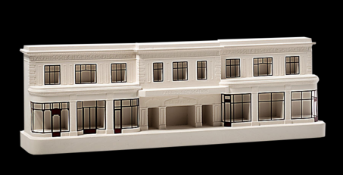

What Enterprise Architecture looks like – 02/02
Every model that is produced and maintained has a price in effort.
All approaches to modelling – formal/informal and broad/narrow – are trade-offs.
Models are consistent representations of things to be understood and analysed.
But models are partial representations of the whole.
Farringdon Station, London
The Architect’s Model
How it is
A Practitioners’ Approach to Developing Enterprise Architecture Following the ADM : Page 15 : §3.2.3
Initially MOD 08
Notes:
Level=2 : L.O.= 1.2b : Explain what an Enterprise Architecture looks like.
See : TOGAF® Series Guide: A Practitioners’ Approach to Developing Enterprise Architecture Following the TOGAF® ADM : Page 15 : §3.2.3
Every model that is produced and maintained has a price in effort
Typically:
narrow, special-purpose models facilitate detailed analysis
broad models facilitate inclusive analysis.
All approaches to modeling – formal/informal and broad/narrow – are trade-offs.
A core unified model can provide a common bridge between discrete models.
The more important a model is to analysis, the more important is the need and clarity of linkage across models.
Models are consistent representations of things to be understood and analyzed.
But models are partial representations of the whole, typically:
described with a limited language
requires experience to read
subject to constraints
tend to require specialist knowledge
tend to be ineffective to communicate usefully
Example:
A balance sheet –
a great model to outline part of an organization’s financial position
requires skill to read
silent on the success, margin, or lifecycle of products
Models are poor general communication tools constrained to exactly tell part of a story.
They carefully render a complex environment into something that represents the world in terms that can be understood, optimized, and compared.
The best communication comes down to views, and “other useful things - purposefully open-ended.
Most of the effective communication about an architecture will be “other useful things”.
3.2.3 What an Enterprise Architecture Looks Like
EA exists to guide and constrain change planning and work to perform the change. The scope of work embedded in a Request for Architecture Work should identify the applicable characteristics of the EA Landscape. Over time, through multiple Architecture Projects, the EA Landscape is populated. This still does not tell us what actually gets written down, nor exactly what is produced.
In short, a Practitioner will need to document three things:
1. Models, in the EA Landscape
2. Views derived from the EA Landscape
... CONTINUES ... SEE REFERENCE SPECIFIED

Slide 7
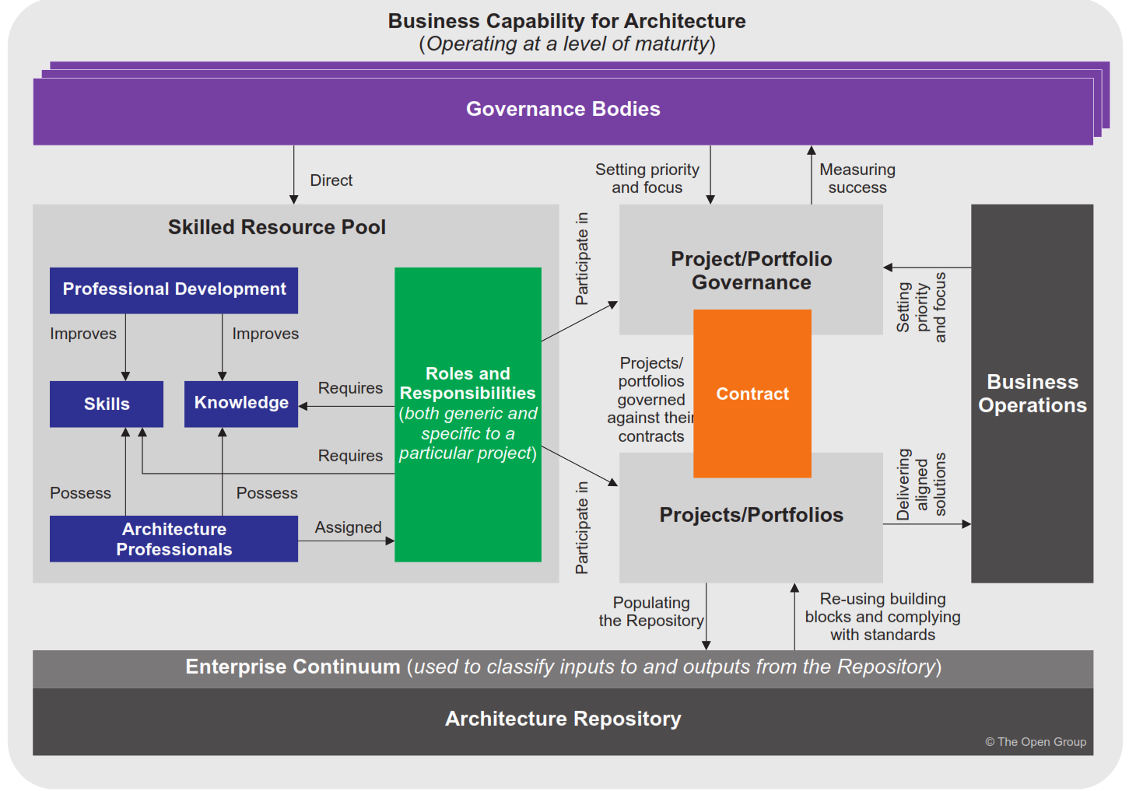
What an Architecture Capability is – 01/02
To carry out architectural activity it is necessary to put in place an appropriate business capability for architecture, through organization structures, roles,
responsibilities, skills, and processes.
Introduction and Core Concepts : Page 33 : §3.13
Initially MOD 08
Notes:
Level=2 : L.O.= 1.3a : Explain what an Architecture Capability is.
See : TOGAF® Standard – Introduction and Core Concepts : Page 33 : §3.13
In order to carry out architectural activity effectively within an enterprise, it is necessary to put in place an appropriate business capability for architecture, through organization structures, roles, responsibilities, skills, and processes.
3.13 Establishing and Maintaining an Enterprise Architecture Capability
In order to carry out architectural activity effectively within an enterprise, it is necessary to put in place an appropriate business capability for architecture, through organization structures, roles, responsibilities, skills, and processes. An overview of the TOGAF Architecture Capability is shown in Figure 3-9.

Slide 8
What an Architecture Capability is – 02/02
The TOGAF Content Framework identifies two sets of work products:
Work products impacting planning, change governance, and benefits realization.
Work products that are used within the EA Capability to produce the first set.
Understanding the EA Capability’s information requirements requires the following questions to be answered:
What is the EA Capability’s purpose in supporting decision-making and governance?
What is the Enterprise Metamodel?
What is the structure of the Architecture Repository?
Are there any other considerations pertinent to the enterprise?
What are the authority, access, and planning divisions for the EA Capability?
How formal should the documentation and work products of the EA Capability be?
The TOGAF Leader’s Guide to Establishing and Evolving an EA Capability : Page 52 : §8
Initially MOD 08
Content Framework or Enterprise Metamodel in V10 – used Enterprise Metamodel.
Notes:
Þ Q-24
Level=2 : L.O.= 1.3b : Explain what an Architecture Capability is.
See : TOGAF® Series Guide: The TOGAF Leader’s Guide to Establishing and Evolving an EA Capability : Page 52 : §8
The TOGAF Content Framework identifies two sets of work products:
work products that impact planning, change governance, and benefits realization
work products that are used within the EA Capability to produce the first set.
Understanding the EA Capability’s information requirements requires the following questions to be answered:
What is the EA Capability’s purpose in supporting decision-making and governance?
What is the Enterprise Content Metamodel?
What is the structure of the architecture repository?
Are there any other considerations pertinent to the enterprise?
What are the authority, access, and planning divisions for the EA Capability?
How formal should the documentation and work products of the EA Capability be?
If using a well-established Content Framework, such as Defense with DoDAF, all of the decisions regarding Content Metamodel and Content Framework have been made by DoDAF.
8 Customization of Architecture Contents and Metamodel
The TOGAF Framework identifies two central concepts: a Content Framework and a Content Metamodel. The TOGAF Content Framework describes the types of work products that will be consumed and produced by an EA Capability. A subset of these will be a formal description or architecture description of a system including the components and their inter-relationships. This subset is the Content Metamodel. Both must be customized based upon the purpose of the EA Capability and the enterprise context.
An EA Capability focused on supporting decision-making for strategy will use a different set of work products than an EA Capability chartered to support governance of projects. This is a critical distinction. The Content Framework and Content Metamodel should be adjusted to align with the charter of the EA Capability. Further, the links between an EA Capability and other functions within an enterprise, such as finance, compliance, and operations aspects, require the EA Capability to fit-in and fill-out.
The TOGAF Content Framework identifies two sets of work products. First, work products that are used by others that impact planning, change governance, and purposeful benefits realization. Second, work products that are used within the EA Capability to produce the first set. An EA Capability produces value in direct relation to the consumed work products that improve planning, change governance, and purposeful benefits realization.
Understanding the EA Capability’s information requirements requires the following questions to be answered:
• What is the EA Capability’s purpose supporting decision-making and governance?
... CONTINUES ... SEE REFERENCE SPECIFIED

Slide 9

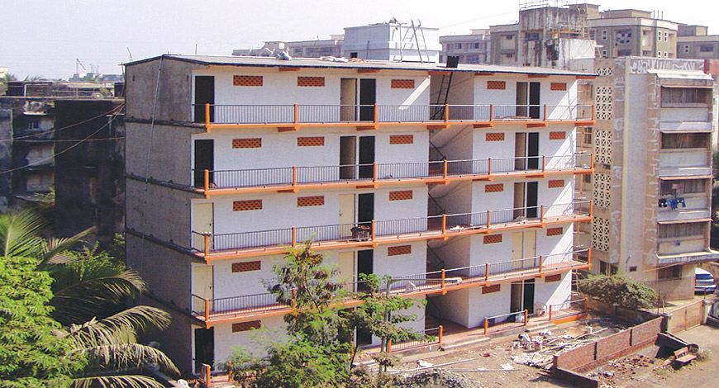
The role of Architecture Governance - 01/02
Two distinct things must be governed:
The development of the Target Architecture
- to support the organization’s leadership in directing and controlling change
All changes within the scope of the Target Architecture
- to validate developing a good target that provides an organization’s best achievable course forward
Baseline
Target
Central to the definition of governance is:
“directs and controls”.
Typically, the Enterprise Architect and implementer are directed and (partly) controlled by the stakeholder.
A Practitioners’ Approach to Developing Enterprise Architecture Following the ADM : Page 108 : §15.1
Initially MOD 08
Notes:
Level=2 : L.O.= 1.4a : Explain the role of Architecture Governance and the role of an Enterprise Architect.
See : TOGAF® Series Guide: A Practitioners’ Approach to Developing Enterprise Architecture Following the TOGAF® ADM : Page 108 : §15.1
Two distinct things must be governed:
the development of the Target Architecture
- to support the organization’s leadership in directing and controlling change
all changes within the scope of the Target Architecture
- to validate developing a good target that provides an organization’s best achievable course forward
Central to the definition of governance is: “directs and controls”.
Typically, the Enterprise Architect and implementer are directed, and partly, controlled by the stakeholder.
15.1 What is Governed and Why?
Two distinct things must be governed. First, the development of the Target Architecture. Second, all change within the scope of the Target Architecture. Without the first, the Practitioner cannot support their organization’s leadership in directing and controlling change. Without the latter, there was no point in developing a good target that provides an organization’s best achievable course forward.
Central to the definition of governance is “directs and controls”. Typically, the Practitioner and implementer are directed, and both are controlled by the stakeholder. This chapter will use the terms direct and control for focus.

Slide 10

The role of Architecture Governance – 02/02
Architectural Governance is necessary to ensure that solutions achieve business targets.
Governance should be: a collaborative and continuous effort.
The architect has a consultative role in this.
The role of the governor is:
An intelligent advisor embedded within a team
The value to Agile Architecture is to provide:
The set of principles and policies to guide the implementation
Not an occasionally visiting policeman
The set of standards and compliance considerations
Surety that the proper governance structures and approvals are in place but in a way that will not constrain the pace of development (including but not limited to Agile development life cycles)
Enabling Enterprise Agility : Page 22 : §4.4.4
Initially MOD 08
Governance is not just for Agile lifecycles – The Enabling Enterprise Agility Series guide included in the source materials for this course identifies four paces
Sprint, Middle Distance, Long Distance and Marathon – so have changed the last bullet.
Notes:
Level=2 : L.O.= 1.4b : Explain the role of Architecture Governance and the role of an Enterprise Architect.
See : TOGAF® Series Guide: Enabling Enterprise Agility : Page 22 : §4.4.4
Architectural governance is necessary:
to ensure that solutions achieve business targets
to address compliance and regulatory requirements
to ensure integrity of the overall endeavour through levels of architecture solution implementation
as a key component of risk management
as a role in providing feedback up through architecture levels when unforeseen difficulties emerge during implementation
Governance should be a collaborative and continuous effort:
between architecture teams at different levels
between architects and delivery teams
key to maintaining good communication and engagement between the different autonomous teams
provide guidance
give them the required freedom to deliver.
The role of the governor is:
an intelligent advisor embedded within a team
not an occasionally visiting policeman
The value to Agile Architecture is to provide:
the set of principles and policies to guide the implementation
the set of standards and compliance considerations
surety that the proper governance structures and approval are in place but in a way that will not constrain the Agile development pace
The architect has a consultative role in this.
4.4.4. Governance in Architecture Iterations
Architectural governance is necessary to ensure that solutions keep on track to achieve business
targets (refer to KPIs from the Strategy level) and compliance and regulatory requirements, and also to
ensure the integrity of the overall endeavour through successive levels of architecture and solution
implementation.
Governance is also a key component of risk management. It is often through governance activities that
wider impacts of local changes are recognized and addressed. Governance also has a role in providing
feedback up through architecture levels where unforeseen difficulties have
... CONTINUES ... SEE REFERENCE SPECIFIED

Slide 11

Architecture Compliance - levels of conformance reviews
Understand clearly the objectives of those soliciting the review; and stay on track and deliver what was asked for.
If it becomes obvious during the discussions that there are other issues that need to be addressed, outside the scope of the requested review, bring it up with the meeting chair afterwards.
Stay "scientific“ …
Ask "open" questions; i.e., questions that do not presume a particular answer.
There are often "hidden agendas" or controversial issues among those soliciting a review.
Treat those being interviewed with respect - they do the best they can under the circumstances in which they are placed.
Help the exercise become a learning experience for you and the presenters.
Reviews should include detailed assessment activities against the architectures.
Enterprise Architecture Capability and Governance : Page 52 : §6.6.2
Initially MOD 08
Notes:
Level=2 : L.O.= 1.5a : Explain Architecture Compliance levels of conformance reviews and the role of the architect.
See : TOGAF® Standard – Enterprise Architecture Capability and Governance : Page 52 : §6.6.2
Understand clearly the objectives of those soliciting the review; and stay on track and deliver what was asked for. For example, they want to know what is right or wrong with the system being architected; not what is right or wrong with the development methodology used, their own management structure, etc.
If it becomes obvious during the discussion that there are other issues that need to be addressed, outside the scope of the requested review, bring it up with the meeting chair afterwards.
Stay "scientific“ … instead of "We like to see large databases hosted on ABC rather than XYZ.", say "The downtime associated with XYZ database environments is much greater than on ABC database environments. Therefore we don’t recommend hosting type M and N systems in an XYZ environment."
Ask "open" questions; i.e., questions that do not presume a particular answer.
There are often "hidden agendas" or controversial issues among those soliciting a review, which you probably won’t know up-front. A depersonalized approach to the discussions may help.
Treat those being interviewed with respect. They may not have built the system "the way it should be", but they probably did the best they could under the circumstances in which they were placed.
Help the exercise become a learning experience for you and the presenters.
Reviews should include detailed assessment activities against the architectures and ensure that the results are stored in the Enterprise Continuum.
6.6.2 Conducting Architecture Compliance Reviews
■ Understand clearly the objectives of those soliciting the review; and stay on track and deliver what was asked for. For example, they typically want to know what is right or wrong
with the system being architected; not what is right or wrong with the development methodology used, their own management structure, etc. It is easy to get off-track and
discuss subjects that are interesting and perhaps worthwhile, but not what was solicited. If you can shed light and insight on technical approaches, but the discussion is not
necessary for the review, volunteer to provide it after the review.
■ If it becomes obvious during the discussion that there are other issues that need to be addressed, which are outside the scope of the requested review, bring it up with the
meeting chair afterwards. A plan for addressing the issues can then be developed in accordance with their degree of seriousness.
... CONTINUES ... SEE REFERENCE SPECIFIED

Slide 12
Alignment to Organizational Objectives – 01/06
There has been a great deal of conversation about aligning with Agile implementation methods
but this has blurred the line between implementation and architecture.
Architecture to support Project and Solution delivery will have
a set of constraints that may or may not limit the choices of the implementation team.
A good Architecture will identify:
What products the Enterprise needs
The boundary of the products
What constraints a product owner has
Phase G serves the stakeholders, guarding the:
Mission
Vision
Goals
Investment roadmap
Enterprise value
A Practitioners’ Approach to Developing Enterprise Architecture Following the ADM : Page 98 : §12.1
Initially MOD 08
Notes:
Level=2 : L.O.= 1.6a : Explain how an architecture enables alignment to organizational objectives using Agile development as an example.
See : TOGAF® Series Guide: A Practitioners’ Approach to Developing Enterprise Architecture Following the TOGAF® ADM : Page 98 : §12.1
There has been a great deal of conversation about aligning to Agile implementation methods but this has blurred the line between implementation and architecture.
The TOGAF standard aligns to Agile development in Phase G. Full Stop. [This is what the manual says – it is ‘a bit contentious’.]
A good Architecture will identify:
what products the Enterprise needs
the boundary of the products
what constraints a product owner has
Architecture to support Project and Solution Delivery will have a set of constraints that limit the choices of the Agile team:
individual product must bend to Enterprise issues
parochial preference of a product owner is not valid
Phase G, Implementation Governance:
The EA serves the stakeholders guarding the:
mission
vision
goals
investment roadmap
enterprise value
12.1 Architecture in an Agile Enterprise
There has been a great deal of conversation about aligning to Agile implementation methods. Ink has been spilled trying to align the phases of the ADM to these development methods. All of this conversation has blurred the line between implementation and architecture. The TOGAF Standard aligns to Agile development in Phase G. Full stop.
A good Architecture to support Portfolio, or Project, will identify what products the Enterprise needs, the boundary of the products, and what constraints a product owner has. In short, a good architecture defines the Enterprise’s backlog.
Architecture to support Project and Solution Delivery will have a set of constraints that limit the choices of the Agile team. These constraints are where an individual product must bend to Enterprise issues and the parochial preference of a product owner is not valid.
Then Phase G, Implementation Governance: the Practitioner serves the stakeholders guarding the mission, vision, goals, and investment roadmap. In short, guarding Enterprise value.

Slide 13
Alignment to Organizational Objectives – 02/06
Top-down direction and planning provides part of the answer for a nimble organization - sometimes the correct decision is to embark on unplanned change.
Every project will have some form of benefits statement.
Phase G is where the Practitioner provides guidance to the Implementation Project - EA Practitioners should look at the context.
EAs must focus on project benefits within the superior architecture of Enterprise benefits realization.
When the EA’s organization is in a hurry, they are focused on receiving value through differentiation and experimentation.
There will be constant micro-iterations exploring discrete statements of the value realized.
In Phase G, the EA is the stakeholders’ agent - be aware of the danger in this dual role.
A Practitioners’ Approach to Developing Enterprise Architecture Following the ADM : Page 96 : §11.4
Initially MOD 08
“EAs must focus not on project benefits but on Enterprise benefits realization” has never made sense so changed the more correct
“EAs must focus on project benefits within the superior architecture of Enterprise benefits realization”
Notes:
Level=2 : L.O.= 1.6b : Explain how an architecture enables alignment to organizational objectives using Agile development as an example.
See : TOGAF® Series Guide: A Practitioners’ Approach to Developing Enterprise Architecture Following the TOGAF® ADM : Page 96 : §11.4
Top-down direction and planning provides part of the answer for a nimble organization - sometimes the correct decision is to embark on unplanned change.
Where the Practitioner has arrived at the implementation of change and stakeholders have less confidence that the project will deliver – at this point EAs have to focus their energy on risk mitigation.
Every project will have some form of benefits statement.
Every organization has some form of strategy. The EA is not expected to correct the project regarding benefits statement and realization plan, instead to mitigate uncertainty regarding realizing the benefits.
Phase G is where the Practitioner provides guidance to the Implementation Project.
While Implementers accommodate the constraints of the project: EAs Practitioners look at the context.
EAs must focus not on project benefits but on Enterprise benefits realization, ensuring the stakeholders understand the implications of their choices.
This is a very fine distinction and is worth reiterating, ensuring stakeholders and implementation teams understand what can be expected.
When the EA’s organization is in a hurry they are focused on receiving value through differentiation and experimentation. A sustained efficiency gain is not achieved without clarifying dependency: focus on value realization.
There will be constant micro-iterations exploring discrete statements of value out, with the purpose of clarifying value and uncertainties - focus on the critical path to value realization.
In Phase G, the EA is the stakeholders’ agent: be aware of the danger in this dual role - guard against:
tunnel vision
personal bias
“tourist dashboard decisions”
1
1.4 Managing Innovation, Creativity, and Circumstance
Top-down direction and planning provides part of the answer for a nimble organization. It provides the guidelines, constraints, and clarity required to make tactical decisions. Sometimes the correct decision is to embark on unplanned change.
... CONTINUES ... SEE REFERENCE

Slide 14
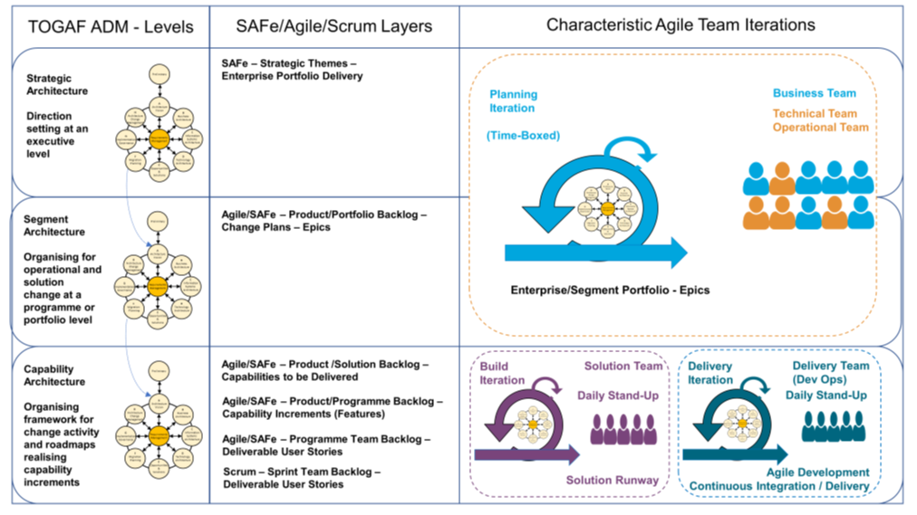
Alignment to Organizational Objectives – 03/06
Different approaches are relevant for different types of change.
TOGAF identifies Robust / Agile / Rapid change.
For more detail on when agile techniques are appropriate – see the Enabling Enterprise Agility Series Guide for the characteristic aspects that identify the most appropriate types of change.
Agile techniques generally apply for smaller scale change and change teams undertaking discovery lead change.
Agile techniques consider that development and delivery work can progress-based on one integrated team across all levels (business, technical, solution, build, and delivery) working in single connected sprints or across the types of boundaries (as shown) that may have separate styles of sprints.
Each level of planning and delivery may cycle through all of the TOGAF phases from A to G.
Enabling Enterprise Agility : Page 22 : §4.5
Initially MOD 08
I finalised this diagram for the Enabling Enterprise Agility Series Guide and wrote the section on different styles and paces of change – it should be noted that specific agile techniques tend to only work well for small teams and small-scale change
Notes:
Level=2 : L.O.= 1.6c : Explain how an architecture enables alignment to organizational objectives using Agile development as an example.
See : TOGAF® Series Guide: Enabling Enterprise Agility : Page 22 : §4.5
Agile techniques consider that development and delivery work can progress based on one integrated team across all levels (business, technical, solution, build, and delivery) working in single connected sprints or across the types of boundaries (as shown) that may have separate styles of sprints.
Each level of planning and delivery may cycle through all of the TOGAF phases from A to G.
4.5. ADM Levels and Phases Mapped to Agile Concepts
As previously described, the TOGAF ADM can be applied to deliver architecture iterations in parallel and partitioned across different levels of detail and change using Strategy, Segment, and Capability Architectures that can be also developed using techniques such as SAFe and Scrum.
Agile techniques consider that development and delivery work can progress based on one integrated team across all levels (business, technical, solution, build, and delivery) working in single connected sprints or across the types of boundaries shown in Figure 5[1] that may have connected but distinctly separate styles of sprints. The exact arrangement will depend on the complexity and scale of each enterprise and the implementation of the Agile approach.
In applying the TOGAF ADM, each level of planning and delivery may cycle through all of the TOGAF® Standard, 10th Edition, 2022 phases from A to G but each of the three levels will often focus on specific elements of the cycle.
In the Strategic level, the focus is more on the Preliminary Phase (if architecture capability changes are needed) and Phases A and B to provide the basis to define the cross-enterprise and strategic change time horizon view. This generates a series of strategic high-level plans known as courses of action.
Agile techniques typically address this with concepts such as high-level strategic themes, and the highest level of an enterprise product portfolio backlog. In this level, interdisciplinary teams (business and technical teams and those that create, implement, and operate) must be involved to develop an Enterprise Architecture that meets both the business goals and objectives of the enterprise and is also potentially deliverable.
In the Segment level, the focus is on partitioning the courses of action across the relevant organization units (based on an understanding of the desired business capabilities and value
... CONTINUES ... SEE REFERENCE SPECIFIED

Slide 15
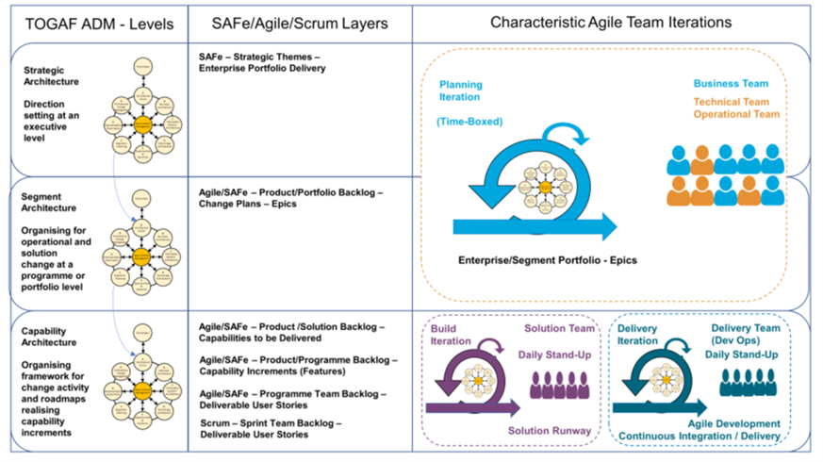
Alignment to Organizational Objectives – 04/6
Strategic level - the focus is more on the Preliminary Phase (if architecture capability changes are needed) and on Phases A and B to provide the basis used to define the cross-enterprise and strategic change time horizon view.
This generates a series of strategic high-level plans known as courses of action.
Agile techniques typically address this with concepts such as high-level strategic themes, and the highest level of an enterprise product portfolio backlog. In this level, interdisciplinary teams must be involved to develop an Enterprise Architecture that meets both the business goals and objectives of the enterprise and is also potentially deliverable.
Enabling Enterprise Agility : Page 22 : §4.5
Initially MOD 08
Notes:
Level=2 : L.O.= 1.6c : Explain how an architecture enables alignment to organizational objectives using Agile development as an example.
See : TOGAF® Series Guide: Enabling Enterprise Agility : Page 22 : §4.5
Strategic level - the focus is more on the Preliminary Phase (if architecture capability changes are needed) and on Phases A and B to provide the basis to define the cross-enterprise and strategic change time horizon view:
This generates a series of strategic high-level plans known as courses of action.
Agile techniques typically address this with concepts such as high-level strategic themes, and the highest level of an enterprise product portfolio backlog. In this level, interdisciplinary must be involved to develop an Enterprise Architecture that meets both the business goals and objectives of the enterprise and is also potentially deliverable.
4.5. ADM Levels and Phases Mapped to Agile Concepts
As previously described, the TOGAF ADM can be applied to deliver architecture iterations in parallel and partitioned across different levels of detail and change using Strategy, Segment, and Capability Architectures that can be also developed using techniques such as SAFe and Scrum.
Agile techniques consider that development and delivery work can progress based on one integrated team across all levels (business, technical, solution, build, and delivery) working in single connected sprints or across the types of boundaries shown in Figure 5[1] that may have connected but distinctly separate styles of sprints. The exact arrangement will depend on the complexity and scale of each enterprise and the implementation of the Agile approach.
In applying the TOGAF ADM, each level of planning and delivery may cycle through all of the TOGAF® Standard, 10th Edition, 2022 phases from A to G but each of the three levels will often focus on specific elements of the cycle.
In the Strategic level, the focus is more on the Preliminary Phase (if architecture capability changes are needed) and Phases A and B to provide the basis to define the cross-enterprise and strategic change time horizon view. This generates a series of strategic high-level plans known as courses of action.
Agile techniques typically address this with concepts such as high-level strategic themes, and the highest level of an enterprise product portfolio backlog. In this level, interdisciplinary teams (business and technical teams and those that create, implement, and operate) must be involved to develop an Enterprise Architecture that meets both the business goals and objectives of the enterprise and is also potentially deliverable.
... CONTINUES ... SEE REFERENCE SPECIFIED

Slide 16
Alignment to Organizational Objectives – 05/06
Segment level - the focus is on partitioning the courses of action across the relevant organizational units. If information acquired from Phases A and B is insufficient, then explore Phases B, C and D in greater detail.
Factor work to self-organizing teams (per organization unit structure) with a high-level iteration through Phases C and D - to provide more detailed information - going deeper into smaller organization areas (segments).
Outputs of this iteration: Epics that reflect large/long-running user stories, and the segment-based initial portfolio and/or backlog.
The output from this level can be used to test and experiment with new products, delivering
descriptions for prototypes to test ideas into the relevant segment market.
Enabling Enterprise Agility : Page 22 : §4.5
Initially MOD 08
Notes:
Level=2 : L.O.= 1.6c : Explain how an architecture enables alignment to organizational objectives using Agile development as an example.
See : TOGAF® Series Guide: Enabling Enterprise Agility : Page 22 : §4.5
Segment level the focus is on partitioning the courses of action across the relevant organization units.
If information acquired from Phases A and B is insufficient, then explore Phases B, C, and D in greater detail:
Factor work to self-organizing teams (per organization unit structure) with a high-level iteration through Phases C and D - to provide more detailed information - going deeper into smaller organization areas (segments). Outputs of this iteration: Epics that reflect large/long-running user stories, and the segment-based initial portfolio and/or backlog.
The output from this level can be used to test and experiment with new products delivering descriptions for prototypes to test ideas into the relevant segment market.
4.5. ADM Levels and Phases Mapped to Agile Concepts
As previously described, the TOGAF ADM can be applied to deliver architecture iterations in parallel and partitioned across different levels of detail and change using Strategy, Segment, and Capability Architectures that can be also developed using techniques such as SAFe and Scrum.
Agile techniques consider that development and delivery work can progress based on one integrated team across all levels (business, technical, solution, build, and delivery) working in single connected sprints or across the types of boundaries shown in Figure 5[1] that may have connected but distinctly separate styles of sprints. The exact arrangement will depend on the complexity and scale of each enterprise and the implementation of the Agile approach.
In applying the TOGAF ADM, each level of planning and delivery may cycle through all of the TOGAF® Standard, 10th Edition, 2022 phases from A to G but each of the three levels will often focus on specific elements of the cycle.
In the Strategic level, the focus is more on the Preliminary Phase (if architecture capability changes are needed) and Phases A and B to provide the basis to define the cross-enterprise and strategic change time horizon view. This generates a series of strategic high-level plans known as courses of action.
Agile techniques typically address this with concepts such as high-level strategic themes, and the highest level of an enterprise product portfolio backlog. In this level, interdisciplinary teams (business
... CONTINUES ... SEE REFERENCE SPECIFIED

Slide 17
Alignment to Organizational Objectives – 06/06
Capability level: is operationally completed in Phase G, Implementation Governance.
Ensures the agreed contracts have been delivered:
The expected capability
All of the required information for operating and changing the output is properly created
It confirms benefits realization in Phase H – ensuring:
Operational and business performance is evaluated to confirm that the value has in fact been delivered
That the users of the output are satisfied with the business outcomes of that capability increment
That the evolving Segment and/or Strategic-level change projects are operating within the appropriate areas
Enabling Enterprise Agility : Page 22 : §4.5
Initially MOD 08
Notes:
Level=2 : L.O.= 1.6c : Explain how an architecture enables alignment to organizational objectives using Agile development as an example.
See : TOGAF® Series Guide: Enabling Enterprise Agility : Page 22 : §4.5
Capability level: is operationally completed in Phase G, Implementation Governance.
Ensures the agreed contracts have delivered:
the expected capability
all of the required information for operating and changing the output is properly created
It confirms benefits realization in Phase H – ensuring:
operational and business performance is evaluated to confirm that the value has in fact been delivered
that the users of the output are satisfied with the business outcomes of that capability increment
that the evolving Segment and/or Strategic-level change projects are operating within the appropriate areas
There may be pressure to move forward beyond the end of the runway defined by the Capability Architecture at a given point in time. This is a type of technical debt that needs careful
management to ensure it does not get out of control.
This should be addressed in Phase H, Architecture Change Management.

Slide 18
Manage multiple architecture states – 01/02
Track transition states across two characteristics:
Time
Conformance testing
It is good practice to architect to value resting states –
a state where the Enterprise can receive value if all change activity is suspended.
Budget cycle pressure often forces time as the pragmatic transition marker.
To the extent possible, minimize transition states.
When considering transition states keep in mind the distinction between:
An Architecture Requirements Specification
An implemented system
Bear in mind that many implementations or operational changes are not architecturally significant.
A Practitioners’ Approach to Developing Enterprise Architecture Following the ADM : Page 51 : §5.4
Initially MOD 08
Notes:
Level=2 : L.O.= 1.7a : Explain the need to manage multiple architecture states (e.g. candidate current transition target).
See : TOGAF® Series Guide: A Practitioners’ Approach to Developing Enterprise Architecture Following the TOGAF® ADM : Page 51 : §5.4
Track transition states across two characteristics:
time
conformance test
Good practice is to architect to value resting states – a state where the Enterprise can receive value if all change activity is suspended.
Budget cycle pressure often forces time as the pragmatic transition marker.
Tracking to change in conformance facilitates the Implementation Project and operational change governance.
To the extent possible, you should seek to minimize transition states.
When considering transition states, keep in mind the distinction between:
an Architecture Requirements Specification
an implemented system.
5.4 Managing Multiple States (Candidate, Current, Transition, and Target)
The Practitioner must track transition states across two characteristics: the first being time, and the second being a conformance test. Theoretically, it might be preferable to use transitions to track the value resting places and changes in conformance. Good practice is to architect to value resting states; a state where the Enterprise can receive value if all change activity is suspended. However, the pressure of the budget cycle forces us to use time is a pragmatic transition marker. Tracking to change in conformance facilitates the Implementation Project and operational change governance. To the extent possible, minimize transition states.
When considering transition states, the Practitioner needs to keep in mind the distinction between an Architecture Requirements Specification and an implemented system. Using the EA Repository as a CMDB confuses implementation record keeping and architecture. Practitioners have to keep in mind that many implementations or operational changes are not architecturally significant. See Chapter 15 for a discussion of the different roles involved in developing and using architecture.

Slide 19
Manage multiple architecture states – 02/02
A linear timescale oversimplifies the reality.
Creating a well aligned set of work packages vectored by business cycle and planning horizon does NOT give potential transition states or a near linear roadmap.
Additional/other organizational factors that add to complexity are:
Advancements and changes outside the Enterprise
Shared services
Collaboration with suppliers and partners, including portfolio ownership models
Impenetrable dependencies
Multiple geopolitical boundaries (fiscal calendars, regulations, cultures)
Varying rates of maturity and growth of teams
EA team model (federated, centralized, etc.)
Availability of multiple solutions or announcement of end-of-life for current products
One Enterprise roadmap gets broken down into segment, portfolio, or geography.
The Enterprise will be pursuing more than one concurrent goal, e.g. efficiency and retooling.
For each business cycle, the roadmap is revisited to make adjustments, both bottom-up and top-down.
A good EA Repository that maintains the integrity of the current state and target state.
A Practitioners’ Approach to Developing Enterprise Architecture Following the ADM : Page 101 : §13
Initially MOD 08
Notes:
Þ Q-29
Level=2 : L.O.= 1.7b : Explain the need to manage multiple architecture states (e.g. candidate current transition target).
See : TOGAF® Series Guide: A Practitioners’ Approach to Developing Enterprise Architecture Following the TOGAF® ADM : Page 101 : §13
A linear timescale oversimplifies the reality.
Creating a well aligned set of work packages vectored by business cycle and planning horizon does NOT give potential transition states or a near linear roadmap.
Additional/other organizational factors that add to complexity are:
Advancements and changes outside the Enterprise
Shared services
Collaboration with suppliers and partners, including portfolio ownership model
Impenetrable dependencies
Multiple geopolitical boundaries (fiscal calendars, regulations, cultures)
Varying rate of maturity and growth of teams
EA team model (federated, centralized, etc.)
Availability of multiple solutions or announcement of end-of-life for current products
One Enterprise roadmap gets broken down into segment, portfolio, or geography.
The Enterprise will be pursuing more than one concurrent goal, e.g. efficiency and retooling.
For each business cycle, the roadmap is revisited to make adjustments, both bottom-up and top-down.
This is a clear use-case that drives the need for a good EA Repository that maintains the integrity of the current state and target state.
13 Transition Architecture: Managing Complex Roadmaps
Until now, this Guide made the effort and process simple by describing most of the concepts using a linear time scale. It gave an impression that creating a well aligned set of work packages vectored by business cycle and planning horizon gives you potential transition states and a near linear roadmap. Recall this simple statement made in Chapter 5 in the context of the EA Repository: “Baseline provides reference for all change. The target state is what stakeholders have approved. Transition states are partially realized targets between current state and target state. Mix the four characteristics of the EA Landscape: breadth, depth, time, and recency. Mix the different Architecture Projects that can work on the same subject at different times and at different levels of detail.” That’s the only hint to indicate real-world complexity.
In addition to characteristics, other organizational factors that add to complexity are:
• Advancements and changes outside the Enterprise
• Shared services
• Collaboration with suppliers and partners, including portfolio ownership model
• Impenetrable dependencies
... CONTINUES ... SEE REFERENCE SPECIFIED

Slide 20

Gap Analysis – 01/07
What may have been forgotten – and how to find it?
The architecture must support all of the essential information processing needs of the organization.
The most critical source of gaps - stakeholder concerns that have not been addressed in prior architectural work.
Potential sources include:
Business domain gaps
Financial gaps
Data domain gaps
Applications impacted
Technologies impacted
ADM Techniques : Page 45 : §5.1
Initially MOD 16
Moved to Context section where it should be
Notes:
Level=2 : L.O.= 8.12a : Explain the technique of gap analysis and where it can be applied.
See: TOGAF® Standard – ADM Techniques : Page 45 : §5.1
What may have been forgotten – and how to find it?
The architecture must support all of the essential information processing needs of the organization.
The most critical source of gaps - stakeholder concerns that have not been addressed in prior architectural work.
Potential sources include:
Business domain gaps:
People gaps (e.g., cross-training requirements)
Process gaps (e.g., process inefficiencies)
Tools gaps (e.g., duplicate or missing tool functionality)
Information gaps
Measurement gaps
Financial gaps
Facilities gaps (buildings, office space, etc.)
Data domain gaps:
Data not of sufficient currency
Data not located where it is needed
Not the data that is needed
Data not available when needed
Data not created
Data not consumed
Data relationship gaps
Applications impacted, eliminated, or created
Technologies impacted, eliminated, or created
5.1 Introduction
A key step in validating an architecture is to consider what may have been forgotten. The architecture must support all of the essential information processing needs of the organization.
The most critical source of gaps that should be considered is stakeholder concerns that have not been addressed in prior architectural work.
Potential sources of gaps include:
■ Business domain gaps:
— People gaps (e.g., cross-training requirements)
— Process gaps (e.g., process inefficiencies)
... CONTINUES ... SEE REFERENCE SPECIFIED

Slide 21
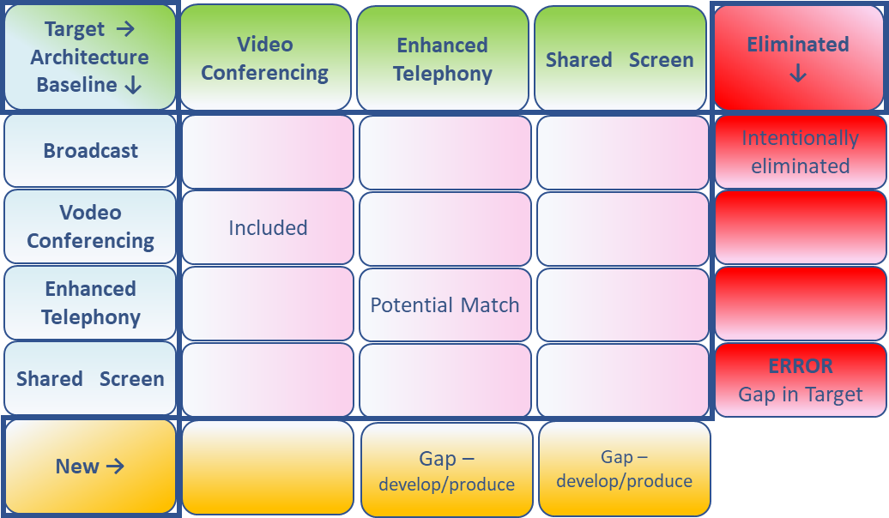
Gap Analysis – 02/07
Suggested Steps
Draw up a matrix with:
  All the ABBs of the Baseline Architecture on the vertical axis
  All the ABBs of the Target Architecture on the horizontal axis
Add to the Baseline Architecture axis a final row labelled "New", and to the Target Architecture axis a final column labelled "Eliminated"
Where an ABB is available in both the Baseline and Target Architectures, record this with "Included" at the intersection
Where an ABB from the Baseline Architecture is missing in the Target Architecture, each must be reviewed:
  If it was correctly eliminated, mark it as such in the appropriate "Eliminated" cell.
  If it was not, an accidental omission in the Target Architecture has been uncovered that must be addressed by reinstating the ABB in the next iteration of the architecture design — mark it as such in the appropriate "Eliminated" cell.
Where an ABB from the Target Architecture cannot be found in the Baseline Architecture, mark it at the intersection with the "New" row as a gap that needs to filled, either by developing or procuring the building block.
The GAP Matrix
Video Conferencing
Anything under "Eliminated" or "New" is a Gap, which should either be explained as correctly eliminated,
marked as to be addressed by reinstating or developing/procuring the building block.
ADM Techniques : Page 46 : §5.2
Initially MOD 16
Moved to Context section where it should be
Notes:
Level=2 : L.O.= 8.12b : Explain the technique of gap analysis and where it can be applied.
See: TOGAF® Standard – ADM Techniques : Page 46 : §5.2
Suggested Steps
Draw up a matrix with:
all the ABBs of the Baseline Architecture on the vertical axis
all the ABBs of the Target Architecture on the horizontal axis
Add to the Baseline Architecture axis a final row labelled "New", and to the Target Architecture axis a final column labeled "Eliminated"
Where an ABB is available in both the Baseline and Target Architectures, record this with "Included" at the intersection
Where an ABB from the Baseline Architecture is missing in the Target Architecture, each must be reviewed.
if it was correctly eliminated, mark it as such in the appropriate "Eliminated" cell.
if it was not, an accidental omission in the Target Architecture has been uncovered that must be addressed by reinstating the ABB in the next iteration of the architecture design — mark it as such in the appropriate "Eliminated" cell.
Where an ABB from the Target Architecture cannot be found in the Baseline Architecture, mark it at the intersection with the "New" row as a gap that needs to filled, either by developing or procuring the building block.
Anything under "Eliminated" or "New" is a Gap, which should either be explained as correctly eliminated, marked as to be addressed by reinstating, or developing/procuring the building block.
5.2 Suggested Steps
The suggested steps are as follows:
■ Draw up a matrix with all the ABBs of the Baseline Architecture on the vertical axis, and all the ABBs of the Target Architecture on the horizontal axis
■ Add to the Baseline Architecture axis a final row labeled "New", and to the Target Architecture axis a final column labeled "Eliminated"
■ Where an ABB is available in both the Baseline and Target Architectures, record this with "Included" at the intersecting cell
■ Where an ABB from the Baseline Architecture is missing in the Target Architecture, each must be reviewed
If it was correctly eliminated, mark it as such in the appropriate "Eliminated" cell. If it was not, an accidental omission in the Target Architecture has been uncovered that must be addressed by reinstating the ABB in the next iteration of the architecture design — mark it as such in the appropriate "Eliminated" cell.
■ Where an ABB from the Target Architecture cannot be found in the Baseline Architecture, mark it at the intersection with the "New" row as a gap that needs to filled, either by
... CONTINUES ... SEE REFERENCE SPECIFIED

Slide 22
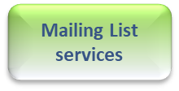
Gap Analysis – 03/07
Example analysis for Architecture Building Blocks . . .
Services from the Network Services category of the Technical Reference Model (TRM) show a number of Services from the Baseline Architecture missing from the Target.
Target →
Architecture
Baseline ↓
Video Conferencing
Enhanced Telephony
Shared Screen
Eliminated
↓
Broadcast
Intentionally eliminated
Video Conferencing
Included
Enhanced Telephony
Potential Match
Shared Screen
ERROR
Gap in Target
New →
Gap –
develop/produce
Gap –
develop/produce
ADM Techniques : Page 45 : §5
Initially MOD 16
Moved to Context section where it should be
Notes:
Level=2 : L.O.= 8.12b : Explain the technique of gap analysis and where it can be applied.
See: TOGAF® Standard – ADM Techniques : Page 46 : §5.2
Example analysis for Architecture Building Blocks . . .
Services from the Network Services category of the Technical Reference Model (TRM) show a number of Services from the Baseline Architecture missing from the Target.
5 Gap Analysis
The technique known as Gap Analysis is widely used in the TOGAF Architecture Development Method (ADM) to validate an architecture that is being developed. The basic premise is to highlight a shortfall between the Baseline Architecture and the Target Architecture; that is, items that have been deliberately omitted, accidentally left out, or not yet defined.
5.1 Introduction
A key step in validating an architecture is to consider what may have been forgotten. The architecture must support all of the essential information processing needs of the organization.
The most critical source of gaps that should be considered is stakeholder concerns that have not been addressed in prior architectural work.
Potential sources of gaps include:
■ Business domain gaps:
— People gaps (e.g., cross-training requirements)
— Process gaps (e.g., process inefficiencies)
— Tools gaps (e.g., duplicate or missing tool functionality)
— Information gaps
— Measurement gaps
— Financial gaps
— Facilities gaps (buildings, office space, etc.)
■ Data domain gaps:
— Data not of sufficient currency
— Data not located where it is needed
— Not the data that is needed
— Data not available when needed
— Data not created
— Data not consumed
— Data relationship gaps
■ Applications impacted, eliminated, or created
... CONTINUES ... SEE REFERENCE SPECIFIED

Slide 23

Gap Analysis – 04/07
Sort – each domain, to gather Gaps
Target →
Architecture
Baseline ↓
Enhanced Telephony
Shared Screen
Video Conferencing
Eliminated
↓
Broadcast
Intentionally eliminated
Elimination
or Error
- Rows
Shared Screen
ERROR
Gap in Target
Enhanced Telephony
Potential Match
Video Conferencing
Included
Perform this process for each domain
New →
Gap –
develop/produce
Gap –
develop/produce
Target →
Architecture
Baseline ↓
Enhanced Telephony
Shared Screen
Video Conferencing
Eliminated
↓
Target →
Architecture
Baseline ↓
Enhanced Telephony
Shared Screen
Video Conferencing
Eliminated
↓
New Gap - Columns
Target →
Architecture
Baseline ↓
Enhanced Telephony
Shared Screen
Video Conferencing
Eliminated
↓
Technology
Data
Application
Business
Target →
Architecture
Baseline ↓
Enhanced Telephony
Shared Screen
Video Conferencing
Eliminated
↓
Broadcast
Intentionally eliminated
Broadcast
Intentionally eliminated
Broadcast
Intentionally eliminated
Shared Screen
Broadcast
ERROR
Gap in Target
Consolidate all Gap rows/columns on one sheet
Sort Columns by precursor/priority
= Consolidated Gaps ordered by work-order
Intentionally eliminated
ERROR
Gap in Target
Enhanced Telephony
Potential Match
ERROR
Gap in Target
Shared Screen
ERROR
Gap in Target
Enhanced Telephony
Potential Match
Enhanced Telephony
Potential Match
Vodeo Conferencing
Enhanced Telephony
Potential Match
Included
Vodeo Conferencing
Included
Vodeo
Included
New →
Gap –
develop/produce
Video Conferencing
Gap –
develop/produce
Included
New →
Gap –
develop/produce
Gap –
develop/produce
New →
Gap –
develop/produce
Gap –
develop/produce
New →
Gap –
develop/produce
Gap –
develop/produce
ADM Techniques : Page 45 : §5
Initially MOD 16
Moved to Context section where it should be
Notes:
Level=2 : L.O.= 8.12b : Explain the technique of gap analysis and where it can be applied.
See: TOGAF® Standard – ADM Techniques : Page 46 : §5.2
5.2 Suggested Steps
The suggested steps are as follows:
■ Draw up a matrix with all the ABBs of the Baseline Architecture on the vertical axis, and all the ABBs of the Target Architecture on the horizontal axis
■ Add to the Baseline Architecture axis a final row labeled "New", and to the Target Architecture axis a final column labeled "Eliminated"
■ Where an ABB is available in both the Baseline and Target Architectures, record this with "Included" at the intersecting cell
■ Where an ABB from the Baseline Architecture is missing in the Target Architecture, each must be reviewed
If it was correctly eliminated, mark it as such in the appropriate "Eliminated" cell. If it was not, an accidental omission in the Target Architecture has been uncovered that must be addressed by reinstating the ABB in the next iteration of the architecture design — mark it as such in the appropriate "Eliminated" cell.
■ Where an ABB from the Target Architecture cannot be found in the Baseline Architecture, mark it at the intersection with the "New" row as a gap that needs to filled, either by developing or procuring the building block
When the exercise is complete, anything under "Eliminated" or "New" is a gap, which should either be explained as correctly eliminated, or marked as to be addressed by reinstating or developing/procuring the building block.
5.3 Example
Figure 5-1 shows an example analysis for ABBs that are services from the Network Services category of the TOGAF Technical Reference Model (TRM), indicating that a number of services from the Baseline Architecture are missing from the Target Architecture– ADM Techniques : Page 45 : §5

Slide 24
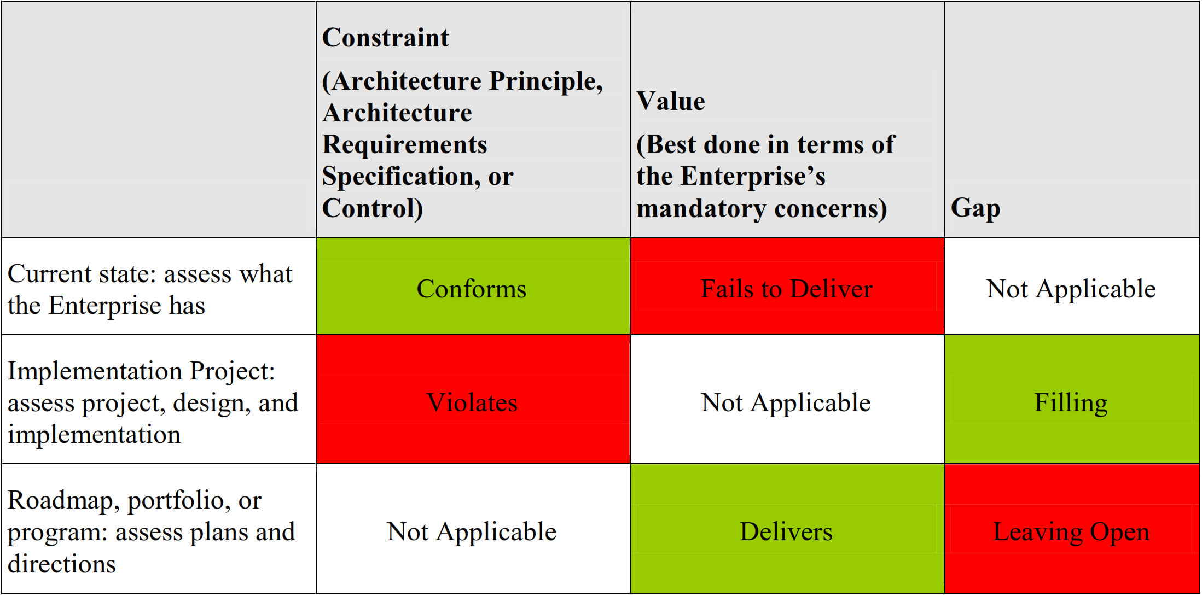
Gap Analysis – 05/07
It is good practice to continuously assess in-flight change.
Consider using summary reporting with a high visual impact.
Binary test preferred: compliance and non-compliance (Red/Green)
Else: 1-to-3 scale (Red/Yellow/Green) should be sufficient.
Example: reporting against constraints, expected value, and known gaps.
A Practitioners’ Approach to Developing Enterprise Architecture Following the ADM : Page 114 : §15.2.3
Initially MOD 16
Moved to Context section where it should be
Notes:
Level=2 : L.O.= 8.12b : Explain the technique of gap analysis and where it can be applied.
See : TOGAF® Standard – ADM Techniques : Page 46 : §5.2
5.2 Suggested Steps
The suggested steps are as follows:
■ Draw up a matrix with all the ABBs of the Baseline Architecture on the vertical axis, and all the ABBs of the Target Architecture on the horizontal axis
■ Add to the Baseline Architecture axis a final row labeled "New", and to the Target Architecture axis a final column labeled "Eliminated"
■ Where an ABB is available in both the Baseline and Target Architectures, record this with "Included" at the intersecting cell
■ Where an ABB from the Baseline Architecture is missing in the Target Architecture, each must be reviewed
If it was correctly eliminated, mark it as such in the appropriate "Eliminated" cell. If it was not, an accidental omission in the Target Architecture has been uncovered that must be addressed by reinstating the ABB in the next iteration of the architecture design — mark it as such in the appropriate "Eliminated" cell.
■ Where an ABB from the Target Architecture cannot be found in the Baseline Architecture, mark it at the intersection with the "New" row as a gap that needs to filled, either by developing or procuring the building block
When the exercise is complete, anything under "Eliminated" or "New" is a gap, which should either be explained as correctly eliminated, or marked as to be addressed by reinstating or developing/procuring the building block.
5.3 Example
Figure 5-1 shows an example analysis for ABBs that are services from the Network Services category of the TOGAF Technical Reference Model (TRM), indicating that a number of services from the Baseline Architecture are missing from the Target Architecture– ADM Techniques : Page 45 : §5

Slide 25
Gap Analysis – 06/07
Develop Target, Baseline, and Gap enough for purpose
The only reason to describe the baseline is to develop gaps.
If stakeholders or SMEs dispute the current state, especially its fitness to objective, then describing current state to get an alignment is useful.
Limit description to where there is a gap.
If no change and/or it is not needed for traceability, why spend time describing it?
How to describe the current state?
Use the exact same techniques as the candidate - at the same level of detail to enable identification of gaps.
Gaps are simply ‘everything that changes’.
A Practitioners’ Approach to Developing Enterprise Architecture Following the ADM : Page 56 : §6.3.2
Initially MOD 16
Moved to Context section where it should be
Notes:
Þ Q-34
Level=2 : L.O.= 8.12c : Explain the technique of gap analysis and where it can be applied.
See: TOGAF® Series Guide: A Practitioners’ Approach to Developing Enterprise Architecture Following the TOGAF® ADM : Page 56 : §6.3.2
6.3.2 Develop Target, Baseline, and Gap
Just enough for the purpose.
If the current state is accepted, the only reason to describe the baseline is to develop gaps. If stakeholders, or SMEs, dispute the current state, especially its fitness to objective, then describing current state to get an alignment is useful. Otherwise, let us re-iterate: only to the extent necessary to determine gaps.
Consider the limitation of restricting description to where there is a gap. If part of the EA Landscape will have no change, and is not needed for traceability, what useful reason is there for a Practitioner to spend time describing it?
A recurrent question is how to describe the current state. Frankly, use the exact same techniques as the candidate. Description using the same technique at the same level of detail enables identification of gaps. A gap is simply everything that changes.

Slide 26
Gap Analysis – 07/07
The process of Gap Analysis results in a formal statement of the difference between:
  Baseline (current state)
  Target (future state)
Potential sources of Gaps include, for example:
  Business domain gaps
  Data domain gaps
  Technologies - eliminated, or created
ADM Techniques : Page 49 : §6
Initially MOD 14
Notes:
Level=2 : L.O.= 8.4a : Explain how migration planning techniques are used to review and consolidate the gap analysis results from earlier phases.
See: TOGAF® Standard – ADM Techniques : Page 49 : §6
The process of Gap Analysis, in TOGAF, results in a formal statement of the difference between the Baseline (current state) and the Target (future state).
Potential sources of Gaps include, for example:
Business domain gaps:
People gaps (e.g., cross-training requirements)
Process gaps (e.g., process inefficiencies)
Tools gaps (e.g., duplicate or missing tool functionality)
Information gaps
Measurement gaps
Financial gaps
Facilities gaps (buildings, office space, etc.)
Applications impacted, eliminated, or created
Data domain gaps:
Data not of sufficient currency
Data not located where it is needed
Not the data that is needed
Data not available when needed
Data not created
Data not consumed
Data relationship gaps
Technologies impacted, eliminated, or created
6.2 Consolidated Gaps, Solutions, & Dependencies Matrix
The technique of creating a Consolidated Gaps, Solutions, and Dependencies matrix allows the architect to group the gaps identiﬁed in the domain architecture gap analysis results and assess potential solutions and dependencies to one or more gaps.
This matrix can be used as a planning tool when creating work packages. The identiﬁed dependencies will drive the creation of projects and migration planning in Phases E and F.
An example matrix is shown in Figure 6-2.

Slide 27
Summary of Module 08
The 16 Learning Points covered in Module 08 are:
​
The 17 Learning points covered in Module 08 are:
1.2a/b : Explain what an Enterprise Architecture looks like.
1.3a/b : Explain what an Architecture Capability is.
1.4a/b : Explain the role of Architecture Governance and the role of an Enterprise Architect.
1.5a/c : Explain Architecture Compliance levels of conformance reviews and what the roles of the architect building blocks are and their use in the ADM.
1.6a/c : Explain how an architecture enables alignment to organizational objectives using Agile development as an example.
1.7a/b : Explain the need to manage multiple architecture states (e.g. candidate current transition target).
8.12a/c : Explain the technique of Gap Analysis and where it can be applied.
Initially MOD 08
“This is module 08 not fifteen so updated the first line to Module 08 and ther are 14 learning points not 20.

Slide 28
End of Teaching Slides
End of
Module 08
The Context for Enterprise Architecture
Initially MOD 08

Slide 29

Module 09/16
TOGAF® EA Training - Practitioner
TOGAF® Standard, 10th Edition
Module 09
Stakeholder Management
TOGAF® is a registered trademark of The Open Group Copyright © The Open Group 2022
​
Initially MOD 09

Slide 30
Course Module Index
# | Topic – Level 1 | ✓
1 | Module 00 - Course Introduction | ✓
2 | Module 01 - Overview | ✓
3 | Module 02 - Concepts | ✓
4 | Module 03 - Introduction to the ADM | ✓
5 | Module 04 - Introduction to the ADM - Techniques | ✓
6 | Module 05 – Applying ADM | ✓
7 | Module 06 - Architecture Governance | ✓
8 | Module 07 – Architecture Content | ✓
# | Topic – Level 2 | ✓
9 | Module 00 - Course Introduction | ✓
10 | Module 08 - The Context for Enterprise Architecture | ✓
11 | Module 09 – Stakeholder Management
12 | Module 10 – Phase A
13 | Module 11 – Architecture Development
14 | Module 12 – Implementing the Architecture
15 | Module 13 – Architecture Change Management
16 | Module 14 – Requirements Management
17 | Module 15 – Supporting the ADM Work
18 | Module 16 – Closure
Course Module Index
Initially MOD 09

Slide 31
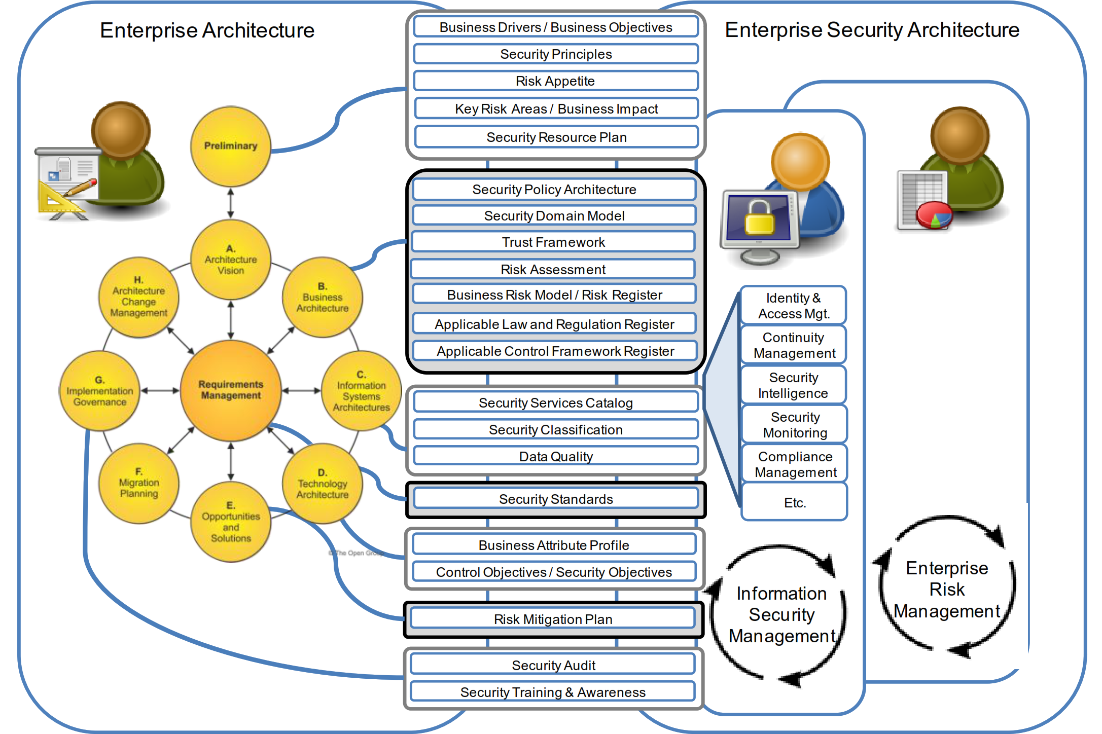
Security Stakeholders - Enterprise Security Architecture
Enterprise Architecture includes Security Architecture.
Information Security has long been considered a separate discipline.
Organizational
Conceptual
Logical
Physical
A Security Architecture is a structure of:
components that interact coherently.
Enterprise Security Architecture builds on existing enterprise information.
The diagram shows [centre column] how Enterprise Architecture and Enterprise Security Architecture relate to each other, highlighting the core security and risk concepts that are used in Information Security Management (ISM) and Enterprise Risk Management (ERM).
Concepts with heavy outline = additions to the TOGAF framework, brought in by ISM or ERM.
Integrating Risk and Security within a Enterprise Architecture : Page 1 : §1
Initially MOD 09
Added security stakeholders to the heading to make it make sense in a module on Stakeholders.
Notes:
Level=2 : L.O.= 1.8a : Briefly explain Enterprise Security Architecture.
See : TOGAF® Series Guide: Integrating Risk and Security within a TOGAF® Enterprise Architecture : Page 1 : §1
Enterprise Architecture includes Security Architecture and is about aligning business systems and supporting information systems to realize business goals in an effective and efficient manner .
Information security has long been considered a separate discipline, isolated from the business processes and Enterprise Architecture.
A Security Architecture is a structure of:
Organizational
Conceptual
Logical
Physical
components that interact in a coherent fashion in order to achieve and maintain a state of managed risk and security (or information security).
An Enterprise Security Architecture builds on enterprise information that is already available in the Enterprise Architecture – also produces information that influences the Enterprise Architecture.
Close integration of Security Architecture in the Enterprise Architecture is beneficial.
Security Architects and Enterprise Architects need to speak the same language to integrate security and risk into an Enterprise Architecture.
The diagram shows [centre column] how Enterprise Architecture and Enterprise Security Architecture relate to each other, highlighting the core security and risk concepts that are used in Information Security Management (ISM) and Enterprise Risk Management (ERM).
Concepts with heavy outline are additions to the TOGAF framework and brought in by ISM or ERM.
1 Introduction
Enterprise Architecture (including Security Architecture) is all about aligning business systems
and supporting information systems to realize business goals in an effective and efficient manner
(systems being the combination of processes, people, and technology). One of the important
quality aspects of an Enterprise Architecture is information security and the way this can be
managed. For too long, information security has been considered a separate discipline, isolated
from the business processes and Enterprise Architecture.
A Security Architecture is a structure of organizational, conceptual, logical, and physical
components that interact in a coherent fashion in order to achieve and maintain a state of
managed risk and security (or information security). It is both a driver and enabler of secure,
... CONTINUES ... SEE REFERENCE SPECIFIED

Slide 32
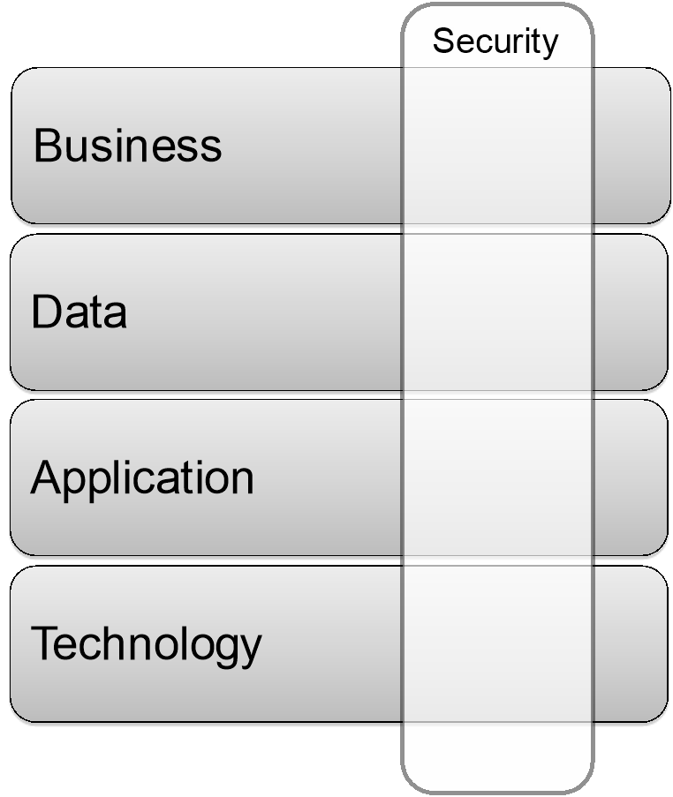
Security is a cross-cutting concern
Security Architecture can be described as:
“a coherent collection of views, viewpoints, and artifacts, including security, privacy, and operational risk perspectives, along with related topics like security objectives and security services”.
The Security Architecture interacts with all four architecture domains:
Business
Data
Application
Technology
and is referred to as ‘cross-cutting’.
© TOGAF® Series Guide: Integrating Risk and Security
Integrating Risk and Security within a Enterprise Architecture : Page 16 : §4
Initially MOD 09
Notes:
Þ M-32
Level=2 : L.O.= 1.9a : Explain how security is a cross-cutting concern.
See : TOGAF® Series Guide: Integrating Risk and Security within a TOGAF® Enterprise Architecture : Page 16 : §4
Security Architecture is pervasive through the whole Enterprise Architecture.
It can be described as: “a coherent collection of views, viewpoints, and artifacts, including security, privacy, and operational risk perspectives, along with related topics like security objectives and security services”.
The Security Architecture interacts with all four architecture domains:
Business
Data
Application
Technology
and is therefore referred to as ‘cross-cutting’.
Aspects of the Security Architecture may be organized outside of the architecture scope . . .
But parts of it need to be developed in an integrated fashion with the architecture . . .
4 Security as a Cross-Cutting Concern
Security Architecture is a cross-cutting concern, pervasive through the whole Enterprise
Architecture. It can be described as a coherent collection of views, viewpoints, and artifacts,
including security, privacy, and operational risk perspectives, along with related topics like
security objectives and security services. The Security Architecture is more than a dataset; it is
based on the ISM and ERM processes.
The TOGAF ADM covers the development of the four architecture domains commonly accepted
as subsets of an Enterprise Architecture: Business, Data, Application, and Technology. The
Security Architecture interacts with all four of them and is therefore called cross-cutting.
Figure 5: Security as a Cross-Cutting Concern through the Architecture
As a cross-cutting concern, the Security Architecture impacts and informs the Business, Data,
Application, and Technology Architectures. The Security Architecture may often be organized
outside of the architecture scope, yet parts of it need to be developed in an integrated fashion
with the architecture. These touch-points will be explained in the next chapter.

Slide 33
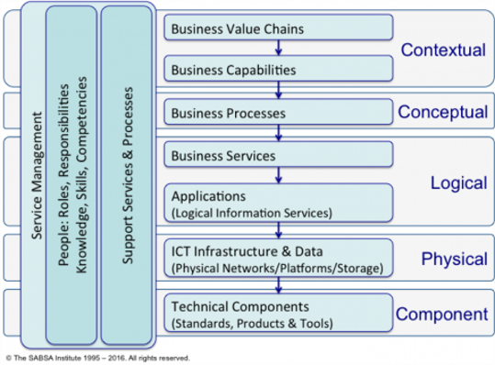
Security And Definition of Risk
Risk is the “effect of uncertainty on objectives”
‘Uncertainty’ is concerned with extrapolation
Every decision is based on assessing:
The balance between opportunities and threats
The likelihood of beneficial outcomes
The magnitude of these events
The likelihood associated with each outcome
© The SABSA Institute
“Risk assessment/analysis” is identifying and assessing these.
“Risk management” is applying these concepts in the decision-making process.
Integrating Risk and Security within a Enterprise Architecture : Page 9 : §3.1.1
Initially MOD 09
Added “security and” to the heading to make it make sense in a module on Stakeholders.
Notes:
Þ M-34
Level=2 : L.O.= 1.10a : Explain why it is important to create an environment in which uncertainty of the success of change can be managed to optimize maximum business benefit and minimum business loss.
See : TOGAF® Series Guide: Integrating Risk and Security within a TOGAF® Enterprise Architecture : Page 9 : §3.1.1
Risk is the “effect of uncertainty on objectives” (ISO 31000:2009) (Merriam-Webster)
Uncertain = * not known beyond doubt
not having certain knowledge
not clearly identified or defined
not constant
not certain to occur
indefinite
‘Uncertainty’ is concerned with extrapolation with limited information.
Every decision is based on assessing:
the balance between potential opportunities and threats
the likelihood of beneficial outcomes versus damaging outcomes
the magnitude of these potential positive or negative events
the likelihood associated with each identified outcome
“Risk assessment/analysis” is identifying and assessing these.
“Risk management” is applying these concepts in the decision-making process.
Risk can be:
strategic long-term level (overall direction of the business)
medium term tactical level (transformation projects and programs)
operational level (regular day-to-day operational decisions, processes, and practices)
Risk can be seen at any level in the business stack.
The objective of risk management is to optimize business outcomes in order to maximize business
value and minimize business losses.
3.1.1 Definition of Risk
Risk is the “effect of uncertainty on objectives” (ISO 31000:2009 [6]).
The effect of uncertainty is any deviation from what is expected – positive and negative.
Understanding the term “risk” is central to understanding the broader concepts of ERM, and the
role of effective Enterprise Architecture and Enterprise Security Architecture. In this Guide we
define risk in line with ISO 31000:2009. Risk is the effect that uncertainty has on the
achievement of business objectives. The uncertainty is concerned with predicting future
... CONTINUES ... SEE REFERENCE SPECIFIED

Slide 34

How the TOGAF Standard Supports the Digital Enterprise
The DPBoK Standard notes four contexts of organizational evolution which relate to Enterprise Architecture and the TOGAF Standard:
Context I: Individual/Founder
Context II: Team
Context III: Team of Teams
Context IV: Enduring Enterprise
Indicating balancing 4 contexts
The requirement for well-designed foundations becomes critical to enterprise existence and health.
The strategy for achieving this is to present a set of Enterprise Architecture services that package the right set of activities.
What is needed is a minimal set of Enterprise Architecture services
Using the TOGAF Standard in the Digital Enterprise : Page 27 : §4.2.1
Initially MOD 09
Notes:
Þ Q-25
Level=2 : L.O.= 1.11a : Briefly explain the role of the Enterprise Architect and Enterprise Architecture in a Digital Enterprise for the four contexts of the DPBoKTM Standard.
See : TOGAF® Series Guide: Using the TOGAF Standard in the Digital Enterprise : Page 27 : §4.2.1
The DPBoK Standard notes four contexts of organizational evolution which relate to Enterprise Architecture and the TOGAF Standard:
Context I: Individual/Founder
Context II: Team
Context III: Team of Teams
Context IV: Enduring Enterprise
As the philosophy of the ‘Digital Enterprise’ inexorably crystalises so the requirement for well designed and rock-solid foundations become critical to enterprise existence and health.
The strategy for achieving this state is to present a set of Enterprise Architecture services that package the right set of activities within the TOGAF Standard to deliver value to the digital enterprise, as needed per context of the emergence model.
What is needed is a minimal set of Enterprise Architecture services that deliver Enterprise Architecture capabilities for decision-making in each context to ensure risk is understood, and to “peek-ahead” in preparation for going to the next context.
4.2. The DPBoK Standard
The DPBoK Standard identifies four contexts of organizational evolution toward a digital enterprise:
• Context I: Individual/Founder
• Context II: Team
• Context III: Team of Teams
• Context IV: Enduring Enterprise
The DPBoK Standard presents these contexts as levels, where the enterprise moves from an earlier
context to the next level of success. This is described as an emergence model where only the
knowledge and activity essential to the level is presented, with enough foreshadowing, to prepare for
the transition to the next level of emergence. It is our strategy to support this emergence model with
Enterprise Architecture through our peek-ahead strategy. So, not only does the Enterprise Architect
support the specific context, but also considers the next level and informs the Digital Practitioners of
ways to position themselves to evolve. At the higher levels of the emergence model, the
... CONTINUES ... SEE REFERENCE SPECIFIED

Slide 35
Role of the Enterprise Architect - Context I: Individual/Founder – 01/02
The Individual/Founder context addresses:
“Minimum essential concerns they must address to develop and sustain a basic digital product”
- the bare minimum requirements of delivering digital value.
The key topics, in the DPBoK Standard, for this context:
Conception of digital value
Digital infrastructure and related practices
Agile development and continuous delivery practices
To support this context, the person acting as the EA has a role to assure that risk is understood and that decisions are made with an understanding of risk.
Using the TOGAF Standard in the Digital Enterprise : Page 27 : §4.2.1
Initially MOD 09
Notes:
Level=2 : L.O.= 1.11a : Briefly explain the role of the Enterprise Architect and Enterprise Architecture in a Digital Enterprise for the four contexts of the DPBoK™ Standard.
See : TOGAF® Series Guide: Using the TOGAF Standard in the Digital Enterprise : Page 27 : §4.2.1
The Individual/Founder context addresses “minimum essential concerns they must address to develop and sustain a basic digital product”
- the bare minimum requirements of delivering digital value.
Key topics, in the DPBoK Standard, for this context:
Conception of digital value – architecture models communicate very well and are often used as a communication medium.
Digital infrastructure and related practices (the essential infrastructure and process choices to quickly deliver value to the market). EA provides the necessary descriptions to communicate the infrastructure available and its appropriate use for both development and delivery - there are usually not dedicated architects - it is a role only performed when needed.
Agile development and continuous delivery practices - Enterprise Architecture is often used to provide answers to questions about Agile development and continuous delivery.
To support this context the person acting as the EA has a role to assure that risk is understood and that decisions are made with an understanding of risk.
4.2.1. Context I: Individual/Founder
The Individual/Founder context addresses “minimum essential concerns they must address to develop
and sustain a basic digital product”. This context represents the bare minimum requirements of
delivering digital value.
The DPBoK Standard key topics for this context are:
• Conception of digital value. Architecture is often used as a communication medium. Architecture models communicate very
well. Also, the Enterprise Architect is a communicator and considered a key enterprise networker.
• Digital infrastructure and related practices (the essential infrastructure and process choices to quickly deliver value to the market). The Enterprise Architecture provides the necessary descriptions to communicate the infrastructure available and its appropriate use for both development and delivery. The Enterprise Architect
... CONTINUES ... SEE REFERENCE SPECIFIED

Slide 36
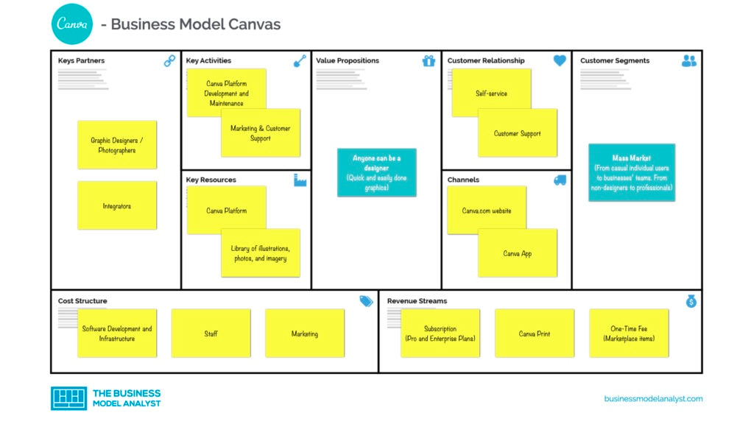
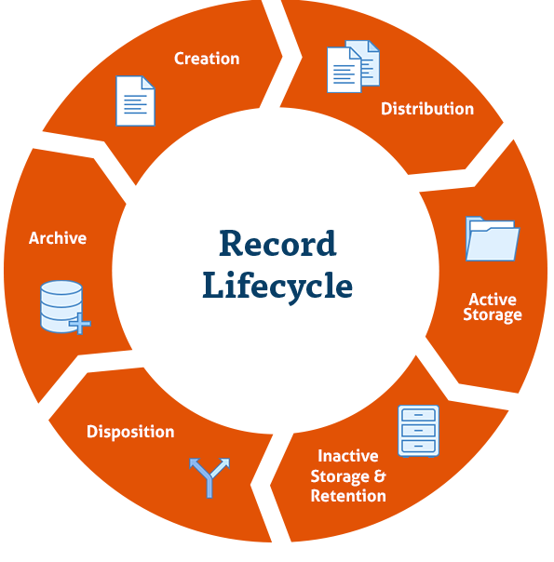
Role of the Enterprise Architect - Context I: Individual/Founder – 02/02
EAs deliver support in an on-demand, service-oriented manner to meet the operating tempo of the individual/founder:
Identifying digital offerings or digital value using an outside-in view
Distinguishing strategy from business model
Helping to distinguish between the problem space and the solution space
Helping to shift from requirements to outcome-oriented and outcome-centred thinking
Increasing or enhancing operational excellence by supporting and providing guidance for operational improvements
Examples of this type of output:
business model canvas
business scenarios
value stream and business capabilities mapping
product and service modelling
use cases and business cases specifically around requirements management
Using the TOGAF Standard in the Digital Enterprise : Page 27 : §4.2.1
Initially MOD 09
Notes:
Level=2 : L.O.= 1.11a : Briefly explain the role of the Enterprise Architect and Enterprise Architecture in a Digital enterprise for the four contexts of the DPBoKTM Standard.
See : TOGAF® Series Guide: Using the TOGAF Standard in the Digital Enterprise : Page 27 : §4.2.1
EAs deliver support in an on-demand, service-oriented manner to meet the operating tempo of the individual/founder – for example:
Identifying digital offerings or digital value using an outside-in view that focuses on the customer or end user first
Distinguishing strategy from business model, and communicating the strategy to support a corporate brand identity
Helping to distinguish between the problem space and the solution space
Helping to shift from requirements to outcome-oriented and outcome-centered thinking in product delivery and value delivery to customers through value streams and capabilities identification
Increasing or enhancing operational excellence by supporting and providing guidance for operational improvements
Examples of this type of output:
business model canvas
business scenarios
value stream and business capabilities mapping
product and service modelling
use cases and business cases specifically around requirements management:
Digital security, security architecture, risk management, and Enterprise Architecture governance to provide protection from harmful events
Creating a digital stack by identifying supporting capabilities for the digital offering
Defining the digital lifecycle through the service, application portfolio, and security infrastructure lifecycle viewpoints
4.2.1. Context I: Individual/Founder
The Individual/Founder context addresses “minimum essential concerns they must address to develop and sustain a basic digital product”. This context represents the bare minimum requirements of delivering digital value.
The DPBoK Standard key topics for this context are:
• Conception of digital value. Architecture is often used as a communication medium. Architecture models communicate very
... CONTINUES ... SEE REFERENCE SPECIFIED

Slide 37

Role of the Enterprise Architect - Context II: Team
The team has a single mission and a cohesive identity
Establishing team collaboration is essential to success
The insights of Agile and themes such as Lean are primary in this context
The DPBoK Standard highlights:
Product Management
Work Execution Management
Operations Management
In the Team context an Enterprise Architect has a role to assure that risk is understood
Modelling and documenting become more important
A common and shared approach to requirements understanding
Enterprise Architects should deliver this support in an on-demand, service-oriented manner
The team
Using the TOGAF Standard in the Digital Enterprise : Page 28 : §4.2.2
Initially MOD 09
Notes:
Level=2 : L.O.= 1.11b : Briefly explain the role of the Enterprise Architect and Enterprise Architecture in a Digital Enterprise for the four contexts of the DPBoKTM Standard.
See : TOGAF® Series Guide: Using the TOGAF Standard in the Digital Enterprise : Page 28 : §4.2.2
The team has a single mission and a cohesive identity; it is all in the same location, can still communicate informally, but there is enough going on that it needs a more organized approach to getting work done.
Establishing team collaboration as a fundamental guiding value is essential to successful digital product development.
The insights of Agile and themes such as Lean are primary in this context.
The DPBoK Standard highlights:
Product Management
Product architecture can provide architecture models that map to a given digital product profile.
Enterprise Architecture makes interdependencies explicit, assuring an holistic view of the digital product.
Work Execution Management
Enterprise Architecture is used to depict processes and workflows. In the Team context very simple models can be constructed to help communicate simple to complex workflows and processes - a good way to communicate within a small team.
Operations Management
In the Teams context a single digital product may need an architecture model to depict how operations are expected to run while team is working on the continuous delivery of improvements to that product.
In the Team context Enterprise Architect has a role to assure that risk is understood; given the greater number of people, it also has an additional role to ensure efficacy of communication. Modeling and documenting become more important in order to have a common shared understanding to support product management, work execution, and operations understanding.
Also critical in a team environment is ensuring a common and shared approach to requirements understanding to avoid different team members moving on different priorities, the approach should be lightweight communication in full support of the team’s tempo.
Enterprise Architects should deliver this support in an on-demand, service-oriented manner to meet the operating tempo of the team.
4.2.2. Context II: Team
The team has a single mission and a cohesive identity, but does not need a lot of overhead to get the job
done. The Team context covers the basic elements necessary for a collaborative product
... CONTINUES ... SEE REFERENCE SPECIFIED

Slide 38
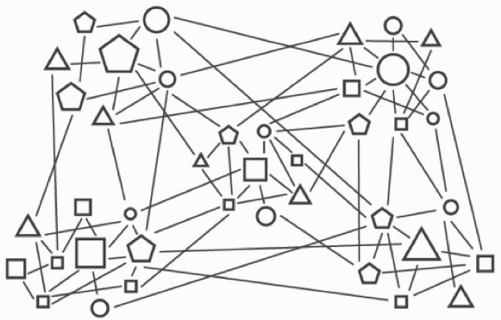
Role of the Enterprise Architect - Context III: Team of Teams – 01/02
Coordinating a Team of Teams is a main concern that EAs need to address.
It is important to balance over-complex coordination with the need to ensure the success.
The traditional strength of EA increases significantly in value by identifying and enabling essential interactions between teams.
The DPBoK Standard key topics for this context are:
Coordinating a Team of Teams
Organization and cultural factors
Coordination and process mechanisms
Investment and portfolio consequences of a multi-team structure
Using the TOGAF Standard in the Digital Enterprise : Page 30 : §4.2.3
Initially MOD 09
Notes:
Level=2 : L.O.= 1.11c : Briefly explain the role of the Enterprise Architect and Enterprise Architecture in a Digital Enterprise for the four contexts of the DPBoKTM Standard.
See : TOGAF® Series Guide: Using the TOGAF Standard in the Digital Enterprise : Page 30 : §4.2.3
Coordinating a team of teams is a main concern that EAs need to address. It is important to balance over-complex coordination with the need to ensure the success of the digital products, and communication is key to ensure successful collaboration and value delivery.
The traditional strength of EA increases significantly in value by identifying and enabling essential interactions between teams while minimizing the cognitive load of those interactions for the team members.
The DPBoK Standard key topics for this context are:
Organization and cultural factors
These are significant drivers in shaping process design, especially in international enterprises and it might be necessary to respect cultural differences through different means such as altering basic processes, different approaches to stakeholder interaction and management, or altering designs. Enterprise Architecture helps to resolve all of these concerns.
Coordination and process mechanisms
Enterprise Architecture is used to depict processes and control mechanisms, to identify and eliminate choke points and for continuous process improvement.
Investment and portfolio consequences of a multi-team structure
Enterprise Architectures that depict portfolios critical resources in portfolio management and support portfolio management decision-making.
4.2.3. Context III: Team of Teams
Coordinating across a team of teams is the main concern that people in an Enterprise Architect role
need to address using Enterprise Architecture and the TOGAF Standard. Too often, coordination
mechanisms (such as overly process-centric operating models) degrade team cohesion and
performance. It is important to balance overcomplex coordination with the need to ensure the success
of a family of digital products.
The Team of Teams context is a natural evolution of the Teams context, but one where the number of
people and digital products involved generates complexity. Coordinating across a team of teams is the
main concern and, too often, coordination mechanisms degrade team cohesion and performance.
... CONTINUES ... SEE REFERENCE SPECIFIED

Slide 39


Role of the Enterprise Architect - Context III: Team of Teams – 02/02
Enterprise Architecture expertise can also be used to remove friction from company operations:
Team of Teams
Identifying key drivers for the transition from a unitary team to a team of teams
Identifying the basics of coordination problems
Identifying the basic product/function spectrum of organizational forms
Identifying important cultural factors and concepts
Using the TOGAF Standard in the Digital Enterprise : Page 30 : §4.2.3
Initially MOD 09
Notes:
Level=2 : L.O.= 1.11c : Briefly explain the role of the Enterprise Architect and Enterprise Architecture in a Digital Enterprise for the four contexts of the DPBoK™ Standard.
See : TOGAF® Series Guide: Using the TOGAF Standard in the Digital Enterprise : Page 30 : §4.2.3
Enterprise Architecture expertise can also be used to remove friction from company operations and growth such as:
Identifying key drivers for the transition from a unitary team to a team of teams
Identifying the basics of coordination problems and providing a solution that solves it
Identifying the basic product/function spectrum of organizational forms
Identifying important cultural factors and concepts for measuring and changing culture
The EA has the additional role of ensuring that the digital products work together, supporting the move from a specific digital product to portfolios of integrated digital products - and:
Can be applied to support cross-activities and interdependencies between teams following a portfolio view
Supports cross-activities and interdependencies between teams following a portfolio view in alignment with, and supported by, the IT4IT™ Standard
Delivers the high-level view and landscape, and identifying the current and target organization maturity level for the digital enterprise
Supports digital product and service catalog definition
Provides capability-based planning and process management guidance
4.2.3. Context III: Team of Teams
Coordinating across a team of teams is the main concern that people in an Enterprise Architect role
need to address using Enterprise Architecture and the TOGAF Standard. Too often, coordination
mechanisms (such as overly process-centric operating models) degrade team cohesion and
performance. It is important to balance overcomplex coordination with the need to ensure the success
of a family of digital products.
The Team of Teams context is a natural evolution of the Teams context, but one where the number of
people and digital products involved generates complexity. Coordinating across a team of teams is the
main concern and, too often, coordination mechanisms degrade team cohesion and performance.
Communication is again key to ensure successful collaboration and value delivery.
The Team of Teams context is where the traditional strengths of Enterprise Architecture increase
... CONTINUES ... SEE REFERENCE SPECIFIED

Slide 40

Role of the Enterprise Architect - Context IV: Enduring Enterprise – 01/02
Enabling an enduring enterprise includes:
Establishing additional feedback mechanisms
Founding and maturing information management across the company
Fostering an architecture-driven and portfolio management culture
An enduring enterprise
Using the TOGAF Standard in the Digital Enterprise : Page 31 : §4.2.4
Initially MOD 09
Notes:
Level=2 : L.O.= 1.11d : Briefly explain the role of the Enterprise Architect and Enterprise Architecture in a Digital Enterprise for the four contexts of the DPBoKTM Standard.
See : TOGAF® Series Guide: Using the TOGAF Standard in the Digital Enterprise : Page 31 : §4.2.4
Enabling an enduring enterprise that the DPBoK Standard may or may not address but is relevant and can be leveraged from TOGAF Standard guidance and experience includes:
Establishing additional feedback mechanisms for steering, managing risk, and assuring performance
Founding and maturing information management across the company
Fostering an architecture-driven and portfolio management culture
Specific areas of supporting strategy/portfolio/projects/solution delivery that the DPBoK Standard guidance and experience includes are:
Defining architecture as a competency area
Defining concepts, quality levels, and implementation guidance for architecture, digital strategy, and portfolio creation and management
Defining and establishing Agile
Implementing the TOGAF Governance Framework to support digital governance
Providing architectural guidance to evolve data from information to knowledge
Providing support in the creation and connectedness between portfolios
Adapting an existing or new capability to support an Agile approach
Adapting TOGAF to fit its delivery style into Agile approaches
Providing the required capabilities to deliver the digital offering
Supporting product and service digitalization
4.2.4. Context IV: Enduring Enterprise
The Enduring Enterprise context is about how to manage an enterprise that has been successful and is
now faced with the realities of operating a sustainable business over periods of time longer than the
next product cycle; see the DPBoK Standard (see Referenced Documents), Section 6.4: “However, what
may be less obvious is that scaling up in size also means scaling out in terms of timeframes: concern for
the past and the future extend further and further in each direction. Organizational history is an
increasing factor, and the need to manage this knowledge base can’t be ignored. The organization is
fulfilling responsibilities set in place by those no longer present and is building product and
... CONTINUES ... SEE REFERENCE SPECIFIED

Slide 41
Role of the Enterprise Architect - Context IV: Enduring Enterprise – 02/02
Specific areas of supporting strategy/portfolio/projects/solution delivery that the DPBoK Standard guidance and experience includes:
Define
Define architecture as a competency area
Define
Define concepts, quality levels, and implementation guidance
Define and establish
Define and establish Agile or other relevant techniques
Implement
Implement the TOGAF governance framework
Provide
Provide architectural guidance to evolve data
Provide
Provide support in the creation and connectedness between portfolios
Adapt
Adapt an existing or new capability to support Agile
Adapt
Adapt to support business strategies that are digital
Using the TOGAF Standard in the Digital Enterprise : Page 31 : §4.2.4
Initially MOD 09
Notes:
Þ Q-26
Level=2 : L.O.= 1.11d : Briefly explain the role of the Enterprise Architect and Enterprise Architecture in a Digital Enterprise for the four contexts of the DPBoKTM Standard.
See : TOGAF® Standard, 10th Edition, 2022® Series Guide: Using the TOGAF Standard in the Digital Enterprise : Page 31 : §4.2.4
Specific areas of supporting strategy/portfolio/projects/solution delivery that the DPBoK Standard may or may not address but are relevant and can be leveraged from Enterprise Architecture and the TOGAF® Standard guidance and experience include:
Defining architecture as a competency area
Defining concepts, quality levels, and implementation guidance for architecture, digital strategy,
and portfolio creation and management
Defining and establishing Agile Enterprise Architecture
Implementing Enterprise Architecture and the TOGAF Standard Governance Framework to support digital governance
Providing architectural guidance that evolves data from information into knowledge that provides value to the company and adapting the trio to fulfill digital enterprise needs
Providing portfolio support in the creation and connectedness between portfolios
Adapting an existing or new Enterprise Architecture capability to support an Agile and digital organization
Adapting Enterprise Architecture and the TOGAF Standard to fit its delivery style into Agile approaches and digital product creation and offerings
Adapting Enterprise Architecture to support business strategies that are digital, and providing the required capabilities to deliver the digital offering, as well as supporting product and service digitalization
4.2.4. Context IV: Enduring Enterprise
The Enduring Enterprise context is about how to manage an enterprise that has been successful and is
now faced with the realities of operating a sustainable business over periods of time longer than the
next product cycle; see the DPBoK Standard (see Referenced Documents), Section 6.4: “However, what
may be less obvious is that scaling up in size also means scaling out in terms of timeframes: concern for
... CONTINUES ... SEE REFERENCE SPECIFIED

Slide 42
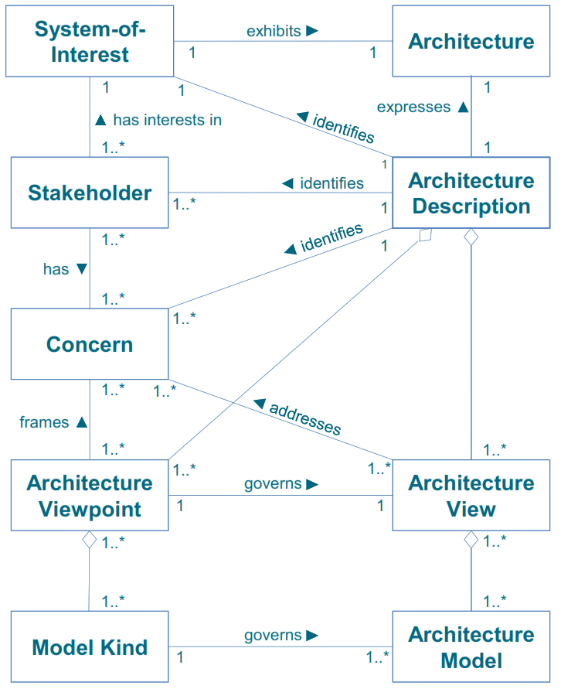
How to Identify Stakeholders and Their Concerns – 01/03
From a practical perspective, consider:
Stakeholder
Concern
View
The Architecture Project provides context for both the development of a new architecture and the change to realize it.
  An EA Landscape will contain Multiple discrete architectures, separated by:
Purpose
Detail
Breadth
Time
Recency
Context
utilized by architecture states
  Current
  Transition(s)
  Target
A Practitioners’ Approach to Developing Enterprise Architecture Following the ADM : Page 17 : §3.3.1
Initially MOD 09
Notes:
Level=2 : L.O.= 2.1a : Explain how to identify stakeholders their concerns views and the communication involved.
See : TOGAF® Series Guide: A Practitioners’ Approach to Developing Enterprise Architecture Following the TOGAF® ADM : Page 17 : §3.3.1
From a practical perspective, consider:
Stakeholder -someone who has approval rights in the Target Architecture being explored by the current Architecture Project, and subsequently has decision rights to the suitability of the implementation
Concern - a consistent set of subjects that capture the stakeholder’s interests and act to consolidate requirements
View - a representation of the EA Landscape that addresses a set of stakeholder’s concerns; either:
describe how the architecture addresses the concerns or
demonstrate how the associated requirements are met
The Architecture Project provides context for both the development of new architecture and the change to realize it.
Although stakeholders, views, and concerns are often explained in terms of a single architecture, an EA Landscape will actually contain multiple discrete architectures, separated by:
Purpose
Detail
Breadth
Time
Recency
Contextualized by architecture states:
Current
Transition(s)
Target
The EA preserves the stakeholder’s concern in the view…the view communicates with the stakeholder and how the architecture will address their
concern giving something useful to govern against.
... CONTINUES ... SEE REFERENCE SPECIFIED

Slide 43
How to Identify Stakeholders and Their Concerns – 02/03
Stakeholders’ power, interest, and requirements will cluster in six to nine topic areas:
Agility
Efficiency
IT complexity
Customer journey
Effectiveness
Value
 | Concern 1 | Concern 1 |  | Concern 2 | Concern 2
 | Power | Interest | Requirement | Power | Interest | Requirement
Stakeholder 1 | High | Low |  | Low | High
Stakeholder 2 | High | High |  | Low | Low
Stakeholder 3 | Low | High |  | High | Low
A view addresses a stakeholder's concern, thus each viewpoint should identify:
The concern
The stakeholder(s)
How the view should be constructed
The information required to address the question
A Practitioners’ Approach to Developing Enterprise Architecture Following the ADM : Page 17 : §3.3.1
Initially MOD 09
Notes:
Level=2 : L.O.= 2.1a : Explain how to identify stakeholders, their concerns and views, and the communication involved.
See : TOGAF® Series Guide: A Practitioners’ Approach to Developing Enterprise Architecture Following the TOGAF® ADM : Page 17 : §3.3.1
Stakeholder’s power, interest, and requirements
Most requirements will cluster in six to nine topic areas:
Agility
Efficiency
IT complexity
Customer journey
Effectiveness
Value
Enterprise priorities and EAs confirm consistency of requirement within a stakeholder’s concern.
Missing requirements within a concern can be either:
a gap in information gathering or
a demonstration that the stakeholder is saying “this does not matter”.
When stakeholders understand the architecture, the change, and the trade-offs, implementation governance is possible.
A view addresses a stakeholder's concern, thus each viewpoint should identify:
the concern
the stakeholder(s)
how the view should be constructed
the information required to address the question
3.3.1 Communicating with Stakeholders (Concern and View) cont…
Table 2 provides an extended TOGAF Stakeholder Map including concern and requirement.
Missing requirements within a concern can either be a gap in information gathering or a
demonstration the stakeholder is saying “this does not matter”. Knowing requirement or lack of
preference in relationship to power and interest directly facilitates trade-off. The trade-off is
performed within a concern and between the concerns.
Views address a stakeholder’s concern about a specific architecture. In a perfect world
Practitioners are able to use a single model directly. This is a mythical happy place. It will never
be possible for a key issue such as agility or cost.
A view simply addresses a stakeholder's concern about an architecture. Often it is a potential
architecture, and the view serves to help the stakeholder’s potential target and associated change.
... CONTINUES ... SEE REFERENCE SPECIFIED

Slide 44
How to Identify Stakeholders and Their Concerns – 03/03
Common Stakeholder Classes
Senior Leaders - responsibility for management and oversight
Program/Portfolio Managers - responsibility for management and oversight of strategic initiatives
Business Requirements Owners - responsible for identifying and expressing business requirements
Implementers - responsible for developing, integrating, and deploying the solution
Risk Owners - interested in risk
Business Partners - who are engaged to provide services sustaining a customer value proposition
Customers - who consume products and services
A Practitioners’ Approach to Developing Enterprise Architecture Following the ADM : Page 118 : §B
Initially MOD 09
Notes:
Þ Q-29 M-40
Level=2 : L.O.= 2.1b : Explain how to identify stakeholders, their concerns and views, and the communication involved.
See : TOGAF® Series Guide: A Practitioners’ Approach to Developing Enterprise Architecture Following the TOGAF® ADM : Page 118 : §B
Common Stakeholder Classes
Senior Leaders are those with responsibility for management and oversight –
this responsibility includes approving and realigning strategic initiatives, tracking a portfolio of
projects, ensuring transformative benefits are realized, and meeting operational business goals.
Program/Portfolio Managers are those with responsibility for management and oversight of strategic initiatives –
this responsibility includes approving and realigning projects, tracking project progress, and
ensuring project benefits are realized
Business Requirements Owners are those responsible for identifying and expressing business requirements –
typically, these stakeholders are responsible for some aspect of business operation.
Implementers are those responsible for developing, integrating, and deploying the solution
Risk Owners are those interested in risk
Business Partners are those who are engaged to provide services sustaining a customer value proposition
Note: The architecture may not be provided to business partners, but must be evaluated from their perspective.
Customers are those who consume products and services
Note: The architecture may not be provided to members, but must be evaluated from their perspective.
B
Stakeholder/Concern Matrix
We recommend that a set of standardized classes of stakeholders, concerns, and associated
viewpoints are maintained for each architecture purpose. This follows the advice of aligning the
EA Capability with the questions that are expected to be answered.
This appendix provides a partial list of common stakeholders, concerns, and their alignment. These examples are
... CONTINUES ... SEE REFERENCE SPECIFIED

Slide 45
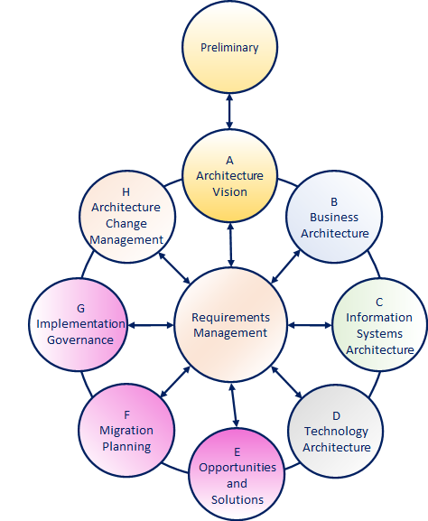
Use of Architecture Views
The choice of which particular Architecture Views to develop is
a key decision to ensure the completeness of the Architecture.
Address* all the pertinent concerns of its stakeholders.
Address* all the pertinent concerns of its stakeholders:
the integrity of the architecture
connecting all the various views to each other
reconciling the conflicting concerns of different stakeholders
showing the trade-offs (e.g. between security and performance)
An Architecture should be developed only to the point at which it is fit-for purpose
Refer to stakeholders’ concerns and requirements for two distinct environments:
This establishes the elements of the Baseline Architecture
  The existing Baseline Architecture
  The Target Architecture
  To be carried forward, and
  The elements to be added, removed, or replaced
* ‘Address’ does not necessarily mean ‘fix in this cycle’
Architecture Content : Page 34 : §3.2
Initially MOD 09
Notes:
Þ M-47
Level=2 : L.O.= 2.2a : Explain the use of architecture views.
See : TOGAF® Standard – Architecture Content : Page 34 : §3.2
The choice of which particular architecture views to develop is one of the key decisions that the architect has to make – to ensure the completeness (fitness-for-purpose) of the Architecture.
Address* all the pertinent concerns of its stakeholders;
the integrity of the architecture
connecting all the various views to each other
satisfactorily reconciling the conflicting concerns of different stakeholders
showing the trade-offs (e.g. between security and performance)
Architecture should be developed only to the point at which it is fit-for purpose.
The typical progression is from business to technology (using a technique such as business scenarios)
and from high-level overview to lower-level detail - refer to stakeholders’ concerns and requirements throughout the process…
For two distinct environments:
the existing Baseline Architecture
the Target Architecture
This provides the context for the Gap Analysis at the end of Phases B, C, and D which establishes the elements of the Baseline Architecture:
to be carried forward and
the elements to be added, removed, or replaced
NB. * Address’ does not necessarily mean ‘fix in this cycle’
3.2 Developing Architecture Views in the ADM
3.2.1 General Guidelines
The choice of which particular architecture views to develop is one of the key decisions that the
architect has to make.
The architect has a responsibility for ensuring the completeness (ﬁtness-for-purpose) of the
architecture, in terms of adequately addressing all the pertinent concerns of its stakeholders;
and the integrity of the architecture, in terms of connecting all the various views to each other,
satisfactorily reconciling the conﬂicting concerns of different stakeholders, and showing the
trade-offs made in so doing (as between security and performance, for example).
The choice has to be constrained by considerations of practicality, and by the principle of ﬁtness for-purpose
(i.e., the architecture should be developed only to the point at which it is ﬁt-for-purpose
... CONTINUES ... SEE REFERENCE SPECIFIED

Slide 46
Stakeholder Engagement and Requirements Management
Requirements Management and Stakeholder Engagement are at the centre of architecture development.
EAs may act for their stakeholders in several roles:
Subject Matter Experts (SMEs)
Agents for their stakeholders
Developers of architecture
Requirements Management is dependent upon clear traceability.
In order to perform this, EAs distinguish between:
Direct effective support
Loose association
Distractions
EAs maintain the complete set of:
Every stakeholder’s preference
The implications of those preferences
A Practitioners’ Approach to Developing Enterprise Architecture Following the ADM : Page 54 : §6.1.1
Initially MOD 09
Notes:
Level=2 : L.O.= 2.3a : Explain how to manage stakeholders’ engagement and requirements.
See : TOGAF® Series Guide: A Practitioners’ Approach to Developing Enterprise Architecture Following the TOGAF® ADM : Page 54 : §6.1.1
The TOGAF Framework places requirements management and stakeholder engagement at the center of architecture development, in accordance with the preferences and priorities of their organization’s stakeholders.
EAs act for their stakeholders in several roles:
Subject Matter Experts (SMEs)
Agents for their stakeholders
Developers of architecture
Requirements management is dependent upon clear traceability from the organization’s vision, mission, business model, and strategies through the most detailed statement of requirement. In order to perform this, EAs distinguish between:
direct effective support
loose association
distractions
EAs maintain the complete set of
every stakeholder’s preference
the implications of those preferences
*Satisfice is a rare and recent English word: it is a gerund, meaning ‘decide on and pursue a course of action that will satisfy the minimum requirements necessary to achieve a particular goal’ – being a blend of satisfy and suffice
6.1.1 Stakeholder Engagement and Requirements Management
The TOGAF Framework places requirements management and stakeholder engagement at the
center of architecture development. Practitioners develop EA in accordance with the preferences
and priorities of their organization’s stakeholders. Architecture is never sold to a stakeholder.
stakeholder preferences are never manipulated.
Stakeholders own the architecture and the value preference and priority the architecture is
expected to enable. Practitioners must completely submerge their preferences, biases, and
priorities. Practitioners must act for their stakeholders.
This is one of the most difficult activities a Practitioner must perform. Good Practitioners are
passionately engaged in the future of their organization, as well as participating in defining and
realizing the target state. Practitioners typically perform several roles: they will act as Subject
Matter Experts (SMEs) and agents for their stakeholders in addition to developing
... CONTINUES ... SEE REFERENCE SPECIFIED

Slide 47
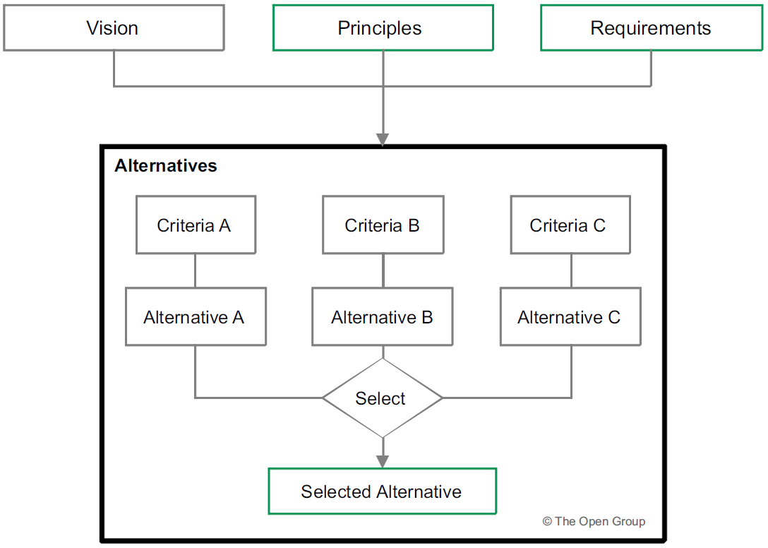
Trade-off to Support Architecture Development – 01/03
A single alternative rarely exists to meet all stakeholders’ concerns.
Alternatives are defined per domain to simplify the analysis of the different alternatives:
First select sets of criteria fitting for different alternatives:
Use the vision
Principles
Requirements
Other information
Second
Define alternatives based on the criteria
Build an understanding of each
Third
Either select one of the alternatives or
Combine features from more than one
To create the proposed alternative
Perform
Criteria
Identify alternatives
Choose from alternatives and define in detail
ADM Techniques : Page 73 : §10.2
Notes:
Level=2 : L.O.= 2.4a : Explain how to use trade-off to support the architecture development.
See : TOGAF® Standard – ADM Techniques : Page 73 : §10.2
Often a single alternative does not exist that will meet all stakeholders’ concerns.
The TOGAF Standard supports a technique to investigate different alternatives and to discuss these with the stakeholders.
Commonly, alternatives are defined per domain – done to simplify the analysis of the different alternatives. Of course, the alternatives per domain can be merged into an overall analysis of the alternatives for the whole architecture.
First
use the vision
principles
requirements
other information
to select sets of criteria fitting for different alternatives
Second
define alternatives based on the criteria
build an understanding of each
Third
either select one of the alternatives or
combine features from more than one
to create the proposed alternative
Perform, in just enough detail to support that decision:
criteria
identify alternatives
choose from alternatives and define in detail
The method can be used for any phase at any level of an architecture.
10.2 Method
It is most common that a single alternative does not exist that will meet all stakeholders’
concerns. The TOGAF Standard supports a technique to investigate different alternatives and to
discuss these with the stakeholders. Commonly, alternatives are deﬁned per domain. This is
done to simplify the analysis of the different alternatives. Of course, the alternatives per domain
can be merged into an overall analysis of the alternatives for the whole architecture.
Figure 10-1 illustrates the architecture trade-off method.
The ﬁrst part of the method uses the vision, principles, requirements, and other information to
select sets of criteria ﬁtting for different alternatives.
... CONTINUES ... SEE REFERENCE SPECIFIED

Slide 48

Trade-off to Support Architecture Development - 02/03
Complex problems do not have clear, unambiguous best answers – they have reasonable compromises.
Trade-off requires a compromise between
One stakeholder’s preferences
Different stakeholders’ preferences
Effective trade-off requires understanding
Value preference
Priority
Scope of change necessary to realize the target
As a rule, stakeholders under-perform when that trade-off
Stands beyond their span of control
Span of interest
Involves the preferences of different stakeholders
In facilitating the trade-off discussion
Chase down all impacts
Think through the end game needs
Surface requisite dimensions
Trade-offs :
Fuel vs Carbon vs Time vs Speed vs Comfort
vs Price vs Control
A Practitioners’ Approach to Developing Enterprise Architecture Following the ADM : Page 55 : §6.1.2
Initially MOD 09
Notes:
Level=2 : L.O.= 2.4b : Explain how to use trade-off to support the architecture development.
See : TOGAF® Series Guide: A Practitioners’ Approach to Developing Enterprise Architecture Following the TOGAF® ADM : Page 55 : §6.1.2
Facilitating a trade-off is often more valuable than finalizing an architecture description.
Complex problems do not have clear, unambiguous best answers – they have reasonable compromises.
Trade-off requires a compromise between:
one stakeholder’s preferences
different stakeholders’ preferences
Effective trade-off requires understanding:
value preference
priority
scope of change necessary to realize the target
As a rule, stakeholders underperform when that trade-off:
stands beyond their span of control
span of interest
involves the preferences of different stakeholders
In facilitating the trade-off discussion:
chase down all impacts
think through the end game needs
surface requisite dimensions
think through all transition states
Practitioners should not underestimate the value their organization receives from facilitation of trade-off across organizational boundaries.
6.1.2 Trade-Off
One of the most valuable activities a Practitioner will perform during architecture development
is facilitating the stakeholders’ trade-off decision. Facilitating trade-off is often more valuable
than finalizing an architecture description. Good architecture addresses complex problems.
Complex problems do not have clear, unambiguous best answers. Instead, they have reasonable
compromises.
Trade-off requires a compromise between one stakeholder’s preferences as well as between
different stakeholders’ preferences. Effective trade-off requires understanding value preference
and priority as well as the scope of change necessary to realize the target.
As a rule, stakeholders underperform when that trade-off stands beyond their span of control or
... CONTINUES ... SEE REFERENCE SPECIFIED

Slide 49
Trade-off to Support Architecture Development - 03/03
The most common interpretations of trade-off are:
“a balance achieved between two desirable but incompatible features; a compromise”
“losing one quality, aspect, or amount of something in return for gaining another quality, aspect, or amount”
In EA, trade-offs are never about compromises.
A Practitioners’ Approach to Developing Enterprise Architecture Following the ADM : Page 55 : §6.2
Initially MOD 09
Notes:
Level=2 : L.O.= 2.4c : Explain how to use trade-off to support the architecture development.
See : TOGAF® Series Guide: A Practitioners’ Approach to Developing Enterprise Architecture Following the TOGAF® ADM : Page 55 : §6.2
The most common interpretations of trade-off are:
“a balance achieved between two desirable but incompatible features; a compromise”
“losing one quality, aspect, or amount of something in return for gaining another quality, aspect, or amount”
In EA, trade-offs are never about compromises but about a question of when, or of the context.
When the context or the objective of the Enterprise is poorly analyzed, some choices will appear obvious or low-cost. Jumping to employ those choices as a viable candidate will result in sub-optimal achievement of the target or total failure of the initiative.
For example, when an EA is exploring a candidate target architecture and discovers what appears to be an obvious improvement without a champion, they are likely to be jumping to a decision that is based on poor analysis. When faced with such circumstances, the EA should look for the hidden value- which will never be described in terms of the obvious.
6.2 Trade-Off Decisions
The most common interpretations of trade-off are “a balance achieved between two desirable but incompatible features; a compromise” and “losing one quality, aspect, or amount of something in return for gaining another quality, aspect, or amount”. In developing an Enterprise Architecture, trade-offs are never about compromises, but about a question of when or the context. When the context or the objective of the Enterprise is poorly analyzed, some choices will appear obvious or low-cost. Jumping to employ those choices as a viable candidate will result in sub-optimal achievement of the target or total failure of the initiative.
For example, when a Practitioner is exploring a candidate target architecture and discovers what appears to be an obvious improvement without a champion, they are likely to be jumping to a decision that is based on poor analysis. When faced with such circumstances, the Practitioner should look for the hidden value. Hidden value will never be described in terms of the obvious cost savings.

Slide 50
Summary of Module 09
The 14 Learning points covered in Module 09 are:
1.8a: Briefly explain Enterprise Security Architecture
1.9a: Explain how security is a cross-cutting concern
1.10a: Explain why it is important to create an environment in which uncertainty of the success of change can be managed to optimize maximum business
1.11a/d: Briefly explain the role of the Enterprise Architect and Enterprise Architecture in a digital enterprise for the four contexts of the DPBoKTM Standard
2.1a/b: Explain how to identify stakeholders and their concerns and views, and the communication involved
2.2a: Explain the use of architecture views
2.3a: Explain how to manage stakeholders’ engagement and requirements
2.4a/c: Explain how to use trade-off to support the architecture development
Initially MOD 09
Notes:
1.8a : Briefly explain Enterprise Security Architecture
1.9a : Explain how security is a cross-cutting concern
1.10a : Explain why it is important to create an environment in which uncertainty of the success of change can be managed to optimize maximum business
1.11a/d : Briefly explain the role of the Enterprise Architect and Enterprise Architecture in a Digital enterprise for the four contexts of the DPBoKTM Standard
2.1a/b : Explain how to identify stakeholders their concerns views and the communication involved
2.2a : Explain the use of architecture views
2.3a : Explain how to manage stakeholders’ engagement and requirements
2.4a/c : Explain how to use trade-off to support the architecture development

Slide 51
End of Teaching Slides
End of
Module 09
Stakeholder Management
Initially MOD 09

Slide 52
Module 10/16
TOGAF® EA Training - Practitioner
TOGAF® Standard, 10th Edition
Module 10
Phase A
TOGAF® is a registered trademark of The Open Group Copyright © The Open Group 2022
​
Initially MOD 10

Slide 53
Course Module Index
# | Topic – Level 1 | ✓
1 | Module 00 - Course Introduction | ✓
2 | Module 01 - Overview | ✓
3 | Module 02 - Concepts | ✓
4 | Module 03 - Introduction to the ADM | ✓
5 | Module 04 - Introduction to the ADM - Techniques | ✓
6 | Module 05 – Applying ADM | ✓
7 | Module 06 - Architecture Governance | ✓
8 | Module 07 – Architecture Content | ✓
# | Topic – Level 2 | ✓
9 | Module 00 - Course Introduction | ✓
10 | Module 08 - The Context for Enterprise Architecture | ✓
11 | Module 09 – Stakeholder Management | ✓
12 | Module 10 – Phase A
13 | Module 11 – Architecture Development
14 | Module 12 – Implementing the Architecture
15 | Module 13 – Architecture Change Management
16 | Module 14 – Requirements Management
17 | Module 15 – Supporting the ADM Work
18 | Module 16 – Closure
Course Module Index
Initially MOD 10

Slide 54
The ADM – 01/03
Core of the TOGAF framework
Contributions from many architecture practitioners
A process for developing an enterprise architecture
Integrates all the elements within the TOGAF®
standard
Designed to address enterprise’s business and IT
needs by providing a set of architectural views:
Business
Data
Application
Technology
A set of recommended deliverables
A method for managing requirements
Guidelines on tools for architecture development
Preliminary
A
Architecture Vision
H
Architecture Change Management
B
Business
Architecture
Requirements Management
C
Information Systems Architectures
G
Implementation Governance
F
Migration Planning
D
Technology Architecture
E
Opportunities and
Solutions
Initially MOD 10
Notes:
The ADM forms the core of the TOGAF Framework
It is the result of contributions from many architecture practitioners
A process for developing an enterprise architecture
Integrates all the elements within the TOGAF®
standard
Designed to address an enterprise’s business and IT
needs by providing a set of architecture views:
Business
Data
Application
Technology
A set of recommended deliverables
A method for managing requirements
Guidelines on tools for architecture development

Slide 55
The ADM – 02/03
Preliminary
The ADM is essentially a set of lists of things you need to do in order to create and realize changes to the processes of an Enterprise.
The lists are presented on a ‘per domain’ basis.
The explanation is somewhat academic.
Parallelism will be introduced at an early stage.
This academic explanation follows the arrows
round the cycle ( ).
A
Architecture Vision
H
Architecture Change Management
B
Business
Architecture
Requirements Management
C
Information Systems Architecture
G
Implementation
Governance
Each Phase considers:
Inputs
Steps
Outputs
F
Migration Planning
D
Technology Architecture
E
Opportunities
and
Solutions
Outputs from a Phase generally provides some input to the next.
Initially MOD 10
Notes:
The ADM is essentially a set of lists of things you need to do in order to create and realize changes to the Processes of an Enterprise.
The lists are presented on a ‘per domain’ basis for the Architecture, and for the Realization phase they reflect the Development process.
The explanation is given, necessarily, as an idealised, somewhat academic, single threaded, serial sequence.
The reality is that parallelism will be introduced at an early stage to facilitate time compression.
This academic explanation follows the arrows around the cycle (an arrow ) through each Phase.
Each Phase considers:
Inputs: what must be available at entry to the Phase to enable its work to be done
Steps: being the operations that entail the work of the Phase
Outputs: what results from performing the Steps
Outputs from a Phase are generally needed as input to the next.
This is generic over all Phases.

Slide 56
The ADM – 03/03
The work of the Enterprise Architects is performed in:
Preliminary
Phase A - Architecture Vision
Phase B – Business Architecture
Phase C – Information Systems Architecture comprising:
Data Architecture
Application Architecture
Phase D – Technology Architecture
A
Architecture Vision
H
Architecture Change Management
B
Business
Architecture
Requirements Management
C
Information Systems Architecture
G
Implementation
Governance
The contribution of Enterprise Architects to:
Phase E – Opportunities and Solutions
Phase F – Migration Planning
Phase G – Implementation Governance
Phase H – Architecture Change Management
is mainly in the form of support and Governance.
F
Migration Planning
D
Technology Architecture
E
Opportunities
and
Solutions
It is logical to consider these two realms as separate projects.
Initially MOD 10
Notes:
Þ M-36
The work of the Enterprise Architects is performed in:
Phase A - Architecture Vision
Phase B – Business Architecture
Phase C – Information Systems Architecture comprising:
Data Architecture
Application Architecture
Phase D – Technology Architecture
The Enterprise Architects contribution to
Phase E – Opportunities and Solutions
Phase F – Migration Planning
Phase G – Implementation Governance
Phase H – Architecture Change Management
is mainly in the form of support and Governance.
It is convenient, and logical, to consider these two realms as separate projects.
For example, it would make little sense to trigger a ‘realization project’ if the Architecture determined it was of no , or even a dis- advantage.

Slide 57
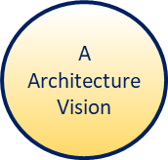


Phase A - Architecture Vision – 01/14
Objectives:
Objective: A time-bounded milestone for an organization used to demonstrate progress towards a goal.
Goal: A high-level statement of intent or direction for an organization.
The Objectives of Phase A are:
Develop a high-level aspirational vision of the capabilities and business value to be delivered as a result of the proposed Enterprise Architecture.
Obtain approval for a Statement of Architecture Work that defines a program of works to develop and deploy the architecture outlined in the Architecture Vision.
Architecture Development Method : Page 30 : §3.2
Initially MOD 10
Notes:
Level=2 : L.O.= 3.1a : Explain how to identify the information necessary to execute the Architecture Vision phase and how iteration cycles will provide more information to take into account in order to execute the phase.
See : TOGAF® Standard – Architecture Development Method : Page 30 : §3.2
Objectives
Objective : A time-bounded milestone for an organization, used to demonstrate progress towards a goal.
Goal : A high-level statement of intent or direction for an organization. Typically used to measure success of an organization (two examples shown)
The Objectives of Phase A are:
Develop a high-level aspirational vision of the capabilities and business value to be delivered as a result of the proposed Enterprise Architecture
Obtain approval for a Statement of Architecture Work that defines a program of works to develop and deploy the architecture outlined in the Architecture Vision
3.1 Objectives
The objectives of Phase A are to:
■Develop a high-level aspirational vision of the capabilities and business value to be delivered as a result of the proposed Enterprise Architecture
■Obtain approval for a Statement of Architecture Work that deﬁnes a program of works to develop and deploy the architecture outlined in the Architecture Vision

Slide 58
Phase A - Architecture Vision – 02/14
Approach:
The developed output of the ADM cycle is completely dependent on the foundation laid by Phase A.
Phase A defines:
→ what is in and what is outside of the architecture
→ constraints
Constraints are informed by principles, business goals and strategic drivers.
Creates the Architecture Vision document.
Architecture Development Method : Page 30 : §3.2
Initially MOD 10
Notes:
Level=2 : L.O.= 3.1a : Explain how to identify the information necessary to execute the Architecture Vision phase and how iteration cycles will provide more information to take into account in order to execute the phase.
See : TOGAF® Standard – Architecture Development Method : Page 30 : §3.2
Approach:
The developed output of the ADM cycle is completely dependent on the foundation laid by a rigorous approach to Phase A
Phase A defines what is in and what is outside of the architecture effort, and the constraints
Constraints are informed by principles, business goals and strategic drivers
Creates the Architecture Vision document:
Clarifying and agreeing the purpose of the architecture
Demonstrating how it will be achieved
A first-cut high-level description of the Baseline and Target architectures
Integral to the Architecture Vision is an understanding of emerging technologies and potential impact
Business models and the business scenarios technique can be used to develop the Architecture Vision
Constraints: Define the constraints that must be dealt with, including enterprise-wide constraints and project-specific constraints (time, schedule, resources, etc.). The enterprise-wide constraints may be informed by the Business and Architectural Principles developed in the preliminary phase or clarified as part of this phase.
The Architecture Vision provides the sponsor with a key tool to sell the benefits of the proposed capability to stakeholders and decision-makers within the enterprise. It describes how the new capability will meet the business goals and strategic objectives and address the stakeholder concerns when implemented. Integral to the Architecture Vision is an understanding of emerging technologies and their potential impact on industries and enterprises, without which many business opportunities may be missed.
Normally, key elements of the Architecture Vision – such as the enterprise mission, vision, strategy, and goals – have been documented as part of some wider business strategy or enterprise planning activity that has its own lifecycle within the enterprise. In such cases, the activity in Phase A is concerned with verifying and understanding the documented business strategy and goals. Phase A may also integrate the enterprise strategy and goals with the strategy and goals implicit within the current architecture. Business models are key strategy artifacts that can provide such a perspective, by showing how the organization intends to deliver value to its customers and stakeholders.
In other cases, little or no Business Architecture work may have been done to date. In such ... CONTINUES ... SEE REFERENCE

Slide 59
Phase A - Architecture Vision – 03/14
Inputs:
Reference Materials External to the Enterprise
Architecture reference materials
Non-Architectural Inputs
Request for Architecture Work
Business principles, goals, drivers
Architectural Inputs
Organizational Model for the Enterprise Architecture
Populated Architecture Repository
Tailored Architecture Framework
Architecture Development Method : Page 30 : §3.2
Initially MOD 10
Notes:
Level=2 : L.O.= 3.1a : Explain how to identify the information necessary to execute the Architecture Vision phase and how iteration cycles will provide more information to take into account in order to execute the phase.
See : TOGAF® Standard – Architecture Development Method : Page 30 : §3.2
Reference Materials External to the Enterprise
Architecture reference materials
Non-Architectural Inputs
Request for Architecture Work
Business principles, business goals, and business drivers
Architectural Inputs
Organizational Model for Enterprise Architecture including:
Scope of organizations impacted
Maturity assessment, gaps, and resolution approach
Roles and responsibilities for architecture team(s)
Constraints on architecture work
Re-use requirements
Budget requirements
Requests for change
Governance and support strategy
Tailored Architecture Framework including:
Tailored architecture method
Tailored architecture content (deliverables and artifacts)
Architecture Principles, including business principles, when pre-existing
Configured and deployed tools
Populated Architecture Repository
Existing architectural documentation (framework description, architectural descriptions, baseline descriptions, Architecture Building Blocks (ABBs), etc.)
3.2.3 Architectural Inputs
■Organizational Model for Enterprise Architecture (see the TOGAF Standard — Architecture Content), including:
—Scope of organizations impacted
—Maturity assessment, gaps, and resolution approach
—Roles and responsibilities for architecture team(s)
—Constraints on architecture work
—Re-use requirements
—Budget requirements
—Requests for change
—Governance and support strategy
... CONTINUES ... SEE REFERENCE SPECIFIED

Slide 60
Phase A - Architecture Vision – 04/14
Set-up essentials:
Define the scope of the Architecture Project.
What problem are you solving?
→ breadth and planning-horizon
→ purpose
→ confirm the level of detail
→ where in the business cycle this architecture will be used
Identify stakeholders, concerns, and associated requirements.
→ explore the EA Repository for architecture constraints/guidance
→ complete the Stakeholder Map
Assess the capability of the EA team.
→ confirm the ability of the EA team to deliver on this architecture development project
A Practitioners’ Approach to Developing Enterprise Architecture Following the ADM : Page 41 : §5.2.1
Initially MOD 10
Notes:
Level=2 : L.O.= 3.1b : Explain how to identify the information necessary to execute the Architecture Vision phase and how iteration cycles will provide more information to take into account in order to execute the phase.
See : TOGAF® Series Guide: A Practitioners’ Approach to Developing Enterprise Architecture Following the TOGAF® ADM : Page 41 : §5.2.1
Set-up essentials:
Define the scope of the Architecture Project
What problem are you solving?
breadth and planning-horizon
purpose
confirm the necessary level of detail
where in the business cycle this architecture will be used
Identify stakeholders, concerns, and associated requirements
explore the EA Repository for architecture constraints and guidance
complete the Stakeholder Map
Assess the capability of the EA team
confirm the ability of the EA team to deliver on this architecture development project
5.2.1 Phase A: The Starting Point
All architecture development needs to start with Phase A. Without the set-up inherent in Phase A, Practitioners can expect to slide off-course and fail to deliver useful architecture.
The set-up essentials of Phase A are:
• Define the scope of the Architecture Project
What problem are you solving? In terms of the EA Landscape (breadth and planning horizon) and in terms of purpose, which will tend to confirm the necessary level of detail?
Be completely clear where in the business cycle this architecture will be used.
•Identify stakeholders, concerns, and associated requirements
Explore the EA Repository for superior architecture constraints and guidance. Complete the Stakeholder Map. Be completely clear which stakeholders must be served and what they are worrying about.
• Assess the capability of the EA team
Take a hard look at the EA team and confirm the ability of the team to deliver on this architecture development project. A good EA team covers gaps in experience, skill, and bias to deliver the architecture that is useful, overcoming weaknesses of few members of the team.
The completion essentials of Phase A:
... CONTINUES ... SEE REFERENCE SPECIFIED

Slide 61

Phase A - Architecture Vision – 05/14
How to apply Phase A
Steps
The level of detail addressed in Phase A will depend on:
The scope and goals of the Request for Architecture Work
The subset of scope and goals associated with this iteration of Architecture development.
The order of the steps in Phase, as well as the time at which they are formally started and completed, should be adapted to the situation at hand.
Architecture Development Method : Page 31 : §3.3
Initially MOD 10
Notes:
Level=2 : L.O.= 3.2a : Explain how to apply the phase and how it contributes to the architecture development work: Scope of the Architecture Project
Stakeholders their concerns and business requirements Business goals business drivers and constraints
See : TOGAF® Standard – Architecture Development Method : Page 31 : §3.3
How to apply Phase A
Steps
The level of detail addressed in Phase A will depend on:
the scope and goals of the Request for Architecture Work
the subset of scope and goals associated with this iteration of architecture development.
The order of the steps in Phase A as well as the time at which they are formally started and completed should be adapted to the situation at hand.
3.3.1 Establish the Architecture Project
Enterprise Architecture is a business capability; each cycle of the ADM should normally be handled as a project using the project management framework of the enterprise. In some cases, architecture projects will be stand-alone. In other cases, architectural activities will be a subset of the activities within a larger project. In either case, architecture activity should be planned and managed using accepted practices for the enterprise.
Conduct the necessary procedures to secure recognition of the project, the endorsement of corporate management, and the support and commitment of the necessary line management.
Include references to other management frameworks in use within the enterprise, explaining how this project relates to those frameworks.

Slide 62
Phase A - Architecture Vision – 06/14
Phase A: Steps - Classic View
11. Develop Statement of Architecture Work; secure approval
Associated with each step is a generic list of tasks.
10. Identify the business transformation risks and mitigation activities
9. Define the Target Architecture’s value propositions and KPIs
This will be adapted as appropriate for each project.
8. Develop Architecture Vision
7. Confirm and elaborate architecture principles, including business principles
The order is not very important.
6. Define Scope
5. Assess readiness for business transformation
It is important that at the end of the phase there is a ‘tick’ in every box [of the adapted list] - or a reason why not!
4. Evaluate capabilities
3. Confirm business goals, drivers, and constraints
2. Identify stakeholders, concerns, and business requirements
1. Establish the Architecture Project
Architecture Development Method : Page 31 : §3.3
Initially MOD 10
Notes:
Level=2 : L.O.= 3.2a : Explain how to apply the phase and how it contributes to the architecture development work: Scope of the Architecture Project.
Stakeholders their concerns and business requirements. Business goals business drivers and constraints.
See : TOGAF® Standard – Architecture Development Method : Page 31 : §3.3
Phase A
Steps - Classic View
Associated with each step is a generic list of tasks.
This will be adapted as fitting for each project.
The order is not very Important.
It is important that at the end of the phase there is a
in every box [of the adapted list] - or a reason why not!
3.3 Steps
The level of detail addressed in Phase A will depend on the scope and goals of the Request for Architecture Work, or the subset of scope and goals associated with this iteration of architecture development.
The order of the steps in Phase A as well as the time at which they are formally started and completed should be adapted to the situation at hand in accordance with the established Architecture Governance.
The steps in Phase A are as follows:
■Establish the architecture project (see Section 3.3.1)
■Identify stakeholders, concerns, and business requirements (see Section 3.3.2)
■Conﬁrm and elaborate business goals ,business drivers, and constraints (see Section 3.3.3)
■Evaluate capabilities (see Section 3.3.4)
■Assess readiness for business transformation (see Section 3.3.5)
■Deﬁne scope (see Section 3.3.6)
■Conﬁrm and elaborate Architecture Principles, including business principles (see Section 3.3.7)
■Develop Architecture Vision (see Section 3.3.8)
■Deﬁne the Target Architecture value propositions and KPIs (see Section 3.3.9)
■Identify the business transformation risks and mitigation activities (see Section 3.3.10)
■Develop Statement of Architecture Work; secure approval(see Section 3.3.11)

Slide 63
Phase A - Architecture Vision – 09/14
Key stakeholder agreement on a summary of the target
Perform sufficient Architecture Development in all domains to enable communication to stakeholders of how the problem you have been assigned can be addressed
Be clear on the target, the value of the target, and the work required to change.
Completing the outputs of Phase A requires exploring all of the domains
Having more than one approach to addressing the problem is acceptable and facilitates better trade-off
Keep in mind that until the target is finalized the EA is exploring the best potential future … not selling a particular future.
A Practitioners’ Approach to Developing Enterprise Architecture Following the ADM : Page 42 : §5.2.1
Initially MOD 10
Notes:
Level=2 : L.O.= 3.2b : Explain how to apply the phase and how it contributes to the architecture development work: Scope of the Architecture Project
Stakeholders their concerns and business requirements. Business goals business drivers and constraints
See : TOGAF® Series Guide: A Practitioners’ Approach to Developing Enterprise Architecture Following the TOGAF® ADM : Page 42 : §5.2.1
The completion essentials of Phase A
Key stakeholder agreement on a summary of the target and the work to reach the target:
perform sufficient architecture development in all domains to enable communication to stakeholders of how the problem you have been assigned can be addressed and the scope of change to reach their articulated preferences
be clear on the target, the value of the target, and the work to change.
Completing the outputs of Phase A requires exploring all of the domains – whether the exploration is to understand what should change, or where change is not an option, to determine the impact of retaining current architecture.
Having more than one approach to addressing the problem is acceptable to key stakeholders and facilitates better trade-off when performing more detailed analysis.
Keep in mind that until the target is finalized the EA is exploring the best potential future … not selling a particular future.
5.2.1 Phase A: The Starting Point
All architecture development needs to start with Phase A. Without the set-up inherent in Phase A, Practitioners can expect to slide off-course and fail to deliver useful architecture.
The set-up essentials of Phase A are:
• Define the scope of the Architecture Project
What problem are you solving? In terms of the EA Landscape (breadth and planning horizon) and in terms of purpose, which will tend to confirm the necessary level of detail?
Be completely clear where in the business cycle this architecture will be used.
• Identify stakeholders, concerns, and associated requirements
Explore the EA Repository for superior architecture constraints and guidance. Complete the Stakeholder Map. Be completely clear which stakeholders must be served and what they are worrying about.
• Assess the capability of the EA team
Take a hard look at the EA team and confirm the ability of the team to deliver on this architecture development project. A good EA team covers gaps in experience, skill, and bias to deliver the architecture that is useful, overcoming weaknesses of few members of the team.
... CONTINUES ... SEE REFERENCE SPECIFIED

Slide 64
Phase A - Architecture Vision – 10/14
In Phase A sufficient security-specific architecture design is carried out to:
Satisfy the security stakeholders that the end-state does not represent any unknown/unacceptable risks.
Satisfy business stakeholders – in particular, those who control the budget.
Identify the complete list of all stakeholders, their concerns, and associated requirements.
The stakeholder requirements are gathered together to determine the security blueprint needed to address the various concerns the stakeholders have.
The Business Attribute Profile can be useful as a basis for the business case
- the SABSA-provided Business Attribute Profile can be used as a starting point.
The viewpoints and business cases must build on security principles, drivers, key risks, and risk appetite.
Integrating Risk and Security within a Enterprise Architecture : Page 19 : §5.2
Initially MOD 10
Notes:
Level=2 : L.O.= 3.3a : Describe a security-specific architecture design to be carried out that is sufficient.
See : TOGAF® Series Guide: Integrating Risk and Security within a TOGAF® Enterprise Architecture : Page 19 : §5.2
In Phase A sufficient security-specific architecture design is carried out to:
Satisfy the security stakeholders that the end-state does not represent any unknown or unacceptable risk and aligns with corporate policies, standards, and principles
Satisfy business stakeholders – in particular those who control the budget – that the Security Architecture is instrumental in enabling and supporting the overall architecture required to deliver the business opportunities and benefits identified with the right balance between risk, compliance, and business benefits
Identify the complete list of all stakeholders, their concerns, and associated requirements for approval of the architecture.
Note:
All stakeholders will have security and risk concerns and associated requirements. Separating security stakeholders ensures that the architecture will address a subset of stakeholders and a subset of requirements.
The stakeholder requirements are gathered to determine the security blueprint needed to address the various concerns the stakeholders have, at a level giving sufficient assurance to the stakeholders that the final artifacts and deliverables will address their concerns appropriately.
Security Value may be metrics about reduced risk and enablement of the overall architecture. The Business Attribute Profile can be useful as a basis for the business case - the SABSA-provided Business Attribute Profile can be used as a starting point. A scenario-based approach may be used to obtain stakeholder approval.
The viewpoints and business cases must build on Security Principles, drivers, key risks, and risk appetite and are an integral part of the overall Architecture Vision deliverables.
5.2 How is ADM Iteration Realized in Practice?
An often-misunderstood element of the TOGAF framework is the ADM and the concept of iteration. The TOGAF ADM graphic provides a stylized representation that is frequently misinterpreted as a linear waterfall process model. This approach leads to some of the most confusing diagrams and explanations. The TOGAF ADM is a logical method that places key activity steps together for the purpose of understanding relationship of activity and clarifying information flow. The classic TOGAF crop-circle diagram is a stylized path that demonstrates essential information flow.
The TOGAF ADM should not be understood as a processes model. The ADM graphic is a stylized representation showing essential information flows and is not a representation of
... CONTINUES ... SEE REFERENCE SPECIFIED

Slide 65

Phase A - Architecture Vision – 11/14
Outputs include at least:
Approved Statement of Architecture Work
Refined Statements of Business Principles/Goals/Drivers
Architecture Principles
Capability Assessment
Tailored Architecture Framework
Tailored architecture method/content (deliverables and artifacts)
Configured and deployed tools
Architecture Vision
Draft Architecture Definition Document
Communications Plan
Additional Content Populating the Architecture Repository
Architecture Development Method : Page 36 : §3.4
Initially MOD 10
Notes:
Level=2 : L.O.= 3.4a : Explain the outputs necessary to proceed with the architecture development work: Statement of Architecture Work, Architecture Vision, Communications Plan
See : TOGAF® Standard – Architecture Development Method : Page 36 : §3.4
Outputs include at least:
Approved Statement of Architecture Work - in particular:
Architecture project description and scope
Overview of Architecture Vision
Architecture project plan and schedule
Refined statements of business principles, business goals, and business drivers
Architecture Principles
Capability Assessment
Tailored Architecture Framework - including:
Tailored architecture method
Tailored architecture content (deliverables and artifacts)
Configured and deployed tools
Architecture Vision - including:
Problem description
Objective of the Statement of Architecture Work
Summary views
Business scenario (optional)
Refined key high-level stakeholder requirements
Draft Architecture Definition Document, which may include Baseline and/or Target Architectures of any architecture domain
Communications Plan
Additional content populating the Architecture Repository
Note: Multiple business scenarios may be used to generate a single Architecture Vision.
See also the TOGAF Standard - Architecture Content.
3.4 Outputs
The outputs of Phase A may include, but are not restricted to:
■Approved Statement of Architecture Work (see the TOGAF Standard — Architecture
Content), including in particular :
—Architecture project description and scope
—Overview of Architecture Vision
—Architecture project plan and schedule
■Reﬁned statements of business principles, business goals, and business drivers (see the
TOGAF Standard — Architecture Content)
■Architecture Principles (see the TOGAF Standard — ADM Techniques)
... CONTINUES ... SEE REFERENCE SPECIFIED

Slide 66
Phase A - Architecture Vision – 13/14
Outputs:
from Phase A are highlighted by Italics
in this table.
It also shows where these outputs are consumed.
Deliverable | Output from... | Input to...
Architecture Building Blocks | F, H | A, B, C, D, E
Architecture Contract | G | G, H
Architecture Definition Document | A, B, C, D, E, F | B, C, D, E, F, G, H
Architecture Principles | Preliminary, A, B, C, D | Preliminary, A, B, C, D, E, F, G, H
Architecture Repository | Preliminary | Preliminary, A, B, C, D, E, F, G, H, Requirements Management
Architecture Requirements | B, C, D, E, F, | C, D,
 | Requirements Management | Requirements Management
Architecture Roadmap | B, C, D, E, F | B, C, D, E, F
Architecture Vision | A, E | B, C, D, E, F, G, H,
 |  | Requirements Management
Business Principles, Business Goals, and Business Drivers | Preliminary, A, B | A, B
Capability Assessment | A, E | B, C, D, E, F
Change Request | F, G, H | —
Communications Plan | A | B, C, D, E, F
Compliance Assessment | G | H
Implementation and Migration Plan | E, F | F
Implementation Governance Model | F | G, H
Organizational Model for Enterprise Architecture | Preliminary | Preliminary, A, B, C, D, E, F, G, H, Requirements Management
Request for Architecture Work | Preliminary, F, H | A, G
Requirements Impact Assessment | Requirements Management | Requirements Management
Solution Building Blocks | G | A, B, C, D, E, F, G
Statement of Architecture Work | A, B, C, D, E, F, G, H | B, C, D, E, F, G, H, Requirements Management
Tailored Architecture Framework | Preliminary, A | Preliminary, A, B, C, D, E, F, G, H, Requirements Management
Architecture Content : Page 64 : §4.2
Initially MOD 10
Notes:
Level=2 : L.O.= 3.4b : Explain the outputs necessary to proceed with the architecture development work:
See : TOGAF® Standard – Architecture Content : Page 64 : §4.2
It is worth pointing out that though this table is reproduced from the stated source, some have questioned its accuracy.
Statement of Architecture Work
Architecture Vision
Communications Plan
Outputs: from Phase A are highlighted by Italics in this Table.
It also shows where these outputs are consumed.
4.1 Introduction
This chapter deﬁnes the deliverables that will typically be consumed and produced across the TOGAF ADM cycle. As deliverables are typically the contractual or formal work products of an architecture project, it is likely that these deliverables will be constrained or altered by any overarching project or process management for the enterprise (such as CMMI, PMBOK® ,PRINCE2®).
This chapter therefore is intended to provide a typical baseline of architecture deliverables in order to better deﬁne the activities required in the ADM and act as a starting point for tailoring within a speciﬁc organization.
The TOGAF Content Framework (see Chapter 1)identiﬁes deliverables that are produced as outputs from executing the ADM cycle and potentially consumed as inputs at other points in the ADM. Other deliverables may be produced elsewhere and consumed by the ADM.
Deliverables produced by executing the ADM are shown in the table below.

Slide 67
Phase A - Architecture Vision – 12/14
Key outputs and outcomes
For an exhaustive list, refer to the TOGAF standard.
Phase A: Architecture Vision
Output & Outcome
Sufficient documentation to get permission to proceed.
Permission to proceed to develop a Target Architecture to prove out a summary target.
Essential Knowledge
The scope of the problem being addressed.
Those who have interests that are fundamental to the problem being addressed (Stakeholders & Concerns).
What summary answer to the problem is acceptable to the stakeholders (Architecture Vision)?
Stakeholder priority and preference.
What value does the summary answer provide?
A signed-off Statement of Work releases budget to proceed
with the rest of the ADM.
A Practitioners’ Approach to Developing Enterprise Architecture Following the ADM : Page 42 : §5.2.2
Initially MOD 10
Notes:
Level=2 : L.O.= 3.4c : Explain the outputs necessary to proceed with the architecture development work: Statement of Architecture Work, Architecture Vision, Communications Plan
See : TOGAF® Series Guide: A Practitioners’ Approach to Developing Enterprise Architecture Following the TOGAF® ADM : Page 42 : §5.2.2
Key outputs and outcomes
For an exhaustive list, refer to the TOGAF standard.
A signed-off Statement of Work releases budget to proceed with the rest of the ADM.
5.2.2 Essential ADM Output and Knowledge
A summary of the essential outcome and output is provided in Table 4. Keep in mind that the essential output is what stakeholders, sponsor, and boss’ boss’ boss wants. No-one wants an architecture; they want guidance on planning and executing an effective change. Practitioners use an architected approach to providing the best available guidance on effective change. The essential outcomes and outputs are derived from the objectives of the phase – the statement of why a Practitioner should perform this activity.
What the Enterprise values and consumes is typically different than what the Practitioner produces. Practitioners deliver an essential output. It is provided as views, roadmaps, architecture specifications, controls, and other useful things. Architecture is developed, and the EA Landscape populated. To do this, Practitioners require a set of essential knowledge. The Enterprise consumes effective guidance about, and the ability to govern, change.
Read Table 4 in conjunction with Table 3 to confirm whether for a particular purpose the output of the phase is already in existence, needs to be created, or is extraneous to the current Architecture Project. Good Practitioners will adjust their work accordingly. Table 4 lists only key outputs and outcomes. For an exhaustive list, refer to the TOGAF standard. In order to achieve these outcomes, the Practitioner may have to perform more activities or create more deliverables than those listed in the table below. The intent is to keep the focus on what is pursued, not what is done.

Slide 68
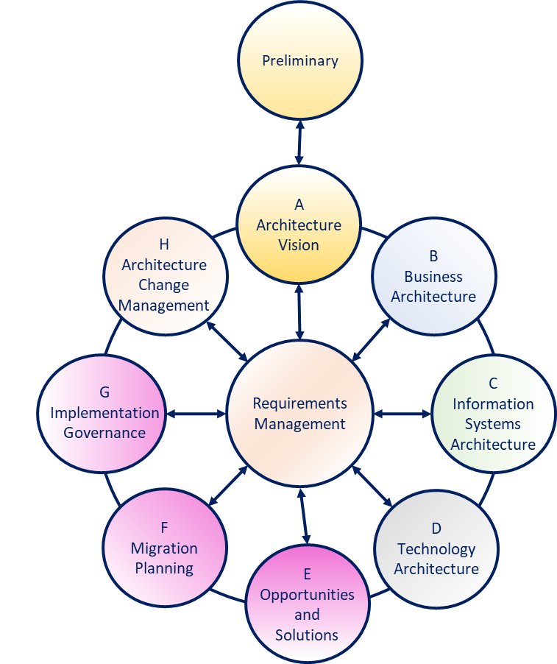
Phase A - Architecture Vision – 14/14
Phase | Output & Outcome | Essential Knowledge
Phase A: Architecture Vision | Sufficient documentation to get permission to proceed. Permission to proceed to develop a Target Architecture to prove out a summary target. | The scope of the problem being addressed. Those who have interests that are fundamental to the problem being addressed. (Stakeholders & Concerns) What summary answer to the problem is acceptable to the stakeholders? (Architecture Vision) Stakeholder priority and preference. What value does the summary answer provide?
In the Content Model there is a list of Artifacts for each Phase.
A Practitioners’ Approach to Developing Enterprise Architecture Following the ADM : Page 42 : §5.2.2
Initially MOD 10
Should say Content Framework so I have changed it
Notes:
Þ Q-33 M-38
Level=2 : L.O.= 3.4c : Explain the outputs necessary to proceed with the architecture development work:
See : TOGAF® Series Guide: A Practitioners’ Approach to Developing Enterprise Architecture Following the TOGAF® ADM : Page 42 : §5.2.2
Statement of Architecture Work
Architecture Vision
Communications Plan
5.2.2 Essential ADM Output and Knowledge
A summary of the essential outcome and output is provided in Table 4. Keep in mind that the essential output is what stakeholders, sponsor, and boss’ boss’ boss wants. No-one wants an architecture; they want guidance on planning and executing an effective change. Practitioners use an architected approach to providing the best available guidance on effective change. The essential outcomes and outputs are derived from the objectives of the phase – the statement of why a Practitioner should perform this activity.
What the Enterprise values and consumes is typically different than what the Practitioner produces. Practitioners deliver an essential output. It is provided as views, roadmaps, architecture specifications, controls, and other useful things. Architecture is developed, and the EA Landscape populated. To do this, Practitioners require a set of essential knowledge. The Enterprise consumes effective guidance about and the ability to govern change.
Read Table 4 in conjunction with Table 3 to confirm whether for a particular purpose the output of the phase is already in existence, needs to be created, or is extraneous to the current Architecture Project. Good Practitioners will adjust their work accordingly. Table 4 lists only key outputs and outcomes. For an exhaustive list, refer to the TOGAF Standard. In order to achieve these outcomes, the Practitioner may have to perform more activities or create more deliverables than those listed in the table below. The intent is to keep the focus on what is pursued, not what is done.
Table 4: Essential ADM Outputs, Outcomes, and Required Knowledge

Slide 69
Summary of Module 10
The 14 Learning points covered in Module 10 are:
3.1a/b: Explain how to identify the information necessary to execute the Architecture Vision phase and how iteration cycles will provide more information to take into account in order to execute the phase.
3.2a/b: Explain how to apply the phase and how it contributes to the architecture development work: Scope of the Architecture Project Stakeholders, their concerns and business requirements. Business goals business drivers and constraints.
3.3a: Describe a security-specific architecture design to be carried out that is sufficient.
3.4/c: Explain the outputs necessary to proceed with the architecture development work: Statement of Architecture Work, Architecture Vision, Communications Plan.
4.1a: Explain the steps applicable to all phases.
4.2b: Explain risk and security considerations during the architecture development.
4.3a/f: Explain the information that is relevant to produce outputs valuable to the architecture development.
Initially MOD 10
Notes:
The 18 Learning points covered in Module 10 are:
3.1a/b: Explain how to identify the information necessary to execute the Architecture Vision phase and how iteration cycles will provide more information to take into account in order to execute the phase.
3.2a/b: Explain how to apply the phase and how it contributes to the architecture development work: Scope of the Architecture Project Stakeholders their concerns and business requirements. Business goals business drivers and constraints.
3.3a: Describe a security-specific architecture design to be carried out that is sufficient.
3.4/c: Explain the outputs necessary to proceed with the architecture development work: Statement of Architecture Work Architecture Vision Communications Plan.
4.1a: Explain the steps applicable to all phases.
4.2b: Explain risk and security considerations during the architecture development.
4.3a/f: Explain the information that is relevant to produce outputs valuable to the architecture development

Slide 70
End of Teaching Slides
End of
Module 10
Phase A
Initially MOD 10

Slide 71
Module 11/16
TOGAF® EA Training - Practitioner
TOGAF® Standard, 10th Edition
Module 11
Architecture Development
TOGAF® is a registered trademark of The Open Group Copyright © The Open Group 2022
​
Initially MOD 11

Slide 72
Course Module Index
# | Topic – Level 1 | ✓
1 | Module 00 - Course Introduction | ✓
2 | Module 01 - Overview | ✓
3 | Module 02 - Concepts | ✓
4 | Module 03 - Introduction to the ADM | ✓
5 | Module 04 - Introduction to the ADM - Techniques | ✓
6 | Module 05 – Applying ADM | ✓
7 | Module 06 - Architecture Governance | ✓
8 | Module 07 – Architecture Content | ✓
# | Topic – Level 2 | ✓
9 | Module 00 - Course Introduction | ✓
10 | Module 08 - The Context for Enterprise Architecture | ✓
11 | Module 09 – Stakeholder Management | ✓
12 | Module 10 – Phase A | ✓
13 | Module 11 – Architecture Development
14 | Module 12 – Implementing the Architecture
15 | Module 13 – Architecture Change Management
16 | Module 14 – Requirements Management
17 | Module 15 – Supporting the ADM Work
18 | Module 16 – Closure
Course Module Index
Initially MOD 11

Slide 73

Steps – All Domain Architecture Phases
Phases B, C, and D – Developing the Architecture
The steps outlined in the TOGAF standard to develop architecture in Phases B, C, and D are identical because the approach to:
  Developing an architecture
  Confirming the work product developed fits and
  Confirming approval are all identical
The steps are also mandatory.
What changes from:
Purpose to purpose
Domain to domain
Project to project
EA team to EA team?
The level of:
Detail
Precision
Formality
Use the steps as a checklist.
A Practitioners’ Approach to Developing Enterprise Architecture Following the ADM : Page 56 : §6.3
Initially MOD 10
In the wrong module moved to Module 11
Notes:
Level=2 : L.O.= 4.1a : Explain the steps applicable to all phases.
See : TOGAF® Series Guide: A Practitioners’ Approach to Developing Enterprise Architecture Following the TOGAF® ADM : Page 56 : §6.3
Phases B, C, and D – Developing the Architecture
Surprisingly, the steps outlined in the TOGAF Standard to develop architecture in Phases B, C, and D are identical because the approach to:
developing an architecture
confirming the work product developed fits
confirming approval are all identical
The steps are also mandatory – if any are skipped the outcome could be at risk.
What changes from:
purpose to purpose
domain to domain
project to project
EA team to EA team ?
It is the level of:
detail
precision
formality
Use the Steps as a checklist.
6.3 Phases B, C, and D – Developing the Architecture
Practitioners often find it surprising that the steps outlined in the TOGAF standard to develop architecture in Phases B, C, and D are identical. The steps are identical because the approach to developing an architecture, confirming the work product developed fits, and confirming approval are identical. These steps are also mandatory. Steps can be skipped, but the final outcome could be at risk.
What changes from purpose to purpose, domain to domain, project to project, and EA team to EA team is the level of detail, precision, and formality. All Practitioners should use the steps as a checklist.

Slide 74
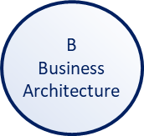
Risk and Security Considerations - Phase B – 01/03
Security Policy Architecture
Business Risk Model/Risk Register
  Contains a set of security policies that express the security strategy, assigns ownership and accountability for security and risk management, and addresses the linkage and hierarchy of operational risk management in general, such as business continuity, information security, system security, and physical security.
  Determines the cost (both qualitative and quantitative) of asset loss/impact in failure cases, based on identified threats, the likelihood of these materializing, and the impact of an incident.
Applicable Law and Regulation Register
Security Domain Model
  Contains the specific laws and regulations that apply within the scope of the Enterprise Architecture engagement.
  A grouping of information (or data entities) by a set of criteria such as security classification, ownership, location, etc.
Applicable Control Framework Register
Trust Framework
Contains the suitable set of control frameworks that best satisfy the requirements - e.g., ISO/IEC 27001:2013 [4], ISO/IEC 27002:2013 [5], COBIT [10], etc.
Factors that drive the selection of control frameworks are:
Mandatory certifications
Way of working of the internal ISM process
Marketing objectives
Support for security audits
  Describes trust relationships between various entities in the architecture domain and on what basis this trust exists.
Risk Assessment
  Is the activity of determining the risks that are relevant to an asset or objective. Qualitative risk assessment delivers a listing of relevant risk scenarios with a high-level prioritization – the quantitative approach looks for numeric determination of the risk.
Integrating Risk and Security within a Enterprise Architecture : Page 20 : §5.3
Initially MOD 10
In the wrong module moved to Module 11
Notes:
Level=2 : L.O.= 4.2b : Explain risk and security considerations during the architecture development.
See : TOGAF® Series Guide: Integrating Risk and Security within a TOGAF® Enterprise Architecture : Page 20 : §5.3
Security Policy Architecture
Contains a set of security policies that express the security strategy, assigns ownership and accountability for security and risk management, addresses the linkage and hierarchy of operational risk management in general, such as business continuity, information security, system security, and physical security.
Security Domain Model
A grouping of information (or data entities) by a set of criteria such as security classification, ownership, location, etc. In the context of security, information domains are defined as a set of users, their information objects and a security policy. Distinguishes between areas of different security/trust levels. A security policy authority is responsible for setting and implementing policy within the domain.
Trust Framework
Describes trust relationships between various entities in the architecture domain and on what basis this trust exists. Trust relationships can be unidirectional, bidirectional, or non-existent. The onus for assessing trust is the responsibility of those choosing to enter into the contracts - and their legal counsel.
Risk Assessment
Is the activity of determining the risks that are relevant to an asset or objective. Qualitative risk assessment delivers a listing of relevant risk scenarios with a high-level prioritization - quantitative approach seeks for numeric determination of the risk. A deliverable of a risk assessment is the Business Risk Model.
Business Risk Model/Risk Register
Determines the cost (both qualitative and quantitative) of asset loss/impact in failure cases, based on identified threats, likelihood of these materializing, and impact of an incident. Security classification should be carried out at this stage based on the risks identified.
Applicable Law and Regulation Register
Contains the specific laws and regulations that apply within the scope of the Enterprise Architecture engagement, based on the business function inventory. It is kept up-to-date, following legal and regulatory changes. This register is important for compliance purposes.
Applicable Control Framework Register
Contains the suitable set of control frameworks that best satisfy the requirements and address the risks related to the engagement scope and context – e.g. ISO/IEC 27001:2013 [4], ISO/IEC 27002:2013 [5], COBIT [10], etc.
Factors that drive the selection of control frameworks are:
Mandatory certifications
... CONTINUES ... SEE REFERENCE SPECIFIED

Slide 75
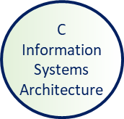
Risk and Security Considerations - Phase C – 02/03
Security Services Catalog
Data Quality
A list of services that provide security-specific functionality as part of the overall architecture Examples of security services are:
Identity & Access Management
Continuity Management
Security Intelligence
Compliance Management
Training & Awareness Programs, etc.
The advantage of the Security Services Catalog is that it uses common terminology.
A key factor in operational risk management.
Key attributes are:
Accuracy
Relevance
Timeliness
Completeness
Consistency
Availability
Accessibility
For each dataset, ownership, and responsibility for the quality of data needs to be assigned. Each of the key attributes should be measured based on log and performance data.
Security Classification
A label attached to an asset, according to a classification scheme, that is defined and described in the information security policy - based on one or more characteristics of the asset:
Business service
Capability
Information
An information system service
Physical data component
Physical technology component.
Integrating Risk and Security within a Enterprise Architecture : Page 22 : §5.4
Initially MOD 10
In the wrong module moved to Module 11
Notes:
Level=2 : L.O.= 4.2b : Explain risk and security considerations during the architecture development.
See : TOGAF® Series Guide: Integrating Risk and Security within a TOGAF® Enterprise Architecture : Page 22 : §5.4
Security Services Catalog
Is a list of services that provide security-specific functionality as part of the overall architecture. Unlike control frameworks that contain requirements, the Security Services Catalog describes security building blocks that actually realize the security goals. It provides a common terminology and reference framework for the domain of security management. The Security Services Catalog contains conceptual definitions of the services, as well as operational information about implementation and usage.
Examples of security services are:
Identity & Access Management
Continuity Management
Security Intelligence
Digital Forensics
Security Analytics
Audit, Network Monitoring
Compliance Management
Training & Awareness Programs, etc.
The advantage of the Security Services Catalog is that it is a common terminology and reference framework for the domain of security management, allowing better cooperation between the parties concerned.
Security Classification
Is a label attached to an asset, according to a classification scheme. In most cases, this scheme is defined and described in the information security policy and the classification is based on one or more characteristics of the asset which can be any relevant component of the architecture business service.
Capability Information
An information system service, physical data component, physical technology component.
The security classification determines the security requirements that apply.
Data Quality
Is a key factor in operational risk management. Some of the key attributes that contribute to data quality are accuracy, relevance, timeliness, currency, completeness, consistency, availability, and accessibility.
... CONTINUES ... SEE REFERENCE SPECIFIED

Slide 76
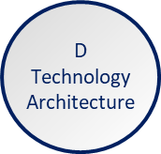
Risk and Security Considerations - Phase D – 03/03
In most cases, the development of specific Technology Architecture security artifacts is not necessary
The Security Architect must ensure that the required controls are included in the Technology Architecture - including technology for:
Provision
Protection
Regulation
Of system resources, such as:
Electric power
Processing capacity
Network bandwidth
Memory
A security stakeholder may request the creation of a specific Technology Architecture security view or deliverable that describes all security-related technology components and how they inter-relate.
Integrating Risk and Security within a Enterprise Architecture : Page 24 : §5.5
In the wrong module moved to Module 11
Notes:
Level=2 : L.O.= 4.2b : Explain risk and security considerations during the architecture development.
See : TOGAF® Standard, 10th Edition, 2022® Series Guide: Integrating Risk and Security within a TOGAF® Enterprise Architecture : Page 24 : §5.5
In most cases, the development of specific Technology Architecture security artifacts is not necessary, as long as it incorporates the relevant security controls and mechanisms defined in the earlier phases.
The Security Architect must ensure that the required controls are included in the Technology Architecture and verify whether the controls are used in an effective and efficient way. This includes the technology for the:
Provision
Protection
Regulation
of system resources, such as:
electric power
processing capacity
network bandwidth
memory
A security stakeholder may request the creation of a specific Technology Architecture security view or deliverable that describes all security-related technology components and how they inter-relate.
This view should explain which business risks are mitigated by what technology, providing justification for the technology.
Non syllabus note
Certain aspects of Security may be recognised, but the handling of these is outside the scope of the enterprise.
Examples include:
Firmware code
e.g. in Routers, Printers, CNC machines etc.
Operating system code
Software package code
Insurance tolerance around threats via these aspects is dwindling.
When these are recognised the EA must draw specific attention to them and give notice to –
Architecture Board
Corporate Counsel
Procurement
Other domain architects
to give clarity about which parties will bear liabilities – this will often crucially affect process design.
... CONTINUES ... SEE REFERENCE SPECIFIED

Slide 77
Business Principles – 01/02
Business Principles contribute to understanding the context for architecture work.
They describe and inform the needs and ways of working employed by the enterprise.
Architecture Principles are an addition to the inherited set of Business Principles.
Many factors that lie outside the consideration of architecture discipline may nevertheless have signiﬁcant implications for the way that architecture is developed.
For example:
We are an ethical bank
We are a green oil company
We support Fairtrade
Architecture Development Method : Page 42 : §4.2
Initially MOD 10
In the wrong module moved to Module 11
Notes:
Level=2 : L.O.= 4.3a : Explain the information that is relevant to produce outputs valuable to the architecture development: Business Principles
See : TOGAF® Standard – Architecture Development Method : Page 42 : §4.2
Business Principles contribute to understanding the context for architecture work.
They describe and inform the needs and ways of working employed by the enterprise.
Architecture Principles are an addition to the inherited set of Business Principles.
Many factors that lie outside the consideration of architecture discipline may nevertheless have signiﬁcant implications for the way that architecture is developed.
For example:
We are an ethical bank
We are a green oil company
We support Fairtrade
4.2 Inputs
This section deﬁnes the inputs to Phase B.
4.2.1 Reference Materials External to the Enterprise
■Architecture reference materials (see the TOGAF Standard — Architecture Content)
4.2.2 Non-Architectural Inputs
■Request for Architecture Work (see the TOGAF Standard — Architecture Content)
■Business principles, business goals, and business drivers (see the TOGAF Standard —
Architecture Content)
■Capability Assessment (see the TOGAF Standard — Architecture Content)
■Communications Plan (see the TOGAF Standard — Architecture Content)

Slide 78
Business Goals – 01/02
… are goals that a business anticipates accomplishing in a set period of time.
They are a consequence of the desire to attain the objective(s) implied by the Strategy.
They are set for the enterprise in general.
Business goals:
Objectives are steps towards a goal
Are broad outcomes
Do not have to be specific
Setting business goals is important:
Provide
Provide a way to measure success
Keep
Keep all employees on the same page as to what the goals of the company are
Give
Give employees a clear understanding of how decision-making reaches company's goals
Ensure
Ensure the company is headed in the right direction
Much Architecture work arises from the need to achieve Business Goals.
Architecture Development Method : Page 42 : §4.2
Initially MOD 10
In the wrong module moved to Module 11
Notes:
Level=2 : L.O.= 4.3a/c : Explain the information that is relevant to produce outputs valuable to the architecture development: Business goals
See : TOGAF® Standard – Architecture Development Method : Page 42 : §4.2
Business Goals
… are goals that a business anticipates accomplishing in a set period of time.
They are a consequence of the desire to attain the objective(s) implied by the Strategy
They are set for the enterprise in general
Business Goals :
may have objective steps
do not have to be specific
are broad outcomes
Setting business goals are important because they:
Provide a way to measure success
Keep all employees on the same page as to what the goals of the company are
Give employees a clear understanding of how decision-making reaches company's goals
Ensure the company is headed in the right direction
Much Architecture work arises from the need to achieve Business Goals.
4.2 Inputs
This section deﬁnes the inputs to Phase B.
4.2.1 Reference Materials External to the Enterprise
■Architecture reference materials (see the TOGAF Standard — Architecture Content)
4.2.2 Non-Architectural Inputs
■Request for Architecture Work (see the TOGAF Standard — Architecture Content)
■Business principles, business goals, and business drivers (see the TOGAF Standard —
Architecture Content)
,■Capability Assessment (see the TOGAF Standard — Architecture Content)
■Communications Plan (see the TOGAF Standard — Architecture Content)

Slide 79
Business Drivers – 01/02
… are the key inputs and activities that drive the operational and financial results of a business.
The term ‘business driver’ has become a fashionable catch-phrase.
In order to make internal choices about business strategy or build a financial model to value a company, it’s critical to gain a solid understanding of the main drivers of a business.
Architecture Development Method : Page 42 : §4.2
Initially MOD 10
In the wrong module moved to Module 11
Notes:
Level=2 : L.O.= 4.3a/c : Explain the information that is relevant to produce outputs valuable to the architecture development: Business goals
See : TOGAF® Standard – Architecture Development Method : Page 42 : §4.2
… are the key inputs and activities that drive the operational and financial results of a business.
Business Drivers
The term ‘business driver’ has become a fashionable catchphrase that refers to any key part of a business.
In order to make internal choices about business strategy or build a financial model to value a company, it’s critical to gain a solid understanding of the main drivers of a business.
Identifying a company’s business drivers gets harder as it becomes more complex.
The business drivers of software companies, for example, are technological innovation, better products, and optimum marketing.
The most common business drivers are:
Legislation and government policy
Litigation
The price of resources or commodities
Competitors’ activities
Customer demand
4.2 Inputs
This section deﬁnes the inputs to Phase B.
4.2.1 Reference Materials External to the Enterprise
■Architecture reference materials (see the TOGAF Standard — Architecture Content)
4.2.2 Non-Architectural Inputs
■Request for Architecture Work (see the TOGAF Standard — Architecture Content)
■Business principles, business goals, and business drivers (see the TOGAF Standard —
Architecture Content)
■Capability Assessment (see the TOGAF Standard — Architecture Content)
■Communications Plan (see the TOGAF Standard — Architecture Content)

Slide 80
Phase B – Business Architecture – 01/09
Objectives
Develop the Target Business Architecture that describes how the enterprise needs to operate to achieve the business goals, and respond to the strategic drivers set out in the Architecture Vision in a way that addresses the Statement of Architecture Work and stakeholder concerns
Identify candidate Architecture Roadmap components based upon gaps between the Baseline and Target Business Architectures
Architecture Development Method : Page 43 : §4.3
Initially MOD 11
Notes:
Level=2 : L.O.= 4.4a : Explain how to apply Phase B and how it contributes to the architecture development work.
See : TOGAF® Standard – Architecture Development Method : Page 43 : §4.3
Objectives
Develop the Target Business Architecture that describes how the enterprise needs to operate to achieve the business goals, and respond to the strategic drivers set out in the Architecture Vision in a way that addresses the Statement of Architecture Work and stakeholder concerns.
Identify candidate Architecture Roadmap components based upon gaps between the Baseline and Target Business Architectures.
4.3 Steps
The level of detail addressed in Phase B will depend on the scope and goals of the overall architecture effort.
New models characterizing the needs of the business will need to be deﬁned in detail during Phase B. Existing business artifacts to be carried over and supported in the target environment
These may already have been adequately deﬁned in previous architectural work; but, if not, they too will need to be deﬁned in Phase B.
The order of the steps in Phase B, as well as the time at which they are formally started and completed, should be adapted to the situation at hand, in accordance with the established Architecture Governance. In particular ,determine whether in this situation it is appropriate to conduct Baseline or Target Architecture development ﬁrst, as described in the TOGAF Standard
Applying the ADM.
All activities that have been initiated in these steps should be closed during the Finalize the Business Architecture step (see Section 4.3.8). The documentation generated from these steps must be formally published in the Create/Update the Architecture Deﬁnition Document step (see Section 4.3.9).

Slide 81

Phase B – Business Architecture – 02/09
Approach
Knowledge of the Business Architecture is a prerequisite for architecture work in the other domains
Business Strategy defines what to achieve
Business Architecture describes how to achieve it
If there is no existing strategy or planning:
→Identify any existing architecture definitions, then verify and update
→New process definitions may require detailed work
In both cases, use business scenarios
The Royal Ontario Museum, Toronto, featuring the Michael Lee-Chin Crystal, designed by Daniel Libeskind
Architecture Development Method : Page 43 : §4.3
Initially MOD 11
Notes:
Level=2 : L.O.= 4.4a : Explain how to apply Phase B and how it contributes to the architecture development work.
See : TOGAF® Standard – Architecture Development Method : Page 43 : §4.3
Approach
Knowledge of the Business Architecture is a prerequisite for architecture work in the other domains (Data, Applications, Technology):
And so is the first activity that needs to be undertaken.
Business Strategy defines what to achieve
Business Architecture describes how to achieve it
This Phase is often required to demonstrate the business value of subsequent work to key stakeholders:
Scope depends on existing strategy and planning
Update and verify bridge between high-level business drivers, strategy, and goals on the one hand, and specific business requirements
Existing architecture discovery must include all relevant detail
If there is no existing strategy or planning:
Identify any existing architecture definitions, then verify and update
New process definitions may require detailed work
In both cases, use business scenarios to identify key business objectives and processes
4.3 Steps
The level of detail addressed in Phase B will depend on the scope and goals of the overall architecture effort.
New models characterizing the needs of the business will need to be deﬁned in detail during Phase B. Existing business artifacts to be carried over and supported in the target environment may already have been adequately deﬁned in previous architectural work; but, if not, they too will need to be deﬁned in Phase B.
The order of the steps in Phase B as well as the time at which they are formally started and completed should be adapted to the situation at hand, in accordance with the established Architecture Governance. In particular, determine whether in this situation it is appropriate to conduct Baseline or Target Architecture development ﬁrst, as described in the TOGAF Standard
Applying the ADM.
All activities that have been initiated in these steps should be closed during the Finalize the Business Architecture step (see Section 4.3.8). The documentation generated from these steps must be formally published in the Create/Update the Architecture Deﬁnition Document step (see Section 4.3.9).

Slide 82

Phase B – Business Architecture – 03/09
Inputs
Reference Materials External to the Enterprise
Architecture reference materials
Non-Architectural Inputs
Request for Architecture Work
Business principles, goals, drivers
Communications Plan
Architectural Inputs
Organizational Model for Enterprise
Tailored Architecture
Approved Statement of Architecture Work
Architecture Principles
Enterprise Continuum
Architecture Repository
Architecture Vision
Draft Architecture Definition Document
Architecture Development Method : Page 43 : §4.3
Initially MOD 11
Notes:
Þ M-57
Level=2 : L.O.= 4.4a : Explain how to apply Phase B and how it contributes to the architecture development work.
See : TOGAF® Standard – Architecture Development Method : Page 43 : §4.3
4.2.2 Non-Architectural Inputs
■Request for Architecture Work (see the TOGAF Standard — Architecture Content)
■Business principles, business goals, and business drivers (see the TOGAF Standard —
Architecture Content)
■Capability Assessment (see the TOGAF Standard — Architecture Content)
■Communications Plan (see the TOGAF Standard — Architecture Content)
4.2.3 Architectural Inputs
■Organizational Model for Enterprise Architecture (see the TOGAF Standard — Architecture
Content), including:
—Scope of organizations impacted
—Maturity assessment, gaps, and resolution approach
—Roles and responsibilities for architecture team(s)
—Constraints on architecture work
—Budget requirements
—Governance and support strategy
■Tailored Architecture Framework (see the TOGAF Standard — Architecture Content),
including:
—Tailored architecture method
—Tailored architecture content (deliverables and artifacts)
—Conﬁgured and deployed tools
■Approved Statement of Architecture Work (see the TOGAF Standard — Architecture
Content)
■Architecture Principles (see the TOGAF Standard — Architecture Content), including
business principles, when pre-existing
■Enterprise Continuum (see the TOGAF Standard — Architecture Content)
■Architecture Repository(see the TOGAF Standard — Architecture Content), including:
—Re-usable building blocks
—Publicly available reference models
—Organization-speciﬁc reference models
—Organization standards
■Architecture Vision (see the TOGAF Standard — Architecture Content), including:
—Problem description
—Objective of the Statement of Architecture Work
—Summary views
—Business Scenario (optional)
... CONTINUES ... SEE REFERENCE SPECIFIED

Slide 83


Phase B – Business Architecture – 04/09
Steps
The TOGAF® Standard includes a generic set of Steps.
The main benefits of having ‘tick lists’ are threefold:
1. You can see clearly what must be done and organize resource accordingly
2. Management is less arduous – there is a clear list of what must be done, and to what precision.
3. You clearly know when you have finished.
The TOGAF® Standard generic set of Steps are in the next slide.
This set of Steps is the distillation of tens of thousands of hours of practical EA work in a myriad of firms, in most industries, worldwide.
Probably you should only add to it.
Architecture Development Method : Page 43 : §4.3
Initially MOD 11
Notes:
Level=2 : L.O.= 4.4a : Explain how to apply Phase B and how it contributes to the architecture development work.
See : TOGAF® Standard – Architecture Development Method : Page 43 : §4.3
Steps
The TOGAF® Standard includes a generic set of Steps.
The main benefits of having ‘tick lists’ are threefold:
You can see clearly what must be done and organize resource accordingly
Management is less arduous – there is a clear list of what must be done, and to what precision.
You clearly know when you have finished.
The TOGAF® Standard generic set of Steps are in the next slide.
This set of Steps is the distillation of tens of thousands of hours of practical EA work in a myriad of firms, in most industries, worldwide.
Probably you should only add to it.
4.3 Steps
The level of detail addressed in Phase B will depend on the scope and goals of the overall architecture effort.
New models characterizing the needs of the business will need to be deﬁned in detail during Phase B. Existing business artifacts to be carried over and supported in the target environment
These may already have been adequately deﬁned in previous architectural work; but, if not, they too will need to be deﬁned in Phase B.
The order of the steps in Phase B as well as the time at which they are formally started and completed should be adapted to the situation at hand, in accordance with the established
Architecture Governance.
In particular, determine whether in this situation it is appropriate to conduct Baseline or Target Architecture development ﬁrst, as described in the TOGAF Standard
Applying the ADM.
All activities that have been initiated in these steps should be closed during the Finalize the Business Architecture step (see Section 4.3.8). The documentation generated from these steps must be formally published in the Create/Update the Architecture Deﬁnition Document step (see Section 4.3.9).

Slide 84
Phase B – Business Architecture – 05/09
Phases
Steps: Classic View
B - Business
9. Create/Update Architecture Definition Document
Associated with each step is a generic list of tasks.
This will be adapted as fitting
for each project.
The order is not very important.
It is important that at the end of the phase there is a ✓ in every box [of the adapted list] or a reason why not!
8. Finalize the Business Architecture
7. Conduct formal stakeholder review
6. Resolve impacts across the Architecture Landscape
5. Define candidate roadmap components
4. Perform gap analysis
3. Develop Target Business Architecture Description
2. Develop Baseline Business Architecture Description
1. Select reference models, viewpoints, and tools
A Practitioners’ Approach to Developing Enterprise Architecture Following the TOGAF® ADM : Page 56 : §6.3
Initially MOD 11
Notes:
Þ R-18
Level=2 : L.O.= 4.1a : Explain the steps applicable to all phases.
See : TOGAF® Series Guide: A Practitioners’ Approach to Developing Enterprise Architecture Following the TOGAF® ADM : Page 56 : §6.3
4.3 Steps
The level of detail addressed in Phase B will depend on the scope and goals of the overall architecture effort.
New models characterizing the needs of the business will need to be deﬁned in detail during Phase B. Existing business artifacts to be carried over and supported in the target environment may already have been adequately deﬁned in previous architectural work; but, if not, they too will need to be deﬁned in Phase B.
The order of the steps in Phase B, as well as the time at which they are formally started and completed, should be adapted to the situation at hand, in accordance with the established Architecture Governance. In particular, determine whether in this situation it is appropriate to conduct Baseline or Target Architecture development ﬁrst, as described in the TOGAF Standard
Applying the ADM.
All activities that have been initiated in these steps should be closed during the Finalize the Business Architecture step (see Section 4.3.8). The documentation generated from these steps must be formally published in the Create/Update the Architecture Deﬁnition Document step (see Section 4.3.9).

Slide 85
Phase B – Business Architecture – 07/09
Key Outputs and Outcomes
What the Enterprise values and consumes is typically different than what the EA produces. EAs deliver essential output.
It is provided as:
views
roadmaps
architecture specifications
controls
other useful things
Architecture is developed, and the EA landscape populated.
To do this, practitioners require a set of essential knowledge.
Phase | Output & Outcome | Essential Knowledge
Phase B | A set of domain architectures approved by the stakeholders for the problem being addressed, with a set of gaps, and work to clear the gaps understood by the stakeholders. | How does the current Enterprise fail to meet the preferences of the stakeholders? What must change to enable the Enterprise to meet the preferences of the stakeholders? (Gaps) What work is necessary to realize the changes, that is consistent with the additional value being created? (Work Package) How stakeholder priority and preference adjust in response to value, effort, and risk of change. (Stakeholder Requirements)
A Practitioners’ Approach to Developing Enterprise Architecture Following the TOGAF® ADM : Page 42 : §5.2.2
Initially MOD 11
Notes:
Level=2 : L.O.= 4.4b : Explain how to apply Phase B and how it contributes to the architecture development work.
See : TOGAF® Series Guide: A Practitioners’ Approach to Developing Enterprise Architecture Following the TOGAF® ADM : Page 42 : §5.2.2
Key Outputs and Outcomes
What the Enterprise values and consumes is typically different than what the EA produces. EAs deliver essential output.
It is provided as:
views
roadmaps
architecture specifications
controls
other useful things
Architecture is developed, and the EA Landscape populated.
To do this, Practitioners require a set of essential knowledge.
5.2.2 Essential ADM Output and Knowledge
A summary of the essential outcome and output is provided in Table 4. Keep in mind that the essential output is what stakeholders, sponsor, and boss’ boss’ boss wants. No-one wants an architecture; they want guidance on planning and executing an effective change. Practitioners use an architected approach to providing the best available guidance on effective change. The essential outcomes and outputs are derived from the objectives of the phase – the statement of why a Practitioner should perform this activity.
What the Enterprise values and consumes is typically different than what the Practitioner produces. Practitioners deliver an essential output. It is provided as views, roadmaps, architecture specifications, controls, and other useful things. Architecture is developed, and the EA Landscape populated. To do this, Practitioners require a set of essential knowledge. The Enterprise consumes effective guidance about, and the ability to govern, change.
Read Table 4 in conjunction with Table 3 to confirm whether for a particular purpose the output of the phase is already in existence, needs to be created, or is extraneous to the current Architecture Project. Good Practitioners will adjust their work accordingly. Table 4 lists only key outputs and outcomes. For an exhaustive list, refer to the TOGAF Standard. In order to achieve these outcomes, the Practitioner may have to perform more activities or create more deliverables than those listed in the table below. The intent is to keep the focus on what is pursued, not what is done.
Table 4: Essential ADM Outputs, Outcomes, and Required Knowledge

Slide 86


Phase B – Business Architecture – 08/09
Outputs
Statement of Architecture Work
Validated business principles, goals and drivers
Refined and updated Business Architecture Principles
Draft Architecture Definition Document
Draft Architecture Requirements Specification
Business Architecture components of an Architecture Roadmap
A Practitioners’ Approach to Developing Enterprise Architecture Following the TOGAF® ADM : Page 42 : §5.2.2
Initially MOD 11
Notes:
Level=2 : L.O.= 4.4b : Explain how to apply Phase B and how it contributes to the architecture development work.
See : TOGAF® Series Guide: A Practitioners’ Approach to Developing Enterprise Architecture Following the TOGAF® ADM : Page 42 : §5.2.2
Key Outputs and Outcomes
What the Enterprise values and consumes is typically different than what the EA produces. EAs deliver essential output.
It is provided as:
views
roadmaps
architecture specifications
controls
other useful things
Architecture is developed, and the EA Landscape populated.
To do this, Practitioners require a set of essential knowledge.
5.2.2 Essential ADM Output and Knowledge
A summary of the essential outcome and output is provided in Table 4. Keep in mind that the essential output is what stakeholders, sponsor, and boss’ boss’ boss wants. No-one wants an architecture; they want guidance on planning and executing an effective change. Practitioners use an architected approach to providing the best available guidance on effective change. The essential outcomes and outputs are derived from the objectives of the phase – the statement of why a Practitioner should perform this activity.
What the Enterprise values and consumes is typically different than what the Practitioner produces. Practitioners deliver an essential output. It is provided as views, roadmaps, architecture specifications, controls, and other useful things. Architecture is developed, and the EA Landscape populated. To do this, Practitioners require a set of essential knowledge. The Enterprise consumes effective guidance about, and the ability to govern, change.
Read Table 4 in conjunction with Table 3 to confirm whether for a particular purpose the output of the phase is already in existence, needs to be created, or is extraneous to the current Architecture Project. Good Practitioners will adjust their work accordingly. Table 4 lists only key outputs and outcomes. For an exhaustive list, refer to the TOGAF Standard. In order to achieve these outcomes, the Practitioner may have to perform more activities or create more deliverables than those listed in the table below. The intent is to keep the focus on what is pursued, not what is done.
Table 4: Essential ADM Outputs, Outcomes, and Required Knowledge

Slide 87

Phase B – Business Architecture – 09/09
Outputs
Refined and updated versions of the Architecture Vision
phase deliverables, where applicable
Draft Architecture Definition Document, including:
Baseline Business Architecture, approved
Target Business Architecture, approved
Draft Architecture Requirements Specification with
Business Architecture requirements as:
Gap Analysis results
Technical requirements
Business Architecture components of Architecture Roadmap
Updated business requirements
A Practitioners’ Approach to Developing Enterprise Architecture Following the TOGAF® ADM : Page 42 : §5.2.2
Initially MOD 11
Notes:
Level=2 : L.O.= 4.4b : Explain how to apply Phase B and how it contributes to the architecture development work.
See : TOGAF® Series Guide: A Practitioners’ Approach to Developing Enterprise Architecture Following the TOGAF® ADM : Page 42 : §5.2.2
Key Outputs and Outcomes
What the Enterprise values and consumes is typically different than what the EA produces. EAs deliver essential output.
It is provided as:
views
roadmaps
architecture specifications
controls
other useful things
Architecture is developed, and the EA Landscape populated.
To do this, Practitioners require a set of essential knowledge.
5.2.2 Essential ADM Output and Knowledge
A summary of the essential outcome and output is provided in Table 4. Keep in mind that the essential output is what stakeholders, sponsor, and boss’ boss’ boss wants. No-one wants an architecture; they want guidance on planning and executing an effective change. Practitioners use an architected approach to providing the best available guidance on effective change. The essential outcomes and outputs are derived from the objectives of the phase – the statement of why a Practitioner should perform this activity.
What the Enterprise values and consumes is typically different than what the Practitioner produces. Practitioners deliver an essential output. It is provided as views, roadmaps, architecture specifications, controls, and other useful things. Architecture is developed, and the EA Landscape populated. To do this, Practitioners require a set of essential knowledge. The Enterprise consumes effective guidance about, and the ability to govern, change.
Read Table 4 in conjunction with Table 3 to confirm whether for a particular purpose the output of the phase is already in existence, needs to be created, or is extraneous to the current Architecture Project. Good Practitioners will adjust their work accordingly. Table 4 lists only key outputs and outcomes. For an exhaustive list, refer to the TOGAF Standard. In order to achieve these outcomes, the Practitioner may have to perform more activities or create more deliverables than those listed in the table below. The intent is to keep the focus on what is pursued, not what is done.
Table 4: Essential ADM Outputs, Outcomes, and Required Knowledge

Slide 88
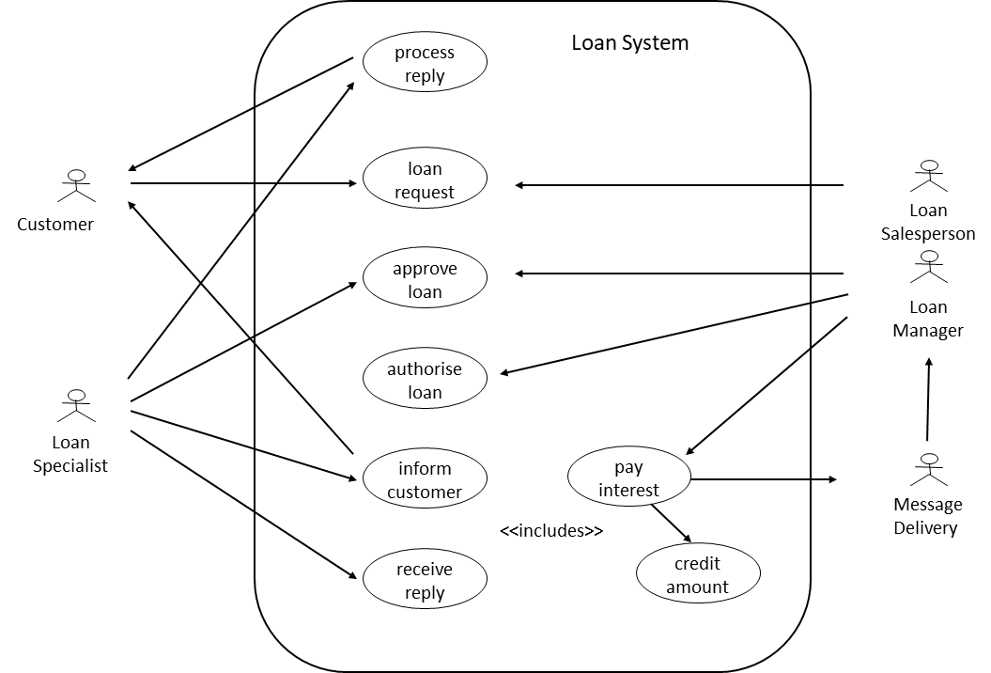
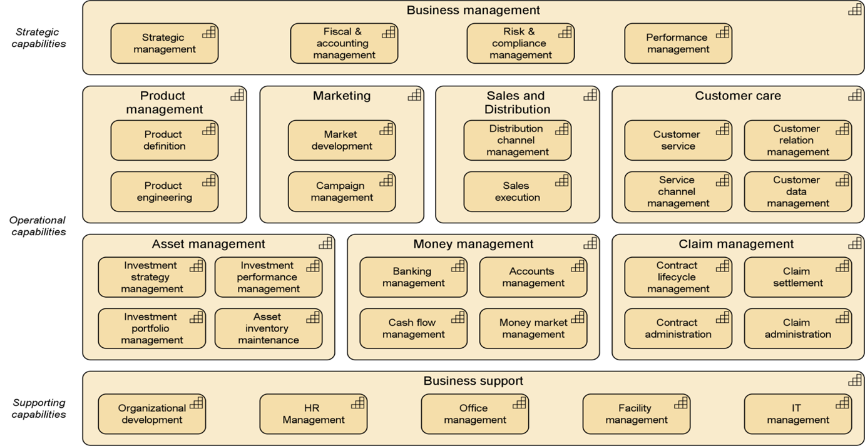
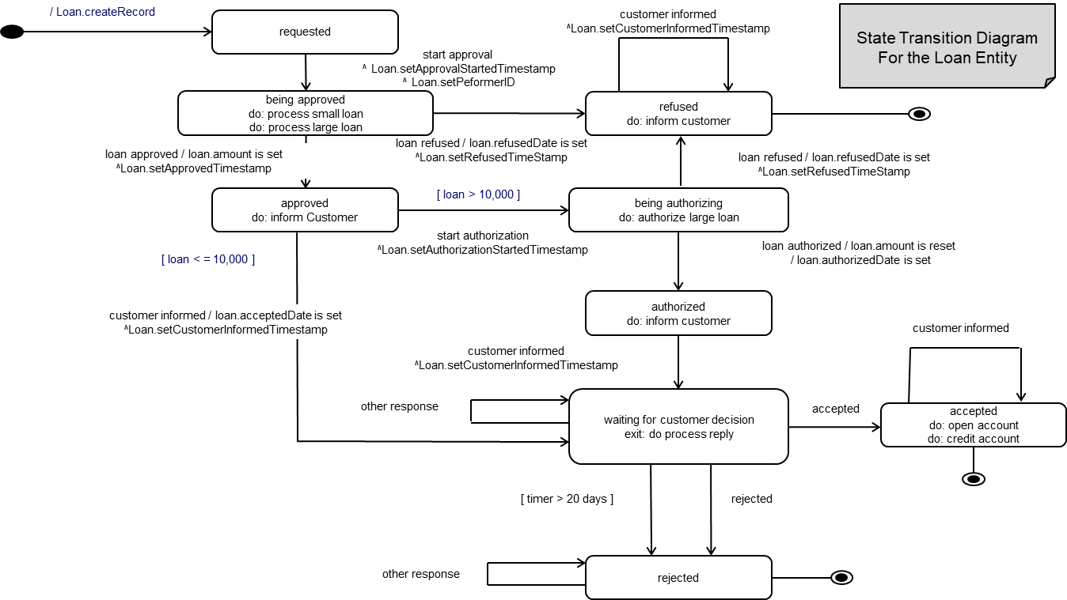
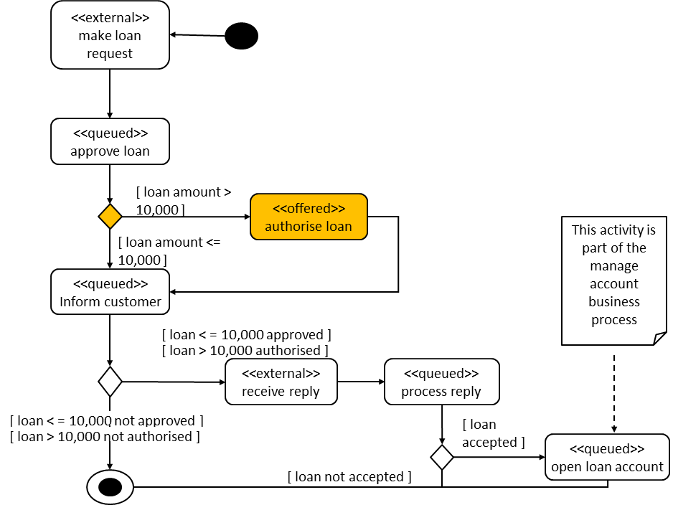
Example Business Artifacts Describing Building Blocks
Use Case Model
System, Role, Activity
Capability Map
Business Functions, Capabilities
State Transition
Diagram
Actions, States, Sequences
Process Activity Diagram
Activities, Decision Points, Flows
Initially MOD 07
Added some example artifacts

Slide 89
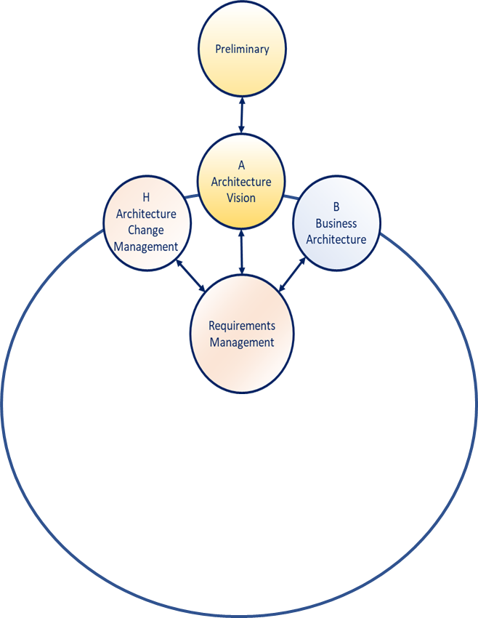
The Business Scenario Technique – 01/04
Key factors in the success of any Enterprise Architecture are:
The extent to which it is linked to business requirements
Its support for business objectives
The Business Scenario method is a technique to:
  Validate
  Elaborate
  Change
The premise(s) behind an architecture effort - where:
  Each iteration requires planning, gathering, analysis,
  documentation, and review
  Each iteration improves the key elements
  Iterations are repeated until fit-for-purpose
A Business Scenario describes:
  Real business problems
  The business and technology environment where problems occur
  Value chains - enabled by capabilities
Used prominently in Phase A (Architecture Vision)
and iteratively in Phase B (Business Architecture)
Business Scenarios : Page 1 : §1
Initially MOD 14
Moved to Phase B where it should be
Notes:
Level=2 : L.O.= 8.2a : Briefly explain the business scenario technique.
See: TOGAF® Series Guide: Business Scenarios : Page 1 : §1
Key factors in the success of any enterprise architecture are:
The extent to which it is linked to business requirements
Its support for business objectives
The Business Scenario method is a technique to:
Validate
Elaborate
Change
the premise(s) behind an architecture effort - where:
Each iteration requires planning, gathering, analysis, documentation, and review
Each iteration should improve one or more of the key elements
Iterations are repeated until understanding is fit-for-purpose
for deciding to move forward
A Business Scenario describes:
Real business problems
The business and technology environment where problems occur
Value chains - enabled by capabilities
Used prominently in Phase A (Architecture Vision)
and iteratively in Phase B (Business Architecture)
1 Introduction
A key factor in the success of an Enterprise Architecture is the extent to which it is linked to business requirements, and demonstrably supporting and enabling the enterprise to achieve its business objectives. Any architectural effort must begin with a baseline view of the needs to be fulfilled by the solution or solutions. Consider guiding the construction of a warehouse building without understanding why the warehouse is needed. This could result in a fine warehouse solution for housing large-scale mechanical parts; however, the need was a warehouse for household goods. Creating an architecture without understanding “why” typically results in mismatches between solutions and needs.
The Business Scenario method is a technique to validate, elaborate, and/or change the premise behind an architecture effort by understanding and documenting the key elements of a Business Scenario in successive iterations where:
• Each iteration requires planning, data gathering, analysis, documentation, and review
... CONTINUES ... SEE REFERENCE SPECIFIED

Slide 90
The Business Scenario Technique – 02/04
A good business scenario:
Is representative of a significant business need or problem
Enables vendors to understand the value of a developed solution to a customer
Is “SMART”
Specific
  defines what needs to be done in the business;
Measurable
  has clear metrics for success;
Actionable
  clearly segments the problem, and provides the basis for finding a solution;
Realistic
  defines the bounds of technology capabilities and cost constraints;
Time-bound
  gives a clear understanding of when a solution expires.
  … see later
A business scenario is a complete description of a problem.
Without this:
There is danger that the requirements will not be complete
The business value to solving the problem will be unclear
The relevance of potential solutions will be unclear
A scenario:
Can play an important role in engaging the stakeholders
Can help to establish good communication with vendors early on
Contributors include, at least:
Enterprise Architects
Business Line Management
IT/Services Vendors
Typically, involvement of management is greatest in the early stages …
the involvement of the architect is greatest in later stages.
Business Scenarios : Page 19 : §7
Initially MOD 14
Moved to Phase B where it should be
Notes:
Level=2 : L.O.= 8.2a : Briefly explain the business scenario technique.
See: TOGAF® Series Guide: Business Scenarios : Page 1 : §1
Business Scenario
Key factors in the success of any enterprise architecture are:
The extent to which it is linked to business requirements
Its support for business objectives
The Business Scenario method is a technique to:
Validate
Elaborate
Change
…the premise(s) behind an architecture effort - where:
Each iteration requires planning, gathering, analysis, documentation, and review
Each iteration should improve one or more of the key elements
Iterations are repeated until understanding is fit-for-purpose
…for deciding to move forward.
A Business Scenario describes:
Real business problems
The business and technology environment where problems occur
Value chains - enabled by capabilities
Used prominently in Phase A (Architecture Vision)
and iteratively in Phase B (Business Architecture)
1 Introduction
A key factor in the success of an Enterprise Architecture is the extent to which it is linked to business requirements, and demonstrably supporting and enabling the enterprise to achieve its business objectives. Any architectural effort must begin with a baseline view of the needs to be fulfilled by the solution or solutions. Consider guiding the construction of a warehouse building without understanding why the warehouse is needed. This could result in a fine warehouse solution for housing large-scale mechanical parts; however, the need was a warehouse for household goods. Creating an architecture without understanding “why” typically results in mismatches between solutions and needs.
The Business Scenario method is a technique to validate, elaborate, and/or change the premise behind an architecture effort by understanding and documenting the key elements of a Business Scenario in successive iterations where:
• Each iteration requires planning, data gathering, analysis, documentation, and review
... CONTINUES ... SEE REFERENCE SPECIFIED

Slide 91
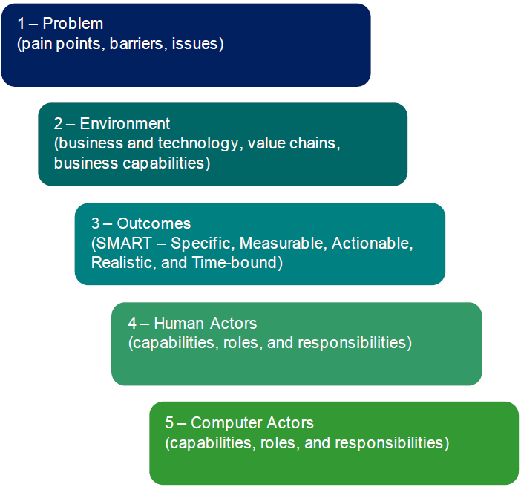
The Business Scenario Technique – 03/04
Steps
Identifying, documenting, and ranking the problem that is driving the scenario.
Identifying the business and technical environment of the scenario and documenting it in scenario models including value chains and capabilities.
Identifying and documenting desired outcomes (the results of handling the problems successfully); get "SMART“.
Identifying the human actors (participants) and their place in the business model.
Identifying computer actors (computing elements) and their place in the technology model.
Checking for “fitness-for-purpose” and refining only if necessary.
Business Scenarios : Page 19 : §7
Initially MOD 14
Moved to Phase B where it should be
Notes:
Level=2 : L.O.= 8.2a : Briefly explain the business scenario technique.
See: TOGAF® Series Guide: Business Scenarios : Page 1 : §1
Level=2 : L.O.= 8.2b : Briefly explain the business scenario technique.
See: TOGAF® Series Guide: Business Scenarios : Page 6 : §3.1
3.1 The Overall Process
Creating a Business Scenario involves the following activities, which ultimately document the elements of a Business Scenario as depicted in Figure 1:
1. Identifying, documenting, and ranking the problem driving the scenario.
2. Identifying the business and technical environment of the scenario and documenting it in scenario models including value chains and capabilities.
3. Identifying and documenting desired outcomes (the results of handling the problems successfully); get "SMART“.
4. Identifying the human actors (participants) and their place in the business model.
5. Identifying computer actors (computing elements) and their place in the technology model.
6. Checking for “fitness-for-purpose” and refining only if necessary.
1 – Problem (pain points, barriers, issues) 2 – Environment (business and technology, value chains, business capabilities) 3 – Outcomes (SMART – Specific, Measurable, Actionable, Realistic, and Time-bound) 4 – Human Actors (capabilities, roles, and responsibilities) 5 – Computer Actors (capabilities, roles, and responsibilities)
Figure 1: Creating a Business Scenario
Below are explanations of a few key terms:
• Outcomes are the changes, benefits, learning, or other effects that happen as a result of what the project or organization offers or provides
• Capability is the ability to achieve an outcome within a known environment through application of human and/or material resources in a value chain
• A value chain is a set of activities that a firm operating in a specific industry performs in order to deliver a valuable product or service for the market
• A value proposition is “a clear statement of the concrete results a customer will get from purchasing and using your products and/or services. ... It is focused on outcomes. Your value proposition statement details the value you provide in an easy-to-remember synopsis that your client can easily grasp and remember. … your value proposition … should relieve their pain …”1
Value propositions are not explicitly documented in a Business Scenario; however, the importance of understanding a customer’s Business Scenario to a solutions provider cannot be understated.
A Business Scenario is developed over a number of phases that formulate, verify, and refine a premise of the business requirements driving an effort. Each phase is comprised of steps to plan the phase, gather information, analyze information gathered, document the results, and review the results of the Business Scenario, as depicted in Figure 2.
In each phase, each of the elements of a Business Scenario (listed above) is successively improved. The refinement phase involves deciding whether to consider the scenario complete and go to the next phase of the TOGAF Architecture Development Method (ADM), or whether further refinement is necessary. This is accomplished by asking whether the current state of the Business Scenario is fit for the purpose of carrying requirements downstream in the architecture process.
The three phases of developing a Business Scenario and steps are described in detail in Figure 2 and Section 3.2.
1 - Problem 2 - Environment 3 - Outcomes 4 – Human Actors 5 – Computer Actors Premise Formulation Phase Steps: • Plan • Gather Information • Analyze/Process • Document • Review 1 - Problem 2 - Environment 3 - Outcomes 4 – Human Actors 5 – Computer Actors Initial Verification Phase Steps: • Plan • Gather Information • Analyze/Process • Document • Review 1 - Problem 2 - Environment 3 - Outcomes 4 – Human Actors 5 – Computer Actors Refinement Phase Steps: • Plan • Gather Information • Analyze/Process • Document • Review
Figure 2: Phases and Steps of Developing a Business Scenario

Slide 92
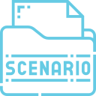
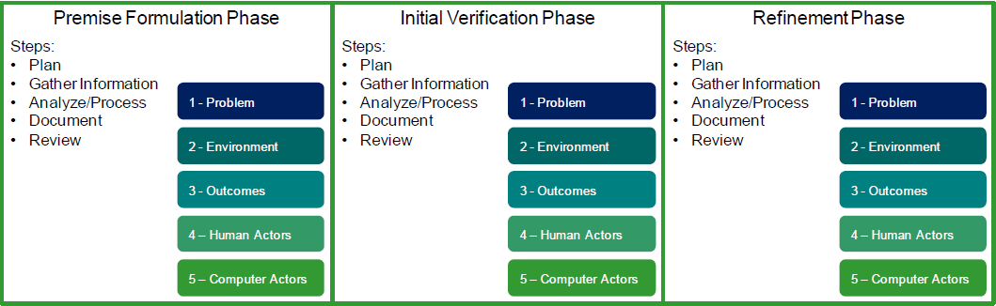
The Business Scenario Technique – 04/04
Outcomes are the changes, benefits, learning, or other effects that happen as a result of the project.
Capability is the ability to achieve an outcome within a known environment through application of resources.
n outcomes. The value proposition Value chain is a set of activities performed to deliver a product or service for the market.
Value proposition is “a clear statement of the concrete results a customer will get … focused ostatement details the value you provide in an easy-to-remember synopsis that your client can easily grasp and remember … and… should relieve their pain …”
A Business Scenario is developed over a number of phases that:
  Formulate and Verify
… each of the elements of a Business Scenario (listed above) that is successively improved.
The refinement phase is accomplished by asking whether the current state of the Business Scenario is fit for the purpose of carrying requirements downstream in the architecture process.
Business Scenarios : Page 6 : §3.1
Initially MOD 14
Moved to Phase B where it should be
Notes:
Þ Q-51
Level=2 : L.O.= 8.2b : Briefly explain the business scenario technique.
See: TOGAF® Series Guide: Business Scenarios : Page 6 : §3.1
3.1 The Overall Process
Creating a Business Scenario involves the following, which ultimately documents the elements of a Business Scenario depicted in Figure 1:
1. Identifying, documenting, and ranking the problem driving the scenario.
2. Identifying the business and technical environment of the scenario and documenting it in scenario models including value chains and capabilities.
3. Identifying and documenting desired outcomes (the results of handling the problems successfully); get "SMART“.
4. Identifying the human actors (participants) and their place in the business model.
5. Identifying computer actors (computing elements) and their place in the technology model.
6. Checking for “fitness-for-purpose” and refining only if necessary.
1 – Problem (pain points, barriers, issues) 2 – Environment (business and technology, value chains, business capabilities) 3 – Outcomes (SMART – Specific, Measurable, Actionable, Realistic, and Time-bound) 4 – Human Actors (capabilities, roles, and responsibilities) 5 – Computer Actors (capabilities, roles, and responsibilities)
Figure 1: Creating a Business Scenario
Below are explanations of a few key terms:
• Outcomes are the changes, benefits, learning, or other effects that happen as a result of what the project or organization offers or provides
• Capability is the ability to achieve an outcome within a known environment through application of human and/or material resources in a value chain
• A value chain is a set of activities that a firm operating in a specific industry performs in order to deliver a valuable product or service for the market
• A value proposition is “a clear statement of the concrete results a customer will get from purchasing and using your products and/or services. ... It is focused on outcomes. Your value proposition statement details the value you provide in an easy-to-remember synopsis that your client can easily grasp and remember. … your value proposition … should relieve their pain …”1
Value propositions are not explicitly documented in a Business Scenario; however, the importance of understanding a customer’s Business Scenario to a solutions provider cannot be understated.
A Business Scenario is developed over a number of phases that formulate, verify, and refine a premise of the business requirements driving an effort. Each phase is comprised of steps to plan the phase, gather information, analyze information gathered, document the results, and review the results of the Business Scenario, as depicted in Figure 2.
In each phase, each of the elements of a Business Scenario (listed above) is successively improved. The refinement phase involves deciding whether to consider the scenario complete and go to the next phase of the TOGAF Architecture Development Method (ADM), or whether further refinement is necessary. This is accomplished by asking whether the current state of the Business Scenario is fit for the purpose of carrying requirements downstream in the architecture process.
The three phases of developing a Business Scenario and steps are described in detail in Figure 2 and Section 3.2.
1 - Problem 2 - Environment 3 - Outcomes 4 – Human Actors 5 – Computer Actors Premise Formulation Phase Steps: • Plan • Gather Information • Analyze/Process • Document • Review 1 - Problem 2 - Environment 3 - Outcomes 4 – Human Actors 5 – Computer Actors Initial Verification Phase Steps: • Plan • Gather Information • Analyze/Process • Document • Review 1 - Problem 2 - Environment 3 - Outcomes 4 – Human Actors 5 – Computer Actors Refinement Phase Steps: • Plan • Gather Information • Analyze/Process • Document • Review
Figure 2: Phases and Steps of Developing a Business Scenario

Slide 93
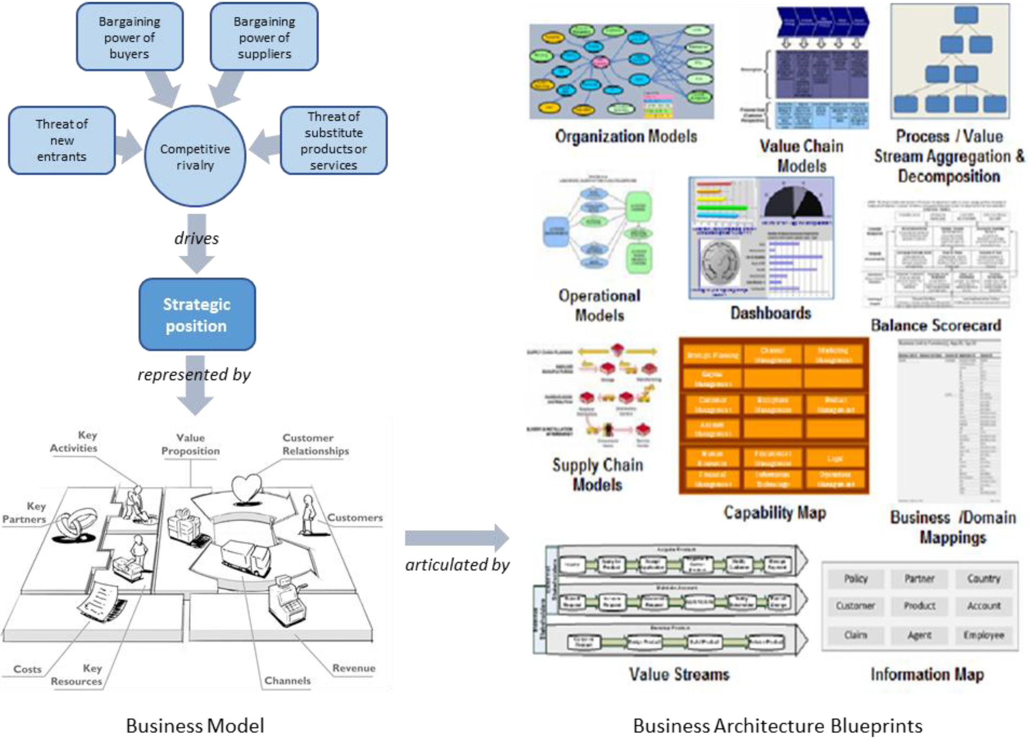
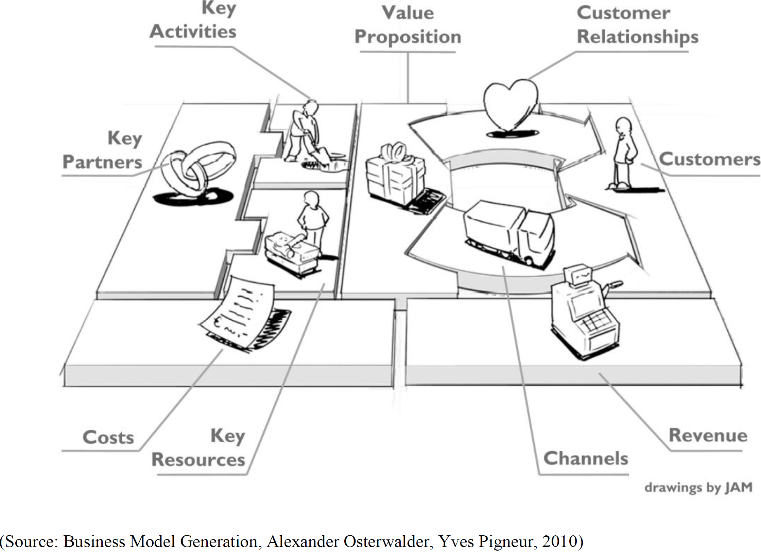
Business Architecture Guidelines – Techniques 01/11
The Five Competitive Forces that Shape Strategy, Michael E. Porter, 2008; and (Business Architecture Blueprints) BIZBOK® Guide, Version 6.5, 2018)
Business Models
Business models provide a powerful construct to help focus and align an organization around its strategic vision and execution.
Business model artifacts are used to:
Provide a common understanding of what the organization is, or looks like, today
Portray what it intends to become in the future
Create a critical link between the business strategy and the required blueprints of the Enterprise Architecture
The plans that describe how to do it
Business Model Canvas™ →
Business Model - relationship with Strategy and Architecture
Business Models : Page 1 : §1
Moved to Phase B where it should be located or duplicated in Phase B so removed
Notes:
Level=2 : L.O.= 8.11i : Briefly explain the guidelines and techniques that can be used during the Business Architecture phase: Applying information mapping
See: TOGAF® Series Guide: Business Models : Page 1 : §1
Business Models
Business models provide a powerful construct to help focus and align an organization around its strategic vision and execution.
Business model artifacts are used to:
Provide a common understanding of what the organization is, or looks like, today
Portray what it intends to become in the future
Create a critical link between the business strategy and the required blueprints of the Enterprise Architecture that define what the business needs to transform to
The plans that describe how to do it
1 Introduction
This TOGAF® Series Guide to Business Models provides a basis for Enterprise Architects to understand and utilize business models, which describe the rationale of how an organization creates, delivers, and captures value.
Business models provide a powerful construct to help focus and align an organization around its strategic vision and execution. In this Guide we cover different forms of business models and approaches to modeling, from the conceptual down to a practical example.
There is a direct relationship between the business innovation captured in these models and the approach to implementing that innovation through Enterprise Architecture. We explore that relation through Business Architecture methods such as value streams and business capabilities, then provide a specific example based on a generic retail company undertaking a Digital Transformation. An appendix delves deeper into the structure of one of the most commonly used business model frameworks for architects interested in working with business leaders to execute their strategy.
1.1 Overview
The world’s top C-suite leaders know that the effective management and exploitation of information is a key factor for business success, and is critical to developing and maintaining competitive advantage. An Enterprise Architecture supports this objective by providing a strategic context for the evolution of technologies in response to the constantly changing needs
... CONTINUES ... SEE REFERENCE SPECIFIED

Slide 94
Business Architecture Guidelines – Techniques 02/11
Business Capability Map
Represents the complete, stable set of business capabilities that covers the business, enterprise, or organizational unit in question.
A self-contained visual depiction (or blueprint) of all the business capabilities at an appropriate level of decomposition and group.
Approach
Capture and document all of the business capabilities that represent the full scope of what the business does today
Organize that information in a logical manner
Either:
Top-down: a top-down business capability mapping approach starts by identifying the top 20 highest-level business capabilities, each of which can decompose into more detailed levels
Bottom-up: When more time is available, business capabilities can be defined from within different parts of the business and built from the bottom up
Three good sources of information with which to create an initial draft of the business capability map:
The organizational structure
The business model
Current strategic, business, and financial plans
Business Model
Business capabilities provide the building blocks upon which to execute an organization’s business model.
Mapping individual business capabilities back to the business model ensures that the organization’s investments are aligned to support enterprise vision and strategy.
Structuring the Business Capability Map
There are two concepts for turning the set of business capabilities into a logical structure:
Business Capability Stratification - each stratification tier provides a different perspective or focal point for different stakeholder groups
Leveling - the number of levels (usually 3 – 6) of decomposition is limited only by the degree necessary to communicate the information required by the intended audience, or to enable the business to make informed decisions about capability gaps
Business Capabilities : Page 1 : §1
Initially MOD 15
Moved to Phase B where it should be located or duplicated in Phase B so removed
Notes:
Level=2 : L.O.= 8.11l : Briefly explain the guidelines and techniques that can be used during the Business Architecture phase: Applying modeling techniques
See: TOGAF® Series Guide: Business Capabilities: Page 1 : §1
Business Capability Map
Represents the complete, stable set of business capabilities that covers the business, enterprise, or organizational unit in question.
A self-contained visual depiction (or blueprint) of all the business capabilities at an appropriate level of decomposition and group.
Approach
Capture and document all of the business capabilities that represent the full scope of what the business does today
Organize that information in a logical manner
Either:
Top-down: a top-down business capability mapping approach starts by identifying the top 20 highest-level business capabilities, each of which can decompose into more detailed levels
Bottom-up: When more time is available, business capabilities can be defined from within different parts of the business and built from the bottom up
Three good sources of information with which to create an initial draft of the business capability map are:
The organizational structure
The business model
Current strategic, business, and financial plans
Business Model
Business capabilities provide the building blocks upon which to execute an organization’s business model.
Mapping individual business capabilities back to the business model ensures that the organization’s investment is aligned to support enterprise vision and strategy.
Structuring the Business Capability Map
There are two concepts for turning the set of business capabilities into a logical structure:
Business Capability Stratification - each stratification tier provides a different perspective or focal point for different stakeholder groups
Leveling - the number of levels (usually 3 – 6) of decomposition is limited only by the degree necessary to communicate the information required by the intended audience or to enable the business to make informed decisions about capability gaps

Slide 95
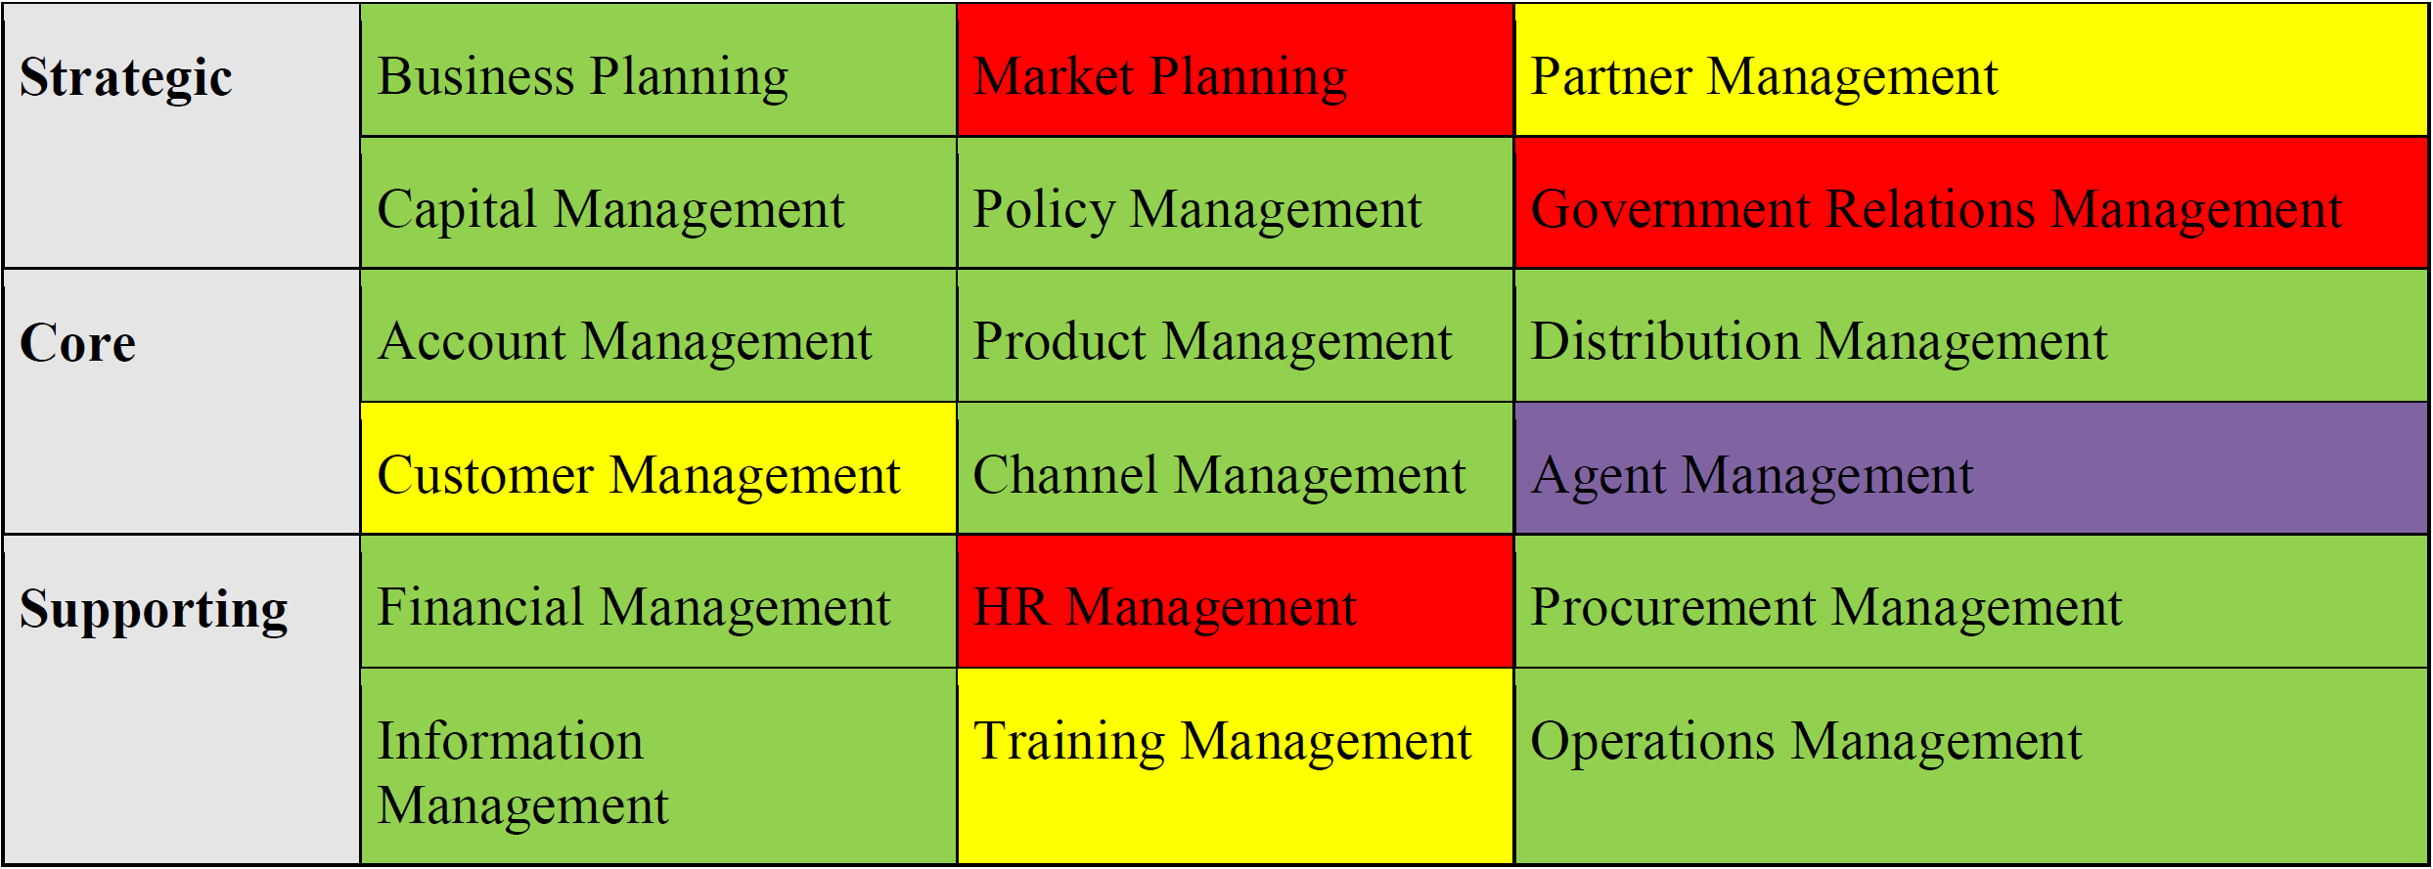
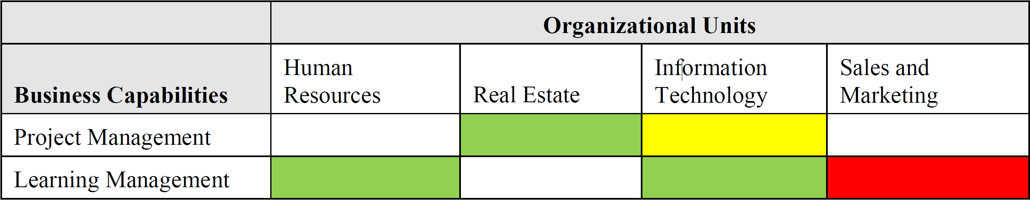
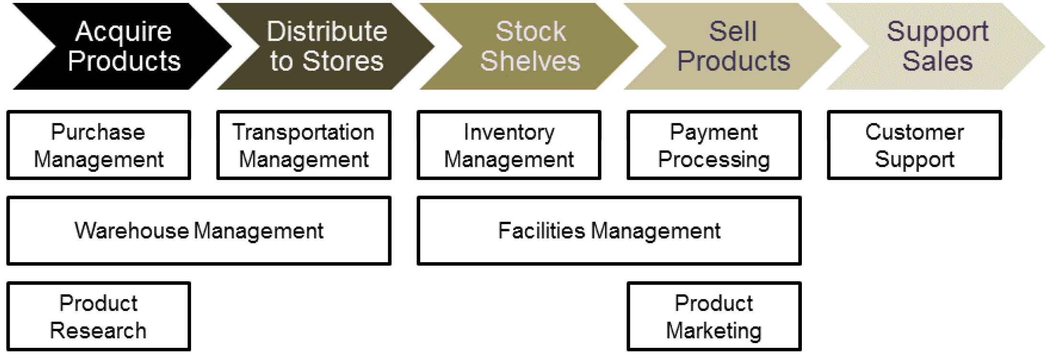
Business Architecture Guidelines – Techniques 03/11
Applying Business Capabilities
The Business Capability Map
from the Vision Phase should be mapped back to:
Organizational units
Value streams
Information systems
Strategic plans
Heat mapping shows a range of different perspectives on the same set of core business capabilities:
Maturity
Effectiveness
Performance
Value of each capability
Cost of each capability
Different attributes determine the colours of each capability on the Business Capability Map.
Typically, for a specific capability:
Green = competence
Yellow = one level down
Red = two or more levels down
Purple = desired capability not yet present
This Gap Analysis is directly tied to the EA project currently underway.
Architecture Development Method : Page 51 : §4.5.3
Initially MOD 15
Moved to Phase B where it should be located or duplicated in Phase B so removed
Notes:
Level=2 : L.O.= 8.11a : Briefly explain the guidelines and techniques that can be used during the Business Architecture phase:
See: TOGAF® Standard – Architecture Development Method : Page 51 : §4.5.3
Applying Business Capabilities
The Business Capability Map from the Vision Phase should be mapped back to:
Organizational units
Value streams
Information systems
Strategic plans
within the scope of the Enterprise Architecture project
Heat mapping shows a range of different perspectives on the same set of core business capabilities:
Maturity
Effectiveness
Performance
Value of each capability
Cost of each capability
Different attributes determine the colors of each capability on the business capability map.
Typically, for a specific capability:
Green = competence
Yellow = one level down
Red = two or more levels down
Purple = desired capability not yet present
4.5.3 Applying Business Capabilities
The business capability map found or developed in the Architecture Vision phase provides a self-contained view of the business that is independent of the current organizational
structure, business processes, information systems and applications ,and the rest of the product or service portfolio. Those business capabilities should be mapped back to the organizational units, value streams, information systems, and strategic plans within the scope of the Enterprise Architecture project. This relationship mapping provides greater insight into the alignment and
... CONTINUES ... SEE REFERENCE SPECIFIED

Slide 96

Business Architecture Guidelines – Techniques 04/11
Value
Value is fundamental to everything that an organization does:
Think of value in the most general sense of usefulness, advantage, benefit, or desirability
Examples:
  Successful delivery of a requested product or service
  Resolving a client’s problem in a timely manner
  Gaining access to up-to-date information
The Business or Enterprise Architect:
  Models
  Measures
  Analyzes
ways that the enterprise achieves value for a given stakeholder per discrete stage of value-producing.
Approaches to Value Analysis:
  Value chain takes an economic value perspective
  Value networks are primarily concerned with identifying the participants involved in creating and delivering value
  Lean value streams are all about optimizing business processes
The Business Architecture value stream is more closely aligned to realizing an organization’s business model rather than financial, organizational, or operational.
Value Streams : Page 1 : §1
Initially MOD 15
Moved to Phase B where it should be located or duplicated in Phase B so removed
Notes:
Þ Q-29
Level=2 : L.O.= 8.11h : Briefly explain the guidelines and techniques that can be used during the Business Architecture phase:Applying information mapping
See: TOGAF® Series Guide: Value Streams : Page 1 : §1
Value
Value is fundamental to everything that an organization does.
Think of value in the most general sense of usefulness, advantage, benefit, or desirability
Examples:
successful delivery of a requested product or service
resolving a client’s problem in a timely manner
gaining access to up-to-date information in order to make better business decisions
The Business or Enterprise Architect:
models
measures
analyzes
ways that the enterprise achieves value for a given stakeholder – and decomposes:
creation
capture
delivery
of value into discrete stages of value-producing
Approaches to Value Analysis:
Value chain takes an economic value perspective
Value networks are primarily concerned with identifying the participants involved in creating and delivering value
Lean value streams are all about optimizing business processes (primarily within a manufacturing context)
Only the Business Architecture value stream is more closely aligned to realizing an organization’s business model rather than the financial, organizational, or operational.
1.1 What is “Value”?
The word “value” originates from the Old French valoir: ‘be worth’. It is the regard that something is held to deserve; the importance, worth, or usefulness of something. Within the context of Business Architecture, it is important to think of value in the most general sense of usefulness, advantage, benefit, or desirability, rather than the relatively narrow accounting or financial perspective that defines value as being the material or monetary worth of something.
Non-monetary examples of value in the business world include such things as the successful
... CONTINUES ... SEE REFERENCE SPECIFIED

Slide 97
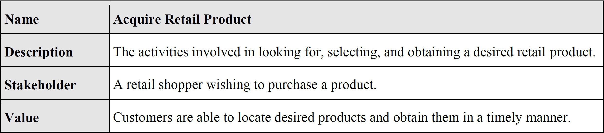
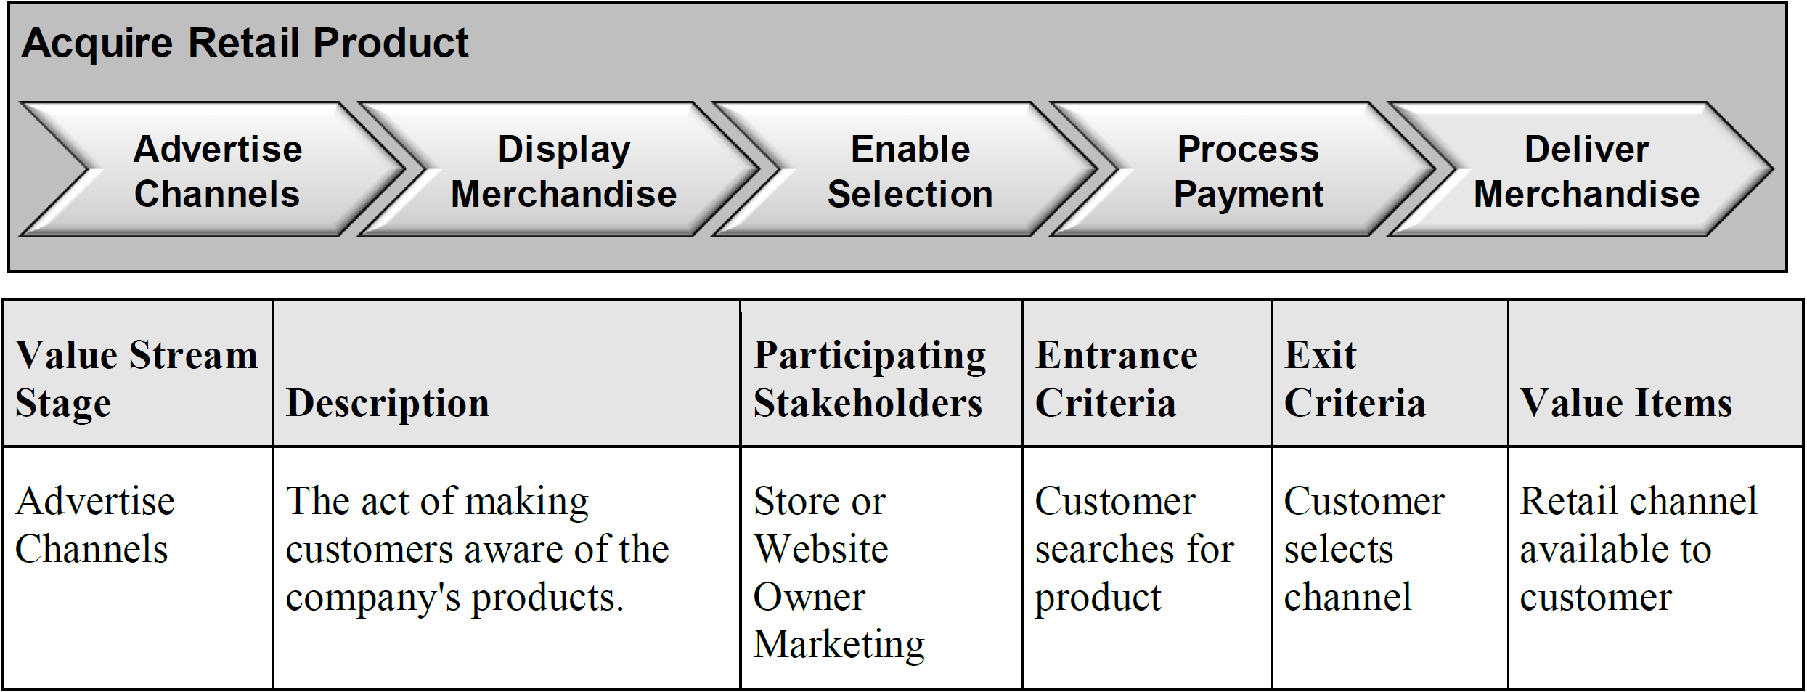
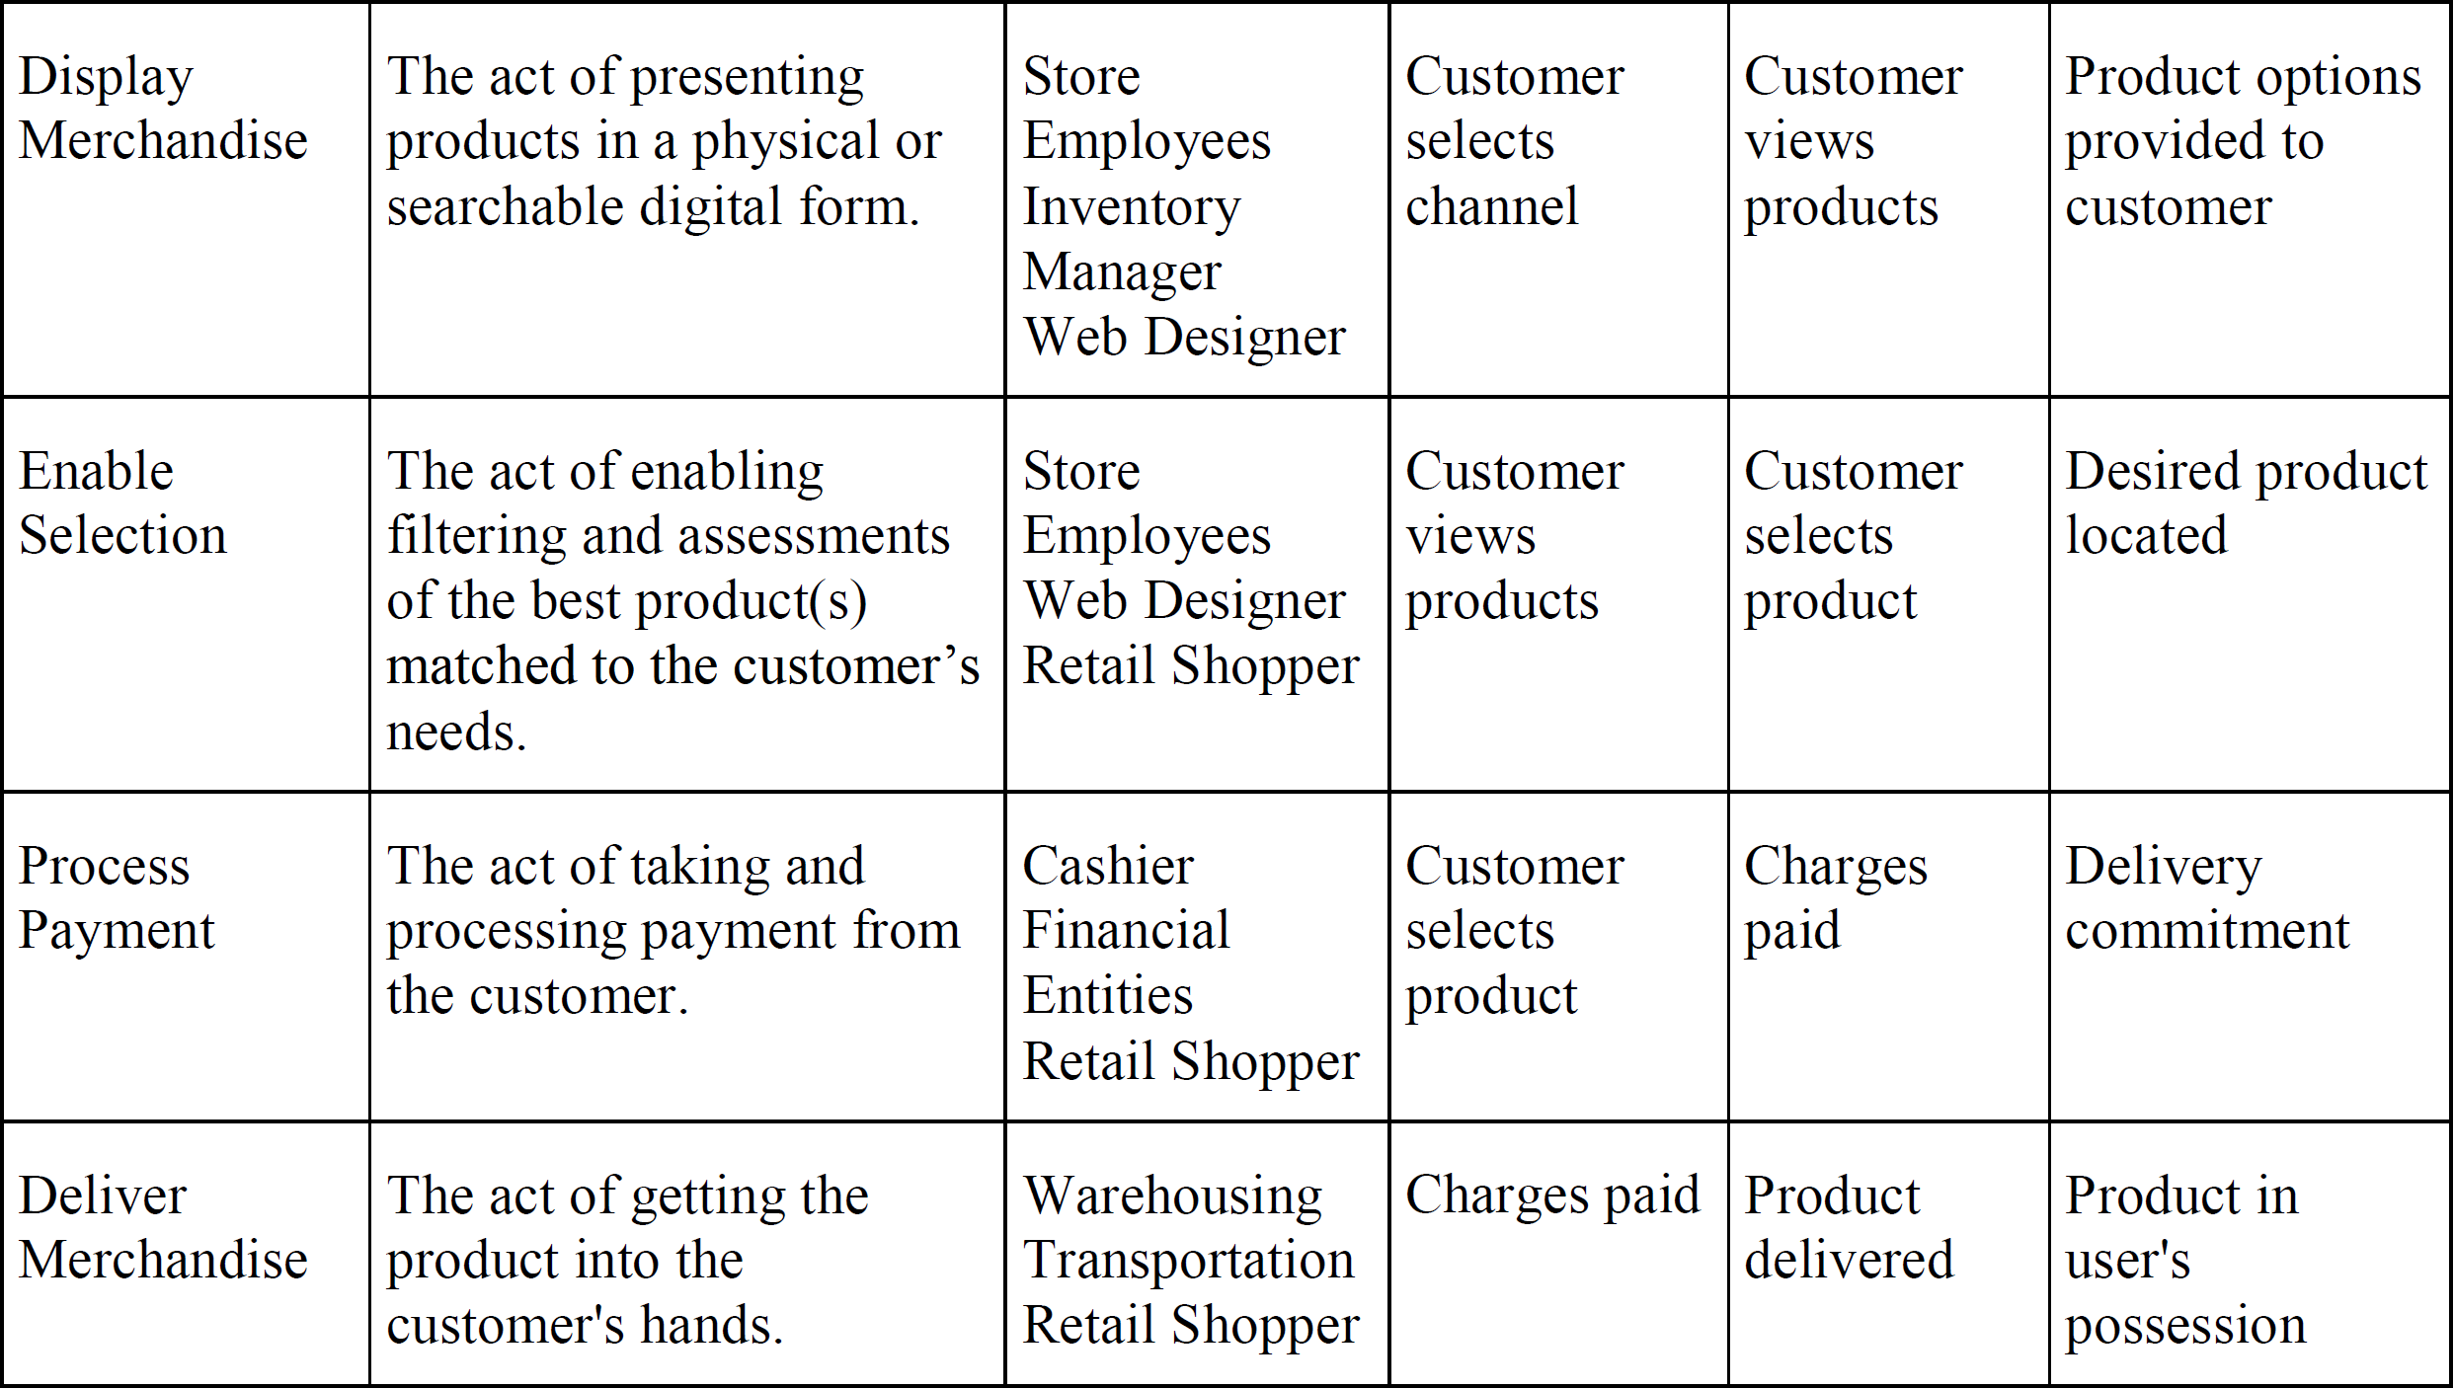
Business Architecture Guidelines – Techniques 05/11
Baseline Example from TOGAF® Series Guide: Value Streams
Applying Value Streams
Value streams provide valuable stakeholder context into why the organization needs business capabilities.
Start with the initial set of value stream models for the business.
A new or existing value stream can be analyzed:
Through heat mapping
By developing use-cases
A project might focus on:
Specific stakeholders
One element of business value
Stressing some stages over others
The most substantive benefits come from:
Mapping relationships between stream stages/capabilities
Then performing a Gap Analysis for capabilities in the context of the business
Architecture Development Method : Page 51 : §4.5.3
Initially MOD 15
Moved to Phase B where it should be located or duplicated in Phase B so removed
Notes:
Level=2 : L.O.= 8.11b : Briefly explain the guidelines and techniques that can be used during the Business Architecture phase:
See: TOGAF® Standard – Architecture Development Method : Page 51 : §4.5.3
Applying Value Streams
Value streams provide valuable stakeholder context into why the organization needs business capabilities.
Start with the initial set of value stream models for the business documented in the Architecture Vision phase.
A new or existing value stream can be analyzed:
Through heat mapping (by value stream stage)
By developing use-cases around a complete definition of the value stream
A project might focus on:
Specific stakeholders
One element of business value
Stressing some stages over others
to develop better requirements for solutions in later phases.
The most substantive benefits come from:
Mapping relationships between stream stages/capabilities
Then performing a Gap Analysis for capabilities in the context of the business value achieved for a specific stakeholder
4.5.3 Applying Business Capabilities
The business capability map found or developed in the Architecture Vision phase provides a self-contained view of the business that is independent of the current organizational
structure, business processes, information systems and applications, and the rest of the product or service portfolio. Those business capabilities should be mapped back to the organizational units, value streams, information systems, and strategic plans within the scope of the Enterprise Architecture project. This relationship mapping provides greater insight into the alignment and optimization of each of those domains (see Relationship Mapping in TOGAF® Series Guide: Business Capabilities).
Another common analysis technique involves heat mapping, which can be used to
... CONTINUES ... SEE REFERENCE SPECIFIED

Slide 98
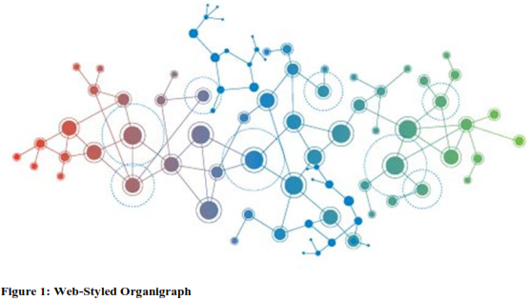
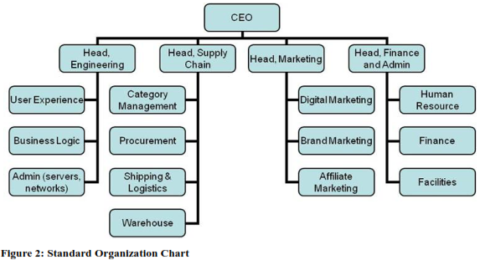
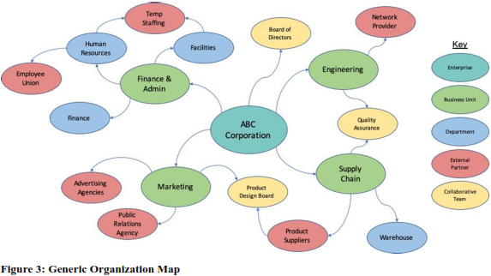
Business Architecture Guidelines – Techniques 06/11
Organization Mapping
The Organization Map provides the organizational context for the whole Enterprise Architecture effort.
The Organization Map identifies the business units or third parties that participate in the value streams.
It provides visibility of which organization units to involve in the architecture effort.
An Organization Map also shows working relationships (informal as well as formal).
Traditional organization charts are more likely to portray the reporting lines.
The Organization Map depicts it as a network of relationships and interactions.
The lack of fluidity with organization charts led to the creation of the concept of organization.
The Organization Map subsumes a web concept suited to describing how organizations actually operate across formal boundaries and siloes.
Organization Mapping : Page 1 : §1
Initially MOD 15
Moved to Phase B where it should be located or duplicated in Phase B so removed
Notes:
Level=2 : L.O.= 8.11k : Briefly explain the guidelines and techniques that can be used during the Business Architecture phase: Applying modeling techniques
See: TOGAF® Series Guide: Organization Mapping : Page 1 : §1
Organization Mapping
The organization map provides the organizational context for the whole Enterprise Architecture effort
The organization map identifies the business units or third parties that participate in the value streams
It provides visibility of which organization units to involve in the architecture effort
An organization map also shows working relationships (informal as well as formal)
Traditional organization charts are more likely to portray the reporting lines
The organization map depicts it as a network of relationships and interactions
The lack of fluidity with organization charts led to the creation of the concept of organization
The organization map subsumes a web concept suited to describing how organizations actually operate across formal boundaries and siloes.
1 Introduction
The organization map is a key element of Business Architecture because it provides the organizational context for the whole Enterprise Architecture effort. While capability mapping exposes what a business does and value stream mapping exposes how it delivers value to specific stakeholders, the organization map identifies the business units or third parties that possess or use those capabilities, and which participate in the value streams.
As one of the four core elements of Business Architecture, the organization map provides a key perspective: the organizational context for Enterprise Architecture. For example, it provides visibility of what organization units are relevant for a particular architecture design or solution.
These key insights mean that the organization map becomes foundational for Enterprise Architecture and the deployment of strategy.
Taken together with the methods outlined in Phase B of the TOGAF® Framework as well as the associated Business Architecture-focused Guides, the organization map provides an understanding of which organizational units to involve in the architecture effort, who with and when to talk about a given requirement, and how to measure the impact of various decisions.
2 What is an Organization Map?
An organization map is a Business Architecture blueprint that shows:
... CONTINUES ... SEE REFERENCE SPECIFIED

Slide 99
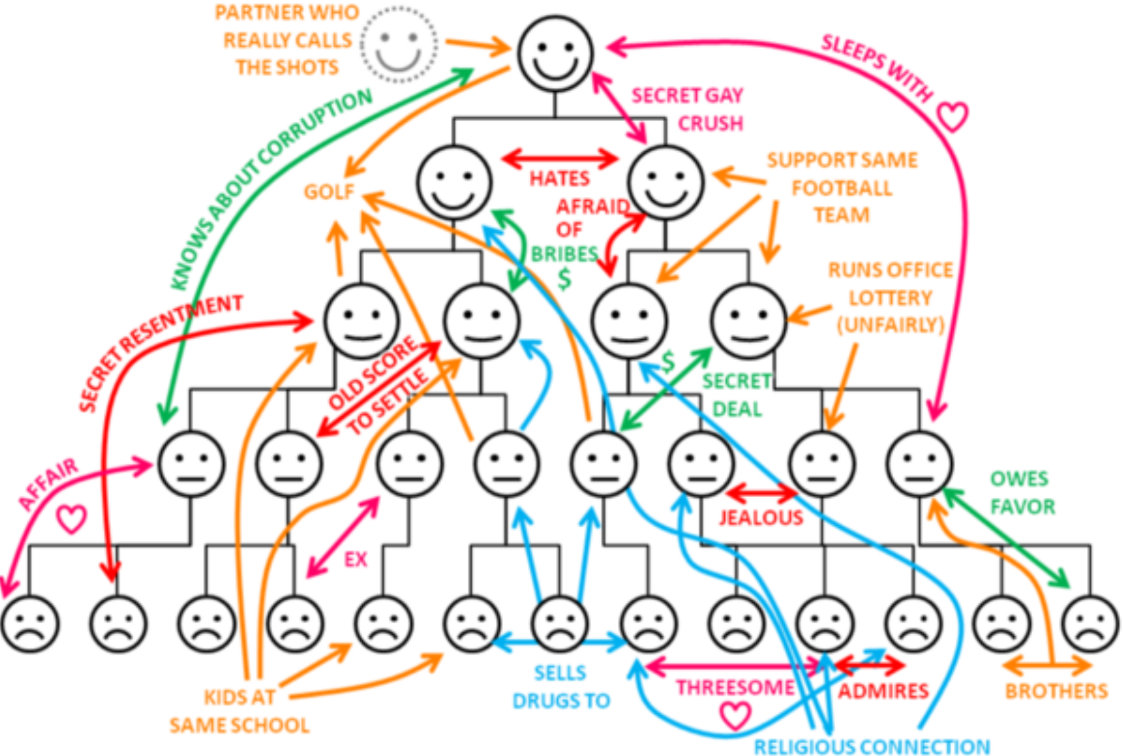
Business Architecture Guidelines – Techniques 07/11
Applying the Organization Map
Depicts the working relationship between:
  key organizational units
  partners
  stakeholder groups entities
Depicted as a network or web
The business unit is the main concept used to establish organization maps
The enterprise may:
  be one business unit for the project underway
  include all business units
  include third parties
  be other stakeholder groups
The interpretation depends on the scope of the architecture effort.
This map is a key element of Business Architecture
The organization map identities the business units or third parties that possess
or use those capabilities and which participate in the value streams:
  architecture effort
  who and when to talk
  how to measure the impact of decisions.
www.integrationtraining.co.uk
see - TOGAF® Series Guide: Organization Mapping
Architecture Development Method : Page 52 : §4.5.5
Initially MOD 15
Moved to Phase B where it should be located or duplicated in Phase B so removed
Notes:
Level=2 : L.O.= 8.11c : Briefly explain the guidelines and techniques that can be used during the Business Architecture phase:
See: TOGAF® Standard – Architecture Development Method : Page 52 : §4.5.5
Applying the Organization Map
Depicts the working relationship between:
key organizational units
partners
stakeholder groups entities
Depicted as a network or web
The business unit is the main concept used to establish organization maps
The enterprise may be:
one business unit for the project underway
include all business units
include third parties
other stakeholder groups
The interpretation depends on the scope of the architecture effort.
This map is a key element of Business Architecture because it provides the organizational context for the whole Enterprise Architecture effort.
The organization map identities the business units or third parties that possess or use those capabilities and which participate in the value streams and provides an understanding of which business units to involve in the:
architecture effort
who and when to talk
how to measure the impact of decisions.
4.5.5 Applying the Organization Map
An organization map shows the key organizational units, partners and stakeholder groups that make up the enterprise ecosystem. The map should also depict the working relationship between those entities, as distinct from an organizational chart that only shows hierarchical reporting relationships. The map is typically depicted as a network or web of relationships and interactions between the various business entities (see Organigraphs: Drawing How Companies Really Work, by Mintzberg and Van der Heyden, 1999).
The business unit is the main concept used to establish organization maps. In keeping with the relatively unconstrained view of what constitutes as enterprise, the enterprise may be one business unit for the project underway, may include all business units, or also include third
... CONTINUES ... SEE REFERENCE SPECIFIED

Slide 100
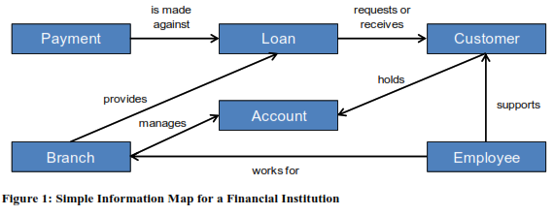
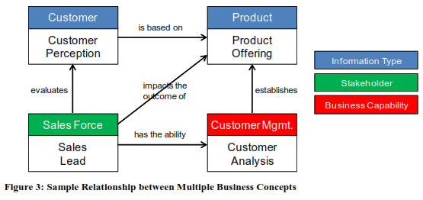
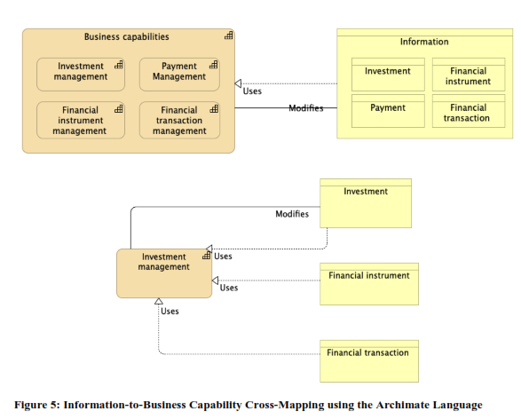
Business Architecture Guidelines – Techniques 08/11
Information Mapping
An Information Map is a collection of information concepts and their relationships to one another.
Information concepts, in effect, reflect the business’ vocabulary; e.g., client, account, or product.
List those elements that matter most to the business and how they are described in business terms.
Discern an information concept by listening for the nouns used when talking about the business. Every noun is potentially an information concept.
Determine if the noun represents an item of information that the business cares about.
Does anyone in the business need to know, store, or manipulate the thing that the noun represents.
Information Mapping : Page 1 : §1
Moved to Phase B where it should be located or duplicated in Phase B so removed
Notes:
Level=2 : L.O.= 8.11j : Briefly explain the guidelines and techniques that can be used during the Business Architecture phase: Applying modeling techniques
See: TOGAF® Series Guide: Information Mapping : Page 1 : §1
Information Mapping
An Information Map is a collection of information concepts and their relationships to one another.
Information concepts, in effect, reflect the business’ vocabulary; e.g., client, account, or product.
Listing those elements that matter most to the business as well as how they are described in business terms.
A useful way to discern an information concept is to listen for the nouns that are used when talking about the business. Every noun is potentially an information concept.
By using a noun challenge process it is possible to determine if the noun represents an item of information that the business cares about.
In other words, does anyone in the business need to know, store, or manipulate the thing that the noun represents
1 Introduction
Information plays an increasingly important role in successful businesses and agencies.
Accurate, timely, and relevant information is crucial for good decision-making and innovation.
Knowledge results from the ability to apply information in a particular way to solve a problem or create value. It is therefore necessary for architects to understand what information matters most to a business before developing or proposing solutions. An Information Map provides a framework to give rise to that understanding.
Businesses acquire, use, store, and manipulate many types of information in the process of their operations. As businesses become more focused on using information as a strategic resource, it becomes critical to understand what information they will be manipulating.
In Business Architecture terms, information is considered to be an intangible, conceptual representation of things that exist in the real world. “Information concepts” are the basis of the architectural elements that are used to make those intangible things explicit. Information concepts are used to model a business rather than an IT system. Defining the core information concepts that support a particular enterprise provides the core of the Information Mapping
... CONTINUES ... SEE REFERENCE SPECIFIED

Slide 101
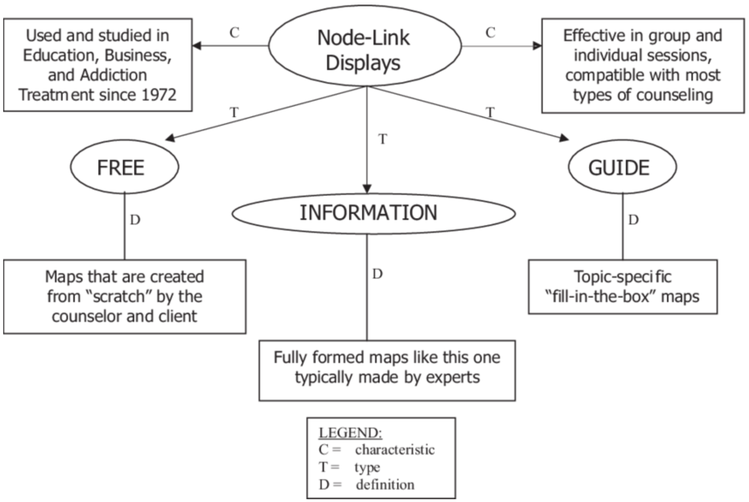
Business Architecture Guidelines – Techniques 09/11
Applying Information Maps
Characterizing information in the Business Architecture phase starts with the elements that matter most to the business such as:
  Product
  Customer
  Factory, etc.
  and how it is described using business terms.
Domains of information can be derived from groupings or categories that the business terms fall into logically.
The most significant benefit then comes from building matrices between information and business capabilities.
The linkage between the information that matters most to the business and the business capabilities … is a key aspect of Business Architecture.
These information maps and relationships to business capabilities apply in later architecture phases on data characterization, applications, and infrastructure.
D. Dwayne Simpson
see the TOGAF® Series Guide: Information Mapping
Architecture Development Method : Page 53 : §4.5.6
Initially MOD 15
Moved to Phase B where it should be located or duplicated in Phase B so removed
Notes:
Þ Q-28
Level=2 : L.O.= 8.11d : Briefly explain the guidelines and techniques that can be used during the Business Architecture phase:
See: TOGAF® Standard – Architecture Development Method : Page 53 : §4.5.6
Applying Information Maps
Characterizing information in the Business Architecture phase starts with the elements that matter most to the business such as:
Product
Customer
Factory, etc.
and how it is described using business terms
Domains of information can be derived from groupings or categories that the business terms fall into logically, starting the information map for completeness and highest value.
The most significant benefit then comes with building matrices between information and business capabilities.
The linkage between the information that matters most to the business and the business capabilities that describe the ability to apply that information to create value is a key aspect of Business Architecture.
These information maps and relationships to business capabilities apply in later architecture phases on data characterization, applications, and infrastructure.
4.5.6 Applying Information Maps
Characterizing information in the Business Architecture phase starts with the elements that matter most to the business, such as product, customer, factory, etc. With a list of these key elements, a cross-discipline team can list and map the information that matters most and how it is described using business terms. Domains of information can be derived from groupings or categories that the business terms fall into logically. These domains are a good place to start the information map for completeness and highest value before proceeding later to the details of data types.
Relationships among the information domains can then be added to the map as the next level of understanding for a good baseline information map. The most signiﬁcant beneﬁt then comes with building matrices between information and business capabilities. The linkage between the information that matters most to the business and the business capabilities that describe the
... CONTINUES ... SEE REFERENCE SPECIFIED

Slide 102
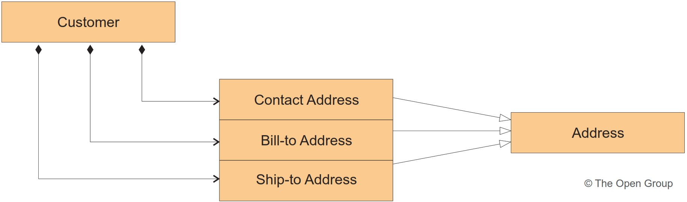
Business Architecture Guidelines – Techniques 10/11
Applying Modelling Techniques
The modelling and mapping techniques provided here are extensions that expand the operating model.
Additional techniques include:
Activity Models [Business Process Models] that describe:
  The enterprise’s business activities
  The data and/or information exchanged between activities (internal exchanges)
  The data and/or information exchanged with other activities that are outside the scope of the model (external exchanges)
  They capture Inputs, Controls, Outputs, and Mechanisms/Resources (ICOMs) of business activities e.g.:
  Integrated Computer Aided Manufacturing (ICAM) DEFinition (IDEF) modeling technique.
  Object Management Group (OMG)’s Business Process Modeling Notation™ (BPMN™).
Use-Case Models describe the business process of an enterprise in terms of:
  Use-cases and actors
  Processes
  Organizational participants
Logical Data Model [Class Model] describe:
  The entities
  Their attributes and the acceptable value for these attributes
  The relationships between the various entities
Applications and information architects use the class diagram, Business Architects use the logical data model.
*see A Method for Identifying Process Re-Use Opportunities to Enhance the Operating Model, M. de Vries et al.
Architecture Development Method : Page 53 : §4.5.7
Initially MOD 15
Moved to Phase B where it should be located or duplicated in Phase B so removed
Notes:
Þ M-31
Level=2 : L.O.= 8.11e : Briefly explain the guidelines and techniques that can be used during the Business Architecture phase:
See: TOGAF® Standard – Architecture Development Method : Page 53 : §4.5.7
Applying Modeling Techniques
The modeling and mapping techniques provided here are extensions that expand the operating model, which is a representation for how an organization operates across a range of domains in order to accomplish its purpose.
Additional techniques include:
Activity Models [Business Process Models] that describe:
the enterprise’s business activities
the data and/or information exchanged between activities (internal exchanges)
the data and/or information exchanged with other activities that are outside the scope of the model (external exchanges)
They capture Inputs, Controls, Outputs, and Mechanisms/Resources (ICOMs) of business activities.
Examples:
Integrated Computer Aided Manufacturing (ICAM) DEFinition (IDEF) modeling technique.
Object Management Group (OMG)’s Business Process Modeling Notation™ (BPMN™).
Use-Case Models describe the business process of an enterprise in terms of:
use-cases and actors
processes
organizational participants
The use-case model is described in use-case diagrams and use-case specifications.
Logical Data Model [Class Model] describe:
the entities
their attributes, and the acceptable values for these attributes
the relationships between the various entities
Applications and information architects use the class diagram, Business Architects use the logical data model.
All three types of model above can be represented in the Unified Modeling Language™ (UML®), and a variety of tools exist for generating such models.
4.5.7 Applying Modeling Techniques
The modeling and mapping techniques provided here are extensions that implement the business capabilities, value streams, and organization maps described above in Phase B into the practices of the business .They expand the operating model, which is a representation for how an organization operates across a range of domains in order to accomplish its purpose
... CONTINUES ... SEE REFERENCE SPECIFIED

Slide 103
Business Architecture Guidelines – Techniques 11/11
Architecture Repository
What relevant Business Architecture resources are available from the Architecture Repository:
Industry reference models relevant to the organization’s industry sector
Enterprise-speciﬁc Business Architecture views (capability maps, value stream maps, organization maps, etc.)
Enterprise-speciﬁc building blocks (process components, business rules, job descriptions, etc.)
Applicable standards
Architecture Development Method : Page 55 : §4.5.8
Initially MOD 15
Notes:
Þ M-31
Level=2 : L.O.= 8.11f : Briefly explain the guidelines and techniques that can be used during the Business Architecture phase:
See: TOGAF® Standard – Architecture Development Method : Page 55 : §4.5.8
Architecture Repository
What relevant Business Architecture resources are available from the Architecture Repository:
Industry reference models relevant to the organization’s industry sector
Enterprise-speciﬁc Business Architecture views (capability maps, value stream maps, organization maps, etc.)
Enterprise-speciﬁc building blocks (process components, business rules, job descriptions, etc.)
Applicable standards
4.5.8 Architecture Repository
As part of Phase B, the architecture team will need to consider what relevant Business Architecture resources are available from the Architecture Repository (see the TOGAF Standard
—Architecture Content), in particular :
■Industry reference models relevant to the organization’s industry sector
■Enterprise-speciﬁc Business Architecture views (capability maps, value stream maps, organization maps ,etc.)
■Enterprise-speciﬁc building blocks (process components, business rules ,job descriptions, etc.)
■Applicable standards

Slide 104
Phase B – Business Architecture – 01/02
Objectives | PHASE B - at-a-glance
Develop the Target Business Architecture that describes how the enterprise needs to operate to achieve the business goals, and respond to the strategic drivers set out in the Architecture Vision in a way that addresses the Statement of Architecture Work and stakeholder concerns. Identify candidate Architecture Roadmap components based upon gaps between the Baseline and Target Business Architectures.
Inputs | Steps | Outputs
Request for Architecture Work Business principles, business goals, and business drivers Capability Assessment Communications Plan Organizational Model for Enterprise Architecture Tailored Architecture Framework Approved Statement of Architecture Work Architecture Principles, including business principles, when pre-existing Enterprise Continuum Architecture Repository Architecture Vision, including: Refined key high-level stakeholder requirements Draft Architecture Definition Document, including: Baseline Business Architecture (high-level) Baseline Data Architecture (high-level) Baseline Application Architecture (high-level) Baseline Technology Architecture (high-level) Target Business Architecture (high-level) Target Data Architecture (high-level) Target Application Architecture (high-level) Target Technology Architecture (high-level) | Select reference models, viewpoints, and tools Develop Baseline Business Architecture Description Develop Target Business Architecture Description Perform Gap Analysis Define candidate roadmap components Resolve impacts across the Architecture Landscape Conduct formal stakeholder review Finalize the Business Architecture Create Architecture Definition Document | Statement of Architecture Work, updated if necessary Validated business principles, business goals, and business drivers Refined and updated Architecture Principles, if applicable Draft Architecture Definition Document containing content updates: Baseline Business Architecture (detailed), if appropriate Target Business Architecture (detailed with Business Capabilities, Value Streams, and Organization Map as core artifacts) Views corresponding to selected viewpoints addressing key stakeholder concerns Draft Architecture Requirements Specification including content updates: Gap Analysis results Technical requirements Updated business requirements Business Architecture components of an Architecture Roadmap
A Practitioners’ Approach to Developing Enterprise Architecture Following the TOGAF® ADM : Page 42 : §5.2.2
Initially MOD 11
Notes:
Level=2 : L.O.= 4.4b : Explain how to apply Phase B and how it contributes to the architecture development work.
See : TOGAF® Series Guide: A Practitioners’ Approach to Developing Enterprise Architecture Following the TOGAF® ADM : Page 42 : §5.2.2
Key Outputs and Outcomes
What the Enterprise values and consumes is typically different than what the EA produces. EAs deliver essential output.
It is provided as:
views
roadmaps
architecture specifications
controls
other useful things
Architecture is developed, and the EA Landscape populated.
To do this, Practitioners require a set of essential knowledge.
5.2.2 Essential ADM Output and Knowledge
A summary of the essential outcome and output is provided in Table 4. Keep in mind that the essential output is what stakeholders, sponsor, and boss’ boss’ boss wants. No-one wants an architecture; they want guidance on planning and executing an effective change. Practitioners use an architected approach to providing the best available guidance on effective change. The essential outcomes and outputs are derived from the objectives of the phase – the statement of why a Practitioner should perform this activity.
What the Enterprise values and consumes is typically different than what the Practitioner produces. Practitioners deliver an essential output. It is provided as views, roadmaps, architecture specifications, controls, and other useful things. Architecture is developed, and the EA Landscape populated. To do this, Practitioners require a set of essential knowledge. The Enterprise consumes effective guidance about, and the ability to govern, change.
Read Table 4 in conjunction with Table 3 to confirm whether for a particular purpose the output of the phase is already in existence, needs to be created, or is extraneous to the current Architecture Project. Good Practitioners will adjust their work accordingly. Table 4 lists only key outputs and outcomes. For an exhaustive list, refer to the TOGAF Standard. In order to achieve these outcomes, the Practitioner may have to perform more activities or create more deliverables than those listed in the table below. The intent is to keep the focus on what is pursued, not what is done.
Table 4: Essential ADM Outputs, Outcomes, and Required Knowledge

Slide 105
Phase B – Business Architecture – 02/02
Phase | Output & Outcome | Essential Knowledge
Phase B | A set of domain architectures approved by the stakeholders for the problem being addressed, with a set of gaps, and work to clear the gaps understood by the stakeholders. | How does the current Enterprise fail to meet the preferences of the stakeholders? What must change to enable the Enterprise to meet the preferences of the stakeholders? (Gaps) What work is necessary to realize the changes, that is consistent with the additional value being created? (Work Package) How stakeholder priority and preference adjust in response to value, effort, and risk of change. (Stakeholder Requirements)
A Practitioners’ Approach to Developing Enterprise Architecture Following the TOGAF® ADM : Page 42 : §5.2.2
Initially MOD 11
Phase entry was wrong have corrected
Notes:
No LO – for context only

Slide 106
Phase C – Information Systems Architecture – 01/12
9. Create/update Architecture Definition Document
Phases B - Business
Steps C -
Classic View D - Technology
Associated with each step is a generic
list of tasks.
This will be adapted as fitting
for each project.
The order is not very important.
It is important that at the
end of the phase there
is a ✓ in every box
[of the adapted list]
or a reason why not!
{
8. Finalize the Architecture
Application
Data
Application
Data
7. Conduct formal stakeholder review
6. Resolve impacts across the Architecture Landscape
5. Define candidate roadmap components
4. Perform Gap Analysis
Application
Data
3. Develop Target Architecture Description
Application
Data
2. Develop Baseline Architecture Description
Select reference models, viewpoints, and tools
Architecture Development Method : Page 67 : §6.5
Initially MOD 11
Notes:
No LO – for context only
Objectives

Slide 107
Phase C – Information Systems Architecture – 02/12
Objectives
Develop Target Information Systems Architectures
How Information Systems Architecture will enable:
  Business Architecture
  Architecture Vision
By addressing:
  Statement of Architecture Work
  Stakeholder concerns
Identify candidate Architecture Roadmap components
Based upon gaps between the:
  Baseline Information Systems Architectures - (Data and Application)
  Target Information Systems Architectures - (Data and Application)
Architecture Development Method : Page 58 : §5.1
Initially MOD 11
Notes:
No LO – for context only
Objectives

Slide 108
Phase C – Information Systems Architecture – 03/12
Inputs - Data
Architecture reference materials
TOGAF® Series Guide: Information Architecture — Customer Master Data Management
The Open Group Guide: Information Architecture: Business Intelligence & Analytics and Metadata Management Reference Models
Request for Architecture Work
Capability Assessment
Communications Plan
Organizational Model for Enterprise Architecture including:
  Scope of organizations impacted
  Maturity assessment, gaps, and resolution approach
  Roles and responsibilities for architecture team(s)
  Constraints on architecture work
  Budget requirements
  Governance and support strategy
Tailored Architecture Framework including:
  Tailored Architecture method
  Tailored Architecture content (deliverables and artifacts)
  Configured and deployed tools
Data principles
Statement of Architecture Work
Architecture Vision
Architecture Repository including:
  Re-usable building blocks (in particular, definitions of current data)
  Publicly available reference models
  Organization-specific reference models
  Organization standards
Draft Architecture Definition Document, which may include Baseline and/or Target Architectures of any architecture domain
Draft Architecture Requirements Specification, including:
  Gap Analysis results (from Business Architecture)
Relevant technical requirements that will apply to this phase
Business Architecture components of an Architecture Roadmap
Architecture Development Method : Page 59 : §6.2
Initially MOD 11
Notes:
Level=2 : L.O.= 4.5a : Explain the information that is relevant to Phase C (Data and Applications) to produce outputs relevant to the architecture development.
See : TOGAF® Standard – Architecture Development Method : Page 59 : §6.2
Inputs
This section defines the inputs to Phase C (Data Architecture).
6.2.1 Reference Materials External to the Enterprise
■ Architecture reference materials (see the TOGAF Standard — Architecture Content)
■ TOGAF® Series Guide: Information Architecture — Customer Master Data Management
■ The Open Group Guide: Information Architecture: Business Intelligence & Analytics and
Metadata Management Reference Models
6.2.2 Non-Architectural Inputs
■ Request for Architecture Work (see the TOGAF Standard — Architecture Content)
■ Capability Assessment (see the TOGAF Standard — Architecture Content)
■ Communications Plan (see the TOGAF Standard — Architecture Content)
TOGAF® Standard — Architecture Development Method 59
Inputs Phase C: Information Systems Architectures — Data Architecture
6.2.3 Architectural Inputs
■ Organizational Model for Enterprise Architecture (see the TOGAF Standard — Architecture
Content), including:
— Scope of organizations impacted
— Maturity assessment, gaps, and resolution approach
— Roles and responsibilities for architecture team(s)
— Constraints on architecture work
— Budget requirements
— Governance and support strategy
■ Tailored Architecture Framework (see the TOGAF Standard — Architecture Content), including:
— Tailored architecture method
— Tailored architecture content (deliverables and artifacts)
— Configured and deployed tools
■ Data principles (see the TOGAF Standard — ADM Techniques), if existing
■ Statement of Architecture Work (see the TOGAF Standard — Architecture Content)
■ Architecture Vision (see the TOGAF Standard — Architecture Content)
■ Architecture Repository (see the TOGAF Standard — Architecture Content), including:
— Re-usable building blocks (in particular, definitions of current data)
— Publicly available reference models
— Organization-specific reference models
— Organization standards
■ Draft Architecture Definition Document, which may include Baseline and/or Target
Architectures of any architecture domain
■ Draft Architecture Requirements Specification (see the TOGAF Standard — Architecture
Content), including:
— Gap Analysis results (from Business Architecture)
— Relevant technical requirements that will apply to this phase
■ Business Architecture components of an Architecture Roadmap (see the TOGAF Standard
— Architecture Content)

Slide 109
Phase C – Information Systems Architecture – 04/12
Inputs - Application
Architecture reference materials
Request for Architecture Work
Capability Assessment
Communications Plan
Organizational Model for Enterprise Architecture, including:
  Scope of organizations impacted
  Maturity assessment, gaps, and resolution approach
  Constraints on Architecture Work
  Budget requirements
  Governance and support strategy
  Tailored Architecture Framework, including:
  Tailored Architecture method
  Tailored Architecture content (deliverables and artifacts)
  Configured and deployed tools
Application principles
Statement of Architecture Work
Architecture Vision
Architecture Repository, including:
  Re-usable building blocks
  Publicly available reference models
  Organization-specific reference models
  Organization standards
Draft Architecture Definition Document, which may include Baseline and/or Target
Draft Architecture Requirements Specification, including:
  Gap Analysis results (from Business Architecture and Data Architecture)
  Relevant technical requirements that will apply to this phase
  Business and Data Architecture components of an Architecture Roadmap, if available
Architecture Development Method : Page 71 : §7.2
Initially MOD 11
Notes:
Level=2 : L.O.= 4.5b : Explain the information that is relevant to Phase C (Data and Applications) to produce outputs relevant to the architecture development.
See : TOGAF® Standard – Architecture Development Method : Page 71 : §7.2
7.2 Inputs
This section defines the inputs to Phase C (Application Architecture).
7.2.1 Reference Materials External to the Enterprise
■ Architecture reference materials (see the TOGAF Standard — Architecture Content)
7.2.2 Non-Architectural Inputs
■ Request for Architecture Work (see the TOGAF Standard — Architecture Content)
■ Capability Assessment (see the TOGAF Standard — Architecture Content)
■ Communications Plan (see the TOGAF Standard — Architecture Content)
7.2.3 Architectural Inputs
■ Organizational Model for Enterprise Architecture (see the TOGAF Standard — Architecture
Content), including:
— Scope of organizations impacted
— Maturity assessment, gaps, and resolution approach
TOGAF® Standard — Architecture Development Method 71
Inputs Phase C: Information Systems Architectures — Application Architecture
— Roles and responsibilities for architecture team(s)
— Constraints on architecture work
— Budget requirements
— Governance and support strategy
■ Tailored Architecture Framework (see the TOGAF Standard — Architecture Content),
including:
— Tailored architecture method
— Tailored architecture content (deliverables and artifacts)
— Configured and deployed tools
■ Application principles (see the TOGAF Standard — ADM Techniques), if existing
■ Statement of Architecture Work (see the TOGAF Standard — Architecture Content)
■ Architecture Vision (see the TOGAF Standard — Architecture Content)
■ Architecture Repository (see the TOGAF Standard — Architecture Content), including:
— Re-usable building blocks
— Publicly available reference models
— Organization-specific reference models
— Organization standards
■ Draft Architecture Definition Document, which may include Baseline and/or Target
Architectures of any architecture domain
■ Draft Architecture Requirements Specification (see the TOGAF Standard — Architecture
Content), including:
— Gap Analysis results (from Business Architecture and Data Architecture, if available)
— Relevant technical requirements that will apply to this phase
■ Business and Data Architecture components of an Architecture Roadmap, if available (see
the TOGAF Standard — Architecture Content),

Slide 110
Phase C – Information Systems Architecture – 05/12
Essential outcome and output - Summary
Phase | Output & Outcome | Essential Knowledge
Phase C | A set of domain architectures approved by the stakeholders for the problem being addressed, with a set of gaps, and work to clear the gaps understood by the stakeholders. | How does the current Enterprise fail to meet the preferences of the stakeholders? What must change to enable the Enterprise to meet the preferences of the stakeholders? (Gaps) What work is necessary to realize the changes, that is consistent with the additional value being created? (Work Package) How stakeholder priority and preference adjust in response to value, effort, and risk of change. (Stakeholder Requirements)
A Practitioners’ Approach to Developing Enterprise Architecture Following the ADM : Page 42 : §5.2.2
Initially MOD 11
Phase entry was wrong have corrected
Notes:
Level=2 : L.O.= 4.5c : Explain the information that is relevant to Phase C (Data and Applications) to produce outputs relevant to the architecture development.
See : TOGAF® Series Guide: A Practitioners’ Approach to Developing Enterprise Architecture Following the TOGAF® ADM : Page 42 : §5.2.2
5.2.2 Essential ADM Output and Knowledge
A summary of the essential outcome and output is provided in Table 4. Keep in mind that the essential output is what stakeholders, sponsor, and boss’ boss’ boss wants. No-one wants an architecture; they want guidance on planning and executing an effective change. Practitioners use an architected approach to providing the best available guidance on effective change. The essential outcomes and outputs are derived from the objectives of the phase – the statement of why a Practitioner should perform this activity.
What the Enterprise values and consumes is typically different than what the Practitioner produces. Practitioners deliver an essential output. It is provided as views, roadmaps, architecture specifications, controls, and other useful things. Architecture is developed, and the EA Landscape populated. To do this, Practitioners require a set of essential knowledge. The Enterprise consumes effective guidance about, and the ability to govern, change.
Read Table 4 in conjunction with Table 3 to confirm whether for a particular purpose the output of the phase is already in existence, needs to be created, or is extraneous to the current Architecture Project. Good Practitioners will adjust their work accordingly. Table 4 lists only key outputs and outcomes. For an exhaustive list, refer to the TOGAF Standard. In order to achieve these outcomes, the Practitioner may have to perform more activities or create more deliverables than those listed in the table below. The intent is to keep the focus on what is pursued, not what is done.
Table 4: Essential ADM Outputs, Outcomes, and Required Knowledge Phase Output & Outcome Essential Knowledge
Phase B, Phase C, & Phase D
A set of domain architectures approved by the stakeholders for the problem being addressed, with a set of gaps, and work to clear the gaps understood by the stakeholders.
How does the current Enterprise fail to meet the preferences of the stakeholders?
What must change to enable the Enterprise to meet the preferences of the stakeholders? (Gaps)
What work is necessary to realize the changes, that is consistent with the additional value being created? (Work Package)
How stakeholder priority and preference adjust in response to value, effort, and risk of change. (Stakeholder Requirements)

Slide 111
Phase C – Information Systems Architecture – 06/12
Key Outputs and Outcomes
What the Enterprise values and consumes is typically different than what the EA produces. EAs deliver essential output provided as
views
roadmaps
architecture specifications
controls
other useful things
Architecture is developed, and the EA landscape populated.
To do this, practitioners require a set of essential knowledge.
Phase | Output & Outcome | Essential Knowledge
Phase C | A set of domain architectures approved by the stakeholders for the problem being addressed, with a set of gaps, and work to clear the gaps understood by the stakeholders. | How does the current Enterprise fail to meet the preferences of the stakeholders? What must change to enable the Enterprise to meet the preferences of the stakeholders? (Gaps) What work is necessary to realize the changes, that is consistent with the additional value being created? (Work Package) How stakeholder priority and preference adjust in response to value, effort, and risk of change. (Stakeholder Requirements)
A Practitioners’ Approach to Developing Enterprise Architecture Following the ADM : Page 42 : §5.2.2
Initially MOD 11
Notes:
Level=2 : L.O.= 4.5c : Explain the information that is relevant to Phase C (Data and Applications) to produce outputs relevant to the architecture development.
See : TOGAF® Series Guide: A Practitioners’ Approach to Developing Enterprise Architecture Following the TOGAF® ADM : Page 42 : §5.2.2
Key Outputs and Outcomes
What the Enterprise values and consumes is typically different than what the EA produces. EAs deliver essential output.
It is provided as:
views
roadmaps
architecture specifications
controls
other useful things
Architecture is developed, and the EA Landscape populated.
To do this, Practitioners require a set of essential knowledge.
5.2.2 Essential ADM Output and Knowledge
A summary of the essential outcome and output is provided in Table 4. Keep in mind that the essential output is what stakeholders, sponsor, and boss’ boss’ boss wants. No-one wants an architecture; they want guidance on planning and executing an effective change. Practitioners use an architected approach to providing the best available guidance on effective change. The essential outcomes and outputs are derived from the objectives of the phase – the statement of why a Practitioner should perform this activity.
What the Enterprise values and consumes is typically different than what the Practitioner produces. Practitioners deliver an essential output. It is provided as views, roadmaps, architecture specifications, controls, and other useful things. Architecture is developed, and the EA Landscape populated. To do this, Practitioners require a set of essential knowledge. The Enterprise consumes effective guidance about, and the ability to govern, change.
Read Table 4 in conjunction with Table 3 to confirm whether for a particular purpose the output of the phase is already in existence, needs to be created, or is extraneous to the current Architecture Project. Good Practitioners will adjust their work accordingly. Table 4 lists only key outputs and outcomes. For an exhaustive list, refer to the TOGAF Standard. In order to achieve these outcomes, the Practitioner may have to perform more activities or create more deliverables than those listed in the table below. The intent is to keep the focus on what is pursued, not what is done.

Slide 112
Phase C – Information Systems Architecture – Data Architecture 07/12
Approach
Data Structure
Data at rest — data in stores
Data in motion — data in transactions or services/APIs
Data in use — data at the border of the application (e.g., GUI)
Open data — data that the organization provides for public usage
All can be used in data exchange models
Key Considerations
Data Management
A clear definition of which application components serve as the system of record
Will there be an enterprise-wide standard
Clearly understand how data entities are:
  utilized by business capabilities, business functions, processes, application services
  created, stored, transported, and reported
Data transformations required to support
  information between applications
data integration with customers/suppliers
Migration
Data Architecture should
  identify data migration requirements
  provide indicators as to the level of transformation/cleansing
  utilize enterprise-wide common data definitions
Governance
Structure: whether the enterprise has the necessary organizational capabilities to manage data entity aspects of transformation
Management system: necessary to manage the governance aspects of data entities throughout its lifecycle
People: addresses what data-related skills and roles the enterprise requires.
Repository
What relevant Data Architecture resources are available e.g. generic data models relevant to the particular industry.
Architecture Development Method : Page 67 : 6.5
Initially MOD 11
Added Data Architecture to the heading
Notes:
Level=2 : L.O.= 4.6a : Explain how to apply Phase C and how it contributes to the architecture development work.
See : TOGAF® Standard – Architecture Development Method : Page 67 : 6.5
6.5 Approach
6.5.1 Data Structure
A Data Architecture should be able to handle:
■ Data at rest — data in stores
■ Data in motion — data in transactions or services/APIs
■ Data in use — data at the border of the application (e.g., GUI)
■ Open data — data that the organization provides for public usage and which it is voluntarily or legally required to provide
Different alternate ways of working with these types of Data Architecture will be added.
Data Architecture is created by using three metamodel entities: data entity, logical data component, and physical data component.
Data entities can be used to create conceptual data models to help the IT developers understand the concepts they will be dealing with. Often the entity relationship models also contain some requirements on the relations (e.g., a customer can only have one address).
Logical data components can be used to create logical data models. Often it is important for the IT area to have a clear view of all data that is used in the IT environment. The logical data model is often used as a requirement on the data stored in applications (at rest), data moved between applications (in motion), or data at the user interface of applications (data in use).
Physical data components are clusters of logical data components that have been implemented by some earlier project (links to, for example, XML message, database schemas) or requirements for new implementation projects.
All three data entities can be used in data exchange models for data passed between/into/out of IS services, logical application components, or physical application components. All data entities can have quality attributes for specific situations.
6.5.2 Key Considerations for Data Architecture
6.5.2.1 Data Management
When an enterprise has chosen to undertake large-scale architectural transformation, it is important to understand and address data management issues. A structured and comprehensive approach to data management enables the effective use of data to capitalize on its competitive advantages.
Considerations include:
■ A clear definition of which application components in the landscape will serve as the
system of record or reference for enterprise master data.
■ Will there be an enterprise-wide standard that all application components, including
software packages, need to adopt?
(In the main, packages can be prescriptive about the data models and may not be flexible.)
■ Clearly understand how data entities are utilized by business capabilities, business
functions, processes, and business and application services.
■ Clearly understand how and where enterprise data entities are created, stored,
transported, and reported.
■ What is the level and complexity of data transformations required to support the
information exchange needs between applications?
■ What will be the requirement for software in supporting data integration with the
enterprise’s customers and suppliers (e.g., use of Extract, Transform, Load (ETL) tools
during data migration, data profiling tools to evaluate data quality, etc.)?
More guidance on data management can be found in the TOGAF® Series Guide: Information
Architecture — Customer Master Data Management.
6.5.2.2 Data Migration
When an existing application is replaced, there will be a critical need to migrate data (master,
transactional, and reference) to the new application. The Data Architecture should identify data
migration requirements and also provide indicators as to the level of transformation, weeding,
and cleansing that will be required to present data in a for mat that meets the requirements and
constraints of the target application. The objective being that the target application has quality
data when it is populated. Another key consideration is to ensure that an enterprise-wide
common data definition is established to support the transformation.
Data Governance
Data governance considerations ensure that the enterprise has the necessary dimensions in
place to enable the transformation, as follows:
■ Structure: this dimension pertains to whether the enterprise has the necessary
organizational structure and the standards bodies to manage data entity aspects of the
Transformation.
■ Management System: here enterprises should have the necessary management system
and data-related programs to manage the governance aspects of data entities throughout
its lifecycle.
■ People: this dimension addresses what data-related skills and roles the enterprise
requires for the transformation.
If the enterprise lacks such resources and skills, the enterprise should consider either
acquiring those critical skills or training existing internal resources to meet the
requirements through a well-defined learning program.
6.5.3 Architecture Repository
As part of this phase, the architecture team will need to consider what relevant Data Architecture
resources are available in the organization’s Architecture Repository (see the TOGAF Standard
— Architecture Content); in particular, generic data models relevant to the organization’s
industry "vertical" sector.

Slide 113
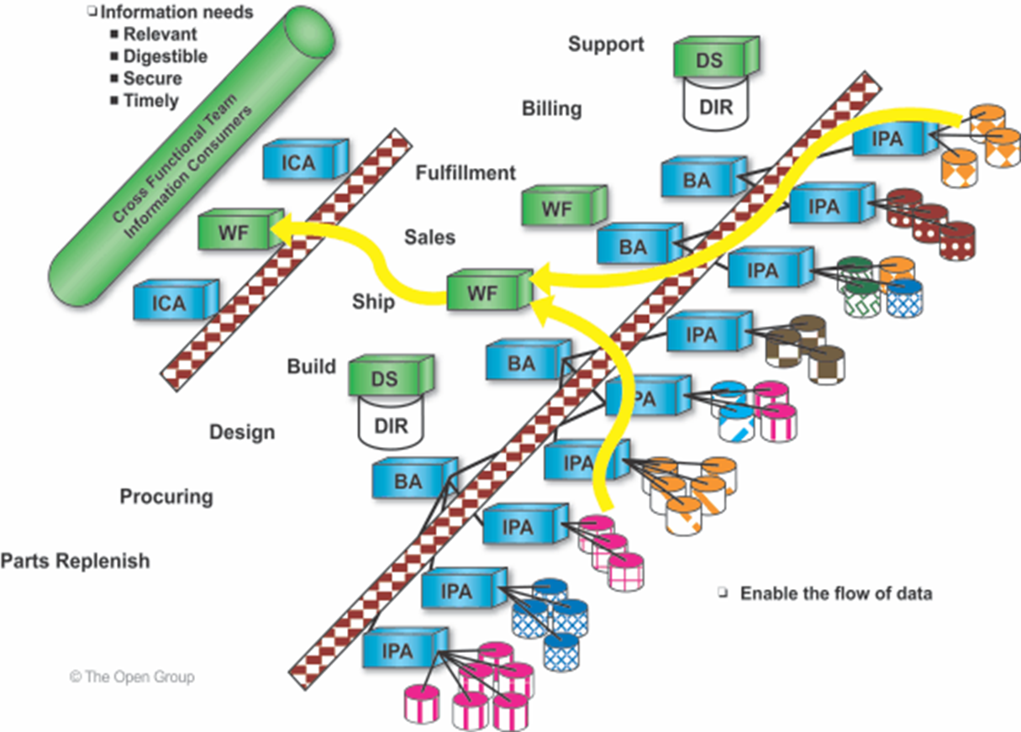
Phase C – Information Systems Architecture – Application Architecture - 08/12
Approach
Architecture Repository
  Generic business models and related application models relevant to the industry sector
  Application models relevant to common high-level business functions, such as electronic commerce, supply chain management, etc.
The Open Group - Reference Model
Integrated Information Infrastructure (III-RM) focuses on
  the application-level components
  services
  that are necessary to provide an integrated information infrastructure.
see: TOGAF® Series Guide: The TOGAF Integrated Information Infrastructure Reference Model (III-RM)
Architecture Development Method : Page 79 : §7.5
Initially MOD 11
Added Application Architecture to the heading
Notes:
Level=2 : L.O.= 4.6b : Explain how to apply Phase C and how it contributes to the architecture development work.
See : TOGAF® Standard – Architecture Development Method : Page 79 : 7.5
7.5 Approach
7.5.1 Architecture Repository
As part of this phase, the architecture team will need to consider what relevant Application
Architecture resources are available in the Architecture Repository (see the TOGAF Standard —
Architecture Content).
In particular :
■ Generic business models and related application models relevant to the organization’s
industry sector
■ Application models relevant to common high-level business functions, such as electronic
commerce, supply-chain management, etc.
The Open Group has a Reference Model for Integrated Information Infrastructure (III-RM) — see
the TOGAF® Series Guide: The TOGAF Integrated Information Infrastructure Reference Model
(III-RM) — that focuses on the application-level components and services necessary to provide
an integrated information infrastructure.

Slide 114
Phase C – Information Systems Architecture – 10/12
Essential outcome and output - Summary
Phase | Output & Outcome | Essential Knowledge
Phase C | A set of domain architectures approved by the stakeholders for the problem being addressed, with a set of gaps, and work to clear the gaps understood by the stakeholders. | How does the current Enterprise fail to meet the preferences of the stakeholders? What must change to enable the Enterprise to meet the preferences of the stakeholders? (Gaps) What work is necessary to realize the changes, that is consistent with the additional value being created? (Work Package) How stakeholder priority and preference adjust in response to value, effort, and risk of change. (Stakeholder Requirements)
A Practitioners’ Approach to Developing Enterprise Architecture Following the TOGAF® ADM : Page 42 : §5.2.2
Initially MOD 11
Phase entry was wrong have corrected
Notes:
Level=2 : L.O.= 4.6c : Explain the information that is relevant to Phase C (Data and Applications) to produce outputs relevant to the architecture development.
See : TOGAF® Series Guide: A Practitioners’ Approach to Developing Enterprise Architecture Following the TOGAF® ADM : Page 42 : §5.2.2
5.2.2 Essential ADM Output and Knowledge
A summary of the essential outcome and output is provided in Table 4. Keep in mind that the essential output is what stakeholders, sponsor, and boss’ boss’ boss wants. No-one wants an architecture; they want guidance on planning and executing an effective change. Practitioners use an architected approach to providing the best available guidance on effective change. The essential outcomes and outputs are derived from the objectives of the phase – the statement of why a Practitioner should perform this activity.
What the Enterprise values and consumes is typically different than what the Practitioner produces. Practitioners deliver an essential output. It is provided as views, roadmaps, architecture specifications, controls, and other useful things. Architecture is developed, and the EA Landscape populated. To do this, Practitioners require a set of essential knowledge. The Enterprise consumes effective guidance about, and the ability to govern, change.
Read Table 4 in conjunction with Table 3 to confirm whether for a particular purpose the output of the phase is already in existence, needs to be created, or is extraneous to the current Architecture Project. Good Practitioners will adjust their work accordingly. Table 4 lists only key outputs and outcomes. For an exhaustive list, refer to the TOGAF Standard. In order to achieve these outcomes, the Practitioner may have to perform more activities or create more deliverables than those listed in the table below. The intent is to keep the focus on what is pursued, not what is done.
Table 4: Essential ADM Outputs, Outcomes, and Required Knowledge Phase Output & Outcome Essential Knowledge
Phase B, Phase C, & Phase D
A set of domain architectures approved by the stakeholders for the problem being addressed, with a set of gaps, and work to clear the gaps understood by the stakeholders.
How does the current Enterprise fail to meet the preferences of the stakeholders?
What must change to enable the Enterprise to meet the preferences of the stakeholders? (Gaps)
What work is necessary to realize the changes, that is consistent with the additional value being created? (Work Package)
How stakeholder priority and preference adjust in response to value, effort, and risk of change. (Stakeholder Requirements)

Slide 115
Phase C – Information Systems Architecture – 11/12
Key Outputs and Outcomes
What the Enterprise values and consumes is typically different than what the EA produces. EAs deliver essential output provided as
views
roadmaps
architecture specifications
controls
other useful things
Architecture is developed, and the EA Landscape populated.
To do this, practitioners require a set of essential knowledge.
Phase | Output & Outcome | Essential Knowledge
Phase C | A set of domain architectures approved by the stakeholders for the problem being addressed, with a set of gaps, and work to clear the gaps understood by the stakeholders. | How does the current Enterprise fail to meet the preferences of the stakeholders? What must change to enable the Enterprise to meet the preferences of the stakeholders? (Gaps) What work is necessary to realize the changes, that is consistent with the additional value being created? (Work Package) How stakeholder priority and preference adjust in response to value, effort, and risk of change. (Stakeholder Requirements)
A Practitioners’ Approach to Developing Enterprise Architecture Following the ADM : Page 42 : §5.2.2
Initially MOD 11
Notes:
Level=2 : L.O.= 4.6c : Explain the information that is relevant to Phase C (Data and Applications) to produce outputs relevant to the architecture development.
See : TOGAF® Series Guide: A Practitioners’ Approach to Developing Enterprise Architecture Following the TOGAF® ADM : Page 42 : §5.2.2
Key Outputs and Outcomes
What the Enterprise values and consumes is typically different than what the EA produces. EAs deliver essential output.
It is provided as:
views
roadmaps
architecture specifications
controls
other useful things
Architecture is developed, and the EA Landscape populated.
To do this, Practitioners require a set of essential knowledge.
5.2.2 Essential ADM Output and Knowledge
A summary of the essential outcome and output is provided in Table 4. Keep in mind that the essential output is what stakeholders, sponsor, and boss’ boss’ boss wants. No-one wants an architecture; they want guidance on planning and executing an effective change. Practitioners use an architected approach to providing the best available guidance on effective change. The essential outcomes and outputs are derived from the objectives of the phase – the statement of why a Practitioner should perform this activity.
What the Enterprise values and consumes is typically different than what the Practitioner produces. Practitioners deliver an essential output. It is provided as views, roadmaps, architecture specifications, controls, and other useful things. Architecture is developed, and the EA Landscape populated. To do this, Practitioners require a set of essential knowledge. The Enterprise consumes effective guidance about, and the ability to govern, change.
Read Table 4 in conjunction with Table 3 to confirm whether for a particular purpose the output of the phase is already in existence, needs to be created, or is extraneous to the current Architecture Project. Good Practitioners will adjust their work accordingly. Table 4 lists only key outputs and outcomes. For an exhaustive list, refer to the TOGAF Standard. In order to achieve these outcomes, the Practitioner may have to perform more activities or create more deliverables than those listed in the table below. The intent is to keep the focus on what is pursued, not what is done.

Slide 116
Phase C – Information Systems Architecture – 12/12
Update the Architecture Vision phase deliverables:
  Statement of Architecture Work
  Validated application and data principles, or new application and data principles
Draft Architecture Deﬁnition Document:
  Baseline Application and Data Architecture Approved
  Target Application and Data Architecture Approved
  Views addressing stakeholder concerns
Draft Architecture Requirements Speciﬁcation:
  Gap analysis results
  Applications and Data interoperability requirements
  Relevant associated technical requirement
  Constraints on the Technology Architecture about to be designed
  Updated business requirements
  Updated application and or data requirements
Application Architecture and Data components of an Architecture Roadmap
Architecture Development Method : Page 78 : §7.4
Initially MOD 11
Many references to business in these bullets when it should be information systems or Application and Data – have changed them
Notes:
Level=2 : L.O.= 4.6c : Explain the information that is relevant to Phase C (Data and Applications) to produce outputs relevant to the architecture development.
See : TOGAF® Series Guide: A Practitioners’ Approach to Developing Enterprise Architecture Following the TOGAF® ADM : Page 42 : §5.2.2
Key Outputs and Outcomes
What the Enterprise values and consumes is typically different than what the EA produces. EAs deliver essential output.
It is provided as:
views
roadmaps
architecture specifications
controls
other useful things
Architecture is developed, and the EA Landscape populated.
To do this, Practitioners require a set of essential knowledge.
5.2.2 Essential ADM Output and Knowledge
A summary of the essential outcome and output is provided in Table 4. Keep in mind that the essential output is what stakeholders, sponsor, and boss’ boss’ boss wants. No-one wants an architecture; they want guidance on planning and executing an effective change. Practitioners use an architected approach to providing the best available guidance on effective change. The essential outcomes and outputs are derived from the objectives of the phase – the statement of why a Practitioner should perform this activity.
What the Enterprise values and consumes is typically different than what the Practitioner produces. Practitioners deliver an essential output. It is provided as views, roadmaps, architecture specifications, controls, and other useful things. Architecture is developed, and the EA Landscape populated. To do this, Practitioners require a set of essential knowledge. The Enterprise consumes effective guidance about, and the ability to govern, change.
Read Table 4 in conjunction with Table 3 to confirm whether for a particular purpose the output of the phase is already in existence, needs to be created, or is extraneous to the current Architecture Project. Good Practitioners will adjust their work accordingly. Table 4 lists only key outputs and outcomes. For an exhaustive list, refer to the TOGAF Standard. In order to achieve these outcomes, the Practitioner may have to perform more activities or create more deliverables than those listed in the table below. The intent is to keep the focus on what is pursued, not what is done.

Slide 117
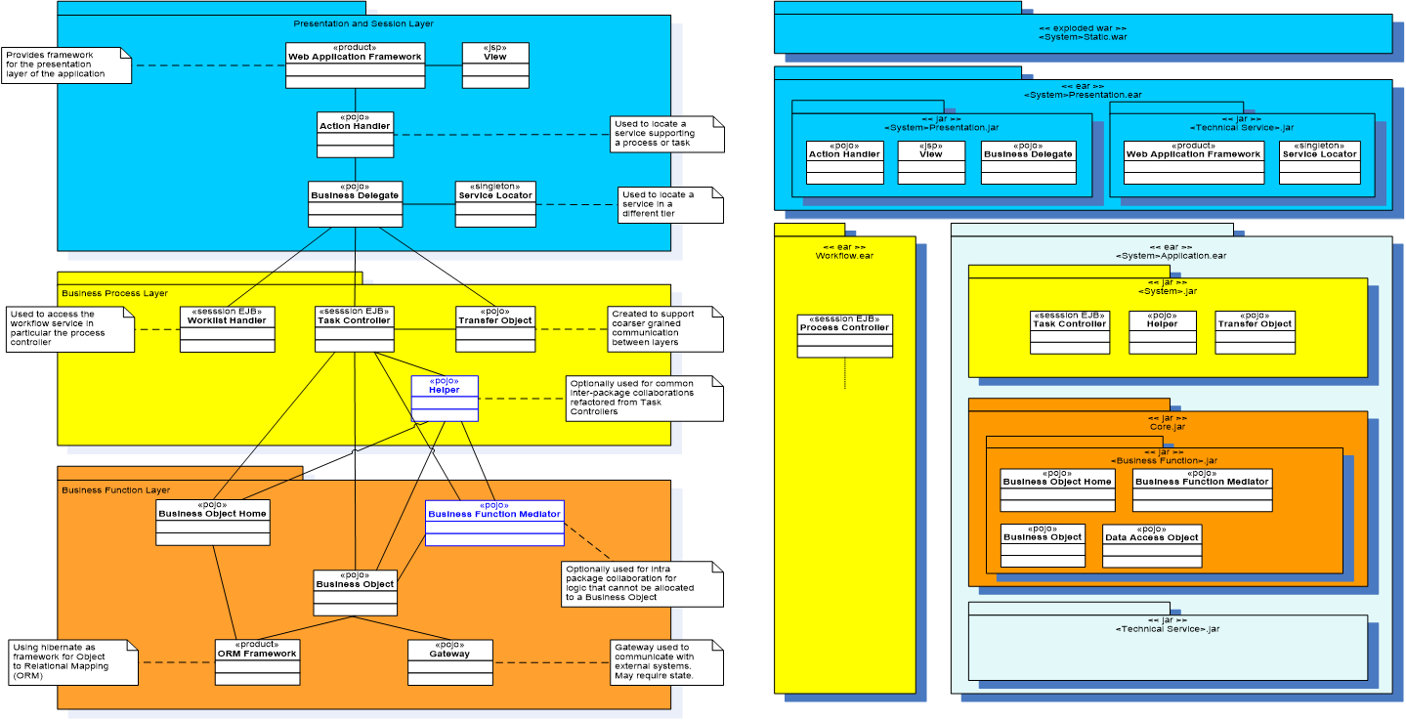
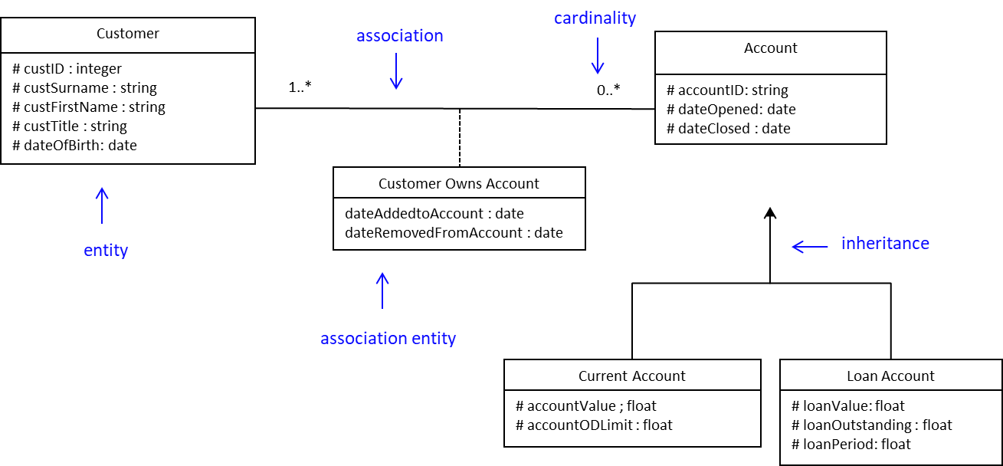
Example Application and Data Artifacts
Software Code Building Blocks
Described By A
Software Processing Diagram Artifact
Data Building Blocks
Described By An
Entity Relationship Diagram Artifact
Code processes data (at rest, in motion and in use)
The solution building blocks are the configurations of the actual code, the devices, the data centres, the locations, the people, the data, the processes etc. and the associated deployed components in the sub-systems and systems that have been created to deliver the changed business services in line with the specifications provided by the architecture building blocks.
Initially MOD 07
Added some example building blocks

Slide 118
Phase D – Technology Architecture – 01/09
Objectives
Develop the Target Technology Architecture that enables the Business and IS Architectures and the Architecture Vision, in a way that addresses the Statement of Architecture Work and stakeholder concerns
Identify candidate Architecture Roadmap components based upon gaps between the Baseline and Target Technology Architectures
A Practitioners’ Approach to Developing Enterprise Architecture Following the ADM : Page 42 : §5.2.2
Initially MOD 11
Changed second objective to say Technology bot Data
Notes:
Context

Slide 119
Phase D – Technology Architecture – 02/09
Std. 9.2
Phases B - Business
Steps C -
Classic View D - Technology
9. Create/Update Architecture Definition Document
{
Application
Data
8. Finalize the Technology Architecture
7. Conduct formal stakeholder review
Associated with each step is a generic list of tasks.
This will be adapted as fitting
for each project.
The order is not very Important.
It is important that at the end of the phase there is a ✓ in every box [of the adapted list] or a reason why not!
6. Resolve impacts across the Architecture Landscape
5. Define candidate roadmap components
4. Perform Gap Analysis
3. Develop Target Technology Architecture Description
2. Develop Baseline Technology Architecture Description
Select reference models, viewpoints, and tools
Initially MOD 11
Notes:
Context – included for 9.2 upgraders

Slide 120

Phase D – Technology Architecture – 03/09
Inputs
Reference Materials External to the Enterprise
Architecture reference materials
Product information on candidate products
Non-Architectural Inputs
Request for Architecture Work
Capability Assessment
Communications Plan
Architectural Inputs
  Organizational Model for Enterprise Architecture
Business, Data, and Application Architecture components
Tailored Architecture Framework
Technology principles
Statement of Architecture Work
Architecture Vision
Architecture Repository
Re-usable building blocks
Draft Architecture Definition Document
Draft Architecture Requirements Specification— Gap Analysis results
Business, Data, and Application Architecture components of an Architecture Roadmap
Cub having ‘input’
Architecture Development Method : Page 82 : §8.2
Initially MOD 11
Notes:
Level=2 : L.O.= 4.7a : Explain the information needed in Phase D to produce outputs relevant to the architecture development.
See : TOGAF® Standard – Architecture Development Method : Page 82 : §8.2
8.2 Inputs
This section deﬁnes the inputs to Phase D.
8.2.1 Reference Materials External to the Enterprise
■Architecture reference materials (see the TOGAF Standard — Architecture Content)
■Product information on candidate products
8.2.2 Non-Architectural Inputs
■Request for Architecture Work (see the TOGAF Standard — Architecture Content)
■Capability Assessment (see the TOGAF Standard — Architecture Content)
■Communications Plan (see the TOGAF Standard — Architecture Content)
8.2.3 Architectural Inputs
■Organizational Model for Enterprise Architecture (see the TOGAF Standard — Architecture
Content), including:
—Scope of organizations impacted
—Maturity assessment, gaps, and resolution approach
—Roles and responsibilities for architecture team(s)
—Constraints on architecture work
—Budget requirements
—Governance and support strategy
■Tailored Architecture Framework (see the TOGAF Standard — Architecture Content), including:
—Tailored architecture method
—Tailored architecture content (deliverables and artifacts)
—Conﬁgured and deployed tools
■Technology principles (see the TOGAF Standard — ADM Techniques), if existing
■Statement of Architecture Work (see the TOGAF Standard — Architecture Content)
■Architecture Vision (see the TOGAF Standard — Architecture Content)
■Architecture Repository(see the TOGAF Standard — Architecture Content), including:
—Re-usable building blocks
—Publicly available reference models
—Organization-speciﬁc reference models
—Organization standards
■Draft Architecture Deﬁnition Document, which may include Baseline and/or Target Architectures of any architecture domain
■Draft Architecture Requirements Speciﬁcation (see the TOGAF Standard — Architecture
... CONTINUES ... SEE REFERENCE SPECIFIED

Slide 121
Phase D – Technology Architecture – 04/09
Essential outcome and output - Summary
Phase | Output & Outcome | Essential Knowledge
Phase D | A set of domain architectures approved by the stakeholders for the problem being addressed, with a set of gaps, and work to clear the gaps understood by the stakeholders. | How does the current Enterprise fail to meet the preferences of the stakeholders? What must change to enable the Enterprise to meet the preferences of the stakeholders? (Gaps) What work is necessary to realize the changes, that is consistent with the additional value being created? (Work Package) How stakeholder priority and preference adjust in response to value, effort, and risk of change. (Stakeholder Requirements)
A Practitioners’ Approach to Developing Enterprise Architecture Following the TOGAF® ADM : Page 42 : §5.2.2
Initially MOD 11
Phase entry was wrong have corrected
Notes:
Level=2 : L.O.= 4.7b : Explain the information that is relevant to Phase D (Technology) to produce outputs relevant to the architecture development.
See : TOGAF® Series Guide: A Practitioners’ Approach to Developing Enterprise Architecture Following the TOGAF® ADM : Page 42 : §5.2.2
5.2.2 Essential ADM Output and Knowledge
A summary of the essential outcome and output is provided in Table 4. Keep in mind that the essential output is what stakeholders, sponsor, and boss’ boss’ boss wants. No-one wants an architecture; they want guidance on planning and executing an effective change. Practitioners use an architected approach to providing the best available guidance on effective change. The essential outcomes and outputs are derived from the objectives of the phase – the statement of why a Practitioner should perform this activity.
What the Enterprise values and consumes is typically different than what the Practitioner produces. Practitioners deliver an essential output. It is provided as views, roadmaps, architecture specifications, controls, and other useful things. Architecture is developed, and the EA Landscape populated. To do this, Practitioners require a set of essential knowledge. The Enterprise consumes effective guidance about, and the ability to govern, change.
Read Table 4 in conjunction with Table 3 to confirm whether for a particular purpose the output of the phase is already in existence, needs to be created, or is extraneous to the current Architecture Project. Good Practitioners will adjust their work accordingly. Table 4 lists only key outputs and outcomes. For an exhaustive list, refer to the TOGAF Standard. In order to achieve these outcomes, the Practitioner may have to perform more activities or create more deliverables than those listed in the table below. The intent is to keep the focus on what is pursued, not what is done.
Table 4: Essential ADM Outputs, Outcomes, and Required Knowledge Phase Output & Outcome Essential Knowledge
Phase B, Phase C, & Phase D
A set of domain architectures approved by the stakeholders for the problem being addressed, with a set of gaps, and work to clear the gaps understood by the stakeholders.
How does the current Enterprise fail to meet the preferences of the stakeholders?
What must change to enable the Enterprise to meet the preferences of the stakeholders? (Gaps)
What work is necessary to realize the changes, that is consistent with the additional value being created? (Work Package)
How stakeholder priority and preference adjust in response to value, effort, and risk of change. (Stakeholder Requirements)

Slide 122
Phase D – Technology Architecture – 05/09
Key Outputs and Outcomes
What the Enterprise values and consumes is typically different than what the EA produces. EAs deliver essential output.
It is provided as:
views
roadmaps
architecture specifications
controls
other useful things
Architecture is developed, and the EA Landscape populated.
To do this, practitioners require a set of essential knowledge.
Phase | Output & Outcome | Essential Knowledge
Phase D | A set of domain architectures approved by the stakeholders for the problem being addressed, with a set of gaps, and work to clear the gaps understood by the stakeholders. | How does the current Enterprise fail to meet the preferences of the stakeholders? What must change to enable the Enterprise to meet the preferences of the stakeholders? (Gaps) What work is necessary to realize the changes, that is consistent with the additional value being created? (Work Package) How stakeholder priority and preference adjust in response to value, effort, and risk of change. (Stakeholder Requirements)
Architecture Development Method : Page 90 : §8.4
Initially MOD 11
Notes:
Level=2 : L.O.= 4.7b : Explain the information that is relevant to Phase D (Technology) to produce outputs relevant to the architecture development.
See : TOGAF® Series Guide: A Practitioners’ Approach to Developing Enterprise Architecture Following the TOGAF® ADM : Page 42 : §5.2.2
5.2.2 Essential ADM Output and Knowledge
A summary of the essential outcome and output is provided in Table 4. Keep in mind that the essential output is what stakeholders, sponsor, and boss’ boss’ boss wants. No-one wants an architecture; they want guidance on planning and executing an effective change. Practitioners use an architected approach to providing the best available guidance on effective change. The essential outcomes and outputs are derived from the objectives of the phase – the statement of why a Practitioner should perform this activity.
What the Enterprise values and consumes is typically different than what the Practitioner produces. Practitioners deliver an essential output. It is provided as views, roadmaps, architecture specifications, controls, and other useful things. Architecture is developed, and the EA Landscape populated. To do this, Practitioners require a set of essential knowledge. The Enterprise consumes effective guidance about, and the ability to govern, change.
Read Table 4 in conjunction with Table 3 to confirm whether for a particular purpose the output of the phase is already in existence, needs to be created, or is extraneous to the current Architecture Project. Good Practitioners will adjust their work accordingly. Table 4 lists only key outputs and outcomes. For an exhaustive list, refer to the TOGAF Standard. In order to achieve these outcomes, the Practitioner may have to perform more activities or create more deliverables than those listed in the table below. The intent is to keep the focus on what is pursued, not what is done.
Table 4: Essential ADM Outputs, Outcomes, and Required Knowledge Phase Output & Outcome Essential Knowledge
Phase B, Phase C, & Phase D
A set of domain architectures approved by the stakeholders for the problem being addressed, with a set of gaps, and work to clear the gaps understood by the stakeholders.
How does the current Enterprise fail to meet the preferences of the stakeholders?
What must change to enable the Enterprise to meet the preferences of the stakeholders? (Gaps)
What work is necessary to realize the changes, that is consistent with the additional value being created? (Work Package)
How stakeholder priority and preference adjust in response to value, effort, and risk of change. (Stakeholder Requirements)

Slide 123
Phase D – Technology Architecture – 06/09
Approach
Emerging Technologies
The evolution of new technologies is a major driver for change in enterprises looking for new and innovative ways of operating and improving their business.
Architecture Repository
Consider what relevant Technology Architecture resources are available in the Architecture Repository
Initially MOD 11
Notes:
Context
Approach
Emerging Technologies
The evolution of new technologies is a major driver for change in enterprises looking for new innovative ways of operating and improving their business.
Stakeholders need to both anticipate and be open to technology-driven change.
Solution development methods are also evolving to challenge traditional development methods.
Without a strong Enterprise Architecture approach, the rapid adoption of changing technologies will cause discontinuities across the enterprise.
Technology Architecture may both drive business capabilities and respond to information system requirements at the same time.
Architecture Repository
Consider what relevant Technology Architecture resources are available in the Architecture Repository :
Existing IT services as documented in the IT repository or IT service catalog
The adopted technical reference model, if applicable
Generic technology models relevant to the organization’s industry sector
Technology models relevant to Common Systems Architectures
The Open Group has a Reference Model for Integrated Information Infrastructure (IIIRM)
See: The TOGAF Integrated Information Infrastructure Reference Model (III-RM)
that focuses on the application-level components and underlying services necessary
to provide an integrated information infrastructure.

Slide 124
Phase D – Technology Architecture – 09/09
Outputs
Refined and updated versions of the Architecture Vision phase deliverables
Draft Architecture Definition Document
Draft Architecture Requirements Specification
Technology Architecture components of an Architecture Roadmap
Architecture Development Method : Page 90 : §8.4
Initially MOD 11
Notes:
Level=2 : L.O.= 4.8b : Explain how to apply Phase D and how it contributes to the architecture development work.
See : TOGAF® Series Guide: A Practitioners’ Approach to Developing Enterprise Architecture Following the TOGAF® ADM : Page 42 : §5.2.2
Outputs
Refined and updated versions of the Architecture Vision phase deliverables:
Statement of Architecture Work
Validated technology principles, or new technology principles
Draft Architecture Definition Document:
Baseline Technology Architecture, Approved, if appropriate
Target Technology Architecture, Approved, including:
Technology Components and their relationships to information systems
Technology platforms and their decomposition, showing the combinations of Technology required to realize a particular technology "stack"
Environments and locations — a grouping of the required technology into Computing environments (e.g., development, production)
Expected processing /distribution load across technology
Physical (network) communications
Hardware and network specifications
Views corresponding to the selected viewpoints addressing key stakeholder concerns
Draft Architecture Requirements Specification:
Gap Analysis results
Requirements output from Phases B and C
Updated technology requirements
Technology Architecture components of an Architecture Roadmap
The TOGAF Standard — Architecture Content contains a detailed description of
architectural artifacts which might be produced in this phase.
8.4 Outputs
The outputs of Phase D may include, but are not restricted to:
■Reﬁned and updated versions of the Architecture Vision phase deliverables, where applicable:
—Statement of Architecture Work (see the TOGAF Standard — Architecture Content), updated if necessary
—Validated technology principles, or new technology principles (if generated here)
■Draft Architecture Deﬁnition Document (see the TOGAF Standard — Architecture Content), including:
—Baseline Technology Architecture, Approved, if appropriate
—Target Technology Architecture, Approved, including:
... CONTINUES ... SEE REFERENCE SPECIFIED

Slide 125




Example Technology Artifacts Describing Building Blocks
Deployment
Diagram
Device, Container, Component
Connector
Data Dissemination Diagram
Data, Technology, Application Location
Role
Data Centre Environment
Diagram
Domain,
Server,
Network, Location
Environments And Locations Diagram
Location, Network, Technology and Role
Initially MOD 07
Added some example artifacts

Slide 126
Architecture Development 02/03
Key Outputs and Outcomes
What the Enterprise values and consumes is typically different than what the EA produces. EAs deliver essential output provided as:
views
roadmaps
architecture specifications
controls
other useful things
Architecture is developed, and the EA Landscape populated.
To do this, practitioners require a set of essential knowledge.
Phase | Output & Outcome | Essential Knowledge
Phase B, C & D | A set of domain architectures approved by the stakeholders for the problem being addressed, with a set of gaps, and work to clear the gaps understood by the stakeholders. | How does the current Enterprise fail to meet the preferences of the stakeholders? What must change to enable the Enterprise to meet the preferences of the stakeholders? (Gaps) What work is necessary to realize the changes, that is consistent with the additional value being created? (Work Package) How stakeholder priority and preference adjust in response to value, effort, and risk of change. (Stakeholder Requirements)
A Practitioners’ Approach to Developing Enterprise Architecture Following the TOGAF® ADM : Page 42 : §5.2.2
Initially MOD 11
Phase should say Phase B, c & D so I have changed it
Notes:
Level=2 : L.O.= 4.8b : Explain how to apply Phase D and how it contributes to the architecture development work.
See : TOGAF® Series Guide: A Practitioners’ Approach to Developing Enterprise Architecture Following the TOGAF® ADM : Page 42 : §5.2.2
Key Outputs and Outcomes
What the Enterprise values and consumes is typically different than what the EA produces. EAs deliver essential output.
It is provided as:
views
roadmaps
architecture specifications
controls
other useful things
Architecture is developed, and the EA Landscape populated.
To do this, Practitioners require a set of essential knowledge.
5.2.2 Essential ADM Output and Knowledge
A summary of the essential outcome and output is provided in Table 4. Keep in mind that the essential output is what stakeholders, sponsor, and boss’ boss’ boss wants. No-one wants an architecture; they want guidance on planning and executing an effective change. Practitioners use an architected approach to providing the best available guidance on effective change. The essential outcomes and outputs are derived from the objectives of the phase – the statement of why a Practitioner should perform this activity.
What the Enterprise values and consumes is typically different than what the Practitioner produces. Practitioners deliver an essential output. It is provided as views, roadmaps, architecture specifications, controls, and other useful things.
A summary of the
architecture; they want guidance on planning and executing an effective change. Practitioners use an architected approach to providing the best available guidance on effective change. The
essential outcomes and outputs are derived from the objectives of the phase – the statement of why a Practitioner should perform this activity.
What the Enterprise values and consumes is typically different than what the Practitioner produces. Practitioners deliver an essential output. It is provided as views, roadmaps,
architecture specifications, controls, and other useful things. Architecture is developed, and the EA Landscape populated. To do this, Practitioners require a set of essential knowledge. The
Enterprise consumes effective guidance about and the ability to govern change.
Read Table 4 in conjunction with Table 3 to confirm whether for a particular purpose the output of the phase is already in existence, needs to be created, or is extraneous to the current
Architecture Project. Good Practitioners will adjust their work accordingly. Table 4 lists only key outputs and outcomes. For an exhaustive list, refer to the TOGAF standard. In order to
achieve these outcomes, the Practitioner may have to perform more activities or create more deliverables than those listed in the table below. The intent is to keep the focus on what is
pursued, not what is done.

Slide 127
Summary of Module 11
The 43 Learning points covered in Module 11 are:
4.5a/b: Explain the information relevant to Phase C (Data and Applications) to produce outputs relevant to the Architecture Development.
4.6a/c: Explain how to apply Phase C and how it contributes to the Architecture Development work.
4.7a/b: Explain the information needed in Phase D to produce outputs relevant to the Architecture Development.
4.8a/b: Explain how to apply Phase D and how it contributes to the Architecture Development work.
4.9a/e: Explain the outputs of Phases B, C, and D necessary to proceed with the Architecture Development work.
8.11a/m :Briefly explain the guidelines and techniques that can be used during the Business Architecture phase.
4.6a/c: Explain the information that is relevant to Phase C (Data and Applications) to produce outputs relevant to the architecture development.
4.7a/c: Explain how to apply Phase C and how it contributes to the architecture development work.
4.8a/c: Explain the outputs necessary to proceed with the architecture development work.
4.9a/b: Explain the information needed in Phase D to produce outputs relevant to the architecture development.
4.10a/b: Explain how to apply Phase D and how it contributes to the architecture development work.
8.2a/c : Briefly explain the business scenario technique.
Initially MOD 11

Slide 128
End of Teaching Slides
End of
Module 11
Architecture Development
Initially MOD 11

Slide 129
Module Title
Module 12/17
TOGAF® EA Training - Practitioner
TOGAF® Standard, 10th Edition
Module 12
Implementing the Architecture
TOGAF® is a registered trademark of The Open Group Copyright © The Open Group 2022
​
Initially MOD 12

Slide 130
Course Module Index
# | Topic – Level 1 | ✓
1 | Module 00 - Course Introduction | ✓
2 | Module 01 - Overview | ✓
3 | Module 02 - Concepts | ✓
4 | Module 03 - Introduction to the ADM | ✓
5 | Module 04 - Introduction to the ADM - Techniques | ✓
6 | Module 05 – Applying ADM | ✓
7 | Module 06 - Architecture Governance | ✓
8 | Module 07 – Architecture Content | ✓
# | Topic – Level 2 | ✓
9 | Module 00 - Course Introduction | ✓
10 | Module 08 - The Context for Enterprise Architecture | ✓
11 | Module 09 – Stakeholder Management | ✓
12 | Module 10 – Phase A | ✓
13 | Module 11 – Architecture Development | ✓
14 | Module 12 – Implementing the Architecture
15 | Module 13 – Architecture Change Management
16 | Module 14 – Requirements Management
17 | Module 15 – Supporting the ADM Work
18 | Module 16 – Closure
Course Module Index
Initially MOD 12

Slide 131

The Realization Phases
The point of EA is to produce a detailed description of something that can be created.
As with plans produced by any design system, it is not sufficient to just pass these to ‘the builders’ in the hope of flawless creation.
It is the Enterprise Architect who ‘signs off’ that the output from the builders [developers] maps accurately to the design.
A formal process and understanding of relationships are needed to assure this happens.
Initially MOD 12

Slide 132
Risk and Security Considerations – 01/03
Phase E – Opportunities and Solutions
It is imperative that security and risk are evaluated:
Ensure the stakeholders’ security/risk concerns are addressed
Confirm that risk owners are consulted
The security building blocks defined in the previous phases become SBBs
Verify the efficacy of existing security services and controls
Integrating Risk and Security within a Enterprise Architecture : Page 24 : §5.6
Initially MOD 12
Notes:
Level=2 : L.O.= 5.1a : Explain the risk and security considerations for the three Phases (E, F and G).
See : TOGAF® Series Guide: Integrating Risk and Security within a TOGAF® Enterprise Architecture : Page 24 : §5.6
Phase E – Opportunities and Solutions
It is imperative that security and risk are evaluated:
Ensure the stakeholders’ security and risk concerns are addressed in the analysis
Confirm that risk owners are consulted
The value expected to be delivered by work packages includes:
measures related to security and risk value to ensure the roadmap addresses the complete set of business goals and drivers
The security building blocks defined in the previous phases become SBBs in this phase so that more specific implementation-oriented requirements and specifications are defined.
A whole solution design might be needed at this stage.
The Security Services Catalog of the Baseline Security Architecture contains:
existing security services or security building blocks that meet the requirements
For example, if the requirement exists for application access control, an existing central authentication service might be used to fill that in.
The efficacy of existing security services and controls earmarked for re-use must be verified to ensure that the end-state contains security measures, which work and integrate well.
5.6 Phase E: Opportunities and Solutions
In defining the roadmap, where the sequence of gaps to be addressed is determined, it is imperative that security and risk are evaluated. Ensure the stakeholders’ security and risk
concerns are addressed in the analysis. Confirm that risk owners are consulted. The value expected to be delivered by work packages should include measures related to security and risk value to ensure the roadmap addresses the complete set of business goals and drivers.
The security building blocks defined in the previous phases become SBBs in this phase so that more specific implementation-oriented requirements and specifications are defined. A whole solution design might be needed at this stage.
The Security Services Catalog of the Baseline Security Architecture probably contains existing security services or security building blocks that meet the requirements. For example, if the requirement exists for application access control, an existing central authentication service might be used to fill that in. The efficacy of existing security services and controls earmarked for reuse
... CONTINUES ... SEE REFERENCE SPECIFIED

Slide 133
Risk and Security Considerations – 02/03
Phase E, F & G
The migration strategy includes:
A Risk Assessment
A Risk Mitigation Plan
In Phase F, the Risk Mitigation Plan addition is limited to the transition.
These concepts have already been mentioned in earlier phases of the ADM. Include regression / reversion planning - to reverse out a failed migration.
Include a security impact analysis to understand impacts of the change.
Integrating Risk and Security within a Enterprise Architecture : Page 25 : §5.7
Initially MOD 12
Top line should say Phases E, F & G – so I have changed it.
Notes:
Level=2 : L.O.= 5.1b : Explain the risk and security considerations for the three Phases (E, F and G).
See : TOGAF® Series Guide: Integrating Risk and Security within a TOGAF® Enterprise Architecture : Page 25 : §5.7
Phase F: Migration Planning
The migration strategy includes:
a risk assessment
a Risk Mitigation Plan
In Phase F, the Risk Mitigation Plan is limited to the transition.
These concepts have already been mentioned in earlier phases of the ADM. Migration of live environments should always include regression planning so that there is a way to reverse out a failed migration.
This is an essential part of risk management.
In addition, migration planning includes a security impact analysis to understand impacts of the target state of the change.
5.7 Phase F: Migration Planning
Migration is itself a business process that needs to be secured. The migration strategy should include a risk assessment and a Risk Mitigation Plan. In Phase F, the Risk Mitigation Plan is limited to the transition. These concepts have already been mentioned in earlier phases of the ADM. Migration of live environments should always include regression planning so that there is a way to reverse out a failed migration. This is an essential part of risk management.
In addition, migration planning should include a security impact analysis to understand any security impacts of the target state of the change.

Slide 134
Risk and Security Considerations – 03/03
Phase E, F & G
Security Architecture implementation governance provides assurance that the detailed design and implemented processes and systems adhere to the overall Security Architecture.
This ensures that deviations from Architecture Principles and implementation guidelines do not create any unacceptable risk.
The following artifacts are relevant in this phase:
Security Audit
Security Training and Awareness
Integrating Risk and Security within a Enterprise Architecture : Page 25 : §5.8
Initially MOD 12
Top line should say Phases E, F & G – so I have changed it.
Notes:
Þ Q-35
Level=2 : L.O.= 5.1c : Explain the risk and security considerations for the three Phases (E, F and G).
See : TOGAF® Series Guide: Integrating Risk and Security within a TOGAF® Enterprise Architecture : Page 25 : §5.8
Phase G: Implementation Governance
Security Architecture implementation governance provides assurance that the detailed design and implemented processes and systems adhere to the overall Security Architecture.
This ensures that deviations from Architecture Principles and implementation guidelines don’t create any unacceptable risk.
The following artifacts are relevant in this phase:
Security Audit: security reviews of implemented processes, technical designs, developed code, and configurations against policies and requirements, security testing, comprising functional security testing, performance testing, and penetration testing.
Security Training and Awareness: sufficient training is provided to ensure correct deployment, configuration, and operations of security-relevant subsystems and components; including awareness training of all users and non-privileged operators of the system and/or its components. It is critical for a proper, continuous, and secure performance. In many control frameworks, security training must be followed and results documented to demonstrate due diligence. Substantiated corrective actions or sanctions are needed in cases where exploits or errors compromise security objectives.
5.8 Phase G: Implementation Governance
Security Architecture implementation governance provides assurance that the detailed design and implemented processes and systems adhere to the overall Security Architecture. This ensures that deviations from Architecture Principles and implementation guidelines don’t create any unacceptable risk.
The following artifacts are relevant in this phase.
5.8.1 Security Audit
Location in the Architecture Framework: Enterprise Security Architecture: ISM.
Security audit includes security reviews of implemented processes, technical designs, developed code, and configurations against policies and requirements. It also includes security testing, comprising functional security testing, performance testing, and penetration testing.
5.8.2 Security Training and Awareness
... CONTINUES ... SEE REFERENCE SPECIFIED

Slide 135

Phase E – Opportunities and Solutions – 01/13
Phase E – Opportunities and Solutions
Is so named because …
Phase E involves consolidating identified gaps into work packages.
Those collectively are the opportunities - for delivering the Target Architecture.
The gaps between the baseline (current) architecture and the target (future) architecture are the opportunities.
Take those requirements, put them into the roadmap and draft implementation plan
and that's the solution element.
Key is to understand what is solution, and how it differs from architecture
Simply – architecture is an abstract view of solution
Phase E generates the first complete version of the Architecture Roadmap – by combining the analysis and suggestions from the Architecture Development phases – B, C & D.
Initially MOD 12
Notes:
Phase E – Opportunities and Solutions
Is so named because …
Phase E involves consolidating the identified gaps into work packages.
These collectively are the opportunities - for delivering the Target Architecture by implementing specific solutions.
The gaps between the baseline (current) architecture and the target (future) architecture are the opportunities.
Then you take those requirements and put them into the roadmap and draft an implementation plan, and that's the solution element.
key is to understand what is solution and how it differs from architecture.
simply – architecture is an abstract view of solution.
Phase E generates the first complete version of the Architecture Roadmap – by combining the analysis and suggestions from the Architecture Development phases – B, C & D.

Slide 136
Phase E – Opportunities and Solutions – 02/13
Objectives
Generate
Generate the initial complete version of the Architecture Roadmap, based upon the Gap Analysis and candidate Architecture Roadmap components from Phases B, C, and D
Determine
Determine whether an incremental approach is required - if so, identify Transition Architectures that will deliver continuous business value*
Define
Define the overall solution building blocks to finalize the Target Architecture based on the Architecture Building Blocks (ABBs)
* Remember the Value Stream…
Initially MOD 12
Notes:
Objectives
Generate the initial complete version of the Architecture Roadmap, based upon the Gap Analysis and candidate Architecture Roadmap components from Phases B, C, and D.
Determine whether an incremental approach is required, and if so, identify Transition Architectures that will deliver continuous business value*.
Define the overall solution building blocks to finalize the Target Architecture based on the Architecture Building Blocks (ABBs)
* Remember the Value Stream …

Slide 137
Phase E – Opportunities and Solutions – 03/13
Approach
This is the first phase concerning implementation
It takes into account the complete set of gaps between the Target and Baseline Architectures in all architecture domains
It logically groups changes into Work Packages*
It builds a best-fit roadmap based upon:
Stakeholder requirements
The enterprise's business transformation readiness
Identified opportunities and solutions
Identified implementation constraints
The following four concepts are key to transitioning from developing to delivering a Target Architecture:
Architecture Roadmap
Work Packages*
Transition Architectures
Implementation and Migration Plan
*A Work Package can be the whole program, project, or even part of the project.
Initially MOD 12
Notes:
Approach
This is the first phase concerning implementation
It takes into account the complete set of gaps between the Target and Baseline Architectures in all architecture domains
It logically groups changes into Work Packages*
It builds a best-fit roadmap based upon:
Stakeholder requirements
The enterprise's business transformation readiness
Identified opportunities and solutions
Identified implementation constraints
The following four concepts are key to transitioning from developing to delivering a Target Architecture:
Architecture Roadmap
Work Packages*
Transition Architectures
Implementation and Migration Plan
*A Work Package can be whole program, project or even part of project.

Slide 138

Phase E – Opportunities and Solutions – 04/13
Steps
The TOGAF® Standard includes a generic set of Steps.
The main benefits of having ‘tick lists’ are threefold:
1. You can see clearly what must be done and organize resources accordingly.
2. Management is less arduous – there is a clear list of what must be done and to what precision.
3. You clearly know when you have finished.
Phase E comprises work and effort in terms of synchronising, typically coordinating the efforts of many internal and external stakeholders.
The TOGAF® Standard generic set of Steps is in the next slides. Consider these as a template from which to construct the set that is tailored to your specific Architecture cycle.
Illustration steps
Initially MOD 12
Notes:
Steps
The TOGAF® Standard includes a generic set of Steps.
The main benefits of having ‘tick lists’ are threefold:
You can see clearly what must be done and organize resources accordingly
Management is less arduous – there is a clear list of what must be done and to what precision.
You clearly know when you have finished.
Phase E comprises a lot of work and with considerable effort into synchronising, typically coordinating the efforts of many internal and external stakeholders.
The TOGAF® Standard generic set of Steps are contained in the next slides. Consider these as a template from which to construct the set that is tailored to your specific Architecture cycle.

Slide 139
Phase E – Opportunities and Solutions – 05/13
Phase E
Steps: Classic View
11. Create Architecture Roadmap & Implementation and Migration Plan
10. Identify Transition Architecture
Associated with each step is a generic list of tasks.
This will be adapted as fitting
for each project.
The order is not very Important.
It is important that at the end of the phase there is a ✓ in every box [of the adapted list] or a reason why not!
9. Identify and group major work packages
8. Formulate Implementation & Migration Strategy
7. Confirm readiness and risk for business transformation
6. Refine and validate dependencies
5. Consolidate and reconcile interoperability requirements
4. Review consolidated requirements across related business functions
3. Review and consolidate Gap Analysis results from Phases B to D
2. Determine business constraints for implementation
1. Determine corporate change attributes
Initially MOD 12
Notes:
Phase E
Steps - Classic View
Associated with each step is a generic list of tasks.
This will be adapted as fitting for each project.
The order is not very Important.
It is important that at the end of the phase there is a ✓ in every box [of the adapted list] or a reason why not!

Slide 140

Gap Analysis Phase E - 01/04
Consolidated Gaps, Solutions, & Dependencies Matrix
The working analysis may be conveniently be represented as shown here.
This is a convenient form when mapping potential [COT] solutions.
This matrix can be used as a planning tool when creating work packages.
Identified dependencies will drive the creation of projects and migration planning in Phases E and F.
ADM Techniques : Page 49 : §6
Initially MOD 14
Moved to Phase E where it should be located
Notes:
Þ Q-54
Level=2 : L.O.= 8.4a : Explain how migration planning techniques are used to review and consolidate the gap analysis results from earlier phases.
See: TOGAF® Standard – ADM Techniques : Page 50 : §6
Consolidated Gaps, Solutions, and Dependencies Matrix
The technique of creating a Consolidated Gaps, Solutions, and Dependencies matrix allows the architect to group the gaps identified in the domain architecture Gap Analysis results and assess potential solutions and dependencies to one or more gaps.
6.2 Consolidated Gaps, Solutions, & Dependencies Matrix
The technique of creating a Consolidated Gaps, Solutions, and Dependencies matrix allows the architect to group the gaps identiﬁed in the domain architecture gap analysis results and assess potential solutions and dependencies to one or more gaps.
This matrix can be used as a planning tool when creating work packages. The identiﬁed dependencies will drive the creation of projects and migration planning in Phases E and F.
An example matrix is shown in Figure 6-2.

Slide 141
Gap Analysis Phase E - 02/04
Architecture Definition Increments Table
Allows the architect to plan a series of Transition Architectures outlining the status of the Enterprise Architecture at specified times.
Architecture Definition – Project Objectives by Increment - Example
Project | April – Year1/2 | April – Year 3 | April – Year 4 | Comments
 | Transition Architecture 1: Preparation | Transition Architecture 2: Initial Operational Capability | Transition Architecture 1: Benefits
Enterprise e-Services Capability | Training and Business Process | E-Licensing Capability | e-Employment Benefits
IT e-Forms | Design and Build
IT e-Information Environment | Design and Build Information Environment | Client Common Data Web Content Design and Build | Enterprise Common Data Component Management Design and Build
… | … | … | … | …
The Table
  Lists the projects
  Assigns their incremental
  deliverables…
across the Transition Architectures.
ADM Techniques : Page 50 : §6
Initially MOD 14
Moved to Phase E where it should be located
Notes:
Level=2 : L.O.= 8.4a : Explain how migration planning techniques are used to review and consolidate the gap analysis results from earlier phases.
See: TOGAF® Standard – ADM Techniques : Page 50 : §6
6.3 Architecture Definition Increments Table
The technique of creating an Architecture Definition Increments table allows the architect to plan
a series of Transition Architectures outlining the status of the Enterprise Architecture at specified
times.
A table should be drawn up, as shown in Figure 6-3, listing the projects and then assigning their
incremental deliverables across the Transition Architectures.

Slide 142

Gap Analysis Phase E - 03/04
Transition Architecture State Evolution Table
Tabulates the proposed state of the architectures at various levels using the defined taxonomy (e.g., the TOGAF TRM) listing:
  Listing the services from the taxonomy used in the enterprise
  Transition Architectures
  Proposed transformations
SBBs are:
  Described with respect to their delivery and impact on these services
  Marked to show the progression of the Enterprise Architecture
ADM Techniques : Page 51 : §6
Initially MOD 14
Moved to Phase E where it should be located
Notes:
Level=2 : L.O.= 8.4a : Explain how migration planning techniques are used to review and consolidate the gap analysis results from earlier phases.
See: TOGAF® Standard – ADM Techniques : Page 51 : §6
6.4 Transition Architecture State Evolution Table
The technique of creating the Transition Architecture State Evolution table allows the architect to show the proposed state of the architectures at various levels using the defined taxonomy (e.g., the TOGAF TRM).
A table should be drawn, listing the services from the taxonomy used in the enterprise, the Transition Architectures, and proposed transformations, as shown in Figure 6-4.
All SBBs should be described with respect to their delivery and impact on these services. They should also be marked to show the progression of the Enterprise Architecture. In the example, where target capability has been reached, this is shown as "new" or "retain"; where capability is transitioned to a new solution, this is marked as "transition"; and where a capability is to be replaced, this is marked as "replace".
Another technique (not shown here) is to use color coding in the matrix; for example:
■ Green: service SBB in place (either new or retained)
■ Yellow: service being transitioned into a new solution
■ Red: service to be replaced

Slide 143

Gap Analysis Phase E - 04/04
Implementation Factor Catalog
Used to document factors impacting the Architecture Implementation and Migration Plan - typically:
  Risks
  Issues
  Assumptions
  Dependencies
  Actions
  Impacts
descriptions, and the deductions that indicate the actions or constraints that have to be taken into consideration when formulating the plans.
ADM Techniques : Page 49 : §6
Initially MOD 14
Moved to Phase E where it should be located
Notes:
Level=2 : L.O.= 8.4e : Explain how migration planning techniques are used to review and consolidate the gap analysis results from earlier phases.
See: TOGAF® Standard – ADM Techniques : Page 49 : §6
This technique is derived from the Canadian Government BTEP Program.
The technique of creating a Consolidated Gaps, Solutions, and Dependencies matrix allows the architect to group the gaps identified in the domain architecture Gap Analysis results and assess potential solutions and dependencies to one or more gaps.
6.1 Implementation Factor Catalog
The technique of creating an Implementation Factor catalog can be used to document factors impacting the architecture Implementation and Migration Plan.
The catalog should include a list of the factors to be considered, their descriptions, and the deductions that indicate the actions or constraints that have to be taken into consideration when formulating the plans.
Factors typically include:
■ Risks
■ Issues
■ Assumptions
■ Dependencies
■ Actions
■ Impacts
An example catalog is shown

Slide 144
Phase E – Opportunities and Solutions – 08/13
Formulate Implementation and Migration Strategy
Three basic approaches:
Greenfield: a completely new implementation
Revolutionary: a radical change
Evolutionary: a strategy of convergence
Architecture Development Method : Page 98 : §9.3.8
Initially MOD 12
Notes:
Level=2 : L.O.= 5.3a : Describe three basic approaches to implementation.
See : TOGAF® Standard – Architecture Development Method : Page 98 : §9.3.8
It is worth pointing out that Evolutionary is only evolutionary when seen from the CEOs office!
For the guy on the ground who loses their job due to ‘an evolutionary change’ it is definitely ‘Revolutionary!
The on-the-ground reality is that Evolutionary is a string of fire-crackers as opposed to a big bang.
9.3.8 Formulate Implementation and Migration Strategy
Create an overall Implementation and Migration Strategy that will guide the implementation of the Target Architecture, and structure any Transition Architectures. The ﬁrst activity is to deter mine an overall strategic approach to implementing the solutions and/or exploiting opportunities.
There are three basic approaches as follows:
■Greenﬁeld: a completely new implementation
■Revolutionary: a radical change (i.e., switch on, switch off)
■Evolutionary: a strategy of convergence, such as parallel running or a phased approach to introduce new capabilities
Next, determine an approach for the overall strategic direction that will address and mitigate the risks identiﬁed in the Consolidated Gaps, Solutions and Dependencies matrix. The most common implementation methodologies are:
■Quick win (snapshots)
■Achievable targets
■Value chain method
These approaches and the identiﬁed dependencies should become the basis for the creation of the work packages. This activity terminates with agreement on the Implementation and Migration Strategy for the enterprise.

Slide 145
Phase E – Opportunities and Solutions – 09/13
Determine an approach for the overall strategic direction
The most common implementation methodologies are:
Quick win (snapshots)
Achievable targets
Value chain method
Architecture Development Method : Page 98 : §9.3.8
Initially MOD 12
Notes:
Level=2 : L.O.= 5.3a : Describe three basic approaches to implementation.
See : TOGAF® Standard – Architecture Development Method : Page 98 : §9.3.8
Methodologies as opposed to strategies …
Determine an approach for the overall strategic direction that will address and mitigate the risks identified in the Consolidated Gaps, Solutions, and Dependencies matrix. The most
common implementation methodologies are:
Quick win (snapshots)
Among the high-performing new leaders, one attribute stood out: a strong focus on results. In fact, most of them had managed to secure a “quick win”—a new and visible contribution to the success of the business made early in their tenure. Those who had achieved a quick win scored on average nearly 20% higher than those who hadn’t.
A quick win is a crucial form of reassurance to the leaders’ bosses, who hope they have made the right promotion decision; to team members deciding whether to place confidence in their new manager; and to peers trying to determine whether an equal has joined their ranks. The Quick Wins Paradox, Mark E. Van Buren and Todd Safferstone, Harvard Business Review (January 2009)
Achievable targets
Achievable goals are the pinnacle of a smart goal-setting strategy. Sure, you should be able to achieve your goals, generally speaking. Yet, there is a lot more to achievable goals. This is because goals are high-productivity enablers. By itself, goal-setting provides structure to individual or team efforts.
And making sure that goals are achievable builds on that. Most of all, achievable goals motivate. They become a milestone. One that requires resilience. To put it simply, achievable goals are something people feel. Achievable goals reward because they feel like the achievement that they are.
Value chain method
Porter's Value Chain focuses on systems, and how inputs are changed into the outputs purchased by consumers.
Using this viewpoint, Porter described a chain of activities common to all businesses.
To identify and understand your company's value chain, follow the steps on the next slide …
9.3.8 Formulate Implementation and Migration Strategy
Create an overall Implementation and Migration Strategy that will guide the implementation of the Target Architecture, and structure any Transition Architectures. The ﬁrst activity is to determine an overall strategic approach to implementing the solutions and/or exploiting opportunities. There are three basic approaches as follows:
■Greenﬁeld: a completely new implementation
... CONTINUES ... SEE REFERENCE SPECIFIED

Slide 146

Phase E – Opportunities and Solutions – 13/13
Outputs of Phase E
Statement of Architecture Work
Architecture Vision
Draft Architecture Definition Document, Draft Architecture Requirements Specification
Consolidated Gaps, Solutions, and Dependencies Assessment
Capability Assessment
Request for Architecture Work
Communications Plan
Organizational model for Enterprise Architecture
Governance Models and Frameworks
Tailored Architecture Framework
Architecture Repository
Change Requests for existing programs and projects
Phase | Output & Outcome | Essential Knowledge
Phase E: Opportunities & Solutions | A set of work packages that address the set of gaps, with an indication of value produced and effort required, and dependencies between the work packages to reach the adjusted target. | Dependency between the set of changes. (Work Package & Gap dependency). Value, effort, and risk associated with each change and work package. How stakeholder priority and preference adjust in response to value, effort, and risk of change.
Initially MOD 12
Notes:
Outputs of Phase E:
Statement of Architecture Work
Architecture Vision
Draft Architecture Definition Document, including:
Transition Architectures, if any
Draft Architecture Requirements Specification
Consolidated Gaps, Solutions and Dependencies Assessment
Capability Assessment, including:
Business Capability Assessment
IT Capability Assessment
Architecture Roadmap, including:
Work Package portfolio
Identification of Transition Architectures
Implementation Factor Assessment and Deduction Matrix
Implementation & Migration Plan (outline)
Request for Architecture Work
Communications Plan
Organizational Model for Enterprise Architecture
Governance Models and Frameworks
Tailored Architecture Framework
Statement of Architecture Work
Architecture Vision
Architecture Repository
Change Requests for existing programs and projects

Slide 147


Phase F – Migration Planning – 01/11
Steps
The TOGAF® Standard includes a generic set of Steps.
The main benefits of having ‘tick lists’ are threefold:
You can see clearly what must be done and organize resources accordingly.
Management is less arduous – there is a clear list of what must be done, and to what level of precision.
You clearly know when you have finished.
While Phase E can be considered as the phase where the overall Program, necessary to realize the Architecture, is worked out …
Phase F is about the creation of a viable Implementation and Migration Plan in cooperation with the portfolio and project managers.
The TOGAF® Standard generic set of Steps is described in the following slides. Consider these as a template from which to construct the set that is tailored to your specific Architecture cycle.
Initially MOD 12
Notes:
Steps
The main benefits of having ‘tick lists’ are threefold:
You can see clearly what must be done and organize resource accordingly.
Management is less arduous – there is a clear list of what must be done, and to what precision.
You clearly know when you have finished.
While Phase E can be considered as the Phase where the overall Program, necessary to realize the Architecture, is worked out …
Phase F is about the creation of a viable Implementation and Migration Plan in co-operation with the portfolio and project managers.
The TOGAF® Standard generic set of Steps are in the next slides. Consider these as a template from which to construct the set that is tailored to your specific Architecture cycle.

Slide 148
Phase F – Migration Planning – 02/11
Phase F
Steps: Classic View
Associated with each step is a generic list of tasks.
This will be adapted as fitting
for each project.
The order is not very Important.
It is important that at the end of the phase there is a ✓ in every box [of the adapted list] or a reason why not!
7. Complete the Architecture Development Cycle and document Lessons Learned
6. Complete the Implementation & Migration Plan
5. Confirm Architecture Roadmap and Architecture Definition Document
4. Prioritize migration projects by means of conducting a cost/benefit assessment and risk validation
3. Estimate resource requirements, project timings, and availability/delivery vehicle
2. Assign a business value to each work package
1. Confirm management framework interactions for the Implementation & Migration Plan
Initially MOD 12
Notes:
Phase F
Steps - Classic View
Associated with each step is a generic list of tasks.
This will be adapted as fitting for each project.
The order is not very Important.
It is important that at the end of the phase there is a ✓ in every box
[of the adapted list] or a reason why not!

Slide 149
Phase F – Migration Planning – 03/11
Step 1: Confirm Management Framework Interactions for the Implementation and Migration Plan
Coordinate the Implementation and Migration Plan with the management frameworks in use within the organization
The outcome of this step may well be that the Implementation and Migration Plan could be part of a different plan produced by another framework with Enterprise Architecture participation
Step 5: Complete the Implementation and Migration Plan
Update the Architecture Roadmap including any Transition Architectures
If the implementation approach has shifted as a result of confirming the implementation increments, update the Architecture Definition Document
Step 2: Assign a Business Value to Each Work Package
Establish what constitutes business value within the organization, how measured, and apply this to each of the projects (/increments)
If Capability-Based Planning is used, then business values assign the business values for deliverables
Use the work packages as a basis for identifying projects
Risks are assigned to the projects by aggregating risks
Estimate the business value for each project using the Business Value Assessment Technique
Step 6: Complete the Implementation and Migration Plan
Integrate all of the projects and activities into a project plan
Any Transition Architectures will act as portfolio milestones
All external dependencies should be captured and included
Project plans may be included in the Implementation/Migration Plan
Step 7: Complete the Architecture Development Cycle and Document Lessons Learned.
Determine costs to create the capability
Determine costs to run and sustain the capability
Identify opportunities to offset costs
Assign resources to each activity and aggregate them
Step 3: Estimate Resource Requirements, Project Timings, and Availability/Delivery Vehicle
Determine costs to create the capability
Determine costs to run and sustain the capability
Identify opportunities to offset costs
Assign resources to each activity and aggregate them
Step 4: Prioritize the Migration Projects by means of conducting a Cost/Benefit Assessment and Risk Validation
Prioritize projects by their business delta value
Determine the net benefit of all of the SBBs
Verify that the risks have been effectively mitigated and factored in
Gain the requisite consensus
Architecture Development Method : Page 106 : §10.3
Initially MOD 12
Notes:
Þ Q-43
Level=2 : L.O.= 5.6a : Explain the impact of the migration projects on the organization and the coordination required.
See: TOGAF® Standard – Architecture Development Method : Page 106 : §10.3
Step 1:Confirm Management Framework Interactions for the Implementation and Migration Plan
Coordinate the Implementation and Migration Plan with the management frameworks in use within the organization:
Business Planning
Enterprise Architecture
Portfolio/Project Management
Operations Management
The outcome of this step may well be that the Implementation and Migration Plan could be part of a different plan produced by another framework with Enterprise Architecture participation
Step 2: Assign a Business Value to Each Work Package
Establish what constitutes business value within the organization, how it is measured, and apply this to each of the project (/increments)
If Capability-Based Planning used, then business values associated with the capabilities and associated increments are be used to assign the business values for deliverables
Use the work packages as a basis of identifying projects that will be in the Implementation and Migration Plan
Risks are assigned to the projects by aggregating risks identified in the Consolidated Gaps, Solutions, and Dependencies Matrix
Estimate the business value for each project using the Business Value Assessment Technique
Step 3: Estimate Resource Requirements, Project Timings, and Availability/Delivery Vehicle
Determine costs to create the capability
Determine costs to run and sustain the capability
Identify opportunities to offset costs by decommissioning existing systems
Assign resources to each activity and aggregate them at the project increment and project level
Step 4: Prioritize the Migration Projects through the Conduct of a Cost/Benefit Assessment and Risk Validation
Prioritize the projects by ascertaining their business value against the cost of delivering them
Determine the net benefit of all of the SBBs delivered by the projects
Verify that the risks have been effectively mitigated and factored in
Gain the requisite consensus to create a prioritized list of projects that will provide the
... CONTINUES ... SEE REFERENCE SPECIFIED

Slide 150

Gap Analysis Phase F - 01/01
Business Value Assessment Technique
Draw up a matrix based on value index x risk index dimensions.
Value index - criteria such as:
  Compliance to principles
  Financial contribution
  Strategic alignment
  Competitive position
Risk index - criteria such as:
  Size and complexity
  Technology
  Organizational capacity
  Impact of failure
Each criterion and weighting should be developed and approved by senior management.
Establish the decision-making criteria before the options are known.
ADM Techniques : Page 52 : §6
Initially MOD 14
Moved to Phase F where it should be located
Notes:
Level=2 : L.O.= 8.4a : Explain how migration planning techniques are used to review and consolidate the gap analysis results from earlier phases.
See: TOGAF® Standard – ADM Techniques : Page 52 : §6
6.5 Business Value Assessment Technique
A technique to assess business value is to draw up a matrix based on a value index dimension
and a risk index dimension. An example is shown in Figure 6-5. The value index should include
criteria such as compliance to principles, financial contribution, strategic alignment, and
competitive position. The risk index should include criteria such as size and complexity,
technology, organizational capacity, and impact of a failure. Each criterion should be assigned an
individual weight.
The index and its criteria and weighting should be developed and approved by senior
management. It is important to establish the decision-making criteria before the options are
known.

Slide 151
Phase F – Migration Planning – 07/11
Assigning a Business Value to each Work Package:
Address :
Performance Evaluation Criteria
Return-on-Investment Criteria
Business Value
Business value is used by portfolio and capability managers to allocate resources
Critical Success Factors (CSFs) are established to define the success of a project
Measures of Effectiveness (MOE) are performance criteria, and many corporations include them in the CSFs
Strategic Fit based upon the overall Enterprise Architecture (all tiers) will be the critical factor for allowing the approval of any new project
Use the work packages as a basis for identifying projects that will be in the Implementation and Migration Plan
Risks should then be assigned to the projects and the project increments
Estimate the business value for each project using the Business Value Assessment Technique.
Architecture Development Method : Page 107 : §10.3.2
Initially MOD 12
Notes:
Level=2 : L.O.= 5.7a : Explain why and how business value is assigned to each work package.
See : TOGAF® Standard – Architecture Development Method : Page 107 : §10.3.2
Assigning a Business Value to Each Work Package
Assign a business value to each work package. Establish:
what constitutes business value within the organization
how value can be measured
then apply this to each one of the projects and project increments.
Address :
Performance Evaluation Criteria are used by portfolio and capability managers to approve and monitor the progress of the architecture transformation
Return-on-Investment Criteria have to be detailed and signed off by the various executive stakeholders
Business Value has to be defined as well as techniques, such as the value chain, which are to be used to illustrate the role in achieving tangible business outcomes
Business value is used by portfolio and capability managers to allocate resources and, in conjunction with ROI, can be used to determine whether an endeavour proceeds, is delayed, or is cancelled.
Critical Success Factors (CSFs) are established to define success for a project and/or project increment to provide managers and implementers with a gauge as to what constitutes a successful implementation.
Measures of Effectiveness (MOE) are often performance criteria and many corporations include them in the CSFs and, if treated discretely, it should be clear how these criteria are grouped.
Strategic Fit based upon the overall Enterprise Architecture (all tiers) will be the critical factor for allowing the approval of any new project or initiative, and for determining the value of any deliverable.
Use the work packages as a basis of identifying projects that will be in the Implementation and Migration Plan – and may require adjustment of the Architecture Roadmap and Architecture Definition Document.
Risks should then be assigned to the projects and project increments by aggregating risks identified Phase E:
Estimate the business value for each project using the Business Value Assessment.
10.3.2 Assign a Business Value to Each Work Package
Establish and assign a business value to each of the work packages. The intent is to ﬁrst establish what constitutes business value within the organization, how value can be measured,
... CONTINUES ... SEE REFERENCE SPECIFIED

Slide 152
Phase F – Migration Planning – 05/11
Key Outputs and Outcomes
For an exhaustive list, refer to the TOGAF Standard. In order to achieve these outcomes the Practitioner may have to perform more activities or create more deliverables than those listed in the table below. The intent is to keep the focus on what is pursued, not what is done.
Phase | Output & Outcome | Essential Knowledge
Phase F: Implementation and Migration Plan | An approved set of projects, containing the objective and any necessary constraints, resources required, and start and finish dates. | Resources available to undertake the change. How stakeholder priority and preference adjust in response to value, effort, and risk of change. (Stakeholder Requirements).
A Practitioners’ Approach to Developing Enterprise Architecture Following the ADM : Page 42 : §5.2.2
Initially MOD 12
Notes:
Level=2 : L.O.= 5.6b : Explain the impact of the migration projects on the organization and the coordination required.
See : TOGAF® Series Guide: A Practitioners’ Approach to Developing Enterprise Architecture Following the TOGAF® ADM : Page 42 : §5.2.2
Key outputs and outcomes
For an exhaustive list, refer to the TOGAF Standard. In order to achieve these outcomes, the Practitioner may have to perform more activities or create more deliverables than those listed in the table below. The intent is to keep the focus on what is pursued, not what is done.
5.2.2 Essential ADM Output and Knowledge
A summary of the essential outcome and output is provided in Table 4. Keep in mind that the essential output is what stakeholders, sponsor, and boss’ boss’ boss wants. No-one wants an architecture; they want guidance on planning and executing an effective change. Practitioners use an architected approach to providing the best available guidance on effective change. The essential outcomes and outputs are derived from the objectives of the phase – the statement of why a Practitioner should perform this activity.
What the Enterprise values and consumes is typically different than what the Practitioner produces. Practitioners deliver an essential output. It is provided as views, roadmaps,
architecture specifications, controls, and other useful things. Architecture is developed, and the EA Landscape populated. To do this, Practitioners require a set of essential knowledge. The Enterprise consumes effective guidance about, and the ability to govern, change.
Read Table 4 in conjunction with Table 3 to confirm whether for a particular purpose the output of the phase is already in existence, needs to be created, or is extraneous to the current Architecture Project. Good Practitioners will adjust their work accordingly. Table 4 lists only key outputs and outcomes. For an exhaustive list, refer to the TOGAF Standard. In order to achieve these outcomes, the Practitioner may have to perform more activities or create more deliverables than those listed in the table below. The intent is to keep the focus on what is pursued, not what is done.

Slide 153
Phase F – Migration Planning – 06/11
Ascertain Dependencies
Balance Options and Suppliers
Finalize Scope and Budget
Prepare for Solution Delivery Governance
A Practitioners’ Approach to Developing Enterprise Architecture Following the ADM : Page 78 : §9
Initially MOD 12
Notes:
Level=2 : L.O.= 5.6c : Explain the impact of the migration projects on the organization and the coordination required.
See : TOGAF® Series Guide: A Practitioners’ Approach to Developing Enterprise Architecture Following the TOGAF® ADM : Page 78 : §9
9. Walk Through Architecture to Support Project
In this context, the architecture is used to clarify the purpose and value of the project, identify requirements to address synergy and future dependency, assure compliance with architectural governance, and to support integration and alignment between projects.
This chapter describes development of architecture for one project within a portfolio. The effort starts with identifying the context, the superior architecture that defines the visions, the scope, and the value the project should deliver. Without initial exploration about where the project sits inside of the EA Landscape, Architecture to Support Project is in a volatile state. It is the responsibility of the Practitioners working in the Architecture Project to gather hints of uncovered barriers to the project. The project lies inside the roadmap at some linear point in a sequence of work packages. There are many hints from the roadmap alone of where to see danger ahead and who to ask about any unknown warning signs.
The purpose is to highlight the level of detail, time, and breadth during the ADM cycle phases for developing an EA as a focus of support to project architecture and governance. Most of the effort happens in the context of Phase F.
Table 8 summarizes the activities and use of appropriate steps from the ADM phases. The content of the table is discussed in detail in the rest of this chapter.
Table 8: Summary Table: ADM Phases and Architecture to Support Project For Architecture to Support Project, the critical focus points are:
• Scoping:
— What is the origin for the receipt of a Request for Architecture Work?
— Where will I have overlap? Who are my neighbours (EA Landscape)?
— Where do I look (EA Landscape: depth, breadth, detail)?
— Are my stakeholders/portfolio guidance still relevant (recency)?
• Domain-specific stakeholders’ concerns and architecture elaboration:
— Viewpoints/Stakeholder Map
— What do I need to know/solve for?
... CONTINUES ... SEE REFERENCE SPECIFIED

Slide 154

Phase F – Migration Planning – 08/11
Phase F: Migration Planning – Risk Assessment
Migration is itself a business process that needs to be secured.
It includes:
A risk assessment
A Risk Mitigation Plan
The Risk Mitigation Plan is limited to the transition.
These concepts have already been mentioned in earlier phases of the ADM.
Migration of live environments always includes:
Regression planning so that there is a way to reverse out a failed migration - an essential part of risk management.
A security impact analysis to understand any security impacts of the target state of the change.
Integrating Risk and Security within a Enterprise Architecture : Page 25 : §5.7
Initially MOD 16
Should be in Phase F so moved there
Notes:
Þ Q-39
Level=2 : L.O.= 8.19e : Explain how risk assessment can be used.
See: TOGAF® Series Guide: Integrating Risk and Security within a TOGAF® Enterprise Architecture : Page 25 : §5.7
Phase F: Migration Planning
Migration is itself a business process that needs to be secured.
Includes:
A risk assessment
A Risk Mitigation Plan
The Risk Mitigation Plan is limited to the transition.
These concepts have already been mentioned in earlier phases of the ADM.
Migration of live environments always includes:
Regression planning so that there is a way to reverse out a failed migration - an essential part of risk management
A security impact analysis to understand any security impacts of the target state of the change.
5.7 Phase F: Migration Planning
Migration is itself a business process that needs to be secured. The migration strategy should include a risk assessment and a Risk Mitigation Plan. In Phase F, the Risk Mitigation Plan is limited to the transition. These concepts have already been mentioned in earlier phases of the ADM. Migration of live environments should always include regression planning so that there is a way to reverse out a failed migration. This is an essential part of risk management.
In addition, migration planning should include a security impact analysis to understand any security impacts of the target state of the change.

Slide 155
Phase F – Migration Planning – 09/11
Conclusion
EAs must:
Understand/analyse possible ways to improve the complex system against a set of often contradictory preferences
Represent the system in a set of models, the architecture – describing the system as components and relationships
Through multiple Architecture Projects, the EA Landscape is gradually populated.
EAs should not expect stakeholders to understand the models’ specialized language.
EAs communicate with three broad communities - that use the architecture differently:
Stakeholders
Implementers
Decision-makers
Informal communication is the most important communication that will be undertaken and provides confidence that cannot be underestimated.
A Practitioners’ Approach to Developing Enterprise Architecture Following the ADM : Page 22 : §3.4
Initially MOD 12
Notes:
Level=2 : L.O.= 5.7b : Explain why and how business value is assigned to each work package.
See : TOGAF® Series Guide: A Practitioners’ Approach to Developing Enterprise Architecture Following the TOGAF® ADM : Page 22 : §3.4
Conclusion
EAs must:
Understand/analyze possible ways to improve the complex system against a set of often contradictory preferences.
Represent the system in a set of models, the architecture – describing the system as components and relationships
Through multiple Architecture Projects, the EA Landscape is gradually populated.
Using an architecture requires translation of the models to a form that is useful to non-specialists. EAs should not expect stakeholders to understand the models’ specialized language, structure, and limitations.
EAs communicate with three broad communities - that use the architecture differently.
Stakeholders: are presented with views that address their concerns enabling them to:
understand the architecture
engage in trade-off decisions
approve the Target Architecture
Implementers: need to understand:
where their project fits within the roadmap
its role in producing value
what work packages and gaps they are responsible for
associated gaps they are not responsible for
how conformance will be assessed
Decision-makers: communication often falls into the category of “other useful things”.
All EAs need to keep in mind that informal communication is the most important communication that will be undertaken. An effectively communicated architecture is one that provides confidence.
Confidence that the architecture and associated roadmap of change is the guidance the Enterprise should follow cannot be underestimated.

Slide 156

Phase F – Migration Planning – 10/11
Outputs
Implementation and Migration Plan (detailed)
Finalized Architecture Definition Document, including:
Finalized Transition Architectures, if any
Finalized Architecture Requirements Specification
Finalized Architecture Roadmap
Re-Usable ABBs
Requests for Architecture Work for a new iteration of the ADM (if any)
Implementation Governance Model
Change Requests
Illustration Output
A Practitioners’ Approach to Developing Enterprise Architecture Following the ADM : Page 91 : §10.6
Initially MOD 12
Notes:
Level=2 : L.O.= 5.6e : Explain the impact of the migration projects on the organization and the coordination required.
See: TOGAF® Series Guide: A Practitioners’ Approach to Developing Enterprise Architecture Following the TOGAF® ADM : Page 91 : §10.6
Outputs
Implementation and Migration Plan (detailed)
Finalized Architecture Definition Document, including:
Finalized Transition Architectures, if any
Finalized Architecture Requirements Specification
Finalized Architecture Roadmap
Re-Usable ABBs
Requests for Architecture Work for a new iteration of the ADM (if any)
Implementation Governance Model
Change Requests
10.6 Conclusion
Many Architecture Practitioners fail in their role when supporting solution delivery. It is quite normal to confuse their role with SME, auditor, stakeholder, and proxy for the Enterprise stakeholder and decision-maker. Review Chapter 11 and Section 15.2.
The realized solution is the new baseline. It is the basis for evolving and analyzing the roadmap to the Target Architecture. All the development that happened in the Enterprise, and the industry, that were kept away from impacting solution delivery is added to the assessment set.
This assessment is the next critical activity the Architecture Practitioner performs. It is this work that justifies closure of the current Architecture Project, Implementation Project, and resources.
It also justifies the Request for Architecture Work for the next set of initiatives to achieve the target transition state (n+1). Involve all stakeholders, decision-makers, and implementers to complete the assessment, and gain the sign-off to close the effort.

Slide 157
Phase F – Migration Planning – 11/11
This table is intended to represent a scenario where a strategist uses the same concepts, methods, techniques, and frameworks to develop EA in order to develop a roadmap that supports the direction of an Enterprise.
Purpose | Breadth | Detail | Time | Recency
Architecture to Support Strategy | No pattern. Some with broad impact some with narrow. | Not very detailed. Typically more guidance than constraint. | Typically looking ahead for a 3 to 10-year period - current Architecture to Support Strategy tends to have a short timeframe. | Typically the need to update and keep this architecture current is highly variable.
Architecture to Support Portfolio | Will cover single subjects (the Portfolio). | Typically not very detailed. | Typically valid for 2 to 5-year period when Target. A portfolio without a view to the future is pointless. | Typically the need to update and keep this architecture current is highly variable.
Architecture to Support Project | Narrow breadth, typically discrete Projects within a Portfolio. | Typically detailed. Typically more constraint than guidance is developed. | Typically detailed. Typically, more constraint than guidance is developed. | Typically will be retained in the EA Landscape for an extended period after transition from Target to Current.
Architecture to Support Solution Delivery | Typically very narrow breadth. | Most detailed EA. Will contain the most detailed constraint. | Typically valid as a Target for <2 years. Will have very long-lived timeframes as current (post realization). | Typically will be retained in the EA Landscape for an extended period after transition from Target to Current.
A Practitioners’ Approach to Developing Enterprise Architecture Following the ADM : Page 13 : §3.2.2
Initially MOD 12
Notes:
Þ Q-49
Level=2 : L.O.= 5.7c : Explain why and how business value is assigned to each work package.
See : TOGAF® Series Guide: A Practitioners’ Approach to Developing Enterprise Architecture Following the TOGAF® ADM : Page 13 : §3.2.2
This table is intended to represent a scenario where a strategist uses the same concepts, methods, techniques, and frameworks to develop EA in order to develop a roadmap that supports the direction of an Enterprise.
3.2.2 Introduction to Purpose
A purpose-based EA Capability model identifies four purposes that typically frame the planning horizon, depth and breadth of an Architecture Project, and the contents of the EA Repository.
The purpose-based EA Capability model used in this Guide was introduced in the World-Class Enterprise Architecture White Paper (see Referenced Documents) and refined in the TOGAF® Leader’s Guide to Establishing and Evolving an EA Capability (see Referenced Documents).
Figure 3: Purposes of Enterprise Architecture
Typically, there are four broad purposes of an EA Capability:
• EA to Support Strategy: Deliver EA to provide an end-to-end Target Architecture, and develop roadmaps of change over a three to ten-year period
An architecture for this purpose will typically span many change programs or portfolios.
In this context, architecture is used to identify change initiatives and supporting portfolio and programs. Set terms of reference, identify synergies, and govern the execution of
strategy via portfolio and programs.
• EA to Support Portfolio: Deliver EA to support cross-functional, multi-phase, and multi-project Change initiatives
An architecture for this purpose will typically span a single portfolio.
In this context, Architecture is used to identify projects, and set their terms of reference, align their approaches, identify synergies, and govern their execution of projects.
• EA to Support Project: Deliver EA to support the Enterprise’s project delivery method
An architecture for this purpose will typically span a single project. In this context, the architecture is used to clarify the purpose and value of the project, identify requirements to
address synergy and future dependency, assure compliance with architectural governance, and to support integration and alignment between projects.
• EA to Support Solution Delivery: Deliver EA that is used to support the solution deployment.
An architecture for this purpose will typically be a single project or a significant part of it.
... CONTINUES ... SEE REFERENCE SPECIFIED

Slide 158
Phase F – Migration Planning – 01/03
Prioritize the Migration Projects
Conduct a Cost/Benefit Assessment and Risk Validation
Prioritize the projects by ascertaining their business value against the cost of delivery
Review the risks
Obtain stakeholders’ agreement on a prioritization of the projects
Formally review the risk assessment
Architecture Development Method : Page 108 : §10.3.4
Initially MOD 12
Notes:
Level=2 : L.O.= 5.8a : Describe how to prioritize the migration projects (Phase F).
See : TOGAF® Standard – Architecture Development Method : Page 108 : §10.3.4
Note that we have left these couple of ‘tail end’ Phase F slides until the beginning of Phase G because though their content is Phase F, the stuff is important foundation for Phase G and sits equally well that way.
Prioritize the Migration Projects
Conduct a Cost/Benefit Assessment and Risk Validation
Prioritize the projects by ascertaining their business value against the cost of delivering them:
determine the net benefit of all of the SBBs delivered by the projects
verify that the risks have been effectively mitigated and factored in
gain the requisite consensus to create a prioritized list of projects
This is the basis for resource allocation:
discover all costs
ensure decision-makers understand the net benefit over time
Review the risks:
ensure that the risks for the project deliverables have been mitigated as much as possible
update project list with risk-related comments.
Get stakeholders agreement on a prioritization of the projects:
Note: it is not unusual for a project to earn a high priority if it provides a critical deliverable on the path to some large benefit, even if the immediate benefit of the project itself is small
Formally review the risk assessment:
revise it as necessary
understand residual risk associated with the prioritization
10.3.4 Prioritize the Migration Projects through the Conduct of a Cost/Beneﬁt Assessment and Risk Validation
Prioritize the projects by ascertaining their business value against the cost of delivering them.
The approach is to ﬁrst determine, as clearly as possible, the net beneﬁt of all of the SBBs delivered by the projects, and then verify that the risks have been effectively mitigated and factored in. Afterwards, the intent is to gain the requisite consensus to create a prioritized list of projects that will provide the basis for resource allocation.
It is important to discover all costs, and to ensure that decision-makers understand the net beneﬁt over time.
Review the risks to ensure that the risks for the project deliverables have been mitigated as
... CONTINUES ... SEE REFERENCE SPECIFIED

Slide 159
Phase F – Migration Planning – 02/03
Confirm Architecture Roadmap and Update Architecture Definition Document
Update the Architecture Roadmap including any Transition Architectures
Assess what the time spans between Transition Architectures should be
This will result in a revised Architecture Roadmap co-ordinating the concurrent instances of the Architectures
Use a Transition Architecture State Evolution Table to show the proposed state of the Domain Architectures at various levels of detail
Update the Architecture Definition Document
Architecture Development Method : Page 108 : §10.3.5
Initially MOD 12
Notes:
Level=2 : L.O.= 5.9a : Describe how to confirm the Architecture Roadmap (Phase F).
See: TOGAF® Standard – Architecture Development Method : Page 108 : §10.3.5
Confirm Architecture Roadmap and Update Architecture Definition Document
Update the Architecture Roadmap including any Transition Architectures
Assess what the time-spans between Transition Architecture should be
- taking into consideration:
the increments in business value
the increments in capability
other factors, such as risk
When capability increments are finalized, consolidate the deliverables by project.
This will result in a revised Architecture Roadmap needed in order to co-ordinate the concurrent instances of the various architectures
Use a Transition Architecture State Evolution Table to show the proposed state of the domain architectures at various levels of detail
Update the Architecture Definition Document:
This may include assigning project objectives and aligning projects and their deliverables with the Transition Architectures to create an Architecture Definition Increments Table
10.3.5 Confirm Architecture Roadmap and Update Architecture Definition Document
Update the Architecture Roadmap including any Transition Architectures. Review the work to date to assess what the time-spans between Transition Architecture should be, taking into consideration the increments in business value and capability and other factors, such as risk.
Once the capability increments have been finalized, consolidate the deliverables by project. This will result in a revised Architecture Roadmap.
This is needed in order to co-ordinate the development of several concurrent instances of the various architectures. A Transition Architecture State Evolution Table (see the TOGAF Standard — ADM Techniques) can be used to show the proposed state of the domain architectures at various levels of detail.
If the implementation approach has shifted as a result of confirming the implementation increments, update the Architecture Definition Document. This may include assigning project objectives and aligning projects and their deliverables with the Transition Architectures to create an Architecture Definition Increments Table (see the TOGAF Standard — ADM Techniques).

Slide 160
Phase F – Migration Planning – 03/03
Outputs - more detailed
The outputs of Phase F may include, but are not restricted to:
Implementation and Migration Plan, Approved
Finalized Architecture Definition
Finalized Architecture Requirements Specification
Finalized Architecture Roadmap
Re-Usable ABBs
Requests for Architecture Work for a new iteration of the ADM cycle (if any)
Implementation Governance Model (if any)
Change Requests for the Architecture Capability arising from lessons learned
Architecture Development Method : Page 109 : §10.4
Initially MOD 12
Notes:
Level=2 : L.O.= 5.10a : Explain the outputs necessary to proceed with the architecture implementation work.
See: TOGAF® Standard – Architecture Development Method : Page 109 : §10.4
Outputs - more detailed
The outputs of Phase F may include, but are not restricted to:
Implementation and Migration Plan, Approved - including:
Implementation and Migration Strategy
Project and portfolio breakdown of the implementation
Allocation of work packages to project and portfolio
Capabilities delivered by projects
Relationship to Target and any Transition Architectures
Milestones and timing
Work breakdown structure
Project charters (optional)
Related work packages
Business value
Risk, issues, assumptions, dependencies
Resource requirements and costs
Benefits of migration
Estimated costs of migration options
Finalized Architecture Definition Document - including:
Finalized Transition Architectures, if any
Finalized Architecture Requirements Specification
Finalized Architecture Roadmap
Re-Usable ABBs
Requests for Architecture Work for a new iteration of the ADM cycle (if any)
Implementation Governance Model (if any)
Change Requests for the Architecture Capability arising from lessons learned
10.4 Outputs
The outputs of Phase F may include, but are not restricted to:
■Implementation and Migration Plan, Approved(see the TOGAF Standard — Architecture Content), including:
—Implementation and Migration Strategy
—Project and portfolio breakdown of the implementation:
—Allocation of work packages to project and portfolio
—Capabilities delivered by projects
—Relationship to Target Architecture and any Transition Architectures
—Milestones and timing
—Work breakdown structure
... CONTINUES ... SEE REFERENCE SPECIFIED

Slide 161

Phase G – Implementation Governance – 01/18
Key outputs and outcomes
For an exhaustive list, refer to the TOGAF Standard
Phase | Output & Outcome | Essential Knowledge
Phase G: Implementation Governance | Completion of the projects to implement the changes necessary to reach the adjusted target state. | Purpose and constraints on the implementation team. (Gap, Architecture Requirement Specification, Control) How stakeholder priority and preference adjust in response to success, value, effort, and risk of change. (Stakeholder Requirements)
A Practitioners’ Approach to Developing Enterprise Architecture Following the ADM : Page 42 : §5.2.2
Initially MOD 13
Slides moved from MOD 13 to correct place.
Notes:
Level=2 : L.O.= 5.10b : Explain the outputs necessary to proceed with the architecture implementation work.
See : TOGAF® Series Guide: A Practitioners’ Approach to Developing Enterprise Architecture Following the TOGAF® ADM : Page 42 : §5.2.2
Key outputs and outcomes
For an exhaustive list, refer to the TOGAF Standard
5.2.2 Essential ADM Output and Knowledge
A summary of the essential outcome and output is provided in Table 4. Keep in mind that the essential output is what stakeholders, sponsor, and boss’ boss’ boss wants. No-one wants an architecture; they want guidance on planning and executing an effective change. Practitioners use an architected approach to providing the best available guidance on effective change. The essential outcomes and outputs are derived from the objectives of the phase – the statement of why a Practitioner should perform this activity.
What the Enterprise values and consumes is typically different than what the Practitioner produces. Practitioners deliver an essential output. It is provided as views, roadmaps,
architecture specifications, controls, and other useful things. Architecture is developed, and the EA Landscape populated. To do this, Practitioners require a set of essential knowledge. The Enterprise consumes effective guidance about, and the ability to govern, change.
Read Table 4 in conjunction with Table 3 to confirm whether for a particular purpose the output of the phase is already in existence, needs to be created, or is extraneous to the current Architecture Project. Good Practitioners will adjust their work accordingly. Table 4 lists only key outputs and outcomes. For an exhaustive list, refer to the TOGAF Standard. In order to achieve these outcomes, the Practitioner may have to perform more activities or create more deliverables than those listed in the table below. The intent is to keep the focus on what is pursued, not what is done.

Slide 162
Phase G – Implementation Governance – 02/18
Objectives
Ensure compliance with the Target Architecture by implementation projects
Perform appropriate Architecture Governance functions for the solution and any implementation-driven architecture Change Requests
Initially MOD 13
Notes:
Objectives
Ensure compliance with the Target Architecture by implementation projects
Perform appropriate Architecture Governance functions for the solution and any implementation-driven architecture Change Requests

Slide 163

Phase G – Implementation Governance – 03/18
Approach
Phase G relates the architecture to the implementation through the Architecture Contract
The information for successful management of the projects must be brought together
The development happens in parallel with Phase G
H
Architecture Change Management
G
Implementation Governance
F
Migration Planning
Project execution
Initially MOD 13
Notes:
Approach
Phase G relates the architecture to the implementation through the Architecture Contract
The information for successful management of the projects must be brought together
The development happens in parallel with Phase G

Slide 164

Phase G – Implementation Governance – 04/18
Inputs
Reference Materials external to the Enterprise
Architecture reference materials
Non-Architectural Inputs
Request for Architecture Work
Capability Assessment
Architectural Inputs
Organizational Model for the Enterprise
Tailored Architecture Framework
Statement of Architecture Work
Architecture Vision
Architecture Repository
Architecture Definition Document
Architecture Requirements Specification
Architecture Roadmap
Architecture Governance Framework
Implementation Governance Model
Architecture Contract (standard)
Request for Architecture Work identified during Phases E and F
Implementation and Migration Plan
Illustration Input
Architecture Development Method : Page 112 : §11.2
Initially MOD 13
Notes:
Level=2 : L.O.= 5.11a : Explain the inputs to Phase G.
See: TOGAF® Standard – Architecture Development Method : Page 112 : §11.2
11.2 Inputs
This section deﬁnes the inputs to Phase G.
11.2.1 Reference Materials External to the Enterprise
■Architecture reference materials (see the TOGAF Standard — Architecture Content)
11.2.2 Non-Architectural Inputs
■Request for Architecture Work (see the TOGAF Standard — Architecture Content)
■Capability Assessment (see the TOGAF Standard — Architecture Content)
11.2.3 Architectural Inputs
■Organizational Model for Enterprise Architecture (see the TOGAF Standard — Architecture Content), including:
—Scope of organizations impacted
—Maturity assessment, gaps, and resolution approach
—Roles and responsibilities for architecture team(s)
—Constraints on architecture work
—Budget requirements
—Governance and support strategy
■Tailored Architecture Framework (see TOGAF Standard — Architecture Content), including:
—Tailored architecture method
—Tailored architecture content (deliverables and artifacts)
—Conﬁgured and deployed tools
■Statement of Architecture Work (see the TOGAF Standard — Architecture Content)
■Architecture Vision (see the TOGAF Standard — Architecture Content)
■Architecture Repository (see the TOGAF Standard — Architecture Content), including:
—Re-usable building blocks
—Publicly available reference models
—Organization-speciﬁc reference models
—Organization standards
■Architecture Deﬁnition Document (see the TOGAF Standard — Architecture Content)
■Architecture Requirements Speciﬁcation (see the TOGAF Standard — Architecture Content), including:
—Architectural requirements
—Gap Analysis results (from Business, Data, Application, and Technology Architectures)
■Architecture Roadmap (see the TOGAF Standard — Architecture Content)
■Architecture Governance Framework (see the TOGAF Standard — Enterprise Architecture
... CONTINUES ... SEE REFERENCE SPECIFIED

Slide 165

Phase G – Implementation Governance – 05/18
Std. 9.2
Phase G
Steps
Classic View
Associated with each step is a generic
list of tasks.
This will be adapted as fitting
for each project.
The order is not very Important.
It is important that at the
end of the phase there
is a ✓ in every box
[of the adapted list]
or a reason why not!
Initially MOD 13
Notes:
Phase G Steps - Classic View [included to calm people upgrading from 9.2]
Associated with each step is a generic list of tasks.
This will be adapted as fitting for each project.
The order is not very Important.
It is important that at the end of the phase there is a ✓ in every box [of the adapted list]
or a reason why not!

Slide 166

Phase G – Implementation Governance – 06/18
Q-8.3,p26
A-1.13,p19
Steps
Confirm scope and priorities for deployment with the development management
Identify deployment resources and skills
Guide development of solutions deployment
Perform EA compliance reviews
Illustration steps
Implement business and IT operations
Perform post-implementation review, close the implementation
Architecture Development Method : Page 113 : §11.3
Initially MOD 13
Notes:
Level=2 : L.O.= 5.12a : Explain how the Implementation Governance is executed (Phase G).
See : TOGAF® Standard – Architecture Development Method : Page 113 : §11.3
Steps
Confirm scope and priorities for deployment with the development management
Identify deployment resources and skills
Guide development of solutions deployment
Perform EA compliance reviews
Implement business and IT operations
Do post-implementation review, close the implementation
11.3 Steps
The level of detail addressed in Phase G will depend on the scope and goals of the overall architecture effort.
The order of the steps in Phase G, as well as the time at which they are formally started and completed, should be adapted to the situation at hand in accordance with the established Architecture Governance.
The steps in Phase G are as follows:
■Conﬁrm scope and priorities for deployment with development management (see Section 11.3.1)
■Identify deployment resources and skills (see Section 11.3.2)
■Guide development of solutions deployment (see Section 11.3.3)
■Perform Enterprise Architecture Compliance reviews (see Section 11.3.4)
■Implement business and IT operations (see Section 11.3.5)
■Perform post-implementation review and close the implementation (see Section 11.3.6)

Slide 167

Phase G – Implementation Governance – 08/18
Managing Innovation, Creativity, and Circumstance
Phase G provides a step for this activity where the EA provides guidance to the Implementation Project
EAs focus on the scope of the Implementation Project, facilitating good decision-making
EAs run constant micro-iterations exploring discrete statements of value through to the implementation
EAs focus attention on the narrow set of concerns on the critical path to value realization
When the organization jumps to Phase G, the EA will routinely need to act as the stakeholders’ agent
EAs must be aware of the danger in acting as both the architect and the stakeholders’ agent
Specialized reporting against the narrow set of concerns on the critical path to value
Illustration critical path
A Practitioners’ Approach to Developing Enterprise Architecture Following the ADM : Page 96 : §11.4
Initially MOD 13
Notes:
Level=2 : L.O.= 5.12b : Explain how the Implementation Governance is executed (Phase G).
See : TOGAF® Series Guide: A Practitioners’ Approach to Developing Enterprise Architecture Following the TOGAF® ADM : Page 96 : §11.4
Managing Innovation, Creativity, and Circumstance
Phase G provides a step for this activity where the EA provides guidance to the Implementation Project:
Implementers are expected to live within the constraints of the project
EAs are expected to look at the context of the project
EAs focus on the scope of the Implementation Project, facilitating good decision-making in the context of:
Enterprise benefits realization
Ensuring the stakeholders and implementers understand the implications of their choices
Ensuring stakeholders and implementation teams understand what to expect in terms of:
value
benefit
EAs run constant micro-iterations exploring discrete statements of value through to the implementation
EAs focus attention on the narrow set of concerns on the critical path to value realization
When the organization jumps to Phase G, the EA will routinely need to act as the stakeholders’ agent
EAs must be aware of the danger acting as both the architect and the stakeholders’ agent – and guard against:
tunnel vision
personal bias
“tourist dashboard decisions”
Specialized reporting against the narrow set of concerns on the critical path to value and the Implementation Project form the control that mitigates lack of preparation and failure to separate duties.
11.4 Managing Innovation, Creativity, and Circumstance
Top-down direction and planning provides part of the answer for a nimble organization. It provides the guidelines, constraints, and clarity required to make tactical decisions. Sometimes the correct decision is to embark on unplanned change.
Whether the Practitioner has arrived at implementation of change unprepared because of a failure or because of a good deliberate decision, the Practitioner still needs to provide useful support of the change activity. Stakeholders simply have to have less confidence that the project
... CONTINUES ... SEE REFERENCE SPECIFIED

Slide 168
Phase G – Implementation Governance – 09/18
Roles, Duties, and Decision Rights
The roles involved in the governance of developing and using architecture, with different accountability and decision rights, are:
Stakeholder: owner of the architecture.
Stakeholder Agent: representative of the stakeholder.
Subject Matter Expert: possesses specialized knowledge about the enterprise or the operating environment.
Implementer: responsible for performing all change activity.
Architect: developer of the Target Architecture.
Auditor: performs systematic reviews of both the target and implementation.
The governance process does not have to be heavyweight - simply demonstrating sufficient traceability so that the organization can have confidence the target is the best path to reaching the enterprise’s preferences.
A Practitioners’ Approach to Developing Enterprise Architecture Following the ADM : Page 109 : §15.1.2
Initially MOD 13
Notes:
Level=2 : L.O.= 5.12c : Explain how the Implementation Governance is executed (Phase G).
See : TOGAF® Series Guide: A Practitioners’ Approach to Developing Enterprise Architecture Following the TOGAF® ADM : Page 109 : §15.1.2
Roles, Duties, and Decision Rights
The roles involved in the governance of developing and using architecture, with different accountability and decision rights are:
Stakeholder: owner of the architecture:
Provides priority, preference, and direction. All decision rights about the Target Architecture are vested in the stakeholders.
Stakeholder Agent: representative of the stakeholder
Subject Matter Expert: possesses specialized knowledge about the Enterprise or the operating environment:
Provides knowledge, advice, and validation of interpretation.
Implementer: responsible for performing all change activity:
Architecture Project Management: How to Manage an Architecture Project using the TOGAF® Framework and Mainstream Project Management Methods (scope of change is not relevant). Transformative capital projects and incremental operational changes are changes performed by an implementer. All decision rights about proposed implementation choices, such as design, product selection, and change sequence, are vested with the implementer.
Architect: developer of the Target Architecture:
Provides recommendations when non-compliance with the target is determined.
Auditor: performs systematic reviews of both the target and implementation:
Best performed at multiple stages to capture errors before the cost of correction exceeds potential value realization. All decision rights about compliance during the development of the architecture and implementation are vested with the implementer. Auditing can be performed within a formal structure such as an architecture governing board or by a peer reviewer. Auditing can also be self-performed but the role being performed needs to be clear in the mind of the individual and that they are acting in accordance with the role.
The governance process does not have to be heavyweight - simply demonstrating sufficient traceability that the organization can have confidence that the target is the best path to reaching the Enterprise’s preferences.

Slide 169

Phase G – Implementation Governance – 12/18
Q-8.3,p26
A-1.13,p19
Contract, in the simplest definition, is an enforceable promise.
Contracts exist at ‘boundaries’ between parties
to agree the behavioural interaction.
In business there are many ‘boundaries’, for example:
Between departments
Between roles
Between companies
The contract is a formal [written] agreed clarification of the parties’
Responsibilities
Obligations
Priorities
to each other, that they both ‘sign-up’ to.
Illustration contract
Some instances of contracts are very important in EA work . . .
Enterprise Architecture Capability and Governance : Page 29 : §5.2
Initially MOD 13
Notes:
Þ Q-41
Level=2 : L.O.= 5.14a : Explain how Architecture Contracts are used to communicate with implementers.
See: TOGAF® Standard – Enterprise Architecture Capability and Governance : Page 29 : §5.2
Contract, in the simplest definition, is an enforceable promise.
The promise may be to do something or to refrain from doing something.
The making of a contract requires the mutual assent of two or more parties, ordinarily, one of them makes an offer and the other accepting.
If one of the parties fails to keep the promise, the other is entitled to redress.
Contracts exist at ‘boundaries’ between parties to agree the behavioural interaction.
In business there are many ‘boundaries’, for example:
between departments
between roles
between companies
The contract is a formal [written] agreed clarification of the parties’:
Responsibilities
Obligations
Priorities
to each other and that they both ‘sign-up’ to.
Some instances of contracts are very important in EA work . . .
5.2.2 Contract between Architecture Design and Development Partners
This is a signed statement of intent on designing and developing the Enterprise Architecture, or signiﬁcant parts of it, from partner organizations, including systems integrators, applications providers, and service providers.
Increasingly, the development of one or more architecture domains (Business, Data, Application, Technology) may be contracted out, with the enterprise’s architecture function providing
oversight of the overall Enterprise Architecture, and co-ordination and control of the overall effort. In some cases even this oversight role may be contracted out, although most enterprises prefer to retain that core responsibility in-house.
Whatever the speciﬁcs of the contracting-out arrangements, the arrangements themselves will normally be governed by an Architecture Contract that deﬁnes the deliverables, quality, and ﬁtness-for-purpose of the developed architecture, and the processes by which the partners in the architecture development will work together.
... CONTINUES ... SEE REFERENCE SPECIFIED

Slide 170
Phase G – Implementation Governance – 13/18
Statement of Architecture Work
The Statement of Architecture Work is created as a deliverable of Phase A, and is effectively an Architecture Contract between the architecting organization and the sponsor of the Enterprise Architecture
(or the IT governance function, on behalf of the enterprise).
The typical contents of a Statement of Architecture Work are defined in the TOGAF Standard Architecture Content.
Enterprise Architecture Capability and Governance : Page 29 : §5.2
Initially MOD 13
Notes:
Level=2 : L.O.= 5.14a : Explain how Architecture Contracts are used to communicate with implementers.
See : TOGAF® Standard – Enterprise Architecture Capability and Governance : Page 29 : §5.2
Statement of Architecture Work
The Statement of Architecture Work is created as a deliverable of Phase A, and is effectively an Architecture Contract between the architecting organization and the sponsor of the Enterprise Architecture (or the IT governance function, on behalf of the enterprise).
The typical contents of a Statement of Architecture Work are defined in the TOGAF Standard Architecture Content.
5.2.1 Statement of Architecture Work
The Statement of Architecture Work is created as a deliverable of Phase A, and is effectively an
Architecture Contract between the architecting organization and the sponsor of the Enterprise
Architecture (or the IT governance function, on behalf of the enterprise).
The typical contents of a Statement of Architecture Work are as deﬁned in the TOGAF Standard
—Architecture Content.

Slide 171

Phase G – Implementation Governance – 15/18
Contract between Architecting Function and Business Stakeholders
When the Implementation and Migration Plan has been agreed (at the end of Phase F), the Architecture Contract is drawn up between the architecting function and the business stakeholders.
This Contract may include:
Introduction and background
The nature of the agreement
Scope
Strategic requirements
Architecture deliverables
Conformance requirements
Architecture adopters
Time window
Architecture business metrics
SLA
This contract is also used to manage changes to the Enterprise Architecture in Phase H.
Illustration agreement
Enterprise Architecture Capability and Governance : Page 29 : §5.2
Initially MOD 13
Notes:
Level=2 : L.O.= 5.14a : Explain how Architecture Contracts are used to communicate with implementers.
See: TOGAF® Standard – Enterprise Architecture Capability and Governance : Page 29 : §5.2
Contract between Architecting Function and Business Stakeholders
When the Implementation and Migration Plan has been agreed (at the end of Phase F), the Architecture Contract is drawn up between the architecting function and the business stakeholders who will build and deploy the architected business solutions.
A Business Stakeholder’s Architecture Contract may include:
Introduction and background
The nature of the agreement
Scope
Strategic requirements
Architecture deliverables that meet the business requirements
Conformance requirements
Architecture adopters
Time window
Architecture business metrics
SLA
This contract is also used to manage changes to the Enterprise Architecture in Phase H.
5.2.3 Contract between Architecting Function and Business Stakeholders
When the Implementation and Migration Plan has been agreed (at the end of Phase F), an Architecture Contract may be drawn up between the architecting function and the business stakeholders who will subsequently be building and deploying the architected business solutions A business stakeholder’s Architecture Contract may include:
■Introduction and background
■The nature of the agreement
■Scope
■Strategic requirements
■Architecture deliverables that meet the business requirements
■Conformance requirements
■Architecture adopters
■Time window
■Architecture business metrics
■SLA
This contract is also used to manage changes to the Enterprise Architecture in Phase H.

Slide 172

Phase G – Implementation Governance – 14/18
Contract between Architecture Design and Development Partners
Increasingly, the development of one or more architectures may be contracted out - the enterprise’s architecture function providing oversight, co-ordination, and control of the overall effort.
Most enterprises still prefer to retain that core responsibility in-house.
The arrangements will be governed by an Architecture Contract.
Typical contents of an Architecture Design and Development Contract are:
  Architecture and strategic principles and requirements
  Conformance requirements
  Architecture development and management process and roles
  Target architecture measures
  Defined phases of deliverables
  Prioritized joint workplan
  Time window(s)
  Architecture delivery and business metrics
Illustration partners
The specific terms of contract will be defined at the appropriate stage of the ADM, depending on the particular work that is being contracted out.
Enterprise Architecture Capability and Governance : Page 29 : §5.2
Initially MOD 13
Notes:
Level=2 : L.O.= 5.14a : Explain how Architecture Contracts are used to communicate with implementers.
See : TOGAF® Standard – Enterprise Architecture Capability and Governance : Page 29 : §5.2
5.2.2 Contract between Architecture Design and Development Partners
This is a signed statement of intent on designing and developing the Enterprise Architecture, or signiﬁcant parts of it, from partner organizations, including systems integrators, applications providers, and service providers.
Increasingly, the development of one or more architecture domains (Business, Data, Application, Technology) may be contracted out, with the enterprise’s architecture function providing oversight of the overall Enterprise Architecture, and co-ordination and control of the overall effort. In some cases even this oversight role may be contracted out, although most enterprises prefer to retain that core responsibility in-house.
Whatever the speciﬁcs of the contracting-out arrangements, the arrangements themselves will normally be governed by an Architecture Contract that deﬁnes the deliverables, quality, and ﬁtness-for-purpose of the developed architecture, and the processes by which the partners in the architecture development will work together.
Typical contents of an Architecture Design and Development Contract are:
■Introduction and background
■The nature of the agreement
■Scope of the architecture
■Architecture and strategic principles and requirements
■Conformance requirements
■Architecture development and management process and roles
■Target architecture measures
■Deﬁned phases of deliverables
■Prioritized joint workplan
■Time window(s)
■Architecture delivery and business metrics
The template for this contract will normally be deﬁned as part of the Preliminary Phase of the ADM, if not existing already, and the speciﬁc contract will be deﬁned at the appropriate stage of the ADM, depending on the particular work that is being contracted out.

Slide 173

Phase G – Implementation Governance – 16/18
Communicating with Implementers (Gap, Specification, and Control)
Implementers need explicit context, gap, architecture specification, and control.
The most critical aspects to an implementer are:
Implementation Project context
Scope
Conformance
It is essential to fulfil the purpose of the TOGAF Architecture Contract.
John Carver’s policy governance approach is a helpful
example for the EA to follow:*
Specifications should be exclusionary
Specification compliance should be reasonably assessed
If architecture does not constrain a choice, it is allowed.
EAs provide the big picture to guide projects
Requirement/specification pairs guide the projects to value
Illustration control
*ISBN 978-0470392522
A Practitioners’ Approach to Developing Enterprise Architecture Following the ADM : Page 19 : §3.3.2
Initially MOD 13
Notes:
Level=2 : L.O.= 5.14b : Explain how Architecture Contracts are used to communicate with implementers.
See: TOGAF® Series Guide: A Practitioners’ Approach to Developing Enterprise Architecture Following the TOGAF® ADM : Page 19 : §3.3.2
Communicating with Implementers (Gap, Specification, and Control)
Implementers need explicit context, gap, architecture specification, and control.
The most critical aspects to an implementer are:
Implementation Project context: where does the project fit within the roadmap, what value or value dependency will the project provide?
Scope: what work packages and gaps is the Implementation Project responsible for, as well as what gaps associated with any architecture components, associated with the project scope is the project not responsible for?
Conformance: what is the set of specific architecture specifications and controls the Implementation Project will be assessed against?
It is essential to fulfill the purpose of the TOGAF Architecture Contract - to link the Implementation Project to the target in terms of context, work required, and conformance test.
John Carver’s policy governance approach is a helpful example for the EA to follow:
Specifications should be exclusionary, highlighting what is prohibited, rather than mandating what is permitted.
Specification compliance should be assessed through a reasonable interpretation test by a reasonable person.
The key concept is if the architecture does not constrain a choice, or prohibit a choice, that choice is allowed.
Best practice is always to link a specification to a requirement – allowing the design, or implementation, to be assessed against a requirement/specification pair.
Following this practice, every specification exists to deliver something, and the implementation can be value tested.
When EAs serve the implementation team well, the stakeholders are supported:
EAs provide the big picture to guide projects implicitly to value production
Requirement/specification pairs to guide the projects explicitly to value
3.2.2 Introduction to Purpose
A purpose-based EA Capability model identifies four purposes that typically frame the planning horizon, depth and breadth of an Architecture Project, and the contents of the EA Repository.
The purpose-based EA Capability model used in this Guide was introduced in the World-Class Enterprise Architecture White Paper (see Referenced Documents) and refined in the TOGAF® Standard, 10th Edition, 2022 ® Leader’s Guide to Establishing and Evolving an EA Capability (see Referenced Documents).
... CONTINUES ... SEE REFERENCE SPECIFIED

Slide 174

Phase G – Implementation Governance – 17/18
Communicating with Decision-Makers (other useful things)
Decision-makers have a strong overlap with stakeholders.
Decision-maker communication will typically be aligned with:
Timing
Trade-off decisions
Status
Budget
Compliance
Confidence
Illustration budget
A Practitioners’ Approach to Developing Enterprise Architecture Following the ADM : Page 20 : §3.3.3
Initially MOD 13
Notes:
See : TOGAF® Series Guide: A Practitioners’ Approach to Developing Enterprise Architecture Following the TOGAF® ADM : Page 20 : §3.3.3
Communicating with Implementers (Other Useful Things)
Decision-makers have a strong overlap with stakeholders - communication to decision-makers often falls into the category of “other useful things”. Decision-maker communication will typically be aligned with:
Timing - when can the decision-maker expect activity - change something, complete something, or start to obtain value.
Trade-off decisions - communication about trade-off decisions is typically to explain the trade-off decision. Critical conversations on trade-off by prior and superior architecture will be happen in Phase F, G, and H, thus informing decision-makers.
Status – the most important status conversations are about agreeing Architecture Vision in Phase A, resolving complex trade-off in Phases B, C, and D, and conclusions regarding the Roadmap’s work packages in Phase E.
Budget - conversations with stakeholders during architecture and roadmap development revolve around value, effort, and risk. In Phase F spend is brought to the fore. In Phase G budget control and availability will impact all Projects.
Compliance - decisions on non-compliance are made by stakeholders. They approve the recommendation to enforce the target, grant relief, or change the architecture.
Confidence - the most critical conversations with decision-makers are about the confidence they should have in the Roadmap and Implementation & Migration Plan, completing the change, and realizing the value.
All architecture is an approximation; no EA can underestimate the importance of confidence.
3.2.2 Introduction to Purpose
A purpose-based EA Capability model identifies four purposes that typically frame the planning horizon, depth and breadth of an Architecture Project, and the contents of the EA Repository.
The purpose-based EA Capability model used in this Guide was introduced in the World-Class Enterprise Architecture White Paper (see Referenced Documents) and refined in the TOGAF® Leader’s Guide to Establishing and Evolving an EA Capability (see Referenced Documents).
Figure 3: Purposes of Enterprise Architecture
Typically, there are four broad purposes of an EA Capability:
• EA to Support Strategy: Deliver EA to provide an end-to-end Target Architecture, and develop roadmaps of change over a three to ten-year period
An architecture for this purpose will typically span many change programs or portfolios.
... CONTINUES ... SEE REFERENCE SPECIFIED

Slide 175

Phase G – Implementation Governance – 18/18
Q-8.3,p26
A-1.14,p20
Balance Opportunity and Viability
Potentially accelerating solutions might be available in the market
Develop the Domain Architecture specifications to the extent needed to scout the market for options
Develop a matrix to enable viability
Identify where a solution may have to be invented
The objectives of the Architecture to support portfolio are:
  to maximize gain from available resources
  to identify conditions where gain is achievable
  to identify barriers to achieving the goal
  to provide assurance of investment/reward ratio
Revisit the dependencies across work packages
Decisions driven here impact the distribution of limited resources
Illustration market
A Practitioners’ Approach to Developing Enterprise Architecture Following the ADM : Page 73 : §8.3
Initially MOD 13
Notes:
Þ Q-44
Level=2 : L.O.= 5.15a : Explain how to balance opportunity and viability.
See: TOGAF® Series Guide: A Practitioners’ Approach to Developing Enterprise Architecture Following the TOGAF® ADM : Page 73 : §8.3
Balance Opportunity and Viability
Potentially accelerating solutions might be available in the market – technological developments and environmental changes might present new options .
Develop the Business, Information Systems, and Technology Architecture specifications to the extent needed to scout the market for options.
For example – if the purpose is to transmit information digitally, identify whether imaging is (not) an acceptable option, leaving the option to innovate the right fit at the solution delivery stage. Also: is the transmission of data for record-keeping purposes or transaction management purposes?
This identifies attributes of the building blocks and potential reuse of solutions already employed.
Develop a matrix of options, risks, and controls to enable viability analysis and trade-off with stakeholders:
Identify the list of standards and reference architecture that can be leveraged.
Capture all possible attributes to inform trade-off analysis.
Identify pockets where a solution may have to be invented. In such a case, create new work packages to perform proof-of-concept validations before scaling out. Note: proof-of-concept work is actually implementation, not architecture.
The objectives of the Architecture to Support Portfolio are:
to maximize the mileage gained with available resources
to identify conditions under with projected mileage gain is achievable
to identify barriers to achieve the goal and build efforts to diminish the impact of such barriers
to provide assurance of investment-to-reward ratio being unaltered
Revisit the dependencies across work packages:
identify the importance and impact of the work packages.
perform an opportunity analysis factoring viable options to approach the solution.
the validation of the portfolio and trade-off is based on grouping by theme, impact, importance.
Any decisions driven here impact the distribution of limited resources.
8.3 Balance Opportunity and Viability
The analysis and architecture development so far has been heavily focused on an inside-out approach. It is time to seek help outside the Enterprise. For the kind of changes being driven,
... CONTINUES ... SEE REFERENCE SPECIFIED

Slide 176

Phase G – Implementation Governance – 10/18
Q-8.3,p26
A-1.13,p19
Outputs
Architecture contract (signed)
Compliance assessments
Change requests
Architecture-compliant solutions deployed
Illustration Output
Architecture Development Method : Page 116 : §11.4
Initially MOD 13
Notes:
Level=2 : L.O.= 5.13a : Explain the outputs necessary to support Architecture Governance.
See : TOGAF® Standard – Architecture Development Method : Page 116 : §11.4
Outputs
Architecture Contract (signed)
Compliance Assessments
Change Requests
Architecture-compliant solutions deployed, including:
Implemented system
Populated Architecture Repository
Recommendations and dispensations
Service delivery requirements
Performance metrics
SLAs
Architecture Vision
Architecture Definition Document
Transition Architecture
Business and IT operating models
11.4 Outputs
The outputs of Phase G may include, but are not restricted to:
■Architecture Contract (signed) (see the TOGAF Standard — Enterprise Architecture Capability and Governance), as recommended in the architecture-compliant implemented architectures
■Compliance Assessments (see the TOGAF Standard — Architecture Content)
■Change Requests (see the TOGAF Standard — Architecture Content)
■Architecture-compliant solutions deployed including:
—The architecture-compliant implemented system
Note:
The implemented system is actually an output of the development process.
However, given the importance of this output, it is stated here as an output of the ADM. The direct involvement of architecture staff in implementation will vary
according to organizational policy, as described in the TOGAF Standard — Enterprise Architecture Capability and Governance.
—Populated Architecture Repository
—Architecture compliance recommendations and dispensations
—Recommendations on service delivery requirements
—Recommendations on performance metrics
—Service-Level Agreements (SLAs)
—Architecture Vision, updated post-implementation
... CONTINUES ... SEE REFERENCE SPECIFIED

Slide 177
Phase G – Implementation Governance – 11/18
Key outputs and outcomes
For an exhaustive list, refer to the TOGAF Standard
Phase | Output & Outcome | Essential Knowledge
Phase G: Implementation Governance | Completion of the projects to implement the changes necessary to reach the adjusted target state. | Purpose and constraints on the implementation team. (Gap, Architecture Requirement Specification, Control) How stakeholder priority and preference adjust in response to success, value, effort, and risk of change. (Stakeholder Requirements)
A Practitioners’ Approach to Developing Enterprise Architecture Following the ADM : Page 42 : §5.2.2
Initially MOD 13
Notes:
Level=2 : L.O.= 5.13b : Explain the outputs necessary to support Architecture Governance.
See : TOGAF® Series Guide: A Practitioners’ Approach to Developing Enterprise Architecture Following the TOGAF® ADM : Page 42 : §5.2.2
Key outputs and outcomes
For an exhaustive list, refer to the TOGAF Standard.
5.2.2 Essential ADM Output and Knowledge
A summary of the essential outcome and output is provided in Table 4. Keep in mind that the essential output is what stakeholders, sponsor, and boss’ boss’ boss wants. No-one wants an architecture; they want guidance on planning and executing an effective change. Practitioners use an architected approach to providing the best available guidance on effective change. The essential outcomes and outputs are derived from the objectives of the phase – the statement of why a Practitioner should perform this activity.
What the Enterprise values and consumes is typically different than what the Practitioner produces. Practitioners deliver an essential output. It is provided as views, roadmaps,
architecture specifications, controls, and other useful things. Architecture is developed, and the EA Landscape populated. To do this, Practitioners require a set of essential knowledge. The Enterprise consumes effective guidance about, and the ability to govern, change.
Read Table 4 in conjunction with Table 3 to confirm whether for a particular purpose the output of the phase is already in existence, needs to be created, or is extraneous to the current Architecture Project. Good Practitioners will adjust their work accordingly. Table 4 lists only key outputs and outcomes. For an exhaustive list, refer to the TOGAF Standard. In order to achieve these outcomes, the Practitioner may have to perform more activities or create more deliverables than those listed in the table below. The intent is to keep the focus on what is pursued, not what is done.

Slide 178
Phase G – Implementation Governance End Point Assessment
Conclusion
The realized solution is the new Baseline.
It is the basis for evolving and analyzing the roadmap to the Target Architecture.
All the development that happened in the Enterprise, and the industry, that was kept away from impacting solution delivery is added to the assessment set.
This assessment is the next critical activity the Architecture Practitioner performs.
It justifies the Request for Architecture Work for the next set of initiatives.
Involve all stakeholders, decision-makers, and implementers to complete the assessment.
A Practitioners’ Approach to Developing Enterprise Architecture Following the ADM : Page 91 : §10.6
Initially MOD 12
Was in MOD 12 but is actually for Implementation Governance – moved to here and changed the heading.
Notes:
Þ Q-46
Level=2 : L.O.= 5.6e : Explain the impact of the migration projects on the organization and the coordination required.
See : TOGAF® Series Guide: A Practitioners’ Approach to Developing Enterprise Architecture Following the TOGAF® ADM : Page 91 : §10.6
Conclusion
Many Architecture Practitioners fail in their role when supporting solution delivery.
The realized solution is the new Baseline.
It is the basis for evolving and analyzing the roadmap to the Target Architecture.
All the development that happened in the Enterprise, and the industry, that were kept away from impacting solution delivery is added to the assessment set.
This assessment is the next critical activity the Architecture Practitioner performs. It is this work that justifies closure of the current Architecture Project, Implementation Project, and resources.
It also justifies the Request for Architecture Work for the next set of initiatives to achieve the subsequent Target Transition State (n+1).
Involve all stakeholders, decision-makers, and implementers to complete the assessment, and gain the sign-off to close the effort.

Slide 179
Phase G – Implementation Governance Summary
Realizing the Solution
Contractually, this is the post-rollout warranty period, putting the solution in the hands of the beneficiaries.
The engagement of the Architecture Practitioner comes to a conclusion when the solution is put to ‘Successful usage’ - the first 30, 60, or 90 days.
The EA initiates a Gap Analysis between the realized architecture and the Baseline Architecture.
Closure of the Architecture Project is achieved when the Implementation EA accepts the superior architecture.
The oversight provided by the EA is retained until solution delivery.
Document the Lessons Learned.
Document controls and constraints that accelerated the overall delivery.
Update the cascading impact of the project on the EA Landscape and roadmap.
Validate, close, and update the Enterprise backlog.
A Practitioners’ Approach to Developing Enterprise Architecture Following the ADM : Page 91 : §10.4
Initially MOD 12
Was in MOD 12 but is actually for Implementation Governance – moved to there.
Notes:
Level=2 : L.O.= 5.6d : Explain the impact of the migration projects on the organization and the coordination required.
See : TOGAF® Series Guide: A Practitioners’ Approach to Developing Enterprise Architecture Following the TOGAF® ADM : Page 91 : §10.4
Realizing the Solution
Contractually, this is the post-rollout, warranty period.
It is the period of putting the solution in the hands of the beneficiaries:
customers
end-users
support personnel
partner set
The engagement of the Architecture Practitioner comes to a conclusion when the solution is put to use.
‘Successful usage’ may be defined as the first 30, 60, or 90 days.
The EA initiates a Gap Analysis between the realized architecture and the Baseline Architecture.
At the end of this analysis a determination can be made about releasing key resources:
the project manager
the implementation architect
supplier representative
technology resources
etc.
Closure of the Architecture Project is achieved when the Implementation EA accepts the superior architecture.
The oversight provided by the EA is retained until the solution delivery completion criteria are met.
Document the lessons learned
Document controls and constraints that accelerated overall delivery of the solution.
Update the cascading impact of the project to the EA Landscape and roadmap.
As needed, validate, close and update the Enterprise backlog.
10.4 Realizing the Solution
Contractually, this is the post-rollout, warranty period. Depending on the solution delivery method used in the Enterprise, this may be a parallel path to Guiding Delivery. It is the period of putting the solution in the hands of the beneficiaries (customers, end-users, support personnel, partners, etc.). The engagement of the Architecture Practitioner comes to a conclusion or shifts
... CONTINUES ... SEE REFERENCE SPECIFIED

Slide 180
Summary of Module 12
The 34 Learning points covered in Module 14 are:
5.1a/c : Explain the risk and security consid- erations for the three Phases (E, F and G).
5.2a : Describe the steps (Phase E) to create the Implementation and Migration Strategy.
5.3a : Describe three basic approaches to implementation.
5.4a : Explain how to identify and group work packages.
5.5a : Explain how to create and document Transition Architectures.
5.6a/e : Explain the impact of the migration projects on the organization and the coordination.
5.7a/c : Explain why and how business value is assigned to each work package.
5.8a : Describe how to prioritize the migration projects (Phase F).
5.9a : Describe how to confirm the Architecture Roadmap (Phase F).
5.9a : Describe how to confirm the Architecture Roadmap (Phase F).
5.10a/b : Explain the outputs necessary to proceed with the architecture implementation work.
5.12a/c : Explain how the Implementation Governance is executed (Phase G).
5.13a/b : Explain the outputs necessary to support Architecture Governance.
5.14a/b : Explain how Architecture Contracts are used to communicate with implementers.
5.15a : Explain how to balance opportunity and viability.
8.14a : Describe how the Implementation Factor Catalog can be used: Consolidated Gaps Solutions and Architecture Definition. Increments Table
8.4a/e : Explain how migration planning techniques are used to review & consolidate Gap Analysis results from earlier phases.
Initially MOD 12

Slide 181
End of Teaching Slides
End of
Module 12
Implementing the Architecture
Initially MOD 12

Slide 182
Module 13/16
TOGAF® EA Training - Practitioner
TOGAF® Standard, 10th Edition
Module 13
Architecture Change Management
TOGAF® is a registered trademark of The Open Group Copyright © The Open Group 2022
​
Initially MOD 13

Slide 183
Course Module Index
# | Topic – Level 1 | ✓
1 | Module 00 - Course Introduction | ✓
2 | Module 01 - Overview | ✓
3 | Module 02 - Concepts | ✓
4 | Module 03 - Introduction to the ADM | ✓
5 | Module 04 - Introduction to the ADM - Techniques | ✓
6 | Module 05 – Applying ADM | ✓
7 | Module 06 - Architecture Governance | ✓
8 | Module 07 – Architecture Content | ✓
# | Topic – Level 2 | ✓
9 | Module 00 - Course Introduction | ✓
10 | Module 08 - The Context for Enterprise Architecture | ✓
11 | Module 09 – Stakeholder Management | ✓
12 | Module 10 – Phase A | ✓
13 | Module 11 – Architecture Development | ✓
14 | Module 12 – Implementing the Architecture | ✓
15 | Module 13 – Architecture Change Management
16 | Module 14 – Requirements Management
17 | Module 15 – Supporting the ADM Work
18 | Module 16 – Closure
Course Module Index
Initially MOD 13

Slide 184

Phase H – Architecture Change Management – 01/11
Objectives
Ensure that the Architecture Lifecycle is maintained
Ensure that the Architecture Governance Framework is executed
Ensure that the enterprise’s Architecture Capability meets current requirements
Initially MOD 13
Notes:
Objectives
Ensure that the architecture lifecycle is maintained
Ensure that the Architecture Governance Framework is executed
Ensure that the enterprise’s Architecture Capability meets current requirements

Slide 185
Phase H – Architecture Change Management – 02/11
Key outputs and outcomes
For an exhaustive list, refer to the TOGAF Standard
Phase | Output & Outcome | Essential Knowledge
Phase H: Architecture Change Management | Direction to proceed and start developing a Target Architecture that addresses perceived, real, or anticipated shortfalls in the Enterprise. | Gaps between approved target, or preference, and realization from prior work. (Value Realization) Changes in preference or priority. (Stakeholder Requirements)
A Practitioners’ Approach to Developing Enterprise Architecture Following the ADM : Page 42 : §5.2.2
Initially MOD 13
Notes:
Level=2 : L.O.= 5.13b : Explain the outputs necessary to support Architecture Governance.
See : TOGAF® Series Guide: A Practitioners’ Approach to Developing Enterprise Architecture Following the TOGAF® ADM : Page 42 : §5.2.2
Key outputs and outcomes
For an exhaustive list, refer to the TOGAF Standard.
5.2.2 Essential ADM Output and Knowledge
A summary of the essential outcome and output is provided in Table 4. Keep in mind that the essential output is what stakeholders, sponsor, and boss’ boss’ boss wants. No-one wants an architecture; they want guidance on planning and executing an effective change. Practitioners use an architected approach to providing the best available guidance on effective change. The essential outcomes and outputs are derived from the objectives of the phase – the statement of why a Practitioner should perform this activity.
What the Enterprise values and consumes is typically different than what the Practitioner produces. Practitioners deliver an essential output. It is provided as views, roadmaps,
architecture specifications, controls, and other useful things. Architecture is developed, and the EA Landscape populated. To do this, Practitioners require a set of essential knowledge. The Enterprise consumes effective guidance about, and the ability to govern, change.
Read Table 4 in conjunction with Table 3 to confirm whether for a particular purpose the output of the phase is already in existence, needs to be created, or is extraneous to the current Architecture Project. Good Practitioners will adjust their work accordingly. Table 4 lists only key outputs and outcomes. For an exhaustive list, refer to the TOGAF Standard. In order to achieve these outcomes, the Practitioner may have to perform more activities or create more deliverables than those listed in the table below. The intent is to keep the focus on what is pursued, not what is done.

Slide 186
Phase H – Architecture Change Management – 03/11
Approach
The goal of an Architecture Change Management process is to ensure that the architecture achieves its original target business value.
This can be done by:
1. Ensuring that changes to the architecture are properly managed
2. Supporting a dynamic architecture
The process will determine the circumstances under which:
1. The architecture will be permitted to change after deployment
2. Another ADM cycle is triggered.
Initially MOD 13
Notes:
Approach
The goal of an Architecture Change Management process is to ensure that the architecture achieves its original target business value.
This can be done by:
Ensuring that changes to the architecture are properly managed
Supporting a dynamic architecture
The process will determine the circumstances under which:
The architecture will be permitted to change after deployment, and the process for this.
Another ADM cycle is triggered.

Slide 187
Phase H – Architecture Change Management – 04/11
Q-9.1,p28
A-1.15,p21
Inputs
Reference Materials external to the enterprise:
Architecture reference materials
Non-Architectural Inputs:
Request for Architecture Work
Architectural Inputs:
Organizational Model for the enterprise
Tailored Architecture Framework
Architecture Repository
Architecture Requirements
Change Request - technology changes
Change Request - business changes
Bullet - input into ballistic gel
Architecture Development Method : Page 120 : §12.2
Initially MOD 13
Notes:
Level=2 : L.O.= 6.1a : Explain the inputs triggering change management: Change Requests
See: TOGAF® Standard – Architecture Development Method : Page 120 : §12.2
Inputs
Reference Materials External to the Enterprise:
Architecture reference materials
Non-Architectural Inputs
Request for Architecture Work
Architectural Inputs:
Organizational Model for Enterprise - including:
Scope of organizations impacted
Maturity assessment, gaps, and resolution approach
Roles and responsibilities for architecture team(s)
Constraints on architecture work
Budget requirements
Governance and support strategy
Tailored Architecture Framework - including:
Tailored architecture method
Tailored architecture content (deliverables and artifacts)
Configured and deployed tools
Statement of Architecture Work
Architecture Vision
12.2 Inputs
This section deﬁnes the inputs to Phase H.
12.2.1 Reference Materials External to the Enterprise
■Architecture reference materials (see the TOGAF Standard — Architecture Content)
12.2.2 Non-Architectural Inputs
■Request for Architecture Work (see the TOGAF Standard — Architecture Content)
12.2.3 Architectural Inputs
■Organizational Model for Enterprise Architecture (see the TOGAF Standard — Architecture Content), including:
—Scope of organizations impacted
—Maturity assessment, gaps, and resolution approach
—Roles and responsibilities for architecture team(s)
—Constraints on architecture work
—Budget requirements
—Governance and support strategy
■Tailored Architecture Framework (see the TOGAF Standard — Architecture Content), including:
... CONTINUES ... SEE REFERENCE SPECIFIED

Slide 188
Phase H – Architecture Change Management – 05/11
Std. 9.2
Phase H - Steps
Classic View
Associated with each step is a generic
list of tasks.
This will be adapted as fitting
for each project.
The order is not very important.
It is important that at the
end of the phase there
is a ✓ in every box
[of the adapted
list] or a reason
why not!
8. Check value realised ??
7. Activate the process to implement Change
6. Manage Governance Process
5. Develop Change Requirements to meet Performance Targets
4. Provide Analysis for Architecture Change Management
3. Manage Risks
2. Deploy Monitoring Tools
Establish Value Realization process
Architecture Development Method : Page 122 : §12.3
Initially MOD 13
Notes:
Level=2 : L.O.= 6.2b : Explain the activities necessary for effective change management (Stakeholder Management).
See: TOGAF® Standard – Architecture Development Method : Page 122 : §12.3
Phase H – Steps included for familiarity for 9.2 upgraders
Classic View
Associated with each step is a generic list of tasks.
This will be adapted as fitting for each project.
The order is not very Important.
It is important that at the end of the phase there is a ✓ in every box [of the adapted list] or a reason why not!
12.3 Steps
The level of detail addressed in Phase H will depend on the scope and goals of the overall architecture effort.
The order of the steps in Phase H, as well as the time at which they are formally started and completed, should be adapted to the situation at hand in accordance with the established Architecture Governance.
The steps in Phase H are as follows:
■Establish value realization process (see Section 12.3.1)
■Deploy monitoring tools (see Section 12.3.2)
■Manage risks (see Section 12.3.3)
■Provide analysis for architecture change management (see Section 12.3.4)
■Develop change requirements to meet performance targets (see Section 12.3.5)
■Manage governance process (see Section 12.3.6)
■Activate the process to implement change (see Section 12.3.7)

Slide 189

Phase H – Architecture Change Management – 06/11
Q-8.2,p29
A-1.16,p22
The level of detail addressed in Phase H will depend on the scope and goals of the overall
architecture effort.
The order of the steps in Phase H as well as the time at which they are formally started/completed should be adapted to the situation at hand.
Establish Value Realization process
Deploy Monitoring Tools
Manage Risks
Provide Analysis for Architecture Change Management
Develop Change Requirements to meet Performance Targets
Manage Governance Process
Activate the process to implement Change
Illustration steps
Architecture Development Method : Page 122 : §12.3
Initially MOD 13
Notes:
Þ Q-47
Level=2 : L.O.= 6.2b : Explain the activities necessary for effective change management (Stakeholder Management).
See: TOGAF® Standard – Architecture Development Method : Page 122 : §12.3
The level of detail addressed in Phase H will depend on the scope and goals of the overall architecture effort.
The order of the steps in Phase H as well as the time at which they are formally started and completed should be adapted to the situation at hand
in accordance with the established Architecture Governance:
Establish Value Realization process
Deploy Monitoring Tools
Manage Risks
Provide Analysis for Architecture Change Management
Develop Change Requirements to meet Performance Targets
Manage Governance Process
Activate the process to implement Change
12.3 Steps
The level of detail addressed in Phase H will depend on the scope and goals of the overall architecture effort.
The order of the steps in Phase H as well as the time at which they are formally started and completed should be adapted to the situation at hand in accordance with the established Architecture Governance.
The steps in Phase H are as follows:
■Establish value realization process (see Section 12.3.1)
■Deploy monitoring tools (see Section 12.3.2)
■Manage risks (see Section 12.3.3)
■Provide analysis for architecture change management (see Section 12.3.4)
■Develop change requirements to meet performance targets (see Section 12.3.5)
■Manage governance process (see Section 12.3.6)
■Activate the process to implement change (see Section 12.3.7)

Slide 190

Phase H – Architecture Change Management – 08/11
Q-9.2,p29
A-1.16,p22
Std. 9.2
Outputs
Architecture updates
Changes to Architecture Framework and Principles
New Request for Architecture Work
Statement of Architecture Work
Architecture Contract
Compliance Assessments
Illustration Output
Architecture Development Method : Page 124 : §12.4
Initially MOD 13
Notes:
Level=2 : L.O.= 6.3a : Explain the outputs relevant to proceed.
See: TOGAF® Standard – Architecture Development Method : Page 124 : §12.4
Outputs
Architecture updates (for maintenance changes)
Changes to architecture framework and principles (for maintenance changes)
New Request for Architecture Work – to move to another cycle (for major changes)
Statement of Architecture Work - updated if necessary
Architecture Contract - updated if necessary
Compliance Assessments - updated if necessary
12.4 Outputs
The outputs of Phase H may include, but are not restricted to:
■Architecture updates (for maintenance changes)
■Changes to architecture framework and principles (for maintenance changes)
■New Request for Architecture Work (see the TOGAF Standard — Architecture Content), to move to another cycle (for major changes)
■Statement of Architecture Work (see the TOGAF Standard — Architecture Content), updated if necessary
■Architecture Contract (see the TOGAF Standard — Enterprise Architecture Capability and Governance), updated if necessary
■Compliance Assessments (see the TOGAF Standard — Architecture Content), updated if necessary

Slide 191
Phase H – Architecture Change Management – 09/11
Std. 9.2
Coordination and Business Cycle in Action - 01/02
Each enterprise has a business cycle that plans and allocates resources – usually fixed by the fiscal year.
Do not waste time in the current cycle.
Usually not stated that the sponsor is looking to protect “future” decisions with EA.
Phase H demands that the EA should:
Identify the bottom-up drivers for change and initiate the architecture work for the next target transition state (top-down driver)
Ensure that the EA team is aligned with the organization’s planning, budgeting, operational, and change processes
Architecture to support Strategy
Architecture to support Portfolio
Architecture to support Project
Architecture to support Solution Delivery
Budget Planning
Budget Preparation
Budget Allocation
Budget Control
Business Cycle and Architecture by Purpose
A Practitioners’ Approach to Developing Enterprise Architecture Following the ADM : Page 105 : §14
Initially MOD 13
Notes:
Level=2 : L.O.= 6.1a : Explain the inputs triggering change management: Change Requests
See: TOGAF® Series Guide: A Practitioners’ Approach to Developing Enterprise Architecture Following the TOGAF® ADM : Page 105 : §14
Coordination and Business Cycle in Action - 01/02
Each Enterprise has a business cycle that plans and allocates resources, normally fixed by the fiscal year.
Do not waste time in the current cycle.
It is usually not stated that the sponsor is looking to protect “future” decisions with EA.
Phase H demands the EA to:
Identify the bottom-up drivers for change due to:
improvements in available technologies
conditions controlling the operations or environment of the Enterprise
Initiate the architecture work for the next target transition state (top-down driver)…
The EA team needs to be aligned with the organization’s planning, budgeting, operational, and change processes.
14 Phase H (Coordination and Business Cycle in Action)
An EA is developed for one very simple reason: to guide effective change. The change can be materialized only when it is adequately supported with resources. Every Enterprise has a business cycle that plans and allocates resources, normally one fiscal year. The fiscal year dates are inflexible and decisions will be made with the data available and reasonable judgment.
If the EA Capability has been requested by the Enterprise, it is an acknowledgement of the fact that “implicit” architecture and the resulting judgments that drove investments and changes are not delivering what the Enterprise wants. It is likely that the EA effort was kicked off after the budget allocation for the current business cycle or with very limited time to influence the decisions of the current business cycle. Do not waste time in the current cycle. Stay happy with the “implicit acknowledgement” and focus on building the data for the next cycle. Though not stated, the sponsor is looking to protect “future” decisions with EA. The moment the Practitioner realizes they are late for the next cycle, shift the time investment to refurbish the résumé of the entire team (see Section 11.2).
Phase H demands the Practitioner to identify the bottom-up drivers for change; change due to
... CONTINUES ... SEE REFERENCE SPECIFIED

Slide 192
Phase H – Architecture Change Management – 11/11
Key outputs and outcomes
For an exhaustive list, refer to the TOGAF Standard
Phase | Output & Outcome | Essential Knowledge
Phase H: Architecture Change Management | Direction to proceed and start developing a Target Architecture that addresses perceived, real, or anticipated shortfalls in the Enterprise | Gaps between approved target, or preference, and realization from prior work. (Value Realization) Changes in preference or priority. (Stakeholder Requirements)
A Practitioners’ Approach to Developing Enterprise Architecture Following the ADM : Page 42 : §5.2.2
Initially MOD 13
Notes:
Þ Q-49
Level=2 : L.O.= 5.13b : Explain the outputs necessary to support Architecture Governance.
See: TOGAF® Series Guide: A Practitioners’ Approach to Developing Enterprise Architecture Following the TOGAF® ADM : Page 42 : §5.2.2
5.2.2 Contract between Architecture Design and Development Partners
This is a signed statement of intent on designing and developing the Enterprise Architecture, or signiﬁcant parts of it, from partner organizations, including systems integrators, applications providers, and service providers.
Increasingly, the development of one or more architecture domains (Business, Data, Application, Technology) may be contracted out, with the enterprise’s architecture function providing oversight of the overall Enterprise Architecture, and co-ordination and control of the overall effort. In some cases even this oversight role may be contracted out, although most enterprises prefer to retain that core responsibility in-house.
Whatever the speciﬁcs of the contracting-out arrangements, the arrangements themselves will normally be governed by an Architecture Contract that deﬁnes the deliverables, quality, and ﬁtness-for-purpose of the developed architecture, and the processes by which the partners in the architecture development will work together.
Typical contents of an Architecture Design and Development Contract are:
■Introduction and background
■The nature of the agreement
■Scope of the architecture
■Architecture and strategic principles and requirements
■Conformance requirements
■Architecture development and management process and roles
■Target architecture measures
■Deﬁned phases of deliverables
■Prioritized joint workplan
■Time window(s)
■Architecture delivery and business metrics
The template for this contract will normally be deﬁned as part of the Preliminary Phase of the ADM, if not existing already, and the speciﬁc contract will be deﬁned at the appropriate stage of the ADM, depending on the particular work that is being contracted out.

Slide 193
Summary of Module 13
The 5 Learning points covered in Module 13 are:
6.1a/c : Explain the activities necessary for effective change management (Stakeholder Management).
6.3a/b : Explain the outputs relevant to proceed.
Initially MOD 13

Slide 194
End of Teaching Slides
End of
Module 13
Architecture Change Management
Initially MOD 13

Slide 195
Module 14/16
TOGAF® EA Training - Practitioner
TOGAF® Standard, 10th Edition
Module 14
Requirements Management
TOGAF® is a registered trademark of The Open Group Copyright © The Open Group 2022
Initially MOD 14

Slide 196
Course Module Index
# | Topic – Level 1 | ✓
1 | Module 00 - Course Introduction | ✓
2 | Module 01 - Overview | ✓
3 | Module 02 - Concepts | ✓
4 | Module 03 - Introduction to the ADM | ✓
5 | Module 04 - Introduction to the ADM - Techniques | ✓
6 | Module 05 – Applying ADM | ✓
7 | Module 06 - Architecture Governance | ✓
8 | Module 07 – Architecture Content | ✓
# | Topic – Level 2 | ✓
9 | Module 00 - Course Introduction | ✓
10 | Module 08 - The Context for Enterprise Architecture | ✓
11 | Module 09 – Stakeholder Management | ✓
12 | Module 10 – Phase A | ✓
13 | Module 11 – Architecture Development | ✓
14 | Module 12 – Implementing the Architecture | ✓
15 | Module 13 – Architecture Change Management | ✓
16 | Module 14 – Requirements Management
17 | Module 15 – Supporting the ADM Work
18 | Module 16 – Closure
Course Module Index
Initially MOD 14

Slide 197

Requirements Management – 01/10
The process of managing architecture requirements:
Preliminary
A
Architecture Vision
  Applies to all phases of the ADM cycle
  Is central to the ADM process
  Is a dynamic process addressing the identification of requirements, their storage and delivery to the phases
H
Architecture Change Management
B
Business
Architecture
Requirements Management
C
Information Systems Architecture
G
Implementation Governance
F
Migration Planning
D
Technology Architecture
E
Opportunities and
Solutions
Initially MOD 14
Notes:
The process of managing architecture requirements:
Applies to all phases of the ADM cycle
Is central to the ADM process
Is a dynamic process addressing the identification of requirements, their storage and delivery to the phases

Slide 198
Requirements Management – 02/10
Objectives
Ensure that the Requirements Management process is sustained and operates for all relevant ADM phases
Manage architecture requirements identified during any execution of the ADM cycle or a phase
Ensure that the relevant architecture requirements are available for use by each phase as the phase is executed
Initially MOD 14
Notes:
Objectives
Ensure that the Requirements Management process is sustained and operates for all relevant ADM phases
Manage the architecture requirements identified during any execution of the ADM cycle or a phase
Ensure that the relevant architecture requirements are available for use by each phase as the phase is executed

Slide 199

Requirements Management – 03/10
Approach
The ability to deal with changes in the requirements is crucial to the ADM process since architecture deals with uncertainty and change.
Architecture bridges the divide between the aspirations of the stakeholders and a practical solution.
The Requirements Management process does not dispose of, address or prioritize requirements; this is done within the phases of the ADM.
It is recommended that a Requirements Repository is used to record and manage all architecture requirements.
Initially MOD 14
Notes:
The Requirements Management process does not itself dispose of, address or prioritize requirements; this is done within the relevant phase of the ADM.
It is recommended that a Requirements Repository is used to record and manage all architecture requirements. TOGAF does not mandate or recommend any specific process or tool for requirements management; it simply states what an effective Requirements Management process should achieve, which could be thought of as “the requirements for requirements”.
Approach
The ability to deal with changes in the requirements is crucial to the ADM process since architecture deals with uncertainty and change.
Architecture bridges the divide between the aspirations of the stakeholders and a practical solution.
The Requirements Management process does not dispose of, address or prioritize requirements; this is done within the phases of the ADM.
It is recommended that a Requirements Repository is used to record and manage all architecture requirements.

Slide 200

Requirements Management – 05/10
Q-10.1,p30
A-1.17,p23
Inputs
A populated Architecture Repository
Organizational Model for Enterprise Architecture Tailored Architecture
Statement of Architecture Work
Architecture Vision
Architecture Requirements, populating an Architecture Requirements Specification
Requirements Impact Assessment
Architecture Development Method : Page 130 : §13.2
Initially MOD 14
Notes:
Level=2 : L.O.= 7.1a : Explain the inputs that can feed the Requirements Management phase.
See : TOGAF® Standard – Architecture Development Method : Page 130 : §13.2
Inputs
A populated Architecture Repository
Organizational Model for Enterprise Architecture - including:
Scope of organizations impacted
Maturity assessment, gaps, and resolution approach
Roles and responsibilities for architecture team(s)
Constraints on architecture work
Budget requirements
Governance and support strategy
Tailored Architecture Framework - including:
Tailored architecture method
Tailored architecture content (deliverables and artifacts)
Configured and deployed tools
Statement of Architecture Work
Architecture Vision
Architecture Requirements, populating an Architecture Requirements Specification
Requirements Impact Assessment
13.2 Inputs
Inputs to the Requirements Management phase are:
■A populated Architecture Repository(see the TOGAF Standard — Architecture Content)
■Organizational Model for Enterprise Architecture (see the TOGAF Standard — Architecture
Content), including:
—Scope of organizations impacted
—Maturity assessment, gaps, and resolution approach
—Roles and responsibilities for architecture team(s)
—Constraints on architecture work
—Budget requirements
—Governance and support strategy
■Tailored Architecture Framework (see the TOGAF Standard — Architecture Content),
including:
—Tailored architecture method
—Tailored architecture content (deliverables and artifacts)
—Conﬁgured and deployed tools
■Statement of Architecture Work (see the TOGAF Standard — Architecture Content)
■Architecture Vision (see the TOGAF Standard — Architecture Content)
■Architecture requirements, populating an Architecture Requirements Speciﬁcation (see the
... CONTINUES ... SEE REFERENCE SPECIFIED

Slide 201
Requirements Management – 06/10
Stakeholder Engagement and Requirements Management:
The TOGAF Framework places Requirements Management … at the center of architecture development.
EA is developed in accordance with the preferences and priorities of their organization’s stakeholders.
Stakeholders own the architecture.
Effective requirements management is dependent upon clear traceability.
A Practitioners’ Approach to Developing Enterprise Architecture Following the ADM : Page 54 : §6.1.1
Initially MOD 14
Notes:
Level=2 : L.O.= 7.1b : Explain the inputs that can feed the Requirements Management phase.
See: TOGAF® Series Guide: A Practitioners’ Approach to Developing Enterprise Architecture Following the TOGAF® ADM : Page 54 : §6.1.1
Stakeholder Engagement and Requirements Management
The TOGAF Framework places Requirements Management … at the center of architecture development.
EA is developed in accordance with the preferences and priorities of their organization’s stakeholders.
Stakeholders own the architecture and the:
Value
Preference
Priority
that the architecture is expected to enable.
Effective requirements management is dependent upon clear traceability from the organization’s:
Vision
Mission
Business model
Strategies
through the most detailed Statement of Requirement.
6.1.1 Stakeholder Engagement and Requirements Management
The TOGAF framework places requirements management and stakeholder engagement at the center of architecture development. Practitioners develop EA in accordance with the preferences and priorities of their organization’s stakeholders. Architecture is never sold to a stakeholder. Stakeholder preferences are never manipulated.
Stakeholders own the architecture and the value preference and priority the architecture is expected to enable. Practitioners must completely submerge their preferences, biases, and
priorities. Practitioners must act for their stakeholders.
This is one of the most difficult activities a Practitioner must perform. Good Practitioners are passionately engaged in the future of their organization, as well as participating in defining and realizing the target state. Practitioners typically perform several roles: they will act as Subject Matter Experts (SMEs) and agents for their stakeholders in addition to developing architecture –
see Chapter 15 for a discussion of roles. As an SME, the Practitioner is a source of expert advice. As an agent, the Practitioner may speak on behalf of a stakeholder. In order to be
... CONTINUES ... SEE REFERENCE SPECIFIED

Slide 202

Requirements Management – 07/10
Trade-Off
Facilitating trade-off is often more valuable than finalizing an architecture description.
Good architecture addresses complex problems.
Complex problems do not have clear/unambiguous optimum answers.
Trade-off requires a compromise.
Effective trade-off requires understanding value preference and priority.
EAs need to:
  facilitate trade-off between stakeholders.
  find the best fit across competing preferences, priorities, and value.
  work with the Enterprise risk management process
  think through all transition states.
  should not underestimate the value their organization receives from facilitation of trade-off.
A Practitioners’ Approach to Developing Enterprise Architecture Following the ADM : Page 55 : §6.1.2
Initially MOD 14
Notes:
Þ M-5
Level=2 : L.O.= 7.1b : Explain the inputs that can feed the Requirements Management phase.
See: TOGAF® Series Guide: A Practitioners’ Approach to Developing Enterprise Architecture Following the TOGAF® ADM : Page 54 : §6.1.1
Trade-Off
Facilitating trade-off is often more valuable than finalizing an architecture description.
Good architecture addresses complex problems.
Complex problems do not have clear/unambiguous best answers - they have reasonable compromises.
Trade-off requires a compromise between one stakeholder’s preferences as well as between different stakeholders’ preferences.
Effective trade-off requires understanding value preference and priority as well as the scope of change necessary to realize the target.
As a rule, stakeholders underperform when that trade-off stands beyond their span of control or span of interest. Stakeholders underperform when the trade-off involves the preferences of different stakeholders.
Stakeholders overemphasize the role and preferences of their portion of the organization.
EAs are very valuable facilitating trade-off between stakeholders and across organizational boundaries.
This facilitation allows different stakeholders to effectively measure preferences, priorities, and costs that they do not intuitively understand.
Best practice EA finds the best fit across competing preference, priority, and value.
In facilitating the trade-off discussion, chase down all impacts and think through the end game needs.
Work with the Enterprise risk management process to surface requisite dimensions.
Think through all transition states.
EAs should not underestimate the value their organization receives from facilitation of trade-off across organizational boundaries.
6.1.2 Trade-Off
One of the most valuable activities a Practitioner will perform during architecture development is facilitating the stakeholders’ trade-off decision. Facilitating trade-off is often more valuable than finalizing an architecture description. Good architecture addresses complex problems.
Complex problems do not have clear, unambiguous best answers. Instead, they have reasonable compromises.
... CONTINUES ... SEE REFERENCE SPECIFIED

Slide 203
Requirements Management – 08/10
 | Requirements Management Steps | ADM Phase Steps
1 |  | Identify requirements (typically by analyzing how business goals/objectives can be met through the design of value streams, business scenarios, user experiences, or the provision of management information) and document them in the Architecture Requirements Specification and Requirements Repository.
2 | Establish baseline requirements: determine priorities, confirm stakeholder agreement to priorities, and document them in the Architecture Requirements Specification and Requirements Repository.
3 | Monitor baseline requirements.
4 |  | Identify new and changed requirements: a. Remove or re-assess priorities b. Add requirements and re-assess priorities c. Modify existing requirements
5 | Identify changed requirements and record priorities: a. Identify changed requirements and ensure the requirements are prioritized by the architect(s) responsible for the current phase, and by the relevant stakeholders b. Record new priorities c. Ensure that any conflicts are identified and managed through the phases to a successful conclusion and prioritization d. Generate Requirements Impact for steering the architecture team
Get table
Architecture Development Method : Page 131 : §13.3
Initially MOD 14
Notes:
Level=2 : L.O.= 7.2a : Explain how the Requirements Management steps correspond to ADM phase steps.
See: TOGAF® Standard – Architecture Development Method : Page 131 : §13.3
13.3 Steps
The steps in the Requirements Management phase are described in the table below:

Slide 204
Requirements Management – 09/10
 | Requirements Management Steps | ADM Phase Steps
6 |  | a. Assess impact of changed requirements on current (active) phase b. Assess impact of changed requirements on previous phases c. Determine whether to implement change, or defer to later ADM cycle; if decision is to implement, assess timescale for change management implementation d. Issue Requirements Impact Statement, Version n+1
7 |  | Implement requirements arising from Phase H. The architecture can be changed through its lifecycle by the Architecture Change Management phase (Phase H). The Requirements Management process ensures that new or changing requirements that are derived from Phase H are managed accordingly.
8 | Update the Architecture Requirements Repository with information relating to the changes requested, including any stakeholder views affected.
9 |  | Implement change in the current phase.
10 |  | Assess and revise Gap Analysis for past phases. The Gap Analysis in the ADM Phases B through to D identifies the gaps between Baseline and Target Architectures. Certain types of gap can give rise to gap requirements. The ADM describes two kinds of gap: Something that is present in the baseline, but not in the target (i.e., eliminated — by accident or design). Something not in the baseline, but present in the target (i.e., new) A "gap requirement" is anything that has been eliminated by accident, and therefore requires a change to the Target Architecture. If the Gap Analysis generates gap requirements, then this step will ensure that they are addressed, documented, and recorded in the Architecture Requirements Repository, and that the Target Architecture is revised accordingly.
Get table
Architecture Development Method : Page 131 : §13.3
Initially MOD 14
Notes:
Level=2 : L.O.= 7.2a : Explain how the Requirements Management steps correspond to ADM phase steps.
See : TOGAF® Standard – Architecture Development Method : Page 131 : §13.3
13.3 Steps
The steps in the Requirements Management phase are described in the table below:

Slide 205

Requirements Management – 10/10
Q-10.1,P30
A-1.17,p23
Outputs
The outputs of the Requirements Management process may include, but are not restricted to:
    Requirements Impact Assessment
    Updated Architecture Requirements Specification
The TOGAF Standard — Architecture Content contains a detailed description of architectural artifacts.
The Architecture Requirements Repository will be updated.
The Architecture Requirements Specification should be updated.
Architecture Development Method : Page 134 : §13.4
Initially MOD 14
Notes:
Þ Q-44 M-58
Level=2 : L.O.= 7.3a : Explain the purpose of the outputs of Requirements Management.
See: TOGAF® Standard – Architecture Development Method : Page 134 : §13.4
Outputs
The outputs of the Requirements Management process may include, but are not restricted to:
Requirements Impact Assessment
Updated Architecture Requirements Specification, if necessary
The TOGAF Standard — Architecture Content contains a detailed description of architectural artifacts.
The Architecture Requirements Repository will be updated as part of the Requirements Management phase and should contain all requirements information.
When new requirements arise, or existing ones are changed, a Requirements Impact Statement is generated, which identifies the phases of the ADM that need to be revisited to address the changes. The statement goes through various iterations until the final version, which includes the full implications of the requirements (e.g., costs, timescales, and business metrics) on the architecture development. Once requirements for the current ADM cycle have been finalized then the Architecture Requirements Specification should be updated.
13.4 Outputs
The outputs of the Requirements Management process may include, but are not restricted to:
■Requirements Impact Assessment (see the TOGAF Standard — Architecture Content)
■Updated Architecture Requirements Speciﬁcation (see the TOGAF Standard — Architecture Content: Architecture Requirements Speciﬁcation), if necessary.
The TOGAF Standard — Architecture Content contains a detailed description of architectural artifacts which may be produced in this phase, describing them in detail and relating them to entities, attributes, and relationships in the TOGAF Enterprise Metamodel.
The Architecture Requirements Repository will be updated as part of the Requirements Management phase and should contain all requirements information.
When new requirements arise, or existing ones are changed, a Requirements Impact Statement is generated, which identiﬁes the phases of the ADM that need to be revisited to address the changes. The statement goes through various iterations until the ﬁnal version, which includes the full implications of the requirements (e.g., costs, timescales, and business metrics) on the architecture development. Once requirements for the current ADM cycle have been ﬁnalized, then the Architecture Requirements Speciﬁcation should be updated.

Slide 206
Summary of Module 14
The 5 Learning points covered in Module 14 are:
The 19 Learning points covered in Module 10 are:
7.1a/c : Explain the inputs that can feed the Requirements Management phase.
4.3f: Explain the information that is relevant to producing outputs valuable to the architecture development: Business drivers
7.2a : Explain how the Requirements Management steps correspond to ADM phase steps.
4.4a/b: Explain how to apply Phase B and how it contributes to the architecture development work
7.3a : Explain the purpose of the outputs of Requirements Management.
4.5a/b: Explain the outputs of Phase B necessary to proceed with the architecture development work:
Initially MOD 14

Slide 207
End of Teaching Slides
End of
Module 14
Requirements Management
Initially MOD 14

Slide 208
Module 15/16
TOGAF® EA Training - Practitioner
TOGAF® Standard, 10th Edition
Module 15
Supporting the ADM Work
TOGAF® is a registered trademark of The Open Group Copyright © The Open Group 2022
​
Initially MOD 15

Slide 209
Course Module Index
# | Topic – Level 1 | ✓
1 | Module 00 - Course Introduction | ✓
2 | Module 01 - Overview | ✓
3 | Module 02 - Concepts | ✓
4 | Module 03 - Introduction to the ADM | ✓
5 | Module 04 - Introduction to the ADM - Techniques | ✓
6 | Module 05 – Applying ADM | ✓
7 | Module 06 - Architecture Governance | ✓
8 | Module 07 – Architecture Content | ✓
# | Topic – Level 2 | ✓
9 | Module 00 - Course Introduction | ✓
10 | Module 08 - The Context for Enterprise Architecture | ✓
11 | Module 09 – Stakeholder Management | ✓
12 | Module 10 – Phase A | ✓
13 | Module 11 – Architecture Development | ✓
14 | Module 12 – Implementing the Architecture | ✓
15 | Module 13 – Architecture Change Management | ✓
16 | Module 14 – Requirements Management | ✓
17 | Module 15 – Supporting the ADM Work
18 | Module 16 – Closure
Course Module Index
Initially MOD 15

Slide 210
The Open Group TOGAF Library – 01/06
Q-11.1,p31
A-1.18,p24
Structure of the TOGAF Documentation Set
The TOGAF documentation set consists of a portfolio of documents as illustrated.
The TOGAF Library is a portfolio of additional guidance material, which supports the practical application of the TOGAF approach.
Introduction and Core Concepts : Page 9 : §2
Initially MOD 14
Notes:
Level=2 : L.O.= 8.1a : Describe how The Open Group TOGAF Library can be used to support the Practitioner’s work.
See: TOGAF® Standard – Introduction and Core Concepts : Page 9 : §2
Structure of the TOGAF Documentation Set
The TOGAF documentation set consists of a portfolio of documents as illustrated.
The TOGAF Library is a portfolio of additional guidance material, which supports the practical application of the TOGAF approach.
2.1 Structure of the TOGAF Documentation Set
The TOGAF documentation set consists of a portfolio of documents illustrated in Figure 2-1.
The TOGAF Standard
The TOGAF Standard describes the generally applicable approach to Enterprise and IT Architecture. It is presented as a series of free-standing, but closely linked documents, as shown in Figure 2-1.
The TOGAF Standard is a standard of The Open Group. The Open Group works with customers and suppliers of technology products and services, and with consortia and other
standards organizations to capture, clarify, and integrate current and emerging requirements, establish standards and policies, and share best practices. Standards ensure openness, interoperability, and consensus.
The TOGAF Library
The TOGAF Library is a portfolio of additional guidance material, which supports the practical application of the TOGAF approach.

Slide 211
The Open Group TOGAF Library – 02/06
Structure of the TOGAF Documentation Set
The TOGAF Library is presented as a series of free-standing, but closely linked documents.
The structure of the TOGAF Standard reflects the structure and content of an Architecture Capability within an enterprise.
Introduction and Core Concepts : Page 9 : §2
Initially MOD 14
Notes:
Level=2 : L.O.= 8.1a : Describe how The Open Group TOGAF Library can be used to support the practitioner’s work.
See: TOGAF® Standard – Introduction and Core Concepts : Page 9 : §2
Structure of the TOGAF Documentation Set
The TOGAF Library is presented as a series of free-standing, but closely linked documents.
The structure of the TOGAF Standard reflects the structure and content of an Architecture Capability within an enterprise.
2.1 Structure of the TOGAF Documentation Set
The TOGAF documentation set consists of a portfolio of documents illustrated in Figure 2-1.
The TOGAF Standard
The TOGAF Standard describes the generally applicable approach to Enterprise and IT Architecture. It is presented as a series of free-standing, but closely linked documents, as shown in Figure 2-1.
The TOGAF Standard is a standard of The Open Group. The Open Group works with customers and suppliers of technology products and services, and with consortia and other
standards organizations to capture, clarify, and integrate current and emerging requirements, establish standards and policies, and share best practices. Standards ensure openness,
interoperability, and consensus.
The TOGAF Library
The TOGAF Library is a portfolio of additional guidance material, which supports the practical application of the TOGAF approach.

Slide 212

The Open Group TOGAF Library – 03/06
Structure of the TOGAF Documentation Set
The TOGAF Library is presented as a series of free-standing, but closely linked documents.
Introduction and Core Concepts : Page 9 : §2
Initially MOD 14
Notes:
Level=2 : L.O.= 8.1a : Describe how The Open Group TOGAF Library can be used to support the practitioner’s work.
See: TOGAF® Standard – Introduction and Core Concepts : Page 9 : §2
2.1 Structure of the TOGAF Documentation Set
The TOGAF documentation set consists of a portfolio of documents illustrated in Figure 2-1.
The TOGAF Standard
The TOGAF Standard describes the generally applicable approach to Enterprise and IT Architecture. It is presented as a series of free-standing but closely linked documents, as shown in Figure 2-1.
The TOGAF Standard is a standard of The Open Group. The Open Group works with customers and suppliers of technology products and services, and with consortia and other
standards organizations to capture, clarify, and integrate current and emerging requirements, establish standards and policies, and share best practices. Standards ensure openness,
interoperability, and consensus.
The TOGAF Library
The TOGAF Library is a portfolio of additional guidance material, which supports the practical application of the TOGAF approach.

Slide 213
The Open Group TOGAF Library – 04/06
The TOGAF Standard
Introduction and Core Concepts
Architecture Development Method
ADM Techniques
Applying the ADM
Architecture Content
Enterprise Architecture Capability and Governance
Introduction and Core Concepts : Page 9 : §2
Initially MOD 14
Notes:
Level=2 : L.O.= 8.1a : Describe how The Open Group TOGAF Library can be used to support the practitioner’s work.
See: TOGAF® Standard – Introduction and Core Concepts : Page 9 : §2
The TOGAF Standard
Introduction and Core Concepts
Architecture Development Method
Describes the TOGAF Architecture Development Method (ADM).
ADM Techniques
Contains a collection of techniques available for use in applying the TOGAF approach and the TOGAF ADM.
Applying the ADM
Contains guidelines for adapting the TOGAF ADM to address the specific style of architecture required in a practical context.
Architecture Content
Describes the TOGAF Content Framework and a structured metamodel for architectural artifacts, the use of re-usable Architecture Building Blocks (ABBs), and an over view of typical architecture deliverables.
Enterprise Architecture Capability and Governance
Discusses the organization, processes, skills, roles, and responsibilities required to establish and operate an architecture function within an enterprise and describes an Enterprise Architecture governance framework.
2.2 The TOGAF Standard
The TOGAF Standard is an open, industry consensus framework for Enterprise Architecture.
It is a foundational framework, which means that it is applicable to the development of any kind of architecture in any context. This foundational framework is supplemented by The Open Group TOGAF Library, an extensive and growing portfolio of guidance material, providing practical guidance in the application of the TOGAF Framework in speciﬁc contexts.
The structure of the TOGAF Standard reﬂects the structure and content of an Architecture Capability within an enterprise, as shown in Figure 2-2.

Slide 214
The Open Group TOGAF Library – 05/06
The TOGAF Standard
This content will evolve more rapidly than the core content to cover new needs as they emerge from market/industry trends.
Activities are running continuously in The Open Group Architecture Forum to deliver this content.
The complete set of TOGAF Series Guides can be found at:
www.opengroup.org/library/guides/togaf/togaf-series-guides
Introduction and Core Concepts : Page 9 : §2
Initially MOD 14
Notes:
Level=2 : L.O.= 8.1a : Describe how The Open Group TOGAF Library can be used to support the practitioner’s work.
See: TOGAF® Standard – Introduction and Core Concepts : Page 9 : §2
The TOGAF Standard
This content will evolve more rapidly than the core content to cover new needs as they emerge from market trends and the needs of the industry.
There is a set of activities running continuously in The Open Group Architecture Forum to deliver this content following a continuous and incremental delivery pipeline.
The complete set of TOGAF Series Guides can be found at www.opengroup.org/libray/guides/togaf/togaf-series-guides
2.2 The TOGAF Standard
The TOGAF Standard is an open, industry consensus framework for Enterprise Architecture.
It is a foundational framework, which means that it is applicable to the development of any kind of architecture in any context. This foundational framework is supplemented by The Open Group TOGAF Library, an extensive and growing portfolio of guidance material, providing practical guidance in the application of the TOGAF framework in speciﬁc contexts.
The structure of the TOGAF Standard reﬂects the structure and content of an Architecture Capability within an enterprise, as shown in Figure 2-2.

Slide 215
The Open Group TOGAF Library – 06/06
The TOGAF Library
A broad portfolio of guidance material
Supports the practical application of the TOGAF approach
Contains guidelines, templates, patterns, etc.
Accelerates the creation of new architectures for the enterprise
Supports the Reference Library
A publicly accessible resource located at www.opengroup.org/togaf-library
Follows a categorization model based on capabilities and features that can be delivered into the market
Introduction and Core Concepts : Page 9 : §2
Initially MOD 14
Notes:
Þ Q-50
The TOGAF Library
A broad portfolio of guidance material
Supports the practical application of the TOGAF approach.
Contains guidelines, templates, patterns, etc.
Accelerates the creation of new architectures for the enterprise
Supports one of the classes of information in the TOGAF Architecture Repository:
the Reference Library
A publicly accessible resource located at www.opengroup.org/togaf-library
Follows a categorization model based on capabilities and features that can be delivered into the market through different sets of documents and resources
2.2 The TOGAF Standard
The TOGAF Standard is an open, industry consensus framework for Enterprise Architecture.
It is a foundational framework, which means that it is applicable to the development of any kind of architecture in any context. This foundational framework is supplemented by The Open Group TOGAF Library, an extensive and growing portfolio of guidance material, providing practical guidance in the application of the TOGAF framework in speciﬁc contexts.
The structure of the TOGAF Standard reﬂects the structure and content of an Architecture Capability within an enterprise, as shown in Figure 2-2.

Slide 216
Compliance Assessments – 01/03
Architecture Compliance Review
A scrutiny of the compliance of a specific project against established architectural criteria, spirit, and business objectives.
A formal process is the core of a Compliance Strategy and includes:
Catch errors in the project architecture early
Application of best practices
Overview of the compliance of an architecture
Establish where the standards require modification
Identify services that are currently application-specific but might be provided as part of the enterprise infrastructure
Document strategies for collaboration, resource sharing, and other synergies
Leverage advances in technology
Communicate the status of business/technical readiness of the project to management
Identify key criteria for procurement activities
Identify and communicate significant architectural gaps to product/service providers
Enterprise Architecture Capability and Governance : Page 33 : §6.3.1
Initially MOD 14
Notes:
Level=2 : L.O.= 8.3a : Explain the purpose of compliance assessments.
See : TOGAF® Standard – Enterprise Architecture Capability and Governance : Page 33 : §6.3.1
Architecture Compliance Review
An Architecture Compliance review is a scrutiny of the compliance of a specific project against established architectural criteria, spirit, and business objectives.
A formal process for such reviews is the core of a Compliance Strategy and include some or all of the following:
Catch errors in the project architecture early - reduce the cost and risk of changes required later on
Ensure the application of best practices
Provide an overview of the compliance of an architecture e.g. to mandated enterprise standards
Identify where the standards themselves may require modification
Identify services that are currently application-specific but might be provided as part of the enterprise infrastructure
Document strategies for collaboration, resource sharing, and other synergies across multiple teams
Leverage advances in technology
Communicate the status of business and technical readiness of the project to management
Identify key criteria for procurement activities e.g. for inclusion in Commercial Off-The-Shelf (COTS) product, Request for Information (RFI)/Request for Proposal (RFP) documents
Identify and communicate significant architectural gaps to product and service providers
6.3.1 Purpose
The goals of an Architecture Compliance review include some or all of the following:
■First and foremost, catch errors in the project architecture early, and thereby reduce the cost and risk of changes required later in the lifecycle
This in turn means that the overall project time is shortened, and that the business gets the bottom-line beneﬁt of the architecture development faster.
■Ensure the application of best practices to architecture work.
■Provide an overview of the compliance of an architecture to mandated enterprise standards.
■Identify where the standards themselves may require modiﬁcation.
■Identify services that are currently application-speciﬁc but might be provided as part of the enterprise infrastructure.
■Document strategies for collaboration, resource sharing, and other synergies across multiple architecture teams.
... CONTINUES ... SEE REFERENCE SPECIFIED

Slide 217
Compliance Assessments – 02/03
Also
… more politically-oriented motivations for conducting Architecture Compliance reviews:
The Architecture Compliance review - deciding between architectural alternatives…
The output of the review is measurable deliverables to the executive management
Architecture reviews - a way for the architecture organization to engage with development projects
Can demonstrate rapid and positive support to the enterprise business community
Architecture Compliance is required for development and implementation - non-compliance provides a mechanism for highlighting:
  Areas for consideration for integration into the architectures
  The latter point identifies the ongoing change and adaptability of the architectures to requirements that may be driven by indiscipline, but also allows for changes to be registered by faster moving changes in the operational environment.
Enterprise Architecture Capability and Governance : Page 33 : §6.3.1
Initially MOD 14
Notes:
Level=2 : L.O.= 8.3a : Explain the purpose of compliance assessments.
See: TOGAF® Standard – Enterprise Architecture Capability and Governance : Page 33 : §6.3.1
Also
… more politically-oriented motivations for conducting Architecture Compliance reviews:
The Architecture Compliance review can be a good way of deciding between architectural alternatives…
what is best for the business vs. what is technically more pleasing or elegant
The output of the review is one of the few measurable deliverables to the executive management to assist in decision-making
Architecture reviews serve as a way for the architecture organization to engage with development projects that might otherwise proceed without involvement of the architecture function
Architecture reviews can demonstrate rapid and positive support to the enterprise business community:
The Enterprise Architecture and Architecture Compliance helps ensure alignment of IT projects with business objectives
Architects can sometimes be regarded as being deep into technical infrastructure and far removed from the core business
Since an Architecture Compliance review tends to look primarily at the critical risk areas of a system, it often highlights the main risks for system owners
While compliance to architecture is required for development and implementation, non-compliance also provides a mechanism for highlighting:
Areas to be addressed for realignment
Areas for consideration for integration into the architectures as they are uncovered by the compliance processes
The latter point identifies the ongoing change and adaptability of the architectures to requirements that may be driven by indiscipline, but also allows for changes to be registered by faster moving changes in the operational environment.
Dispensations will be used to highlight these changes and set in motion a process for registering, monitoring, and assessing the suitability of any changes required.
6.3.1 Purpose
The goals of an Architecture Compliance review include some or all of the following:
■First and foremost, catch errors in the project architecture early, and thereby reduce the cost and risk of changes required later in the lifecycle
This in turn means that the overall project time is shortened, and that the business gets the bottom-line beneﬁt of the architecture development faster.
■Ensure the application of best practices to architecture work
... CONTINUES ... SEE REFERENCE SPECIFIED

Slide 218
Compliance Assessments – 03/03
Q-11.1,p31
A-1.18,p24
What to Expect in a Well-Run EA Repository
It will contain all of the components necessary to perform effective compliance assessments:
The first step of compliance assessment is clarity on what compliance will be assessed against.
The Architecture Contract identifies what an Implementation Project is expected to deliver.
The EA Repository contains an Architecture Contract for every Implementation Project.
Phase G identifies two areas where compliance is assessed:
The scope of the project.
Compliance assessment confirms Architecture Requirements Specifications have been followed.
Phase H contains a further value-based compliance assessment based on value realization.
‘Rule-following’ compliance assessment is common:
Best practice is to go beyond simple compliance and include compliance with intent.
Divide architecture specification into four types:
Principle, used to provide guidance on how to think about the decision;
Pattern, used to provide a reusable approach to the decision;
Standard, used to specify a correct approach to the problem;
Rule, used to specify a correct answer and eliminate any decision.
A Practitioners’ Approach to Developing Enterprise Architecture Following the ADM : Page 38 : §5.1.5
Initially MOD 14
Notes:
Þ Q-53
Level=2 : L.O.= 8.3b : Explain the purpose of compliance assessments.
See: TOGAF® Series Guide: A Practitioners’ Approach to Developing Enterprise Architecture Following the TOGAF® ADM : Page 38 : §5.1.5
What to Expect in a Well-Run EA Repository
Compliance Assessments:
The EA Repository will contain all of the components necessary to perform effective compliance assessments plus the compliance assessments
The first step of compliance assessment is clarity on what compliance will be assessed against
The Architecture Contract identifies what an Implementation Project is expected to deliver and the set of constraints
The EA Repository will contain the equivalent of an Architecture Contract for every Implementation Project
TOGAF Phase G identifies two areas where compliance is assessed…
The scope of the project…
performing scope, and implementation approach, compliance is the first step in protecting value
the actual implementation, whether designed or the performance change.
The Architecture Requirements Specification identifies what must be, what must be done, and what is prohibited and provides the set of constraints on more detailed architecture development, design, and implementation.
Compliance assessment confirms whether specific Architecture Requirements Specifications have been followed.
TOGAF Phase H contains a further value-based compliance assessment based on value realization.
Typically, expected value will not be realized for a significant period of time after an Implementation Project.
Using the linkage provided by the Architecture Contract, recurrent value realization assessments can be performed and maintaining the linkage from specification to stakeholder expectation facilitates consistent review.
‘Rule-following’ compliance assessment is common where the Architecture Requirements Specification eliminates all design and implementation choice.
Best practice is to go beyond simple compliance with the statement, and to include compliance with intent.
This protects the expected value of the Target Architecture.
Distinguish use of an architecture specification to address a stakeholder requirement, from a control specification to address a risk.
Stakeholder requirements have an up-side, where risks have a downside.
Divide architecture specification into four types:
... CONTINUES ... SEE REFERENCE SPECIFIED

Slide 219

Repository Structure – 01/08
Storing the huge volume of architectural information requires a formal structural framework for an Architecture Repository.
It must distinguish between different types of architectural assets that exist at different levels of abstraction in the organization.
It is a subset of the wider Enterprise Repository.
There are three main areas of note:
Enterprise Repository
Comprises ALL the information stored by the Enterprise in media which is in its direct or contracted control.
External Repository
Comprises ALL the information, beyond the Enterprise Repository, to which the Enterprise has access.
This logical model is also explained in Level 1.
Architecture Repository
Comprises the information which falls under the ownership and purview of the highest enterprise’s level Architecture Board.
Architecture Content : Page 97 : §7.1
Initially MOD 14
Notes:
Level=2 : L.O.= 8.5 : Describe how a repository can be structured using the TOGAF repository as an example:
See : TOGAF® Standard – Architecture Content : Page 97 : §7.1
Repository Structure
Storing the huge volume of architectural information requires a formal structural framework for an Architecture Repository.
It must distinguish between different types of architectural assets that exist at different levels of abstraction in the organization.
It is a subset of the wider Enterprise Repository.
There are three main areas of note:
Enterprise Repository - Comprises ALL the information stored by the Enterprise in media which is in its direct or contracted control.
External Repository - Comprises ALL the information, beyond the Enterprise Repository, to which the Enterprise has access.
Architecture Repository – Comprises the information which falls under the ownership and purview of the highest enterprise’s level Architecture Board.
7.1 Overview
Operating a mature Architecture Capability within a large enterprise creates a huge volume of architectural output. Effective management and leverage of these architectural work products require a formal taxonomy for different types of architectural asset alongside dedicated processes and tools for architectural content storage.
This section provides a structural framework for an Architecture Repository that allows an enterprise to distinguish between different types of architectural assets that exist at different
levels of abstraction in the organization. This Architecture Repository is one part of the wider Enterprise Repository, which provides the capability to link architectural assets to components of the Detailed Design, Deployment, and Service Management Repositories.
At a high level, the following classes of architectural information are expected to be held within an Architecture Repository:
■The Architecture Metamodel describes the organizationally tailored application of an architecture framework, including a method for architecture development and a metamodel
For architecture content
■The Architecture Capability deﬁnes the parameters, structures, and processes that support governance of the Architecture Repository
■The Architecture Landscape presents an architectural representation of assets in use, or
... CONTINUES ... SEE REFERENCE SPECIFIED

Slide 220


Repository Structure – 02/08
Architecture Landscape
Holds architectural views of the state of the enterprise at particular points in time:
Strategic Architectures
Segment Architectures
Capability Architectures
Architecture Content : Page 98 : §7.2
Notes:
Level=2 : L.O.= 8.5a : Describe how a repository can be structured using the TOGAF repository as an example:
See : TOGAF® Standard – Architecture Content : Page 98 : §7.2
Architecture Landscape
Holds architectural views of the state of the enterprise at particular points in time:
Strategic Architectures:
show a long-term summary view of the entire enterprise
provide an organizing framework for operational and
change activity
allow for direction setting at an executive level
Segment Architectures
provide more detailed operating models for areas
within an enterprise
can be used at the program or portfolio level
organize and operationally align more detailed change activity
Capability Architectures
show in a more detailed fashion how the enterprise can support a particular unit of capability
are used to provide an overview of:
current capability
target capability
capability increments
allow for individual work packages and projects to be grouped within managed portfolios and programs
7.2 Architecture Landscape
The Architecture Landscape holds architectural views of the state of the enterprise at particular points in time. Due to the sheer volume and the diverse stakeholder needs throughout an entire enterprise, the Architecture Landscape is divided into three levels of granularity:
Strategic Architectures (see the TOGAF Standard — Architecture Development Method) show a long-term summary view of the entire enterprise.
Strategic Architectures provide an organizing framework for operational and change activity and allow for direction setting at an executive level.
Segment Architectures (see the TOGAF Standard — Architecture Development Method) provide more detailed operating models for areas within an enterprise.
Segment Architectures can be used at the program or portfolio level to organize and operationally align more detailed change activity.

Slide 221

Repository Structure – 03/08
Reference Library
Provides a repository to hold reference materials that should be used to develop architectures.
Reference materials that are held may be obtained from a variety of sources:
Standards bodies
Product and service vendors
Industry communities or forums
Standard templates
Enterprise best practices
The Reference Library should contain:
Reference Architectures
Reference Models
Viewpoint Library
Templates
In order to segregate different classes of architecture reference materials,
the Reference Library can use the Architecture Continuum as a method for classification.
Architecture Content : Page 99 : §7.3
Initially MOD 14
Notes:
Level=2 : L.O.= 8.5b : Describe how a repository can be structured using the TOGAF repository as an example:
See: TOGAF® Standard – Architecture Content : Page 99 : §7.3
Reference Library
Provides a repository to hold reference materials that should be used to develop architectures.
The reference materials held may be obtained from a variety of sources:
Standards bodies
Product and service vendors
Industry communities or forums
Standard templates
Enterprise best practice
The Reference Library should contain:
Reference Architectures
Reference Models
Viewpoint Library
Templates
In order to segregate different classes of architecture reference materials, the Reference Library can use the Architecture Continuum as a method for classification.
7.3 Reference Library
7.3.1 Overview
The Reference Library provides a repository to hold reference materials that should be used to develop architectures. Reference materials held may be obtained from a variety of sources, including:
■Standards bodies
■Product and service vendors
■Industry communities or forums
■Standard templates
■Enter prise best practice
The Reference Library should contain:
■Reference Architectures
■Reference Models
■Viewpoint Library
■Templates
Note:
The terms reference architecture and reference model are not used carefully in most literature.
... CONTINUES ... SEE REFERENCE SPECIFIED

Slide 222

Repository Structure – 04/08
Standards Library
A repository area to hold a set of specifications, to which architectures must conform.
Provides an unambiguous basis for Architecture Governance because:
The standards are easily accessible to projects
Standards are stated in a clear and unambiguous manner
Standards typically fall into three classes:
Legal and Regulatory Obligations: mandated by Law
Industry Standards: established by industry bodies
Organizational Standards: set within the organization
Standards Lifecycle
Proposed Standard: a potential standard has been identified
Provisional Standard: a potential standard - not tried or tested
Active Standard : generally the approach of choice
Deprecated Standard: at the end of its useful lifecycle
Retired/Obsolete Standard: no longer valid within the landscape
Standards Classification within the Standards Library
At the top level, in line with the TOGAF architecture domains:
Business Standards
Data Standards
Applications Standards
Technology Standards
Architecture Content : Page 100 : §7.4
Initially MOD 14
Notes:
Level=2 : L.O.= 8.5c : Describe how a repository can be structured using the TOGAF repository as an example:
See: TOGAF® Standard – Architecture Content : Page 100 : §7.4
Standards Library
A repository area to hold a set of specifications, to which architectures must conform.
Provides an unambiguous basis for Architecture Governance because:
The standards are easily accessible to projects
Standards are stated in a clear and unambiguous manner
Standards typically fall into three classes:
Legal and Regulatory Obligations: these standards are mandated by Law
Industry Standards: established by industry bodies
Organizational Standards: these standards are set within the organization
Standards Lifecycle
Proposed Standard: a potential standard has been identified for the organization
Provisional Standard: a potential standard, not been tried or tested
Active Standard: should generally be used as the approach of choice
Deprecated Standard: at the end of its useful lifecycle
Retired/Obsolete Standard): no longer valid within the landscape
Standards Classification within the Standards Library
At the top level, in line with the TOGAF architecture domains:
Business Standards
Data Standards
Applications Standards
Technology Standards
7.3 Reference Library
7.3.1 Overview
The Reference Library provides a repository to hold reference materials that should be used to develop architectures. Reference materials held may be obtained from a variety of sources, including:
■Standards bodies
■Product and service vendors
■Industry communities or forums
■Standard templates
■Enter prise best practice
The Reference Library should contain:
■Reference Architectures
■Reference Models
... CONTINUES ... SEE REFERENCE SPECIFIED

Slide 223

Repository Structure – 05/08
Governance Repository
Information relating to ongoing governance of projects:
Decisions made during projects are important to retain and access
Many stakeholders are interested in the outcome of project governance
Contents of the Governance Repository:
Decision Log
A log of all architecturally significant decisions.
Compliance Assessments
At key formal checkpoint milestones in the progress of a project.
Capability Assessments
Some projects will carry out assessments of business, IT, or Architecture capability.
Calendar
A schedule of in-flight projects and formal review sessions.
Project Portfolio
Summary information about all in-flight projects under
Architecture Governance.
Performance Measurement
A number of performance criteria will typically be defined.
Architecture Content : Page 103 : §7.5
Initially MOD 14
Notes:
Level=2 : L.O.= 8.5d : Describe how a repository can be structured using the TOGAF repository as an example:
See: TOGAF® Standard – Architecture Content : Page 103 : §7.5
Governance Repository
Information relating to ongoing governance of projects:
Decisions made during projects are important to retain and access on an ongoing basis
Many stakeholders are interested in the outcome of project governance
Contents of the Governance Repository:
Decision Log
a log of all architecturally significant decisions
Compliance Assessments
at key checkpoint milestones in the progress of a project, a formal architecture review will be carried out
Capability Assessments
depending on their objectives, some projects will carry out assessments of business, IT, or Architecture Capability
Calendar
a schedule of in-flight projects and formal review sessions
to be held against these projects
Project Portfolio
summary information about all in-flight projects that fall under Architecture Governance
Performance Measurement
based on a charter for the architecture function, a number of performance criteria will typically be defined
7.5.1 Overview
The Governance Repository provides a repository area to hold shared information relating to the ongoing governance of projects. Maintaining a shared repository of governance information is important, because:
■ Decisions made during projects (such as standards deviations or the rationale for a particular architectural approach) are important to retain and access on an ongoing basis.
For example, if a system is to be replaced, having sight of the key architectural decisions that shaped the initial implementation is highly valuable as it will highlight constraints that
may otherwise be obscured.
■ Many stakeholders are interested in the outcome of project governance (e.g., other projects, customers of the project, the Architecture Board, etc.)
... CONTINUES ... SEE REFERENCE SPECIFIED

Slide 224

Repository Structure – 06/08
The Architecture Requirements Repository
Used by all phases of the ADM to record and manage all information relevant to the Architecture Requirements.
Contents of the Architecture Requirements Repository
Three levels of granularity:
Strategic Architecture Requirements - executive level
  A long-term summary view of the enterprise’s requirements
  Operational requirements
  Change requirements
  Segment Architecture Requirements
  Provide more detailed operating model
  Requirements at the program/portfolio level
  More detailed change activity
Capability Architecture Requirements
  Detailed requirements for a particular unit of capability
  Requirements for:
    individual work packages
    individual projects
grouped within managed portfolios and programs
Architecture Content : Page 104 : §7.6
Initially MOD 14
Notes:
Level=2 : L.O.= 8.5e : Describe how a repository can be structured using the TOGAF repository as an example:
See: TOGAF® Standard – Architecture Content : Page 104 : §7.6
The Architecture Requirements Repository
Used by all phases of the ADM to record and manage all information relevant to the architecture requirements - which are the major drivers for the Enterprise Architecture and are gathered at every stage of the architecture development.
Contents of the Architecture Requirements Repository
Three levels of granularity:
Strategic Architecture Requirements:
a long-term summary view of the requirements for the entire enterprise
identify operational requirements
identify change requirements
for direction setting at an executive level
Segment Architecture Requirements:
provide more detailed operating model
identify requirements at the program/portfolio level
identify and align more detailed change activity
Capability Architecture Requirements:
identify the detailed requirements for a particular unit of capability.
identify requirements for:
individual work packages
individual projects
to be grouped within managed portfolios and programs
7.6 The Architecture Requirements Repository
7.6.1 Overview
The Architecture Requirements Repository is used by all phases of the ADM to record and manage all information relevant to the architecture requirements. The requirements address the many types of architecture requirements; i.e., strategic, segment, and capability requirements which are the major drivers for the Enterprise Architecture.
Requirements can be gathered at every stage of the architecture development cycle and need to be approved through the various phases and governance processes.
The Requirements Management phase is responsible for the management of the contents of the Architecture Requirements Repository and ensuring the integrity of all requirements and their
... CONTINUES ... SEE REFERENCE SPECIFIED

Slide 225

Repository Structure – 07/08
Solutions Landscape
Holds the SBBs which support the ABBs specified, developed, and deployed.
Building Blocks may be products or services categorized according to the Enterprise Continuum categorization, and/or the ABB specifications as:
  Strategic
  Segment
  Capability
  SBBs
SBBs may also include tools, systems, services, and information which describe the actual solutions that may be selected and their operation.
e.g. Vendor-specific reference models or vendor-specific Levels 4 and 5 of the IT4IT Reference Architecture would be defined here.
Solutions Landscape will not include the information and data content produced by the solutions selected; that is the responsibility of the solutions themselves.
Architecture Content : Page 105 : §7.7
Initially MOD 14
Notes:
Level=2 : L.O.= 8.5f : Describe how a repository can be structured using the TOGAF repository as an example
See: TOGAF® Standard – Architecture Content : Page105: §7.7
Solutions Landscape
Holds the SBBs which support the ABBS specified, developed, and deployed.
Building Blocks may be products or services categorized according to the Enterprise Continuum categorization, and/or the ABB specifications as:
Strategic
Segment
Capability
SBBs.
SBBs may also include tools, systems, services, and information which describe the actual solutions that may be selected and their operation.
e.g. vendor-specific reference models or vendor-specific Levels 4 and 5 of the IT4IT Reference Architecture would be defined here.
Solutions Landscape will not include the information and data content produced by the solutions selected; that is the responsibility of the solutions themselves.
7.7 Solutions Landscape
The Solutions Landscape holds the SBBs which support the ABBs speciﬁed, developed, and deployed. The building blocks may be products or services which may be categorized according to the Enterprise Continuum categorization and/or the ABB speciﬁcations as Strategic, Segment, or Capability SBBs.
SBBs may also include tools, systems, services, and information which describe the actual solutions that may be selected and their operation. For example, vendor-speciﬁc reference
models or vendor-speciﬁc Levels 4 and 5 of the IT4IT Reference Architecture would be deﬁned here.
However, the Solutions Landscape will not include the information and data content produced by the solutions selected; that is the responsibility of the solutions themselves.

Slide 226
Repository Structure – 08/08
The well-run Enterprise Repository
  Ruthless minimization of information gathered/ maintained.
  Information not required for current project is not captured.
  Ruthless minimization of work is not skipping necessary work.
  All stakeholders’ concerns must be addressed.
  Stakeholder management is necessary.
  Non-key stakeholders are rarely on the critical path.
  The test of sufficiency is a function of fitness for purpose.
  Ensuring sufficient architecture work is produced to support decisions and actions about the enterprise’s change activity.
Example EA Repository (screenshot)
A Practitioners’ Approach to Developing Enterprise Architecture Following the TOGAF® ADM : Page 28 : §5.1
Initially MOD 14
Notes:
Þ Q-55
Level=2 : L.O.= 8.6a : Explain what to expect in a well-run Architecture Repository.
See: TOGAF® Series Guide: A Practitioners’ Approach to Developing Enterprise Architecture Following the TOGAF® ADM : Page 28 : §5.1
5.1 What to Expect in a Well-Run Architecture Repository & EA Landscape
Note: In order to provide concrete examples of working in a repository, this Guide presents a few screenshots using a modeling tool. These represent one way that the challenges of a managing an EA Landscape can be met. As outlined in Section 1.3, this Guide does not mean to suggest that the referenced tool, techniques, and literature are definitive. These examples are intended to illustrate the TOGAF concepts. Other tools and techniques are available.
The TOGAF Standard identifies a broad set of materials that will be contained within the Architecture Repository. As a Practitioner, you will be directly concerned with the EA Landscape, Reference Library, Standards Information Base, Requirements Repository, and the Compliance Assessments in the Governance Log. Typically, these are implemented by a modeling and analytic tool, and a file repository.
The Enterprise Repository
While the Architecture Repository holds information concerning the Enterprise Architecture and associated specifications and artifacts, there are a considerable number of enterprise repositories that support the architecture both inside and outside of the enterprise.
These can include development repositories, specific operating environments, instructions, and configuration management repositories.
A high-functioning EA team cannot deliver without using modeling and analytic software. Some Practitioners sketch diagrams casually as initial steps in understanding a system, or explaining one. Maintenance of a collection of sketches is not practical. It does not matter where they use a marker and 11” x 17” paper or spend hours connecting objects in drawing software, these sketches are not modeling and do not provide a meaningful contribution to the EA Landscape. Further, the gaps and errors inherent in casual sketching preclude considering the sketches as a model.
Do not confuse the guidance about managing an EA Landscape and EA Repository with commentary on effective communication. Most things an EA Capability needs to represent are complex. Visualization of complex situations to support the Practitioner, the stakeholder, and others that need to be communicated with is critical. Hand sketches are one of the most powerful communication tools available to a Practitioner. Beyond ideation it is a serious error to present poorly thought-out visualizations to stakeholders and decision-makers. This Guide strongly recommends the inclusion of information visualization skills in any EA team to address the needs of different communities – decision-makers, implementers, and stakeholders. One of the most significant challenges to developing a high-functioning EA team is overcoming poor information management and information presentation practice.
A significant factor that results in a well-run sustainable EA Repository is the ruthless minimization of information gathered and maintained. Any information that is not required for the current Architecture Project, or supports minimal traceability, should not be captured. EA teams routinely drown in an information overload after capturing and maintaining extraneous information – information that is typically only useful for more detailed architecture analysis or implementation. Good Practitioners will not confuse ruthless minimization of work with skipping necessary work: all stakeholders’ concerns must be addressed. Leading Practitioners will understand that stakeholder management is necessary and attention to non-key stakeholders is rarely on the critical path.

Slide 227

Architecture Levels – 01/07
Typically, many architectures will be described in the Architecture Landscape at any point in time to:
Address very specific needs
Be more general.
Address detail
Provide a big picture
To address this complexity, the TOGAF Standard uses the concepts of:
Levels
The Enterprise Continuum
to provide a conceptual framework for organizing the Architecture Landscape.
These concepts are tightly linked with organizing actual content in the Architecture Repository
Applying the ADM : Page 17 : §3.1
Initially MOD 15
Notes:
Level=2 : L.O.= 8.7a : Explain how the concepts of Architecture Levels are used to organize the Architecture Landscape.
See : TOGAF® Standard – Applying the ADM : Page 17 : §3.1
In a typical enterprise, many architectures will be described in the Architecture Landscape at any point in time to:
Address very specific needs
Be more general.
Address detail
Provide a big picture
To address this complexity, the TOGAF Standard uses the concepts of;
Levels
The Enterprise Continuum
to provide a conceptual framework for organizing the Architecture Landscape.
These concepts are tightly linked with organizing actual content in the Architecture Repository
3.1 Overview
In a typical enterprise, many architectures will be described in the Architecture Landscape at any point in time. Some architectures will address very speciﬁc needs; others will be more general.
Some will address detail; some will provide a big picture. To address this complexity, the TOGAF® Standard, 10th Edition, 2022 Standard uses the concepts of levels and the Enterprise Continuum to provide a conceptual framework for organizing the Architecture Landscape. These concepts are tightly linked with organizing actual content in the Architecture Repository and any architecture partitions discussed in the TOGAF Standard — Architecture Content.

Slide 228

Architecture Levels – 02/07
Architecture Landscape
Levels divide the Architecture Landscape into three levels of granularity:
Strategic Architecture
Segment Architecture
Capability Architecture
Applying the ADM : Page 17 : §3.2
Initially MOD 15
Notes:
Level=2 : L.O.= 8.7b : Explain how the concepts of Architecture Levels are used to organize the Architecture Landscape.
See: TOGAF® Standard – Applying the ADM : Page 17 : §3.2
Architecture Landscape
Levels divide the Architecture Landscape into three levels of granularity:
Strategic Architecture
provides an organizing framework for operational and change activity and allows for direction setting at an executive level.
Segment Architecture
provides an organizing framework for operational and change activity and allows for direction setting and the development of effective architecture roadmaps at a program or portfolio level.
Capability Architecture
provides an organizing framework for change activity and the development of effective architecture roadmaps realizing capability increments.
3.2 Architecture Landscape
Levels provide a framework for dividing the Architecture Landscape into three levels of granularity:
1. Strategic Architecture provides an organizing framework for operational and change activity and allows for direction setting at an executive level.
2. Segment Architecture provides an organizing framework for operational and change activity and allows for direction setting and the development of effective architecture roadmaps at a program or portfolio level.
3. Capability Architecture provides an organizing framework for change activity and the development of effective architecture roadmaps realizing capability increments.
Figure 3-1 shows a summary of the classiﬁcation model for Architecture Landscapes.

Slide 229
Architecture Levels – 03/07
Developing Architectures at Different Levels
Each architecture sits within a governance hierarchy.
Broad/summary architectures set the direction for narrow and detailed architectures.
A number of techniques can be employed to use the ADM to support such hierarchies.
Two strategies that can be applied:
Architectures at different levels can be developed through iterations within a single cycle of the ADM process
Architectures at different levels can be developed through a hierarchy of ADM processes, executed concurrently
Either of these two options can be fully adopted.
In practice, an architect is likely to need to blend elements of each to fit the exact requirements of their Request for Architecture Work.
Applying the ADM : Page 19 : §3.3
Initially MOD 15
Notes:
Level=2 : L.O.= 8.7c : Explain how the concepts of Architecture Levels are used to organize the Architecture Landscape.
See: TOGAF® Standard – Applying the ADM : Page 19 : §3.3
Developing Architectures at Different Levels
Each architecture typically does not exist in isolation and must therefore sit within a governance hierarchy.
Broad/summary architectures set the direction for narrow and detailed architectures.
A number of techniques can be employed to use the ADM as a process that supports such hierarchies of architectures.
Essentially there are two strategies that can be applied:
Architectures at different levels can be developed through iterations within a single cycle of the ADM process
Architectures at different levels can be developed through a hierarchy of ADM processes, executed concurrently
At the extreme ends of the scale, either of these two options can be fully adopted.
In practice, an architect is likely to need to blend elements of each to fit the exact requirements of their Request for Architecture Work.
3.3 Developing Architectures at Different Levels
The previous sections have identiﬁed that different types of architecture are required to address different stakeholder needs at different levels of the organization. Each architecture typically does not exist in isolation and must therefore sit within a governance hierarchy. Broad, summary architectures set the direction for narrow and detailed architectures.
A number of techniques can be employed to use the ADM as a process that supports such hierarchies of architectures. Essentially there are two strategies that can be applied:
1. Architectures at different levels can be developed through iterations within a single cycle of the ADM process
2. Architectures at different levels can be developed through a hierarchy of ADM processes, executed concurrently
At the extreme ends of the scale, either of these two options can be fully adopted. In practice, an architect is likely to need to blend elements of each to ﬁt the exact requirements of their Request for Architecture Work. Each of these approaches is described in Chapter 2.

Slide 230

Architecture Levels – 04/07
Organizing the Architecture Landscape to Understand the State of the Enterprise
The following characteristics are typically used to
organize the Architecture Landscape:
Breadth - the breadth (subject matter) area is generally the primary organizing characteristic.
Depth - with broader subject areas, less detail is needed to ensure that the architecture has a manageable size and complexity.
Time - for a specific breadth and depth an enterprise can create a Baseline Architecture and a set of Target Architectures that stretch into the future.
Recency - finally, each architecture view will progress through a development cycle where it increases in accuracy until finally approved.
Using these criteria, architectures can be grouped into Strategic, Segment, and Capability Architecture levels.
Applying the ADM : Page 19 : §3.4
Initially MOD 15
Notes:
Level=2 : L.O.= 8.7d : Explain how the concepts of Architecture Levels are used to organize the Architecture Landscape.
See: TOGAF® Standard – Applying the ADM : Page 19 : §3.4
Organizing the Architecture Landscape to Understand the State of the Enterprise
The following characteristics are typically used to organize the Architecture Landscape:
Breadth - the breadth (subject matter) area is generally the primary organizing characteristic for describing an Architecture Landscape. Architectures
are functionally decomposed into a hierarchy of specific subject areas or segments.
Depth - with broader subject areas, less detail is needed to ensure that the architecture has a manageable size and complexity
More specific subject matter areas will generally permit (and require) more detailed architectures.
Time - for a specific breadth and depth an enterprise can create a Baseline Architecture and a set of Target Architectures that stretch into the future. Broader and less detailed architectures will generally be valid for longer periods of time and can provide a vision for the enterprise that stretches further into the future.
Recency - finally, each architecture view will progress through a development cycle where it increases in accuracy until finally approved. After approval, an architecture will begin to decrease in accuracy if not actively maintained. In some cases recency may be used as an organizing factor for historic architectures.
Using these criteria architectures can be grouped into Strategic, Segment, and Capability Architecture levels.
3.4 Organizing the Architecture Landscape to Understand the State of the Enterprise
The following characteristics are typically used to organize the Architecture Landscape:
■Breadth: the breadth (subject matter) area is generally the primary organizing characteristic for describing an Architecture Landscape
Architectures are functionally decomposed into a hierarchy of speciﬁc subject areas or segments.
■Depth: with broader subject areas, less detail is needed to ensure that the architecture has a manageable size and complexity
More speciﬁc subject matter areas will generally permit (and require) more detailed architectures.
■Time: for a speciﬁc breadth and depth an enterprise can create a Baseline Architecture and a set of Target Architectures that stretch into the future
Broader and less detailed architectures will generally be valid for longer periods of time and can provide a vision for the enterprise that stretches further into the future.
■Recency: ﬁnally, each architecture view will progress through a development cycle where it
... CONTINUES ... SEE REFERENCE SPECIFIED

Slide 231

Architecture Levels – 05/07
The Architecture Continuum is a useful tool to discover commonality and eliminate redundancy. Levels and the Architecture Continuum provide a mechanism to describe and classify the Architecture Landscape.
These concepts are used to organize the Architecture Landscape into a set of related architectures with:
Manageable complexity
Defined groupings
Defined hierarchies
Defined navigation structures
Appropriate processes, roles, and responsibilities
There is no definitive organizing model for architecture, as each enterprise adopts a model that reflects its own operating model.
Applying the ADM : Page 17 : §3.2
Initially MOD 15
Notes:
Level=2 : L.O.= 8.8a : Explain the different levels of architecture that exist in an organization.
See: TOGAF® Standard – Applying the ADM : Page 17 : §3.2
The Architecture Continuum is a useful tool to discover commonality and eliminate unnecessary redundancy. Levels and the Architecture Continuum provide a comprehensive mechanism to describe and classify the Architecture Landscape.
These concepts can be used to organize the Architecture Landscape into a set of related architectures with:
Manageable complexity for each individual architecture or solution
Defined groupings
Defined hierarchies
Defined navigation structures
Appropriate processes, roles, and responsibilities attached to each grouping
There is no definitive organizing model for architecture, as each enterprise should adopt a model that reflects its own operating model.
3.2 Architecture Landscape …cont.
The Architecture Continuum provides a method of dividing each level of the Architecture Landscape (see the TOGAF Standard — Architecture Content) by abstraction. It offers a
consistent way to deﬁne and understand the generic rules, representations, and relationships in an architecture, including traceability and derivation relationships. The Architecture Continuum shows the relationships from foundation elements to organization-speciﬁc architecture ,as shown in Figure 3-2.
The Architecture Continuum is a useful tool to discover commonality and eliminate unnecessary redundancy.
Levels and the Architecture Continuum provide a comprehensive mechanism to describe and classify the Architecture Landscape. These concepts can be used to organize the Architecture Landscape into a set of related architectures with:
■Manageable complexity for each individual architecture or solution
■Deﬁned groupings
■Deﬁned hierarchies and navigation structures
■Appropriate processes, roles, and responsibilities attached to each grouping
There is no deﬁnitive organizing model for architecture, as each enterprise should adopt a model that reﬂects its own operating model.

Slide 232
Architecture Levels – 06/07
There are different ways of looking at and understanding the TOGAF Levels concept in terms of Levels of Detail
that indicate the logic of the thinking behind the
Levels concept:
Strategic - Long term, in the range of 3 - 5 years
Segment - Mid term, in the range of 1 - 2 years
Capability - Short term, in the range of 6 - 12 months
or
Strategic (Enterprise) Architect
A broad view across the whole of the enterprise
and coordinates all views and viewpoints.
Segment Architect
Focuses on a specific aspect of the business or organization – e.g. Branch Banking, Pallet Warehousing.
Capability (Solution) Architect
Knows the detailed information about systems, products, and technologies.
Applying the ADM : Page 17 : §3.2
Initially MOD 15
Notes:
Level=2 : L.O.= 8.9a : Explain at which level an architecture is being developed and the associated level of detail expected.
See: TOGAF® Standard – Applying the ADM : Page 17 : §3.2
There are different ways of looking at and understanding the TOGAF Levels concept in terms of Levels of Detail.
These indicate the logic of the thinking behind the Levels concept:
Strategic - Long term in the range of 3 - 5 years
Segment - Mid term in the range of 1 - 2 years
Capability - Short term in the range of 6 - 12 months
or
Strategic (Enterprise) Architect - a broad view across the whole of the enterprise and coordinates all views and viewpoints.
Segment Architect - focuses on a specific aspect of the business or organization – e.g. Branch Banking, Pallet Warehousing.
Capability (Solution) Architect - knows the detailed information about systems, products, and technologies.
3.2 Architecture Landscape
Levels provide a framework for dividing the Architecture Landscape into three levels of granularity:
1. Strategic Architecture provides an organizing framework for operational and change activity and allows for direction setting at an executive level.
2. Segment Architecture provides an organizing framework for operational and change activity and allows for direction setting and the development of effective architecture
roadmaps at a program or portfolio level.
3. Capability Architecture provides an organizing framework for change activity and the development of effective architecture roadmaps realizing capability increments.
Figure 3-1 shows a summary of the classiﬁcation model for Architecture Landscapes.

Slide 233


Architecture Levels – 07/07
EA Landscape contents are only developed when needed.
Architecture Projects are never neat cubes … a better representation looks like a sea urchin or virus – a consolidated center but with spikes going in all directions.
The superior architecture may exist, either as an unrealized target, unrealized transition, or a realized current state.
The energy and efficacy of an EA team is diluted when it tries to do too much.
The Request for Architecture Work tells the EA team that the Enterprise is looking for a Target Architecture addressing a specific set of subjects at a necessary level of detail and that can be accomplished within a particular planning horizon.
When stakeholders accept the target, all further EA work, change planning, and change execution are governed by the approved architecture.
A Practitioners’ Approach to Developing Enterprise Architecture Following the ADM : Page 10 : §3.2.1
Initially MOD 15
Notes:
Þ Q-25
Level=2 : L.O.= 8.9b : Explain at which level an architecture is being developed and the associated level of detail expected.
See: TOGAF® Series Guide: A Practitioners’ Approach to Developing Enterprise Architecture Following the TOGAF® ADM : Page 10 : §3.2.1
EA Landscape contents are only developed when needed
Architecture Projects are never neat cubes … a better representation looks like a sea urchin – a consolidated center but with spikes going in all directions.
The Architecture Project covers a specific portion of the EA Landscape – the portion defined regarding breadth, planning horizon, and detail.
This example Architecture Project:
does not cover the least or the most detailed layers
does not cover all time periods nor subjects
addresses a specific portion of the landscape
will populate, or refresh, a portion of the EA Landscape
stops at a level of detail so the Practitioner will need to constrain the level of detail
is within the total planning horizon of the Enterprise and will be constrained by what can and must be done within the planning horizon
is a subset of the potential breadth of the scope of the EA Landscape
The superior architecture may exist either as an unrealized target, unrealized transition, or a realized current state.
The energy and efficacy of an EA team is diluted when it tries to be in every conversation by trying to do too much.
The Request for Architecture Work tells the EA team that the Enterprise is looking for a Target Architecture addressing a specific set of subjects at a necessary level of detail and that can be accomplished within a particular planning horizon.
When stakeholders accept the target, all further EA work, change planning, and change execution are governed by the approved architecture.
3.2.1 Introduction to the EA Landscape
The TOGAF Framework uses a concept of the EA Landscape to refer to the complete set of descriptions or the EA. This Guide distinguishes EA Landscape from EA, because there will not be a single description in a comprehensive EA Landscape. At any point in time, a typical Enterprise will have several architectures described. Some architectures will address very
specific needs; others will be more general. Some will address detail; some will provide a big picture. Some will address the same topics in different states (current, target, and transition), or different periods of time. To address this complexity, the TOGAF standard provides a
... CONTINUES ... SEE REFERENCE SPECIFIED

Slide 234

Architecture Building Blocks – 01/02
Architecture Building Blocks
Relate to the Architecture Continuum and are defined or selected as a result of the application of the ADM
Capture architecture requirements; from Business, Data, Application, and Technology
Direct and guide the development of SBBs
ABB specifications include the following as a minimum:
Fundamental functionality and attributes
  Semantic
  Unambiguous
Interfaces
  Chosen set
  Supplied
Interoperability/relationship with other building blocks
Dependent building blocks
  Required functionality
  Named user interfaces
Map to business/organizational entities and policies
See - www.omg.org/spec/RAS
Architecture Content : Page 80 : §5.2.3
Initially MOD 15
Notes:
Þ M-30
Level=2 : L.O.= 8.10a : Explain the role of Architecture Building Blocks (ABBs) and when they are used.
See: TOGAF® Standard – Architecture Content : Page 80 : §5.2.3
Architecture Building Blocks:
Relate to the Architecture Continuum and are defined or selected as a result of the application of the ADM
Capture architecture requirements; from Business, Data, Application, and Technology
Direct and guide the development of SBBs
ABB specifications include the following as a minimum:
Fundamental functionality and attributes:
Semantic
Unambiguous
security
capability
manageability
Interfaces
chosen set
supplied
Interoperability and relationship with other building blocks
Dependent building blocks
required functionality
named user interfaces
Map to business/organizational entities and policies
5.2.3 Architecture Building Blocks
Architecture Building Blocks (ABBs) relate to the Architecture Continuum (see Section 6.4.1), and are deﬁned or selected as a result of the application of the ADM.
5.2.3.1 Characteristics
ABBs:
■Capture architecture requirements; e.g., Business, Data, Application, and Technology requirements
■Direct and guide the development of SBBs
5.2.3.2 Speciﬁcation Content
ABB speciﬁcations include the following as a minimum:
■Fundamental functionality and attributes: semantic, unambiguous, including security capability and manageability
■Interfaces: chosen set, supplied
■Interoperability and relationship with other building blocks
... CONTINUES ... SEE REFERENCE SPECIFIED

Slide 235
Architecture Building Blocks – 02/02
Knowledge of the Business Architecture is a prerequisite for architecture work in any other domain
Business Architecture is a means of demonstrating the business value to key stakeholders
The scope of work in Phase B is determined by the Architecture Vision
Business strategy deﬁnes the goals and drivers
Business Architecture may be done in other activities - there may be a need to verify
If little Business Architecture work has been done - verify objectives/processes that the architecture is to support
Use the business scenarios technique
A key objective is to re-use existing material
Gather/analyze only that information relevant to the scope of this architecture effort
Architecture Development Method : Page 50 : §4.5
Initially MOD 15
Notes:
Level=2 : L.O.= 8.11a : Briefly explain the guidelines and techniques that can be used during the Business Architecture phase:
See: TOGAF® Standard – Architecture Development Method : Page 50 : §4.5
Knowledge of the Business Architecture is a prerequisite for architecture work in any other domain
Business Architecture is a means of demonstrating the business value of subsequent architecture work to key stakeholders
The scope of work in Phase B is determined by the Architecture Vision as set out in Phase A.
Business strategy deﬁnes the goals and drivers - the role of the Business Architecture is how to get there
Business Architecture may be done in other activities - there may be a need to verify and update the currently documented business strategy and plans
If little Business Architecture work has been done - verify objectives/processes that the architecture is to support
Use the business scenarios technique (see the TOGAF® Series Guide: Business Scenarios)
A key objective is to re-use existing material as much as possible
Gather/analyze only that information which allows informed decisions to be made relevant to the scope of this architecture effort
4.5.1 General
A knowledge of the Business Architecture is a prerequisite for architecture work in any other domain (Data, Application, Technology), and is therefore the ﬁrst architecture activity that needs to be undertaken, if not catered for already in other organizational processes (enterprise planning, strategic business planning, business process re-engineering, etc.).
In practical terms, the Business Architecture is also often necessary as a means of demonstrating the business value of subsequent architecture work to key stakeholders, and the return on investment to those stakeholders from supporting and participating in the subsequent work.
The scope of work in Phase B is primarily determined by the Architecture Vision as set out in Phase A. The business strategy deﬁnes the goals and drivers and the metrics for success, but not necessarily how to get there. That is the role of the Business Architecture, deﬁned in detail in Phase B.
This will depend to a large extent on the enterprise environment. In some cases, key
... CONTINUES ... SEE REFERENCE SPECIFIED

Slide 236
Summary of Module 15
The 17 Learning points covered in Module 15 are:
8.1a : Describe how The Open Group TOGAF Library can be used to support the practitioner’s work.
8.5a/g : Describe how a repository can be structured using the TOGAF repository as an example: Architecture Landscape Reference Library Standards
8.6a : Explain what to expect in a well-run Architecture Repository.
8.7a/d : Explain how the concepts of Architecture Levels are used to organize the Architecture Landscape.
8.8a : Explain the different levels of architecture that exist in an organization.
8.9a/b : Explain at which level an architecture is being developed and the associated level of detail expected.
8.10a : Explain the role of Architecture Building Blocks (ABBs) and when they are used.
Initially MOD 15

Slide 237
End of Teaching Slides
End of
Module 15
Supporting the ADM Work
Initially MOD 15

